Slide 1
Reaching out to Parents
XSI, 2017

Slide 2
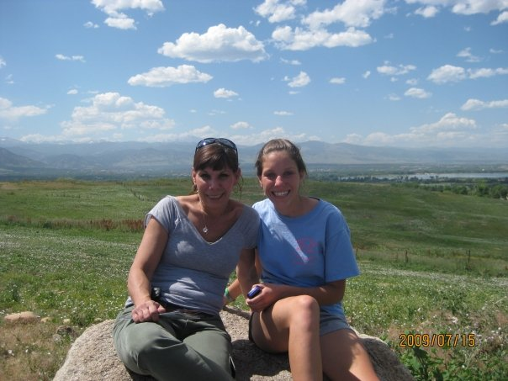
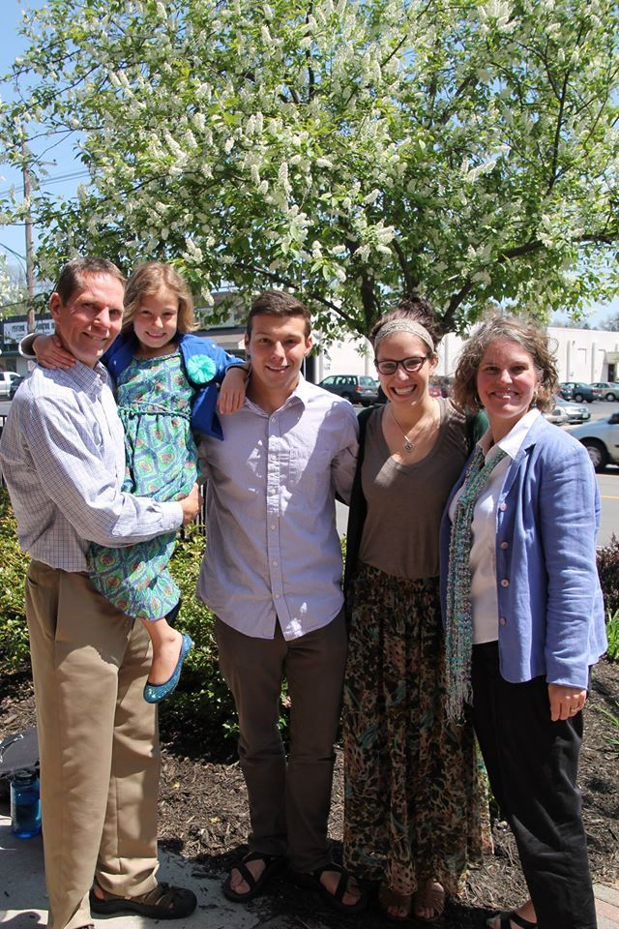
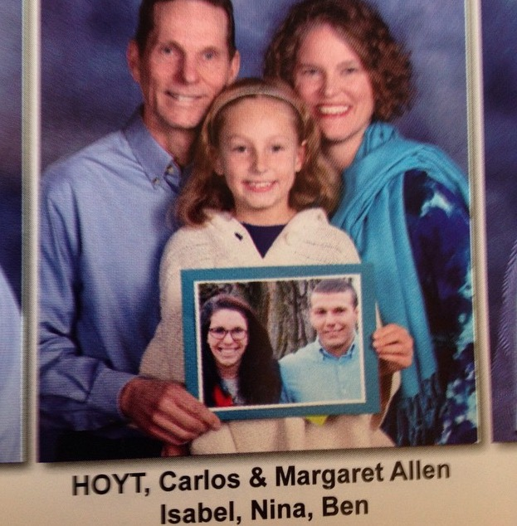
Nina’s Family

Slide 3
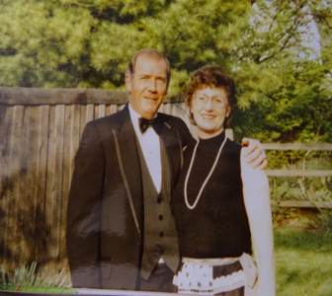
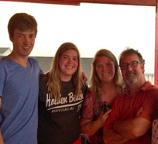
Liz’s Family

Slide 4
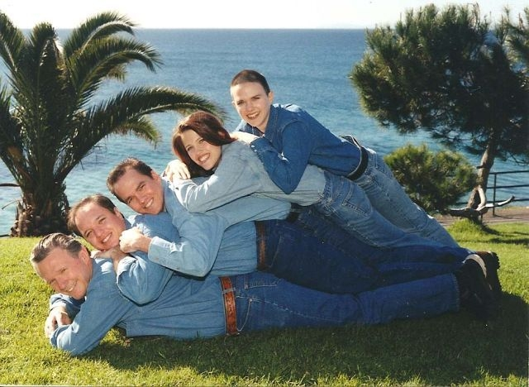
Family Dynamics Impact Our Lives
For some family is very important
“You don't choose your family. They are God's gift to you, as you are to them.”
Desmond Tutu

Slide 5
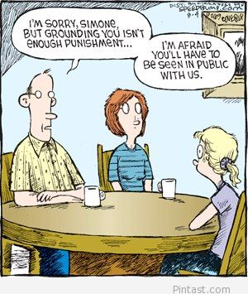
Family Dynamics Impact Our Lives
For others family is difficult
We didn’t choose our family
“Happiness is having a large, loving, caring, close-knit family in another city.”
George Burns

Slide 6
Why reach out to family?
The Great Commission
“Then Jesus came to them and said, “All authority in heaven and on earth has been given to me. Therefore go and make disciples of all nations, baptizing them in the name of the Father and of the Son and of the Holy Spirit, and teaching them to obey everything I have commanded you. And surely I am with you always, to the very end of the age.” -Matthew 28:18-20
We have the opportunity to be missionaries to our own families!

Slide 7
Unique issues of reaching out to parents:
Backwards: Parents should be teaching children
Pride: Parents might feel shame/ irritation that kids know something they don’t
Deep hurt/ Bitterness in relationships
Guilt about having a hard time talking to them
Emotionally charged
We have been bad examples/ Normal relating
Incredibly unhealthy: No boundaries, unfair relating
Healthy: See no need
Notes:
You might be the only person and the best person who they love, who they can ask questions of, and who is positioned to be used by God.

Slide 8
Loving our Parents
There is no Formula, but God will transform you
God’s Role
Mindset
Practical

Slide 9
God’s Role
Convicts People of their need
Leads us
Empowers us
Opens Doors
Places People in their lives
He doesn’t allow anyone to perish with the opportunity to know Him.
John 16:8 And He, when He comes, will convict the world concerning sin and righteousness and judgment
Luke 12:12 For the Holy Spirit will teach you in that very hour what you ought to say.
Acts 1:8 But you will receive power when the Holy Spirit has come upon you; and you shall be My witnesses both in Jerusalem, and in all Judea and Samaria, and even to the remotest part of the earth.
Colossians 4: ³ praying at the same time for us as well, that God will open up to us a door for the word, so that we may speak forth the mystery of Christ, for which I have also been imprisoned;
1 Timothy 2: ^{3b} God our Savior, ⁴ who desires all men to be saved and to come to the knowledge of the truth.

Slide 10
Mindset
Biblical Love
Prayer
Gratitude
Spiritual Attack

Slide 11
Mindset: Align thinking with Biblical view of love.
1 John 4: ⁹ This is how God showed his love among us: He sent his one and only Son into the world that we might live through him. ¹⁰ This is love: not that we loved God, but that he loved us and sent his Son as an atoning sacrifice for our sins. ¹¹ Dear friends, since God so loved us, we also ought to love one another (NIV).
Because He first loved us

Slide 12
Mindset: Align thinking with Biblical View of Love
God Initiates
We need to learn to initiate love
We cannot expect our unsaved parents to know how to initiate loving us
God is Sacrificial
Biblical love is costly
We are often takers with our parents

Slide 13
How well do you initiate and sacrifice?
How often do you offer to help with the dishes/ chores?
Is your time with parents as an opportunity to have a conversation or to nap?
How often do you snap at your parents?
How often are you just at your parents’ house for food/ money?
How long does it take you to respond to your parent’s text?
How often do you roll your eyes at your parents?
How often do you resent listening to the same story or helping take care of your parents?

Slide 14
Mindset: Prayer
Seeing our parents as God sees them:
Lost and Loved
Luke 19: 10 For the Son of Man has come to seek and to save that which was lost (NASB).
John 3: 16 For God so loved the world that he gave his one and only Son, that whoever believes in him shall not perish but have eternal life (NASB).

Slide 15
Mindset: Prayer
What does it look like to pray for my parents?
Develop a burden
Forgiveness
A change of heart (from us)
A softened heart towards Christ
Ezekiel 36:26 I will give you a new Heart and put a new spirit in you; I will remove from you your heart of stone and give you a heart of flesh (NIV).

Slide 16
Mindset: Prayer
“When we pray for the salvation of our family, we release them to God. We relinquish a prideful belief that their salvation is dependent on us. We admit that perhaps the only thing we can do is pray. Our prayers work in two directions—they pry loose our fingers from the control we thought we had on our relatives and they ask God to work in wooing ways in their hearts. Our prayers for our family may steer us in directions we hadn’t anticipated” Newman, Randy. Bringing the Gospel Home: Witnessing to Family Members, Close Friends, and Others Who Know You Well. (Kindle version) Wheaton, IL: Crossway, 2011. (Kindle Version, chapter 5.)
Not Just a Carpenter (Nina’s stepmom)

Slide 17
Mindset: Gratitude
What does it look like to practice gratitude?
“Thank your family for all that they did that was good and right and supportive, even if there are tons of other things they did wrong. It was only after I humbled myself before the Lord that I could do the same before my parents. And that’s when they started listening to me” Newman, Randy. Bringing the Gospel Home: Witnessing to Family Members, Close Friends, and Others Who Know You Well. (Kindle version) Wheaton, IL: Crossway, 2011. (Kindle Version, chapter 5.)

Slide 18
Mindset: Gratitude
How do we practice gratitude towards our parents?
Ask God for an understanding of the sacrifices our parents made
Develop Positive focus: Write down what we are thankful for
Take a step to thank them

Slide 19
Mindset: Spiritual Attack
SATAN’S ULTIMATE GOAL: to convince you that your parents will not be saved… and it is easy to fall into believing this.
Reflect on truth: 2 Peter 3: 9 The Lord is not slow in keeping his promise, as some understand slowness. Instead he is patient with you, not wanting anyone to perish, but everyone to come to repentance (NIV).

Slide 20
Mindset: Spiritual attack
Throughout the whole journey of reaching your parents, Satan will be crouching at the door
Ephesians 6:12 For our struggle is not against flesh and blood, but against the rulers, against the authorities, against the powers of this dark world and against the spiritual forces of evil in the heavenly realms (NIV).
Don’t be surprised!
Ex: Nina’s Dad

Slide 21
Practical: Building a relationship with parents
Listening
Initiating Love (Love Languages)
Initiating Spiritual Discussion
Special opportunities

Slide 22
Practical: Listening
We have a difficult time with listening...especially to our parents
We spend 45% of our time listening, yet we remember about 20% of what we hear (Edgar Dale, 1960).
James 1:19 Understand this, my dear brothers and sisters: You must all be quick to listen, slow to speak, and slow to get angry (NLT).
Proverbs 18: 2 Fools have no interest in understanding; they only want to air their own opinions (NLT).

Slide 23
Practical: Listening
“The voice any person likes to hear best is his own. Everyone likes to talk, but some do more than others. Many people would give anything to find someone who would just listen to them. When we listen long enough, we not only begin to know and understand an individual; we also gain his gratitude and his willingness to listen to us, enabling us later to speak relevantly to him.”
Paul Little, Little, Paul E. How to Give Away Your Faith. Chicago: Inter-Varsity, 1966. 32. Print.

Slide 24
Practical: Listening
Learn to ask questions (and listen for the answer):
Wondering: “What is your favorite….”
Clarifying: “I’m hearing you say this… is that correct?” “You seem upset... Is there something not sitting right about this?”
Agitating: “What do you think about the idea that I want to live my life for Christ?”
Probing and thoughtful questions enable you to learn about them and can help parents see their worldview is flawed.

Slide 25
Practical: Love Languages
Taken from Gary Chapman, The 5 love languages. Chicago: Northfield Pub., 2015
Words of Affirmation
Quality Time
Receive Gifts
Physical Affection
Acts of Service
Pray about how you can initiate love with your parents

Slide 26
Practical: Initiating Spiritual Discussions
You are in a unique position!
Decision Continuum
Sample Questions/ Ideas:
“Do you ever think much about spiritual things?”
“What is your worldview/spiritual background?”
“What are some questions you have about the Bible/ God?”
What do you think it means to be a Christian?

Slide 27
Practical: Initiating Spiritual Discussions
Creatively weave Gospel into conversation
Encourage investigation
Initiate studying the Bible with them
Expose to Body of Christ
Invite to Bible study/ or hang outs with adults
Consider writing a Letter
Share your Testimony

Slide 28
Take Advantage of Special Opportunities
Vacations
Holidays
Family meals
Phone conversations
Bringing your friends in the Body of Christ around your family

Slide 29
Special Topic: Forgiveness
We often have something that we are holding onto that interferes with loving our parents
Bitterness is the result
Colossians 3:13 Bear with one another and forgive each other if any of you has a grievance against someone. Forgive as the Lord forgave you (NIV).
“Bitterness is like drinking poison and waiting for the other person to die”
Joanna Weaver, Having a Mary Spirit: Allowing God to change us from the inside out

Slide 30
Special Topic: Perseverance
Prepare for failures
Adjust our timeline
Pray for endurance, God’s perspective, and Holy Spirit’s empowerment
It may be a marathon

Slide 31
Special Topic: Perseverance
Hebrews 12: 1Therefore, since we are surrounded by such a great cloud of witnesses, let us throw off everything that hinders and the sin that so easily entangles. And let us run with perseverance the race marked out for us, ² fixing our eyes on Jesus, the pioneer and perfecter of faith. For the joy set before him he endured the cross, scorning its shame, and sat down at the right hand of the throne of God. ³ Consider him who endured such opposition from sinners, so that you will not grow weary and lose heart (NIV).

Slide 32
Suggested Reading
Bringing the Gospel Home: Witnessing to Your Family Members, Close Friends, and Others Who Know You Well, Newman, Randy, 2011, Crossway Publishing
sweetl@xenos.org (Liz Sweet)
hoytnina@gmail.com (Nina Hoyt)

