Slide 1
Raising Kids in the Age of Technology
Parent Meeting May 7th, 2025

Slide 2
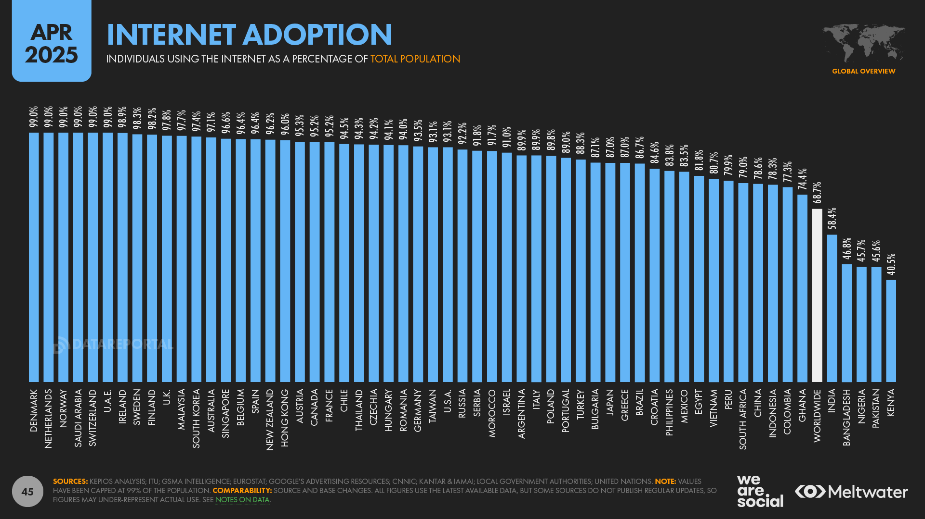
The Age of Technology
Source: https://datareportal.com/reports/digital-2025-global-overview-report

Slide 3
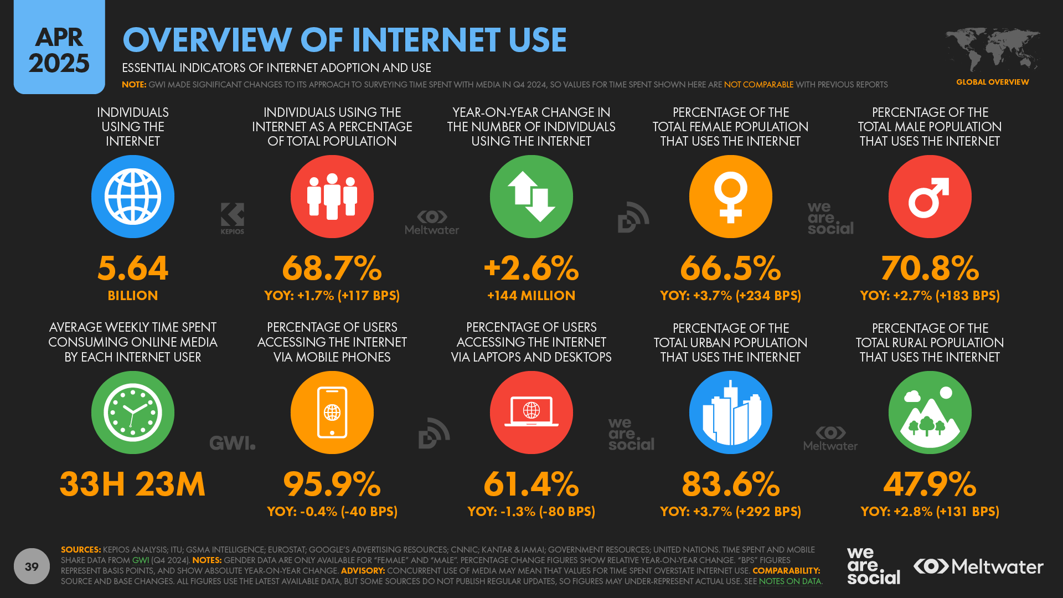
The Age of Technology
Source: https://datareportal.com/reports/digital-2025-global-overview-report

Slide 4
In Recent Years..
Amazing advancement in technology!
The internet has connected the world in ways that could not have been imagined 50 years ago
In fact, it has only been 42 years since the birth of the Internet!

Slide 5
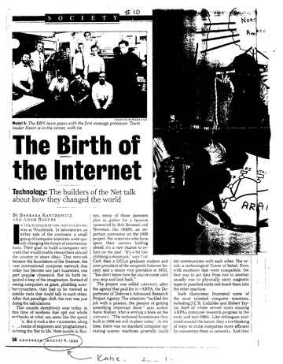
In Recent Years..
Amazing advancement in technology!
The internet has connected the world in ways that could not have been imagined 50 years ago
In fact, it has only been 42 years since the birth of the Internet!
1983
Image source: https://archive.org/details/TheBirthOfTheInternet

Slide 6
In Recent Years..
We live in a very different world than our parents and grandparents grew up in!
The same can be said for kids growing up today.
Image source: https://medium.com/@nabeelfaraz/the-history-of-computers-is-a-fascinating-journey-that-spans-centuries-of-innovation-12eee1db5a61

Slide 7
Today’s Digital World
A lot more functionality and accessibility than we ever had at their ages.
A growing concern for parents and educators as we realize the effects this increase in digital on the developing minds of children and teens.

Slide 8
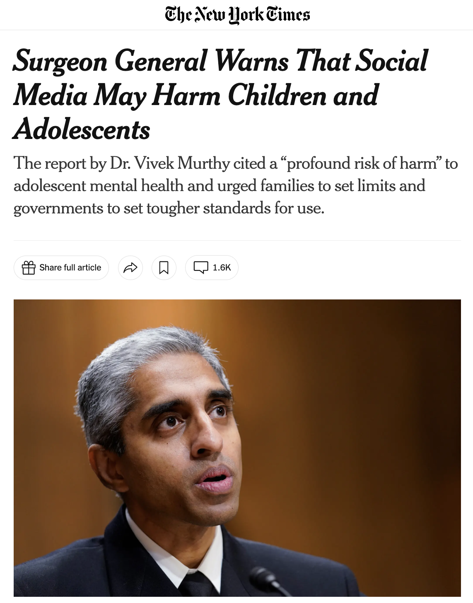
Today’s Digital World
A lot more functionality and accessibility than we ever had at their ages.
A growing concern for parents and educators as we realize the effects this increase in digital on the developing minds of children and teens.
Image source: https://www.nytimes.com/2023/05/23/health/surgeon-general-social-media-mental-health.html

Slide 9
Cultivating a Biblical Perspective
God knows humanity and what we are capable of.
He knows the desires of our hearts (he gave us good desires!)
No matter what humanity comes up with, we always have the option to turn to God for help, wisdom, and guidance.
From a Christian perspective, we should never feel hopeless about any cultural trend, data points, or the challenges they pose.
Isaiah 46:10
“declaring the end from the beginning
and from ancient times things not yet done,
saying, ‘My counsel shall stand,
and I will accomplish all my purpose,’
Philippians 4:6-7
“Do not be anxious about anything, but in every situation, by prayer and petition, with thanksgiving, present your requests to God. And the peace of God, which transcends all understanding, will guard your hearts and your minds in Christ Jesus.”

Slide 10
Social Media and Youth Mental Health:
US Surgeon General Advisory
Key takeaways from the advisory
Social media use by young people is nearly universal.
Up to 95% of young people aged 13-17 report using a social media platform.
Nearly two thirds of teenagers report using social media every day and one third report using social media “almost constantly.

Slide 11
Social Media and Youth Mental Health:
US Surgeon General Advisory
Key takeaways from the advisory
2. Social media presents a meaningful risk of harm to youth, while also providing benefits.
The types of use and content children and adolescents are exposed to pose mental health concerns.
Children and adolescents who spend more than 3 hours a day on social media face double the risk of mental health problems including experiencing symptoms of depression and anxiety.
This is concerning as a recent survey showed that teenagers spend an average of 3.5 hours a day on social media.
And when asked about the impact of social media on their body image, 46% of adolescents aged 13-17 said social media makes them feel worse.

Slide 12
Social Media and Youth Mental Health:
US Surgeon General Advisory
Key takeaways from the advisory
3. We cannot conclude that social media is sufficiently safe for children and adolescents
We have gaps in our full understanding of the mental health impacts posed by social media but at this point cannot conclude it is sufficiently safe for children and adolescents.
We must better understand the answers to key questions, such as, which types of content are most harmful and what factors can protect young people from the negative effects of social media.

Slide 13
Social Media and Youth Mental Health:
US Surgeon General Advisory
Handout: Advisory Executive Summary
Handout: Surgeon General List “What Parents and Caregivers Can Do”, “What Children and Adolescents Can Do” (pg. 16-17 of full advisory document)

Slide 14
Social Media and Youth Mental Health:
US Surgeon General Advisory
What Parents and Caregivers Can Do:
Create a family media plan
Create tech-free zones and encourage children to foster in-person friendships
Model responsible social media behavior
Teach kids about technology and empower them to be responsible online participants at an appropriate age.
Report cyberbullying and online abuse and exploitation
Work with other parents to establish shared norms and practices

Slide 15
Social Media and Youth Mental Health:
US Surgeon General Advisory
What Children and Adolescents Can Do:
Reach out for help
Create boundaries to help balance online and offline activities
Develop positive strategies and healthy practices
Be cautious about what you share
Protect yourself and others
Don’t keep harassment or abuse a secret
Don’t take part in online harassment or abuse

Slide 16
Benefits of Digital Technology and Media
Connection
Learning
Creativity
Productivity
Information and News

Slide 17
Positive Effects of Digital Technology and Media
 | Positive Impact 👍 | Negative Impact 👎
Connection 🤝 | Keeping in touch with family and friends
Learning 📚 | Enhancing our love of learning by exploring interests and solving problems. Expanded knowledge base.
Creativity 🎨 | Enhancing one's creativity by using tools to bring ideas to fruition.
Productivity 📎 | Spending less time on menial tasks, more time for connecting with others and serving.
News and Information 🗞 | Greater opportunity to pray for needs around the world

Slide 18
Negative Effects of Digital Technology and Media
 | Positive Impact 👍 | Negative Impact 👎
Connection 🤝 | Keeping in touch with family and friends
Learning 📚 | Enhancing our love of learning by exploring interests and solving problems. Expanded knowledge base.
Creativity 🎨 | Enhancing one's creativity by using tools to bring ideas to fruition.
Productivity 📎 | Spending less time on menial tasks, more time for connecting with others and serving.
News and Information 🗞 | Greater opportunity to pray for needs around the world
Comparing real self to the best images curated by friends and family.
Lazy learning- cutting corners. Missing out on deep learning.
Stealing or claiming others’ work as own: fair use, copyright, plagiarism
Workaholism
Inability to rest
Achieving = utmost importance
Source of anxiety

Slide 19
Negative Effects of Digital Technology and Media
 | Positive Impact 👍 | Negative Impact 👎
Connection 🤝 | Keeping in touch with family and friends
Learning 📚 | Enhancing our love of learning by exploring interests and solving problems. Expanded knowledge base.
Creativity 🎨 | Enhancing one's creativity by using tools to bring ideas to fruition.
Productivity 📎 | Spending less time on menial tasks, more time for connecting with others and serving.
News and Information 🗞 | Greater opportunity to pray for needs around the world
Comparing real self to the best images curated by friends and family.
Wisdom = recognizing healthy usage vs. misuse and overuse
Lazy learning- cutting corners. Missing out on deep learning.
Stealing or claiming others’ work as own: fair use, copyright, plagiarism
Workaholism
Inability to rest
Achieving = utmost importance
Source of anxiety

Slide 20
Family Digital Wellbeing Self-Assessment
Six Elements that Foster Digitally Healthy Families
Awareness
Boundaries and Safeguards
Modeling
Teaching Wisdom Principles and Skills
Keeping and Open Dialogue
Prayer

Slide 21
Awareness
Awareness is the 1st level of any kind of “self-defense”
This involves:
Parental Awareness
Do you know what apps and media are out there?
Do you know what apps and media your child consumes?
The Child’s Awareness
Is your child aware that some apps and media can be harmful to their minds?
Is your child aware of things they should do if they run into inappropriate content? Or if they notice they are not sleeping well, feeling more anxious, depressed, lonely, etc.

Slide 22
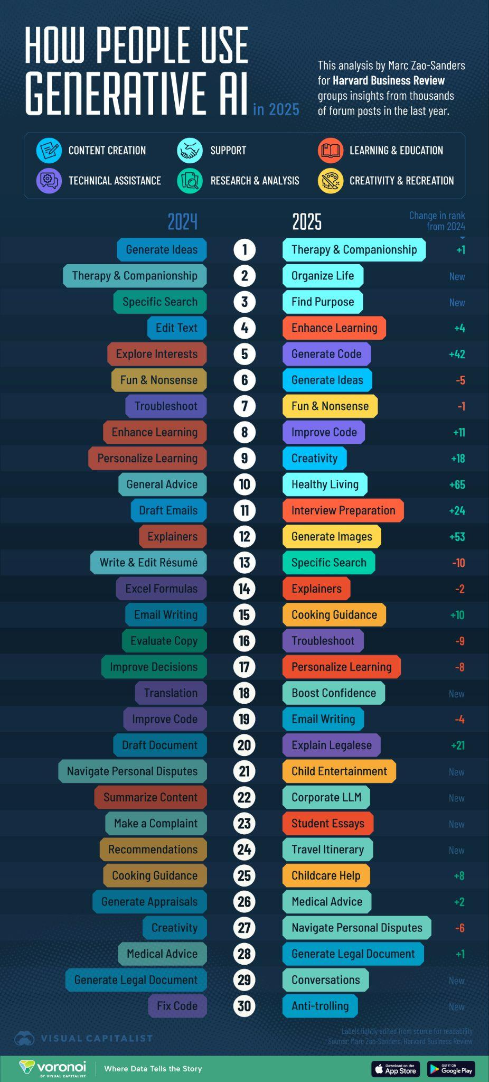
Awareness
Parent Alert!
→ New in 2025: concerns arising in regard to AI development of “companionship models” within generative AI tools.
→ concerning article from WSJ described how these AI models are built into many generative AI programs that are within mainstream apps (Facebook, Instagram, ChatGPT, etc)
→ the AI companion can be prompted to play different “personas” and many will engage in explicit conversations and scenarios without regard to the user’s age.
→ App developers seem hesitant to create boundaries and restrictions to their AI programs, even for minors.
Awareness is the 1st level of any kind of “self-defense”
This involves:
Parental Awareness
Do you know what apps and media are out there?
Do you know what apps and media your child consumes?
The Child’s Awareness
Is your child aware that some apps and media can be harmful to their minds?
Is your child aware of things they should do if they run into inappropriate content? Or if they notice they are not sleeping well, feeling more anxious, depressed, lonely, etc.
Article: https://www.wsj.com/tech/ai/meta-ai-chatbots-sex-a25311bf?st=ZKwsEN&reflink=article_imessage_share

Slide 23
Awareness
Parent Alert!
→ New in 2025: concerns arising in regard to AI development of “companionship models” within generative AI tools.
→ concerning article from WSJ described how these AI models are built into many generative AI programs that are within mainstream apps (Facebook, Instagram, ChatGPT, etc)
→ the AI companion can be prompted to play different “personas” and many will engage in explicit conversations and scenarios without regard to the user’s age.
→ App developers seem hesitant to create boundaries and restrictions to their AI programs, even for minors.
Awareness is the 1st level of any kind of “self-defense”
This involves:
Parental Awareness
Do you know what apps and media are out there?
Do you know what apps and media your child consumes?
The Child’s Awareness
Is your child aware that some apps and media can be harmful to their minds?
Is your child aware of things they should do if they run into inappropriate content? Or if they notice they are not sleeping well, feeling more anxious, depressed, lonely, etc.
Article: https://www.wsj.com/tech/ai/meta-ai-chatbots-sex-a25311bf?st=ZKwsEN&reflink=article_imessage_share

Slide 24
Awareness: Heart Issues at the Core
People are searching for things to fill their basic human needs and desires
If we don’t recognize the underlying needs that issues with digital technology are bringing to light, we will find ourselves putting bandaids on deeper needs and wounds.
Starting with this type of awareness, we can be poised to offer the message of hope that God offers in himself.
All people are valuable and made in his image
We were made to be relational- to connect with God and other people
When we try to fill our needs in things other than God and his design for these things, we experience disordered desires and thinking that break down our mental health and our relationships.

Slide 25
Awareness: Heart Issues at the Core
The answer is to reconnect with God and his truth, to put everything back into alignment.

Slide 26
Boundaries and Safeguards
Boundaries
Device and App time limits
Device usage curfews
No devices in bedrooms overnight
Safeguards
Screen monitoring and blocking apps or software

Slide 27
Modeling
Household Rules about Devices
At the dinner table
Before bed
Screen time allowance
Share about the Negative Impacts on Yourself
Apologize for distractedness and irritability due to your device
Share what you are going to try to limit negative impacts
Plan Tech-Free Weekends to Unplug the Whole Family
Make it a regular part of your family’s schedule
Vacation or staycation

Slide 28
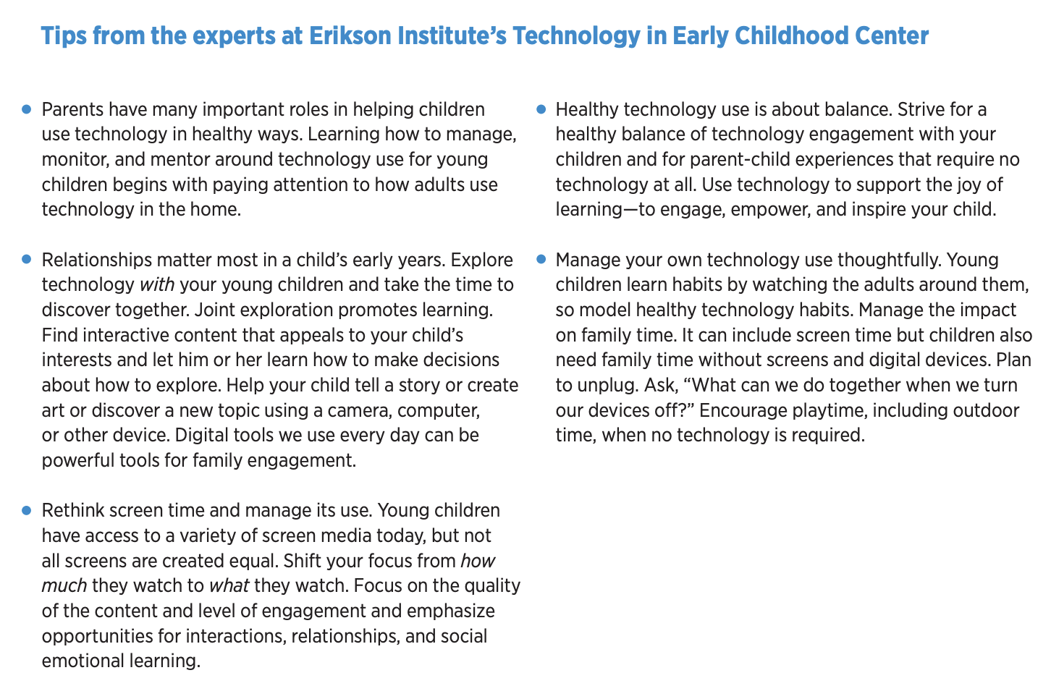
Modeling and Boundaries?
Technology and Young Children in the Digital Age A Report from the Erikson Institute (2016)
85 percent of parents reported that they allow their young children (under 6) to use technology
86 percent of parents reported that they were satisfied with how their young children use technology
72 percent of parents had concerns about technology use, specifically around too much screen time, inappropriate content, commercial messages aimed at young children, and how technology use takes away from time spent outdoors, enjoying active play, and whether it disrupts sleep.
What About Very Young Children and Tech?
No solid guidance from research in this area.
Available statistics on trends show high engagement with technology under 5 years old.

Slide 29
Teaching Wisdom Principles and Skills
Dinner Table Discussions
Family TEDTalk presentations
Family Challenges
Discussions during planned quality time

Slide 30
Keeping Open Dialogue
Inviting your kids to tell you what they are thinking and feeling, without judgement or correcting.
Listen first, ask questions, then share another perspective when needed
“What makes you say that?”
“How do your friends typically handle those types of situations?”
“What worked? What didn’t”

Slide 31
Prayer
Our most powerful tool
James 1:5
"If any of you is lacking in wisdom, you should ask God, who will give it to you because he is generous and will not hold it against you."

Slide 32
Digging Deeper: Mental Health and Wellbeing Issues
Anxiety
Self-Esteem & Body-Image
Bullying
Inappropriate Content
Inattention
Sleep Issues

Slide 33
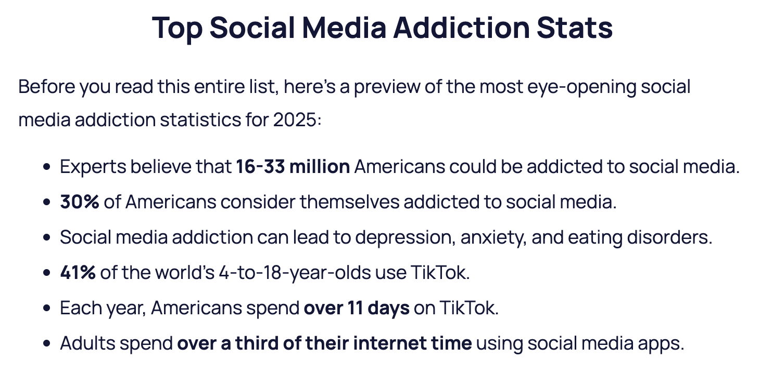
Digging Deeper: Mental Health and Wellbeing Issues
Anxiety
Self-Esteem & Body-Image
Bullying
Inappropriate Content
Inattention
Sleep Issues
For young children: if we know that screen addition leads to negative consequences when kids are older, we should be very thoughtful about practices that wire developing brains at young ages to crave digital stimuli. Both in education and at home.
https://explodingtopics.com/blog/social-media-addiction

Slide 34
Digging Deeper: Mental Health and Wellbeing Issues
Suggestions for Combating Negative Impacts:
Anxiety
Limit tech time
Reading (fill mind with intentional content)
Open dialogue
Teach coping skills (rather than only running to distractions)

Slide 35
Digging Deeper: Mental Health and Wellbeing Issues
Suggestions for Combating Negative Impacts:
Self-Esteem & Body-Image
Healthy critique of messages in the media
Find and highlight positive role models in your lives
Memorize Bible verses (Ephesians 2:10)

Slide 36
Digging Deeper: Mental Health and Wellbeing Issues
Suggestions for Combating Negative Impacts:
Bullying & Inappropriate Content
Screen monitoring
Open dialogue
Reporting

Slide 37
Digging Deeper: Mental Health and Wellbeing Issues
Suggestions for Combating Negative Impacts:
Inattention & Sleep Issues
Device time limits
Technology curfew
No devices in bedrooms overnight

Slide 38
Digging Deeper: Mental Health and Wellbeing Issues
Intentional activities…
Increase family connectedness
Reduce loneliness
Provide avenues for YOU & their relationship with God to be their source of information and wisdom
Build positive relating skills and coping skills

Slide 39
Let’s Discuss Some Ideas!
From the Surgeon General’s Recommendation list
What would you want to put on your family media plan?
What are some ideas for creating tech-free zones?
How do you encourage your children to foster in-person friendships?
How do you model responsible social media behavior?
How do you teach kids about technology and empower them to be responsible online participants?
What age would you consider an appropriate age to allow them to use devices and social media?
How might parents work with other parents to establish shared norms and practices that support healthy digital usage?
Are there tools or strategies mentioned earlier that you could see yourself using?

Slide 40
Resources for More Information
US Department of Human Services (hhs.gov)
Common Sense Media (commonsensemedia.org)
Child Mind Institute (childmind.org)
DataReportal.com/ (for Global and Regional Data Reports on Media Usage)

Slide 41
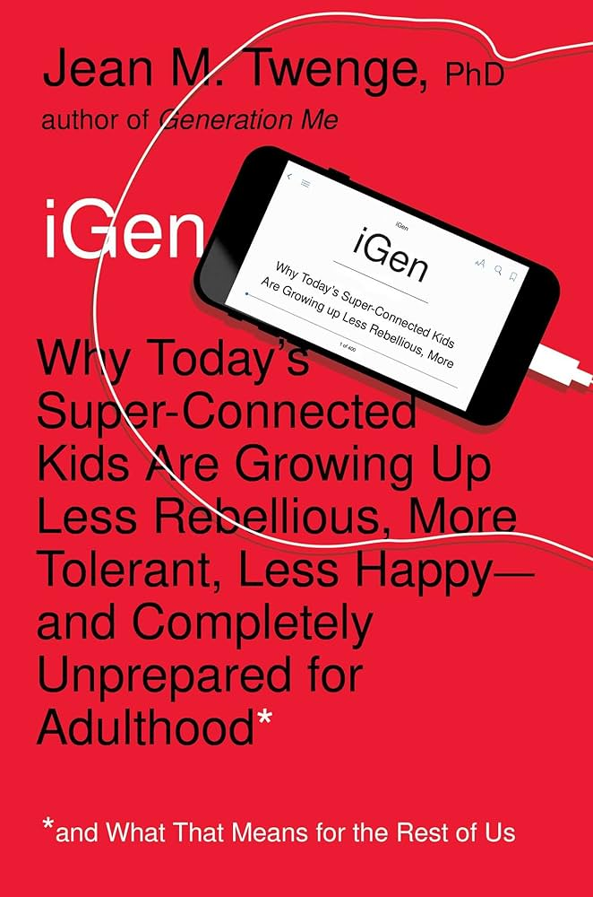
Book List
12 Ways Your Phone is Changing You by Tony Reinke
The Anxious Generation by Jonathan Haidt
iGen by Jean Twenge
The Ruthless Elimination of Hurry by John Mark Comer

Slide 42
Resources for Tools to Use
Creating a Family Media Plan
www.healthychildren.org/MediaUsePlan
https://instituteofchildpsychology.com/familymediaplan/?#
Accountability Software
Bark
Accountable2You
Covenant Eyes

Slide 43
Research and Articles on Tech Use with Children Under 5
https://www.lse.ac.uk/research/research-for-the-world/society/young-children-digital-lives (most recent - 2024)
https://www.pewresearch.org/internet/2020/07/28/childrens-engagement-with-digital-devices-screen-time/ (2020)
https://www.erikson.edu/wp-content/uploads/2018/07/Erikson-Institute-Technology-and-Young-Children-Survey.pdf (2016)

Slide 44
References
https://www.hhs.gov/surgeongeneral/reports-and-publications/youth-mental-health/social-media/index.html
https://www.hhs.gov/sites/default/files/sg-youth-mental-health-social-media-summary.pdf
https://www.pewresearch.org/internet/2024/03/11/how-teens-and-parents-approach-screen-time/
https://www.commonsensemedia.org/sites/default/files/research/report/8-18-census-integrated-report-final-web_0.pdf
https://childmind.org/article/how-using-social-media-affects-teenagers/

