Slide 1
Acts
Acts 18 Corinth

Slide 2
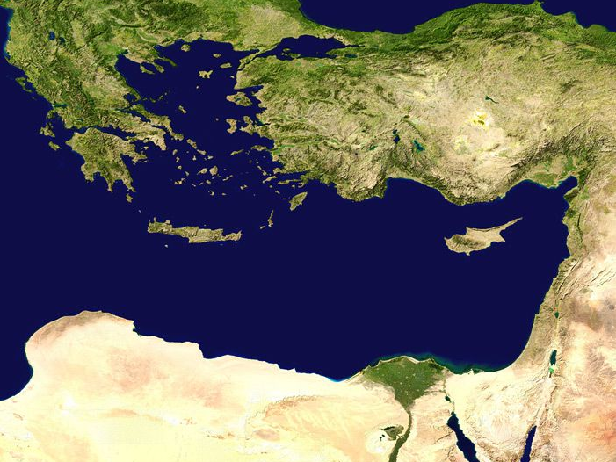
Thessalonica
Philippi
Troas
Berea
P. Antioch
Iconium
Derbe
Lystra
Athens
Tarsus
Antioch
The Second Missionary Journey
Jerusalem

Slide 3
Thessalonica
Philippi
Troas
Berea
P. Antioch
Iconium
Derbe
Lystra
Athens
Tarsus
Corinth
Antioch
The Second Missionary Journey
Jerusalem
^{Acts 17:18} After these things he left Athens and went to Corinth.

Slide 4
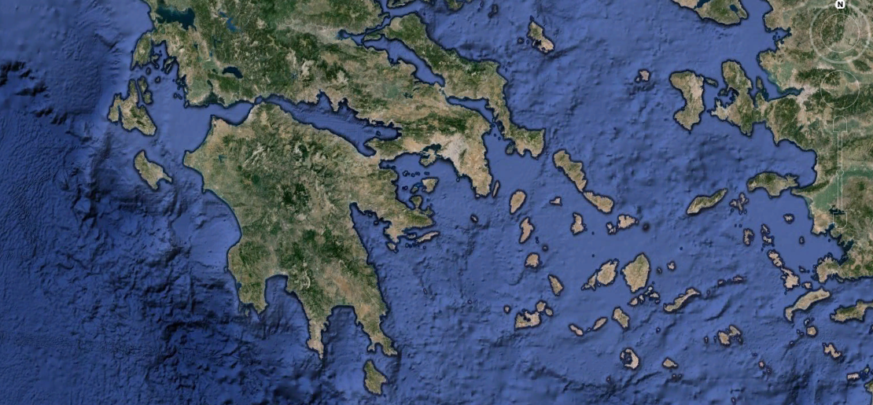
Ancient Corinth:
^{Acts 17:18} After these things he left Athens and went to Corinth.

Slide 5
Ancient Corinth:
^{Acts 17:18} After these things he left Athens and went to Corinth.

Slide 6
Ancient Corinth:
^{Acts 17:18} After these things he left Athens and went to Corinth.

Slide 7
Ancient Corinth:
Corinth
^{Acts 17:18} After these things he left Athens and went to Corinth.

Slide 8
Ancient Corinth:
Corinth
^{Acts 17:18} After these things he left Athens and went to Corinth.

Slide 9
Ancient Corinth:
Corinth
^{Acts 17:18} After these things he left Athens and went to Corinth.

Slide 10
Ancient Corinth:
Corinth
^{Acts 17:18} After these things he left Athens and went to Corinth.

Slide 11
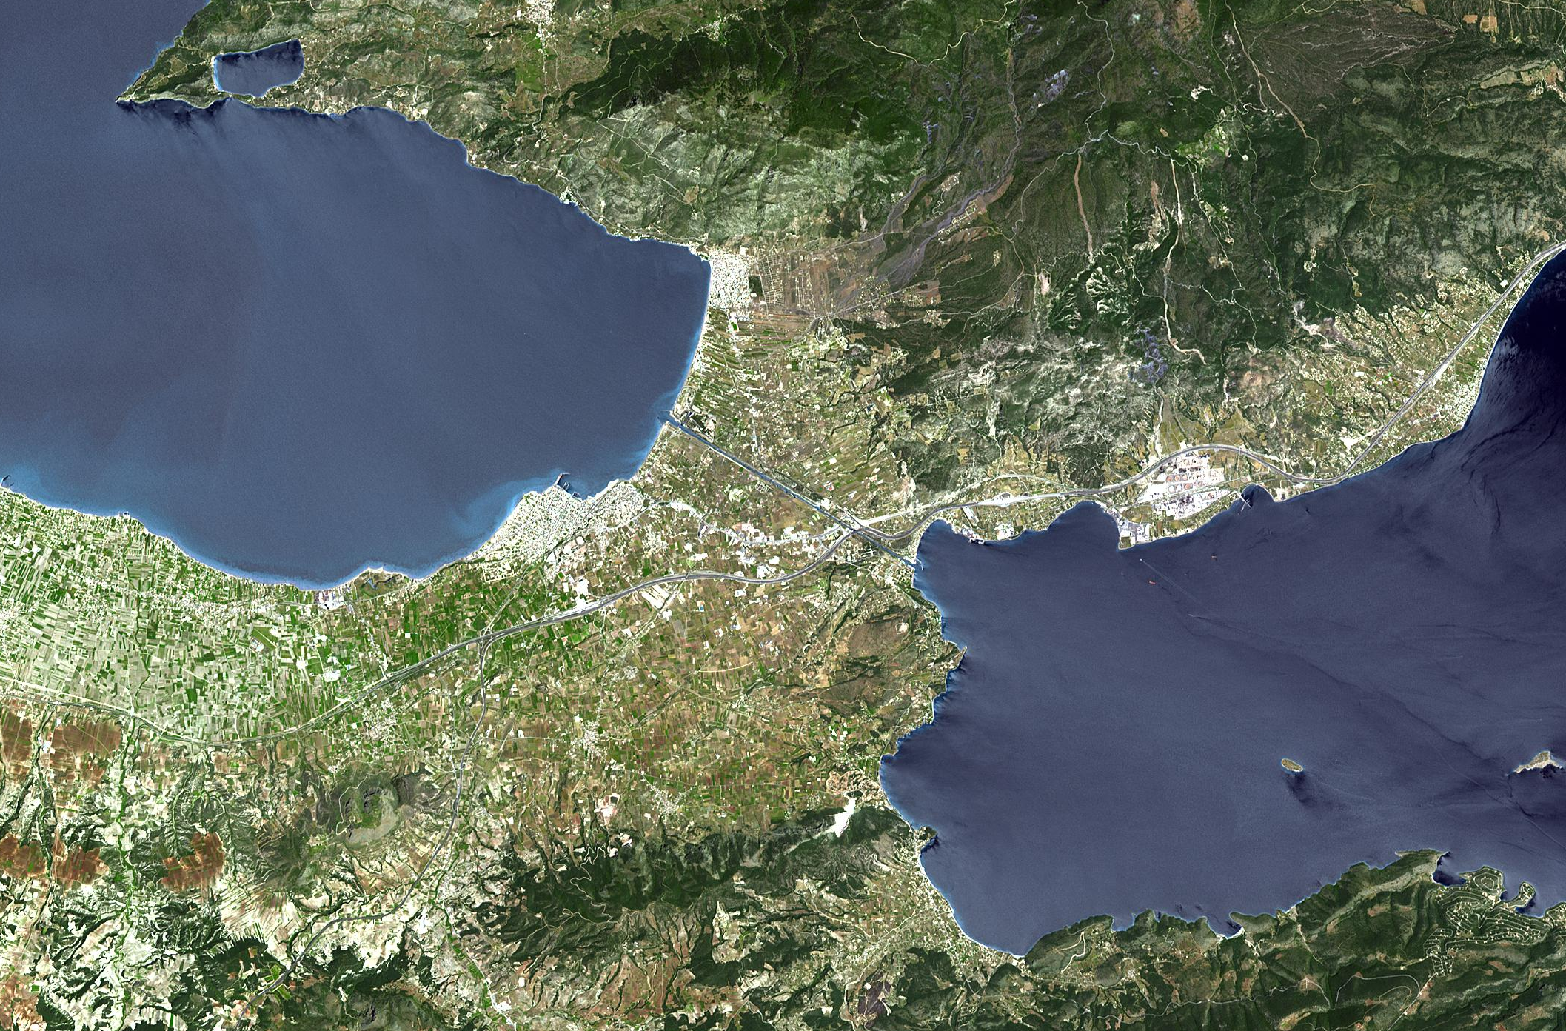
Ancient Corinth:

Slide 12
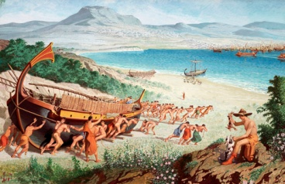
Ancient Corinth:

Slide 13
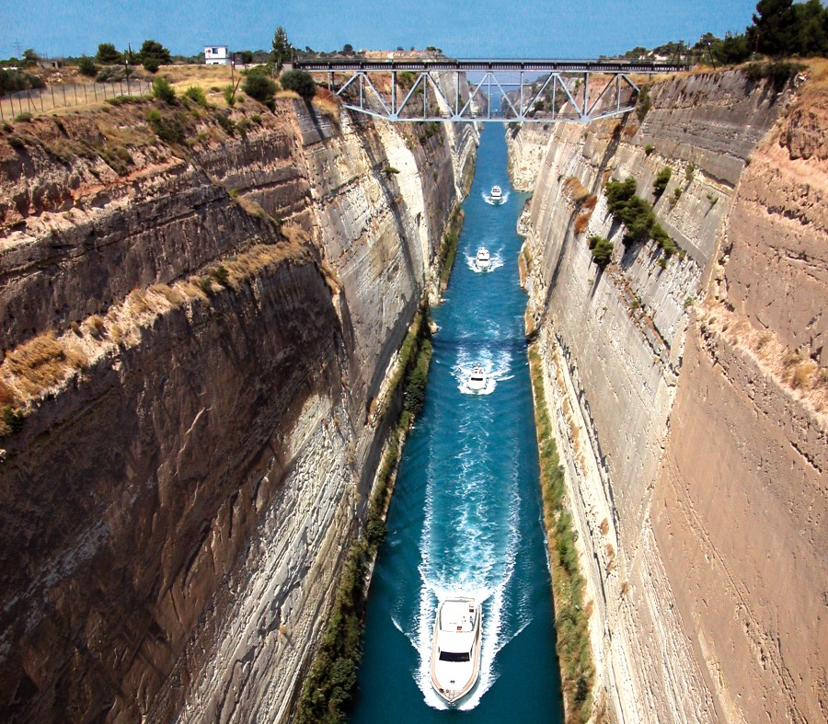
Ancient Corinth:

Slide 14
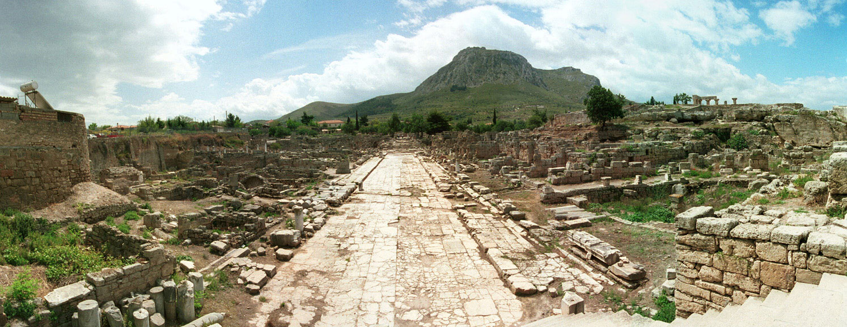
Ancient Corinth:
Trade Crossroads
Wealthy

Slide 15
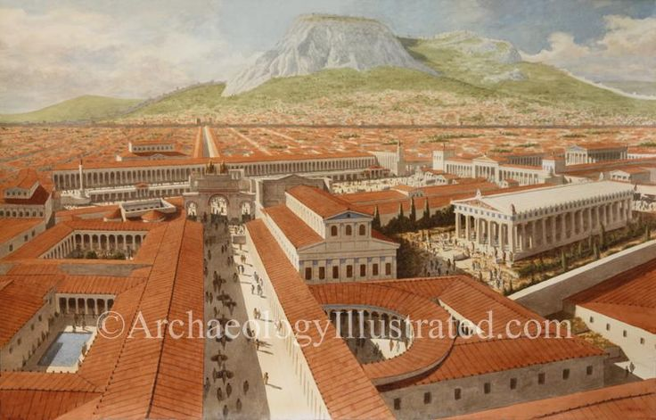
Ancient Corinth:
Trade Crossroads
Wealthy

Slide 16
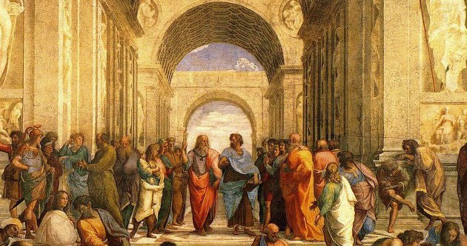
Ancient Corinth:
Trade Crossroads
Wealthy
Learned

Slide 17
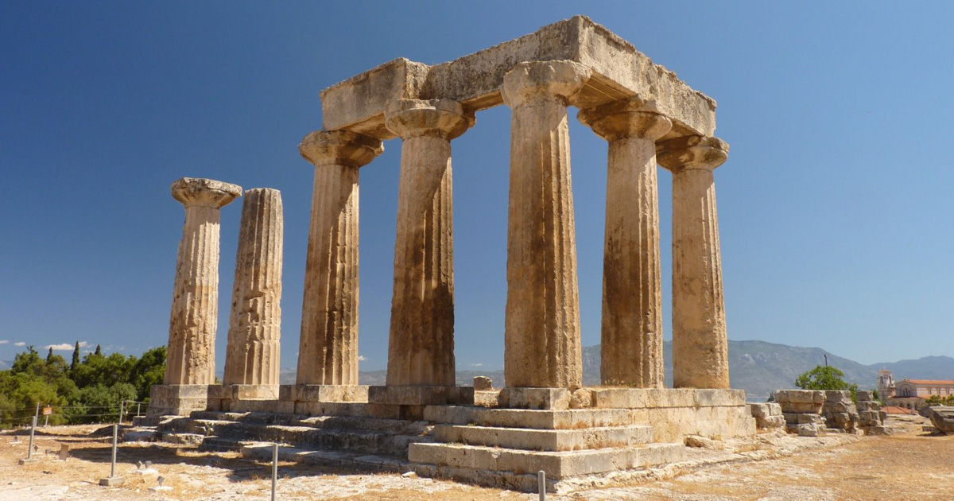
Ancient Corinth:
Trade Crossroads
Wealthy
Learned
Pantheistic

Slide 18
Ancient Corinth:
Trade Crossroads
Wealthy
Learned
Pantheistic
Apollo – Poseidon – Demeter – Bacchus - Aphrodite

Slide 19
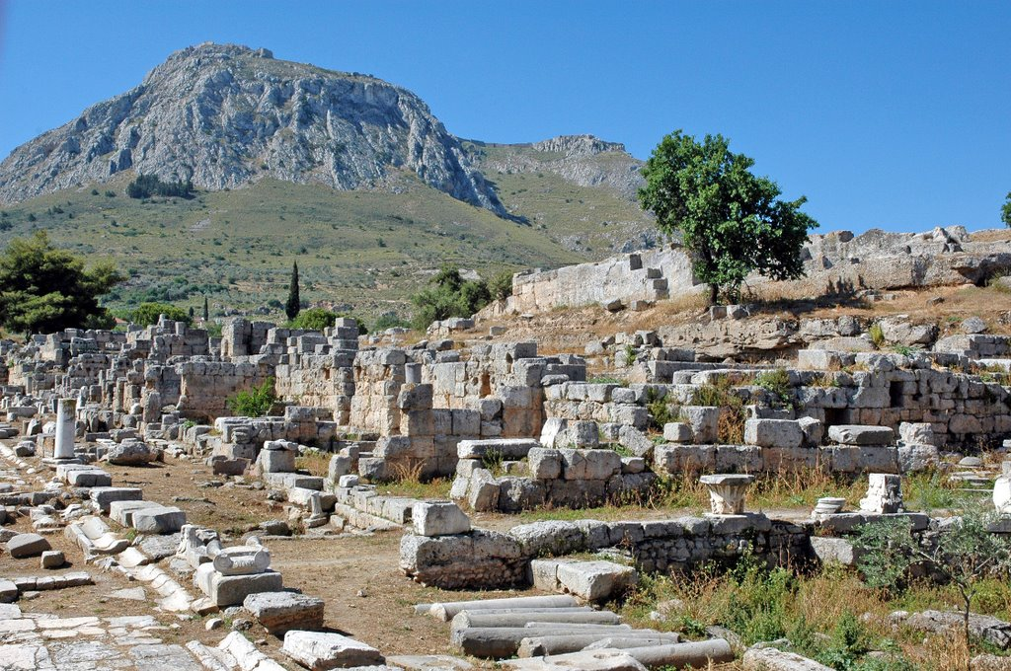
Ancient Corinth:
Trade Crossroads
Wealthy
Learned
Pantheistic
(Apollo, Poseidon, Demeter, Bacchus, Aphrodite)

Slide 20
Ancient Corinth:
Trade Crossroads
Wealthy
Learned
Pantheistic
Wild
Notorious reputation recorded by Roman historians
To “Corinthianize”

Slide 21
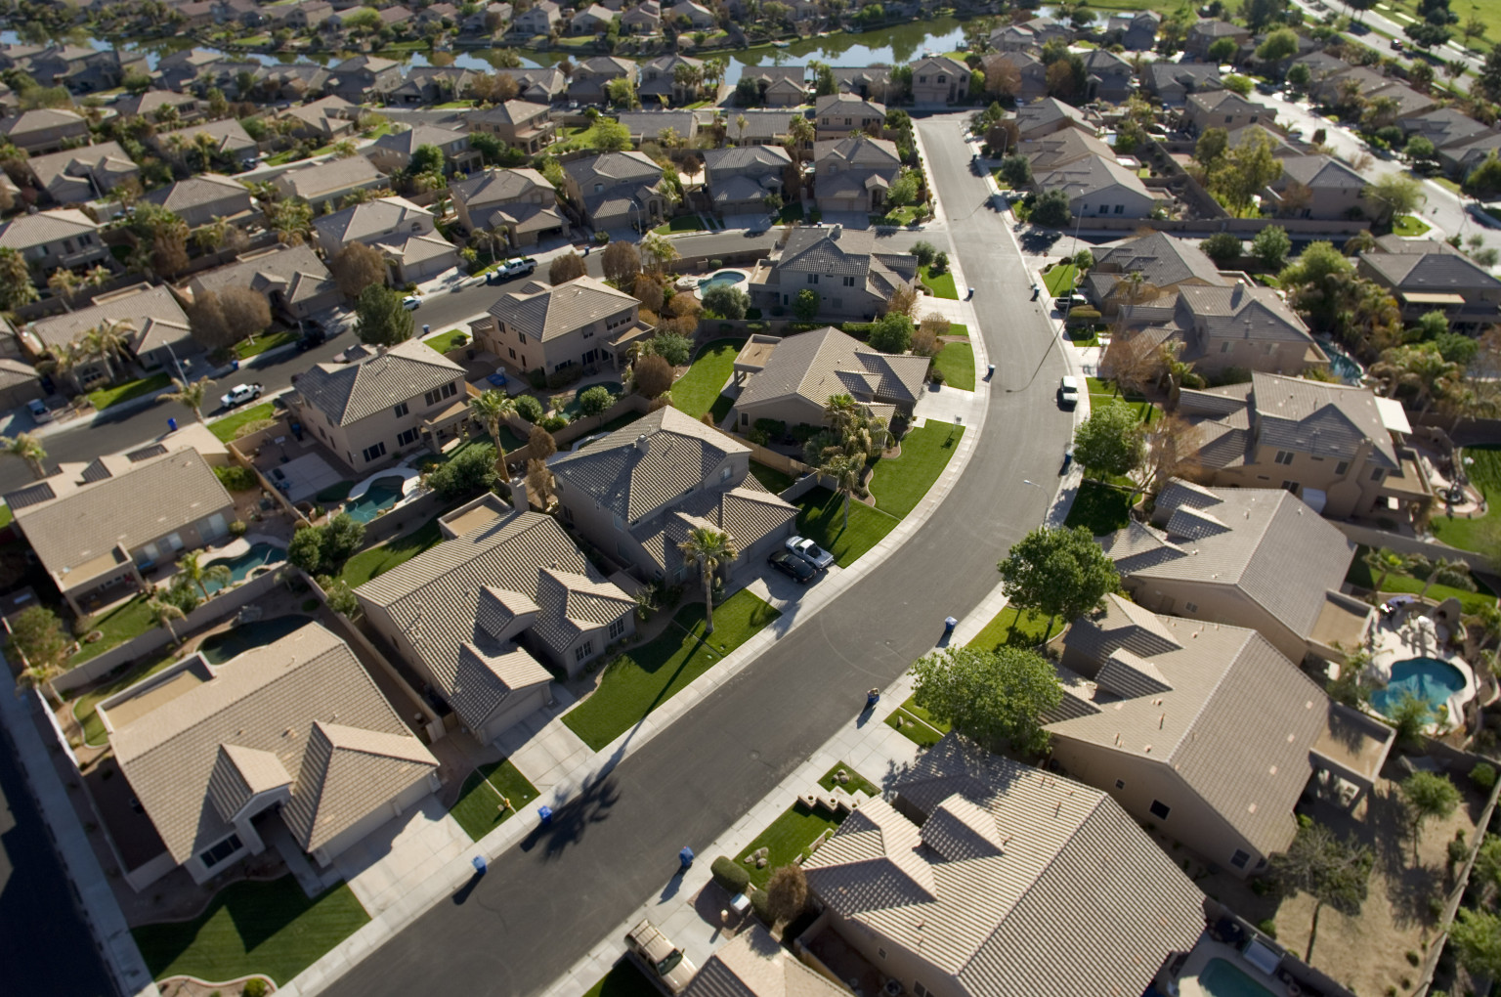
Ancient Corinth:
Trade Crossroads
Wealthy
Learned
Pantheistic
Wild
Summary: material & financial wealth, high level of education, competitive social hierarchy, religious & moral relativism, everyone going after money, achievement, comfort, entertainment, sex … and lots of wine...
Notorious reputation recorded by Roman historians
To “Corinthianize”

Slide 22
^{1 Cor 2:3 “}I came to you in weakness - timid and trembling. ⁴ And my message and my preaching were very plain.”

Slide 23
And yet, a huge response to the gospel!

Slide 24
And yet, a huge response to the gospel!
Does that surprise you?

Slide 25
^{Rev 3:20} Behold, I stand at the door and knock; if anyone hears My voice and opens the door, I will come in to him and will dine with him, and he with Me.
And yet, a huge response to the gospel!
Does that surprise you?

Slide 26
^{Rev 3:20} Behold, I stand at the door and knock; if anyone hears My voice and opens the door, I will come in to him and will dine with him, and he with Me.
Sometimes it’s the worst “sinners” who can hear His knock the most clearly
And yet, a huge response to the gospel!
Does that surprise you?

Slide 27
^{Rev 3:20} Behold, I stand at the door and knock; if anyone hears My voice and opens the door, I will come in to him and will dine with him, and he with Me.
Sometimes it’s the worst “sinners” who can hear His knock the most clearly
And sometimes we hear His knock most clearly just when we “have it all,” and yet recognize a prevailing sense of emptiness
And yet, a huge response to the gospel!
Does that surprise you?

Slide 28
^{Rev 3:20} Behold, I stand at the door and knock; if anyone hears My voice and opens the door, I will come in to him and will dine with him, and he with Me.
Ancient Corinth:
Sometimes it’s the worst “sinners” who can hear His knock the most clearly
And sometimes we hear His knock most clearly just when we “have it all,” and yet recognize a prevailing sense of emptiness
God: “you are ready to hear the gospel!”

Slide 29
^{Acts 18:1} Then Paul left Athens and went to Corinth. ² There he became acquainted with a Jew named Aquila, born in Pontus, who had recently arrived from Italy with his wife, Priscilla. They had left Italy when Claudius Caesar deported all Jews from Rome.
^{Acts 18:1} Then Paul left Athens and went to Corinth. ² There he became acquainted with a Jew named Aquila, born in Pontus, who had recently arrived from Italy with his wife, Priscilla. They had left Italy when Claudius Caesar deported all Jews from Rome.

Slide 30
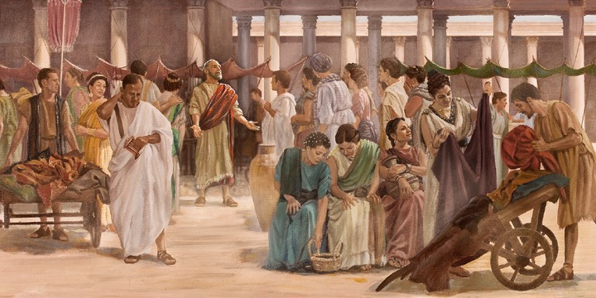
^{Acts 18:3} Paul lived and worked with them, for they were tentmakers just as he was. ⁴ Each Sabbath found Paul at the synagogue, trying to convince the Jews and Greeks alike. ⁵ And after Silas and Timothy came down from Macedonia, Paul spent all his time preaching the word.
^{Acts 18:3} Paul lived and worked with them, for they were tentmakers just as he was. ⁴ Each Sabbath found Paul at the synagogue, trying to convince the Jews and Greeks alike. ⁵ And after Silas and Timothy came down from Macedonia, Paul spent all his time preaching the word.
^{Acts 18:3} Paul lived and worked with them, for they were tentmakers just as he was. ⁴ Each Sabbath found Paul at the synagogue, trying to convince the Jews and Greeks alike. ⁵ And after Silas and Timothy came down from Macedonia, Paul spent all his time preaching the word.

Slide 31
^{Acts 18:6} But when they opposed and insulted him, Paul shook the dust from his clothes and said, “Your blood is upon your own heads—I am innocent. From now on I will go preach to the Gentiles.”

Slide 32
^{Acts 18:7} Then he left and went to the home of Titius Justus, a Gentile who worshiped God and lived next door to the synagogue.
^{Acts 18:7} Then he left and went to the home of Titius Justus, a Gentile who worshiped God and lived next door to the synagogue.

Slide 33
^{Acts 18:8} Crispus, the leader of the synagogue, and everyone in his household believed in the Lord. Many others in Corinth also heard Paul, became believers, and were baptized.

Slide 34
Sometimes the people who are most responsive to the gospel are the last people you would expect!
^{Acts 18:8} Crispus, the leader of the synagogue, and everyone in his household believed in the Lord. Many others in Corinth also heard Paul, became believers, and were baptized.

Slide 35
Sometimes the people who are most responsive to the gospel are the last people you would expect!
^{Acts 18:8} Crispus, the leader of the synagogue, and everyone in his household believed in the Lord. Many others in Corinth also heard Paul, became believers, and were baptized.
^{Acts 18:8} Crispus, the leader of the synagogue, and everyone in his household believed in the Lord. Many others in Corinth also heard Paul, became believers, and were baptized.
^{Acts 18:8} Crispus, the leader of the synagogue, and everyone in his household believed in the Lord. Many others in Corinth also heard Paul, became believers, and were baptized.

Slide 36
^{Acts 18:9} One night the Lord spoke to Paul in a vision and told him, “Don’t be afraid! Speak out! Don’t be silent! ¹⁰ For I am with you, and no one will attack and harm you, for many people in this city belong to me.”

Slide 37
Catching a glimpse of God’s perspective:
God is busy orchestrating connections: putting messengers and willing recipients in one another's lives.
^{Acts 18:9} One night the Lord spoke to Paul in a vision and told him, “Don’t be afraid! Speak out! Don’t be silent! ¹⁰ For I am with you, and no one will attack and harm you, for many people in this city belong to me.”
^{Acts 18:9} One night the Lord spoke to Paul in a vision and told him, “Don’t be afraid! Speak out! Don’t be silent! ¹⁰ For I am with you, and no one will attack and harm you, for many people in this city belong to me.”
^{Acts 18:9} One night the Lord spoke to Paul in a vision and told him, “Don’t be afraid! Speak out! Don’t be silent! ¹⁰ For I am with you, and no one will attack and harm you, for many people in this city belong to me.”
^{Acts 18:9} One night the Lord spoke to Paul in a vision and told him, “Don’t be afraid! Speak out! Don’t be silent! ¹⁰ For I am with you, and no one will attack and harm you, for many people in this city belong to me.”

Slide 38
^{Acts 18:11} So Paul stayed there for the next year and a half, teaching the word of God.

Slide 39
^{Acts 18:12} But when Gallio became governor of Achaia, some Jews rose up together against Paul and brought him before the governor for judgment.

Slide 40
^{Acts 18:12} But when Gallio became governor of Achaia, some Jews rose up together against Paul and brought him before the governor for judgment.

Slide 41
We are reading history, not mythology
^{Acts 18:12} But when Gallio became governor of Achaia, some Jews rose up together against Paul and brought him before the governor for judgment.

Slide 42
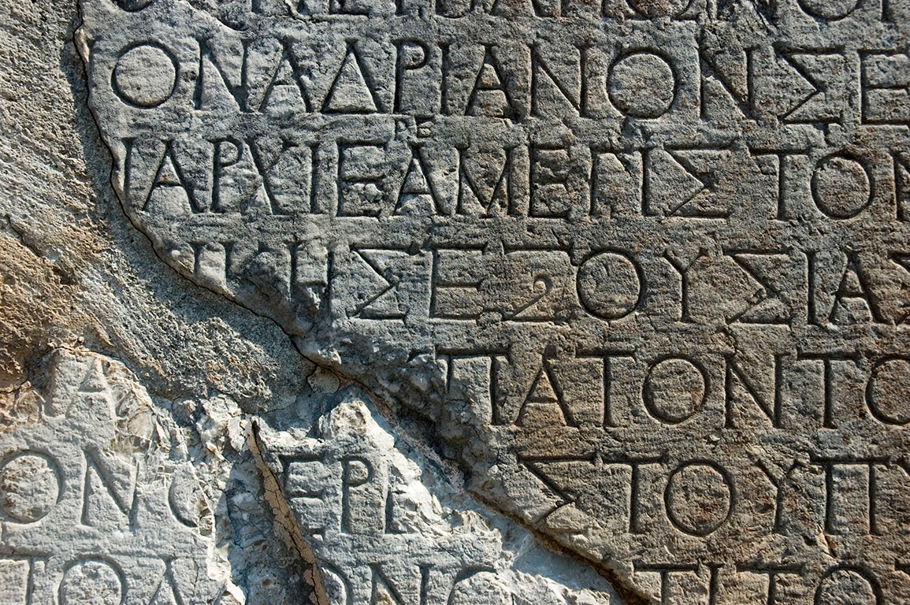
We are reading history, not mythology
^{Acts 18:12} But when Gallio became governor of Achaia, some Jews rose up together against Paul and brought him before the governor for judgment.

Slide 43
We are reading history, not mythology
^{Acts 18:2} They had left Italy when Claudius Caesar deported all Jews from Rome.
^{Acts 18:12} But when Gallio became governor of Achaia, some Jews rose up together against Paul and brought him before the governor for judgment.

Slide 44
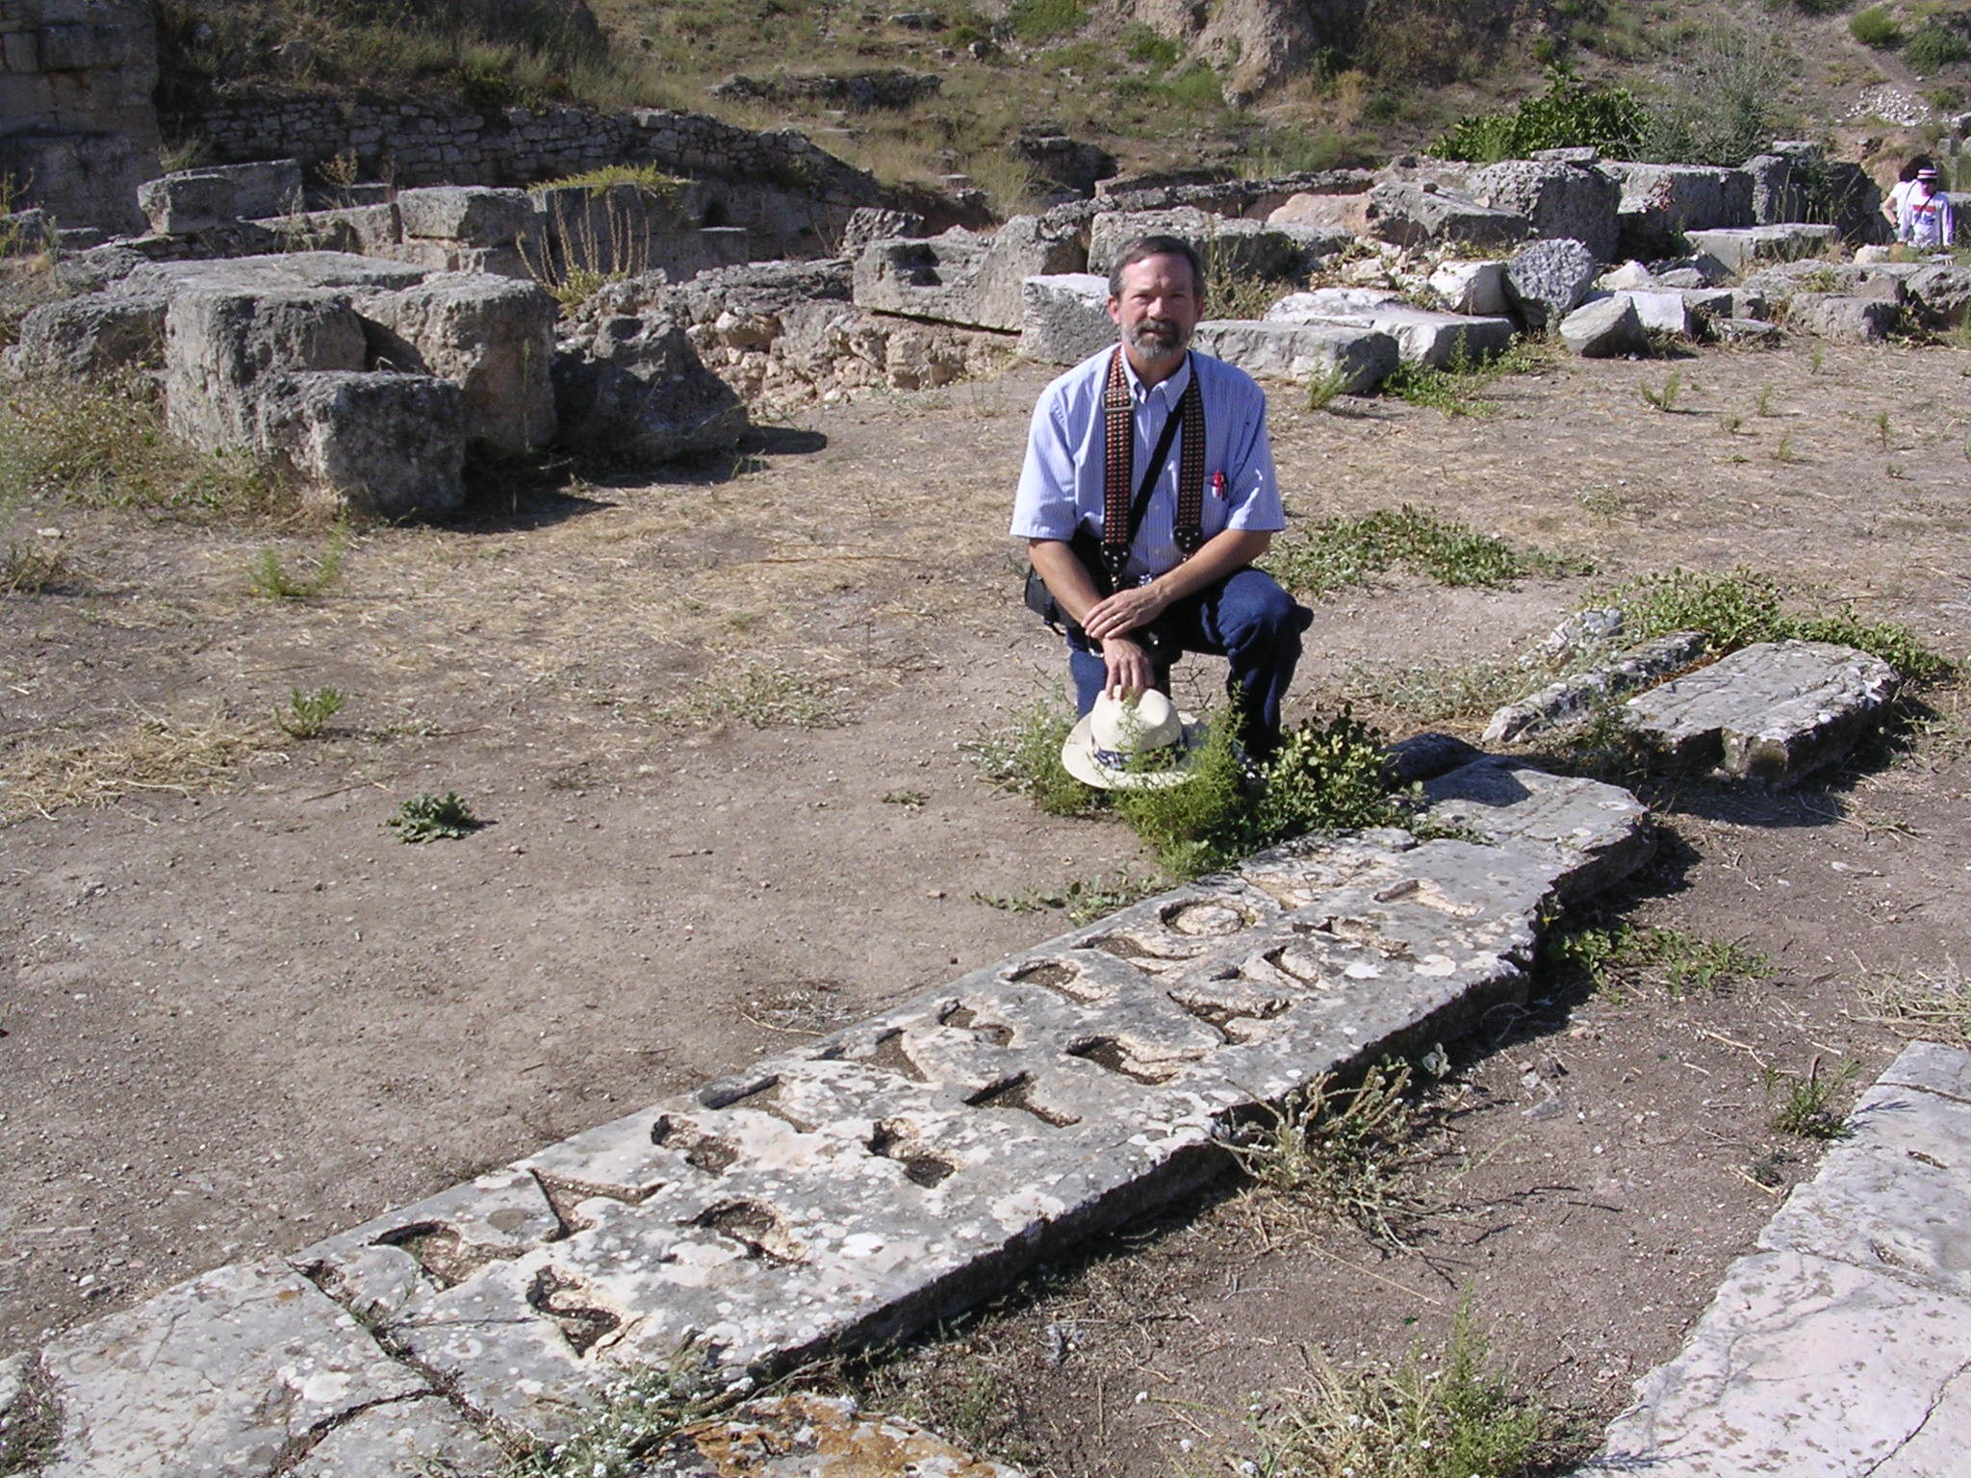
We are reading history, not mythology
^{Romans 16:23} Gaius, whose hospitality I and the whole church here enjoy, sends you his greetings. Erastus, who is the city’s director of public works, and our brother Quartus send you their greetings.
^{Acts 18:12} But when Gallio became governor of Achaia, some Jews rose up together against Paul and brought him before the governor for judgment.

Slide 45
We are reading history, not mythology
^{Romans 16:23} Gaius, whose hospitality I and the whole church here enjoy, sends you his greetings. Erastus, who is the city’s director of public works, and our brother Quartus send you their greetings.
^{Acts 18:12} But when Gallio became governor of Achaia, some Jews rose up together against Paul and brought him before the governor for judgment.
"Erastus in return for his aedileship laid the pavement at his own expense”

Slide 46
We are reading history, not mythology
^{Romans 16:23} Gaius, whose hospitality I and the whole church here enjoy, sends you his greetings. Erastus, who is the city’s director of public works, and our brother Quartus send you their greetings.
^{Acts 18:12} But when Gallio became governor of Achaia, some Jews rose up together against Paul and brought him before the governor for judgment.
"Erastus in return for his aedileship laid the pavement at his own expense”

Slide 47
We are reading history, not mythology
One of the standout features of the Bible
No other religious text cross references with history like the Bible!
^{Acts 18:12} But when Gallio became governor of Achaia, some Jews rose up together against Paul and brought him before the governor for judgment.

Slide 48
We are reading history, not mythology
The biblical account is corroborated over and over again by contemporary, extra-biblical, often hostile sources
And holds up under the scrutiny of modern scholarship
^{Acts 18:12} But when Gallio became governor of Achaia, some Jews rose up together against Paul and brought him before the governor for judgment.

Slide 49
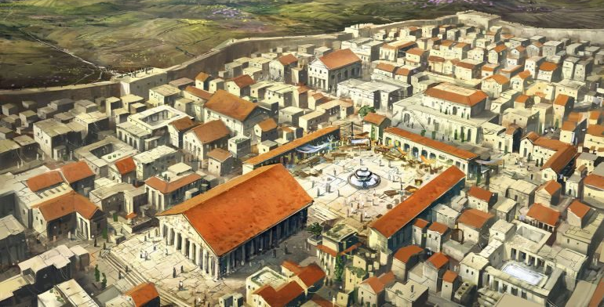
^{Acts 18:12} But when Gallio became governor of Achaia, some Jews rose up together against Paul and brought him before the governor for judgment.

Slide 50
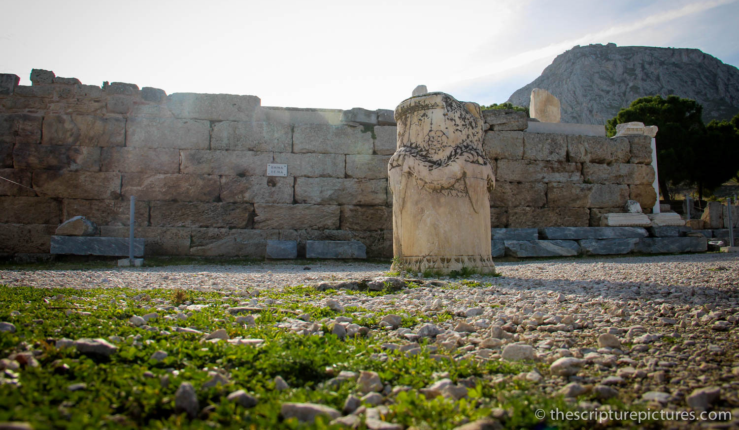
^{Acts 18:12} But when Gallio became governor of Achaia, some Jews rose up together against Paul and brought him before the governor for judgment.

Slide 51
^{Acts 18:13} saying, “This man persuades men to worship God contrary to the law.” ¹⁴ But just as Paul started to make his defense, Gallio turned to Paul’s accusers and said,
^{Acts 18:13} saying, “This man persuades men to worship God contrary to the law.” ¹⁴ But just as Paul started to make his defense, Gallio turned to Paul’s accusers and said,

Slide 52
^{Acts 18:14} “Listen, you Jews, if this were a case involving some wrongdoing or a serious crime, I would have a reason to accept your case. ¹⁵ But since it is merely a question of words and names and your Jewish law, take care of it yourselves. I refuse to judge such matters.” ¹⁶ And he threw them out of the courtroom.

Slide 53
^{Acts 18:17} The crowd then grabbed Sosthenes, the leader of the synagogue, and beat him right there in the courtroom. But Gallio paid no attention.

Slide 54
^{1 Corinthians 1:1} This letter is from Paul, chosen by the will of God to be an apostle of Christ Jesus, and from our brother Sosthenes.
^{Acts 18:17} The crowd then grabbed Sosthenes, the leader of the synagogue, and beat him right there in the courtroom. But Gallio paid no attention.

Slide 55
Sometimes we can hear God’s knock most clearly when life chews us up and spits us out
^{1 Corinthians 1:1} This letter is from Paul, chosen by the will of God to be an apostle of Christ Jesus, and from our brother Sosthenes.
^{Acts 18:17} The crowd then grabbed Sosthenes, the leader of the synagogue, and beat him right there in the courtroom. But Gallio paid no attention.

Slide 56
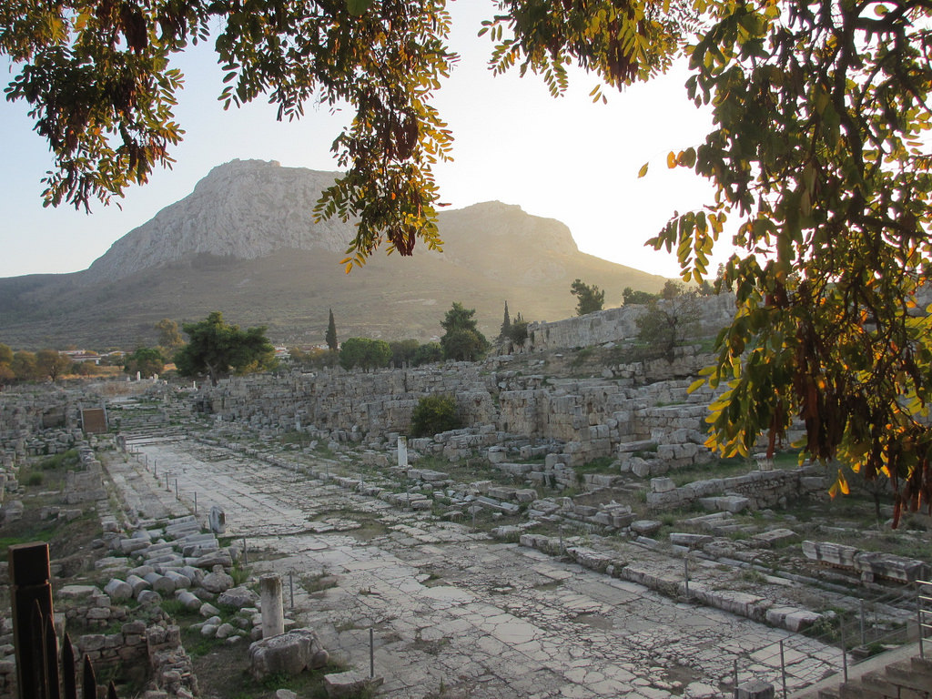
^{Acts 18:18} Paul stayed in Corinth for some time after that, then said good-bye to the brothers and sisters and went to nearby Cenchrea.

Slide 57
God made good on His promise
^{Acts 18:18} Paul stayed in Corinth for some time after that, then said good-bye to the brothers and sisters and went to nearby Cenchrea.

Slide 58
God made good on His promise
^{Acts 18:18} Paul stayed in Corinth for some time after that, then said good-bye to the brothers and sisters and went to nearby Cenchrea.
^{Acts 18:9} “Don’t be afraid! Speak out! Don’t be silent! ¹⁰ For I am with you, and no one will attack and harm you, for many people in this city belong to me.”

Slide 59
Do you think that many people belong to God in this city?
^{Acts 18:18} Paul stayed in Corinth for some time after that, then said good-bye to the brothers and sisters and went to nearby Cenchrea.
^{Acts 18:9} “Don’t be afraid! Speak out! Don’t be silent! ¹⁰ For I am with you, and no one will attack and harm you, for many people in this city belong to me.”

Slide 60
Challenge: we should strive to adopt God’s perspective on people
Seeing the need of people down on their luck
^{Acts 18:18} Paul stayed in Corinth for some time after that, then said good-bye to the brothers and sisters and went to nearby Cenchrea.
^{Acts 18:9} “Don’t be afraid! Speak out! Don’t be silent! ¹⁰ For I am with you, and no one will attack and harm you, for many people in this city belong to me.”

Slide 61
Challenge: we should strive to adopt God’s perspective on people
And the need of people who “have it together”
^{Acts 18:18} Paul stayed in Corinth for some time after that, then said good-bye to the brothers and sisters and went to nearby Cenchrea.
^{Acts 18:9} “Don’t be afraid! Speak out! Don’t be silent! ¹⁰ For I am with you, and no one will attack and harm you, for many people in this city belong to me.”

Slide 62
Challenge: we should strive to adopt God’s perspective on people
Including the last people we expect to respond to Christ
^{Acts 18:18} Paul stayed in Corinth for some time after that, then said good-bye to the brothers and sisters and went to nearby Cenchrea.
^{Acts 18:9} “Don’t be afraid! Speak out! Don’t be silent! ¹⁰ For I am with you, and no one will attack and harm you, for many people in this city belong to me.”

Slide 63
Challenge: we should strive to adopt God’s perspective on people
Including those who hate us!
^{Acts 18:18} Paul stayed in Corinth for some time after that, then said good-bye to the brothers and sisters and went to nearby Cenchrea.
^{Acts 18:9} “Don’t be afraid! Speak out! Don’t be silent! ¹⁰ For I am with you, and no one will attack and harm you, for many people in this city belong to me.”

Slide 64
To see the need, and believe that the gospel is the remedy
… and be bold enough to say so!
^{Acts 18:18} Paul stayed in Corinth for some time after that, then said good-bye to the brothers and sisters and went to nearby Cenchrea.
^{Acts 18:9} “Don’t be afraid! Speak out! Don’t be silent! ¹⁰ For I am with you, and no one will attack and harm you, for many people in this city belong to me.”

Slide 65
Acts
Next Time . . .

