Slide 1
Biblical Hope:
From Suffering
To Glory
Romans 8:18-25

Slide 2
Romans 8
¹⁸ For I consider that the sufferings of this present time are not worthy to be compared with the glory that is to be revealed to
us.

Slide 3
Romans 8
¹⁸ For I consider that the sufferings of this present time are not worthy to be compared with the glory that is to be revealed to us. ¹⁹ For the eagerly awaiting creation waits for the revealing of the sons and daughters of God. ²⁰ For the creation was subjected to futility, not willingly, but because of Him who subjected it, in hope ²¹ that the creation itself also will be set free from its slavery to corruption into the freedom of the glory of the children of God.

Slide 4
Romans 8
¹⁸ For I consider that the sufferings of this present time are not worthy to be compared with the glory that is to be revealed to us. ¹⁹ For the eagerly awaiting creation waits for the revealing of the sons and daughters of God. ²⁰ For the creation was subjected to futility, not willingly, but because of Him who subjected it, in hope ²¹ that the creation itself also will be set free from its slavery to corruption into the freedom of the glory of the children of God.

Slide 5
Romans 8
¹⁸ For I consider that the sufferings of this present time are not worthy to be compared with the glory that is to be revealed to us. ¹⁹ For the eagerly awaiting creation waits for the revealing of the sons and daughters of God. ²⁰ For the creation was subjected to futility, not willingly, but because of Him who subjected it, in hope ²¹ that the creation itself also will be set free from its slavery to corruption into the freedom of the glory of the children of God.
Mátaios- Vain or Ineffectual
Phthorá: Decay

Slide 6
Romans 8
¹⁸ For I consider that the sufferings of this present time are not worthy to be compared with the glory that is to be revealed to us. ¹⁹ For the eagerly awaiting creation waits for the revealing of the sons and daughters of God. ²⁰ For the creation was subjected to futility, not willingly, but because of Him who subjected it, in hope ²¹ that the creation itself also will be set free from its slavery to corruption into the freedom of the glory of the children of God. ²² .
The heavens are the heavens of the Lord; but the earth He has given to the sons of men.
Psalm 115:16
Genesis 3:19
“By the sweat of your face you shall eat bread, until you return to the ground, because from it you were taken; For you are dust, And to dust you shall return.”
NOT that animal death entered at the fall
The EARTH has become subject to US, bad stewards, and we cause further decay.
WE are subject to the futility of nature and mortality in our separation from God.

Slide 7
Common Concern?
YES. The earth is a stewardship and needs cared for…and mankind is destroying it. Physical life is special, amazing, and worthy of respect.
But, will humans will be able to avoid an apocalyptic future?
-Humans can’t find equilibrium with nature like other species.
-Human behavior is driven by over-desire and excess.
Therefore—mankind needs a makeover before the earth gets one!

Slide 8
Common Concern?
YES. The earth is a stewardship and needs cared for…and mankind is destroying it. Physical life is special, amazing, and worthy of respect.
But, will humans will be able to avoid an apocalyptic future?
-Humans can’t find equilibrium with nature like other species.
-Human behavior is driven by over-desire and excess.
Therefore—mankind needs a makeover before the earth gets one!
Things SEEM hopeless….
We don’t have what it takes to fix the world.
We don’t’ have what it takes to fix ourselves.
There is no future “utopia” apart from God
All mortals will face suffering

Slide 9
Why does God allow the earth and humanity to suffer? Why is he taking so long to act?

Slide 10
Why does God allow the earth and humanity to suffer? Why is he taking so long to act?
Rom. 8:20- “because of Him who subjected it, in hope”
² Peter 3:8-9- But do not let this one fact escape your notice, beloved, that with the Lord one day is like a thousand years, and a thousand years like one day. The Lord is not slow about His promise, as some count slowness, but is patient toward you, not willing for any to perish, but for all to come to repentance.

Slide 11
Suffering
¹⁸ For I consider that the sufferings of this present time are not worthy to be compared with the glory that is to be revealed to us. ¹⁹ For the eagerly awaiting creation waits for the revealing of the sons and daughters of God. ²⁰ For the creation was subjected to futility, not willingly, but because of Him who subjected it, in hope ²¹ that the creation itself also will be set free from its slavery to corruption into the freedom of the glory of the children of God. ²² For we know that the whole creation groans and suffers the pains of childbirth together until now.

Slide 12
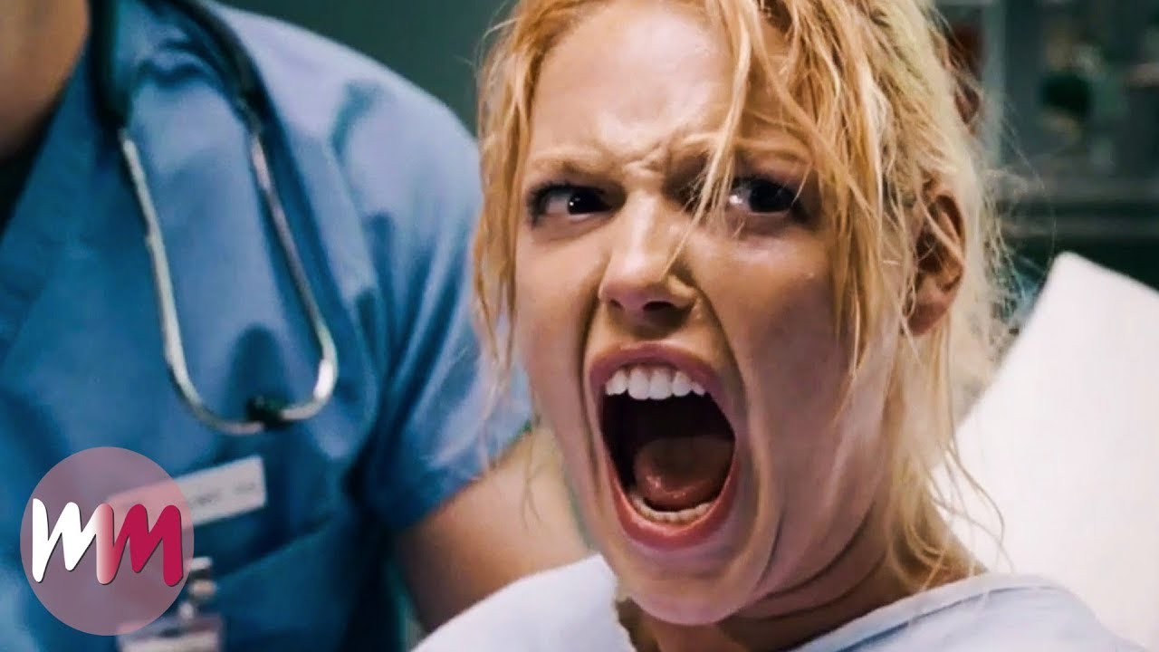
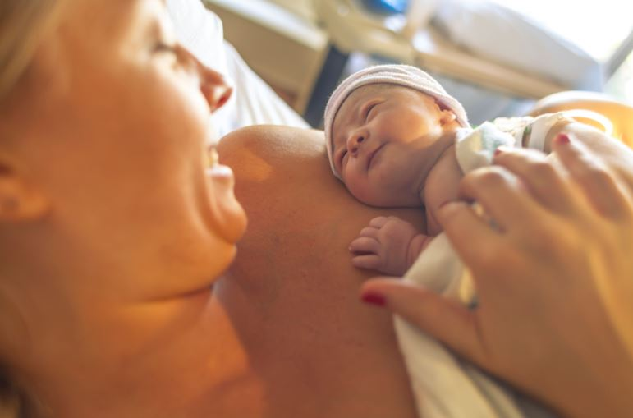
Suffering
¹⁸ For I consider that the sufferings of this present time are not worthy to be compared with the glory that is to be revealed to us. ¹⁹ For the eagerly awaiting creation waits for the revealing of the sons and daughters of God. ²⁰ For the creation was subjected to futility, not willingly, but because of Him who subjected it, in hope ²¹ that the creation itself also will be set free from its slavery to corruption into the freedom of the glory of the children of God. ²² For we know that the whole creation groans and suffers the pains of childbirth together until now.

Slide 13
Suffering
¹⁸ For I consider that the sufferings of this present time are not worthy to be compared with the glory that is to be revealed to us. ¹⁹ For the eagerly awaiting creation waits for the revealing of the sons and daughters of God. ²⁰ For the creation was subjected to futility, not willingly, but because of Him who subjected it, in hope ²¹ that the creation itself also will be set free from its slavery to corruption into the freedom of the glory of the children of God. ²² For we know that the whole creation groans and suffers the pains of childbirth together until now.
Hebrews 12:1b-2- and let’s run with endurance the race that is set before us, looking only at Jesus, the originator and perfecter of the faith, who for the joy set before Him endured the cross, despising the shame, and has sat down at the right hand of the throne of God.

Slide 14
Romans 8
²³ And not only that, but also we ourselves, having the first fruits of the Spirit, even we ourselves groan within ourselves, waiting eagerly for our adoption as sons and daughters, the redemption of our
body.
NOT the person you want to be…
NOT the goal you wanted to see…

Slide 15
Romans 8
²³ And not only that, but also we ourselves, having the first fruits of the Spirit, even we ourselves groan within ourselves, waiting eagerly for our adoption as sons and daughters, the redemption of our
body.
2 Corinthians 4:16-17
Therefore we do not lose heart, but though our outer person is decaying, yet our inner person is being renewed day by day. For our momentary, light affliction is producing for us an eternal weight of glory far beyond all comparison…

Slide 16
Romans 8
²³ And not only that, but also we ourselves, having the first fruits of the Spirit, even we ourselves groan within ourselves, waiting eagerly for our adoption as sons and daughters, the redemption of our
body.
When we don’t “wait eagerly”?
Easily defeated
Easily distracted
Apathy
Spiritual shortcuts
Results focused

Slide 17
Romans 8
²³ And not only that, but also we ourselves, having the first fruits of the Spirit, even we ourselves groan within ourselves, waiting eagerly for our adoption as sons and daughters, the redemption of our
body.
When we don’t “wait eagerly”?
Easily defeated
Easily distracted
Apathy
Spiritual shortcuts
Results focused
Waiting eagerly:
THE NEW HEAVEN AND EARTH!

Slide 18
Romans 8
²⁶ Now in the same way the Spirit also helps our weakness; for we do not know what to pray for as we should, but the Spirit Himself intercedes for us with groaning's too deep for words; ²⁷ and He who searches the hearts knows what the mind of the Spirit is, because He intercedes for the saints according to the will of God.

Slide 19
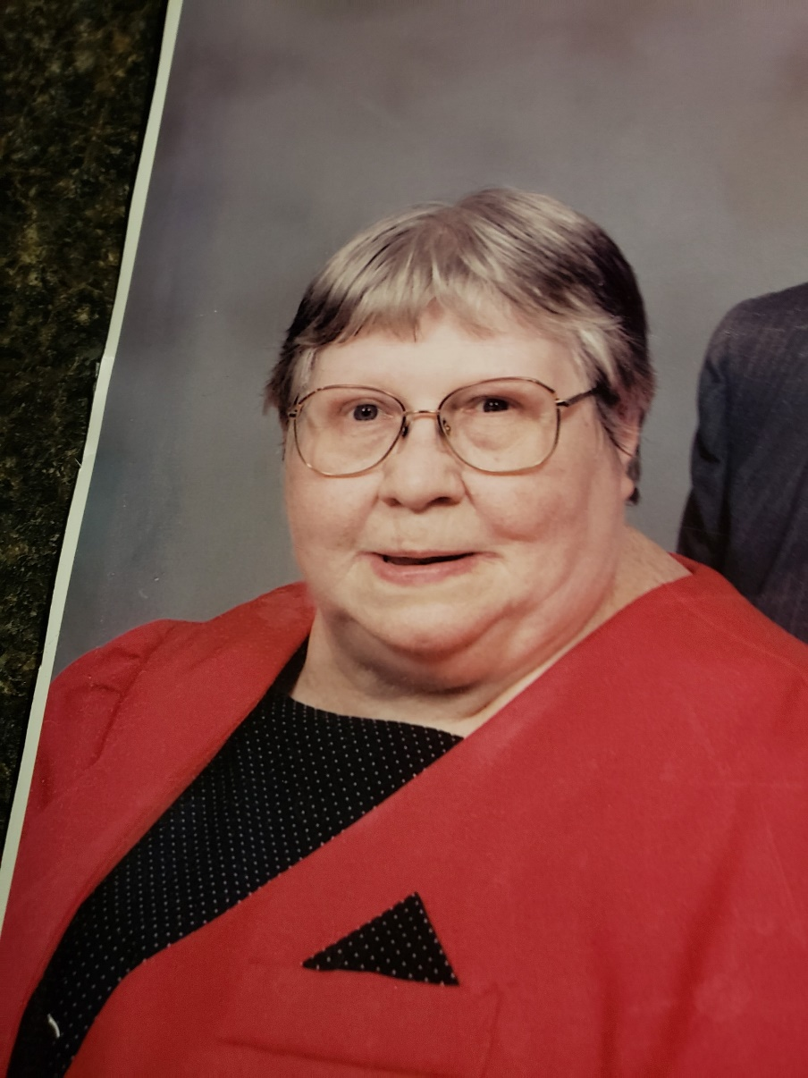
Romans 8
²⁶ Now in the same way the Spirit also helps our weakness; for we do not know what to pray for as we should, but the Spirit Himself intercedes for us with groaning's too deep for words; ²⁷ and He who searches the hearts knows what the mind of the Spirit is, because He intercedes for the saints according to the will of God.
The “pray until you pray” principle.
Pray for the impossible!

Slide 20
Romans 8
²⁸ And we know that God causes all things to work together for good to those who love God, to those who are called according to His purpose.

Slide 21
Romans 8
²⁸ And we know that God causes all things to work together for good to those who love God, to those who are called according to His purpose.
CERTAIN
COMPREHENSIVE

Slide 22
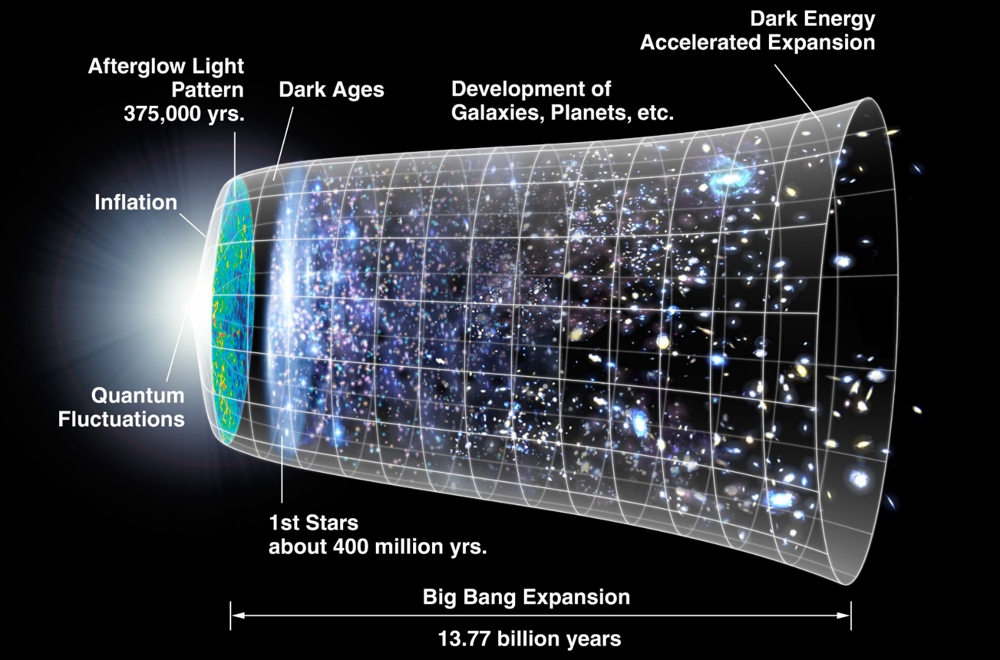
Ecclesiasties 3:8-9- Yet God has made everything beautiful for its own time. He has planted eternity in the human heart, but even so, people cannot see the whole scope of God’s work from beginning to end.
Stars after 400 million years!
Watery earth at 9.5 billion years!
Image-bears at 13.7 billion years!

Slide 23
Romans 8
²⁸ And we know that God causes all things to work together for good to those who love God, to those who are called according to His purpose.
CERTAIN
COMPREHENSIVE
COOPERATIVE
CONSTRUCTIVE
CONDITIONAL

Slide 24
Biblical Hope
Hope for the God’s seeking of humanity
Hope for the earth to be renewed under God
Hope for our immortality
Hope in God’s sovereignty during setbacks, for ultimate victory and vindication
OUR PART
Build eagerness—fill your mind with the eternal!
Pray until you pray…
Hold onto the promise of God’s sovereignty.

Slide 25
Romans 8
³¹ What then shall we say to these things?

Slide 26
Romans 8
³¹ What then shall we say to these things? If God is for us, who is against us? ³² He who did not spare His own Son, but delivered Him over for us all, how will He not also with Him freely give us all things?

Slide 27
Romans 8
³¹ What then shall we say to these things? If God is for us, who is against us? ³² He who did not spare His own Son, but delivered Him over for us all, how will He not also with Him freely give us all things? ³³ Who will bring charges against God’s elect? God is the one who justifies; ³⁴ who is the one who condemns? Christ Jesus is He who died, but rather, was raised, who is at the right hand of God, who also intercedes for us.

Slide 28
Romans 8
³¹ What then shall we say to these things? If God is for us, who is against us? ³² He who did not spare His own Son, but delivered Him over for us all, how will He not also with Him freely give us all things? ³³ Who will bring charges against God’s elect? God is the one who justifies; ³⁴ who is the one who condemns? Christ Jesus is He who died, but rather, was raised, who is at the right hand of God, who also intercedes for us. ³⁵ Who will separate us from the love of ^{[t]}Christ? Will tribulation, or trouble, or persecution, or famine, or nakedness, or danger, or sword? ³⁶ Just as it is written:
“For Your sake we are killed all day long; We were regarded as sheep to be slaughtered.”

Slide 29
Romans 8
³⁷ But in all these things we overwhelmingly conquer through Him who loved us. ³⁸ For I am convinced that neither death, nor life, nor angels, nor principalities, nor things present, nor things to come, nor powers, ³⁹ nor height, nor depth, nor any other created thing will be able to separate us from the love of God that is in Christ Jesus our Lord.

