Slide 1
Fighting for delight in the word
What does it mean to “delight?”
“The Word” - our source of delight?
Fighting for new ground of delight!

Slide 2
What does it mean to delight?
Ezekiel
Author(s) of Psa 119
Martha & Mary
Psa 119:17-32 Open my eyes, that I may behold wonderful things from Your law… Do not hide Your Word…My soul is crushed with longing after Your Word at all times…Even though princes sit and talk against me, Your servant meditates on Your Word. Your Word is my delight; They are my counselors…Revive me according to Your word…Teach me Your Word…Make me understand…so I will meditate on Your wonders… Strengthen me according to Your word…I cling to Your testimonies…I shall run the way of Your Word, for You will enlarge my heart.
Luke 10:38-42 …as they were traveling, a woman named Martha welcomed Him into her home. She had a sister called Mary, who was seated at the Lord’s feet, listening to His word. But Martha was distracted with all her preparations; and she came up to Him and said, “Lord, do You not care that my sister has left me to do all the serving alone? Then tell her to help me.” But the Lord answered and said to her, “Martha, Martha, you are worried and bothered about so many things; but only one thing is necessary, for Mary has chosen the good part, which shall not be taken away from her.”
He said to me, “Son of man, feed your stomach and fill your body with this scroll which I am giving you.” Then I ate it, and it was sweet as honey in my mouth. Ezekiel 3:3

Slide 3
What does it mean to delight?
Ezekiel
Author(s) of Psa 119
Martha & Mary
Biblical delight is the feeling or expression
of pleasure as a result of
developing / cultivating a taste to enjoy
what is good & provided by God

Slide 4
What does it mean to delight?
Ezekiel
Author(s) of Psa 119
Martha & Mary
Biblical delight is the feeling or expression
of pleasure as a result of
developing / cultivating a taste to enjoy
what is good & provided by God
Psa 94:19 When my anxious thoughts multiply within me, your words delight my soul.

Slide 5
“the word”- our source of delight
The Word as theology
The Word as wisdom
The Word as gift
The Word as weapon
The Word as stewardship
The Word as revelation of relationship
John 1:1-18 In the beginning was the Word, and the Word was with God, and the Word was God. He was in the beginning with God. All things came into being through Him, and apart from Him nothing came into being that has come into being. In Him was life, and the life was the Light of men. The Light shines in the darkness, and the darkness did not comprehend it…And the Word became flesh, and dwelt among us, and we saw His glory, glory as of the only begotten from the Father, full of grace and truth…He has explained Him.

Slide 6
“the word”- our source of delight
The Word as theology
The Word as wisdom
The Word as gift
The Word as weapon
The Word as stewardship
The Word as revelation of relationship
“…we become acquainted with the character of God. Our eyes are divinely opened to see what a lovely Being God is! And this good, gracious, loving, heavenly Father is ours – our portion for time and for eternity…And what will make us exceedingly happy in heaven? It will be the fuller knowledge of God.”
A Narrative of Some of the Lord’s Dealing with George Mueller
Isa 6: 3 And one called out to another and said, “Holy, Holy, Holy, is the Lord of hosts, the whole earth is full of His glory.”
Rev 4:8 …and day and night they do not cease to say, “Holy, holy, holy is the Lord God, the Almighty, who was and who is and who is to come.”

Slide 7
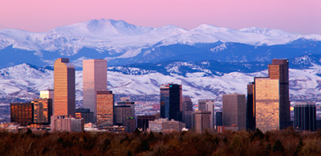
“the word”- our source of delight
The Word as theology
The Word as wisdom
The Word as gift
The Word as weapon
The Word as stewardship
The Word as revelation of relationship
“…we become acquainted with the character of God. Our eyes are divinely opened to see what a lovely Being God is! And this good, gracious, loving, heavenly Father is ours – our portion for time and for eternity…And what will make us exceedingly happy in heaven? It will be the fuller knowledge of God.”
A Narrative of Some of the Lord’s Dealing with George Mueller
Isa 6: 3 And one called out to another and said, “Holy, Holy, Holy, is the Lord of hosts, the whole earth is full of His glory.”
Rev 4:8 …and day and night they do not cease to say, “Holy, holy, holy is the Lord God, the Almighty, who was and who is and who is to come.”

Slide 8
“the word”- our source of delight
The Word as theology
The Word as wisdom
The Word as gift
The Word as weapon
The Word as stewardship
The Word as revelation of relationship
“…we become acquainted with the character of God. Our eyes are divinely opened to see what a lovely Being God is! And this good, gracious, loving, heavenly Father is ours – our portion for time and for eternity…And what will make us exceedingly happy in heaven? It will be the fuller knowledge of God.”
A Narrative of Some of the Lord’s Dealing with George Mueller
Isa 6: 3 And one called out to another and said, “Holy, Holy, Holy, is the Lord of hosts, the whole earth is full of His glory.”
Rev 4:8 …and day and night they do not cease to say, “Holy, holy, holy is the Lord God, the Almighty, who was and who is and who is to come.”

Slide 9
Fighting for new ground of delight!
The “warfare for delight”
Prov 2:1-6 My son, if you will receive my words, and treasure my commandments within you, make your ear attentive to wisdom, incline your heart to understanding; for if you cry for discernment, lift your voice for understanding; if you seek her as silver and search for her as for hidden treasures; then you will discern the fear of the Lord and discover the knowledge of God. For the Lord gives wisdom; from His mouth come knowledge and understanding.
1&2Tim Guard what has been entrusted… Guard through the Holy Spirit who dwells in us, the treasure which has been entrusted to you… Retain the standard of sound words…Remind them of these things… be diligent to-handle accurately the Word of truth…continue in the things you have learned
Phil 4:8-9 Finally, brethren, whatever is true, whatever is honorable, whatever is right, whatever is pure, whatever is lovely, whatever is of good repute, if there is any excellence and if anything worthy of praise, dwell on these things.The things you have learned and received and heard and seen in me, practice these things, and the God of peace will be with you.

Slide 10
Fighting for new ground of delight!
The “warfare for delight”
Enemies of delight
Satan
“Satan knows that no Christian can be overcome more easily than the one who neglects to hold rendezvous with his Lord. A human heart cannot be void. If it is not filled with God every day, it will…be filled with the world. It will follow the spiritual law of gravity and sink down, either into open or into secret worldliness. The latter is without question…the most dangerous. Such a heart becomes a stranger to God… Such a soul is bleeding to death…” Under His Wings, O.Hallesby, p140
“…the strength of the Mary-souls is that they are fully aware (of the enemies of delight.”)
Under His Wings, O.Hallesby, p143

Slide 11
Fighting for new ground of delight!
The “warfare for delight”
Enemies of delight
Satan
Prayerlessness
“Greasy delights”
“He can stand a great deal of religiosity…religious exercises and religious work. In fact, he has no objections to prayer either, provided he does not have to risk meeting God…He feels that quiet hours in the presence of the Lord are death to him, and therefore seeks instinctively to avoid them.”
Under His Wings, O.Hallesby, p138-139
Psa 40:1-3 I waited patiently for the Lord; and He inclined to me and heard my cry. He brought me up out of the pit of destruction, out of the miry clay, and He set my feet upon a rock making my footsteps firm. He put a new song in my mouth, a song of praise to our God; many will see and fear and will trust in the Lord.
“Greasy delights” are…
all that gets obsessive (I always think about it)
all that gets impulsive (Just Do It)
all that gets compulsive (I can’t help it)
all that gets cancerous (expands, devours, destroys)
all that gets mutated (unstable, restless & bizarre)
Innocent Pleasures, David Powlison,
The Journal of Biblical Counseling, p25, Fall 2005
Isa 55:2 “Why do you spend money for what is not bread, and your wages for what does not satisfy?
Listen carefully to Me, and eat what is good, and delight yourself in abundance.

Slide 12
Fighting for new ground of delight!
The “warfare for delight”
Enemies of delight
Satan
Prayerlessness
“Greasy delights”
Cynicism
Psa 1:1-2 How blessed is the man who does not walk in the counsel of the wicked, nor stand in the path of sinners, nor sit in the seat of scoffers! But his delight is in the law of the Lord, and in His law he meditates day and night. For he will be like…

Slide 13
Fighting for new ground of delight!
The “warfare for delight”
Enemies of delight
New Ground Worth Taking!
Pray
Advance Intentionally
Matt 7:7-8 Ask, and it will be given to you; seek, and you will find; knock, and it will be opened to you. For everyone who asks receives, and he who seeks finds, and to him who knocks it will be opened.
2 Chron15:2b …And if you seek Him, He will let you find Him;
Psa 111:2 Great are the works of the Lord; they are studied by all who delight in them.
Psa 119:92 If Your Word had not been my delight, then I would have perished in my affliction.
Psa 119:147-148 I rise before dawn and cry for help; I wait for Your words. My eyes anticipate the night watches, that I may meditate on Your word

Slide 14
Fighting for new ground of delight!
The “warfare for delight”
Enemies of delight
New Ground Worth Taking!
Pray
Advance Intentionally
Plan your advance
Uncover resources
Log your discoveries
Meditate on your findings
Secure a memorial
Explore His “nature”
Find new trails of interest
Go public

Slide 15
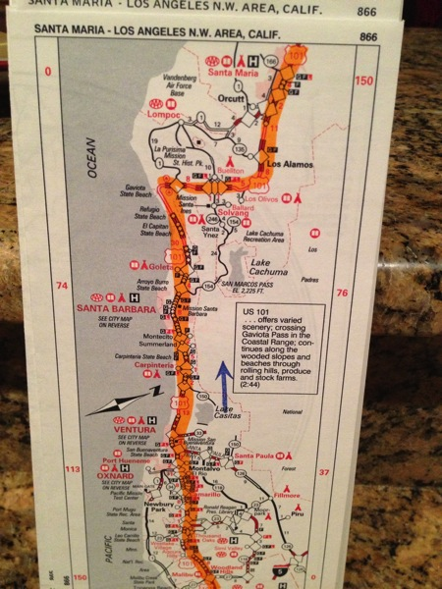
Fighting for new ground of delight!
The “warfare for delight”
Enemies of delight
New Ground Worth Taking!
Pray
Advance Intentionally
Plan your advance
Uncover resources
Log your discoveries
Meditate on your findings
Secure a memorial
Explore His “nature”
Find new trails of interest
Go public

Slide 16
Fighting for new ground of delight!
The “warfare for delight”
Enemies of delight
New Ground Worth Taking!
Pray
Advance Intentionally
Plan your advance
Uncover resources
Log your discoveries
Meditate on your findings
Secure a memorial
Explore His “nature”
Find new trails of interest
Go public

Slide 17
Fighting for new ground of delight!
The “warfare for delight”
Enemies of delight
New Ground Worth Taking!
Pray
Advance Intentionally
Plan your advance
Uncover resources
Log your discoveries
Meditate on your findings
Secure a memorial
Explore His “nature”
Find new trails of interest
Go public

Slide 18
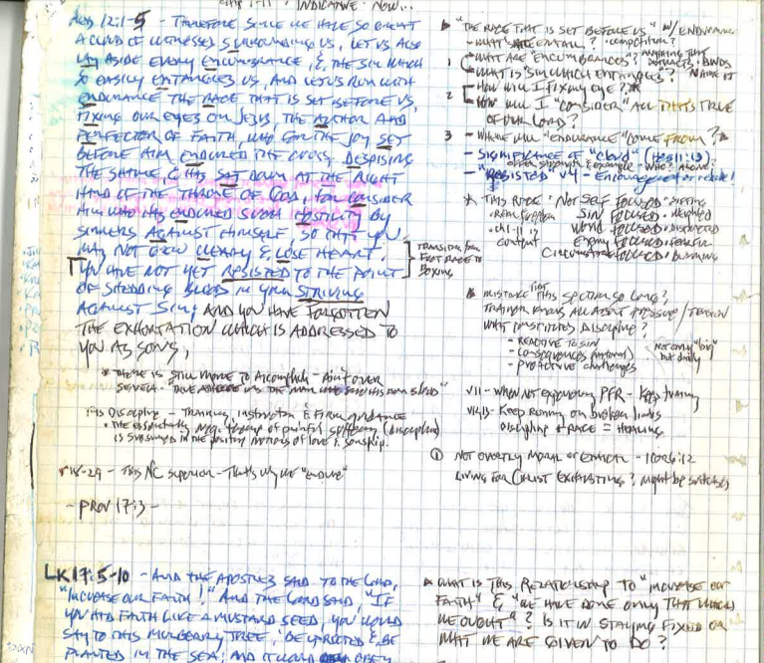
Fighting for new ground of delight!
The “warfare for delight”
Enemies of delight
New Ground Worth Taking!
Pray
Advance Intentionally
Plan your advance
Uncover resources
Log your discoveries
Meditate on your findings
Secure a memorial
Explore His “nature”
Find new trails of interest
Go public

Slide 19
Fighting for new ground of delight!
The “warfare for delight”
Enemies of delight
New Ground Worth Taking!
Pray
Advance Intentionally
Plan your advance
Uncover resources
Log your discoveries
Meditate on your findings
Secure a memorial
Explore His “nature”
Find new trails of interest
Go public

Slide 20
Fighting for new ground of delight!
The “warfare for delight”
Enemies of delight
New Ground Worth Taking!
Pray
Advance Intentionally
Plan your advance
Uncover resources
Log your discoveries
Meditate on your findings
Secure a memorial
Explore His “nature”
Find new trails of interest
Go public
“(Children) always say, “do it again”, and the grown-up person does it again and again until he is nearly dead. For grown-up people are not strong enough to exult in monotony.” God is though – the sun, the moon, flowers. He continues, “…for we have sinned and grown old, and our Father is younger than we.” Orthodoxy, GK Chesterton, p60
Psa 19:1-6 The heavens are telling of the glory of God; and their expanse is declaring the work of His hands. Day to day pours forth speech, and night to night reveals knowledge. There is no speech, nor are there words; Their voice is not heard. Their line has gone out through all the earth, and their utterances to the end of the world. In them He has placed a tent for the sun, which is as a bridegroom coming out of his chamber; it rejoices as a strong man to run his course. Its rising is from one end of the heavens, and its circuit to the other end of them; and there is nothing hidden from its heat.

Slide 21
Fighting for new ground of delight!
The “warfare for delight”
Enemies of delight
New Ground Worth Taking!
Pray
Advance Intentionally
Plan your advance
Uncover resources
Log your discoveries
Meditate on your findings
Secure a memorial
Explore His “nature”
Find new trails of interest
Go public
Mindset of soldier in battle
Securing undistracted devotion to the Lord – 1Cor7:35
God’s history of faithfulness
Moving toward difficult conversations
Avoiding “sleeping with the enemy”
Has God really been offering ‘the desires of my heart?”
What “passion for God” looks like? Is it realistic for me?
Our sleepy approach to our Identity in Christ
Re-Write of Psa 119
What “destruction of fortresses” involve? 2 Cor 10:3-5
“While you were still helpless…” verses showing contrast
Role vs Purpose
Shutting Up while Growing God’s Voice louder

Slide 22
Fighting for new ground of delight!
The “warfare for delight”
Enemies of delight
New Ground Worth Taking!
Pray
Advance Intentionally
Plan your advance
Uncover resources
Log your discoveries
Meditate on your findings
Secure a memorial
Explore His “nature”
Find new trails of interest
Go public
God is glorified not only by His glory’s being seen, but by its being rejoiced in…His glory is then received by the whole soul, both by the understanding and by the heart.
The End For Which God Created the World, Jonathan Edwards

Slide 23
What does it mean to delight? “the word”- our source of delight Fighting for new ground of delight!
Psa 18:19 He brought me forth also into a broad place; He rescued me, because He delighted in me.
Jer 15:16 Your words were found and I ate them, and Your words became for me a joy and the delight of my heart; for I have been called by Your name, O Lord God of hosts.

Slide 24
What does it mean to delight? “the word”- our source of delight Fighting for new ground of delight!
Psa 18:19 He brought me forth also into a broad place; He rescued me, because He delighted in me.
Explorer | Tourist
Travels with whatever is needed Takes time to uncover highlights Moves slowly to avoid missing highlights Expects some opposition Expects & prepared for rough conditions | Travels light Takes time only for the highlights Moves on quickly to next highlight Expects to be treated well Expects conditions to be favorable
Jer 15:16 Your words were found and I ate them, and Your words became for me a joy and the delight of my heart; for I have been called by Your name, O Lord God of hosts.

Slide 25
Fighting for delight in the word
What does it mean to “delight?”
“The Word” - our source of delight?
Fighting for new ground of delight!

Slide 26
“the word”- our source of delight
The Word as theology
The Word as wisdom
The Word as gift
The Word as weapon
The Word as stewardship
The Word as revelation of relationship
The Word as optional?
Jer 2:13 “For My people have committed two evils: they have forsaken Me, the fountain of living waters, to hew for themselves cisterns, broken cisterns that can hold no water.

