Slide 1
FIRST PETER
THE BOOK OF

Slide 2
1 Peter 1
¹ Peter, an apostle of Jesus Christ, to God’s elect, exiles scattered throughout the provinces of Pontus, Galatia, Cappadocia, Asia and Bithynia.

Slide 3
1 Peter 1
¹ Peter, an apostle of Jesus Christ, to God’s elect, exiles scattered throughout the provinces of Pontus, Galatia, Cappadocia, Asia and Bithynia.

Slide 4
1 Peter 1
¹ Peter, an apostle of Jesus Christ, to God’s elect, exiles scattered throughout the provinces of Pontus, Galatia, Cappadocia, Asia and Bithynia.
» He was among Jesus’ twelve disciples.
» Some critics of the Bible have questioned Peter’s authorship of this book.
Acts 4:13: “When they saw the courage of Peter and John and realized that they were unschooled, ordinary men, they were astonished and they took note that these men had been with Jesus.”

Slide 5
1 Peter 1
¹ Peter, an apostle of Jesus Christ, to God’s elect, exiles scattered throughout the provinces of Pontus, Galatia, Cappadocia, Asia and Bithynia.
» He was among Jesus’ twelve disciples.
» Some critics of the Bible have questioned Peter’s authorship of this book.
Greek was the trade language of the ancient world.
Peter’s level of education does not indicate his level of intelligence.

Slide 6
1 Peter 1
¹ Peter, an apostle of Jesus Christ, to God’s elect, exiles scattered throughout the provinces of Pontus, Galatia, Cappadocia, Asia and Bithynia.
1 Peter 2:11-12: “Dear friends, I urge you, as foreigners and exiles, to abstain from sinful desires, which wage war against your soul. Live such good lives among [non-Christian people] that, though they accuse you of doing wrong, they may see your good deeds and glorify God on the day he visits us.”

Slide 7
1 Peter 1
¹ Peter, an apostle of Jesus Christ, to God’s elect, exiles scattered throughout the provinces of Pontus, Galatia, Cappadocia, Asia and Bithynia.

Slide 8
1 Peter 1
² [To those] who have been chosen according to the foreknowledge of God the Father, through the sanctifying work of the Spirit, to be obedient to Jesus Christ and sprinkled with his blood: Grace and peace be yours in abundance.

Slide 9
1 Peter 1
² [To those] who have been chosen according to the foreknowledge of God the Father, through the sanctifying work of the Spirit, to be obedient to Jesus Christ and sprinkled with his blood: Grace and peace be yours in abundance.

Slide 10
1 Peter 1
² [To those] who have been chosen according to the foreknowledge of God the Father, through the sanctifying work of the Spirit, to be obedient to Jesus Christ and sprinkled with his blood: Grace and peace be yours in abundance.
Matthew 23:37: “Jerusalem, Jerusalem, you who kill the prophets and stone those sent to you, how often I have longed to gather your children together, as a hen gathers her chicks under her wings, and you were not willing.”

Slide 11
1 Peter 1
² [To those] who have been chosen according to the foreknowledge of God the Father, through the sanctifying work of the Spirit, to be obedient to Jesus Christ and sprinkled with his blood: Grace and peace be yours in abundance.
= “to set apart” or “to make distinct.”

Slide 12
1 Peter 1
² [To those] who have been chosen according to the foreknowledge of God the Father, through the sanctifying work of the Spirit, to be obedient to Jesus Christ and sprinkled with his blood: Grace and peace be yours in abundance.

Slide 13
1 Peter 1
² [To those] who have been chosen according to the foreknowledge of God the Father, through the sanctifying work of the Spirit, to be obedient to Jesus Christ and sprinkled with his blood: Grace and peace be yours in abundance.

Slide 14
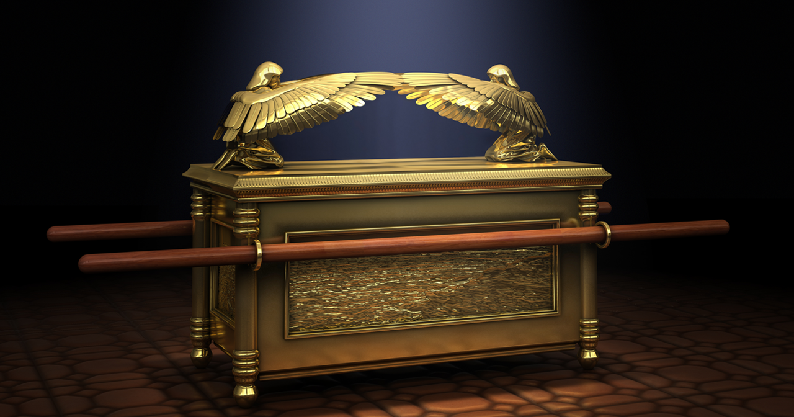

Slide 15
1 Peter 1
³ Praise be to the God and Father of our Lord Jesus Christ! In his great mercy he has given us new birth into a living hope through the resurrection of Jesus Christ from the dead,
⁴ and into an inheritance that can never perish, spoil or fade.

Slide 16
1 Peter 1
³ Praise be to the God and Father of our Lord Jesus Christ! In his great mercy he has given us new birth into a living hope through the resurrection of Jesus Christ from the dead,
⁴ and into an inheritance that can never perish, spoil or fade.

Slide 17
1 Peter 1
³ Praise be to the God and Father of our Lord Jesus Christ! In his great mercy he has given us new birth into a living hope through the resurrection of Jesus Christ from the dead,
⁴ and into an inheritance that can never perish, spoil or fade.
Our inheritance is untouched by death, unstained from evil, and unimpaired by time

Slide 18
1 Peter 1
⁴ This inheritance is kept in heaven for you,
⁵ who through faith are shielded by God’s power until the coming of the salvation that is ready to be revealed in the last time.

Slide 19
1 Peter 1
⁴ This inheritance is kept in heaven for you,
⁵ who through faith are shielded by God’s power until the coming of the salvation that is ready to be revealed in the last time.
Fear leads to compulsion; whereas love leads to obedience.
John 10:28-30: I give [my followers] eternal life, and they shall never perish; no one will snatch them out of my hand. My Father, who has given them to me, is greater than all; no one can snatch them out of my Father’s hand. I and the Father are one.”

Slide 20
1 Peter 1
⁶ In all this you greatly rejoice, though now for a little while you may have had to suffer grief in all kinds of trials.
⁷ These have come so that the proven genuineness of your faith—of greater worth than gold, which perishes even though refined by fire—may result in praise, glory and honor when Jesus Christ is revealed.

Slide 21
1 Peter 1
⁶ In all this you greatly rejoice, though now for a little while you may have had to suffer grief in all kinds of trials.
⁷ These have come so that the proven genuineness of your faith—of greater worth than gold, which perishes even though refined by fire—may result in praise, glory and honor when Jesus Christ is revealed.
Even though it takes incredible courage to die for Christ, it takes lots of courage to live for Christ.
Various trials include…
• Physical Illnesses or Disease or Injuries
• Relational

Slide 22
1 Peter 1
⁶ In all this you greatly rejoice, though now for a little while you may have had to suffer grief in all kinds of trials.
⁷ These have come so that the proven genuineness of your faith—of greater worth than gold, which perishes even though refined by fire—may result in praise, glory and honor when Jesus Christ is revealed.
Even though it takes incredible courage to die for Christ, it takes lots of courage to live for Christ.
Various trials include…
• Financial
• Emotional Distress

Slide 23
1 Peter 1
⁶ In all this you greatly rejoice, though now for a little while you may have had to suffer grief in all kinds of trials.
⁷ These have come so that the proven genuineness of your faith—of greater worth than gold, which perishes even though refined by fire—may result in praise, glory and honor when Jesus Christ is revealed.

Slide 24
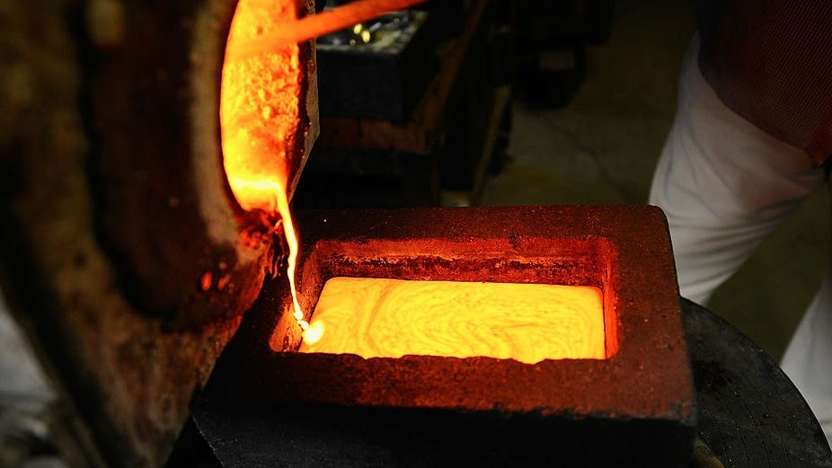

Slide 25
1 Peter 1
⁶ In all this you greatly rejoice, though now for a little while you may have had to suffer grief in all kinds of trials.
⁷ These have come so that the proven genuineness of your faith—of greater worth than gold, which perishes even though refined by fire—may result in praise, glory and honor when Jesus Christ is revealed.

Slide 26
1 Peter 1
⁸ Though you have not seen him, you love him; and even though you do not see him now, you believe in him and are filled with an inexpressible and glorious joy,
⁹ for you are receiving the end result of your faith, the salvation of your souls.

