Slide 1
Acts
Acts 25 & 26 Paul’s Testimony

Slide 2
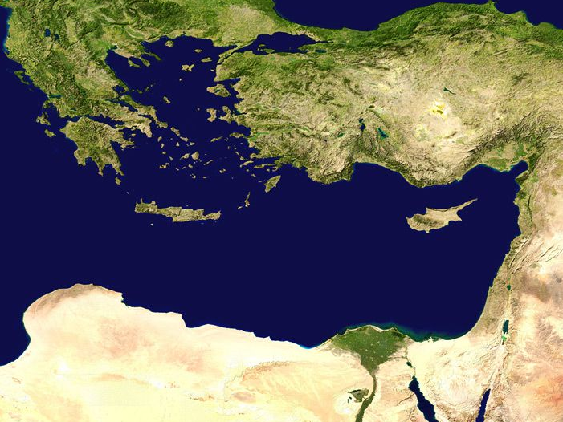
Antioch
Miletus
The 3rd Missionary Journey
Jerusalem
Last week: Paul’s Farewell

Slide 3
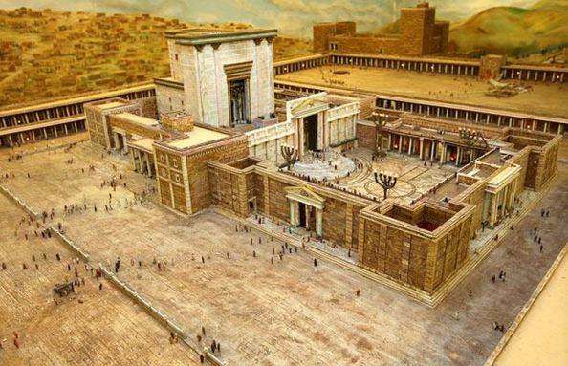
Chapter 21: Jerusalem

Slide 4
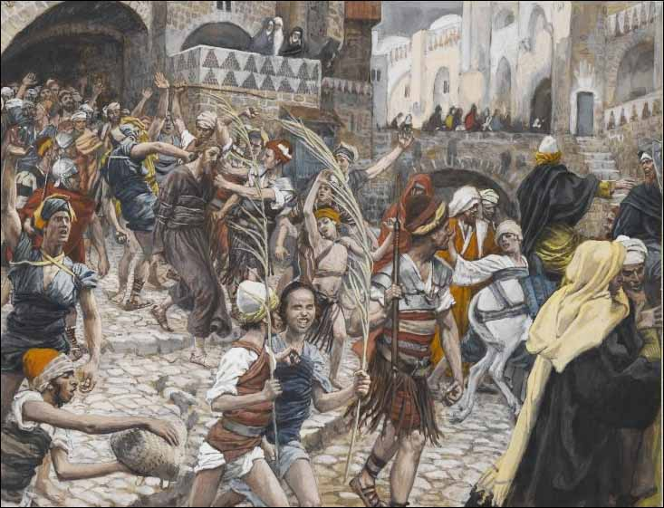
Chapter 21: Jerusalem
Paul is taken into Roman Custody

Slide 5
Chapter 22: Jerusalem
Defense to the Mob

Slide 6
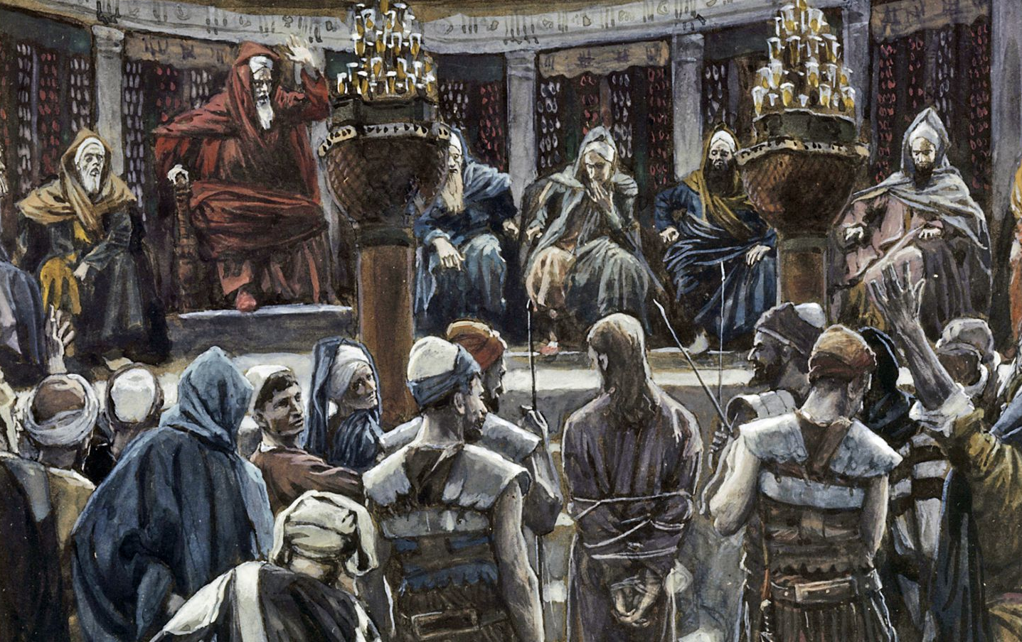
Chapter 23: Jerusalem
Defense to the Council

Slide 7
Chapter 24: Caesarea

Slide 8
Caesarea
Jerusalem
Chapter 24: Caesarea

Slide 9
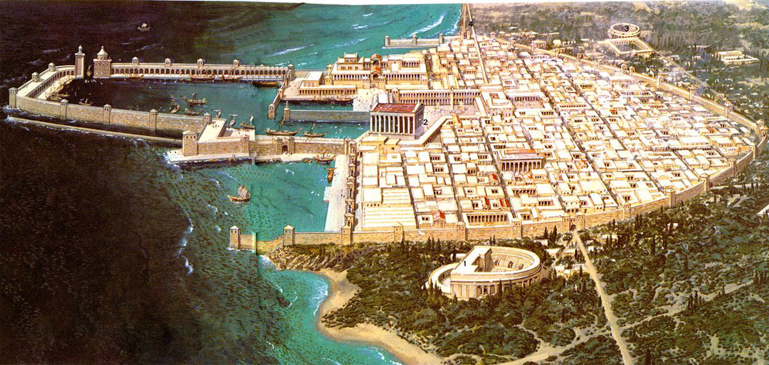
Caesarea
Jerusalem
Chapter 24: Caesarea
Defense before Felix

Slide 10
Chapter 24: Caesarea
Imprisoned for TWO YEARS!

Slide 11
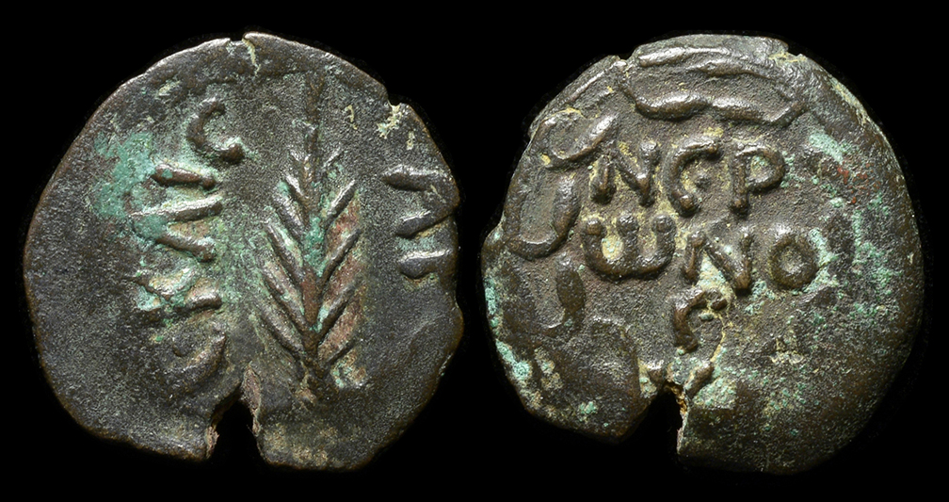
Chapter 24: Caesarea
Felix succeeded by Festus . . .

Slide 12
^{Acts 25:1} Festus then, having arrived in the province, three days later went up to Jerusalem from Caesarea. ² And the chief priests and the leading men of the Jews brought charges against Paul,

Slide 13
Caesarea
Jerusalem
^{Acts 25:1} Festus then, having arrived in the province, three days later went up to Jerusalem from Caesarea. ² And the chief priests and the leading men of the Jews brought charges against Paul,
^{Acts 25:1} Festus then, having arrived in the province, three days later went up to Jerusalem from Caesarea. ² And the chief priests and the leading men of the Jews brought charges against Paul,

Slide 14
Caesarea
Jerusalem
^{Acts 25:1} Festus then, having arrived in the province, three days later went up to Jerusalem from Caesarea. ² And the chief priests and the leading men of the Jews brought charges against Paul,
^{Acts 25:1} Festus then, having arrived in the province, three days later went up to Jerusalem from Caesarea. ² And the chief priests and the leading men of the Jews brought charges against Paul,

Slide 15
Caesarea
Jerusalem
^{Acts 25:1} Festus then, having arrived in the province, three days later went up to Jerusalem from Caesarea. ² And the chief priests and the leading men of the Jews brought charges against Paul,
^{Acts 25:2} and they were urging him, ³ requesting a concession against Paul, that he might have him brought to Jerusalem (at the same time, setting an ambush to kill him on the way).
^{Acts 25:2} and they were urging him, ³ requesting a concession against Paul, that he might have him brought to Jerusalem (at the same time, setting an ambush to kill him on the way).

Slide 16
Caesarea
Jerusalem
^{Acts 25:4} Festus then answered that Paul was being kept in custody at Caesarea and that he himself was about to leave shortly. ⁵ “Therefore,” he said, “let the influential men among you go there with me, and if there is anything wrong about the man, let them prosecute him.”
^{Acts 25:1} Festus then, having arrived in the province, three days later went up to Jerusalem from Caesarea. ² And the chief priests and the leading men of the Jews brought charges against Paul,
^{Acts 25:2} and they were urging him, ³ requesting a concession against Paul, that he might have him brought to Jerusalem (at the same time, setting an ambush to kill him on the way).

Slide 17
Caesarea
Jerusalem
^{Acts 25:6} After he had spent not more than eight or ten days among them, he went down to Caesarea, and on the next day he took his seat on the tribunal and ordered Paul to be brought.

Slide 18
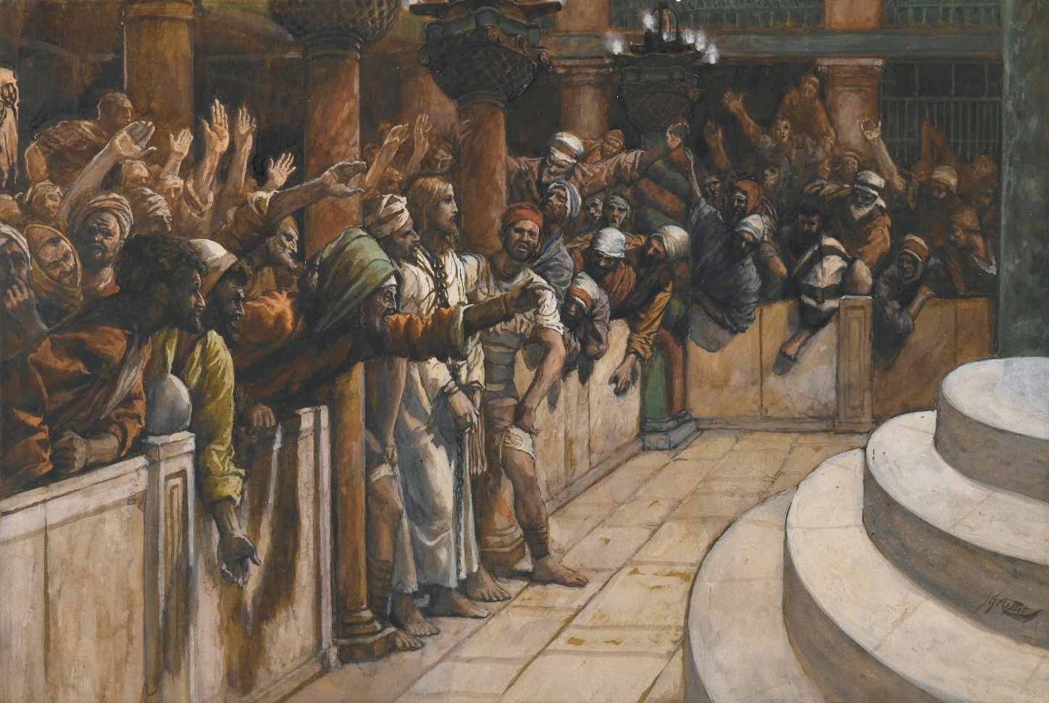
Caesarea
Jerusalem
^{Acts 25:7} After Paul arrived, the Jews who had come down from Jerusalem stood around him, bringing many and serious charges against him which they could not prove,

Slide 19
^{Acts 25:8} while Paul said in his own defense, “I have committed no offense either against the Law of the Jews or against the temple or against Caesar.”

Slide 20
^{Acts 25:9} But Festus, wishing to do the Jews a favor, answered Paul and said, “Are you willing to go up to Jerusalem and stand trial before me on these charges?”
^{Acts 25:9} But Festus, wishing to do the Jews a favor, answered Paul and said, “Are you willing to go up to Jerusalem and stand trial before me on these charges?”

Slide 21
^{Acts 25:10} But Paul said, “I am standing before Caesar’s tribunal, where I ought to be tried. I have done no wrong to the Jews, as you also very well know.

Slide 22
^{Acts 25:11} If, then, I am a wrongdoer and have committed anything worthy of death, I do not refuse to die; but if none of those things is true of which these men accuse me, no one can hand me over to them. I appeal to Caesar.”
^{Acts 25:11} If, then, I am a wrongdoer and have committed anything worthy of death, I do not refuse to die; but if none of those things is true of which these men accuse me, no one can hand me over to them. I appeal to Caesar.”

Slide 23
^{Acts 25:12} Then when Festus had conferred with his council, he answered, “You have appealed to Caesar, to Caesar you shall go.”

Slide 24
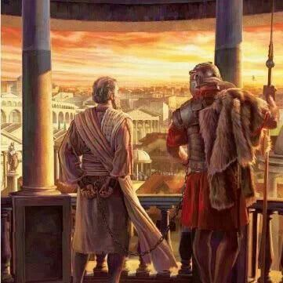
^{Acts 25:13} Now when several days had elapsed, King Agrippa and Bernice arrived at Caesarea and paid their respects to Festus. ¹⁴ While they were spending many days there, Festus laid Paul’s case before the king, saying,
^{Acts 25:13} Now when several days had elapsed, King Agrippa and Bernice arrived at Caesarea and paid their respects to Festus. ¹⁴ While they were spending many days there, Festus laid Paul’s case before the king, saying,

Slide 25
^{Acts 25:14} “There is a man who was left as a prisoner by Felix; ¹⁵ and when I was at Jerusalem, the chief priests and the elders of the Jews brought charges against him, …

Slide 26
^{Acts 25:18} When the accusers stood up, they began bringing charges against him not of such crimes as I was expecting, ¹⁹ but they simply had some points of disagreement with him about their own religion and about a dead man, Jesus, whom Paul asserted to be alive.

Slide 27
^{Acts 25:20} Being at a loss how to investigate such matters, I asked whether he was willing to go to Jerusalem and there stand trial on these matters. ²¹ But when Paul appealed to be held in custody for the Emperor’s decision, I ordered him to be kept in custody until I send him to Caesar.”

Slide 28
^{Acts 25:22} Then Agrippa said to Festus, “I also would like to hear the man myself.”
“Tomorrow,” he said, “you shall hear him.”

Slide 29
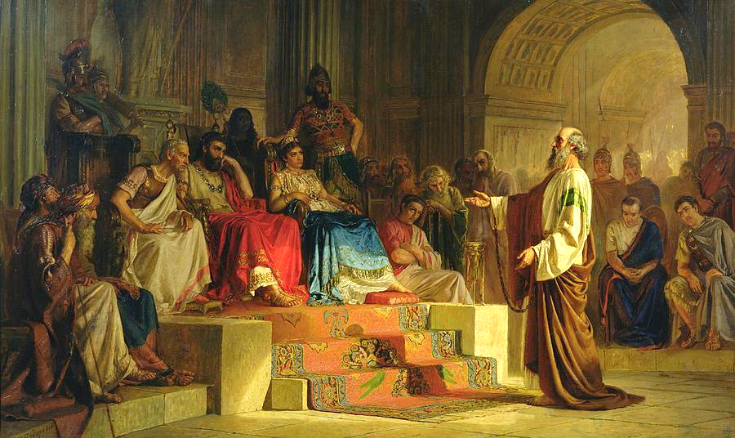
Tough Room!
^{Acts 25:23} So, on the next day when Agrippa came together with Bernice amid great pomp, and entered the auditorium accompanied by the commanders and the prominent men of the city, at the command of Festus, Paul was brought in.

Slide 30
^{Acts 25:24} Festus said, “King Agrippa, and all you gentlemen here present with us, you see this man about whom all the people of the Jews appealed to me, both at Jerusalem and here, loudly declaring that he ought not to live any longer.

Slide 31
^{Acts 25:24} But I found that he had committed nothing worthy of death; and since he himself appealed to the Emperor, I decided to send him. ²⁶ Yet I have nothing definite about him to write to my lord.
^{Acts 25:24} But I found that he had committed nothing worthy of death; and since he himself appealed to the Emperor, I decided to send him. ²⁶ Yet I have nothing definite about him to write to my lord.

Slide 32
^{Acts 25:26} Therefore I have brought him before you all and especially before you, King Agrippa, so that after the investigation has taken place, I may have something to write. ²⁷ For it seems absurd to me in sending a prisoner, not to indicate also the charges against him.”

Slide 33
^{Acts 26:1} Agrippa said to Paul, “You are permitted to speak for yourself.” Then Paul stretched out his hand and proceeded to make his defense: ² “In regard to all the things of which I am accused by the Jews,

Slide 34
^{Acts 26:2} “I consider myself fortunate, King Agrippa, that I am about to make my defense before you today; ³ especially because you are an expert in all customs and questions among the Jews; therefore I beg you to listen to me patiently.
^{Acts 26:2} “I consider myself fortunate, King Agrippa, that I am about to make my defense before you today; ³ especially because you are an expert in all customs and questions among the Jews; therefore I beg you to listen to me patiently.
^{Acts 26:2} “I consider myself fortunate, King Agrippa, that I am about to make my defense before you today; ³ especially because you are an expert in all customs and questions among the Jews; therefore I beg you to listen to me patiently.

Slide 35
^{Acts 26:4} “So then, all Jews know my manner of life from my youth up, which from the beginning was spent among my own nation and at Jerusalem;

Slide 36
^{Acts 26:5} since they have known about me for a long time, if they are willing to testify, that I lived as a Pharisee according to the strictest sect of our religion.

Slide 37
The “fall”…
Herod knows what this trial is really all about…
whether or not God kept His promise of rescue
^{Acts 26:6} And now I am standing trial for the hope of the promise made by God to our fathers; ⁷ the promise to which our twelve tribes hope to attain, as they earnestly serve God night and day.

Slide 38
The “fall”…
God’s dilemma…
God’s Promise …
A “Messiah”
Herod knows what this trial is really all about…
whether or not God kept His promise of rescue
^{Acts 26:6} And now I am standing trial for the hope of the promise made by God to our fathers; ⁷ the promise to which our twelve tribes hope to attain, as they earnestly serve God night and day.

Slide 39
The “fall”…
God’s dilemma…
God’s Promise …
A “Messiah”
Herod knows what this trial is really all about…
whether or not God kept His promise of rescue
^{Acts 26:7} And for this hope, O King, I am being accused by Jews. ⁸ Why is it considered incredible among you people if God does raise the dead?
^{Acts 26:7} And for this hope, O King, I am being accused by Jews. ⁸ Why is it considered incredible among you people if God does raise the dead?

Slide 40
Common ground
^{Acts 26:9} “So then, I thought to myself that I had to do many things hostile to the name of Jesus of Nazareth. ¹⁰ And this is just what I did in Jerusalem; not only did I lock up many of the saints in prisons, having received authority from the chief priests, but also when they were being put to death I cast my vote against them.

Slide 41
^{Acts 26:11} And as I punished them often in all the synagogues, I tried to force them to blaspheme; and being furiously enraged at them, I kept pursuing them even to foreign cities.
^{Acts 26:11} And as I punished them often in all the synagogues, I tried to force them to blaspheme; and being furiously enraged at them, I kept pursuing them even to foreign cities.

Slide 42
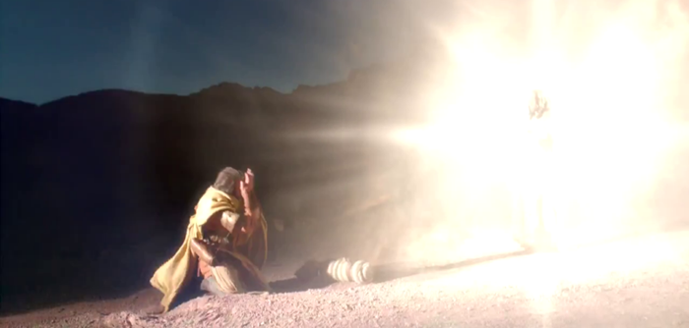
^{Acts 26:12} “While so engaged as I was journeying to Damascus with the authority and commission of the chief priests, ¹³ at midday, O King, I saw on the way a light from heaven, brighter than the sun, shining all around me and those who were journeying with me.

Slide 43
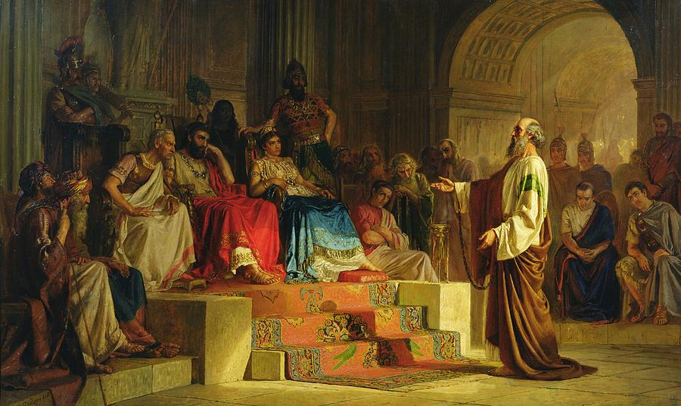
Paul’s Testimony
^{Acts 26:14} And when we had all fallen to the ground, I heard a voice saying to me in the Hebrew dialect, ‘Saul, Saul, why are you persecuting Me? It is hard for you to kick against the goads.’

Slide 44
^{Acts 1:8} you shall be My witnesses both in Jerusalem, and in all Judea and Samaria, and even to the remotest part of the earth.”
Paul’s Testimony
^{Acts 26:14} And when we had all fallen to the ground, I heard a voice saying to me in the Hebrew dialect, ‘Saul, Saul, why are you persecuting Me? It is hard for you to kick against the goads.’

Slide 45
^{Acts 1:8} you shall be My witnesses both in Jerusalem, and in all Judea and Samaria, and even to the remotest part of the earth.”
“to give a testimony of the facts”
Paul’s Testimony
^{Acts 26:14} And when we had all fallen to the ground, I heard a voice saying to me in the Hebrew dialect, ‘Saul, Saul, why are you persecuting Me? It is hard for you to kick against the goads.’

Slide 46
Hostile → “Enraged” → Inner Dissonance → Encounter → Questions → More Revelation → Conviction → GRACE → Purpose → Witness
Hostile → “Enraged” → Inner Dissonance → Encounter → Questions → More Revelation → Conviction → GRACE → Purpose → Witness
Paul’s Testimony
^{Acts 26:14} And when we had all fallen to the ground, I heard a voice saying to me in the Hebrew dialect, ‘Saul, Saul, why are you persecuting Me? It is hard for you to kick against the goads.’

Slide 47
Hostile → “Enraged” → Inner Dissonance → Encounter → Questions → More Revelation → Conviction → GRACE → Purpose → Witness
Hostile → “Enraged” → Inner Dissonance → Encounter → Questions → More Revelation → Conviction → GRACE → Purpose → Witness
Hostile → “Enraged” → Inner Dissonance → Encounter → Questions → More Revelation → Conviction → GRACE → Purpose → Witness
Paul’s Testimony
^{Acts 26:14} And when we had all fallen to the ground, I heard a voice saying to me in the Hebrew dialect, ‘Saul, Saul, why are you persecuting Me? It is hard for you to kick against the goads.’

Slide 48
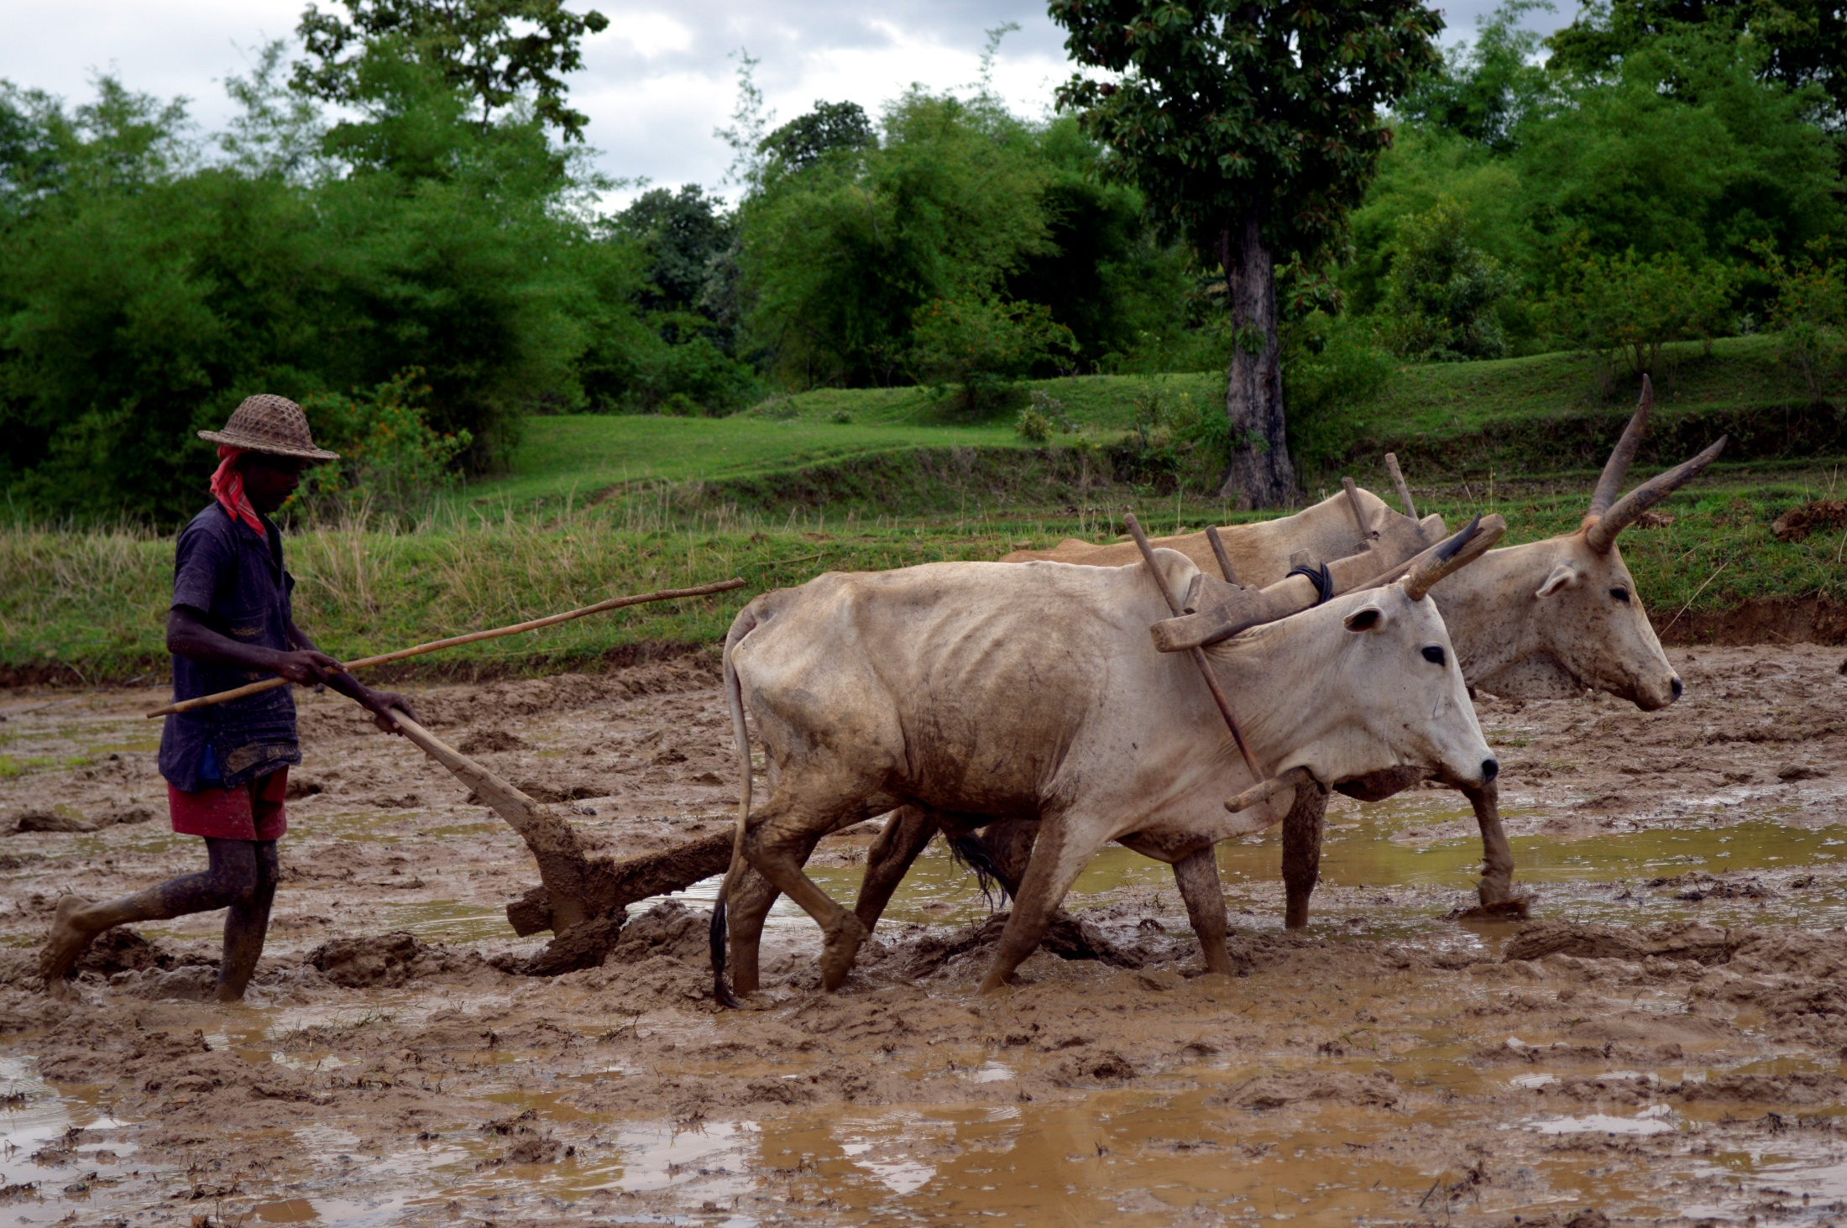
Hostile → “Enraged” → Inner Dissonance → Encounter → Questions → More Revelation → Conviction → GRACE → Purpose → Witness
Hostile → “Enraged” → Inner Dissonance → Encounter → Questions → More Revelation → Conviction → GRACE → Purpose → Witness
Hostile → “Enraged” → Inner Dissonance → Encounter → Questions → More Revelation → Conviction → GRACE → Purpose → Witness
Paul’s Testimony
^{Acts 26:14} And when we had all fallen to the ground, I heard a voice saying to me in the Hebrew dialect, ‘Saul, Saul, why are you persecuting Me? It is hard for you to kick against the goads.’

Slide 49
Hostile → “Enraged” → Inner Dissonance → Encounter → Questions → More Revelation → Conviction → GRACE → Purpose → Witness
Hostile → “Enraged” → Inner Dissonance → Encounter → Questions → More Revelation → Conviction → GRACE → Purpose → Witness
Paul’s Testimony
^{Acts 26:14} And when we had all fallen to the ground, I heard a voice saying to me in the Hebrew dialect, ‘Saul, Saul, why are you persecuting Me? It is hard for you to kick against the goads.’

Slide 50
Hostile → “Enraged” → Inner Dissonance → Encounter → Questions → More Revelation → Conviction → GRACE → Purpose → Witness
Hostile → “Enraged” → Inner Dissonance → Encounter → Questions → More Revelation → Conviction → GRACE → Purpose → Witness
Hostile → “Enraged” → Inner Dissonance → Encounter → Questions → More Revelation → Conviction → GRACE → Purpose → Witness
Paul’s Testimony
^{Acts 26:15} And I said, ‘Who are You, Lord?’ And the Lord said, ‘I am Jesus whom you are persecuting.

Slide 51
Hostile → “Enraged” → Inner Dissonance → Encounter → Questions → More Revelation → Conviction → GRACE → Purpose → Witness
Hostile → “Enraged” → Inner Dissonance → Encounter → Questions → More Revelation → Conviction → GRACE → Purpose → Witness
Hostile → “Enraged” → Inner Dissonance → Encounter → Questions → More Revelation → Conviction → GRACE → Purpose → Witness
Hostile → “Enraged” → Inner Dissonance → Encounter → Questions → More Revelation → Conviction → GRACE → Purpose → Witness
Paul’s Testimony
^{Acts 26:15} And I said, ‘Who are You, Lord?’ And the Lord said, ‘I am Jesus whom you are persecuting.

Slide 52
Hostile → “Enraged” → Inner Dissonance → Encounter → Questions → More Revelation → Conviction → GRACE → Purpose → Witness
Hostile → “Enraged” → Inner Dissonance → Encounter → Questions → More Revelation → Conviction → GRACE → Purpose → Witness
Hostile → “Enraged” → Inner Dissonance → Encounter → Questions → More Revelation → Conviction → GRACE → Purpose → Witness
Hostile → “Enraged” → Inner Dissonance → Encounter → Questions → More Revelation → Conviction → GRACE → Purpose → Witness
Paul’s Testimony
^{Acts 26:15} And I said, ‘Who are You, Lord?’ And the Lord said, ‘I am Jesus whom you are persecuting.

Slide 53
Hostile → “Enraged” → Inner Dissonance → Encounter → Questions → More Revelation → Conviction → GRACE → Purpose → Witness
Hostile → “Enraged” → Inner Dissonance → Encounter → Questions → More Revelation → Conviction → GRACE → Purpose → Witness
Hostile → “Enraged” → Inner Dissonance → Encounter → Questions → More Revelation → Conviction → GRACE → Purpose → Witness
Hostile → “Enraged” → Inner Dissonance → Encounter → Questions → More Revelation → Conviction → GRACE → Purpose → Witness
Hostile → “Enraged” → Inner Dissonance → Encounter → Questions → More Revelation → Conviction → GRACE → Purpose → Witness
Paul’s Testimony
^{Acts 26:15} And I said, ‘Who are You, Lord?’ And the Lord said, ‘I am Jesus whom you are persecuting.

Slide 54
Hostile → “Enraged” → Inner Dissonance → Encounter → Questions → More Revelation → Conviction → GRACE → Purpose → Witness
Hostile → “Enraged” → Inner Dissonance → Encounter → Questions → More Revelation → Conviction → GRACE → Purpose → Witness
Hostile → “Enraged” → Inner Dissonance → Encounter → Questions → More Revelation → Conviction → GRACE → Purpose → Witness
Hostile → “Enraged” → Inner Dissonance → Encounter → Questions → More Revelation → Conviction → GRACE → Purpose → Witness
Hostile → “Enraged” → Inner Dissonance → Encounter → Questions → More Revelation → Conviction → GRACE → Purpose → Witness
Hostile → “Enraged” → Inner Dissonance → Encounter → Questions → More Revelation → Conviction → GRACE → Purpose → Witness
Paul’s Testimony
^{Acts 26:16} But get up and stand on your feet; for this purpose I have appeared to you,

Slide 55
Hostile → “Enraged” → Inner Dissonance → Encounter → Questions → More Revelation → Conviction → GRACE → Purpose → Witness
Paul’s Testimony
^{Acts 26:16} But get up and stand on your feet; for this purpose I have appeared to you,

Slide 56
Hostile → “Enraged” → Inner Dissonance → Encounter → Questions → More Revelation → Conviction → GRACE → Purpose → Witness
Hostile → “Enraged” → Inner Dissonance → Encounter → Questions → More Revelation → Conviction → GRACE → Purpose → Witness
Hostile → “Enraged” → Inner Dissonance → Encounter → Questions → More Revelation → Conviction → GRACE → Purpose → Witness
Hostile → “Enraged” → Inner Dissonance → Encounter → Questions → More Revelation → Conviction → GRACE → Purpose → Witness
Hostile → “Enraged” → Inner Dissonance → Encounter → Questions → More Revelation → Conviction → GRACE → Purpose → Witness
Hostile → “Enraged” → Inner Dissonance → Encounter → Questions → More Revelation → Conviction → GRACE → Purpose → Witness
Paul’s Testimony
^{Acts 26:16} to appoint you a minister and a witness not only to the things which you have seen, but also to the things in which I will appear to you; ¹⁷ rescuing you from the Jewish people and from the Gentiles, to whom I am sending you

Slide 57
Hostile → “Enraged” → Inner Dissonance → Encounter → Questions → More Revelation → Conviction → GRACE → Purpose → Witness
Hostile → “Enraged” → Inner Dissonance → Encounter → Questions → More Revelation → Conviction → GRACE → Purpose → Witness
Hostile → “Enraged” → Inner Dissonance → Encounter → Questions → More Revelation → Conviction → GRACE → Purpose → Witness
Hostile → “Enraged” → Inner Dissonance → Encounter → Questions → More Revelation → Conviction → GRACE → Purpose → Witness
Hostile → “Enraged” → Inner Dissonance → Encounter → Questions → More Revelation → Conviction → GRACE → Purpose → Witness
Hostile → “Enraged” → Inner Dissonance → Encounter → Questions → More Revelation → Conviction → GRACE → Purpose → Witness
Hostile → “Enraged” → Inner Dissonance → Encounter → Questions → More Revelation → Conviction → GRACE → Purpose → Witness
Paul’s Testimony
^{Acts 26:16} to appoint you a minister and a witness not only to the things which you have seen, but also to the things in which I will appear to you; ¹⁷ rescuing you from the Jewish people and from the Gentiles, to whom I am sending you

Slide 58
Hostile → “Enraged” → Inner Dissonance → Encounter → Questions → More Revelation → Conviction → GRACE → Purpose → Witness
Hostile → “Enraged” → Inner Dissonance → Encounter → Questions → More Revelation → Conviction → GRACE → Purpose → Witness
Hostile → “Enraged” → Inner Dissonance → Encounter → Questions → More Revelation → Conviction → GRACE → Purpose → Witness
Hostile → “Enraged” → Inner Dissonance → Encounter → Questions → More Revelation → Conviction → GRACE → Purpose → Witness
Hostile → “Enraged” → Inner Dissonance → Encounter → Questions → More Revelation → Conviction → GRACE → Purpose → Witness
Hostile → “Enraged” → Inner Dissonance → Encounter → Questions → More Revelation → Conviction → GRACE → Purpose → Witness
Hostile → “Enraged” → Inner Dissonance → Encounter → Questions → More Revelation → Conviction → GRACE → Purpose → Witness
Paul’s Testimony
^{Acts 26:18} to open their eyes so that they may turn from darkness to light and from the dominion of Satan to God, that they may receive forgiveness of sins and an inheritance among those who have been sanctified by faith in Me.’

Slide 59
This is Paul’s story: convinced… and eventually TRANSFORMED by God’s Grace
Paul’s Testimony
^{Acts 26:18} to open their eyes so that they may turn from darkness to light and from the dominion of Satan to God, that they may receive forgiveness of sins and an inheritance among those who have been sanctified by faith in Me.’

Slide 60
^{Acts 26:19} “So, King Agrippa, I did not prove disobedient to the heavenly vision,

Slide 61
^{Acts 26:20} but kept declaring both to those of Damascus first, and also at Jerusalem and then throughout all the region of Judea, and even to the Gentiles, that they should repent and turn to God, performing deeds appropriate to repentance. ²¹ For this reason some Jews seized me in the temple and tried to put me to death.

Slide 62
^{Acts 26:22} So, having obtained help from God, I stand to this day testifying both to small and great, stating nothing but what the Prophets and Moses said was going to take place; ²³ that the Christ was to suffer, and that by reason of His resurrection from the dead He would be the first to proclaim light both to the Jewish people and to the Gentiles

Slide 63
“All I’m saying is that our God has kept His promise!”
^{Acts 26:22} So, having obtained help from God, I stand to this day testifying both to small and great, stating nothing but what the Prophets and Moses said was going to take place; ²³ that the Christ was to suffer, and that by reason of His resurrection from the dead He would be the first to proclaim light both to the Jewish people and to the Gentiles

Slide 64
“All I’m saying is that our God has kept His promise!”
The Prophets & Scriptures began to fill in the picture of how God would rescue humanity
Revealing more about the identity of the Messiah
Revealing more about how the Messiah would save
^{Acts 26:22} So, having obtained help from God, I stand to this day testifying both to small and great, stating nothing but what the Prophets and Moses said was going to take place; ²³ that the Christ was to suffer, and that by reason of His resurrection from the dead He would be the first to proclaim light both to the Jewish people and to the Gentiles

Slide 65
All of these threads / stories / prophecies culminate in the life of one man: Jesus the Christ!
The Prophets & Scriptures began to fill in the picture of how God would rescue humanity
Revealing more about the identity of the Messiah
Revealing more about how the Messiah would save
^{Acts 26:22} So, having obtained help from God, I stand to this day testifying both to small and great, stating nothing but what the Prophets and Moses said was going to take place; ²³ that the Christ was to suffer, and that by reason of His resurrection from the dead He would be the first to proclaim light both to the Jewish people and to the Gentiles

Slide 66
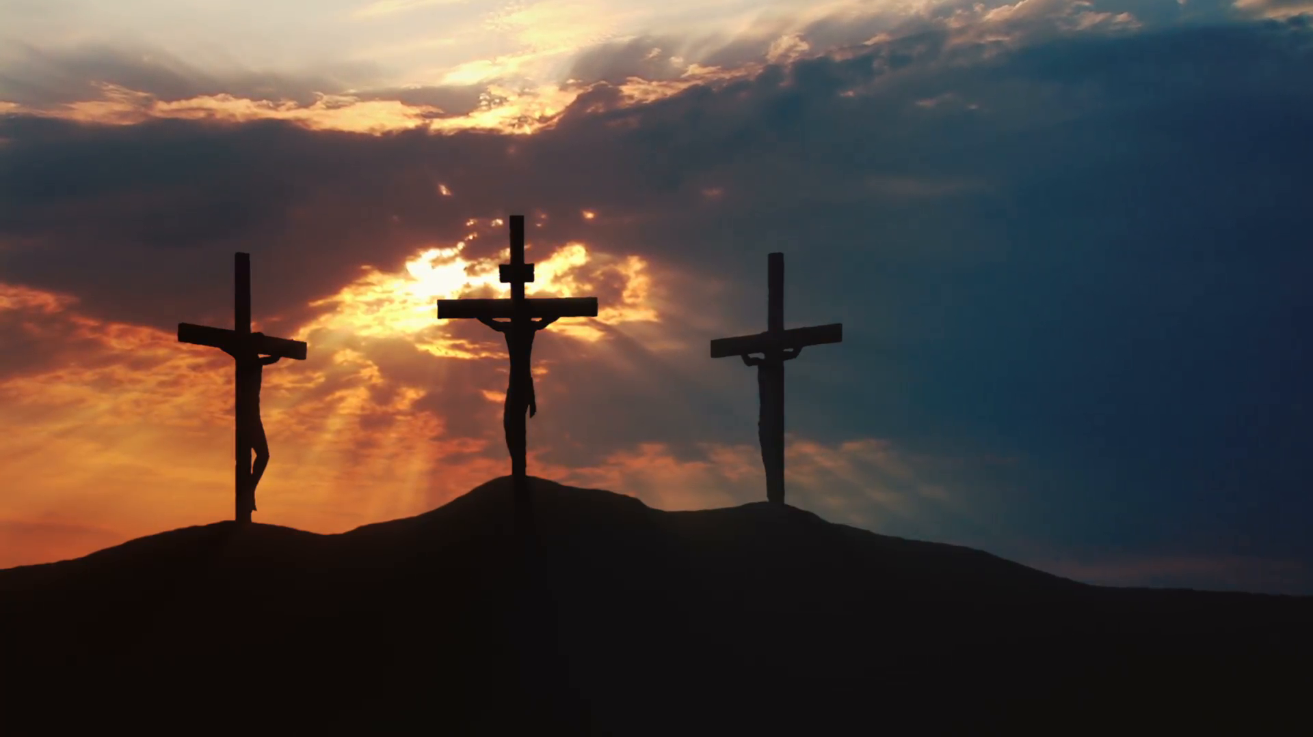
All of these threads / stories / prophecies culminate in the life of one man: Jesus the Christ!
His death resolves the problem of our guilt
^{Acts 26:22} So, having obtained help from God, I stand to this day testifying both to small and great, stating nothing but what the Prophets and Moses said was going to take place; ²³ that the Christ was to suffer, and that by reason of His resurrection from the dead He would be the first to proclaim light both to the Jewish people and to the Gentiles
^{Acts 26:22} So, having obtained help from God, I stand to this day testifying both to small and great, stating nothing but what the Prophets and Moses said was going to take place; ²³ that the Christ was to suffer, and that by reason of His resurrection from the dead He would be the first to proclaim light both to the Jewish people and to the Gentiles

Slide 67
All of these threads / stories / prophecies culminate in the life of one man: Jesus the Christ!
His resurrection brings the hope of new life
^{Acts 26:22} So, having obtained help from God, I stand to this day testifying both to small and great, stating nothing but what the Prophets and Moses said was going to take place; ²³ that the Christ was to suffer, and that by reason of His resurrection from the dead He would be the first to proclaim light both to the Jewish people and to the Gentiles
^{Acts 26:22} So, having obtained help from God, I stand to this day testifying both to small and great, stating nothing but what the Prophets and Moses said was going to take place; ²³ that the Christ was to suffer, and that by reason of His resurrection from the dead He would be the first to proclaim light both to the Jewish people and to the Gentiles

Slide 68
All of these threads / stories / prophecies culminate in the life of one man: Jesus the Christ!
^{Acts 26:22} So, having obtained help from God, I stand to this day testifying both to small and great, stating nothing but what the Prophets and Moses said was going to take place; ²³ that the Christ was to suffer, and that by reason of His resurrection from the dead He would be the first to proclaim light both to the Jewish people and to the Gentiles
^{Acts 26:22} So, having obtained help from God, I stand to this day testifying both to small and great, stating nothing but what the Prophets and Moses said was going to take place; ²³ that the Christ was to suffer, and that by reason of His resurrection from the dead He would be the first to proclaim light both to the Jewish people and to the Gentiles

Slide 69
^{18 “}to open their eyes so that they may turn from darkness to light and from the dominion of Satan to God, that they may receive forgiveness of sins and an inheritance among those who have been sanctified by faith in Me.’

Slide 70
^{Acts 26:24} While Paul was saying this in his defense, Festus said in a loud voice, “Paul, you are out of your mind! Your great learning is driving you mad.”

Slide 71
^{Acts 26:25} But Paul said, “I am not out of my mind, most excellent Festus, but I utter words of sober truth.

Slide 72
^{Acts 26:26} For the king knows about these matters, and I speak to him also with confidence, since I am persuaded that none of these things escape his notice; for this has not been done in a corner.

Slide 73
^{Acts 26:27} King Agrippa, do you believe the Prophets? I know that you do.”

Slide 74
^{Acts 26:28} Agrippa replied to Paul, “In a short time you will persuade me to become a Christian.”

Slide 75
^{Acts 26:29} And Paul said, “I would wish to God, that whether in a short or long time, not only you, but also all who hear me this day, might become such as I am, except for these chains.”

Slide 76
^{Acts 26:30} The king stood up and the governor and Bernice, and those who were sitting with them, ³¹ and when they had gone aside, they began talking to one another, saying, “This man is not doing anything worthy of death or imprisonment.”

Slide 77
God wanted Paul’s testimony to be heard again and again, all over the world!
^{Acts 26:32} And Agrippa said to Festus, “This man might have been set free if he had not appealed to Caesar.”

Slide 78
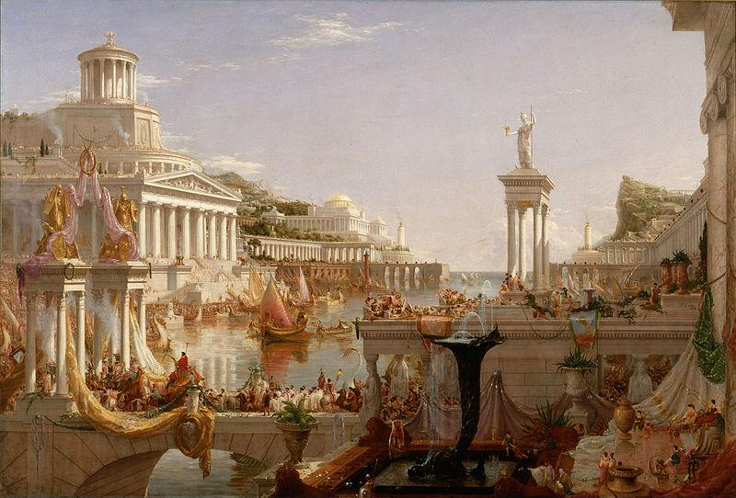
God wanted Paul’s testimony to be heard again and again, all over the world!
^{Acts 28:30} And he stayed two full years in his own rented quarters and was welcoming all who came to him, ³¹ preaching the kingdom of God and teaching concerning the Lord Jesus Christ with all openness, unhindered.

Slide 79
Acts

