Slide 2
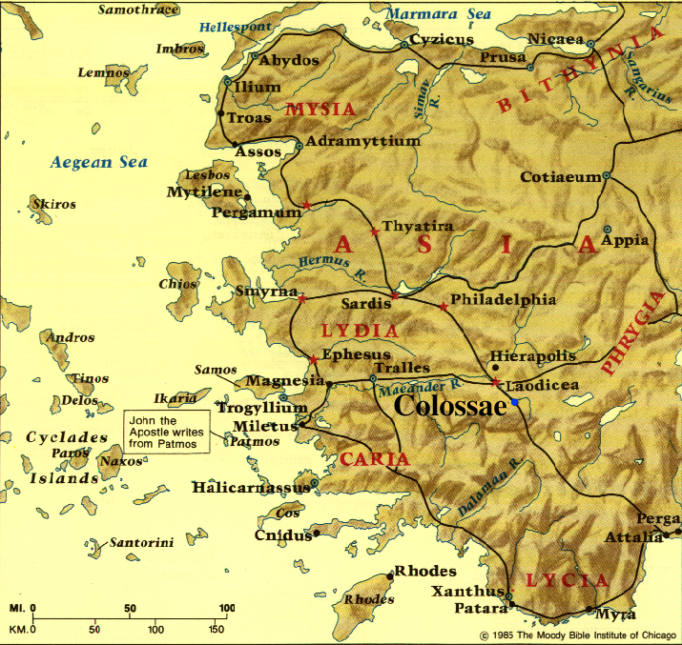

Slide 3
^{Colossians} ^{1:3} We give thanks to God . . . ⁴ since we heard of your faith in Christ Jesus . . . ⁵ . . . of (Whom) you previously heard in the word of truth, the gospel ⁶ which has come to you, just as in all the world also it is constantly bearing fruit and increasing, even as it has been doing in you also since the day you heard of it and understood the grace of God in truth . . .

Slide 4
^{1:9} For this reason also, since the day we heard of it, we have not ceased to pray for you . . .

Slide 5
Colossians 1:9-14 Paul’s Prayer for Spiritual Transformation
^{1:9} For this reason also, since the day we heard of it, we have not ceased to pray for you . . .

Slide 6
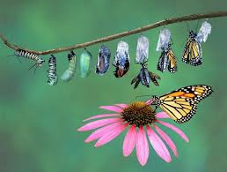
Colossians 1:9-14 Paul’s Prayer for Spiritual Transformation
^{Romans 12:2} Don’t allow the world to squeeze you into its mold, but instead allow God to transform (metamorphoo) you . . .

Slide 7
Colossians 1:9-14 Paul’s Prayer for Spiritual Transformation
WHAT SPIRITUAL TRANSFORMATION LOOKS LIKE
HOW WE COOPERATE WITH GOD

Slide 8
Colossians 1:9-14 Paul’s Prayer for Spiritual Transformation
WHAT SPIRITUAL TRANSFORMATION LOOKS LIKE

Slide 9
Colossians 1:9-14 Paul’s Prayer for Spiritual Transformation
WHAT SPIRITUAL TRANSFORMATION LOOKS LIKE
Its essence (1:10a)
^{1:10a} . . . so that you will walk in a manner worthy of the Lord, to please Him in all respects . . .

Slide 10
Colossians 1:9-14 Paul’s Prayer for Spiritual Transformation
WHAT SPIRITUAL TRANSFORMATION LOOKS LIKE
Its essence (1:10a)
Living in a way that represents God well, that enhances His reputation with others
^{1:10a} . . . so that you will walk in a manner worthy of the Lord, to please Him in all respects . . .

Slide 11
Colossians 1:9-14 Paul’s Prayer for Spiritual Transformation
WHAT SPIRITUAL TRANSFORMATION LOOKS LIKE
Its essence (1:10a)
GOD-CENTERED – NOT SELF-CENTERED
^{1:10a} . . . so that you will walk in a manner worthy of the Lord, to please Him in all respects . . .

Slide 12
Colossians 1:9-14 Paul’s Prayer for Spiritual Transformation
WHAT SPIRITUAL TRANSFORMATION LOOKS LIKE
Its essence (1:10a)
COMPREHENSIVE – NOT COMPARTMENTALIZED
^{1:10a} . . . so that you will walk in a manner worthy of the Lord, to please Him in all respects . . .

Slide 13
Colossians 1:9-14 Paul’s Prayer for Spiritual Transformation
WHAT SPIRITUAL TRANSFORMATION LOOKS LIKE
Its essence (1:10a)
FULFILLING – NOT CONSTRICTING OR REGRET-PRODUCING
^{1:10a} . . . so that you will walk in a manner worthy of the Lord, to please Him in all respects . . .
^{Romans 12:2} . . . be transformed by the renewing of your mind, so that you may prove what the will of God is, that which is good and well-pleasing and perfect.

Slide 14
Colossians 1:9-14 Paul’s Prayer for Spiritual Transformation
WHAT SPIRITUAL TRANSFORMATION LOOKS LIKE
A snap-shot of its outworking (1:10b-14)
^{1:10} . . . bearing fruit in every good work and increasing in the knowledge of God; ¹¹ strengthened with all power, according to His glorious might, for the attaining of all steadfastness and patience; joyously ¹² giving thanks to the Father, who has qualified us to share in the inheritance of the saints in Light. ¹³ For He rescued us from the domain of darkness, and transferred us to the kingdom of His beloved Son, ¹⁴ in whom we have redemption, the forgiveness of sins.

Slide 15
Colossians 1:9-14 Paul’s Prayer for Spiritual Transformation
WHAT SPIRITUAL TRANSFORMATION LOOKS LIKE
A snap-shot of its outworking (1:10b-14)
A LOVING LIFE THAT ATTRACTS PEOPLE TO GOD
^{1:10} . . . bearing fruit in every good work and increasing in the knowledge of God; ¹¹ strengthened with all power, according to His glorious might, for the attaining of all steadfastness and patience; joyously ¹² giving thanks to the Father, who has qualified us to share in the inheritance of the saints in Light. ¹³ For He rescued us from the domain of darkness, and transferred us to the kingdom of His beloved Son, ¹⁴ in whom we have redemption, the forgiveness of sins.

Slide 16
Colossians 1:9-14 Paul’s Prayer for Spiritual Transformation
WHAT SPIRITUAL TRANSFORMATION LOOKS LIKE
A snap-shot of its outworking (1:10b-14)
^{1:10} . . . bearing fruit in every good work and increasing in the knowledge of God; ¹¹ strengthened with all power, according to His glorious might, for the attaining of all steadfastness and patience; joyously ¹² giving thanks to the Father, who has qualified us to share in the inheritance of the saints in Light. ¹³ For He rescued us from the domain of darkness, and transferred us to the kingdom of His beloved Son, ¹⁴ in whom we have redemption, the forgiveness of sins.

Slide 17
Colossians 1:9-14 Paul’s Prayer for Spiritual Transformation
WHAT SPIRITUAL TRANSFORMATION LOOKS LIKE
A snap-shot of its outworking (1:10b-14)
DEEPENING PERSONAL INTIMACY WITH GOD
^{1:10} . . . bearing fruit in every good work and increasing in the knowledge of God; ¹¹ strengthened with all power, according to His glorious might, for the attaining of all steadfastness and patience; joyously ¹² giving thanks to the Father, who has qualified us to share in the inheritance of the saints in Light. ¹³ For He rescued us from the domain of darkness, and transferred us to the kingdom of His beloved Son, ¹⁴ in whom we have redemption, the forgiveness of sins.

Slide 18
Colossians 1:9-14 Paul’s Prayer for Spiritual Transformation
WHAT SPIRITUAL TRANSFORMATION LOOKS LIKE
A snap-shot of its outworking (1:10b-14)
^{1:10} . . . bearing fruit in every good work and increasing in the knowledge of God; ¹¹ strengthened with all power, according to His glorious might, for the attaining of all steadfastness and patience; joyously ¹² giving thanks to the Father, who has qualified us to share in the inheritance of the saints in Light. ¹³ For He rescued us from the domain of darkness, and transferred us to the kingdom of His beloved Son, ¹⁴ in whom we have redemption, the forgiveness of sins.

Slide 19
Colossians 1:9-14 Paul’s Prayer for Spiritual Transformation
WHAT SPIRITUAL TRANSFORMATION LOOKS LIKE
A snap-shot of its outworking (1:10b-14)
POWER TO PRESEVERE THROUGH DIFFICULTIES
^{1:10} . . . bearing fruit in every good work and increasing in the knowledge of God; ¹¹ strengthened with all power, according to His glorious might, for the attaining of all steadfastness and patience; joyously ¹² giving thanks to the Father, who has qualified us to share in the inheritance of the saints in Light. ¹³ For He rescued us from the domain of darkness, and transferred us to the kingdom of His beloved Son, ¹⁴ in whom we have redemption, the forgiveness of sins.

Slide 20
Colossians 1:9-14 Paul’s Prayer for Spiritual Transformation
WHAT SPIRITUAL TRANSFORMATION LOOKS LIKE
A snap-shot of its outworking (1:10b-14)
^{1:10} . . . bearing fruit in every good work and increasing in the knowledge of God; ¹¹ strengthened with all power, according to His glorious might, for the attaining of all steadfastness and patience; joyously ¹² giving thanks to the Father, who has qualified us to share in the inheritance of the saints in Light. ¹³ For He rescued us from the domain of darkness, and transferred us to the kingdom of His beloved Son, ¹⁴ in whom we have redemption, the forgiveness of sins.

Slide 21
Colossians 1:9-14 Paul’s Prayer for Spiritual Transformation
WHAT SPIRITUAL TRANSFORMATION LOOKS LIKE
A snap-shot of its outworking (1:10b-14)
JOY & GRATITUDE BECAUSE OF GOD’S GRACE
^{1:10} . . . bearing fruit in every good work and increasing in the knowledge of God; ¹¹ strengthened with all power, according to His glorious might, for the attaining of all steadfastness and patience; joyously ¹² giving thanks to the Father, who has qualified us to share in the inheritance of the saints in Light. ¹³ For He rescued us from the domain of darkness, and transferred us to the kingdom of His beloved Son, ¹⁴ in whom we have redemption, the forgiveness of sins.

Slide 22
Colossians 1:9-14 Paul’s Prayer for Spiritual Transformation
WHAT SPIRITUAL TRANSFORMATION LOOKS LIKE
A snap-shot of its outworking (1:10b-14)
JOY & GRATITUDE BECAUSE OF GOD’S GRACE
^{1:10} . . . bearing fruit in every good work and increasing in the knowledge of God; ¹¹ strengthened with all power, according to His glorious might, for the attaining of all steadfastness and patience; joyously ¹² giving thanks to the Father, who has qualified us to share in the inheritance of the saints in Light. ¹³ For He rescued us from the domain of darkness, and transferred us to the kingdom of His beloved Son, ¹⁴ in whom we have redemption, the forgiveness of sins.

Slide 23
Colossians 1:9-14 Paul’s Prayer for Spiritual Transformation
WHAT SPIRITUAL TRANSFORMATION LOOKS LIKE
A snap-shot of its outworking (1:10b-14)
A LOVING LIFE THAT ATTRACTS PEOPLE TO GOD
DEEPENING PERSONAL INTIMACY WITH GOD
POWER TO PRESEVERE THROUGH DIFFICULTIES
JOY & GRATITUDE BECAUSE OF GOD’S GRACE

Slide 24
Colossians 1:9-14 Paul’s Prayer for Spiritual Transformation
WHAT SPIRITUAL TRANSFORMATION LOOKS LIKE
A snap-shot of its outworking (1:10b-14)
A LOVING LIFE THAT ATTRACTS PEOPLE TO GOD
DEEPENING PERSONAL INTIMACY WITH GOD
POWER TO PRESEVERE THROUGH DIFFICULTIES
JOY & GRATITUDE BECAUSE OF GOD’S GRACE
This transformation is possible regardless of your past poor decisions, how others have mistreated you, your current circumstances…

Slide 25
Colossians 1:9-14 Paul’s Prayer for Spiritual Transformation
HOW WE COOPERATE WITH GOD
^{1:9} . . . we have not ceased to pray for you and to ask that you may be filled with the knowledge of His will in all spiritual wisdom and understanding, ¹⁰ so that you may (be transformed) . . .
^{2:2} . . . all the wealth that comes from the full assurance of understanding, resulting in a true knowledge of God’s mystery, that is, Christ Himself, ³ in whom are hidden all the treasures of wisdom and knowledge.

Slide 26
Colossians 1:9-14 Paul’s Prayer for Spiritual Transformation
HOW WE COOPERATE WITH GOD
Become very familiar with the contents of the gospel
^{3:16} Let the word of Christ richly dwell within you . . .

Slide 27
Colossians 1:9-14 Paul’s Prayer for Spiritual Transformation
HOW WE COOPERATE WITH GOD
Become very familiar with the contents of the gospel
Ask God to illuminate the gospel’s application to your life
^{1:9} . . . we have not ceased to pray for you and to ask that you may be filled with the knowledge of His will in all spiritual wisdom and understanding . . .

Slide 28
Colossians 1:9-14 Paul’s Prayer for Spiritual Transformation
HOW WE COOPERATE WITH GOD
Become very familiar with the contents of the gospel
Ask God to illuminate the gospel’s application to your life
Do both of the above with other believers
^{3:16} Let the word of Christ richly dwell within you (plural), with all wisdom teaching and counseling one another . . .

Slide 29
Colossians 1:9-14 Paul’s Prayer for Spiritual Transformation
HOW WE COOPERATE WITH GOD
Become very familiar with the contents of the gospel
Ask God to illuminate the gospel’s application to your life
Do both of the above with other believers
^{2:2} . . . that their hearts may be encouraged, having been knit together in love, and attaining to all the wealth that . . . resulting in a true knowledge of God’s mystery, that is, Christ Himself . . .

