Slide 1
FORGIVENESS
A COMMUNITY OF

Slide 2
Matthew 18
²¹ Then Peter came to Jesus and asked, “Lord, how many times shall I forgive my brother or sister who sins against me?”

Slide 3
Matthew 18
²¹ Then Peter came to Jesus and asked, “Lord, how many times shall I forgive my brother or sister who sins against me?”
“Up to seven times?”
²² Jesus answered, “I tell you, not seven times, but seventy-seven times.”

Slide 4
Matthew 18
²¹ Then Peter came to Jesus and asked, “Lord, how many times shall I forgive my brother or sister who sins against me?”
“Up to seven times?”
²² Jesus answered, “I tell you, not seven times, but seventy-seven times.”

Slide 5
Matthew 18
²³ “Therefore, the kingdom of heaven is like a king who wanted to settle accounts with his servants.
²⁴ As he began the settlement, a man who owed him ten thousand bags of gold was brought to him.

Slide 6
Matthew 18
²³ “Therefore, the kingdom of heaven is like a king who wanted to settle accounts with his servants.
²⁴ As he began the settlement, a man who owed him ten thousand bags of gold was brought to him.
Gk. talanton = 130 lbs.

Slide 7
Matthew 18
²³ “Therefore, the kingdom of heaven is like a king who wanted to settle accounts with his servants.
²⁴ As he began the settlement, a man who owed him ten thousand bags of gold was brought to him.
1,100,000 lbs. of gold = $33 billion

Slide 8
Matthew 18
²³ “Therefore, the kingdom of heaven is like a king who wanted to settle accounts with his servants.
²⁴ As he began the settlement, a man who owed him ten thousand bags of gold was brought to him.
²⁵ Since he was not able to pay, the master ordered that he and his wife and his children and all that he had be sold to repay the debt.

Slide 9
Matthew 18
²⁶ At this the servant fell on his knees before him. ‘Be patient with me,’ he begged, ‘and I will pay back everything.’
²⁷ The servant’s master took pity on him, canceled the debt and let him go.

Slide 10
Matthew 18
²⁶ At this the servant fell on his knees before him. ‘Be patient with me,’ he begged, ‘and I will pay back everything.’
²⁷ The servant’s master took pity on him, canceled the debt and let him go.
The way we remain bitter at someone is by creating a caricature of that person.
Miroslav Volf: “Forgiveness flounders when I exclude the enemy from the community of humans and I exclude myself from the community of sinners.”

Slide 11
Matthew 18
²⁶ At this the servant fell on his knees before him. ‘Be patient with me,’ he begged, ‘and I will pay back everything.’
²⁷ The servant’s master took pity on him, canceled the debt and let him go.

Slide 12
Matthew 18
²⁶ At this the servant fell on his knees before him. ‘Be patient with me,’ he begged, ‘and I will pay back everything.’
²⁷ The servant’s master took pity on him, canceled the debt and let him go.
Jeremiah 31:34: “For I will forgive their wickedness and will remember their sins no more.”

Slide 13
Matthew 18
²⁶ At this the servant fell on his knees before him. ‘Be patient with me,’ he begged, ‘and I will pay back everything.’
²⁷ The servant’s master took pity on him, canceled the debt and let him go.
Psalm 139:2: “Even from far away, you [O Lord] understand my motives.”

Slide 14
Matthew 18
²⁶ At this the servant fell on his knees before him. ‘Be patient with me,’ he begged, ‘and I will pay back everything.’
²⁷ The servant’s master took pity on him, canceled the debt and let him go.
It’s as if our sins never occurred…

Slide 15
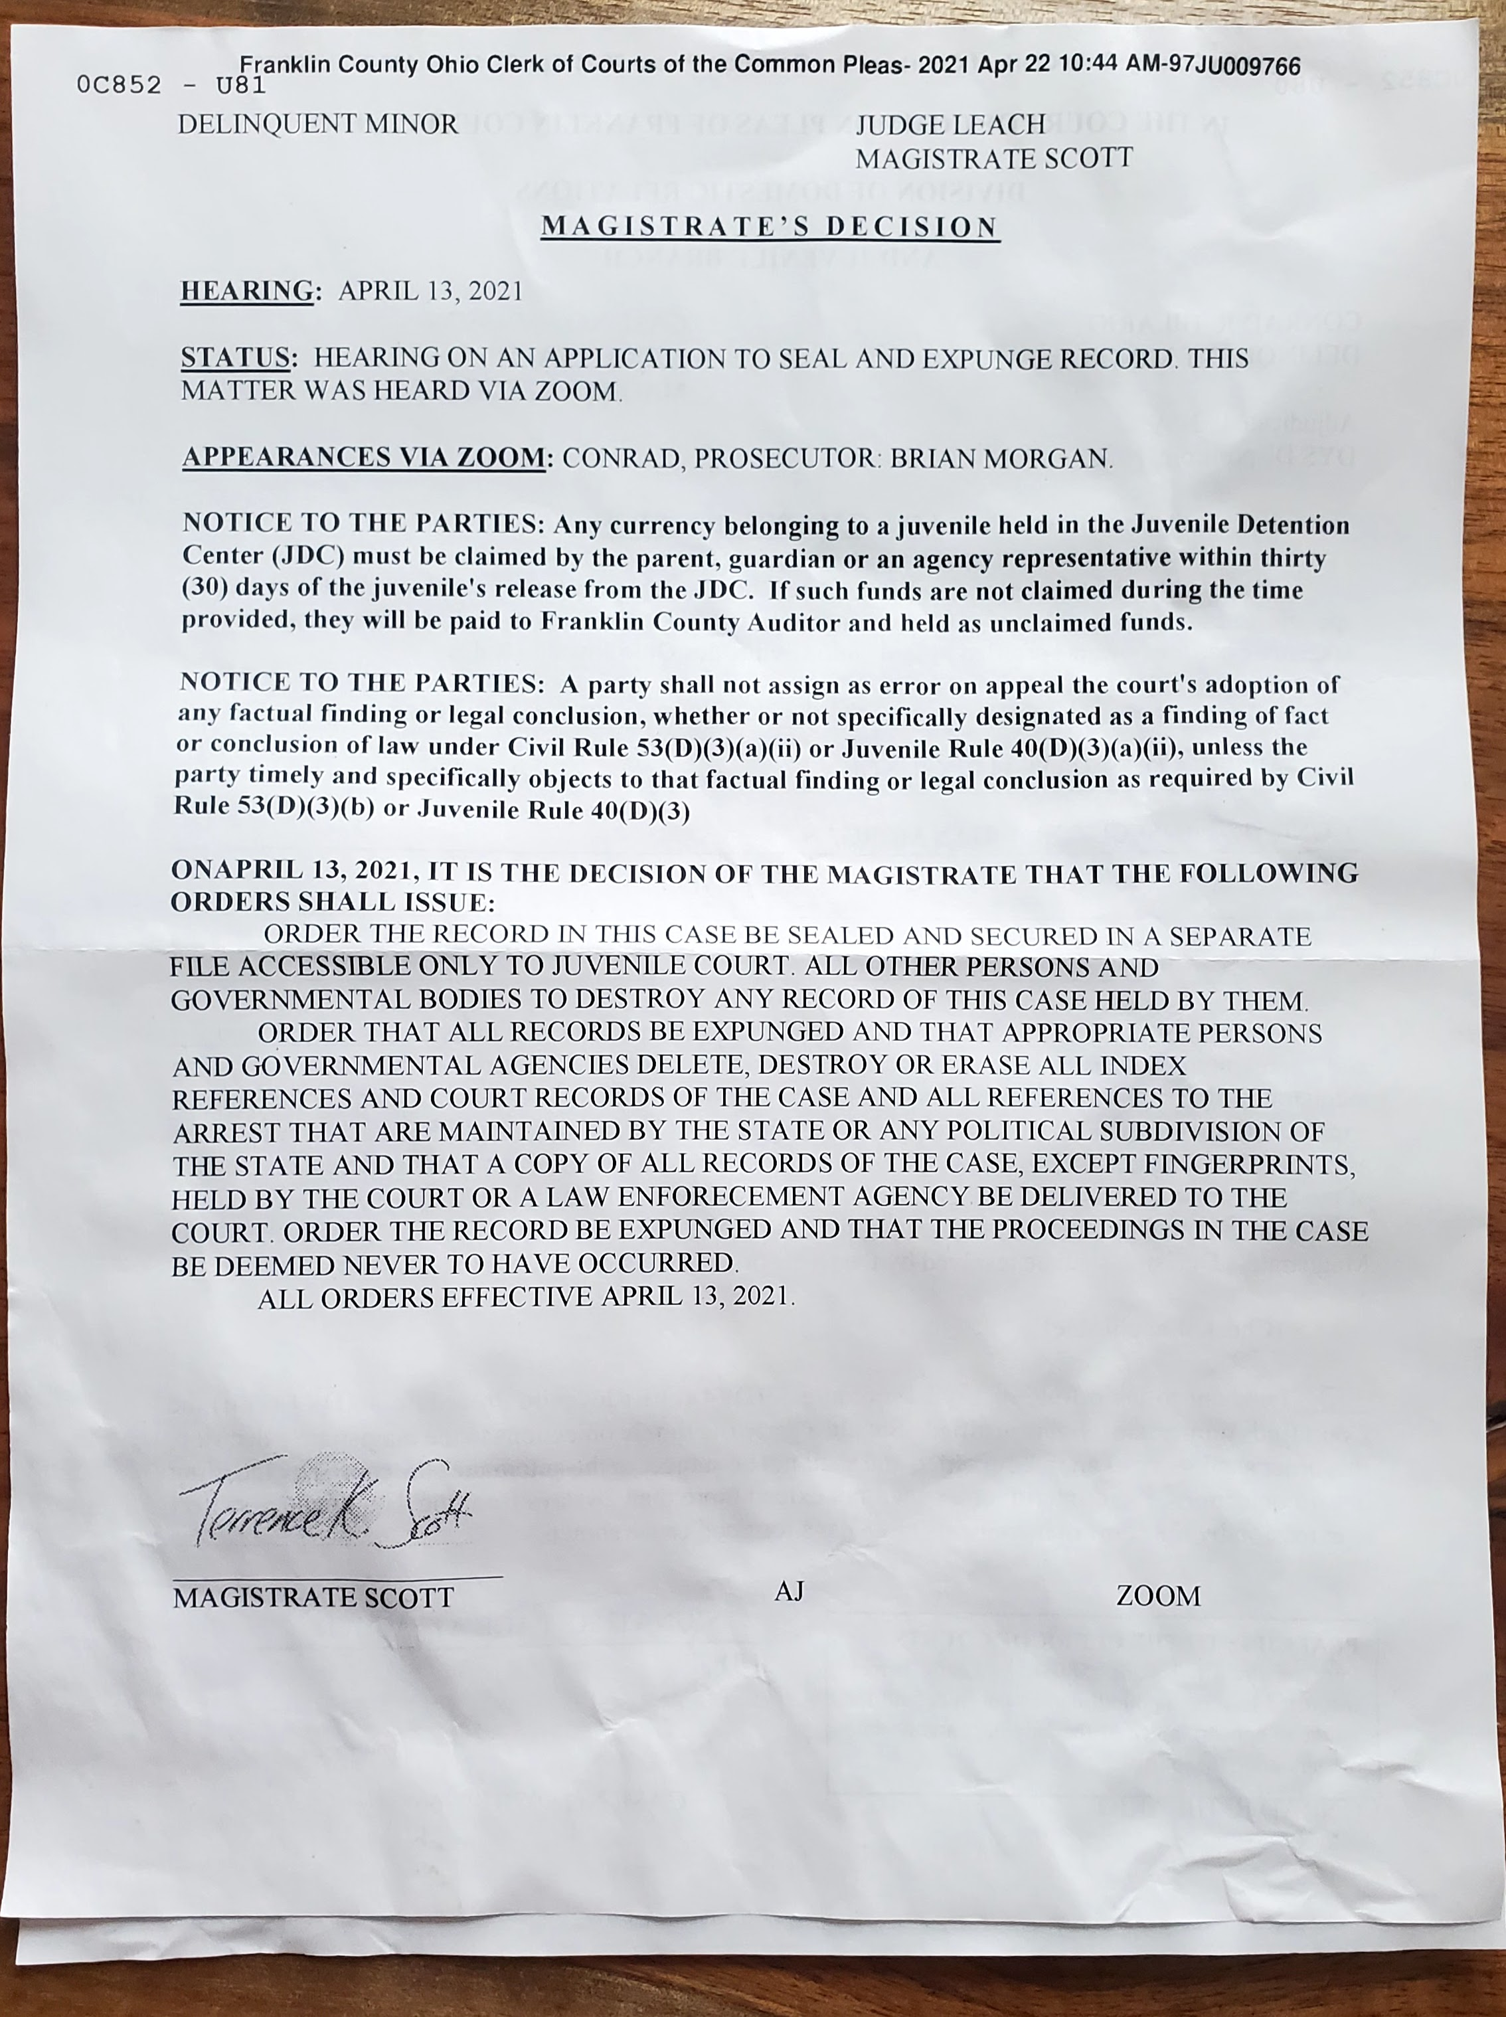

Slide 16
Matthew 18
²⁸ But when that servant went out, he found one of his fellow servants who owed him a hundred silver coins. He grabbed him and began to choke him. ‘Pay back what you owe me!’ he demanded.

Slide 17
Matthew 18
²⁸ But when that servant went out, he found one of his fellow servants who owed him a hundred silver coins. He grabbed him and began to choke him. ‘Pay back what you owe me!’ he demanded.
$200/day = $19,000
Some of you are struggling to forgive people who seriously wronged you.

Slide 18
Matthew 18
²⁹ His fellow servant fell to his knees and begged him, ‘Be patient with me, and I will pay it back.’
³⁰ But he refused. Instead, he went off and had the man thrown into prison until he could pay the debt.
³¹ When the other servants saw what had happened, they were outraged and went and told their master everything that had happened.

Slide 19
Matthew 18
Why should we forgive?
» God has canceled all of our debt.
» Unforgiveness often means the person with whom you are angry still has power over you.
³² Then the master called the servant in. ‘You wicked servant,’ he said, ‘I canceled all that debt of yours because you begged me to.
³³ Shouldn’t you have had mercy on your fellow servant just as I had on you?’
³⁴ In anger his master handed him over to the jailers to be tortured, until he should pay back all he owed.

Slide 20
Matthew 18
Why should we forgive?
» Resentment and anger will consume you.
Fredrick Buechner: “Of all the [sins] anger is possibly the most fun…To smack your lips over grievances long past, to roll over your tongue the prospect of bitter confrontations still to come, to savor to the last toothsome morsel [of] the pain you are giving back--in many ways it is a feast fit for a king. The chief drawback is that what you are wolfing down [at this feast] is yourself.”
³² Then the master called the servant in. ‘You wicked servant,’ he said, ‘I canceled all that debt of yours because you begged me to.
³³ Shouldn’t you have had mercy on your fellow servant just as I had on you?’
³⁴ In anger his master handed him over to the jailers to be tortured, until he should pay back all he owed.

Slide 21
Matthew 18
Why should we forgive?
» Resentment and anger will consume you.
» God can use your act of forgiveness as a powerful example of his love and mercy.
³² Then the master called the servant in. ‘You wicked servant,’ he said, ‘I canceled all that debt of yours because you begged me to.
³³ Shouldn’t you have had mercy on your fellow servant just as I had on you?’
³⁴ In anger his master handed him over to the jailers to be tortured, until he should pay back all he owed.

Slide 22
video

Slide 23
Practical Steps
» Realize that forgiveness is often granted long before it is felt.
Forgiveness is a promise not to exact a payment from the person who wronged you.
Depending on the severity the promise means making reoccurring payments in which you relinquish revenge.

Slide 24
Practical Steps
» Determine not to exact the price, but to pay the price ourselves.
Dan Hamilton: “[Forgiveness] is to deal with our emotions by sending them away – by denying ourselves the dark pleasures of venting them or fondling them in our minds...”

Slide 25
Practical Steps
» Determine not to exact the price, but to pay the price ourselves.
Ways to exact payment from the person who offended us:
We can make cutting remarks and drag out the past.
We can be far more demanding and controlling with that person because "they’ve hurt us.”

Slide 26
Practical Steps
» Determine not to exact the price, but to pay the price ourselves.
Ways to exact payment from the person who offended us:
We can avoid them or be cold to them.
We can run them down to others, under the guise of “warning” people about them.
We can run them down to others, under the guise of “sharing our hurt.”

Slide 27
Practical Steps
» Determine not to exact the price, but to pay the price ourselves.
Ways to exact payment from the person who offended us:
We can playback the mental video of what they did to us in order to keep the sense of hurt fresh and real.
We can root for their failure or fall.
Each time we refrain from doing these, we are absorbing the cost and "making payments.”

Slide 28
Practical Steps
» Determine not to exact the price, but to pay the price ourselves.
» Seek to reconcile when possible or appropriate.
Forgiveness does not automatically restore trust.
Forgiveness does not therefore mean you cannot criticize, oppose or contend against continued destructive behavior.

Slide 29
Practical Steps
» Cultivate humility.
Daniel Darling, “Resist the Pharisee Temptation on Social Media,” “From COVID to racial unrest to a divisive political election, there was no shortage of ways in 2020 to trust in ourselves and look down on everyone else…our social platforms are like modern-day temples where, like the Pharisee, we can clarify multiple times a day that we are not like those…public servants…

Slide 30
Practical Steps
» Cultivate humility.
Daniel Darling, “Social media may be the most public forum for this kind of Pharisee. Here we dunk on the worst, cherry-picked extremes from other traditions and tribes in order to let the world know we are better—more sophisticated…more pure. And the algorithms encourage this! The way to go viral is to call out someone else with incendiary language that leaves our critics seething and our fans cheering.”

Slide 31
Practical Steps
» Cultivate humility.
1 Timothy 1:13-14: Even though I was once a blasphemer and a persecutor and a violent man, I was shown mercy because I acted in ignorance and unbelief. The grace of our Lord was poured out on me abundantly, along with the faith and love that are in Christ Jesus.

Slide 32
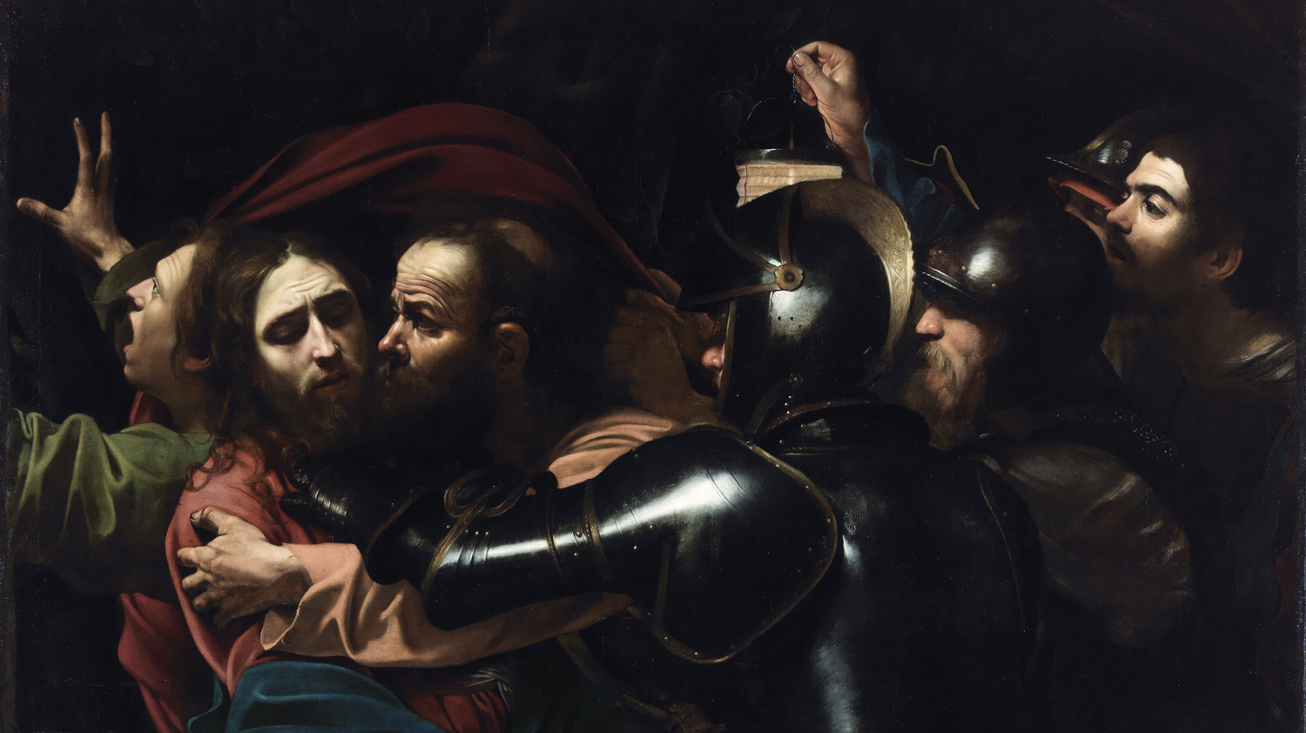

Slide 33
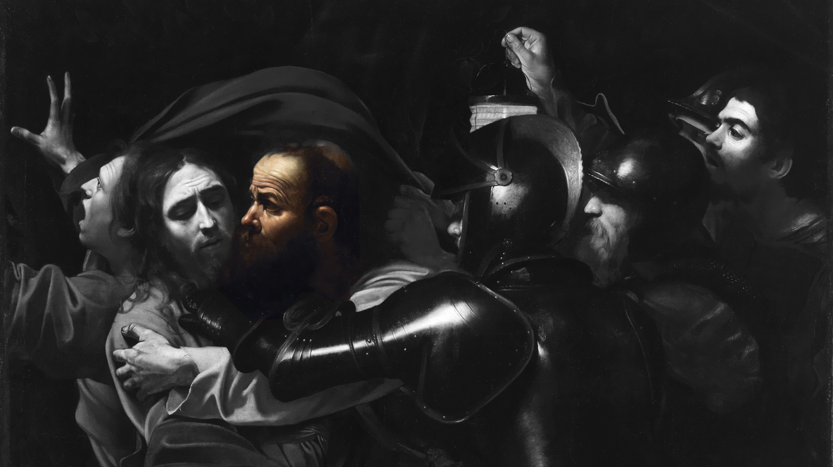

Slide 34
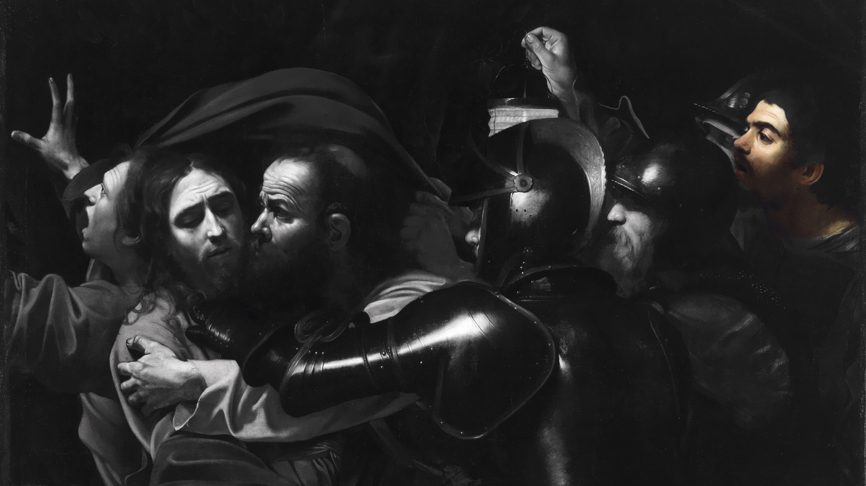

Slide 35
Practical Steps
» Cultivate humility.
» Take the first step toward forgiveness.

