Slide 1
God’s Rest
XSI 2021

Slide 2
God’s Rest
Matthew 11:28-30 – Then Jesus said, “Come to me, all of you who are weary and carry heavy burdens, and I will give you rest.
Take my yoke upon you. Let me teach you, because I am humble and gentle at heart, and you will find rest for your souls.
For my yoke is easy to bear and the burden I give you is light.”

Slide 3
God’s Rest
Psalm 23:1-3 – Yahweh is my shepherd; I have all that I need.
He makes me lie down in green pastures, he leads me beside quiet waters,
he refreshes my soul.

Slide 4
God’s Rest
Hebrews 4:9-11 – So there remains a Sabbath rest for the people of God.
For the one who has entered His rest has rested from his work, as God did from His.
Therefore let us be diligent to enter that rest, so that no one will fall, through following the same example of disobedience.

Slide 5
God’s Rest
How do we picture ‘rest’?

Slide 6
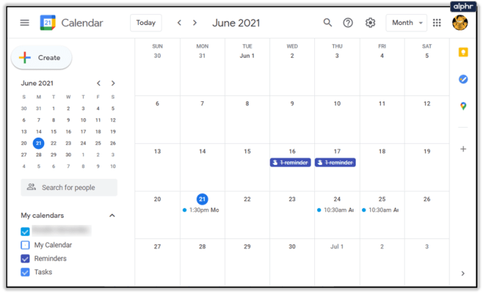
God’s Rest
How do we picture ‘rest’?

Slide 7
Paul Miller
A Praying Life – Connecting with God in a Distracting World (NavPress, 2009), 23
Many assume that the spiritual person is unruffled by life, unfazed by pressure.
This idea that a spiritual person floats above life comes from the ancient world and, in particular, the Greek mind – although we see it strongly in the Eastern mind as well.

Slide 8
Paul Miller
A Praying Life – Connecting with God in a Distracting World (NavPress, 2009), 23
But even a cursory glance at Jesus’ life reveals a busy life…Jesus’ life seems out of balance. But he loves people and has the power to help, so he has one interruption after another.
If Jesus lived today, his cell phone would be ringing constantly.

Slide 9
Paul Miller
A Praying Life – Connecting with God in a Distracting World (NavPress, 2009), 23
The quest for a contemplative life can actually be self-absorbing, focused on my quiet and me…
Learning to pray does not offer us a less busy life; it offers us a less busy heart.

Slide 10
Chuck Smith
Why Grace Changes Everything (The Word for Today, 1994), 79
Have you ever considered the vast difference between “works” and “fruit”?

Slide 11
Chuck Smith
Why Grace Changes Everything (The Word for Today, 1994), 79
Works suggests a factory complete with pressures, deadlines, and the constant need to produce.
But fruit pictures a peaceful, tranquil garden; a place where we are inclined to stay and drink in the beauty while we enjoy each other’s company.

Slide 12
Chuck Smith
Why Grace Changes Everything (The Word for Today, 1994), 79
The gospel of grace invites us to leave behind the smog and pressure of a factory-like life of works, and instead bear the fruit that God desires to see in the garden of our lives.

Slide 13
God’s Rest
Hebrews 4:9-11 – So there remains a Sabbath rest for the people of God.
Exodus 1 → Numbers 13 OR Joshua 3-6
1 Corinthians 10:1-11
V11 – Now these things happened to them as a type, and they were written for our instruction…

Slide 14
God’s Rest
Hebrews 4:9-11 – So there remains a Sabbath rest for the people of God.
Exodus 1 → Numbers 13 OR Joshua 3-6
Entry into Canaan: The Faith-Rest Walk for the Christian

Slide 15
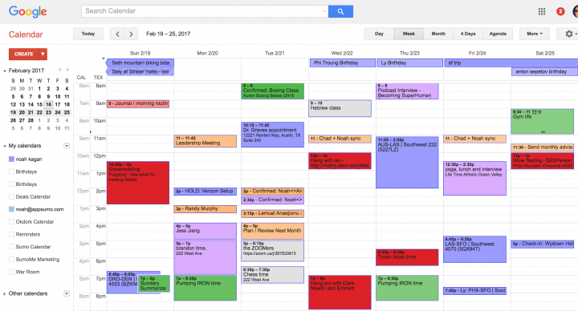
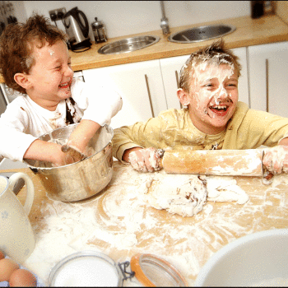
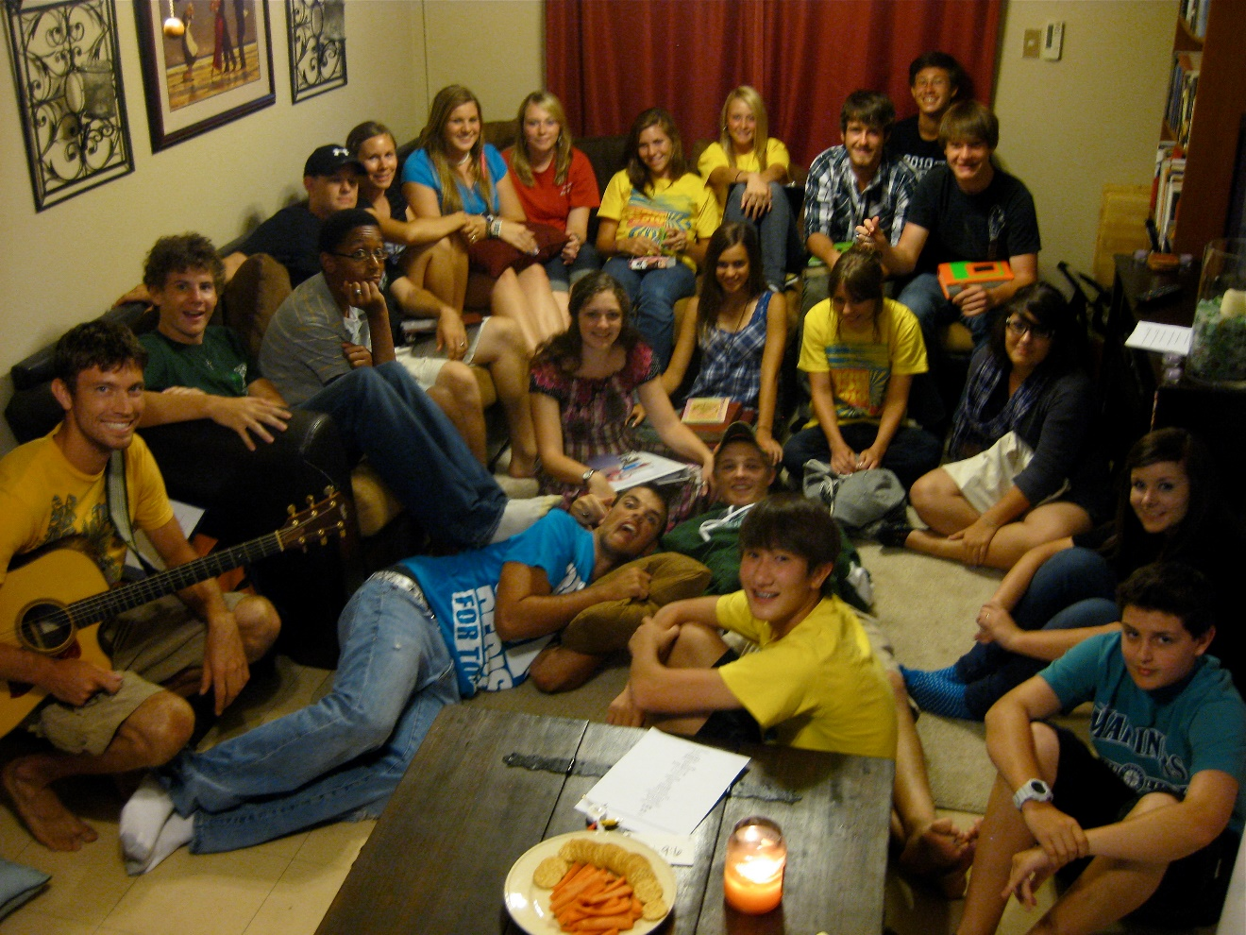
God’s Rest
God’s rest?

Slide 16
Oswald Sanders
A Spiritual Clinic – Problems of Christian Discipleship (The Moody Bible Institute of Chicago, 1958), 9
Strain and tension characterize our age. People in all walks of life are subject to their ravages, and if the truth be told, despite the rich promises of heart-rest and serenity held out to the believing soul, Christians are too readily subject to these same disorders...

Slide 17
Oswald Sanders
A Spiritual Clinic – Problems of Christian Discipleship (The Moody Bible Institute of Chicago, 1958), 9
In spite of tears and prayers and self-reproach there are some who seem unable to enter into the rest that remains to the people of God.
This should not and need not be.

Slide 18
Symptoms of Unrest
Stress

Slide 19
Kevin DeYoung
Crazy Busy (Crossway, 2013), 1
I suppose there might be a six-year-old somewhere out there who doesn’t “have anything to do” and some dear folks in a nursing home who could use a few more interruptions,

Slide 20
Kevin DeYoung
Crazy Busy (Crossway, 2013), 1
but for almost everyone else in between there is a pervasive sense of being unrelentingly filled up and stressed out.

Slide 21
Kevin DeYoung
Crazy Busy (Crossway, 2013), 16
No doubt, some people are quantitatively less busy than others and some much more so, but that doesn’t change the shared experience:
most everyone I know feels frazzled and overwhelmed most of the time.

Slide 22
Symptoms of Unrest
Stress – and its accompanying health problems:
Back problems (upper and lower)
Headaches
Digestive issues (upper and lower)
Sleep disorders
And I’m only listing my issues!

Slide 23
Symptoms of Unrest
Stress
Out of control areas: eating, spending, screen

Slide 24
Robert Putnam
Bowling Alone (Touchstone, 2000), 238, 240
Television watching, [Robert] Kubey and [Michael] Csikszentmihalyi found, is a relaxing, low-concentration activity. Viewers feel passive and less alert after watching...

Slide 25
Robert Putnam
Bowling Alone (Touchstone, 2000), 238, 240
Viewing is experienced as a relaxing release of tension [according to British researchers Sue Bowden and Avner Offer].

Slide 26
Symptoms of Unrest
Stress
Out of control areas: eating, spending, screen

Slide 27
Symptoms of Unrest
Stress
Out of control areas: eating, spending, screen
Anger

Slide 28
Carl Honore
In Praise of Slow (HarperOne, 2004), 13
A delivery van stops outside my neighbour’s house, forcing the traffic behind to wait while the driver unloads a small table.
Within a minute, the forty-something business woman in the first car begins thrashing around in her seat, flailing her arms and snapping her head back and forth.

Slide 29
Carl Honore
In Praise of Slow (HarperOne, 2004), 13
A low, guttural wail escapes from her window…I decide she must be having an epileptic fit, and run downstairs to help.
But when I reach the sidewalk, it turns out she is simply annoyed at being held up.

Slide 30
Carl Honore
In Praise of Slow (HarperOne, 2004), 13
She leans out the window and screams at no one in particular, “If you don’t move that f***ing van, I’ll f***ing kill you!”

Slide 31
Symptoms of Unrest
Stress
Out of control areas: eating, spending, screen
Anger
Resenting God or the work of God

Slide 32
Chuck Smith
Why Grace Changes Everything (The Word for Today, 1994), 88
Any relationship based on works soon becomes a grind in which we lose the joy of our relationship with the Lord.
Suddenly it’s a duty, an obligation, an onerous task. Before long, we being griping.

Slide 33
Chuck Smith
Why Grace Changes Everything (The Word for Today, 1994), 88
The joy of the Lord departs from our walk.
We no longer enjoy freedom, but labor under a yoke of bondage.

Slide 34
Causes of Unrest
The screen

Slide 35
Nicholas Carr
The Shallows - What the Internet is Doing to our Brains (W.W. Norton & Co., 2011), 5
Over the past few years I’ve had an uncomfortable sense that someone, or something, has been tinkering with my brain…
My mind isn’t going – so far as I can tell – but it’s changing. I’m not thinking the way I used to think.

Slide 36
Nicholas Carr
The Shallows - What the Internet is Doing to our Brains (W.W. Norton & Co., 2011), 5
I feel it most strongly when I’m reading. I used to find it easy to immerse myself…
Now my concentration starts to drift after a page or two. I get fidgety…

Slide 37
Nicholas Carr
The Shallows - What the Internet is Doing to our Brains (W.W. Norton & Co., 2011), 16
At first I’d figured that the problem was a symptom of middle-age mind rot. But my brain, I realized, wasn’t just drifting.
It was hungry.
It was demanding to be fed the way the Net feeds it – and the more it was fed, the hungrier it became.

Slide 38
Nicholas Carr
The Shallows - What the Internet is Doing to our Brains (W.W. Norton & Co., 2011), 10
Calm, focused, undistracted, the linear mind is being pushed aside by a new kind of mind that wants and needs to take in and dole out information in short, disjointed, often overlapping bursts – the faster, the better.

Slide 39
Causes of Unrest
The screen
My experience at teachings and in meetings

Slide 40
Causes of Unrest
The screen
People-pleasing

Slide 41
Kevin DeYoung
Crazy Busy (Crossway, 2013), 35
We are busy because we try to do too many things.
We do too many things because we say yes to too many people.
We say yes to all these people because we want them to like us and we fear their disapproval…

Slide 42
Kevin DeYoung
Crazy Busy (Crossway, 2013), 35
It makes our lives miserable (living and dying by the approval of others),
and it usually hurts those who are closest to us (who get what’s left over of our time and energy after we try to please everyone else.)

Slide 43
Oswald Sanders
A Spiritual Clinic – Problems of Christian Discipleship (The Moody Bible Institute of Chicago, 1958), 163
The truth is that if we do not have sufficient time to discharge our responsibilities,
we either have undertaken responsibilities not laid upon us by the Lord,
or we are not making strategic use of the time He has given us.

Slide 44
Causes of Unrest
The screen
People-pleasing
Disobedience
Hebrews 3:18 – And to whom did He swear that they would not enter His rest, but to those who were disobedient?

Slide 45
Ajith Fernando
The Family Life of a Christian Leader (Crossway, 2016), 58
Christians are called to a balanced life.
That does not mean doing everything in moderation; rather, it means being obedient in every area of life.

Slide 46
Causes of Unrest
The screen
People-pleasing
Disobedience
Independence
John 15:5 – I am the vine and you are the branches. If you abide in me and I in you, you will bear much fruit; apart from me you can do nothing.

Slide 47
Causes of Unrest
The screen
People-pleasing
Disobedience
Independence
Unbelief
Hebrews 3:19 – So we see that they were not able to enter because of unbelief.

Slide 48
Results of Unrest
Weary and worn out
Matt 11:28 – Come to me all of you who are weary and heavy laden

Slide 49
Results of Unrest
Weary and worn out
Distance from God
Hebrews 3:12 – Take care, brethren, that there not be any one of you with an evil, unbelieving heart that falls away from the living God

Slide 50
Results of Unrest
Weary and worn out
Distance from God
Lack of joy and peace
John 15:11 – “These things I have spoken to you so that My joy may be in you, and that your joy may be made full.”

Slide 51
Results of Unrest
Weary and worn out
Distance from God
Lack of joy and peace
Our perspective starts to shift
Numbers 13:2-4 – “If only we had died in Egypt, or even here in the wilderness! Why is the LORD taking us to this country only to have us die in battle?

Slide 52
Results of Unrest
Weary and worn out
Distance from God
Lack of joy and peace
Our perspective starts to shift
Numbers 13:2-4 – “Our wives and our little ones will be carried off as plunder! Wouldn’t it be better for us to return to Egypt?”

Slide 53
Do I have a hardened heart?
There is always hope
Hebrews 3:7 – Therefore, just as the Holy Spirit says, ‘Today if you hear his voice, do not harden your heart…’
3:17 – “Today if you hear his voice, do not harden your heart…”
4:7 – “Today if you hear his voice, do not harden your hearts.”

Slide 54
Do I have a hardened heart?
There is always hope
The question is not ‘Do I’ but ‘Where do I?”

Slide 55
Steps Towards Rest
TIME WITH GOD

Slide 56
Kevin DeYoung
Crazy Busy (Crossway, 213), 113
If you are sick and tired of feeling so dreadfully busy and are looking for a one-point plan to help restore order to your life, this is the best advice I know:
devote yourself to the Word of God and prayer. This means public worship and private worship.

Slide 57
Steps Towards Rest
TIME WITH GOD
Matt 11:28-29 – Come to me all of you who are weary and heavy laden, and I will give you rest. Take my yoke upon you. Let me teach you.

Slide 58
Steps Towards Rest
TIME WITH GOD
John 15:7 – If you abide in me, and my words abide in you, ask whatever you wish, and it will be done for you.

Slide 59
Steps Towards Rest
TIME WITH GOD
Hebrews 4:13 – The word of God is living and active, and sharper than any two-edged sword…and able to judge the thoughts and intentions of the heart.

Slide 60
Kevin DeYoung
Crazy Busy (Crossway, 2013), 113
Sitting at the feet of Jesus, whether corporately or individually, never just happens. We must make learning from him and taking time to be with him a priority. The priority, in fact.
Matthew 6:33 – Seek first his kingdom and his righteousness, and all these things will be given you as well.

Slide 61
Steps Towards Rest
TIME WITH GOD
Including honesty
Hebrews 4:16 – Therefore let us draw near with confidence to the throne of grace, so that we may receive mercy and find grace to help in time of need.

Slide 62
Steps Towards Rest
TIME WITH GOD
Boundaries?

Slide 63
Oswald Sanders
A Spiritual Clinic – Problems of Christian Discipleship (The Moody Bible Institute of Chicago, 1958), 168
There are certain obvious obligations and duties, both spiritual and temporal, which naturally demand a place and adequate time should be allowed for these.
Then there are secondary things which should be carefully pruned to a minimum and fitted in.

Slide 64
Steps Towards Rest
TIME WITH GOD
Boundaries?
Scheduled rest

Slide 65
Kevin DeYoung
Crazy Busy (Crossway, 213), 91
I hope every Christian can agree that God has made us from the dust to need regular times of rest…God has given us Sabbath as a gift; it’s an island of get-to in a sea of have-to.
He also offers us Sabbath as a test; it’s an opportunity to trust God’s work more than our own.

Slide 66
Steps Towards Rest
TIME WITH GOD
Boundaries?
Scheduled rest
Hobbies
Exercise

Slide 67
Steps Towards Rest
TIME WITH GOD
Boundaries?
Scheduled rest
Enforced rest
Psalm 23:2 – He makes me lie down in green pastures

Slide 68
Steps Towards Rest
TIME WITH GOD
Boundaries?
Scheduled rest
Regular relating
Hebrews 10:25 – Not forsaking our own assembling together, but encouraging one another; and all the more as you see the day drawing near.

Slide 69
Results of Rest
Closeness with God
Psalm 23:6 – Surely your goodness and unfailing love will pursue me all the days of my life,
and I will live in the house of Yahweh forever.

Slide 70
Results of Rest
Closeness with God
Closeness with other people
John 15:12 – This is my commandment, that you love one another, just as I have loved you.

Slide 71
Results of Rest
Closeness with God
Closeness with other people
Steps of faith
Israel in Joshua 1-6 instead of Numbers 13

Slide 72
Results of Rest
Closeness with God
Closeness with other people
Steps of faith
Fruit
John 15:8 – My Father is glorified by this , that you bear much fruit, and so prove to be My disciples.

Slide 73
Conclusion
God’s rest is available to everyone
Ask Him TODAY how to enter it

Slide 74
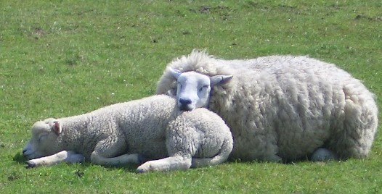
God’s Rest
Questions?
Comments?
Experiences?
risleyc@dwellcc.org

