Slide 1
1 Peter 2:4-10
God’s Building Project

Slide 2
1 Peter
Who are you?
Chosen (1:2)
Citizens of heaven and pilgrims in this world (1:2)
“Born again” (1:3, 23)
Guaranteed eternal life (1:4)
Cleansed with Christ’s blood (1:18-19)
Purified souls to love others (1:22)

Slide 3
1 Peter
Now live out your new identity!
Last time: Commit yourself to the Word of God
This time: Commit yourself to the Christian community that God is building (“the church”)
What is the church?
How do I join the church?
What is the church supposed to do?

Slide 4
1 Peter 2
4 And coming to Him as to a living stone which has been rejected by men, but is choice and precious in the sight of God,
5 you also, as living stones, are being built up as a spiritual house for a holy priesthood, to offer up spiritual sacrifices acceptable to God through Jesus Christ.
The church is like a building
What is the church? (v. 4-5)

Slide 5
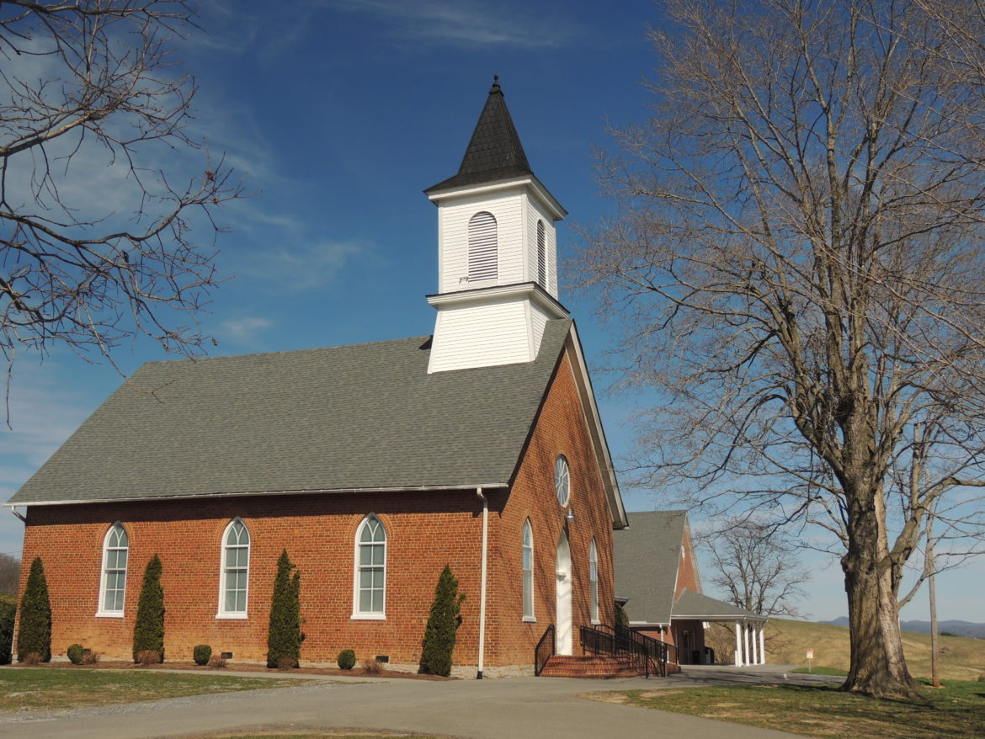

Slide 6
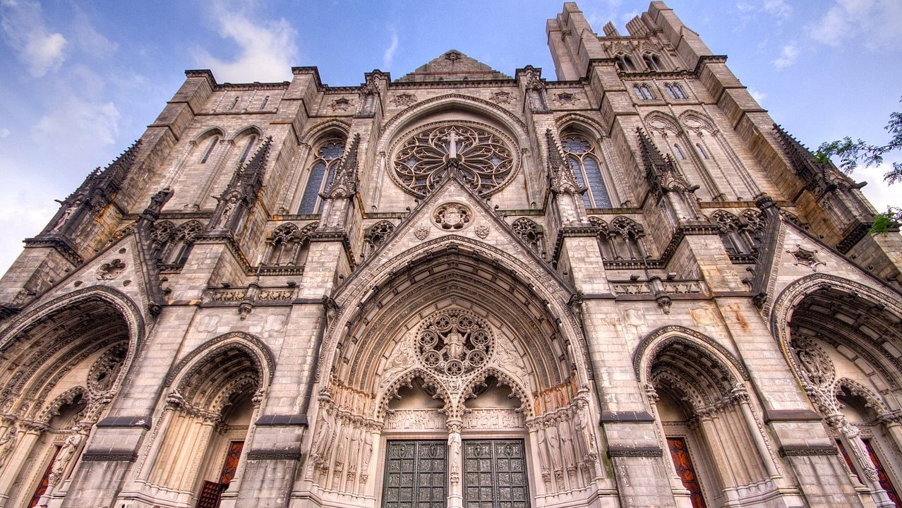

Slide 8
1 Peter 2
4 And coming to Him as to a living stone which has been rejected by men, but is choice and precious in the sight of God,
5 you also, as living stones, are being built up as a spiritual house for a holy priesthood, to offer up spiritual sacrifices acceptable to God through Jesus Christ.
The church is like a building
The church is like a temple (Eph 2:21-22; 1 Cor 3:16; 2 Cor 6:16)
What is the church? (v. 4-5)

Slide 9
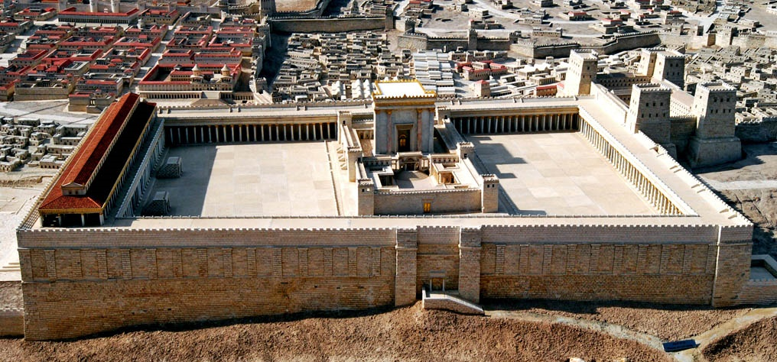
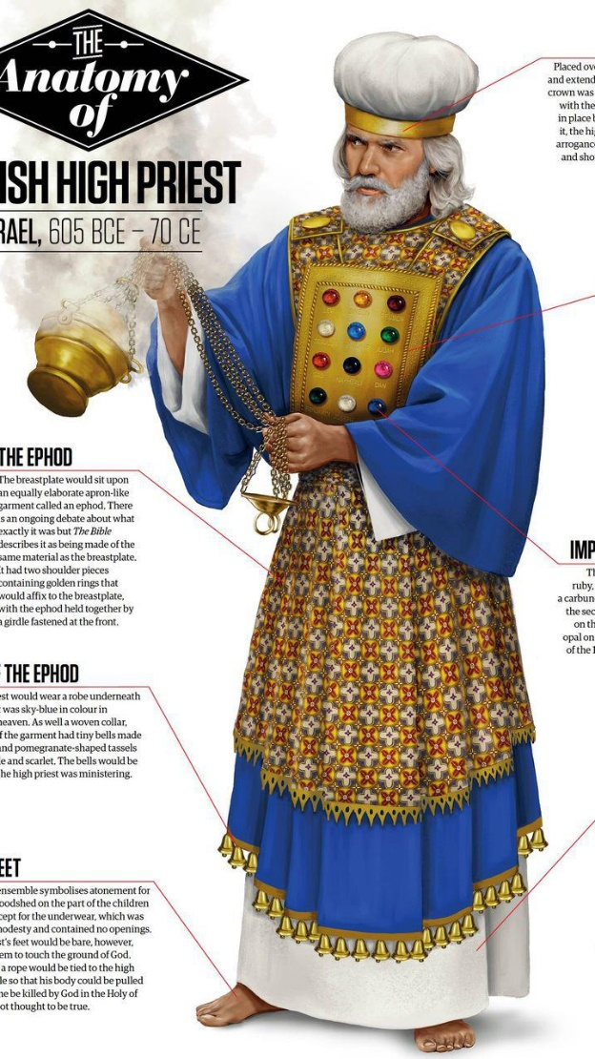

Slide 10
Temples in the NT:
Jesus’s body (John 2:19-21)
The Christian’s body (1 Cor 6:19)
A Community of Christians

Slide 11
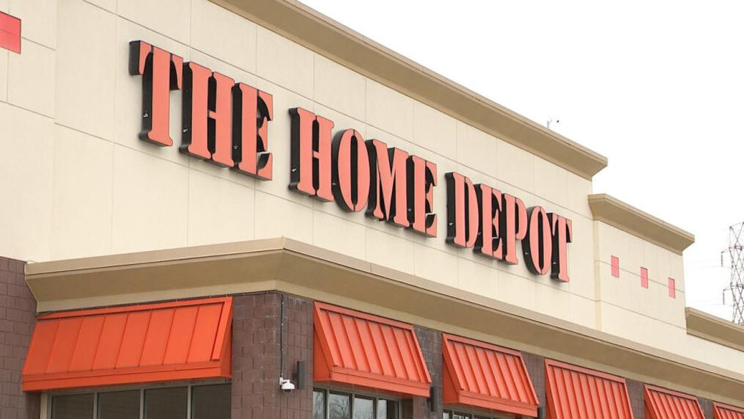
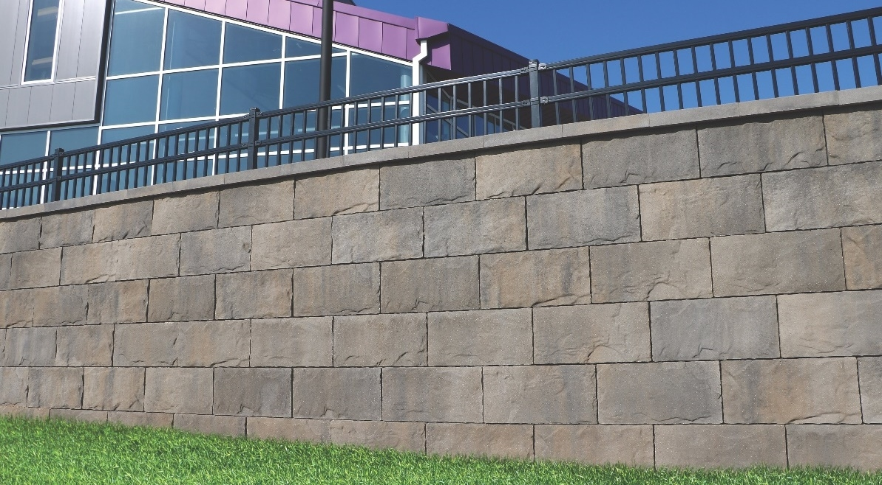
The New Temple
You … are being built up as a spiritual house

Slide 12
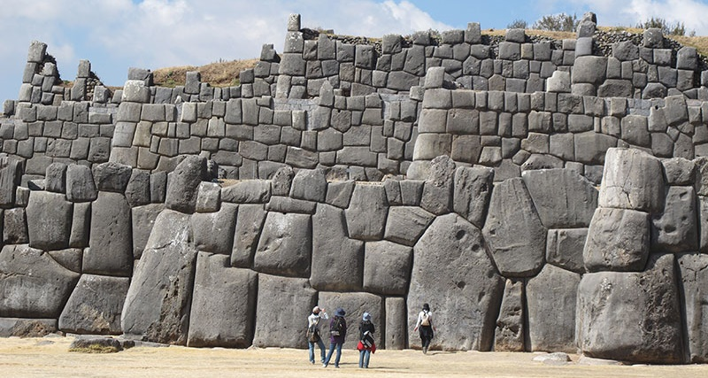
The New Temple
You … are being built up as a spiritual house

Slide 13
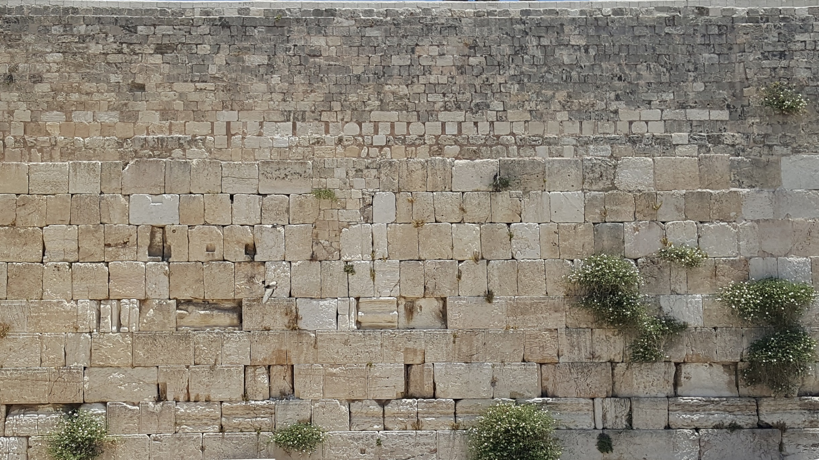
The New Temple
You … are being built up as a spiritual house

Slide 14
The New Temple
Sovereign placement (1 Cor 12:18)
You … are being built up as a spiritual house
Implication #1: There’s a Master Builder

Slide 15
The New Temple
You … are being built up as a spiritual house
Power!
Implication #1: There’s a Master Builder

Slide 16
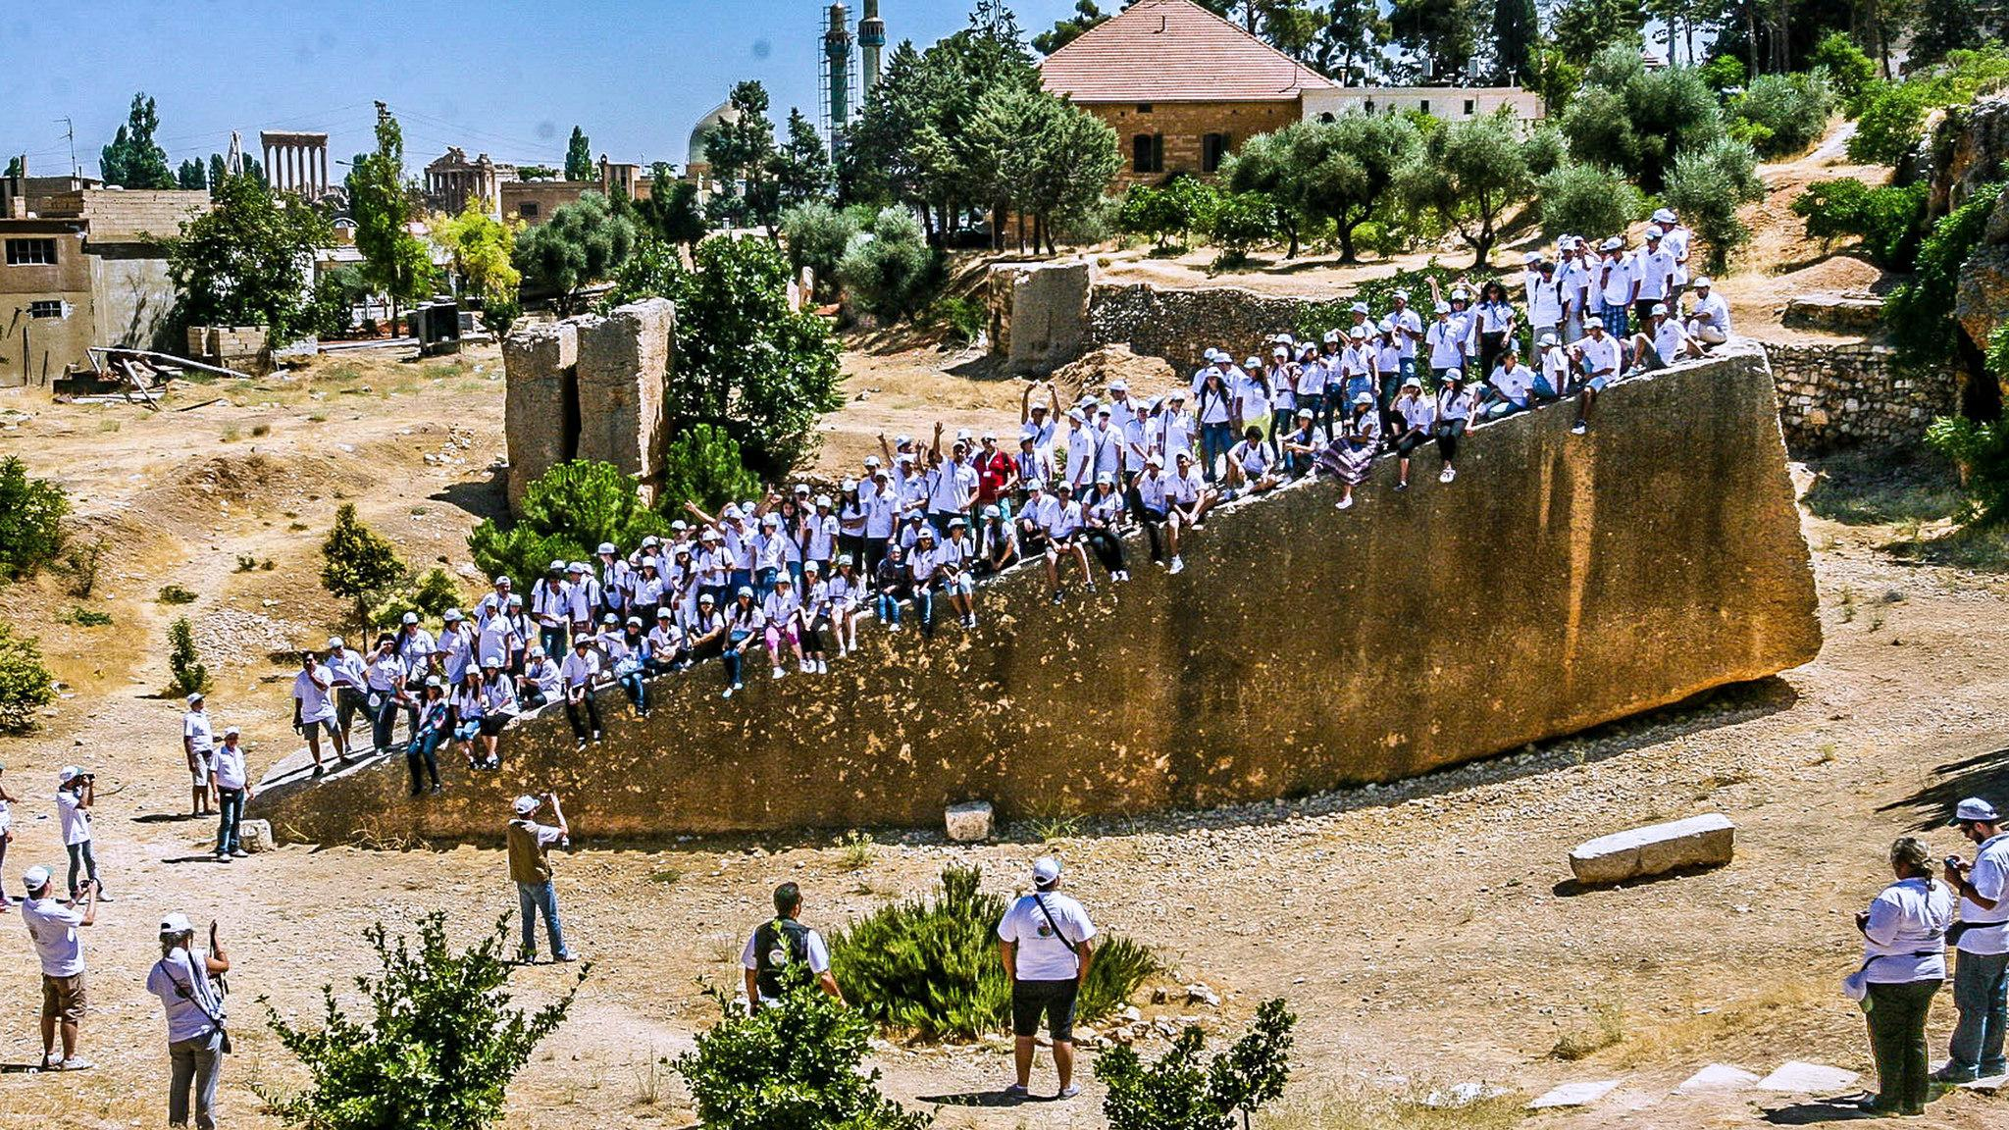
64 ft x 19.6 ft x 18 ft, 3.3 million lbs

Slide 17
The New Temple
You … are being built up as a spiritual house
Sovereign choice
Implication #1: There’s a Master Builder

Slide 18
The New Temple
Each stone rests on other stones
You … are being built up as a spiritual house
“I don’t need people”
Requires time, openness, being easy to please
#2: We are designed to be in a wall

Slide 19
The New Temple
Each stone supports other stones
You … are being built up as a spiritual house
“No one would miss me”
Requires consistency, listening, initiation, prayer, helping others learn to support
#2: We are designed to be in a wall

Slide 20
The New Temple
We are stronger together
You … are being built up as a spiritual house
#2: We are designed to be in a wall

Slide 21
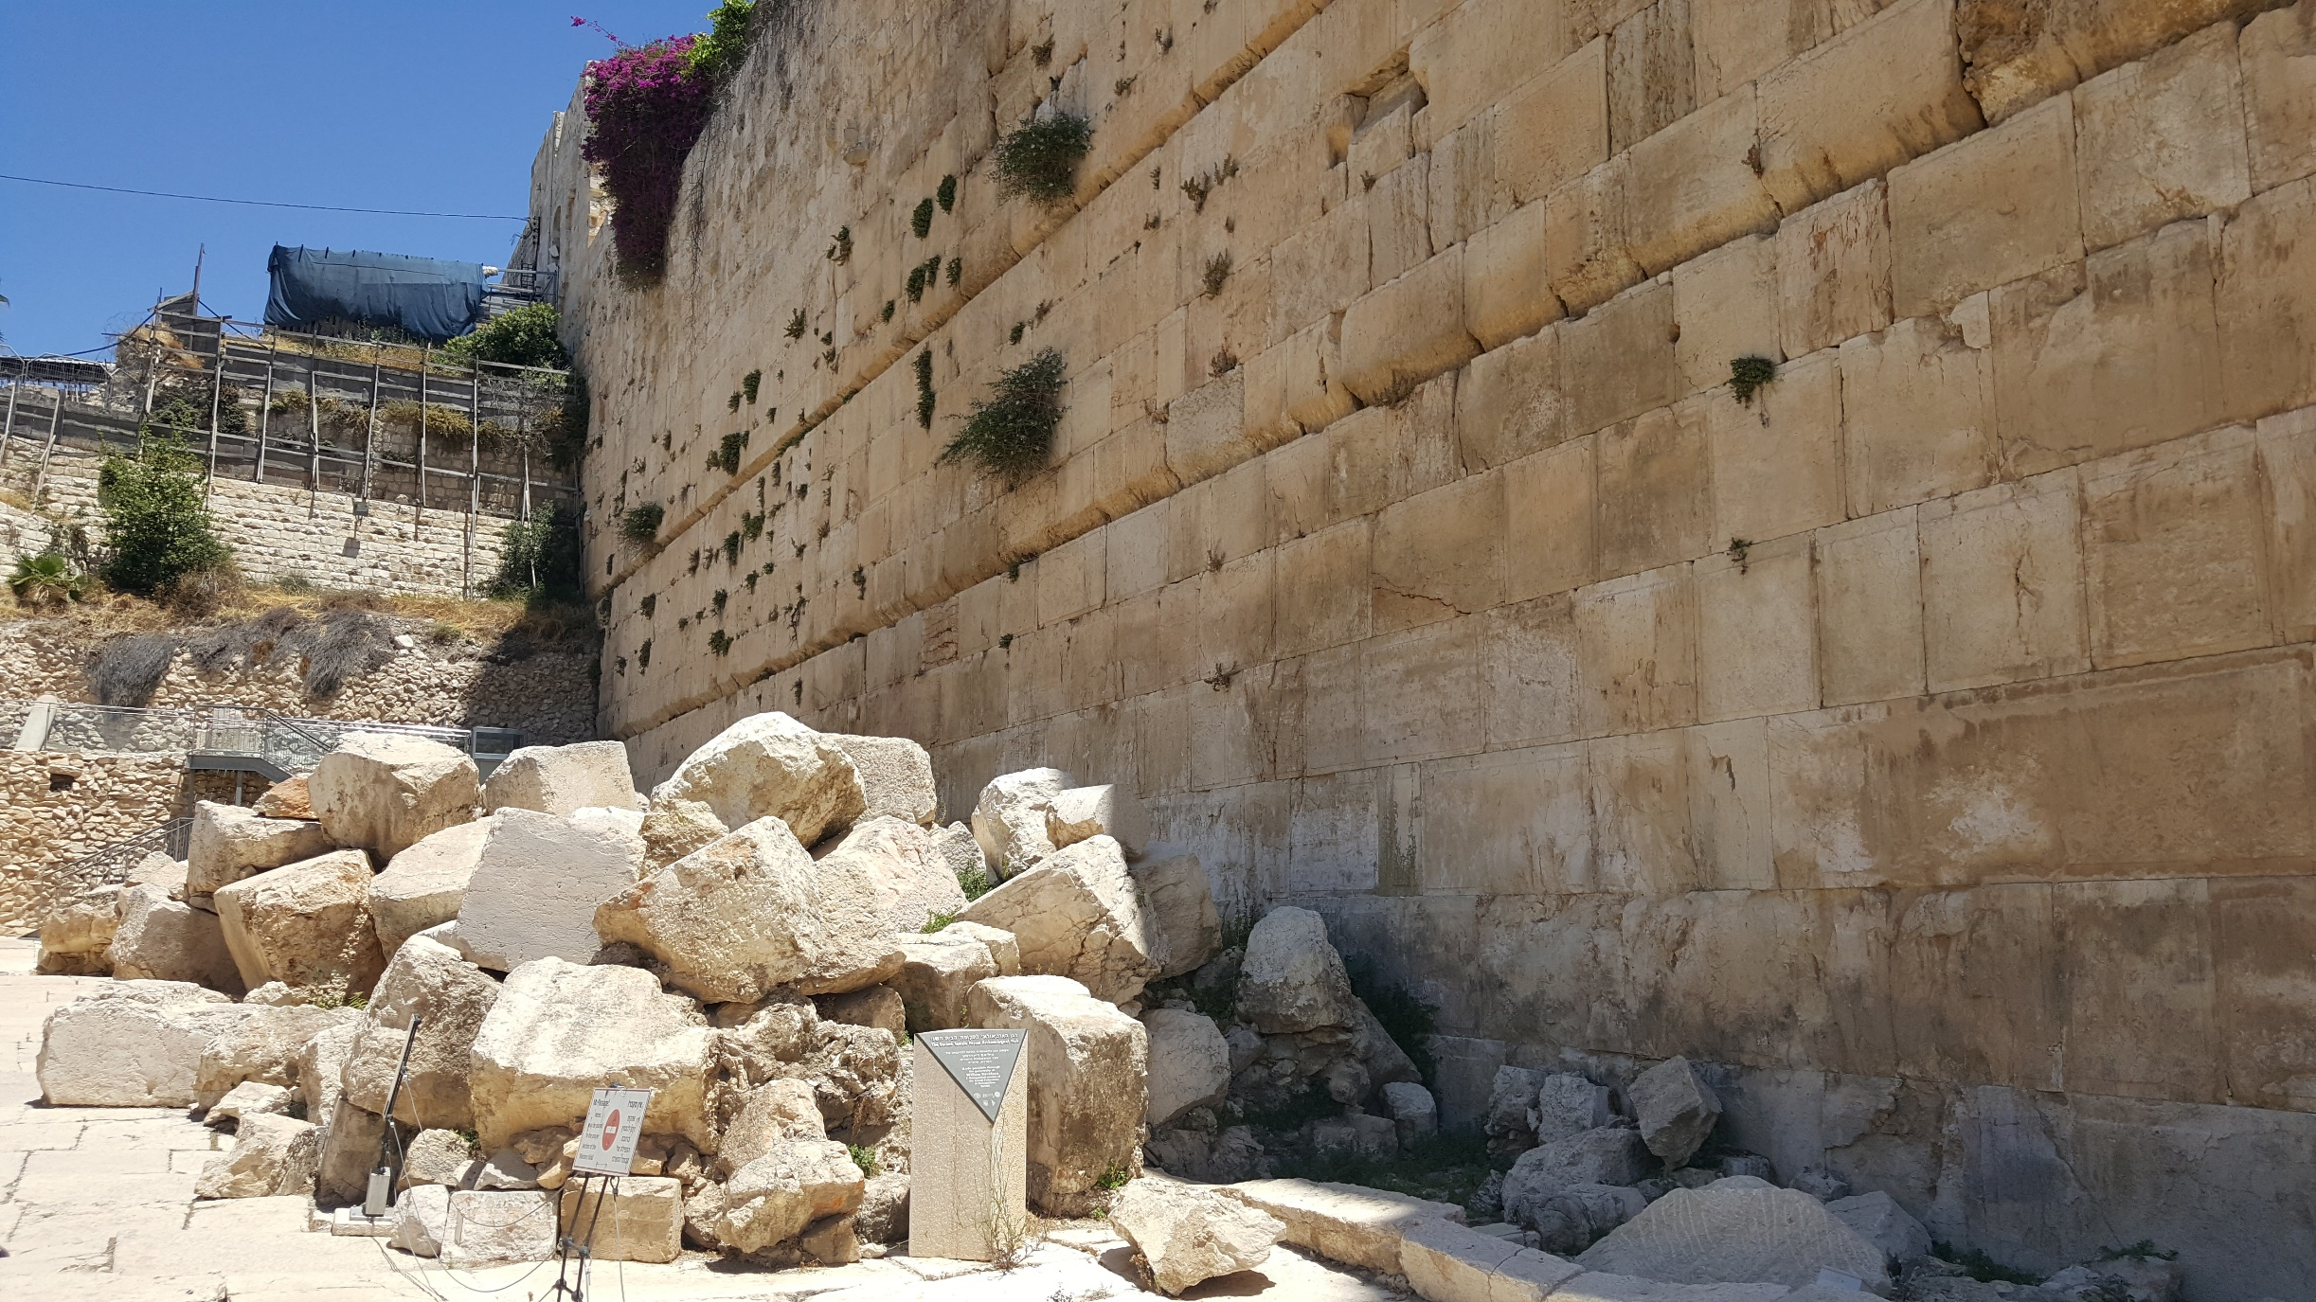
The New Temple
We are stronger together
You … are being built up as a spiritual house
Strength comes from real closeness
#2: We are designed to be in a wall

Slide 22
The New Temple
You … are being built up as a spiritual house
It’s not a building, but a living, breathing community
How do I join?

Slide 23
1 Peter 2
6 For this is contained in Scripture:
“Behold, I lay in Zion a choice stone, a precious corner stone, and he who believes in him will not be disappointed.” [Isaiah 28:16]
And coming to Him as to a living stone which has been rejected by men, but is choice and precious in the sight of God
How do I join the church?

Slide 24
1 Peter 2
6 For this is contained in Scripture:
“Behold, I lay in Zion a choice stone, a precious corner stone, and he who believes in him will not be disappointed.” [Isaiah 28:16]
The cornerstone was the starting point
How do I get into the church?
Believe in him!
How do I join the church?

Slide 25
1 Peter 2
7 This precious value, then, is for you who believe; but for those who disbelieve,
“The stone which the builders rejected, this became the very corner stone,” [Psalm 118:22]
8 and, “A stone of stumbling and a rock of offense” [Isaiah 8:14]
Jesus applied these prophecies to himself (Matt 21:33-44)
How do I join the church?

Slide 26
1 Peter 2
8b for they stumble because they are disobedient to the word, and to this doom they were also appointed.
In the end there are two kinds of people
How do I join the church?

Slide 27
1 Peter 2
9 But you are a chosen race, a royal priesthood, a holy nation, a people for God’s own possession,
so that you may proclaim the excellencies of Him who has called you out of darkness into His marvelous light; [cf. Exod 19:5–6; Isa 43:20–21; and Mal 3:17]
“Sing songs!”
What should the church do?

Slide 28
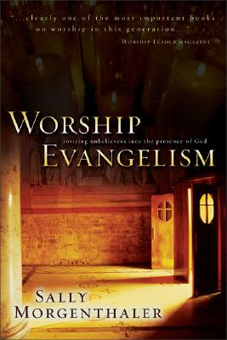
Morgenthaler, Sally. Worship Evangelism: Inviting Unbelievers into the Presence of God. Grand Rapids, MI: Zondervan Pub. House, 1995. 9.
Unbelievers… will draw lasting conclusions about the veracity and uniqueness of our God based on what they see or do not see happening in our weekly church services.

Slide 29
Morgenthaler, Sally. Worship Evangelism: Inviting Unbelievers into the Presence of God. Grand Rapids, MI: Zondervan Pub. House, 1995. 9.
Do they detect something supernatural and life-changing going on?

Slide 30
Sally Morgenthaler, “Worship as Evangelism,” Rev! May/June 2007. 48.
In 2001 a worship-driven congregation in my area finally did a survey as to who they were really reaching, and they were shocked.
They’d thought their congregation was at least 50 percent unchurched.
The real number was 3 percent.

Slide 31
1 Peter 2
9 But you are a chosen race, a royal priesthood, a holy nation, a people for God’s own possession,
so that you may proclaim the excellencies of Him who has called you out of darkness into His marvelous light; [cf. Exod 19:5–6; Isa 43:20–21; and Mal 3:17]
Survey: Why does the church exist?
What should the church do?

Slide 32
1 Peter 2
10 for you once were not a people, but now you are the people of God;
you had not received mercy, but now you have received mercy. [Hosea 2:23]
What should the church do?

Slide 33
Conclusions
Who will Christ be to you?
Will you play your part as a member of God’s new community?

Slide 34
1 Peter 2:4-10
Questions?
Comments?
Experiences?
risleys@dwellcc.org
See the Dwell App OR teachings.dwellcc.org
Next time: 1 Peter 2:11-25 – Faithfulness in a Hostile World

