Slide 2
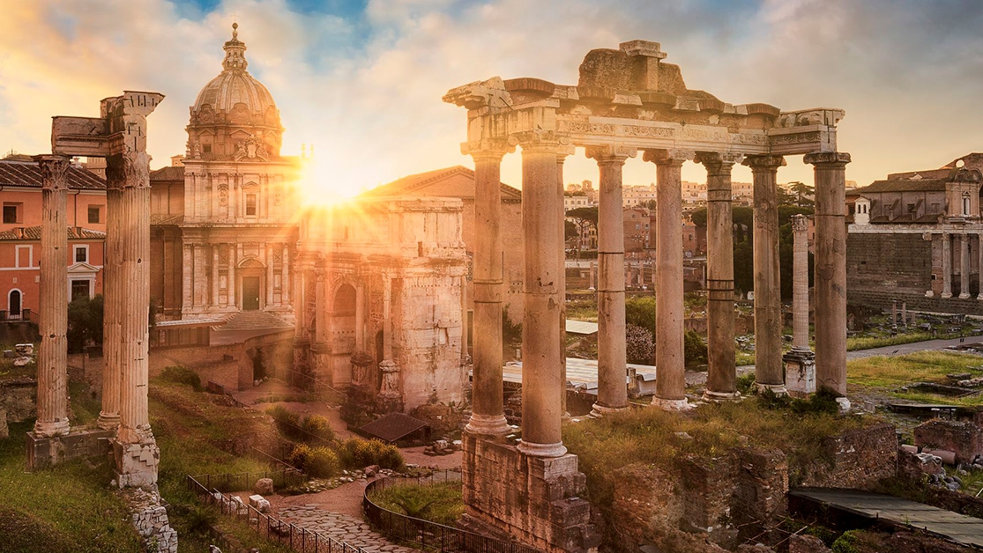
R O M A N S
Salvation
^{Romans} ^{5:1} Therefore, having been justified by faith, we have peace with God through our Lord Jesus Christ, ² through whom also we have obtained our introduction by faith into this grace in which we stand; and we exult in hope of the glory of God.

Slide 3
R O M A N S
Salvation
Salvation by grace through faith apart from works
^{Romans} ^{5:1} Therefore, having been justified by faith, we have peace with God through our Lord Jesus Christ, ² through whom also we have obtained our introduction by faith into this grace in which we stand; and we exult in hope of the glory of God.

Slide 4
R O M A N S
Salvation
Today: the beneficial results of justification
^{Romans} ^{5:1} Therefore, having been justified by faith, we have peace with God through our Lord Jesus Christ, ² through whom also we have obtained our introduction by faith into this grace in which we stand; and we exult in hope of the glory of God.

Slide 5
Justification is just the beginning!
Today: the beneficial results of justification
^{Romans} ^{5:1} Therefore, having been justified by faith, we have peace with God through our Lord Jesus Christ, ² through whom also we have obtained our introduction by faith into this grace in which we stand; and we exult in hope of the glory of God.

Slide 6
Justification is just the beginning!
Today: the beneficial results of justification
kauchaomai: to glory, rejoice, or boast
^{Romans} ^{5:1} Therefore, having been justified by faith, we have peace with God through our Lord Jesus Christ, ² through whom also we have obtained our introduction by faith into this grace in which we stand; and we exult in hope of the glory of God.

Slide 7
Justification is just the beginning!
^{Romans} ^{5:1} Therefore, having been justified by faith, we have peace with God through our Lord Jesus Christ, ² through whom also we have obtained our introduction by faith into this grace in which we stand; and we exult in hope of the glory of God.

Slide 8
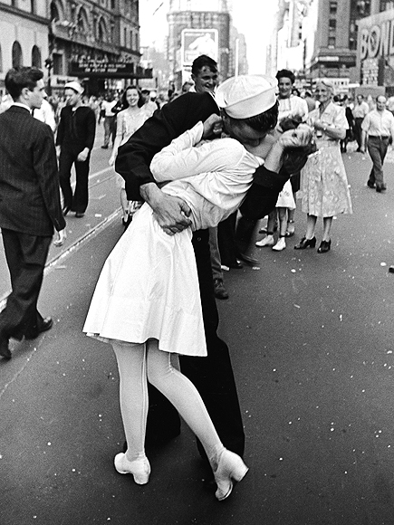
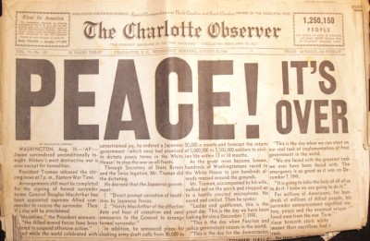
Peace with God
^{Romans} ^{5:1} Therefore, having been justified by faith, we have peace with God through our Lord Jesus Christ, ² through whom also we have obtained our introduction by faith into this grace in which we stand; and we exult in hope of the glory of God.

Slide 9
Peace with God
^{Romans} ^{5:6} For while we were still helpless, at the right time Christ died for the ungodly. ⁷ For one will hardly die for a righteous man; though perhaps for the good man someone would dare even to die. ⁸ But God demonstrates His own love toward us, in that while we were yet sinners, Christ died for us. ⁹ Much more then, having now been justified by His blood, we shall be saved from the wrath of God through Him. ¹⁰ For if while we were enemies we were reconciled to God through the death of His Son, much more, having been reconciled, we shall be saved by His life.

Slide 10
Peace with God
Enemies??
^{Romans} ^{5:6} For while we were still helpless, at the right time Christ died for the ungodly. ⁷ For one will hardly die for a righteous man; though perhaps for the good man someone would dare even to die. ⁸ But God demonstrates His own love toward us, in that while we were yet sinners, Christ died for us. ⁹ Much more then, having now been justified by His blood, we shall be saved from the wrath of God through Him. ¹⁰ For if while we were enemies we were reconciled to God through the death of His Son, much more, having been reconciled, we shall be saved by His life.

Slide 11
Peace with God
^{Romans} ^{5:6} For while we were still helpless, at the right time Christ died for the ungodly. ⁷ For one will hardly die for a righteous man; though perhaps for the good man someone would dare even to die. ⁸ But God demonstrates His own love toward us, in that while we were yet sinners, Christ died for us. ⁹ Much more then, having now been justified by His blood, we shall be saved from the wrath of God through Him. ¹⁰ For if while we were enemies we were reconciled to God through the death of His Son, much more, having been reconciled, we shall be saved by His life.

Slide 12
Peace with God
^{Romans} ^{5:6} For while we were still helpless, at the right time Christ died for the ungodly. ⁷ For one will hardly die for a righteous man; though perhaps for the good man someone would dare even to die. ⁸ But God demonstrates His own love toward us, in that while we were yet sinners, Christ died for us. ⁹ Much more then, having now been justified by His blood, we shall be saved from the wrath of God through Him. ¹⁰ For if while we were enemies we were reconciled to God through the death of His Son, much more, having been reconciled, we shall be saved by His life.

Slide 13
Peace with God
From “ungodly, sinners deserving of wrath”
To “justified, saved, and reconciled”
^{Romans} ^{5:6} For while we were still helpless, at the right time Christ died for the ungodly. ⁷ For one will hardly die for a righteous man; though perhaps for the good man someone would dare even to die. ⁸ But God demonstrates His own love toward us, in that while we were yet sinners, Christ died for us. ⁹ Much more then, having now been justified by His blood, we shall be saved from the wrath of God through Him. ¹⁰ For if while we were enemies we were reconciled to God through the death of His Son, much more, having been reconciled, we shall be saved by His life.

Slide 14
Peace with God
And when did this happen?
^{Romans} ^{5:6} For while we were still helpless, at the right time Christ died for the ungodly. ⁷ For one will hardly die for a righteous man; though perhaps for the good man someone would dare even to die. ⁸ But God demonstrates His own love toward us, in that while we were yet sinners, Christ died for us. ⁹ Much more then, having now been justified by His blood, we shall be saved from the wrath of God through Him. ¹⁰ For if while we were enemies we were reconciled to God through the death of His Son, much more, having been reconciled, we shall be saved by His life.

Slide 15
Peace with God
And when did this happen?
^{Romans} ^{5:6} For while we were still helpless, at the right time Christ died for the ungodly. ⁷ For one will hardly die for a righteous man; though perhaps for the good man someone would dare even to die. ⁸ But God demonstrates His own love toward us, in that while we were yet sinners, Christ died for us. ⁹ Much more then, having now been justified by His blood, we shall be saved from the wrath of God through Him. ¹⁰ For if while we were enemies we were reconciled to God through the death of His Son, much more, having been reconciled, we shall be saved by His life.

Slide 16
Peace with God
And when did this happen?
He took initiative, not us
^{Romans} ^{5:6} For while we were still helpless, at the right time Christ died for the ungodly. ⁷ For one will hardly die for a righteous man; though perhaps for the good man someone would dare even to die. ⁸ But God demonstrates His own love toward us, in that while we were yet sinners, Christ died for us. ⁹ Much more then, having now been justified by His blood, we shall be saved from the wrath of God through Him. ¹⁰ For if while we were enemies we were reconciled to God through the death of His Son, much more, having been reconciled, we shall be saved by His life.

Slide 17
Peace with God
And when did this happen?
He took initiative, not us
^{Romans} ^{5:6} For while we were still helpless, at the right time Christ died for the ungodly. ⁷ For one will hardly die for a righteous man; though perhaps for the good man someone would dare even to die. ⁸ But God demonstrates His own love toward us, in that while we were yet sinners, Christ died for us. ⁹ Much more then, having now been justified by His blood, we shall be saved from the wrath of God through Him. ¹⁰ For if while we were enemies we were reconciled to God through the death of His Son, much more, having been reconciled, we shall be saved by His life.

Slide 18
Peace with God
And when did this happen?
He took initiative, not us
A demonstration of his gracious love
^{Romans} ^{5:6} For while we were still helpless, at the right time Christ died for the ungodly. ⁷ For one will hardly die for a righteous man; though perhaps for the good man someone would dare even to die. ⁸ But God demonstrates His own love toward us, in that while we were yet sinners, Christ died for us. ⁹ Much more then, having now been justified by His blood, we shall be saved from the wrath of God through Him. ¹⁰ For if while we were enemies we were reconciled to God through the death of His Son, much more, having been reconciled, we shall be saved by His life.

Slide 19
Peace with God
And when did this happen?
If I did not cause his grace in any way, it means that I likewise cannot cause it to fail.
^{Romans} ^{5:6} For while we were still helpless, at the right time Christ died for the ungodly. ⁷ For one will hardly die for a righteous man; though perhaps for the good man someone would dare even to die. ⁸ But God demonstrates His own love toward us, in that while we were yet sinners, Christ died for us. ⁹ Much more then, having now been justified by His blood, we shall be saved from the wrath of God through Him. ¹⁰ For if while we were enemies we were reconciled to God through the death of His Son, much more, having been reconciled, we shall be saved by His life.

Slide 20
Peace with God
And when did this happen?
^{Romans} ^{5:6} For while we were still helpless, at the right time Christ died for the ungodly. ⁷ For one will hardly die for a righteous man; though perhaps for the good man someone would dare even to die. ⁸ But God demonstrates His own love toward us, in that while we were yet sinners, Christ died for us. ⁹ Much more then, having now been justified by His blood, we shall be saved from the wrath of God through Him. ¹⁰ For if while we were enemies we were reconciled to God through the death of His Son, much more, having been reconciled, we shall be saved by His life.
Katallasso: “reconcile”
(to bring two things at odds back into agreement)

Slide 21
Peace with God
^{Romans} ^{5:10 NLT} For since our friendship with God was restored by the death of his Son while we were still his enemies, we will certainly be saved through the life of his Son.

Slide 22
Peace with God
This goes beyond the judicial ruling of justification
Jesus can restore our relationship as friends of God
^{Romans} ^{5:10 NLT} For since our friendship with God was restored by the death of his Son while we were still his enemies, we will certainly be saved through the life of his Son.

Slide 23
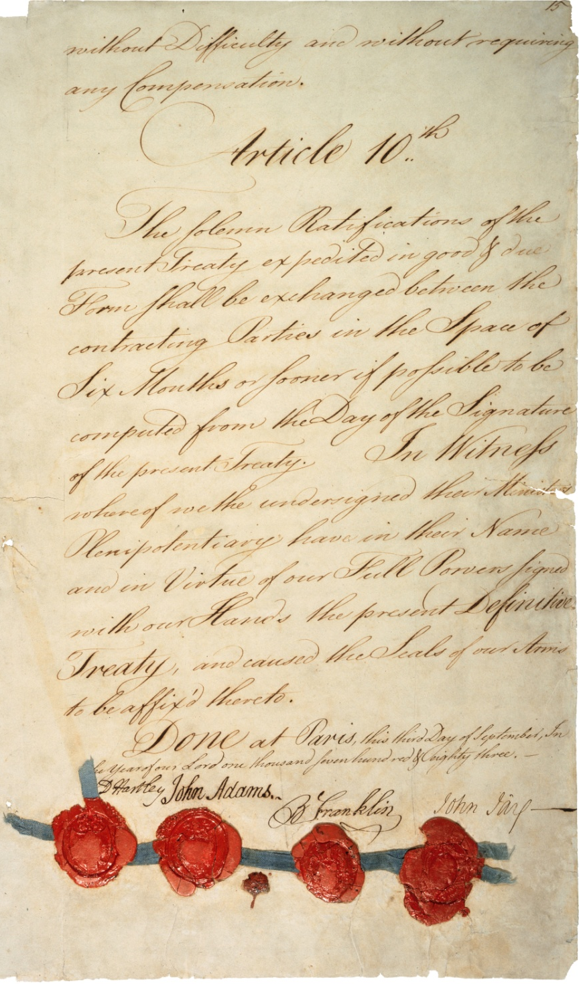
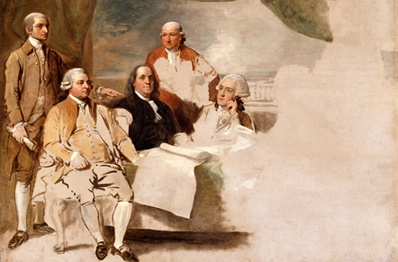
Peace with God
God: “I want more than peace, I want reconciliation!”

Slide 24
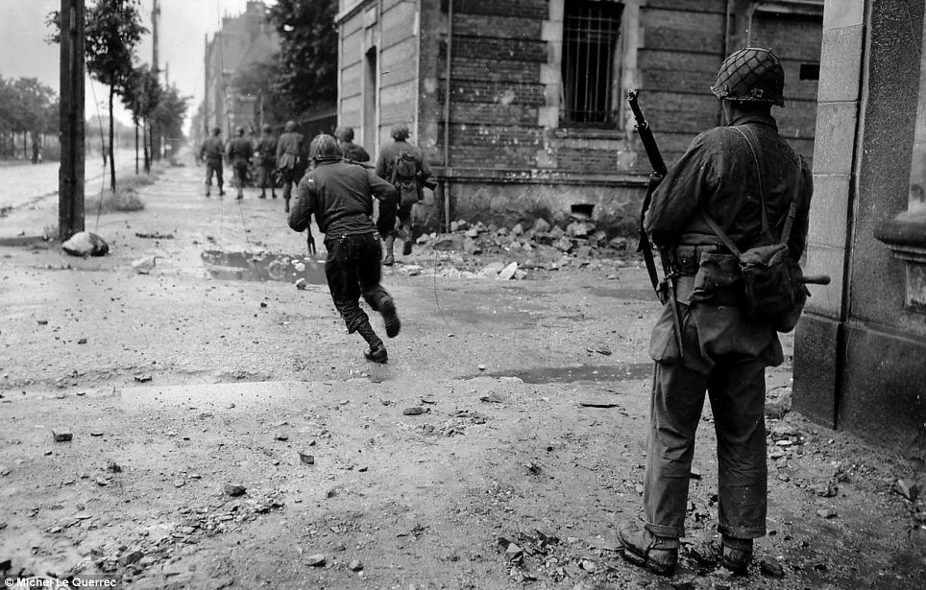
Peace: a concrete reality that trickles down into every aspect of life

Slide 25
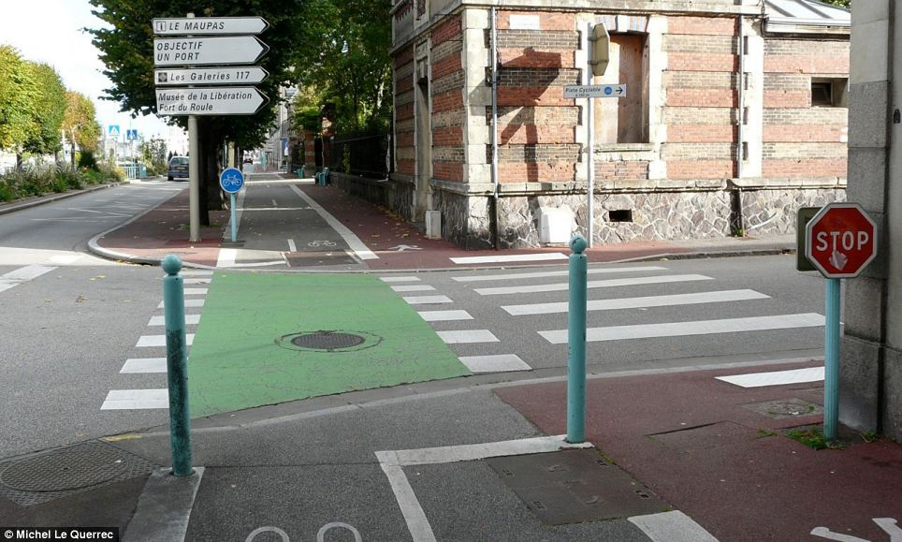
Peace: a concrete reality that trickles down into every aspect of life

Slide 26
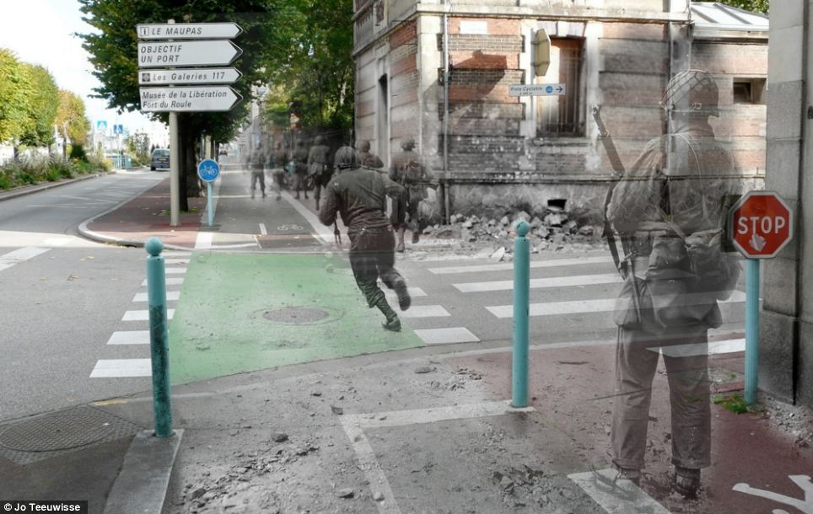
Peace: a concrete reality that trickles down into every aspect of life

Slide 27
We have peace with God!
More than just a “status”
A way of life that should impact how we think, feel and live every part of every single day

Slide 28
But Paul is not done exalting …
^{Romans} ^{5:1} Therefore, having been justified by faith, we have peace with God through our Lord Jesus Christ, ² through whom also we have obtained our introduction by faith into this grace in which we stand; and we exult in hope of the glory of God.

Slide 29
But Paul is not done exalting …
Prosagōgē: “to bring or summon, approach, access”
^{Romans} ^{5:1} Therefore, having been justified by faith, we have peace with God through our Lord Jesus Christ, ² through whom also we have obtained our introduction by faith into this grace in which we stand; and we exult in hope of the glory of God.

Slide 30
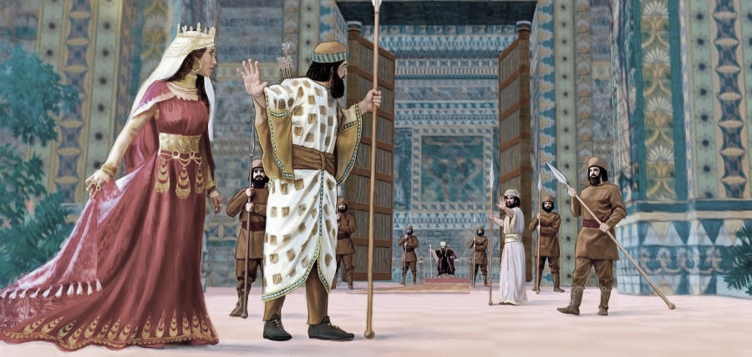
But Paul is not done exalting …
^{Esther 4:11} “all the kings servants and the people of the king’s provinces know that for any man or woman who comes to the king to the inner court who is not summoned, he has but one law, that he be put to death, unless the king holds out to him the golden scepter so that he may live.

Slide 31
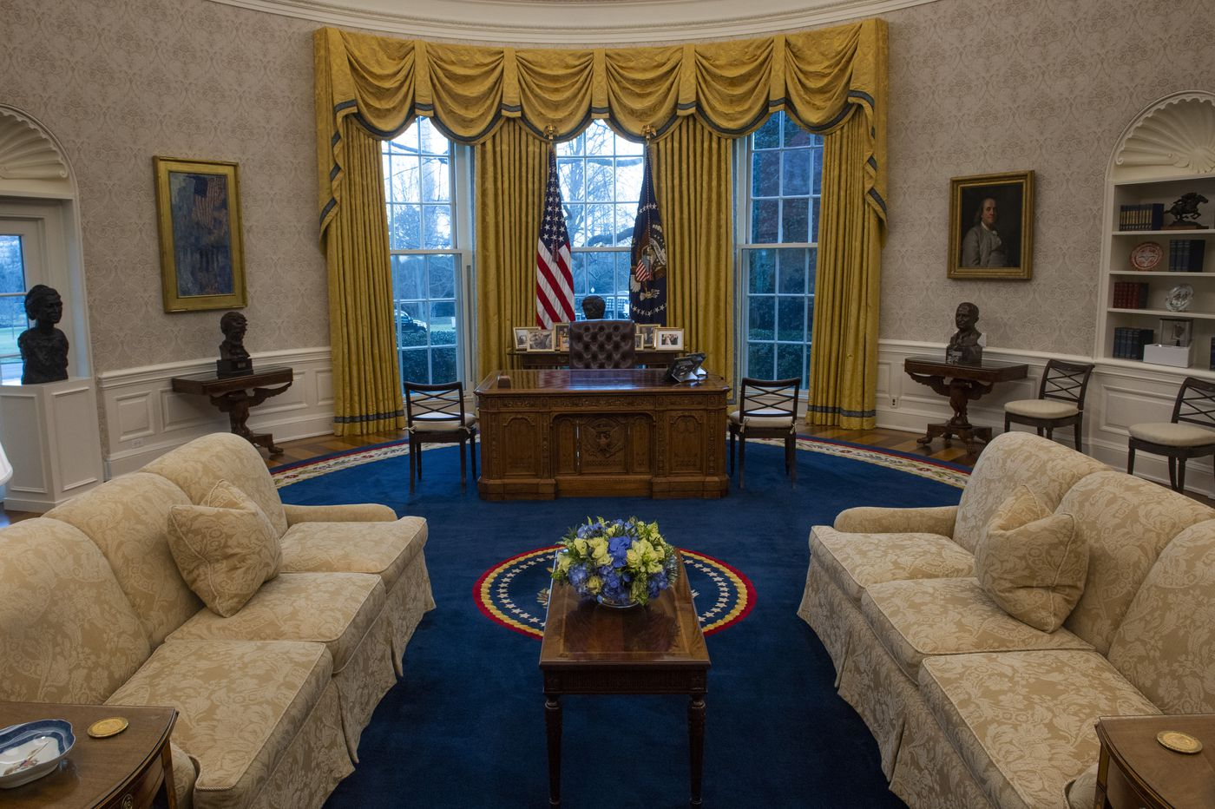

Slide 32
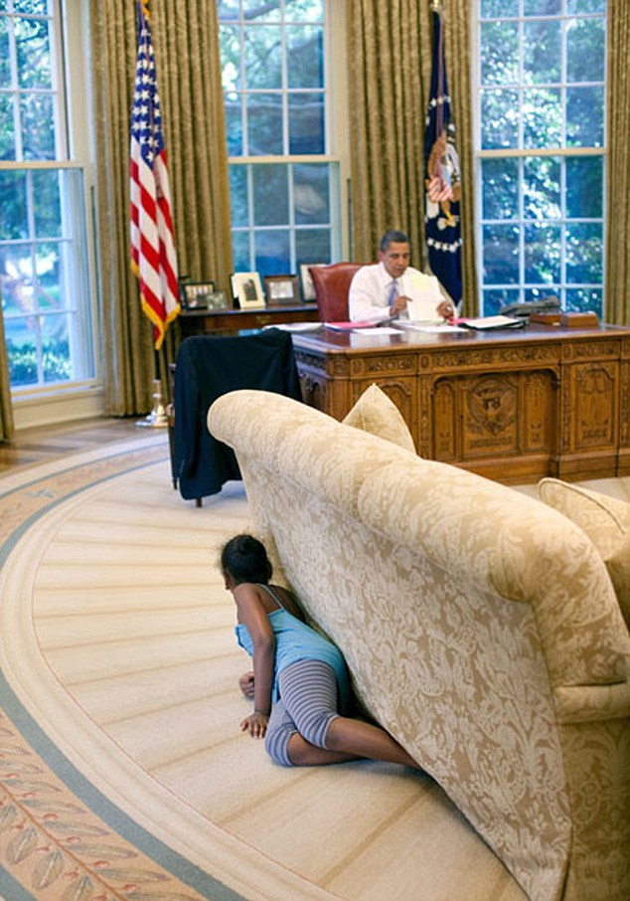

Slide 33
But Paul is not done exalting …
^{Hebrews 4:16} Therefore let us draw near with confidence to the throne of grace, so that we may receive mercy and find grace to help in time of need.
If you have received justification by grace through faith, you have privileged access to God
^{Romans} ^{5:1} Therefore, having been justified by faith, we have peace with God through our Lord Jesus Christ, ² through whom also we have obtained our introduction by faith into this grace in which we stand; and we exult in hope of the glory of God.

Slide 34
But Paul is not done exalting …
^{Hebrews 4:16} Therefore let us draw near with confidence to the throne of grace, so that we may receive mercy and find grace to help in time of need.
A standing invitation to the throne room of God!
And you should put it to use every day!
^{Romans} ^{5:1} Therefore, having been justified by faith, we have peace with God through our Lord Jesus Christ, ² through whom also we have obtained our introduction by faith into this grace in which we stand; and we exult in hope of the glory of God.

Slide 35
The HOPE of future glory
^{Romans} ^{5:1} Therefore, having been justified by faith, we have peace with God through our Lord Jesus Christ, ² through whom also we have obtained our introduction by faith into this grace in which we stand; and we exult in hope of the glory of God.

Slide 36
Peace with God acting in 3 directions
Justification
Glory
Standing
^{Romans} ^{5:1} Therefore, having been justified by faith, we have peace with God through our Lord Jesus Christ, ² through whom also we have obtained our introduction by faith into this grace in which we stand; and we exult in hope of the glory of God.

Slide 37
We “exult in hope”…
^{Romans} ^{5:3} And not only this, but we also exult in our tribulations, knowing that tribulation brings about perseverance; ⁴ and perseverance, proven character; and proven character, hope; ⁵ and hope does not disappoint, because the love of God has been poured out within our hearts through the Holy Spirit who was given to us.

Slide 38
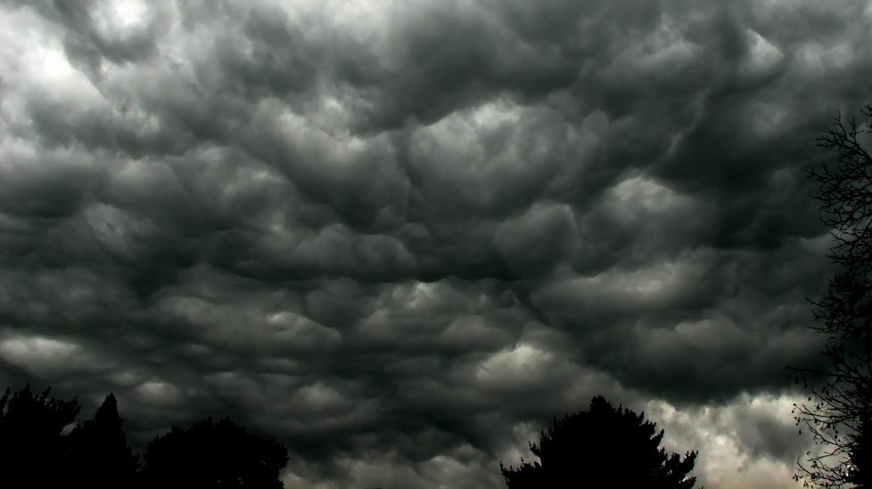
We “exult in hope”…
and we exult in tribulations??
^{Romans} ^{5:3} And not only this, but we also exult in our tribulations, knowing that tribulation brings about perseverance; ⁴ and perseverance, proven character; and proven character, hope; ⁵ and hope does not disappoint, because the love of God has been poured out within our hearts through the Holy Spirit who was given to us.

Slide 39
We “exult in hope”…
and we exult in tribulations??
Because trials and difficulties actually direct our attention to that hope, and bring it into sharper relief
^{Romans} ^{5:3} And not only this, but we also exult in our tribulations, knowing that tribulation brings about perseverance; ⁴ and perseverance, proven character; and proven character, hope; ⁵ and hope does not disappoint, because the love of God has been poured out within our hearts through the Holy Spirit who was given to us.

Slide 40
We “exult in hope”…
and we exult in tribulations??
Our future is so good, that we can be glad when life reminds us to look that direction
^{Romans} ^{5:3} And not only this, but we also exult in our tribulations, knowing that tribulation brings about perseverance; ⁴ and perseverance, proven character; and proven character, hope; ⁵ and hope does not disappoint, because the love of God has been poured out within our hearts through the Holy Spirit who was given to us.

Slide 41
Peace with God gives us a whole new lens through which we can view troubles
Through the lens of hope
^{Romans} ^{5:3} And not only this, but we also exult in our tribulations, knowing that tribulation brings about perseverance; ⁴ and perseverance, proven character; and proven character, hope; ⁵ and hope does not disappoint, because the love of God has been poured out within our hearts through the Holy Spirit who was given to us.

Slide 42
Peace with God gives us a whole new lens through which we can view troubles
Through the lens of hope
Through the lens of God’s work in our character
Through the lens of friendship with God
^{Romans} ^{5:3} And not only this, but we also exult in our tribulations, knowing that tribulation brings about perseverance; ⁴ and perseverance, proven character; and proven character, hope; ⁵ and hope does not disappoint, because the love of God has been poured out within our hearts through the Holy Spirit who was given to us.

Slide 43
Peace with God gives us a whole new lens through which we can view troubles
Through the lens of hope
Through the lens of God’s work in our character
Through the lens of friendship with God
^{Romans} ^{5:3} And not only this, but we also exult in our tribulations, knowing that tribulation brings about perseverance; ⁴ and perseverance, proven character; and proven character, hope; ⁵ and hope does not disappoint, because the love of God has been poured out within our hearts through the Holy Spirit who was given to us.

Slide 44
Peace with God gives us a whole new lens through which we can view troubles
We don’t go through it alone!
His love, “demonstrated” on the cross (vs 8), and “poured out” in our heart
^{Romans} ^{5:3} And not only this, but we also exult in our tribulations, knowing that tribulation brings about perseverance; ⁴ and perseverance, proven character; and proven character, hope; ⁵ and hope does not disappoint, because the love of God has been poured out within our hearts through the Holy Spirit who was given to us.

Slide 45
Peace with God dramatically changes the experience of suffering!
^{Romans} ^{5:3} And not only this, but we also exult in our tribulations, knowing that tribulation brings about perseverance; ⁴ and perseverance, proven character; and proven character, hope; ⁵ and hope does not disappoint, because the love of God has been poured out within our hearts through the Holy Spirit who was given to us.

Slide 46
Peace with God dramatically changes the experience of suffering!
And this happens through the Holy Spirit
“I’m not just going to give you access to My love, I’m going to give you the presence of my love”
^{Romans} ^{5:3} And not only this, but we also exult in our tribulations, knowing that tribulation brings about perseverance; ⁴ and perseverance, proven character; and proven character, hope; ⁵ and hope does not disappoint, because the love of God has been poured out within our hearts through the Holy Spirit who was given to us.

Slide 47
Peace with God dramatically changes the experience of suffering!
You will go through trials, but when you do, you can be in my throne room, and I will be in your heart
^{Romans} ^{5:3} And not only this, but we also exult in our tribulations, knowing that tribulation brings about perseverance; ⁴ and perseverance, proven character; and proven character, hope; ⁵ and hope does not disappoint, because the love of God has been poured out within our hearts through the Holy Spirit who was given to us.

Slide 48
One more observation…
^{Romans} ^{5:1} having been justified … ² also …
^{Romans} ^{5:3} And not only this …
^{Romans} ^{5:9} Much more then, having now been justified by His blood, we shall be saved from the wrath of God through Him. ¹⁰ For if while we were enemies we were reconciled to God through the death of His Son, much more, having been reconciled, we shall be saved by His life.

Slide 49
Much more then…
If this is how he treated me when we were enemies…
If he was willing to do the hard thing on the cross …
If he blessed me this much through his death …
^{Romans} ^{5:9} Much more then, having now been justified by His blood, we shall be saved from the wrath of God through Him. ¹⁰ For if while we were enemies we were reconciled to God through the death of His Son, much more, having been reconciled, we shall be saved by His life.

Slide 50
Much more then…
If this is how he treated me when we were enemies…
If he was willing to do the hard thing on the cross …
If he blessed me this much through his death …
^{Romans} ^{5:9} Much more then, having now been justified by His blood, we shall be saved from the wrath of God through Him. ¹⁰ For if while we were enemies we were reconciled to God through the death of His Son, much more, having been reconciled, we shall be saved by His life.

Slide 51
Much more then…
If this is how he treated me when we were enemies…
If he was willing to do the hard thing on the cross …
If he blessed me this much through his death …
^{Romans} ^{5:9} Much more then, having now been justified by His blood, we shall be saved from the wrath of God through Him. ¹⁰ For if while we were enemies we were reconciled to God through the death of His Son, much more, having been reconciled, we shall be saved by His life.

Slide 52
Justification is just the beginning!
If you think his death was amazing… wait until you see what he can do through his life!
Transitioning to the next section of Romans …
^{Romans} ^{5:9} Much more then, having now been justified by His blood, we shall be saved from the wrath of God through Him. ¹⁰ For if while we were enemies we were reconciled to God through the death of His Son, much more, having been reconciled, we shall be saved by His life.

Slide 53
Justification is just the beginning!
^{Romans} ^{5:11} And not only this, but we also exult in God through our Lord Jesus Christ, through whom we have now received the reconciliation.

Slide 54
Justification is just the beginning!
^{Romans} ^{5:11} And not only this, but we also exult in God through our Lord Jesus Christ, through whom we have now received the reconciliation.

Slide 55
Peace with God

Slide 56
Justification
Salvation
Reconciliation
Access
Hope
Love
Holy Spirit
Life
Joy
Peace with God
These are the terms
You can end your conflict with God once for all
GOD
When you do, these become the facts at the foundation of all your dealings with God

