Slide 3
(Eccl. 3:1) There is a time for everything, and a season for every activity under the heavens:

Slide 4
(Eccl. 3:2) A time to be born and a time to die,
a time to plant and a time to uproot,
³ a time to kill and a time to heal,
a time to tear down and a time to build up,
⁴ a time to weep and a time to laugh,
a time to mourn and a time to dance

Slide 5
(Eccl. 3:5) A time to scatter stones and a time to gather them,
a time to embrace and a time to refrain from embracing,
⁶ a time to search and a time to give up,
a time to keep and a time to throw away,

Slide 6
(Eccl. 3:7) A time to tear and a time to mend,
a time to be silent and a time to speak,
⁸ a time to love and a time to hate,
a time for war and a time for peace.
Is this a positive section?
Some think so.
Michael A. Eaton, Ecclesiastes (1983), p.90.
J. Stafford Wright, Ecclesiastes (1991), p.1160.

Slide 8
(Eccl. 3:7) A time to tear and a time to mend,
a time to be silent and a time to speak,
⁸ a time to love and a time to hate,
a time for war and a time for peace.
If this is wisdom literature,
what exactly does it teach us?
Mutually self-destructing claims.
Born… dead
Plant… uproot
Heal… kill
Build up… tear down
Laugh… weep
Dance… mourn
We’re still “under heaven” (v.1).
“Toil” (v.9) and “burden” (v.10).
Is this a positive section?
Some think so.
Michael A. Eaton, Ecclesiastes (1983), p.90.
J. Stafford Wright, Ecclesiastes (1991), p.1160.
Others think not.
Derek Kidner, The Message of Ecclesiastes (1984), 38.
Duane A. Garrett, Ecclesiastes, (1993), 298.

Slide 9
(Eccl. 3:9) What do workers gain from their toil?
¹⁰ I have seen the burden God has laid on the human race.
The curtain lifts temporarily…

Slide 10
(Eccl. 3:11) God has made everything beautiful in its time.
He has also set
eternity in the human heart.
Yet no one can fathom what God has done from beginning to end.
We are torn between time and eternity!
Will my life count for something in the end?
Am I part of some sort of plan?
Does any of this mean anything?

Slide 11
(Eccl. 3:16) And I saw something else under the sun:
The curtain closes once again…

Slide 12
(Eccl. 3:16) And I saw something else under the sun: In the place of judgment—wickedness was there.
In the place of justice—wickedness was there.
¹⁷ I said to myself, “God will bring into judgment both the righteous and the wicked, for there will be a time for every activity, a time to judge every deed.”

Slide 13
(Eccl. 3:18) I also said to myself,
“As for humans, God tests them so that they may see that they are like the animals.”
¹⁹ “Surely the fate of human beings is like that of the animals. The same fate awaits them both: As one dies, so dies the other. All have the same breath.
Humans have no advantage over animals. Everything is meaningless.”

Slide 14
(Eccl. 3:20) “All go to the same place. All come from dust, and to dust all return.”
²¹ “Who knows if the human spirit rises upward and if the spirit of the animal goes down into the earth?”
(Eccl. 7:2) Better to spend your time at funerals than at parties. After all, everyone dies—so the living should take this to heart.
⁴ A wise person thinks a lot about death, while a fool thinks only about having a good time.

Slide 15
(Eccl. 3:20) “All go to the same place. All come from dust, and to dust all return.”
²¹ “Who knows if the human spirit rises upward and if the spirit of the animal goes down into the earth?”
OPTION #1. Your loved ones will live to see you die by an accident, by murder, or by disease.
OPTION #2. You will live long enough to see your loved ones die by an accident, by murder, or by disease.

Slide 16
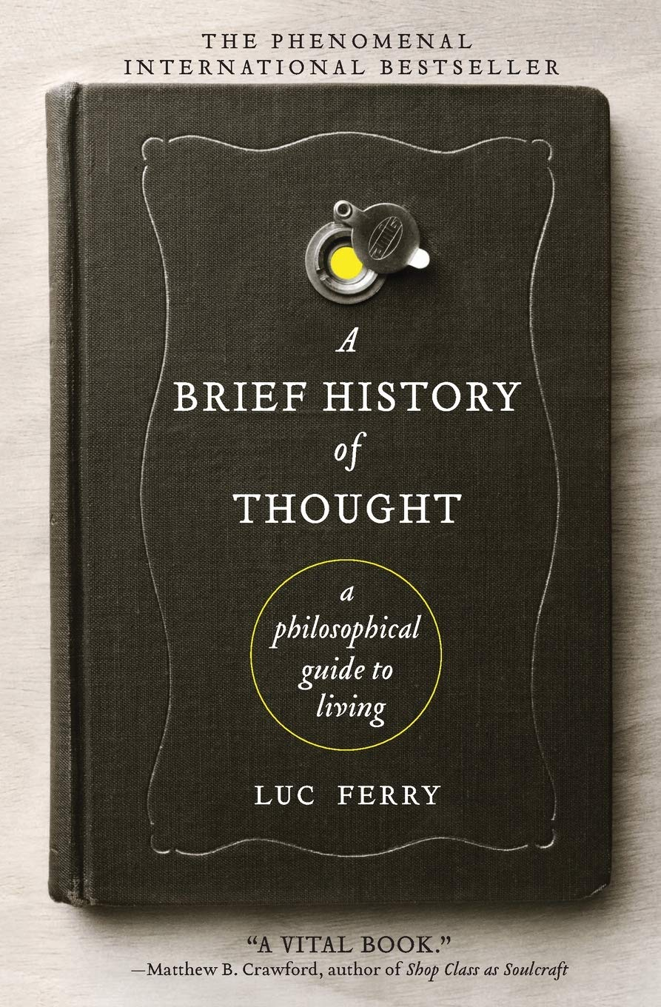
Luc Ferry
(French secular philosopher)
Luc Ferry, A Brief History of Thought: A Philosophical Guide to Living, trans. Theo Cuffe (New York: Harper, 2010), 2-3, 12.
“[A human] knows that he will die, and that his near ones, those he loves, will also die.”

Slide 17
Luc Ferry
(French secular philosopher)
Luc Ferry, A Brief History of Thought: A Philosophical Guide to Living, trans. Theo Cuffe (New York: Harper, 2010), 2-3, 12.
“Consequently he cannot prevent himself from thinking about this state of affairs, which is disturbing and absurd, almost unimaginable…”

Slide 18
Luc Ferry
(French secular philosopher)
Luc Ferry, A Brief History of Thought: A Philosophical Guide to Living, trans. Theo Cuffe (New York: Harper, 2010), 2-3, 12.
“The quest for a salvation without God
is at the heart of every great philosophical system,
and that is its essential and ultimate objective.”

Slide 19
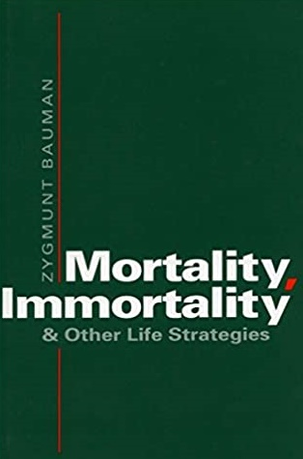
Zygmunt Bauman
(Sociologist and philosopher)
Zygmunt Bauman, Mortality, Immortality, and Other Life Strategies (Stanford: Stanford University Press, 1992), 12, 13.
“The horror of death is the horror of the void”
and it is “bound to remain, traumatic.”

Slide 20
Irvin D. Yalom
(Psychiatrist, Epicurean philosophy)
Irvin D. Yalom, Staring at the Sun: Overcoming the Terror of Death (San Francisco: Wiley, 2008), vii.
“I share the fear of death with every human being: it is our dark shadow from which we are never severed.”

Slide 21
Irvin D. Yalom
(Psychiatrist, Epicurean philosophy)
Irvin D. Yalom, Staring at the Sun: Overcoming the Terror of Death (San Francisco: Wiley, 2008), 5-6.
“Despite the staunchest, most venerable defenses, we can never completely subdue death anxiety:
it is always there, lurking in some hidden ravine of the mind.”

Slide 22
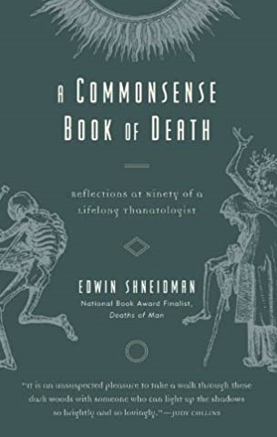
Edwin Shneidman
(Thanatologist)
Edwin Shneidman, A Commonsense Book of Death (New York: Rowman & Littlefield, 2008), p.34.
“To cease as though one had never been, to exit life with no hope of living on in the memory of another, to be expunged from history’s record—that is a fate literally far worse than death.”

Slide 23
Edwin Shneidman
(Thanatologist)
Edwin Shneidman, A Commonsense Book of Death (New York: Rowman & Littlefield, 2008), p.34.
“To cease as though one had never been, to exit life with no hope of living on in the memory of another, to be expunged from history’s record—that is a fate literally far worse than death.”

Slide 24
Solutions?
Denial?
Why won’t you think about death, when it’s the most certain fact of your existence?

Slide 25
Solutions?
Denial?
Good causes?
(Eccl. 4:1) I observed all the oppression under the sun.
² I concluded that the dead are better off than the living.
³ But most fortunate of all are those who are not yet born.
They have not seen all the evil that is done under the sun.

Slide 26
Solutions?
Denial?
Good causes?
Philanthropic causes don’t prolong life as much as they postpone death.
(Eccl. 4:1) I observed all the oppression under the sun.
² I concluded that the dead are better off than the living.
³ But most fortunate of all are those who are not yet born.
They have not seen all the evil that is done under the sun.

Slide 32
Solutions?
Denial?
Good causes?
Philanthropic causes don’t prolong life as much as they postpone death.
(Eccl. 4:1) I observed all the oppression under the sun.
² I concluded that the dead are better off than the living.
³ But most fortunate of all are those who are not yet born. They have not seen all the evil that is done under the sun.

Slide 33
Does the Fear of Death lead to Distraction?
#1. Given a flyer to help with “back pain.”
#2. Given a flyer to help with “fear of death.”
“Alcoholic or non-alcoholic beverage?”
Tsachi Ein-Dor et al., “Implicit Death Primes Increase Alcohol Consumption,” Health Psychology 33, no. 7 (2013): 748-51.
Solutions?
Denial?
Good causes?
Distractions?

Slide 34
Solutions?
Denial?
Good causes?
Distractions?
Does the Fear of Death lead to Distraction?
#1. Given a flyer to help with “back pain.”
#2. Given a flyer to help with “fear of death.”
“Alcoholic or non-alcoholic beverage?”
Tsachi Ein-Dor et al., “Implicit Death Primes Increase Alcohol Consumption,” Health Psychology 33, no. 7 (2013): 748-51.
It’s hard to enjoy yourself when the reality of death hangs over your head!

Slide 35
Solutions?
Denial?
Good causes?
Distractions?
Career?

Slide 36
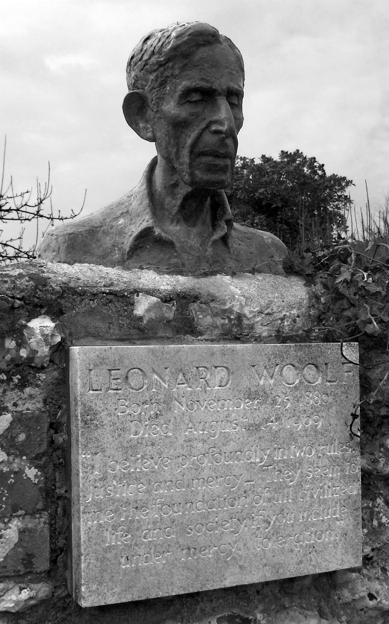
Leonard Wolff
(Politician, author, husband of Virginia Woolf)
Leonard Woolf, The Journey Not the Arrival Matters: An Autobiography of the Years 1939 to 1969 (London: The Hogarth Press, 1973), 157-158.
What was the use of all this work?
Was it of the slightest importance?
Did it achieve anything substantial of what it was intended to achieve?

Slide 37
Leonard Wolff
(Politician, author, husband of Virginia Woolf)
Leonard Woolf, The Journey Not the Arrival Matters: An Autobiography of the Years 1939 to 1969 (London: The Hogarth Press, 1973), 157-158.
Looking back at the age of eighty-eight over the fifty-seven years of my political work in England,
knowing what I aimed at and the results… I see clearly that I achieved practically nothing.

Slide 38
Leonard Wolff
(Politician, author, husband of Virginia Woolf)
Leonard Woolf, The Journey Not the Arrival Matters: An Autobiography of the Years 1939 to 1969 (London: The Hogarth Press, 1973), 157-158.
…The history of the human anthill during the last fifty-seven years would be exactly the same
as it is if I had played pingpong instead of sitting on committees and writing books and memoranda.

Slide 39
Leonard Wolff
(Politician, author, husband of Virginia Woolf)
Leonard Woolf, The Journey Not the Arrival Matters: An Autobiography of the Years 1939 to 1969 (London: The Hogarth Press, 1973), 157-158.
I have therefore to make the rather ignominious confession… that I must have in a long life ground through between 150,000 and 200,000 hours of perfectly useless work.

Slide 40
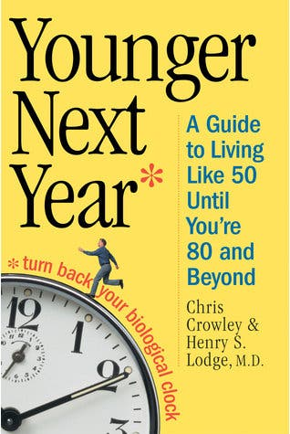
Solutions?
Denial?
Good causes?
Distractions?
Career?
Health & fitness?
Died of cancer at age 70.
Died of cancer at age 66.
Died of cancer at age 58.
Died on a run at age 52.

Slide 41
Solutions?
Denial?
Good causes?
Distractions?
Career?
Health & fitness?
Have kids?
(Eccl. 2:18) I came to hate all my hard work here on earth,
for I must leave to others everything I have earned.
¹⁹ And who can tell whether my successors will be wise or foolish? Yet they will control everything I have gained by my skill and hard work under the sun. How meaningless!

Slide 42
Solutions?
Denial?
Good causes?
Distractions?
Career?
Health & fitness?
Have kids?
(Eccl. 2:18) I came to hate all my hard work here on earth,
for I must leave to others everything I have earned.
¹⁹ And who can tell whether my successors will be wise or foolish? Yet they will control everything I have gained by my skill and hard work under the sun. How meaningless!
What if you never have kids?
10th generation? (0.05% genes)
If meaning comes from kids,
then I’m having kids to exploit them for my benefit!

Slide 43
Solutions?
Denial?
Good causes?
Distractions?
Career?
Health & fitness?
Have kids?
Emotional detachment?

Slide 44
Elizabeth Kübler-Ross
(Secular psychologist)
Elisabeth Kübler-Ross, On Death and Dying (New York: Scribner, 2014), 109-110.
“[The terminally ill] will reach a stage during which he is neither depressed nor angry about his ‘fate.’
…Acceptance should not be mistaken for a happy stage.
It is almost void of feelings.”

Slide 45
Solutions?
Denial?
Good causes?
Distractions?
Career?
Health & fitness?
Have kids?
Emotional detachment?
Horrific!

Slide 46
Luc Ferry
(French secular philosopher)
Luc Ferry, A Brief History of Thought: A Philosophical Guide to Living, trans. Theo Cuffe (New York: Harper, 2010), 261.
“Compared to Christianity—whose promise of the resurrection of the body means that we shall be reunited with those we love after death—a humanism without metaphysics is small beer.”

Slide 47
Luc Ferry
(French secular philosopher)
Luc Ferry, A Brief History of Thought: A Philosophical Guide to Living, trans. Theo Cuffe (New York: Harper, 2010), 261.
“I grant you that amongst the available doctrines of salvation,
nothing can compete with Christianity
—provided, that is, that you are a believer.”

Slide 48
Luc Ferry
(French secular philosopher)
Luc Ferry, A Brief History of Thought: A Philosophical Guide to Living, trans. Theo Cuffe (New York: Harper, 2010), 261.
(Eccl. 3:11) God set eternity in the human heart.
(Eccl. 12:7) The dust will return to the earth,
and the spirit will return to God who gave it.
¹³ Here now is my final conclusion: Fear God and obey his commands, for this is everyone’s duty.
¹⁴ God will judge us for everything we do,
including every secret thing, whether good or bad.
“I grant you that amongst the available doctrines of salvation,
nothing can compete with Christianity
—provided, that is, that you are a believer.”

Slide 49
Luc Ferry
(French secular philosopher)
Luc Ferry, A Brief History of Thought: A Philosophical Guide to Living, trans. Theo Cuffe (New York: Harper, 2010), 261.
If you want to come to know God…
He will fill your life with ultimate significance and anticipation of the future.
You will never have to worry about what will happen to you when you die.
Not even death will be able to rob your joy.
“I grant you that amongst the available doctrines of salvation,
nothing can compete with Christianity
—provided, that is, that you are a believer.”

Slide 51
The Third Noble Truth
Suffering will cease if we give up our attachment to our cravings and attachments.
Siddhartha Gautama
Left his wife and newborn son to become “enlightened.”
Lewis Hopfe, Religions of the World (4th ed. London: MacMillan, 1987), p.147.

