Slide 2
Jesus One on One
John 4

Slide 3
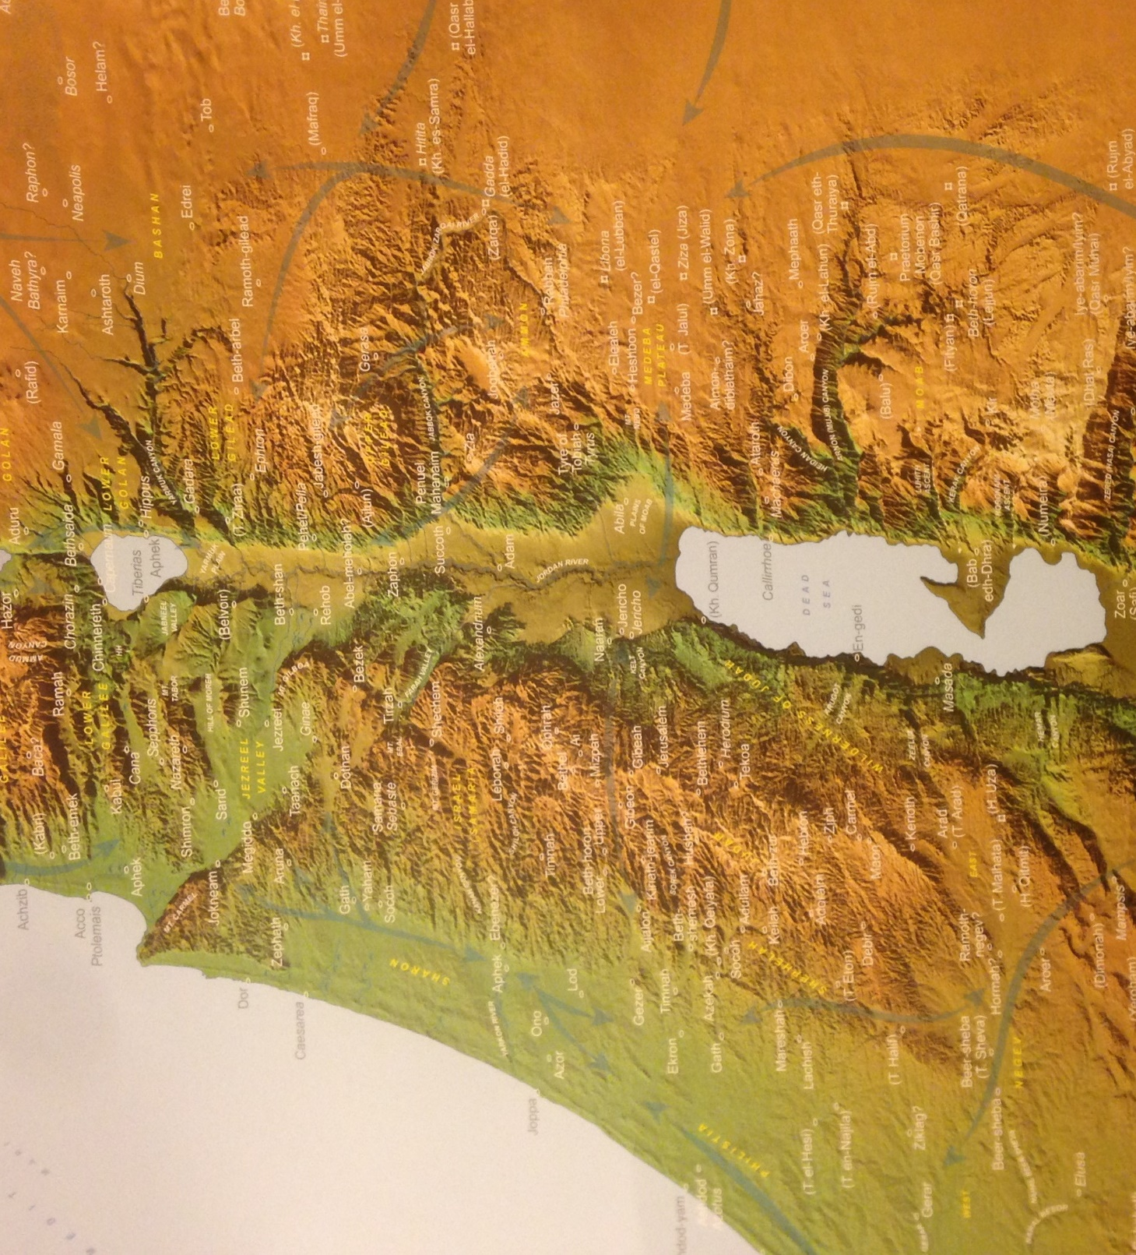
^{John 4:1} Jesus knew the Pharisees had heard that he was baptizing and making more disciples than John ² (though Jesus himself didn’t baptize them—his disciples did). ³ So he left Judea and returned to Galilee. ⁴ He had to go through Samaria on the way.
^{John 4:1} Jesus knew the Pharisees had heard that he was baptizing and making more disciples than John ² (though Jesus himself didn’t baptize them—his disciples did). ³ So he left Judea and returned to Galilee. ⁴ He had to go through Samaria on the way.
Galilee
Jesus One on One
Judea
Jerusalem

Slide 4
^{John 4:1} Jesus knew the Pharisees had heard that he was baptizing and making more disciples than John ² (though Jesus himself didn’t baptize them—his disciples did). ³ So he left Judea and returned to Galilee. ⁴ He had to go through Samaria on the way.
^{John 4:1} Jesus knew the Pharisees had heard that he was baptizing and making more disciples than John ² (though Jesus himself didn’t baptize them—his disciples did). ³ So he left Judea and returned to Galilee. ⁴ He had to go through Samaria on the way.
^{John 4:1} Jesus knew the Pharisees had heard that he was baptizing and making more disciples than John ² (though Jesus himself didn’t baptize them—his disciples did). ³ So he left Judea and returned to Galilee. ⁴ He had to go through Samaria on the way.
Galilee
Samaria
Judea
Jerusalem

Slide 5
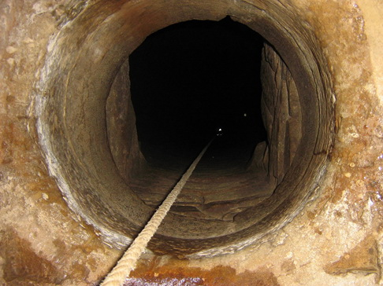
^{John 4:1} Jesus knew the Pharisees had heard that he was baptizing and making more disciples than John ² (though Jesus himself didn’t baptize them—his disciples did). ³ So he left Judea and returned to Galilee. ⁴ He had to go through Samaria on the way.
^{John 4:1} Jesus knew the Pharisees had heard that he was baptizing and making more disciples than John ² (though Jesus himself didn’t baptize them—his disciples did). ³ So he left Judea and returned to Galilee. ⁴ He had to go through Samaria on the way.
^{John 4:5} Eventually he came to the Samaritan village of Sychar, near the field that Jacob gave to his son Joseph.
Jacob’s well was there; and Jesus, tired from the long walk, sat wearily beside the well about noontime.
Galilee
Samaria
Judea
Jerusalem

Slide 6
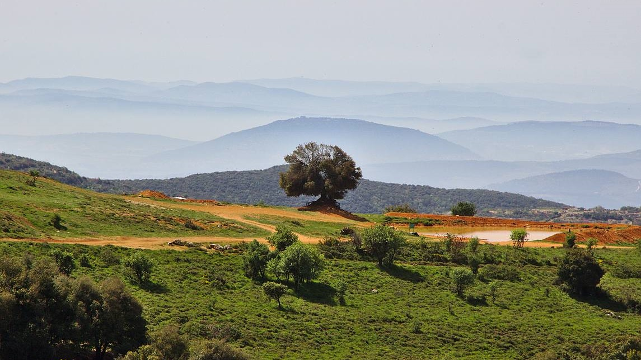
^{4:7} “please give me a drink.”
^{John 4:7} Soon a Samaritan woman came to draw water, and Jesus said to her,

Slide 7
Jesus One on One: Jesus and the Samaritan Woman
^{4:7} “please give me a drink.”
^{John 4:7} Soon a Samaritan woman came to draw water, and Jesus said to her … ⁸ He was alone at the time because his disciples had gone into the village to buy some food.

Slide 8
Jesus One on One: Jesus and the Samaritan Woman
^{4:7} “please give me a drink.”
^{4:9} “You are a Jew, and I am a Samaritan woman. Why are you asking me for a drink?”
^{John 4:8} He was alone at the time because his disciples had gone into the village to buy some food. ⁹ The woman was surprised, for Jews refuse to have anything to do with Samaritans. She said to Jesus,
^{John 4:9} The woman was surprised, for Jews refuse to have anything to do with Samaritans. She said to Jesus,

Slide 9
Jesus One on One: Jesus and the Samaritan Woman
^{4:10} “If only you knew the gift God has for you and who you are speaking to, you would ask me, and I would give you living water.”
^{4:11} “But sir, you don’t have a rope or a bucket,” she said, “and this well is very deep. Where would you get this living water?
^{John 4:10} Jesus replied,

Slide 10
Jesus One on One: Jesus and the Samaritan Woman
^{John 4:12} And besides, do you think you’re greater than our ancestor Jacob, who gave us this well? How can you offer better water than he and his sons and his animals enjoyed?”
^{4:10} “If only you knew the gift God has for you and who you are speaking to, you would ask me, and I would give you living water.”
^{John 4:10} Jesus replied,

Slide 11
Jesus One on One: Jesus and the Samaritan Woman
^{4:13} “Anyone who drinks this water will soon become thirsty again. ¹⁴ But those who drink the water I give will never be thirsty again. It becomes a fresh, bubbling spring within them, giving them eternal life.”
^{4:15} “Please, sir,” the woman said, “give me this water! Then I’ll never be thirsty again, and I won’t have to come here to get water.”
^{John 4:13} And Jesus replied,

Slide 12
Jesus One on One: Jesus and the Samaritan Woman
^{4:16} “ Go and get your husband,”
^{John 4:16} Jesus told her.

Slide 13
Jesus One on One: Jesus and the Samaritan Woman
^{4:16} “ Go and get your husband,”
^{4:17} “I don’t have a husband,”
^{John 4:16} Jesus told her.
^{4:17} the woman replied.

Slide 14
Jesus One on One: Jesus and the Samaritan Woman
^{4:17} “You’re right! You don’t have a husband – ¹⁸ for you have had five husbands, and you aren’t even married to the man you’re living with now. You certainly spoke the truth!”
^{4:19} “Sir, you must be a prophet…”
^{John 4:17} Jesus said
^{4:19} the woman said,

Slide 15
Jesus One on One: Jesus and the Samaritan Woman
^{4:17} “You’re right! You don’t have a husband – ¹⁸ for you have had five husbands, and you aren’t even married to the man you’re living with now. You certainly spoke the truth!”
^{4:19} “Sir, you must be a prophet…”
^{John 4:17} Jesus said
^{4:19} the woman said,

Slide 16
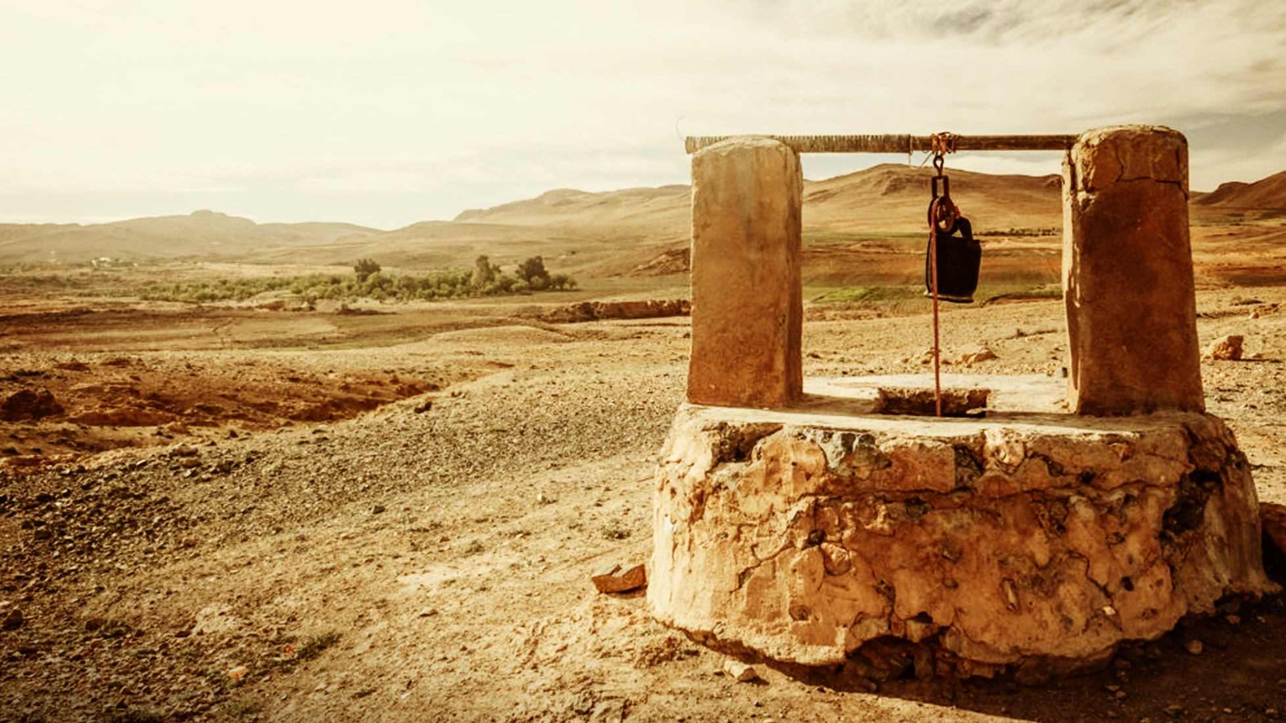
Thirst
^{Psalm 42:1} As the deer longs for streams of water, so I long for you, O God. I thirst for God, the living God. When can I go and stand before him?

Slide 17
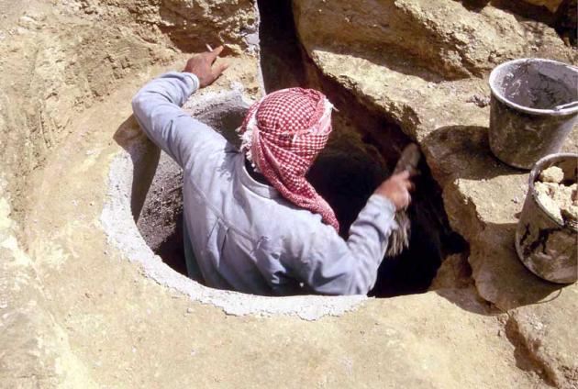
A relationship with God is the only thing that can quench your thirst
Thirst
^{Jeremiah 2:13} For my people have done two evil things: They have abandoned me – the fountain of living water. And they have dug for themselves cracked cisterns that can hold no water at all!

Slide 18
A relationship with God is the only thing that can quench your thirst
Thirst
^{Jeremiah 2:13} For my people have done two evil things: They have abandoned me – the fountain of living water. And they have dug for themselves cracked cisterns that can hold no water at all!

Slide 19
A relationship with God is the only thing that can quench your thirst
Thirst
^{John 4:10} Jesus replied, “If only you knew the gift God has for you…
¹⁴ But those who drink the water I give will never be thirsty again. It becomes a fresh, bubbling spring within them, giving them eternal life.”
¹⁴ But those who drink the water I give will never be thirsty again. It becomes a fresh, bubbling spring within them, giving them eternal life.”

Slide 20
A relationship with God is the only thing that can quench your thirst
Thirst
^{John 4:10} Jesus replied, “If only you knew the gift God has for you…
¹⁴ But those who drink the water I give will never be thirsty again. It becomes a fresh, bubbling spring within them, giving them eternal life.”
¹⁴ But those who drink the water I give will never be thirsty again. It becomes a fresh, bubbling spring within them, giving them eternal life.”
¹⁴ But those who drink the water I give will never be thirsty again. It becomes a fresh, bubbling spring within them, giving them eternal life.”

Slide 21
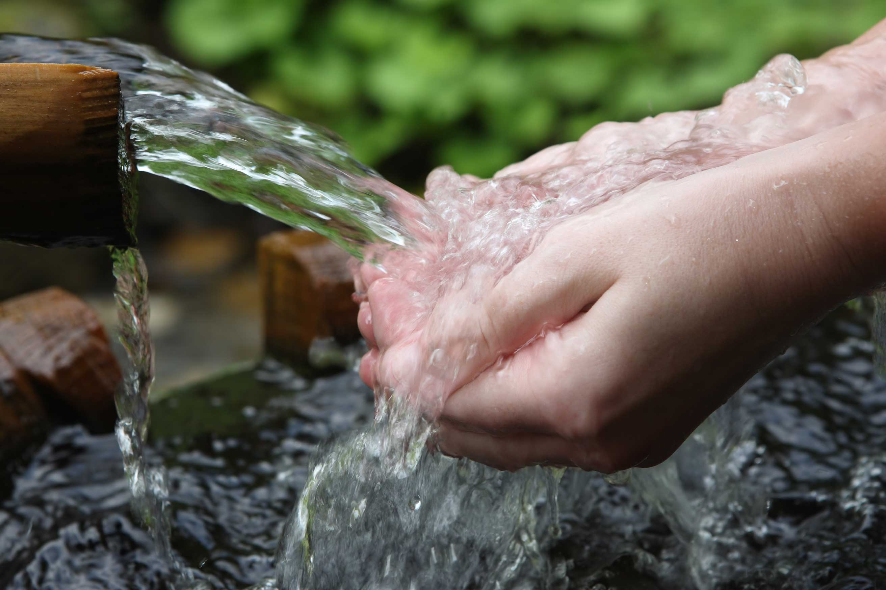
A relationship with God is the only thing that can quench your thirst
Thirst
^{John 4:10} Jesus replied, “If only you knew the gift God has for you…
¹⁴ But those who drink the water I give will never be thirsty again. It becomes a fresh, bubbling spring within them, giving them eternal life.”
¹⁴ But those who drink the water I give will never be thirsty again. It becomes a fresh, bubbling spring within them, giving them eternal life.”
¹⁴ But those who drink the water I give will never be thirsty again. It becomes a fresh, bubbling spring within them, giving them eternal life.”

Slide 22
A relationship with God is the only thing that can quench your thirst
Thirst
^{John 7:37} “If anyone is thirsty, let him come to Me and drink. He who believes in Me, as the Scripture said, ‘from his innermost being will flow rivers of living water.’”

Slide 23
The
relationship
you were
made for

Slide 24
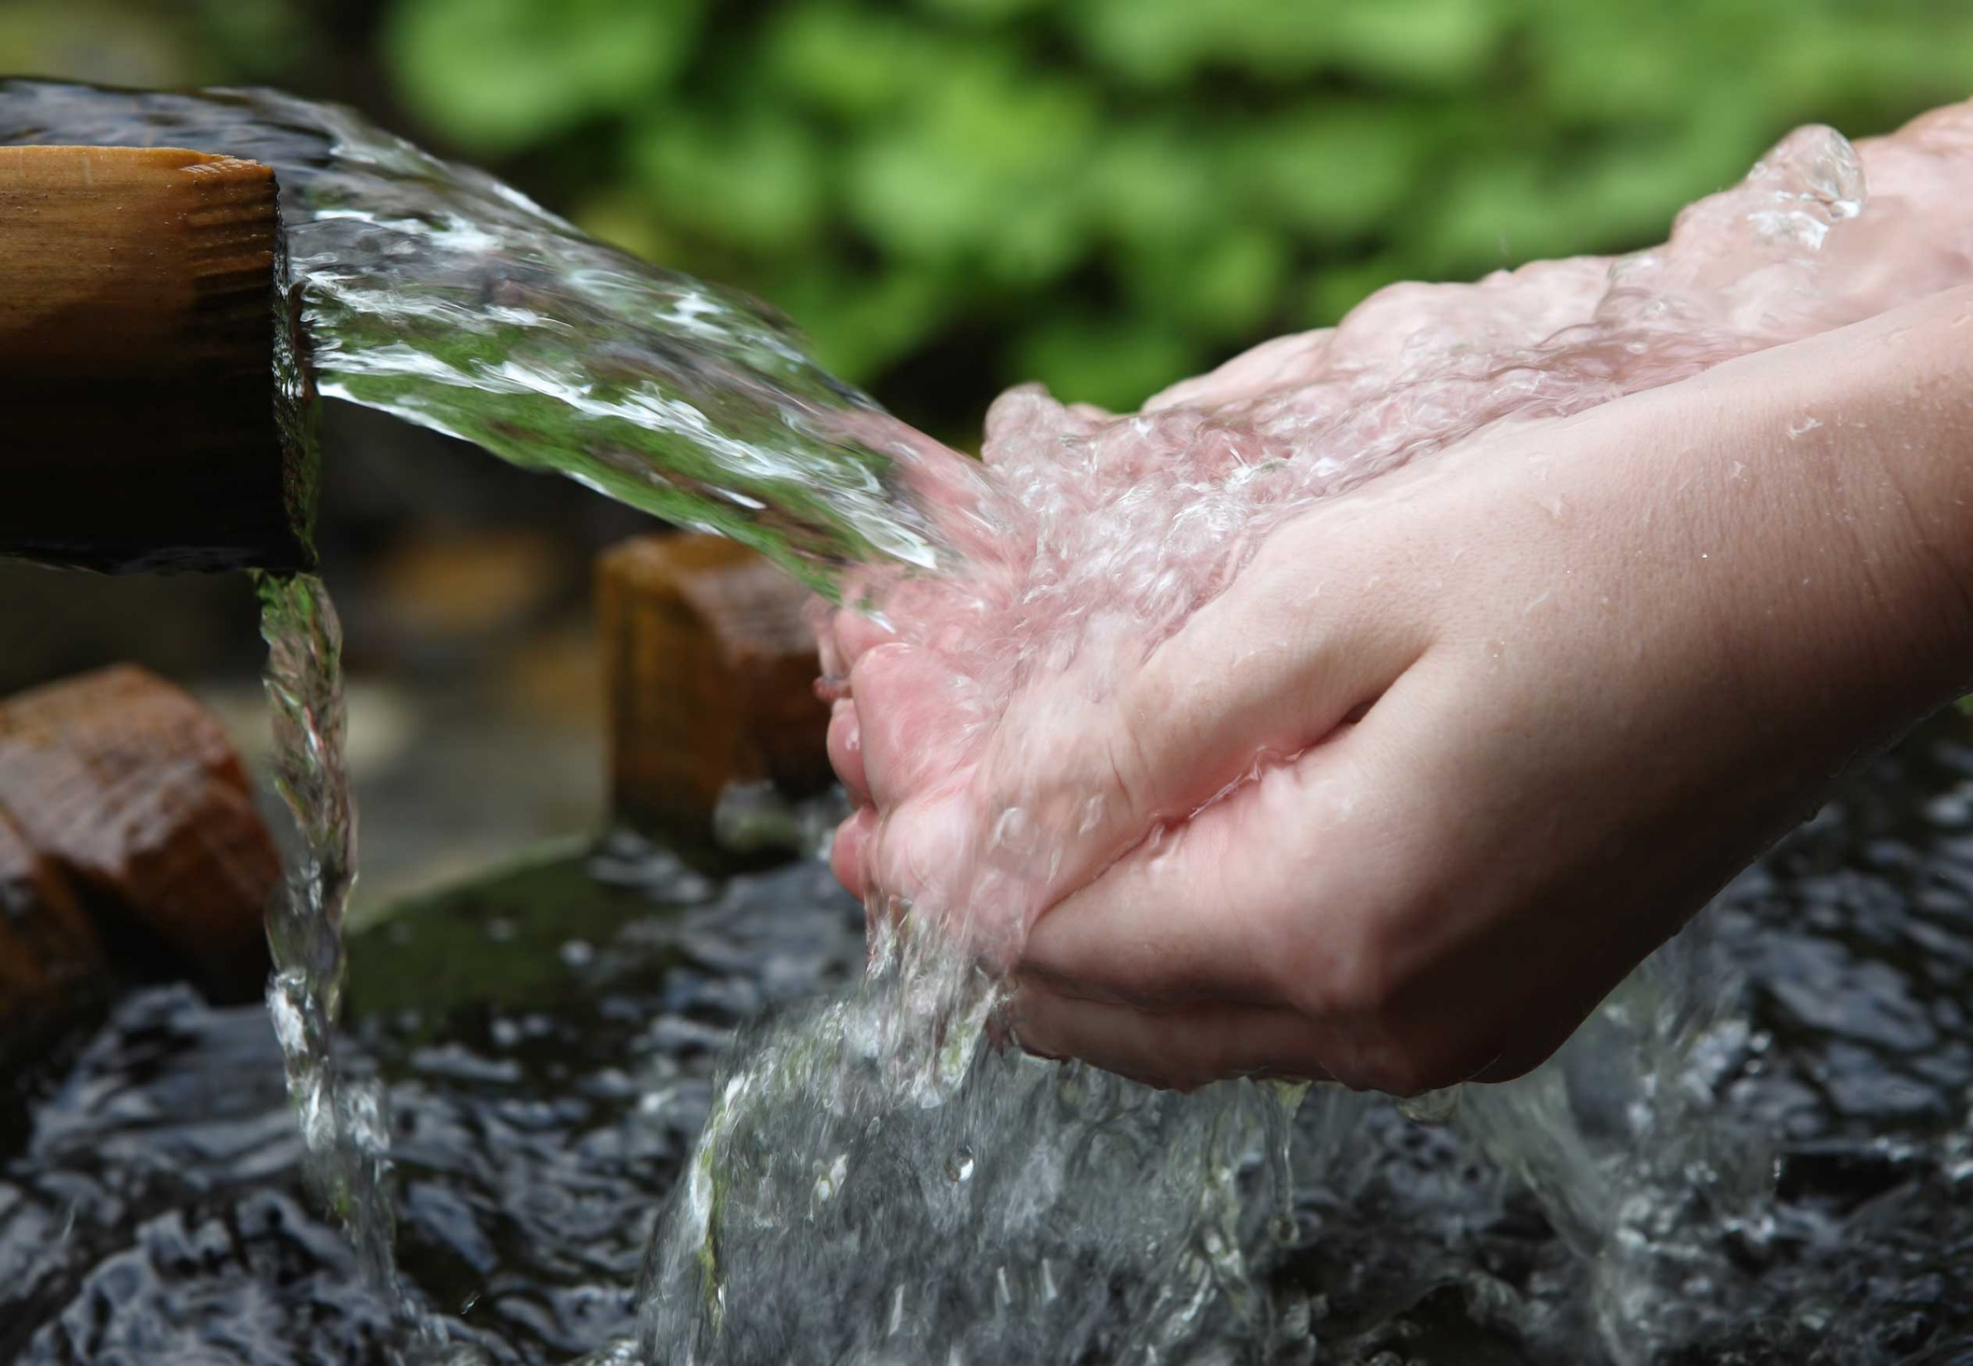
The
relationship
you were
made for
Thirst
Racial Barriers

Slide 25
The
relationship
you were
made for
Thirst
POLITICAL
BARRIERS
Racial Barriers

Slide 26
The
relationship
you were
made for
Thirst
GENDER Barriers
POLITICAL
BARRIERS
Racial Barriers

Slide 27
The
relationship
you were
made for
SOCIAL BARRIERS
Thirst
GENDER Barriers
POLITICAL
BARRIERS
Racial Barriers

Slide 28
The
relationship
you were
made for
SOCIAL BARRIERS
Thirst
RELIGIOUS
Barriers
GENDER Barriers
POLITICAL
BARRIERS
Racial Barriers

Slide 29
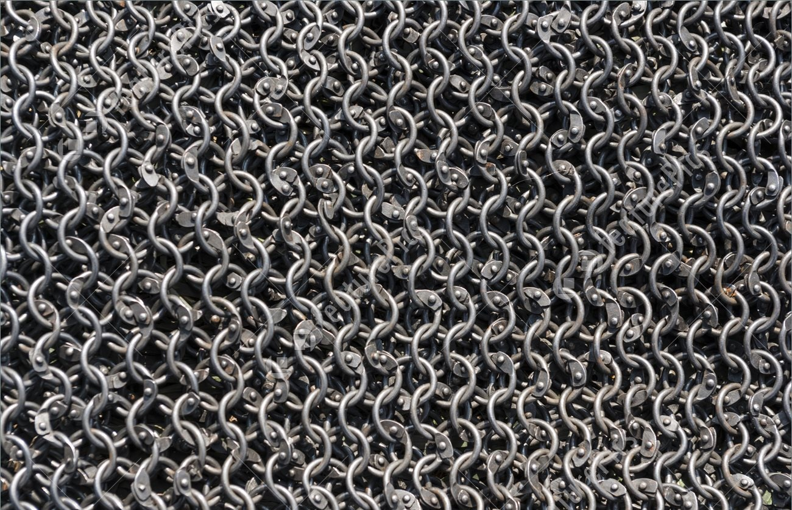
The
relationship
you were
made for
SOCIAL BARRIERS
Thirst
RELIGIOUS
Barriers
GENDER Barriers
GUILT
POLITICAL
BARRIERS
Racial Barriers

Slide 30
The
relationship
you were
made for
SOCIAL BARRIERS
SHAME
Thirst
RELIGIOUS
Barriers
GENDER Barriers
GUILT
POLITICAL
BARRIERS
Racial Barriers

Slide 31
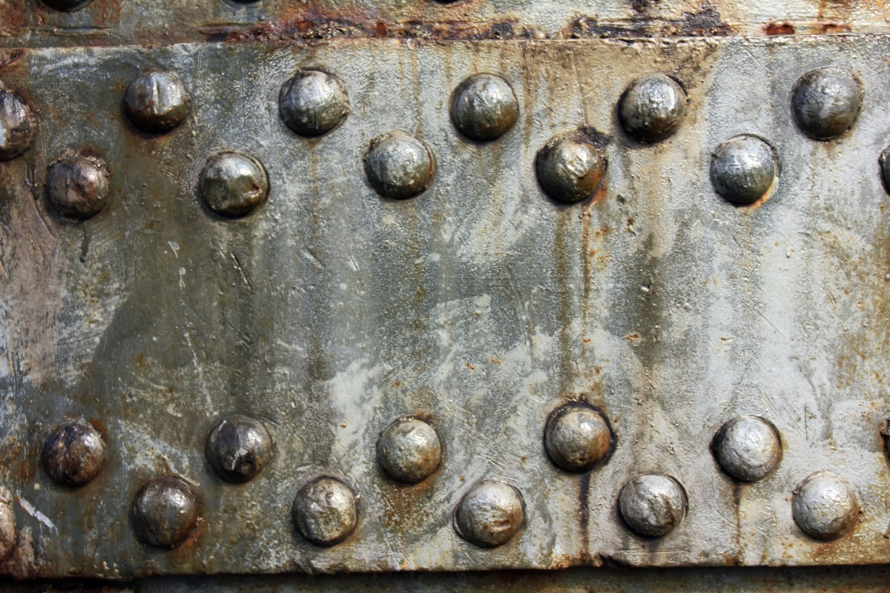
The
relationship
you were
made for
SOCIAL BARRIERS
SHAME
Thirst
RELIGIOUS
Barriers
GENDER Barriers
GUILT
The HEART
POLITICAL
BARRIERS
Racial Barriers

Slide 32
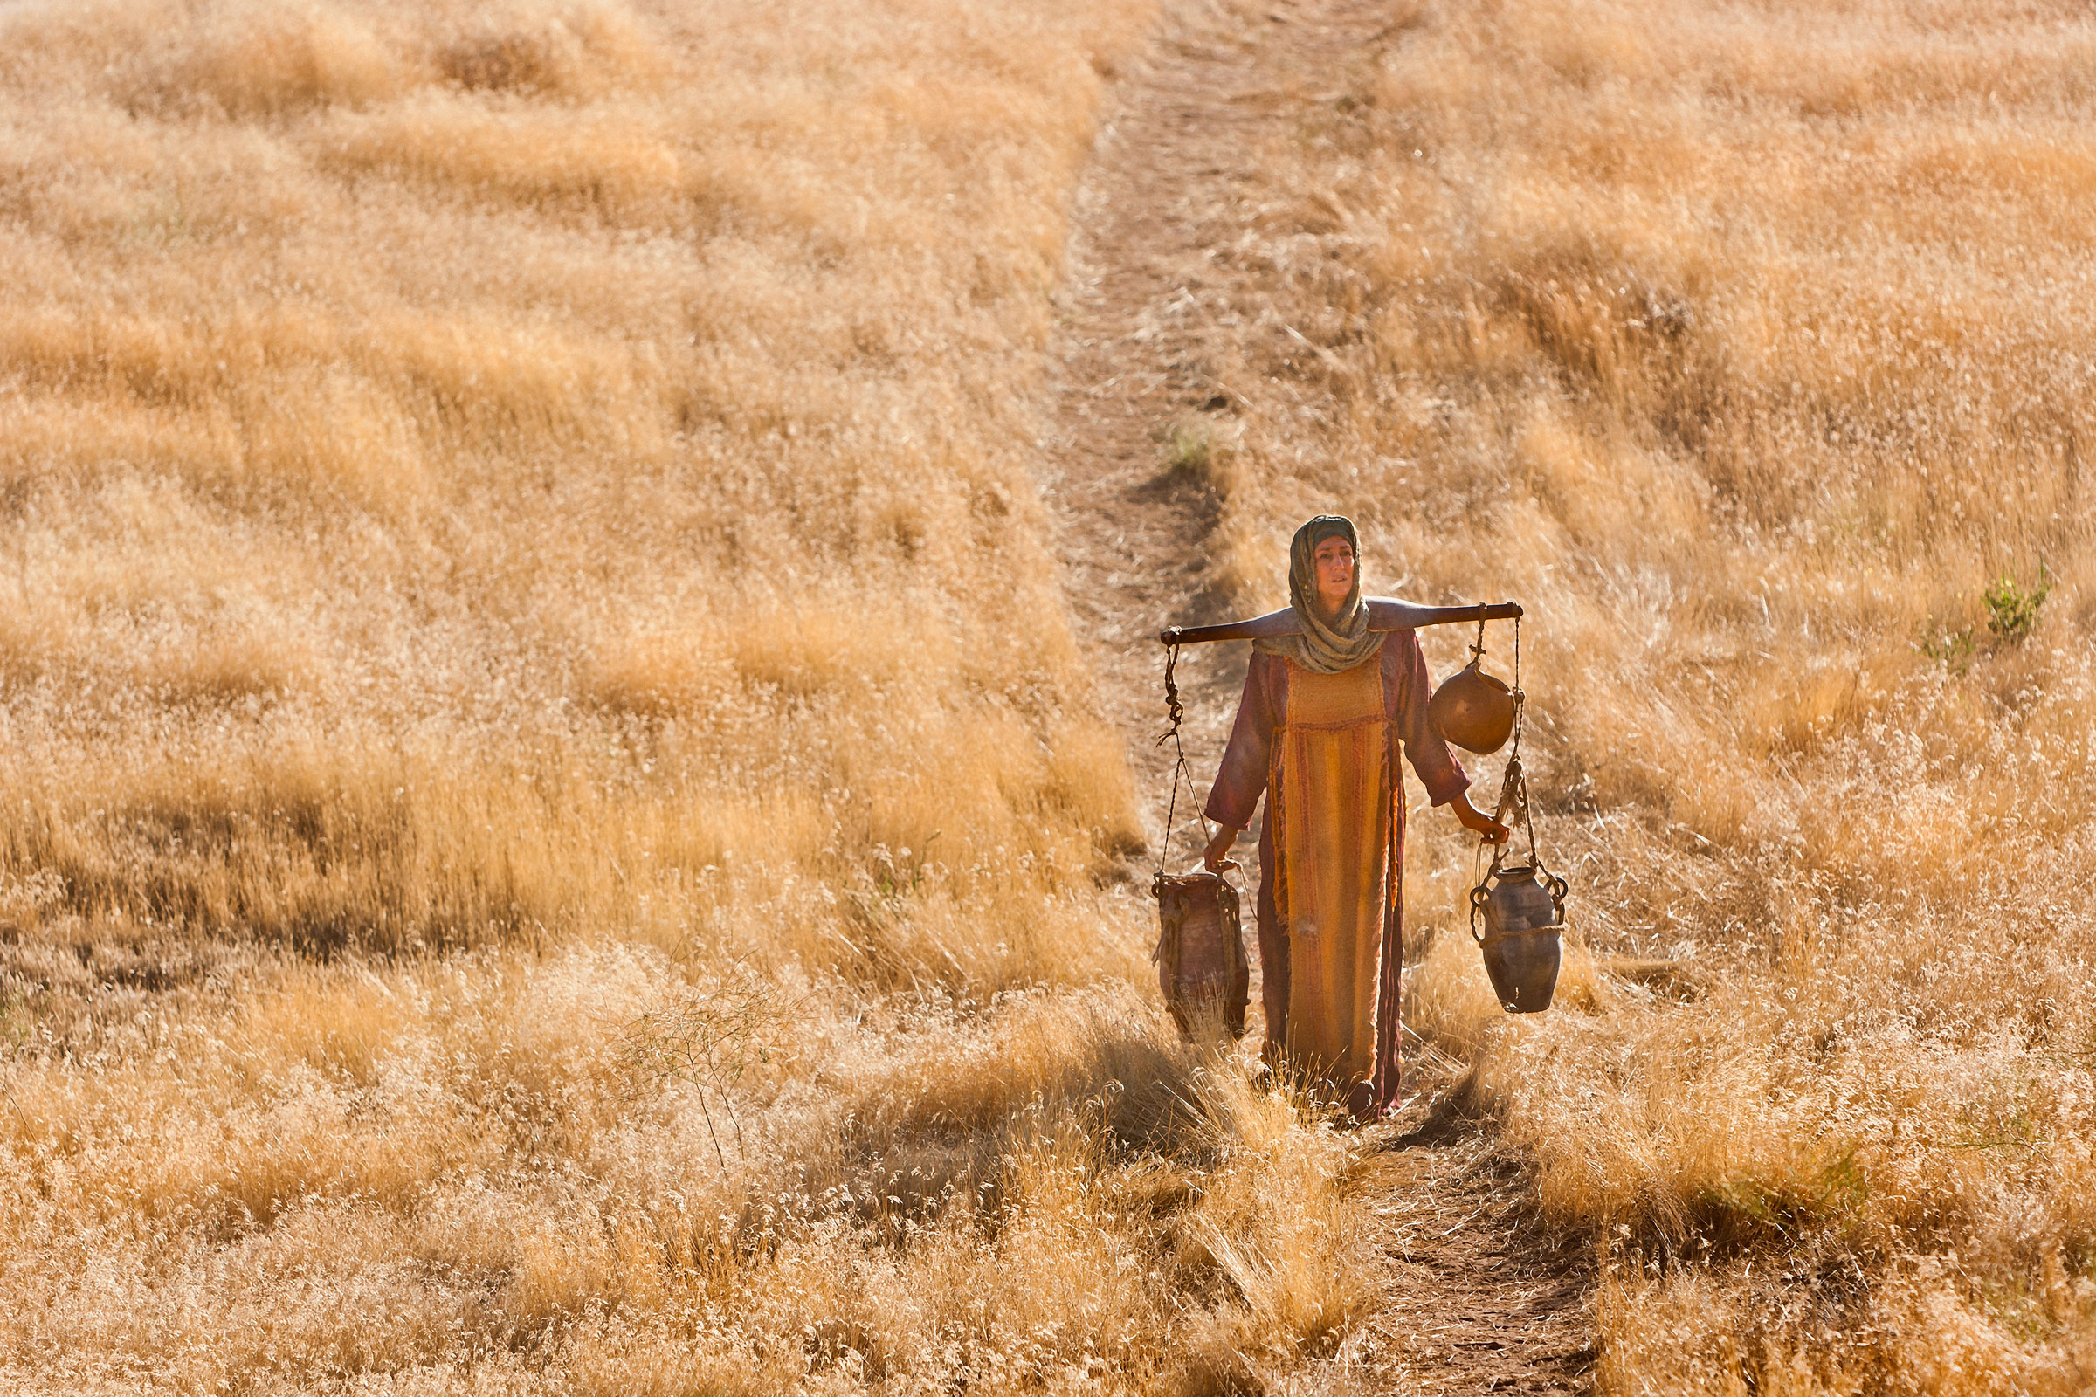
She is about the least likely person ever to follow Jesus
Jesus specializes in the unlikely!

Slide 33
GUILT
RELIGIOUS
Barriers
^{John 4:7} “Please give me a drink”
^{John 4:9} The woman was surprised
Racial Barriers
The HEART
SIN
Surprise!
POLITICAL
BARRIERS
GENDER Barriers

Slide 34
GUILT
RELIGIOUS
Barriers
Racial Barriers
The HEART
SIN
POLITICAL
BARRIERS
GENDER Barriers

Slide 35
GUILT
RELIGIOUS
Barriers
^{4:19} “Sir, you must be a prophet…”
The HEART
SIN
²⁰ So tell me, why is it that you Jews insist that Jerusalem is the only place of worship, while we Samaritans claim it is here at Mount Gerizim, where our ancestors worshiped?”

Slide 36
GUILT
RELIGIOUS
Barriers
^{4:19} “Sir, you must be a prophet…”
^{4:21}““Believe me, dear woman, the time is coming when it will no longer matter whether you worship the Father on this mountain or in Jerusalem. ²² You Samaritans know very little about the one you worship, while we Jews know all about him, for salvation comes through the Jews.
^{4:21}““Believe me, dear woman, the time is coming when it will no longer matter whether you worship the Father on this mountain or in Jerusalem. ²² You Samaritans know very little about the one you worship, while we Jews know all about him, for salvation comes through the Jews.
The HEART
SIN
²⁰ So tell me, why is it that you Jews insist that Jerusalem is the only place of worship, while we Samaritans claim it is here at Mount Gerizim, where our ancestors worshiped?”
^{John 4:21} Jesus replied,

Slide 37
GUILT
RELIGIOUS
Barriers
^{4:19} “Sir, you must be a prophet…”
^{John 4:23} But the time is coming—indeed it’s here now—when true worshipers will worship the Father in spirit and in truth. The Father is looking for those who will worship him that way. ²⁴ For God is Spirit, so those who worship him must worship in spirit and in truth.”
^{John 4:23} But the time is coming—indeed it’s here now—when true worshipers will worship the Father in spirit and in truth. The Father is looking for those who will worship him that way. ²⁴ For God is Spirit, so those who worship him must worship in spirit and in truth.”
The HEART
SIN
²⁰ So tell me, why is it that you Jews insist that Jerusalem is the only place of worship, while we Samaritans claim it is here at Mount Gerizim, where our ancestors worshiped?”
^{John 4:21} Jesus replied,

Slide 38
GUILT
RELIGIOUS
Barriers
The HEART
GUILT

Slide 39
GUILT
He knows all about that ... and the offer stands!
The HEART
GUILT

Slide 40
GUILT
He knows all about that ... and the offer stands!
The HEART
GUILT

Slide 41
SHAME
The HEART

Slide 42
^{John 4:15} “Please, sir,” the woman said, “give me this water! Then I’ll never be thirsty again, and I won’t have to come here to get water.”
The HEART
^{4:16} Go and get your husband,

Slide 43
^{John 4:25} The woman said, “I know the Messiah is coming—the one who is called Christ. When he comes, he will explain everything to us.”
The HEART
^{4:26} Then Jesus told her, I AM the Messiah!

Slide 44
^{John 4:25} The woman said, “I know the Messiah is coming—the one who is called Christ. When he comes, he will explain everything to us.”
The HEART
^{4:26} Then Jesus told her, I AM the Messiah!
^{John 4:27} Just then his disciples came back. They were shocked to find him talking to a woman, but none of them had the nerve to ask, “what do you want with her?” or “Why are you talking to her?”

Slide 45
^{John 4:28} The woman left her water jar beside the well and ran back to the village, telling everyone, ²⁹ “Come and see a man who told me everything I ever did! Could he possibly be the Messiah?” ³⁰ So the people came streaming from the village to see him.

Slide 46
^{John 4:31} Meanwhile, the disciples were urging Jesus, “Rabbi, eat something.” ³² But Jesus replied, “I have a kind of food you know nothing about.”

Slide 47
^{John 4:33} “Did someone bring him food while we were gone?” the disciples asked each other. ³⁴ Then Jesus explained: “My nourishment comes from doing the will of God, who sent me, and from finishing his work.

Slide 48
^{John 4:35} You know the saying, ‘Four months between planting and harvest.’ But I say, wake up and look around.

Slide 49
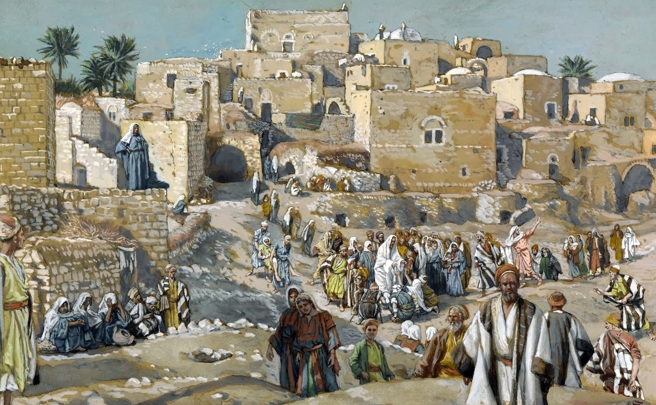
^{John 4:35} The fields are already ripe for harvest. ³⁶ The harvesters are paid good wages, and the fruit they harvest is people brought to eternal life.
^{John 4:35} You know the saying, ‘Four months between planting and harvest.’ But I say, wake up and look around.

Slide 50
^{John 4:36} What joy awaits both the planter and the harvester alike! ³⁷ You know the saying, ‘One plants and another harvests.’ And it’s true. ³⁸ I sent you to harvest where you didn’t plant; others had already done the work, and now you will get to gather the harvest.”

Slide 51
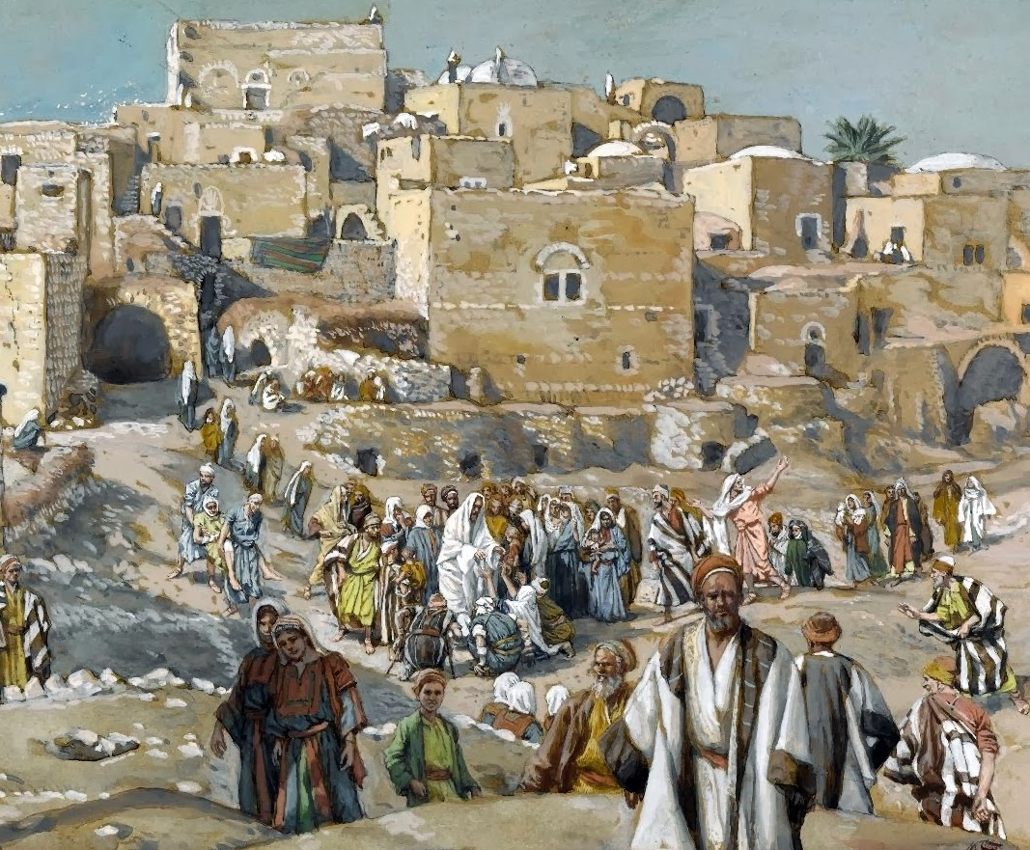
^{John 4:36} What joy awaits both the planter and the harvester alike! ³⁷ You know the saying, ‘One plants and another harvests.’ And it’s true. ³⁸ I sent you to harvest where you didn’t plant; others had already done the work, and now you will get to gather the harvest.”
Jesus: Join me in my work! Be a fellow barrier-breaker

Slide 52
^{John 4:39} Many Samaritans from the village believed in Jesus because the woman had said, “He told me everything I ever did!” ⁴⁰ When they came out to see him, they begged him to stay in their village.

Slide 53
^{John 4:40} So he stayed for two days, ⁴¹ long enough for many more to hear his message and believe. ⁴² Then they said to the woman, “Now we believe, not just because of what you told us, but because we have heard him ourselves. Now we know that he is indeed the Savior of the world.”

Slide 54
About ourselves:
About Salvation:
About Jesus:

