Slide 2
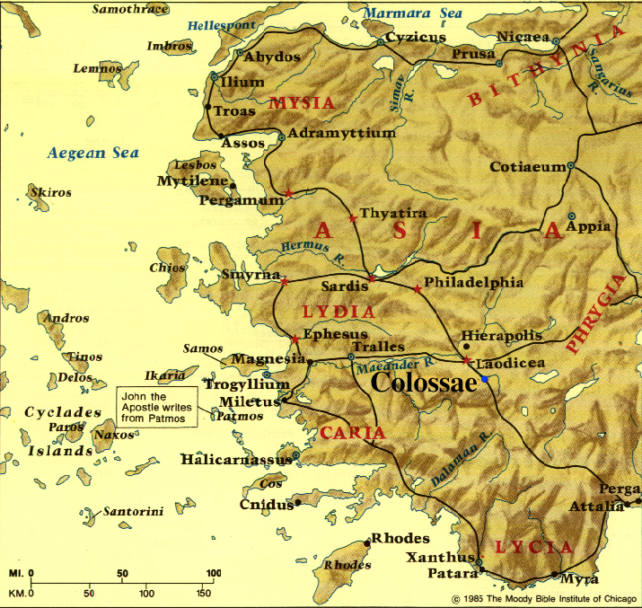

Slide 3
Spiritual maturity/development is not facilitated by ritual observance, dramatic spiritual experiences, or legalistic prohibitions

Slide 4
Spiritual maturity/development is facilitated by receiving & focusing on God’s love through Jesus, & by giving God’s love to others

Slide 5
Spiritual maturity/development is facilitated by receiving & focusing on God’s love through Jesus, & by giving God’s love to others (“SPIRITUAL RESPIRATION”)
GOD
ME
GOD & OTHERS
RECEIVE GOD’S LOVE
GIVE GOD’S LOVE

Slide 6
Spiritual maturity/development is facilitated by receiving & focusing on God’s love through Jesus, & by giving God’s love to others (“SPIRITUAL RESPIRATION”)
TOWARD GOD (3:15b,16b,17b)
TOWARD OTHER CHRISTIANS (3:12-16)
TOWARD NON-CHRISTIANS (3:17-4:6)

Slide 7
Colossians 3:12-16 Spiritual Development through Loving Other Christians
^{3:12} So, as those who have been chosen of God, holy and beloved, put on a heart of compassion, kindness, humility, gentleness and patience; ¹³ bearing with one another, and forgiving each other, whoever has a complaint against anyone; just as the Lord forgave you, so also should you. ¹⁴ Beyond all these things put on love, which is the perfect bond of unity. ¹⁵ Let the peace of Christ rule in your hearts, to which indeed you were called in one body; and be thankful. ¹⁶ Let the word of Christ richly dwell within you, with all wisdom teaching and admonishing one another, with psalms and hymns and spiritual songs, singing with thankfulness in your hearts to God.

Slide 8
Colossians 3:12-16 Spiritual Development through Loving Other Christians
LOVE THAT FORGES OBSERVABLE UNITY
¹⁴ Beyond all these things put on love, which is the perfect bond of unity. ¹⁵ et the peace of Christ rule in your hearts, to which indeed you were called in one body; and be thankful.

Slide 9
Colossians 3:12-16 Spiritual Development through Loving Other Christians
LOVE THAT FORGES OBSERVABLE UNITY
^{John 13:34} “A new commandment I give to you, that you love one another, even as I have loved you, that you also love one another. ³⁵ By this all people will know that you are My disciples, if you have love for one another.”
¹⁴ Beyond all these things put on love, which is the perfect bond of unity. ¹⁵ t the peace of Christ rule in your hearts, to which indeed you were called in one body; and be thankful.

Slide 10
Colossians 3:12-16 Spiritual Development through Loving Other Christians
LOVE THAT FORGES OBSERVABLE UNITY
^{John 17:21} “(I pray) that they may all be one; even as You, Father, are in Me and I in You, that they also may be in Us, so that the world may believe that You sent Me . . . ²³ . . . that they may be perfected in unity, so that the world may know that You sent Me, and loved them, even as You have loved Me.
¹⁴ Beyond all these things put on love, which is the perfect bond of unity. ¹⁵ Let the peace of Christ rule in your hearts, to which indeed ou were called in one body; and be thankful.

Slide 11
Colossians 3:12-16 Spiritual Development through Loving Other Christians
LOVE THAT FORGES OBSERVABLE UNITY
¹⁴ Beyond all these things put on love, which is the perfect bond of unity. ¹⁵ Let the peace of Christ rule in your hearts, to which indeed you were called in one body; and be thankful.

Slide 12
Colossians 3:12-16 Spiritual Development through Loving Other Christians
“The church that convinces people that there is a God is a church that manifests what only a God can do, that is, to unite human beings in love . . . There is nothing that convinces people that God exists or that awakens their craving for Him like the discovery of Christian brothers and sisters who love one another . . . The sight of loving unity among Christians arrests non-Christian(s). It crashes through his intellect, stirs up his conscience and creates a tumult of longing in his heart because he was created to enjoy the very thing that you are demonstrating.”
John White, The Fight (InterVarsity Press, 1979), pp. 149,150.
LOVE THAT FORGES OBSERVABLE UNITY
¹⁴ Beyond all these things put on love, which is the perfect bond of unity. ¹⁵ Let the peace of Christ rule in your hearts, to which indeed you were called in one body; and be thankful.

Slide 13
Colossians 3:12-16 Spiritual Development through Loving Other Christians
LOVE THAT FORGES OBSERVABLE UNITY
No wonder every New Testament letter emphasizes loving unity between Christians!!
¹⁴ Beyond all these things put on love, which is the perfect bond of unity. ¹¹⁵ Let the peace of Christ rule in your hearts, to which indeed you were called in one body; and be thankful.ce of Christ rule in your hearts, to which indeed you were called in one body; and be thankful.

Slide 14
Colossians 3:12-16 Spiritual Development through Loving Other Christians
LOVE THAT FORGES OBSERVABLE UNITY
¹⁴ Beyond all these things put on love, which is the perfect bond of unity. ¹⁵ Let the peace of Christ rule in your hearts, to which indeed you were called in one body; and be thankful.

Slide 15
Colossians 3:12-16 Spiritual Development through Loving Other Christians
LOVE THAT FORGES OBSERVABLE UNITY
NOT: Don’t make important decisions unless you feel God’s peace
¹⁴ Beyond all these things put on love, which is the perfect bond of unity. ¹⁵ Let the peace of Christ rule in your hearts, to which indeed you were called in one body; and be thankful.

Slide 16
Colossians 3:12-16 Spiritual Development through Loving Other Christians
LOVE THAT FORGES OBSERVABLE UNITY
BUT: Prioritize unity when deciding how to relate to other Christians
¹⁴ Beyond all these things put on love, which is the perfect bond of unity. ¹⁵ Let the peace of Christ rule in your hearts, to which indeed you were called in one body; and be thankful.

Slide 17
Colossians 3:12-16 Spiritual Development through Loving Other Christians
LOVE THAT HUMBLY SERVES THOSE WHO ARE MESSY & SINFUL
¹² So, as those who have been chosen of God, holy and beloved, put on a heart of compassion, kindness, humility, gentleness and patience; ¹³ bearing with one another, and forgiving each other, whoever has a complaint against anyone; just as the Lord forgave you, so also should you.

Slide 18
Colossians 3:12-16 Spiritual Development through Loving Other Christians
LOVE THAT HUMBLY SERVES THOSE WHO ARE MESSY & SINFUL
¹² So, as those who have been chosen of God, holy and beloved, put on a heart of compassion, kindness, humility, gentleness and patience; ¹³ bearing with one another, and forgiving each other, whoever has a complaint against anyone; just as the Lord forgave you, so also should you.

Slide 19
Colossians 3:12-16 Spiritual Development through Loving Other Christians
LOVE THAT HUMBLY SERVES THOSE WHO ARE MESSY & SINFUL
Are you involved enough with some other Christians that you need to exercise these aspects of love?
¹² So, as those who have been chosen of God, holy and beloved, put on a heart of compassion, kindness, humility, gentleness and patience; ¹³ bearing with one another, and forgiving each other, whoever has a complaint against anyone; just as the Lord forgave you, so also should you.

Slide 20
Colossians 3:12-16 Spiritual Development through Loving Other Christians
LOVE THAT HUMBLY SERVES THOSE WHO ARE MESSY & SINFUL
Only the security of being loved by God gives us the dignity & motivation to serve other Christians in this way

Slide 21
Colossians 3:12-16 Spiritual Development through Loving Other Christians
LOVE THAT HUMBLY SERVES THOSE WHO ARE MESSY & SINFUL
Only the security of being loved by God gives us the dignity & motivation to serve other Christians in this way
³ Jesus, knowing that the Father had given all things into His hands, and that He had come forth from God and was going back to God, ⁴ got up from supper, and laid aside His garments; and taking a towel, He girded Himself. ⁵ Then He poured water into the basin, & began to wash the disciples’ feet & to wipe them with the towel with which He was girded.

Slide 22
Colossians 3:12-16 Spiritual Development through Loving Other Christians
LOVE THAT HUMBLY SERVES THOSE WHO ARE MESSY & SINFUL
Only the security of being loved by God gives us the dignity & motivation to serve other Christians in this way
¹² So, as those who have been chosen of God, holy and beloved, put on a heart of compassion, kindness, humility, gentleness and patience; ¹³ bearing with one another, and forgiving each other, whoever has a complaint against anyone; just as the Lord forgave you, so also should you.

Slide 23
Colossians 3:12-16 Spiritual Development through Loving Other Christians
LOVE THAT IS FUELED & INFORMED BY GOD’S WORD
¹⁶ Let the word of Christ richly dwell within you, with all wisdom teaching and admonishing one another, with psalms and hymns and spiritual songs, singing with thankfulness in your hearts to God.

Slide 24
Colossians 3:12-16 Spiritual Development through Loving Other Christians
LOVE THAT IS FUELED & INFORMED BY GOD’S WORD
Saturated with it so that it influences other Christians through us for their good
¹⁶ Let the word of Christ richly dwell within you, with all wisdom teaching and admonishing one another, with psalms and hymns and spiritual songs, singing with thankfulness in your hearts to God.

Slide 25
Colossians 3:12-16 Spiritual Development through Loving Other Christians
LOVE THAT IS FUELED & INFORMED BY GOD’S WORD
Using it to appropriately instruct, remind, encourage, counsel, correct, etc.
¹⁶ Let the word of Christ richly dwell within you, with all wisdom teaching and admonishing one another, with psalms and hymns and spiritual songs, singing with thankfulness in your hearts to God.

Slide 26
Colossians 3:12-16 Spiritual Development through Loving Other Christians
LOVE THAT IS FUELED & INFORMED BY GOD’S WORD
Using it to appropriately instruct, remind, encourage, counsel, correct, etc.
“These people really know & love the Bible, & see it as relevant to all of life”
¹⁶ Let the word of Christ richly dwell within you, with all wisdom teaching and admonishing one another, with psalms and hymns and spiritual songs, singing with thankfulness in your hearts to God.

Slide 27
Colossians 3:12-16 Spiritual Development through Loving Other Christians
LOVE THAT IS FUELED & INFORMED BY GOD’S WORD
Using it to praise & thank God together as well as in private
¹⁶ Let the word of Christ richly dwell within you, with all wisdom teaching and admonishing one another, with psalms and hymns and spiritual songs, singing with thankfulness in your hearts to God.

Slide 28
Colossians 3:12-16 Spiritual Development through Loving Other Christians
LOVE THAT IS FUELED & INFORMED BY GOD’S WORD
Using it to praise & thank God together as well as in private
“These people believe God is real & good, & that He sustains them through all of life”
¹⁶ Let the word of Christ richly dwell within you, with all wisdom teaching and admonishing one another, with psalms and hymns and spiritual songs, singing with thankfulness in your hearts to God.

Slide 29
Colossians 3:12-16 Spiritual Development through Loving Other Christians
LOVE THAT FORGES OBSERVABLE UNITY
LOVE THAT HUMBLY SERVES THOSE WHO ARE MESSY & SINFUL
LOVE THAT IS FUELED & INFORMED BY GOD’S WORD

Slide 30
NEXT WEEK:
Another One of God’s’ Invitations

