Slide 1
Acts
Acts 10 Peter & Cornelius

Slide 2
Acts
God’s 3-stage plan for “the gospel”

Slide 3
Acts
^{Acts1:8} you shall be My witnesses both in Jerusalem, and in all Judea and Samaria, and even to the remotest part of the earth.”
God’s 3-stage plan for “the gospel”

Slide 4
^{Acts1:8} you shall be My witnesses both in Jerusalem, and in all Judea and Samaria, and even to the remotest part of the earth.”
^{Acts1:8} you shall be My witnesses both in Jerusalem, and in all Judea and Samaria, and even to the remotest part of the earth.”
^{Acts1:8} you shall be My witnesses both in Jerusalem, and in all Judea and Samaria, and even to the remotest part of the earth.”
^{Acts1:8} you shall be My witnesses both in Jerusalem, and in all Judea and Samaria, and even to the remotest part of the earth.”
Samaria
Jerusalem
Judea
God’s 3-stage plan for “the gospel”

Slide 5
Samaria
Jerusalem
Judea
^{9:31} So the church throughout all Judea and Galilee and Samaria enjoyed peace, being built up; and going on in the fear of the Lord and in the comfort of the Holy Spirit, it continued to increase.
God’s 3-stage plan for “the gospel”

Slide 6
Samaria
Jerusalem
Judea
^{9:32} Now as Peter was traveling through all those regions, he came down also to the saints who lived at Lydda.
God’s 3-stage plan for “the gospel”

Slide 7
Samaria
Jerusalem
Lydda
Judea
^{9:32} Now as Peter was traveling through all those regions, he came down also to the saints who lived at Lydda.
God’s 3-stage plan for “the gospel”

Slide 8
Jerusalem
Lydda
^{9:33} There he found a man named Aeneas, who had been bedridden eight years, for he was paralyzed.
God’s 3-stage plan for “the gospel”

Slide 9
Jerusalem
Lydda
^{9:34} Peter said to him, “Aeneas, Jesus Christ heals you; get up and make your bed.” Immediately he got up. ³⁵ And all who lived at Lydda and Sharon saw him, and they turned to the Lord.
^{9:34} Peter said to him, “Aeneas, Jesus Christ heals you; get up and make your bed.” Immediately he got up. ³⁵ And all who lived at Lydda and Sharon saw him, and they turned to the Lord.
God’s 3-stage plan for “the gospel”

Slide 10
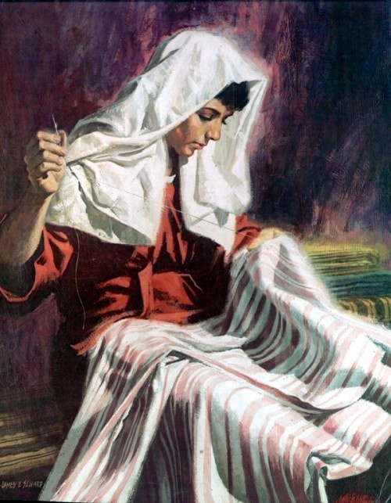
Jerusalem
Joppa
Lydda
^{9:36} Now in Joppa there was a disciple named Tabitha (which translated in Greek is called Dorcas); this woman was abounding with deeds of kindness and charity which she continually did.
^{9:36} Now in Joppa there was a disciple named Tabitha (which translated in Greek is called Dorcas); this woman was abounding with deeds of kindness and charity which she continually did.
^{9:36} Now in Joppa there was a disciple named Tabitha (which translated in Greek is called Dorcas); this woman was abounding with deeds of kindness and charity which she continually did.
God’s 3-stage plan for “the gospel”

Slide 11
Jerusalem
Joppa
Lydda
^{9:37} And it happened at that time that she fell sick and died; and when they had washed her body, they laid it in an upper room.
God’s 3-stage plan for “the gospel”

Slide 12
Jerusalem
Joppa
Lydda
^{9:38} Since Lydda was near Joppa, the disciples, having heard that Peter was there, sent two men to him, imploring him, “Do not delay in coming to us.”
God’s 3-stage plan for “the gospel”

Slide 13
Jerusalem
Joppa
Lydda
^{9:39} So Peter arose and went with them. When he arrived, they brought him into the upper room; and all the widows stood beside him, weeping and showing all the tunics and garments that Dorcas used to make while she was with them.
God’s 3-stage plan for “the gospel”

Slide 14
Jerusalem
Joppa
Lydda
^{9:40} But Peter sent them all out and knelt down and prayed, and turning to the body, he said, “Tabitha, arise.” And she opened her eyes, and when she saw Peter, she sat up. ⁴¹ And he gave her his hand and raised her up; and calling the saints and widows, he presented her alive.
God’s 3-stage plan for “the gospel”

Slide 15
Jerusalem
Joppa
Lydda
^{9:42} It became known all over Joppa, and many believed in the Lord.⁴³ And Peter stayed many days in Joppa with a tanner named Simon.
^{9:42} It became known all over Joppa, and many believed in the Lord.⁴³ And Peter stayed many days in Joppa with a tanner named Simon.
^{9:42} It became known all over Joppa, and many believed in the Lord.⁴³ And Peter stayed many days in Joppa with a tanner named Simon.
God’s 3-stage plan for “the gospel”

Slide 16
Caesarea
Jerusalem
Joppa
Lydda
^{10:1} Now there was a man at Caesarea named Cornelius, a centurion of what was called the Italian cohort, ² a devout man and one who feared God with all his household, and gave many alms to the Jewish people and prayed to God continually.
^{10:1} Now there was a man at Caesarea named Cornelius, a centurion of what was called the Italian cohort, ² a devout man and one who feared God with all his household, and gave many alms to the Jewish people and prayed to God continually.
^{9:42} It became known all over Joppa, and many believed in the Lord.⁴³ And Peter stayed many days in Joppa with a tanner named Simon.
God’s 3-stage plan for “the gospel”

Slide 17
Caesarea
Jerusalem
Joppa
Lydda
^{10:1} Now there was a man at Caesarea named Cornelius, a centurion of what was called the Italian cohort, ² a devout man and one who feared God with all his household, and gave many alms to the Jewish people and prayed to God continually.
^{9:42} It became known all over Joppa, and many believed in the Lord.⁴³ And Peter stayed many days in Joppa with a tanner named Simon.
God’s 3-stage plan for “the gospel”

Slide 18
Caesarea
Jerusalem
Joppa
Lydda
^{10:1} Now there was a man at Caesarea named Cornelius, a centurion of what was called the Italian cohort, ² a devout man and one who feared God with all his household, and gave many alms to the Jewish people and prayed to God continually.
^{9:42} It became known all over Joppa, and many believed in the Lord.⁴³ And Peter stayed many days in Joppa with a tanner named Simon.
God’s 3-stage plan for “the gospel”

Slide 19
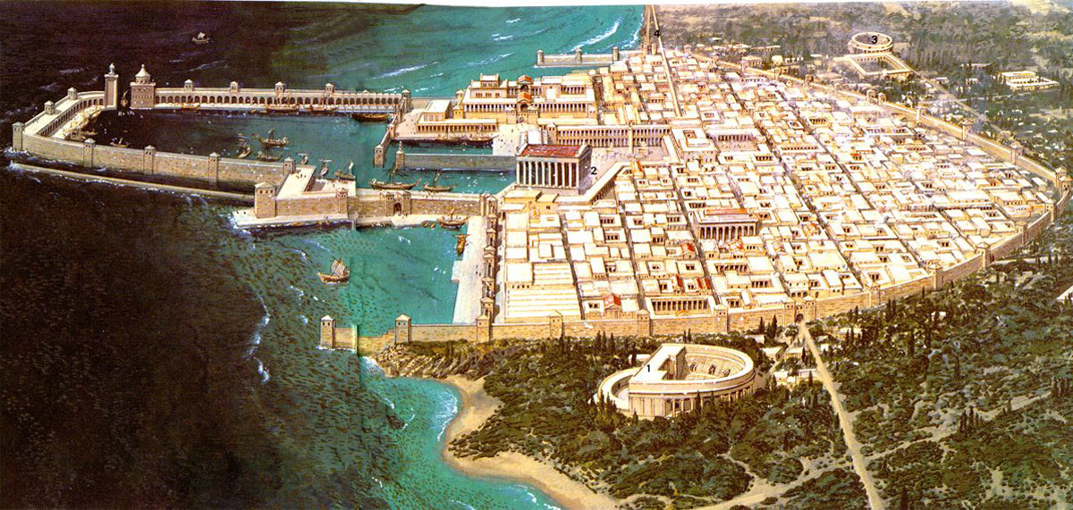
Caesarea
Spearhead of Roman occupation
Jerusalem
Joppa
Lydda
^{10:1} Now there was a man at Caesarea named Cornelius, a centurion of what was called the Italian cohort, ² a devout man and one who feared God with all his household, and gave many alms to the Jewish people and prayed to God continually.
^{9:42} It became known all over Joppa, and many believed in the Lord.⁴³ And Peter stayed many days in Joppa with a tanner named Simon.
God’s 3-stage plan for “the gospel”

Slide 20
Caesarea
Prominent deep water port
Jerusalem
Joppa
Lydda
^{10:1} Now there was a man at Caesarea named Cornelius, a centurion of what was called the Italian cohort, ² a devout man and one who feared God with all his household, and gave many alms to the Jewish people and prayed to God continually.
^{9:42} It became known all over Joppa, and many believed in the Lord.⁴³ And Peter stayed many days in Joppa with a tanner named Simon.
God’s 3-stage plan for “the gospel”

Slide 21
Caesarea
Mixed population: Jew & Gentile
Jerusalem
Joppa
Lydda
^{10:1} Now there was a man at Caesarea named Cornelius, a centurion of what was called the Italian cohort, ² a devout man and one who feared God with all his household, and gave many alms to the Jewish people and prayed to God continually.
^{9:42} It became known all over Joppa, and many believed in the Lord.⁴³ And Peter stayed many days in Joppa with a tanner named Simon.
God’s 3-stage plan for “the gospel”

Slide 22
Caesarea
Hotbed of racial/ethnic/cultural strife
Jerusalem
Joppa
Lydda
^{10:1} Now there was a man at Caesarea named Cornelius, a centurion of what was called the Italian cohort, ² a devout man and one who feared God with all his household, and gave many alms to the Jewish people and prayed to God continually.
^{9:42} It became known all over Joppa, and many believed in the Lord.⁴³ And Peter stayed many days in Joppa with a tanner named Simon.
God’s 3-stage plan for “the gospel”

Slide 23
Caesarea
Jews Vs Gentiles
Jews Vs Gentiles
Distinction → Superiority → Separation → Hate
Jews Vs Gentiles
Distinction → Superiority → Separation → Hate
Jews Vs Gentiles
Distinction → Superiority → Separation → Hate
Jews Vs Gentiles
Distinction → Superiority → Separation → Hate
Hotbed of racial/ethnic/cultural strife
Jerusalem
Joppa
Lydda
^{10:1} Now there was a man at Caesarea named Cornelius, a centurion of what was called the Italian cohort, ² a devout man and one who feared God with all his household, and gave many alms to the Jewish people and prayed to God continually.
^{9:42} It became known all over Joppa, and many believed in the Lord.⁴³ And Peter stayed many days in Joppa with a tanner named Simon.
God’s 3-stage plan for “the gospel”

Slide 24
Caesarea
Jerusalem
Joppa
Lydda
^{10:1} Now there was a man at Caesarea named Cornelius, a centurion of what was called the Italian cohort, ² a devout man and one who feared God with all his household, and gave many alms to the Jewish people and prayed to God continually.
^{10:1} Now there was a man at Caesarea named Cornelius, a centurion of what was called the Italian cohort, ² a devout man and one who feared God with all his household, and gave many alms to the Jewish people and prayed to God continually.
^{9:42} It became known all over Joppa, and many believed in the Lord.⁴³ And Peter stayed many days in Joppa with a tanner named Simon.
God’s 3-stage plan for “the gospel”

Slide 25
^{10:3} About the ninth hour of the day he clearly saw in a vision an angel of God who had just come in and said to him, “Cornelius!” ⁴ And fixing his gaze on him and being much alarmed, he said, “What is it, Lord?”
^{10:3} About the ninth hour of the day he clearly saw in a vision an angel of God who had just come in and said to him, “Cornelius!” ⁴ And fixing his gaze on him and being much alarmed, he said, “What is it, Lord?”
^{10:3} About the ninth hour of the day he clearly saw in a vision an angel of God who had just come in and said to him, “Cornelius!” ⁴ And fixing his gaze on him and being much alarmed, he said, “What is it, Lord?”
God’s 3-stage plan for “the gospel”

Slide 26
^{10:4} And he said to him, “Your prayers and alms have ascended as a memorial before God. ⁵ Now dispatch some men to Joppa and send for a man named Simon, who is also called Peter; ⁶ he is staying with a tanner named Simon, whose house is by the sea.”
^{10:4} And he said to him, “Your prayers and alms have ascended as a memorial before God. ⁵ Now dispatch some men to Joppa and send for a man named Simon, who is also called Peter; ⁶ he is staying with a tanner named Simon, whose house is by the sea.”
God’s 3-stage plan for “the gospel”

Slide 27
^{10:7} When the angel who was speaking to him had left, he summoned two of his servants and a devout soldier of those who were his personal attendants, ⁸ and after he had explained everything to them, he sent them to Joppa.
God’s 3-stage plan for “the gospel”

Slide 28
Caesarea
Joppa
^{10:7} When the angel who was speaking to him had left, he summoned two of his servants and a devout soldier of those who were his personal attendants, ⁸ and after he had explained everything to them, he sent them to Joppa.
God’s 3-stage plan for “the gospel”

Slide 29
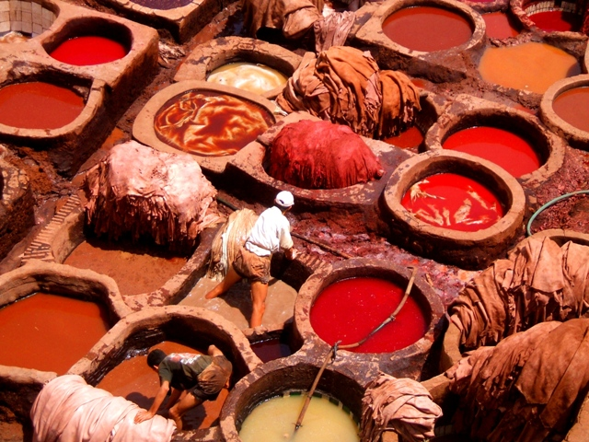
Caesarea
^{10:6} he is staying with a tanner named Simon, whose house is by the sea.”
Joppa
^{10:7} When the angel who was speaking to him had left, he summoned two of his servants and a devout soldier of those who were his personal attendants, ⁸ and after he had explained everything to them, he sent them to Joppa.
God’s 3-stage plan for “the gospel”

Slide 30
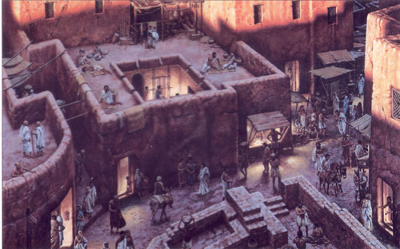
Caesarea
^{10:6} he is staying with a tanner named Simon, whose house is by the sea.”
Joppa
^{10:9} On the next day, as they were on their way and approaching the city, Peter went up on the housetop about the sixth hour to pray.
^{10:9} On the next day, as they were on their way and approaching the city, Peter went up on the housetop about the sixth hour to pray.
^{10:9} On the next day, as they were on their way and approaching the city, Peter went up on the housetop about the sixth hour to pray.
God’s 3-stage plan for “the gospel”

Slide 31
Caesarea
^{10:6} he is staying with a tanner named Simon, whose house is by the sea.”
Joppa
^{10:10} But he became hungry and was desiring to eat; but while they were making preparations, he fell into a trance
^{10:9} On the next day, as they were on their way and approaching the city, Peter went up on the housetop about the sixth hour to pray.
^{10:9} On the next day, as they were on their way and approaching the city, Peter went up on the housetop about the sixth hour to pray.
God’s 3-stage plan for “the gospel”

Slide 32
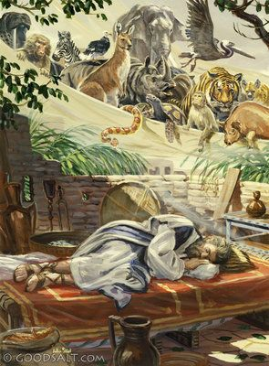
^{10:11} and he saw the sky opened up, and an object like a great sheet coming down, lowered by four corners to the ground, ¹² and there were in it all kinds of four-footed animals and crawling creatures of the earth and birds of the air. ¹³ A voice came to him, “Get up, Peter, kill and eat!”
^{10:11} and he saw the sky opened up, and an object like a great sheet coming down, lowered by four corners to the ground, ¹² and there were in it all kinds of four-footed animals and crawling creatures of the earth and birds of the air. ¹³ A voice came to him, “Get up, Peter, kill and eat!”
Caesarea
Joppa

Slide 33
^{10:11} and he saw the sky opened up, and an object like a great sheet coming down, lowered by four corners to the ground, ¹² and there were in it all kinds of four-footed animals and crawling creatures of the earth and birds of the air. ¹³ A voice came to him, “Get up, Peter, kill and eat!”
^{10:11} and he saw the sky opened up, and an object like a great sheet coming down, lowered by four corners to the ground, ¹² and there were in it all kinds of four-footed animals and crawling creatures of the earth and birds of the air. ¹³ A voice came to him, “Get up, Peter, kill and eat!”
Caesarea
Joppa
This would be strange for anyone…

Slide 34
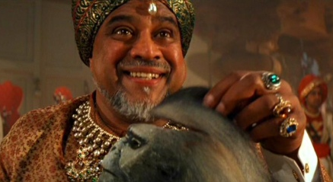
^{10:11} and he saw the sky opened up, and an object like a great sheet coming down, lowered by four corners to the ground, ¹² and there were in it all kinds of four-footed animals and crawling creatures of the earth and birds of the air. ¹³ A voice came to him, “Get up, Peter, kill and eat!”
^{10:11} and he saw the sky opened up, and an object like a great sheet coming down, lowered by four corners to the ground, ¹² and there were in it all kinds of four-footed animals and crawling creatures of the earth and birds of the air. ¹³ A voice came to him, “Get up, Peter, kill and eat!”
Caesarea
Joppa
This would be strange for anyone…

Slide 35
^{10:11} and he saw the sky opened up, and an object like a great sheet coming down, lowered by four corners to the ground, ¹² and there were in it all kinds of four-footed animals and crawling creatures of the earth and birds of the air. ¹³ A voice came to him, “Get up, Peter, kill and eat!”
^{10:11} and he saw the sky opened up, and an object like a great sheet coming down, lowered by four corners to the ground, ¹² and there were in it all kinds of four-footed animals and crawling creatures of the earth and birds of the air. ¹³ A voice came to him, “Get up, Peter, kill and eat!”
Caesarea
Joppa
This would be strange for anyone…
But for Peter it would be unthinkable

Slide 36
^{10:11} and he saw the sky opened up, and an object like a great sheet coming down, lowered by four corners to the ground, ¹² and there were in it all kinds of four-footed animals and crawling creatures of the earth and birds of the air. ¹³ A voice came to him, “Get up, Peter, kill and eat!”
^{10:14} But Peter said, “By no means, Lord, for I have never eaten anything unholy and unclean.”
^{10:14} But Peter said, “By no means, Lord, for I have never eaten anything unholy and unclean.”
Caesarea
Joppa

Slide 37
^{10:11} and he saw the sky opened up, and an object like a great sheet coming down, lowered by four corners to the ground, ¹² and there were in it all kinds of four-footed animals and crawling creatures of the earth and birds of the air. ¹³ A voice came to him, “Get up, Peter, kill and eat!”
^{10:14} But Peter said, “By no means, Lord, for I have never eaten anything unholy and unclean.”
^{10:15} Again a voice came to him a second time, “What God has cleansed, no longer consider unholy.”
Caesarea
Joppa

Slide 38
^{10:11} and he saw the sky opened up, and an object like a great sheet coming down, lowered by four corners to the ground, ¹² and there were in it all kinds of four-footed animals and crawling creatures of the earth and birds of the air. ¹³ A voice came to him, “Get up, Peter, kill and eat!”
^{10:14} But Peter said, “By no means, Lord, for I have never eaten anything unholy and unclean.”
^{10:15} Again a voice came to him a second time, “What God has cleansed, no longer consider unholy.”
Caesarea
^{Mark} ^{7:18} whatever goes into the man from outside cannot defile him, ¹⁹ because it does not go into his heart, but into his stomach, and is eliminated?” (Thus He declared all foods clean.) ²⁰ And He was saying, “That which proceeds out of the man, that is what defiles the man.
Joppa

Slide 39
^{10:15} Again a voice came to him a second time, “What God has cleansed, no longer consider unholy.”
^{10:15} Again a voice came to him a second time, “What God has cleansed, no longer consider unholy.”
¹⁶ This happened three times, and immediately the object was taken up into the sky.
^{10:15} Again a voice came to him a second time, “What God has cleansed, no longer consider unholy.”
¹⁶ This happened three times, and immediately the object was taken up into the sky.
Caesarea
Joppa

Slide 40
Caesarea
Joppa
^{10:17} Now while Peter was greatly perplexed in mind as to what the vision which he had seen might be, behold, the men who had been sent by Cornelius, having asked directions for Simon’s house, appeared at the gate;
^{10:17} Now while Peter was greatly perplexed in mind as to what the vision which he had seen might be, behold, the men who had been sent by Cornelius, having asked directions for Simon’s house, appeared at the gate;
God’s 3-stage plan for “the gospel”

Slide 41
Caesarea
Joppa
^{10:18} and calling out, they were asking whether Simon, who was also called Peter, was staying there.
God’s 3-stage plan for “the gospel”

Slide 42
Caesarea
Joppa
^{10:19} While Peter was reflecting on the vision, the Spirit said to him, “Behold, three men are looking for you. ²⁰ But get up, go downstairs and accompany them without misgivings, for I have sent them Myself.”
^{10:19} While Peter was reflecting on the vision, the Spirit said to him, “Behold, three men are looking for you. ²⁰ But get up, go downstairs and accompany them without misgivings, for I have sent them Myself.”
^{10:19} While Peter was reflecting on the vision, the Spirit said to him, “Behold, three men are looking for you. ²⁰ But get up, go downstairs and accompany them without misgivings, for I have sent them Myself.”

Slide 43
Caesarea
Joppa
^{10:21} Peter went down to the men and said, “Behold, I am the one you are looking for; what is the reason for which you have come?”
God’s 3-stage plan for “the gospel”

Slide 44
Caesarea
Joppa
^{10:22} They said, “Cornelius, a centurion, a righteous and God-fearing man well spoken of by the entire nation of the Jews, was divinely directed by a holy angel to send for you to come to his house and hear a message from you.”
God’s 3-stage plan for “the gospel”

Slide 45
Caesarea
Joppa
^{10:23} So he invited them in and gave them lodging. And on the next day he got up and went away with them, and some of the brethren from Joppa accompanied him. ²⁴ On the following day he entered Caesarea.
^{10:23} So he invited them in and gave them lodging. And on the next day he got up and went away with them, and some of the brethren from Joppa accompanied him. ²⁴ On the following day he entered Caesarea.
^{10:23} So he invited them in and gave them lodging. And on the next day he got up and went away with them, and some of the brethren from Joppa accompanied him. ²⁴ On the following day he entered Caesarea.
God’s 3-stage plan for “the gospel”

Slide 46
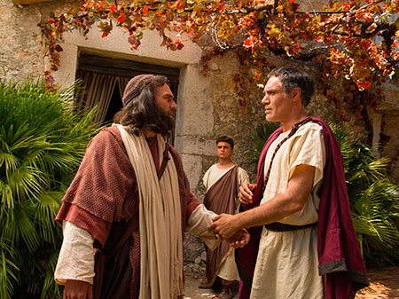
Caesarea
Joppa
^{10:23} So he invited them in and gave them lodging. And on the next day he got up and went away with them, and some of the brethren from Joppa accompanied him. ²⁴ On the following day he entered Caesarea.
^{10:23} So he invited them in and gave them lodging. And on the next day he got up and went away with them, and some of the brethren from Joppa accompanied him. ²⁴ On the following day he entered Caesarea.
^{10:25} When Peter entered, Cornelius met him, and fell at his feet and worshiped him. ²⁶ But Peter raised him up, saying, “Stand up; I too am just a man.” ²⁷ As he talked with him, he entered and found many people assembled.
^{10:25} When Peter entered, Cornelius met him, and fell at his feet and worshiped him. ²⁶ But Peter raised him up, saying, “Stand up; I too am just a man.” ²⁷ As he talked with him, he entered and found many people assembled.
^{10:25} When Peter entered, Cornelius met him, and fell at his feet and worshiped him. ²⁶ But Peter raised him up, saying, “Stand up; I too am just a man.” ²⁷ As he talked with him, he entered and found many people assembled.
^{10:25} When Peter entered, Cornelius met him, and fell at his feet and worshiped him. ²⁶ But Peter raised him up, saying, “Stand up; I too am just a man.” ²⁷ As he talked with him, he entered and found many people assembled.
God’s 3-stage plan for “the gospel”

Slide 47
Caesarea
This is awkward…
Joppa
^{10:23} So he invited them in and gave them lodging. And on the next day he got up and went away with them, and some of the brethren from Joppa accompanied him. ²⁴ On the following day he entered Caesarea.
^{10:23} So he invited them in and gave them lodging. And on the next day he got up and went away with them, and some of the brethren from Joppa accompanied him. ²⁴ On the following day he entered Caesarea.
^{10:25} When Peter entered, Cornelius met him, and fell at his feet and worshiped him. ²⁶ But Peter raised him up, saying, “Stand up; I too am just a man.” ²⁷ As he talked with him, he entered and found many people assembled.
^{10:25} When Peter entered, Cornelius met him, and fell at his feet and worshiped him. ²⁶ But Peter raised him up, saying, “Stand up; I too am just a man.” ²⁷ As he talked with him, he entered and found many people assembled.
^{10:25} When Peter entered, Cornelius met him, and fell at his feet and worshiped him. ²⁶ But Peter raised him up, saying, “Stand up; I too am just a man.” ²⁷ As he talked with him, he entered and found many people assembled.
^{10:25} When Peter entered, Cornelius met him, and fell at his feet and worshiped him. ²⁶ But Peter raised him up, saying, “Stand up; I too am just a man.” ²⁷ As he talked with him, he entered and found many people assembled.
God’s 3-stage plan for “the gospel”

Slide 48
Caesarea
This is awkward…
Joppa
Peter is being led further and further out of his comfort zone
^{10:23} So he invited them in and gave them lodging. And on the next day he got up and went away with them, and some of the brethren from Joppa accompanied him. ²⁴ On the following day he entered Caesarea.
^{10:23} So he invited them in and gave them lodging. And on the next day he got up and went away with them, and some of the brethren from Joppa accompanied him. ²⁴ On the following day he entered Caesarea.
^{10:25} When Peter entered, Cornelius met him, and fell at his feet and worshiped him. ²⁶ But Peter raised him up, saying, “Stand up; I too am just a man.” ²⁷ As he talked with him, he entered and found many people assembled.
^{10:25} When Peter entered, Cornelius met him, and fell at his feet and worshiped him. ²⁶ But Peter raised him up, saying, “Stand up; I too am just a man.” ²⁷ As he talked with him, he entered and found many people assembled.
^{10:25} When Peter entered, Cornelius met him, and fell at his feet and worshiped him. ²⁶ But Peter raised him up, saying, “Stand up; I too am just a man.” ²⁷ As he talked with him, he entered and found many people assembled.
^{10:25} When Peter entered, Cornelius met him, and fell at his feet and worshiped him. ²⁶ But Peter raised him up, saying, “Stand up; I too am just a man.” ²⁷ As he talked with him, he entered and found many people assembled.
God’s 3-stage plan for “the gospel”

Slide 49
^{10:28} And he said to them, “You yourselves know how unlawful it is for a man who is a Jew to associate with a foreigner or to visit him; and yet God has shown me that I should not call any man unholy or unclean.
^{10:28} And he said to them, “You yourselves know how unlawful it is for a man who is a Jew to associate with a foreigner or to visit him; and yet God has shown me that I should not call any man unholy or unclean.
God’s 3-stage plan for “the gospel”

Slide 50
Peter is interpreting his vision
^{10:28} And he said to them, “You yourselves know how unlawful it is for a man who is a Jew to associate with a foreigner or to visit him; and yet God has shown me that I should not call any man unholy or unclean.
^{10:28} And he said to them, “You yourselves know how unlawful it is for a man who is a Jew to associate with a foreigner or to visit him; and yet God has shown me that I should not call any man unholy or unclean.
God’s 3-stage plan for “the gospel”

Slide 51
God wasn’t just trying to open my eyes about food …
Peter is interpreting his vision
^{10:28} And he said to them, “You yourselves know how unlawful it is for a man who is a Jew to associate with a foreigner or to visit him; and yet God has shown me that I should not call any man unholy or unclean.
^{10:28} And he said to them, “You yourselves know how unlawful it is for a man who is a Jew to associate with a foreigner or to visit him; and yet God has shown me that I should not call any man unholy or unclean.
God’s 3-stage plan for “the gospel”

Slide 52
God wasn’t just trying to open my eyes about food …
Peter is interpreting his vision
He was trying open my eyes about PEOPLE.
^{10:28} And he said to them, “You yourselves know how unlawful it is for a man who is a Jew to associate with a foreigner or to visit him; and yet God has shown me that I should not call any man unholy or unclean.
^{10:28} And he said to them, “You yourselves know how unlawful it is for a man who is a Jew to associate with a foreigner or to visit him; and yet God has shown me that I should not call any man unholy or unclean.
God’s 3-stage plan for “the gospel”

Slide 53
God wasn’t just trying to open my eyes about food …
Peter is interpreting his vision
He was trying open my eyes about PEOPLE.
God: I love all people. I desire to rescue all people. And your prejudice has to go – not just because it’s WRONG, but also because now it is a direct obstacle to the next stage of my plan
^{10:28} And he said to them, “You yourselves know how unlawful it is for a man who is a Jew to associate with a foreigner or to visit him; and yet God has shown me that I should not call any man unholy or unclean.
^{10:28} And he said to them, “You yourselves know how unlawful it is for a man who is a Jew to associate with a foreigner or to visit him; and yet God has shown me that I should not call any man unholy or unclean.
God’s 3-stage plan for “the gospel”

Slide 54
^{10:29} That is why I came without even raising any objection when I was sent for. So I ask for what reason you have sent for me.”
^{10:28} And he said to them, “You yourselves know how unlawful it is for a man who is a Jew to associate with a foreigner or to visit him; and yet God has shown me that I should not call any man unholy or unclean. ²⁹
God’s 3-stage plan for “the gospel”

Slide 55
Peter was open to God leading him in counterintuitive ways
^{10:29} That is why I came without even raising any objection when I was sent for. So I ask for what reason you have sent for me.”
^{10:28} And he said to them, “You yourselves know how unlawful it is for a man who is a Jew to associate with a foreigner or to visit him; and yet God has shown me that I should not call any man unholy or unclean. ²⁹
God’s 3-stage plan for “the gospel”

Slide 56
Peter was open to God leading him in counterintuitive ways
If you’re going to make your life about following God’s path… you’re going to be in for some surprises.
^{10:29} That is why I came without even raising any objection when I was sent for. So I ask for what reason you have sent for me.”
^{10:28} And he said to them, “You yourselves know how unlawful it is for a man who is a Jew to associate with a foreigner or to visit him; and yet God has shown me that I should not call any man unholy or unclean. ²⁹
God’s 3-stage plan for “the gospel”

Slide 57
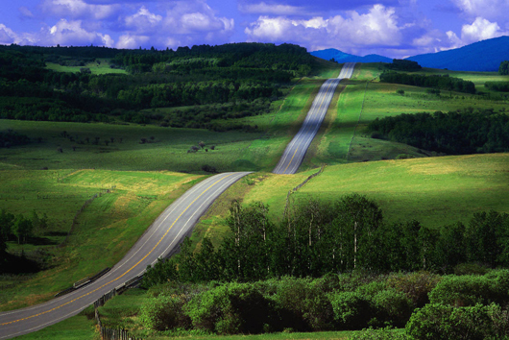
Peter was open to God leading him in counterintuitive ways
If you’re going to make your life about following God’s path… you’re going to be in for some surprises.
^{10:29} That is why I came without even raising any objection when I was sent for. So I ask for what reason you have sent for me.”
^{10:28} And he said to them, “You yourselves know how unlawful it is for a man who is a Jew to associate with a foreigner or to visit him; and yet God has shown me that I should not call any man unholy or unclean. ²⁹
God’s 3-stage plan for “the gospel”

Slide 58
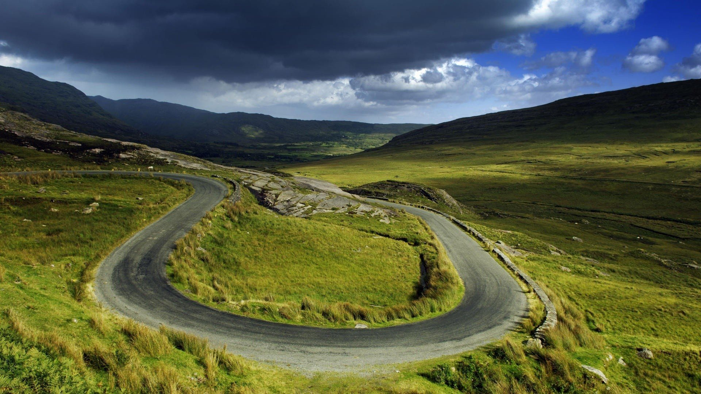
Peter was open to God leading him in counterintuitive ways
If you’re going to make your life about following God’s path… you’re going to be in for some surprises.
^{10:29} That is why I came without even raising any objection when I was sent for. So I ask for what reason you have sent for me.”
^{10:28} And he said to them, “You yourselves know how unlawful it is for a man who is a Jew to associate with a foreigner or to visit him; and yet God has shown me that I should not call any man unholy or unclean. ²⁹
God’s 3-stage plan for “the gospel”

Slide 59
Peter was open to God leading him in counterintuitive ways
What’s your attitude going to be?
If you’re going to make your life about following God’s path… you’re going to be in for some surprises.
^{10:29} That is why I came without even raising any objection when I was sent for. So I ask for what reason you have sent for me.”
^{10:28} And he said to them, “You yourselves know how unlawful it is for a man who is a Jew to associate with a foreigner or to visit him; and yet God has shown me that I should not call any man unholy or unclean. ²⁹
God’s 3-stage plan for “the gospel”

Slide 60
Peter was open to God leading him in counterintuitive ways
What’s your attitude going to be?
If you’re going to make your life about following God’s path… you’re going to be in for some surprises.
Dismay?
^{10:29} That is why I came without even raising any objection when I was sent for. So I ask for what reason you have sent for me.”
^{10:28} And he said to them, “You yourselves know how unlawful it is for a man who is a Jew to associate with a foreigner or to visit him; and yet God has shown me that I should not call any man unholy or unclean. ²⁹
God’s 3-stage plan for “the gospel”

Slide 61
Peter was open to God leading him in counterintuitive ways
What’s your attitude going to be?
If you’re going to make your life about following God’s path… you’re going to be in for some surprises.
Resist?
^{10:29} That is why I came without even raising any objection when I was sent for. So I ask for what reason you have sent for me.”
^{10:28} And he said to them, “You yourselves know how unlawful it is for a man who is a Jew to associate with a foreigner or to visit him; and yet God has shown me that I should not call any man unholy or unclean. ²⁹
God’s 3-stage plan for “the gospel”

Slide 62
Peter was open to God leading him in counterintuitive ways
What’s your attitude going to be?
If you’re going to make your life about following God’s path… you’re going to be in for some surprises.
Or you can go without misgivings
^{10:29} That is why I came without even raising any objection when I was sent for. So I ask for what reason you have sent for me.”
^{10:28} And he said to them, “You yourselves know how unlawful it is for a man who is a Jew to associate with a foreigner or to visit him; and yet God has shown me that I should not call any man unholy or unclean. ²⁹
God’s 3-stage plan for “the gospel”

Slide 63
^{10:29} That is why I came without even raising any objection when I was sent for. So I ask for what reason you have sent for me.”
^{10:28} And he said to them, “You yourselves know how unlawful it is for a man who is a Jew to associate with a foreigner or to visit him; and yet God has shown me that I should not call any man unholy or unclean. ²⁹
God’s 3-stage plan for “the gospel”

Slide 64
^{10:30} Cornelius said, “Four days ago to this hour, I was praying in my house during the ninth hour; and behold, a man stood before me in shining garments, ³¹ and he said, ‘Cornelius, your prayer has been heard and your alms have been remembered before God. ³² Therefore send to Joppa and invite Simon, who is also called Peter, to come to you; he is staying at the house of Simon the tanner by the sea.’ ³³ So I sent for you immediately, and you have been kind enough to come.
^{10:30} Cornelius said, “Four days ago to this hour, I was praying in my house during the ninth hour; and behold, a man stood before me in shining garments, ³¹ and he said, ‘Cornelius, your prayer has been heard and your alms have been remembered before God. ³² Therefore send to Joppa and invite Simon, who is also called Peter, to come to you; he is staying at the house of Simon the tanner by the sea.’ ³³ So I sent for you immediately, and you have been kind enough to come.

Slide 65
That would be creepy…
^{10:30} Cornelius said, “Four days ago to this hour, I was praying in my house during the ninth hour; and behold, a man stood before me in shining garments, ³¹ and he said, ‘Cornelius, your prayer has been heard and your alms have been remembered before God. ³² Therefore send to Joppa and invite Simon, who is also called Peter, to come to you; he is staying at the house of Simon the tanner by the sea.’ ³³ So I sent for you immediately, and you have been kind enough to come.
^{10:30} Cornelius said, “Four days ago to this hour, I was praying in my house during the ninth hour; and behold, a man stood before me in shining garments, ³¹ and he said, ‘Cornelius, your prayer has been heard and your alms have been remembered before God. ³² Therefore send to Joppa and invite Simon, who is also called Peter, to come to you; he is staying at the house of Simon the tanner by the sea.’ ³³ So I sent for you immediately, and you have been kind enough to come.

Slide 66
Super-specific details
That would be creepy…
^{10:30} Cornelius said, “Four days ago to this hour, I was praying in my house during the ninth hour; and behold, a man stood before me in shining garments, ³¹ and he said, ‘Cornelius, your prayer has been heard and your alms have been remembered before God. ³² Therefore send to Joppa and invite Simon, who is also called Peter, to come to you; he is staying at the house of Simon the tanner by the sea.’ ³³ So I sent for you immediately, and you have been kind enough to come.
^{10:30} Cornelius said, “Four days ago to this hour, I was praying in my house during the ninth hour; and behold, a man stood before me in shining garments, ³¹ and he said, ‘Cornelius, your prayer has been heard and your alms have been remembered before God. ³² Therefore send to Joppa and invite Simon, who is also called Peter, to come to you; he is staying at the house of Simon the tanner by the sea.’ ³³ So I sent for you immediately, and you have been kind enough to come.

Slide 67
parallel experiences
That would be creepy…
^{10:30} Cornelius said, “Four days ago to this hour, I was praying in my house during the ninth hour; and behold, a man stood before me in shining garments, ³¹ and he said, ‘Cornelius, your prayer has been heard and your alms have been remembered before God. ³² Therefore send to Joppa and invite Simon, who is also called Peter, to come to you; he is staying at the house of Simon the tanner by the sea.’ ³³ So I sent for you immediately, and you have been kind enough to come.

Slide 68
Complementary visions
That would be creepy…
^{10:30} Cornelius said, “Four days ago to this hour, I was praying in my house during the ninth hour; and behold, a man stood before me in shining garments, ³¹ and he said, ‘Cornelius, your prayer has been heard and your alms have been remembered before God. ³² Therefore send to Joppa and invite Simon, who is also called Peter, to come to you; he is staying at the house of Simon the tanner by the sea.’ ³³ So I sent for you immediately, and you have been kind enough to come.

Slide 69
Synchronized timing
That would be creepy…
^{10:30} Cornelius said, “Four days ago to this hour, I was praying in my house during the ninth hour; and behold, a man stood before me in shining garments, ³¹ and he said, ‘Cornelius, your prayer has been heard and your alms have been remembered before God. ³² Therefore send to Joppa and invite Simon, who is also called Peter, to come to you; he is staying at the house of Simon the tanner by the sea.’ ³³ So I sent for you immediately, and you have been kind enough to come.

Slide 70
God orchestrated all of this!
Why?
O M G
^{10:30} Cornelius said, “Four days ago to this hour, I was praying in my house during the ninth hour; and behold, a man stood before me in shining garments, ³¹ and he said, ‘Cornelius, your prayer has been heard and your alms have been remembered before God. ³² Therefore send to Joppa and invite Simon, who is also called Peter, to come to you; he is staying at the house of Simon the tanner by the sea.’ ³³ So I sent for you immediately, and you have been kind enough to come.

Slide 71
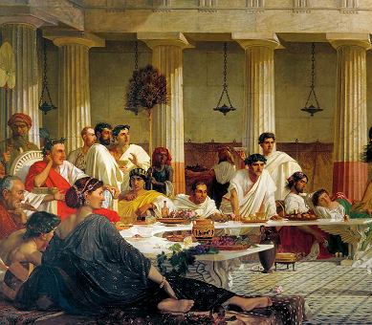
^{10:33} Now then, we are all here present before God to hear all that you have been commanded by the Lord.”

Slide 72
^{10:23} So he invited them in and gave them lodging. And on the next day he got up and went away with them, and some of the brethren from Joppa accompanied him. ²⁴ On the following day he entered Caesarea.
^{10:23} So he invited them in and gave them lodging. And on the next day he got up and went away with them, and some of the brethren from Joppa accompanied him. ²⁴ On the following day he entered Caesarea.
^{10:34} Opening his mouth, Peter said: “I most certainly
understand now that God is not one to show partiality,³⁵ but in every nation the man who fears Him and does what is right is welcome to Him.
^{10:34} Opening his mouth, Peter said: “I most certainly
understand now that God is not one to show partiality,³⁵ but in every nation the man who fears Him and does what is right is welcome to Him.
^{10:34} Opening his mouth, Peter said: “I most certainly
understand now that God is not one to show partiality,³⁵ but in every nation the man who fears Him and does what is right is welcome to Him.
God’s 3-stage plan for “the gospel”

Slide 73
There is a message – handed down from God through Israel
It is a message of peace between man and God
^{10:36} The word which He sent to the sons of Israel, preaching peace through Jesus Christ (He is Lord of all)— ³⁷ you yourselves know the thing which took place throughout all Judea, starting from Galilee, after the baptism which John proclaimed.
^{10:36} The word which He sent to the sons of Israel, preaching peace through Jesus Christ (He is Lord of all)— ³⁷ you yourselves know the thing which took place throughout all Judea, starting from Galilee, after the baptism which John proclaimed.

Slide 74
Jesus Christ is the Messiah
A claim that is well-supported by historical evidence
^{10:36} The word which He sent to the sons of Israel, preaching peace through Jesus Christ (He is Lord of all)— ³⁷ you yourselves know the thing which took place throughout all Judea, starting from Galilee, after the baptism which John proclaimed.
^{10:36} The word which He sent to the sons of Israel, preaching peace through Jesus Christ (He is Lord of all)— ³⁷ you yourselves know the thing which took place throughout all Judea, starting from Galilee, after the baptism which John proclaimed.
^{10:36} The word which He sent to the sons of Israel, preaching peace through Jesus Christ (He is Lord of all)— ³⁷ you yourselves know the thing which took place throughout all Judea, starting from Galilee, after the baptism which John proclaimed.

Slide 75
Jesus Christ is the Messiah
A claim that is well-supported by historical evidence
^{10:38} You know of Jesus of Nazareth, how God anointed Him with the Holy Spirit and with power, and how He went about doing good and healing all who were oppressed by the devil, for God was with Him.

Slide 76
Jesus Christ is the Messiah
A claim that is well-supported by historical evidence
^{10:39} We are witnesses of all the things He did both in the land of the Jews and in Jerusalem.

Slide 77
He was killed, and raised from the dead
^{10:39} They also put Him to death by hanging Him on a cross. ⁴⁰ God raised Him up on the third day and granted that He become visible, ⁴¹ not to all the people, but to witnesses who were chosen beforehand by God, that is, to us who ate and drank with Him after He arose from the dead.

Slide 78
He was killed, and raised from the dead
^{10:42} And He ordered us to preach to the people, and solemnly to testify that this is the One who has been appointed by God as Judge of the living and the dead.

Slide 79
Bad news:
He will judge right and wrong for each person based on His perfect standard
^{10:42} And He ordered us to preach to the people, and solemnly to testify that this is the One who has been appointed by God as Judge of the living and the dead.

Slide 80
This was all predicted in the scriptures hundreds of years in advance
^{10:43} Of Him all the prophets bear witness that through His name everyone who believes in Him receives forgiveness of sins.”

Slide 81
Good News: He paid for all sin once for all on the cross – and invites you to turn to Him to be forgiven!
^{10:43} Of Him all the prophets bear witness that through His name everyone who believes in Him receives forgiveness of sins.”

Slide 82
Good News: He paid for all sin once for all on the cross – and invites you to turn to Him to be forgiven!
^{10:44} While Peter was still speaking these words, the Holy Spirit fell upon all those who were listening to the message.

Slide 83
^{10:45} All the circumcised believers who came with Peter were amazed, because the gift of the Holy Spirit had been poured out on the Gentiles also ⁴⁶ For they were hearing them speaking with tongues and exalting God.
^{10:45} All the circumcised believers who came with Peter were amazed, because the gift of the Holy Spirit had been poured out on the Gentiles also ⁴⁶ For they were hearing them speaking with tongues and exalting God.

Slide 84
Gentiles?!
^{10:45} All the circumcised believers who came with Peter were amazed, because the gift of the Holy Spirit had been poured out on the Gentiles also ⁴⁶ For they were hearing them speaking with tongues and exalting God.
^{10:45} All the circumcised believers who came with Peter were amazed, because the gift of the Holy Spirit had been poured out on the Gentiles also ⁴⁶ For they were hearing them speaking with tongues and exalting God.

Slide 85
The gospel has made an incremental progression outward all through the book
The 12 – the 120 – “devout men” – Hebraic Jews – Hellenistic Jews – “all Jerusalem” – Priests – Judeans – Samaritans – Ethiopian Eunuch – God’s enemies …
Gentiles?!
^{10:45} All the circumcised believers who came with Peter were amazed, because the gift of the Holy Spirit had been poured out on the Gentiles also ⁴⁶ For they were hearing them speaking with tongues and exalting God.
^{10:45} All the circumcised believers who came with Peter were amazed, because the gift of the Holy Spirit had been poured out on the Gentiles also ⁴⁶ For they were hearing them speaking with tongues and exalting God.

Slide 86
for Jews…
for Gentiles…
for everyone!
^{10:45} All the circumcised believers who came with Peter were amazed, because the gift of the Holy Spirit had been poured out on the Gentiles also ⁴⁶ For they were hearing them speaking with tongues and exalting God.
^{10:45} All the circumcised believers who came with Peter were amazed, because the gift of the Holy Spirit had been poured out on the Gentiles also ⁴⁶ For they were hearing them speaking with tongues and exalting God.

Slide 87
for Jews…
for Gentiles…
for everyone!
^{10:45} All the circumcised believers who came with Peter were amazed, because the gift of the Holy Spirit had been poured out on the Gentiles also ⁴⁶ For they were hearing them speaking with tongues and exalting God.
^{10:46} Then Peter answered, ⁴⁷ “Surely no one can refuse the water for these to be baptized who have received the Holy Spirit just as we did, can he?” ⁴⁸ And he ordered them to be baptized in the name of Jesus Christ. Then they asked him to stay on for a few days.

Slide 88
So what’s the point for us?

Slide 89
God cares about the people who are “far away”
So what’s the point for us?

Slide 90
God cares about the people who are “far away”
^{Eph2:11} Once you were far away from God, but now you have been brought near to him through the blood of Christ...
^{Eph2:17} He brought this Good News of peace to you Gentiles who were far away from him, and peace to the Jews who were near.
So what’s the point for us?

Slide 91
God cares about the people who are “far away”
¹⁸ Now all of us can come to the Father through the same Holy Spirit because of what Christ has done for us.
^{Eph2:19} So now you Gentiles are no longer strangers and foreigners. You are citizens along with all of God’s holy people. You are members of God’s family.
So what’s the point for us?

Slide 92
God intends for the gospel to move outward…
So what’s the point for us?

Slide 93
God intends for the gospel to move outward…
And we are His messengers
So what’s the point for us?

Slide 94
Who are the people who are
“far off” in your life?
Who are the most different from you …
Who are the hardest for you to love …
Who seem beyond the reach of the gospel …

Slide 95
Are you willing to be led out of your comfort zone?

Slide 96
Acts

