Slide 1
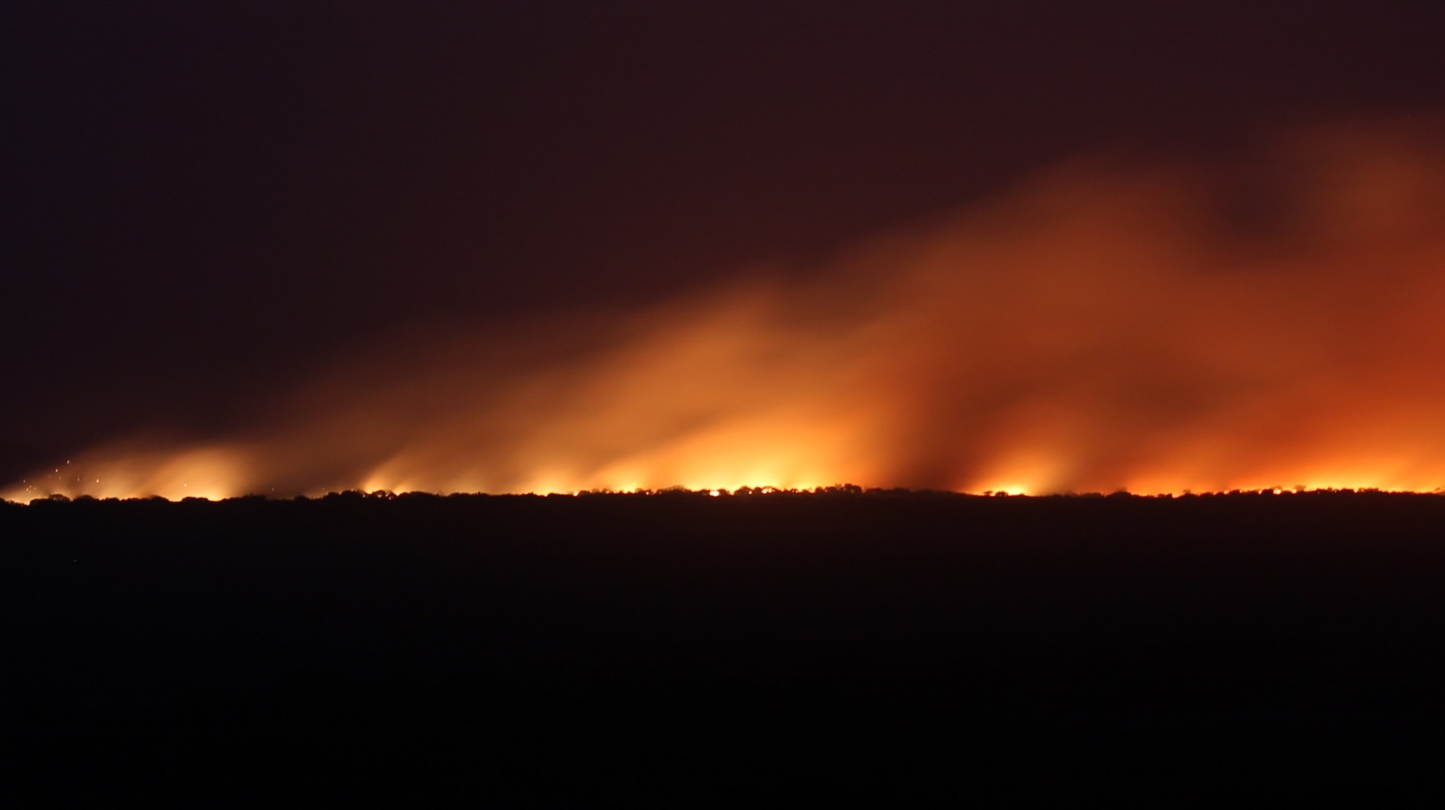
1 Peter 1:1-12
Living Hope

Slide 2
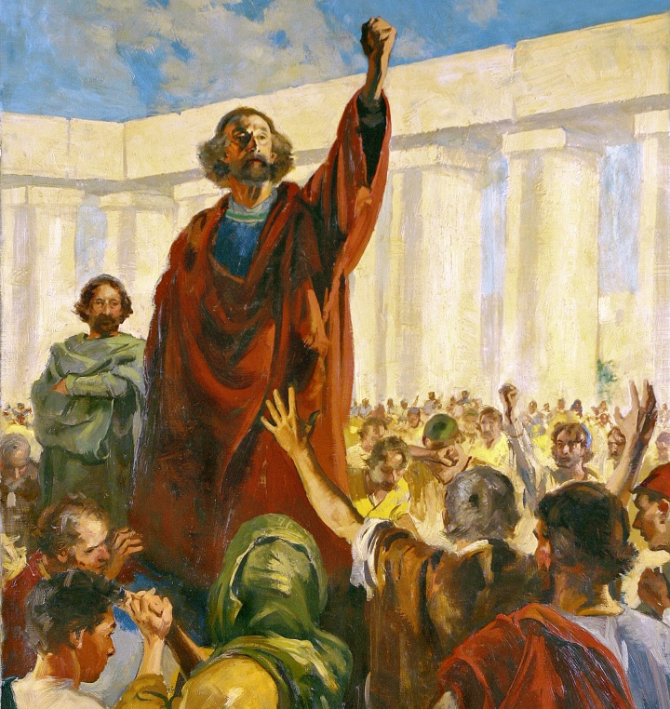
^{1 Peter 1:1} Peter, an apostle of Jesus Christ, To those who reside as aliens, scattered throughout Pontus, Galatia, Cappadocia, Asia, and Bithynia, who are chosen ² according to the foreknowledge of God the Father, by the sanctifying work of the Spirit, to obey Jesus Christ and be sprinkled with His blood: May grace and peace be yours in the fullest measure.
^{1 Peter 1:1} Peter, an apostle of Jesus Christ, To those who reside as aliens, scattered throughout Pontus, Galatia, Cappadocia, Asia, and Bithynia, who are chosen ² according to the foreknowledge of God the Father, by the sanctifying work of the Spirit, to obey Jesus Christ and be sprinkled with His blood: May grace and peace be yours in the fullest measure.

Slide 3
^{1 Peter 1:1} Peter, an apostle of Jesus Christ, To those who reside as aliens, scattered throughout Pontus, Galatia, Cappadocia, Asia, and Bithynia, who are chosen ² according to the foreknowledge of God the Father, by the sanctifying work of the Spirit, to obey Jesus Christ and be sprinkled with His blood: May grace and peace be yours in the fullest measure.

Slide 4
^{1 Peter 1:1} Peter, an apostle of Jesus Christ, To those who reside as aliens, scattered throughout Pontus, Galatia, Cappadocia, Asia, and Bithynia, who are chosen ² according to the foreknowledge of God the Father, by the sanctifying work of the Spirit, to obey Jesus Christ and be sprinkled with His blood: May grace and peace be yours in the fullest measure.

Slide 5
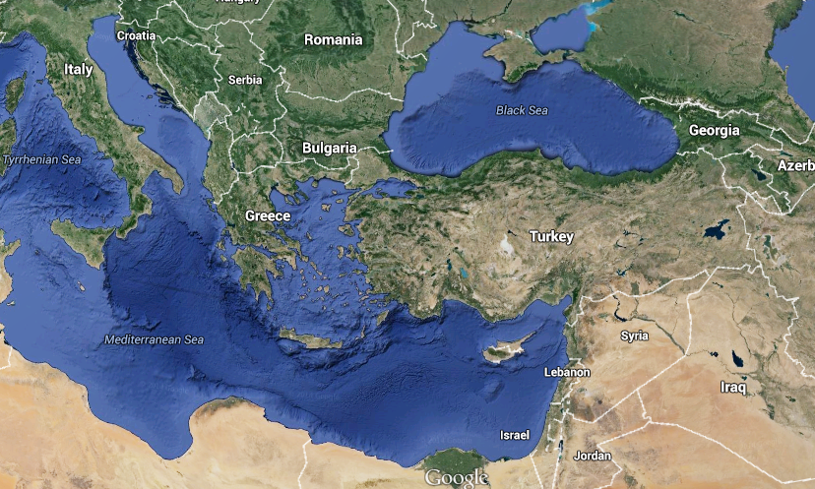
^{1 Peter 1:1} Peter, an apostle of Jesus Christ, To those who reside as aliens, scattered throughout Pontus, Galatia, Cappadocia, Asia, and Bithynia, who are chosen ² according to the foreknowledge of God the Father, by the sanctifying work of the Spirit, to obey Jesus Christ and be sprinkled with His blood: May grace and peace be yours in the fullest measure.
Rome
Jerusalem

Slide 6
^{1 Peter 1:1} Peter, an apostle of Jesus Christ, To those who reside as aliens, scattered throughout Pontus, Galatia, Cappadocia, Asia, and Bithynia, who are chosen ² according to the foreknowledge of God the Father, by the sanctifying work of the Spirit, to obey Jesus Christ and be sprinkled with His blood: May grace and peace be yours in the fullest measure.
Rome
Jerusalem

Slide 7
^{1 Peter 1:1} Peter, an apostle of Jesus Christ, To those who reside as aliens, scattered throughout Pontus, Galatia, Cappadocia, Asia, and Bithynia, who are chosen ² according to the foreknowledge of God the Father, by the sanctifying work of the Spirit, to obey Jesus Christ and be sprinkled with His blood: May grace and peace be yours in the fullest measure.
Rome
Jerusalem

Slide 8
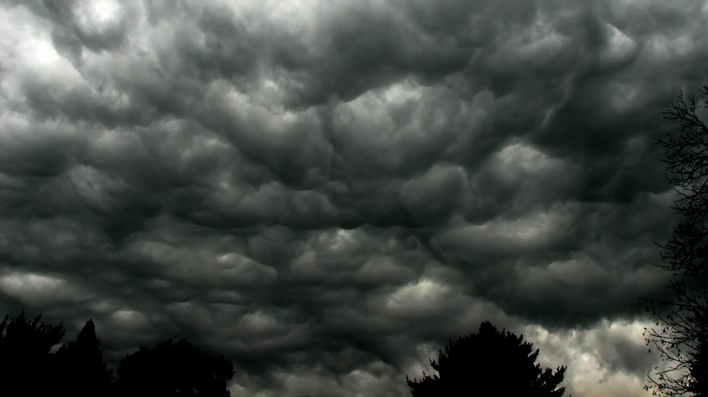
Rising Tension
^{1:6} … distressed by various trials …
^{2:4} … rejected by men …
^{2:12} … they slander you as evildoers…
^{1Pet 3} … slandered … reviled … insulted…
^{4:5} … they malign you …
^{4:12} … fiery ordeal among you …

Slide 9
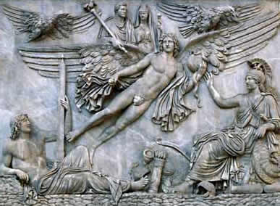
Rising Tension
Religious Tension
Tension with Rome

Slide 10
Rising Tension
Religious Tension
Tension with Rome
Suspicion and Rumors
Social Tension
Burgeoning Persecution

Slide 11
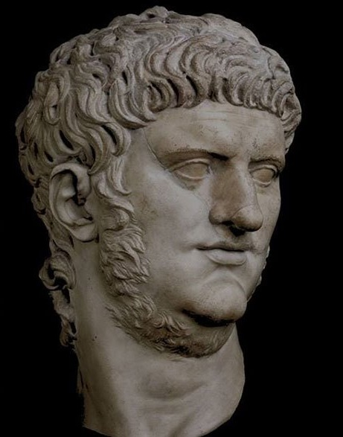
Rising Tension
Religious Tension
Tension with Rome
Suspicion and Rumors
Social Tension
Burgeoning Persecution

Slide 12
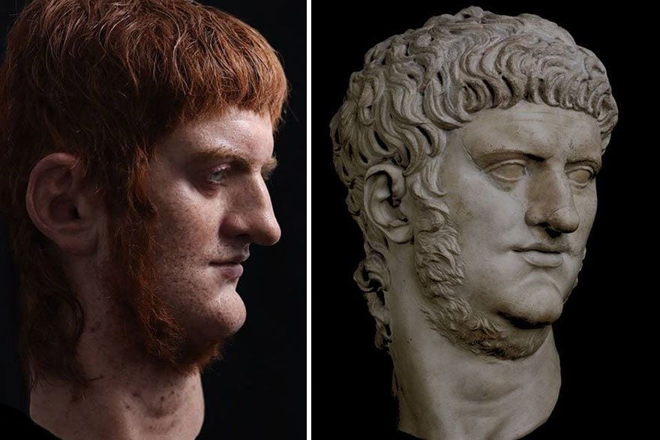
Rising Tension
Religious Tension
Tension with Rome
Suspicion and Rumors
Social Tension
Burgeoning Persecution

Slide 13
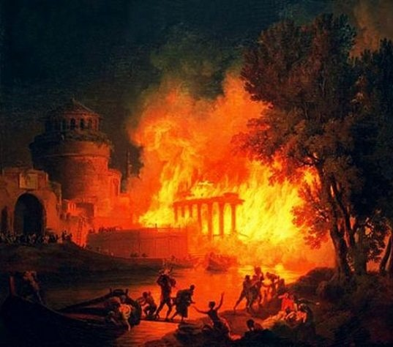
Rising Tension
Religious Tension
Tension with Rome
Suspicion and Rumors
Social Tension
Burgeoning Persecution

Slide 14
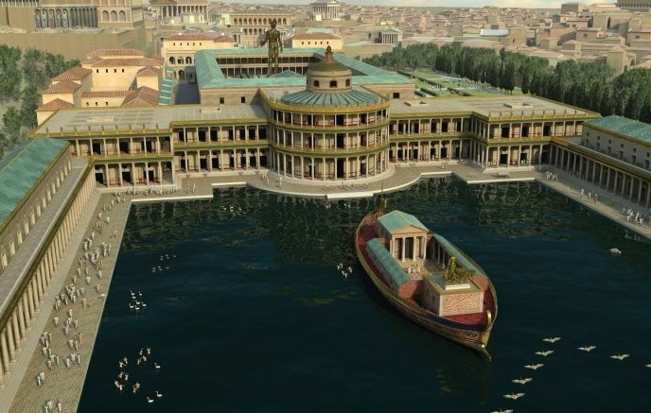

Slide 15
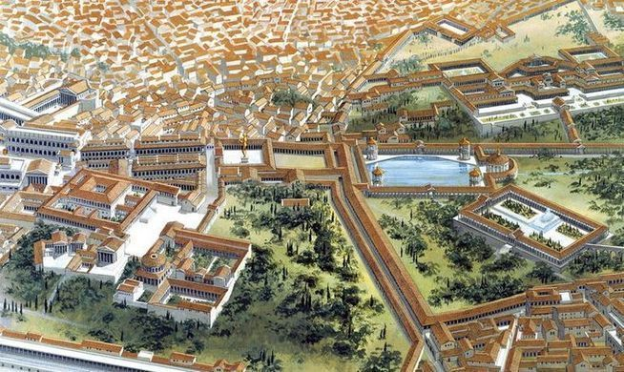

Slide 16
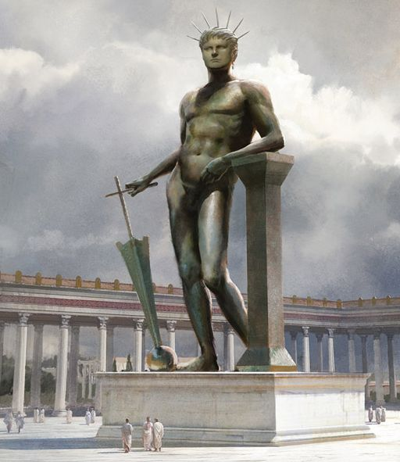

Slide 17
^{Tacitus, Annals} Consequently, to get rid of the report, Nero fastened the guilt and inflicted the most exquisite tortures on a class hated for their abominations, called Christians by the populace. Christus, from whom the name had its origin, suffered the extreme penalty during the reign of Tiberius at the hands of one of our procurators, Pontius Pilatus, and a most mischievous superstition, thus checked for the moment, again broke out not only in

Slide 18
Judea, the first source of the evil, but even in Rome, where all things hideous and shameful from every part of the world find their center and become popular. Accordingly, an arrest was first made of all who pleaded guilty; then, upon their information, an immense multitude was convicted, not so much of the crime of firing the city, as of hatred against mankind. Mockery of every sort was added to their deaths. Covered with the skins of beasts, they were torn by

Slide 19
dogs and perished, or were nailed to crosses, or were doomed to the flames and burnt, to serve as a nightly illumination, when daylight had expired. Nero offered his gardens for the spectacle, and was exhibiting a show in the circus, while he mingled with the people in the dress of a charioteer or stood aloft on a car.

Slide 20
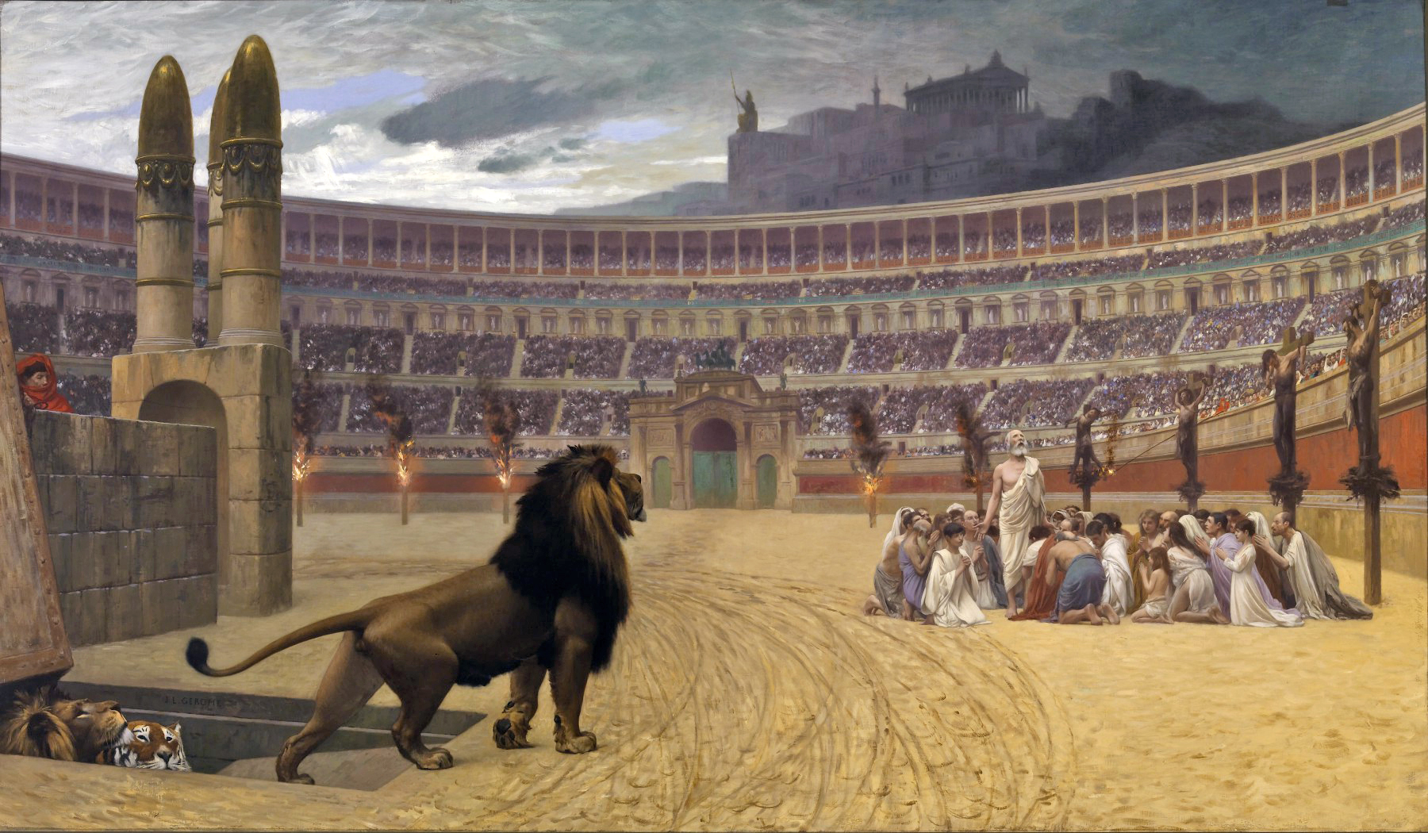
dogs and perished, or were nailed to crosses, or were doomed to the flames and burnt, to serve as a nightly illumination, when daylight had expired. Nero offered his gardens for the spectacle, and was exhibiting a show in the circus, while he mingled with the people in the dress of a charioteer or stood aloft on a car.

Slide 21
How do you encourage people facing a “fiery ordeal”?

Slide 22
How do you encourage people facing a “fiery ordeal”?
^{1 Peter 1:1} … who are chosen ² according to the foreknowledge of God the Father, by the sanctifying work of the Spirit, to obey Jesus Christ and be sprinkled with His blood: May grace and peace be yours in the fullest measure.

Slide 23
How do you encourage people facing a “fiery ordeal”?
^{1:3} Blessed be the God and Father of our Lord Jesus Christ, who according to His great mercy has caused us to be born again to a living hope through the resurrection of Jesus Christ from the dead,

Slide 24
How do you encourage people facing a “fiery ordeal”?
^{1:3} Blessed be the God and Father of our Lord Jesus Christ, who according to His great mercy has caused us to be born again to a living hope through the resurrection of Jesus Christ from the dead,

Slide 25
“Praise God!”
^{1:3} Blessed be the God and Father of our Lord Jesus Christ, who according to His great mercy has caused us to be born again to a living hope through the resurrection of Jesus Christ from the dead,

Slide 26
“Praise God!”
^{1:3} Blessed be the God and Father of our Lord Jesus Christ, who according to His great mercy has caused us to be born again to a living hope through the resurrection of Jesus Christ from the dead,

Slide 27
“Eternal Perspective”
“Praise God! You have HOPE through Jesus Christ”
^{1:3} Blessed be the God and Father of our Lord Jesus Christ, who according to His great mercy has caused us to be born again to a living hope through the resurrection of Jesus Christ from the dead,

Slide 28
The foundation of the Christian life is a forward-looking hope
^{1:3} Blessed be the God and Father of our Lord Jesus Christ, who according to His great mercy has caused us to be born again to a living hope through the resurrection of Jesus Christ from the dead,

Slide 29
The foundation of the Christian life is a forward-looking hope
^{1:3} Blessed be the God and Father of our Lord Jesus Christ, who according to His great mercy has caused us to be born again to a living hope through the resurrection of Jesus Christ from the dead, ⁴ to obtain an inheritance which is imperishable and undefiled and will not fade away, reserved in heaven for you,⁵ who are protected by the power of God through faith for a salvation ready to be revealed in the last time. ⁶ In this you greatly rejoice, even though now for a little while, if necessary,

Slide 30
The foundation of the Christian life is a forward-looking hope
^{1:6} you have been distressed by various trials, ⁷ so that the proof of your faith, being more precious than gold which is perishable, even though tested by fire, may be found to result in praise and glory and honor at the revelation of Jesus Christ; ⁸ and though you have not seen Him, you love Him, and though you do not see Him now, but believe in Him, you greatly rejoice with joy inexpressible and full of glory, ⁹ obtaining as the outcome of your faith the salvation of your souls.

Slide 31
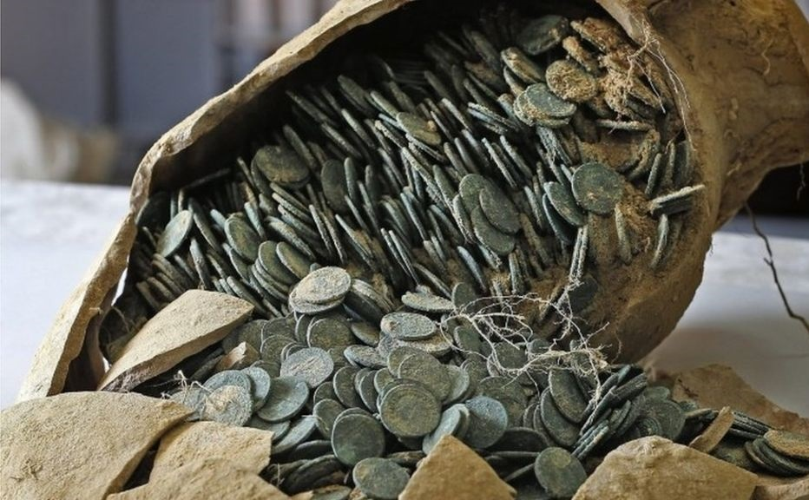
^{1:4} to obtain an
inheritance which is imperishable and undefiled and will not fade away, reserved in heaven for you, ⁵ who are protected by the power of God through faith for a salvation ready to be revealed in the last time.
1) The object of our hope: Inheritance
Wealth, property, residence, livestock, family name, title, status, reputation, debts/promises

Slide 32
^{1:4} to obtain an
inheritance which is imperishable and undefiled and will not fade away, reserved in heaven for you, ⁵ who are protected by the power of God through faith for a salvation ready to be revealed in the last time.
1) The object of our hope: Inheritance
^{1:3} who according to His great mercy has caused us to be born again to a living hope through the resurrection of Jesus Christ from the dead, ⁴ to obtain an inheritance

Slide 33
^{1:4} to obtain an
inheritance which is imperishable and undefiled and will not fade away, reserved in heaven for you, ⁵ who are protected by the power of God through faith for a salvation ready to be revealed in the last time.
1) The object of our hope: Inheritance
^{1:3} who according to His great mercy has caused us to be born again to a living hope through the resurrection of Jesus Christ from the dead, ⁴ to obtain an inheritance

Slide 34
^{1:4} to obtain an
inheritance which is imperishable and undefiled and will not fade away, reserved in heaven for you, ⁵ who are protected by the power of God through faith for a salvation ready to be revealed in the last time.
1) The object of our hope: Inheritance

Slide 35
^{1:4} to obtain an
inheritance which is imperishable and undefiled and will not fade away, reserved in heaven for you, ⁵ who are protected by the power of God through faith for a salvation ready to be revealed in the last time.
1) The object of our hope: Inheritance

Slide 36
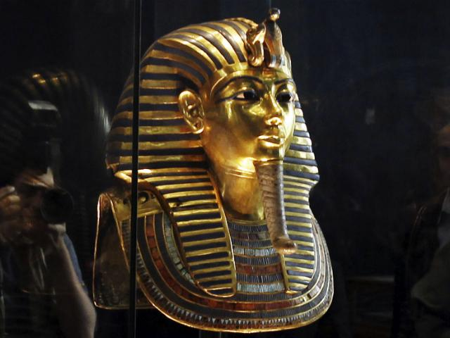
^{1:4} to obtain an
inheritance which is imperishable and undefiled and will not fade away, reserved in heaven for you, ⁵ who are protected by the power of God through faith for a salvation ready to be revealed in the last time.
1) The object of our hope: Inheritance

Slide 37
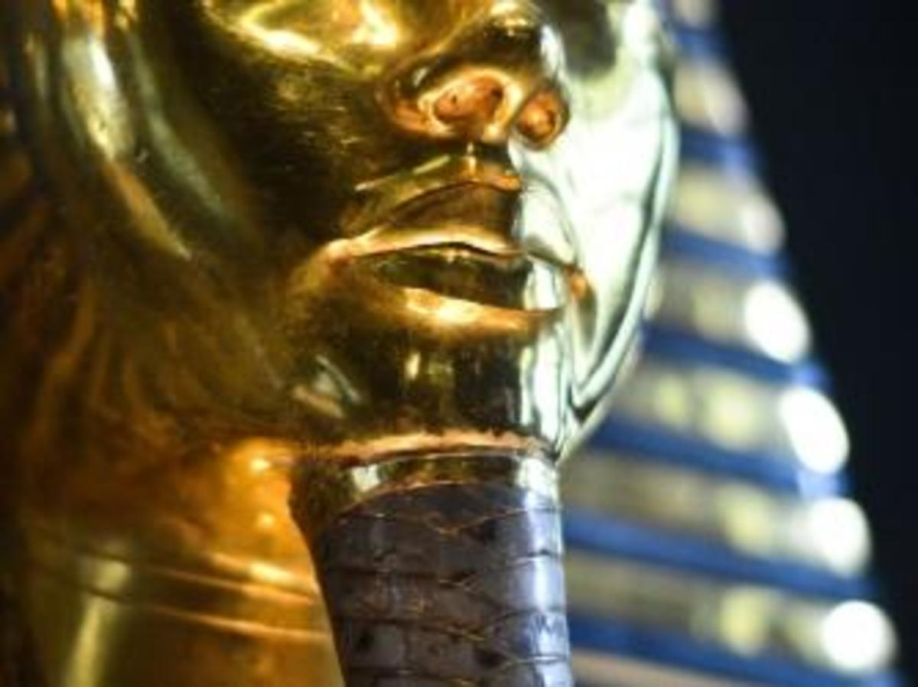
^{1:4} to obtain an
inheritance which is imperishable and undefiled and will not fade away, reserved in heaven for you, ⁵ who are protected by the power of God through faith for a salvation ready to be revealed in the last time.
1) The object of our hope: Inheritance

Slide 38
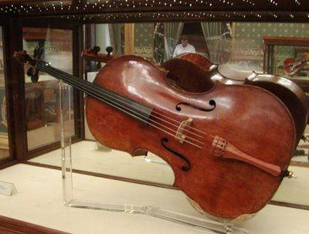
^{1:4} to obtain an
inheritance which is imperishable and undefiled and will not fade away, reserved in heaven for you, ⁵ who are protected by the power of God through faith for a salvation ready to be revealed in the last time.
1) The object of our hope: Inheritance

Slide 39
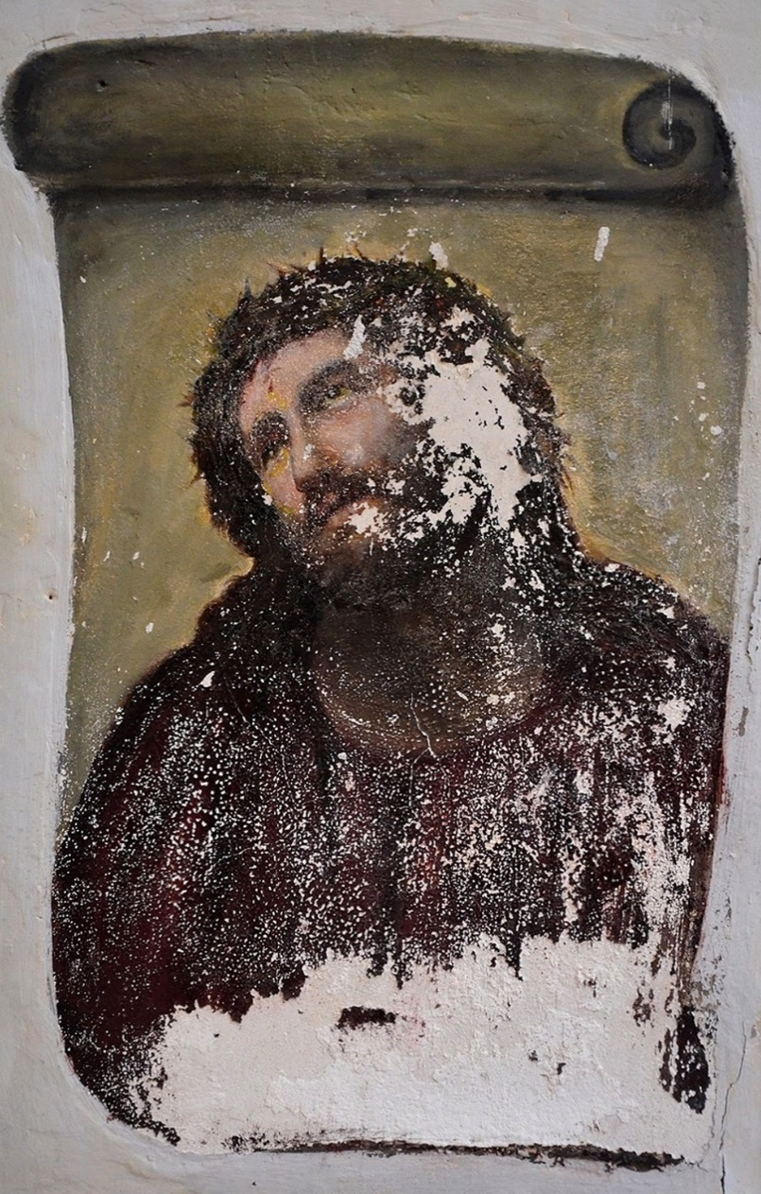
^{1:4} to obtain an
inheritance which is imperishable and undefiled and will not fade away, reserved in heaven for you, ⁵ who are protected by the power of God through faith for a salvation ready to be revealed in the last time.
1) The object of our hope: Inheritance

Slide 40
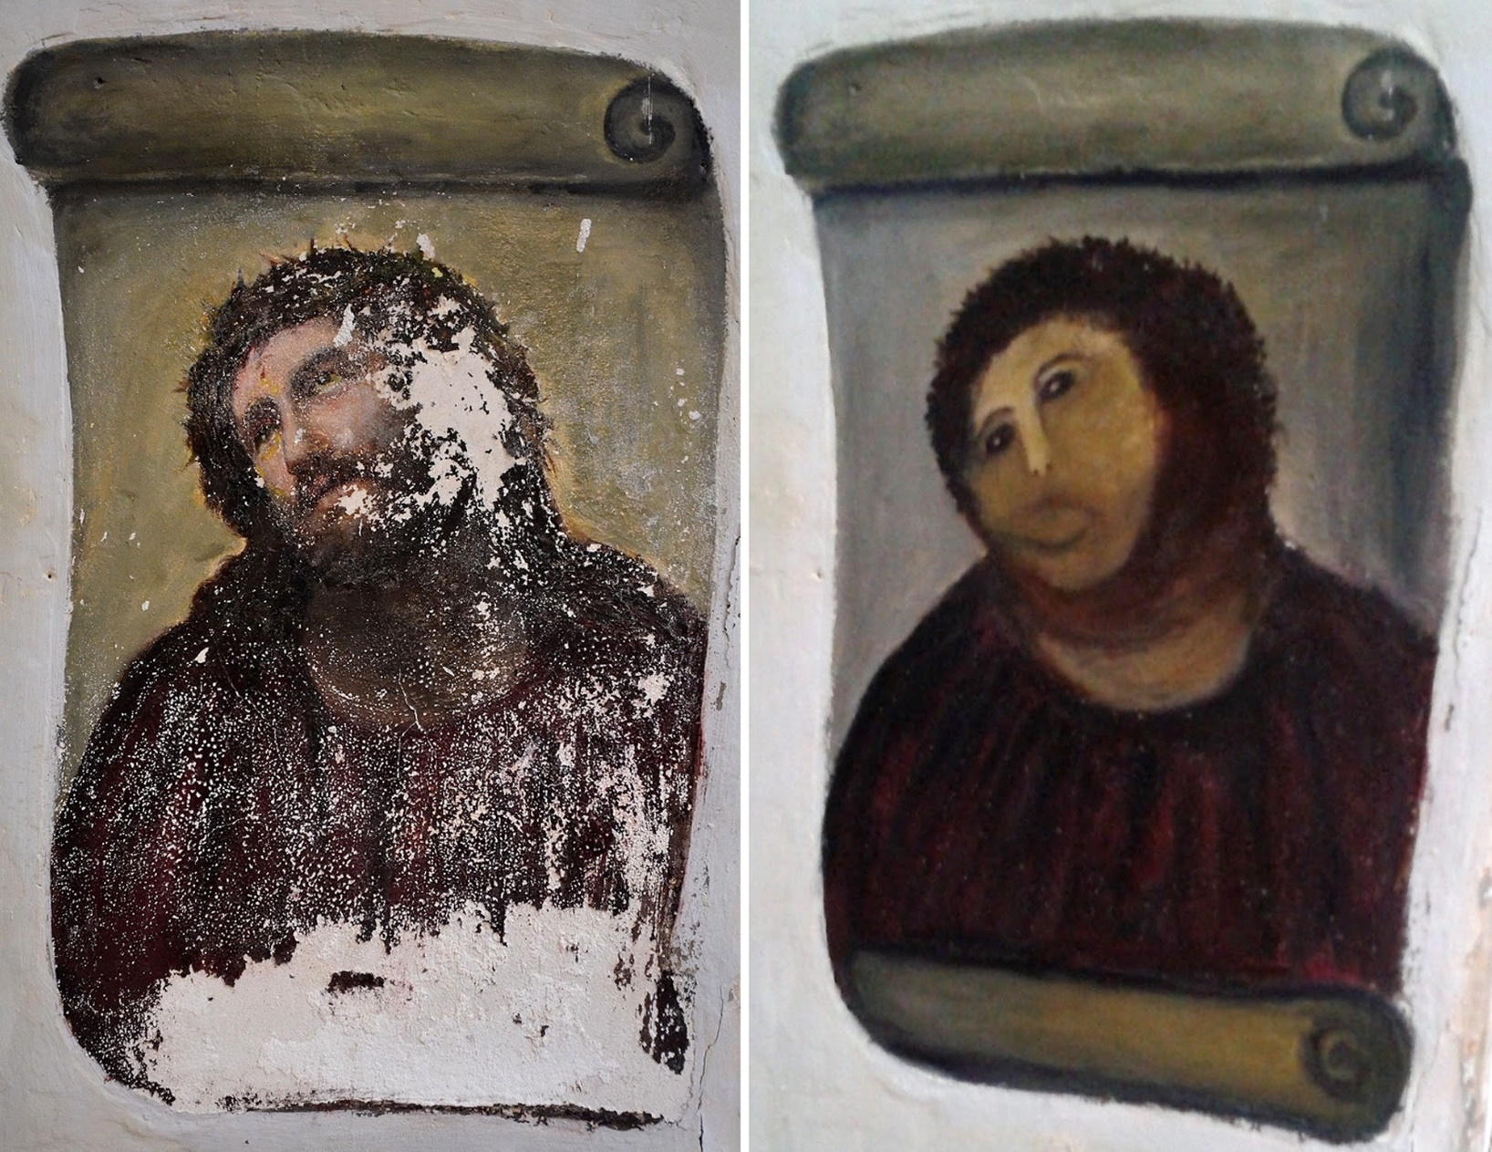
^{1:4} to obtain an
inheritance which is imperishable and undefiled and will not fade away, reserved in heaven for you, ⁵ who are protected by the power of God through faith for a salvation ready to be revealed in the last time.
1) The object of our hope: Inheritance

Slide 41
^{1:4} to obtain an
inheritance which is imperishable and undefiled and will not fade away, reserved in heaven for you, ⁵ who are protected by the power of God through faith for a salvation ready to be revealed in the last time.
1) The object of our hope: Inheritance

Slide 42
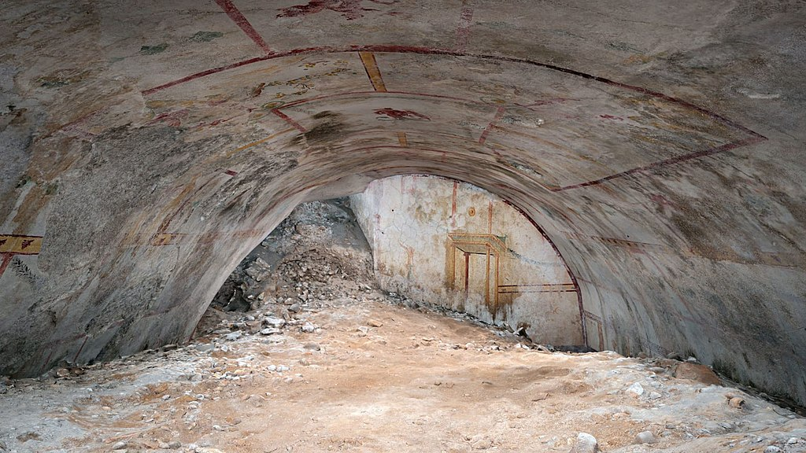
^{1:4} to obtain an
inheritance which is imperishable and undefiled and will not fade away, reserved in heaven for you, ⁵ who are protected by the power of God through faith for a salvation ready to be revealed in the last time.
1) The object of our hope: Inheritance
^{Isaiah 24:4} The world fades and withers, the exalted people of the earth fade away

Slide 43
^{1:4} to obtain an
inheritance which is imperishable and undefiled and will not fade away, reserved in heaven for you, ⁵ who are protected by the power of God through faith for a salvation ready to be revealed in the last time.
1) The object of our hope: Inheritance
^{Matt 6:19} “Do not store up for yourselves treasures on earth, where moth and rust destroy, and where thieves break in and steal. ²⁰ But store up for yourselves treasures in heaven, where neither moth nor rust destroys, and where thieves do not break in or steal

Slide 44
^{1:4} to obtain an
inheritance which is imperishable and undefiled and will not fade away, reserved in heaven for you, ⁵ who are protected by the power of God through faith for a salvation ready to be revealed in the last time.
1) The object of our hope: Inheritance
This is a pristine, perfect, secure, permanent lasting inheritance

Slide 45
^{1:4} to obtain an
inheritance which is imperishable and undefiled and will not fade away, reserved in heaven for you, ⁵ who are protected by the power of God through faith for a salvation ready to be revealed in the last time.
1) The object of our hope: Inheritance
This is a pristine, perfect, secure, permanent lasting inheritance
…Inevitable…
You can bank on it

Slide 46
^{1:4} to obtain an
inheritance which is imperishable and undefiled and will not fade away, reserved in heaven for you, ⁵ who are protected by the power of God through faith for a salvation ready to be revealed in the last time.
1) The object of our hope: Inheritance

Slide 47
^{1:4} to obtain an
inheritance which is imperishable and undefiled and will not fade away, reserved in heaven for you, ⁵ who are protected by the power of God through faith for a salvation ready to be revealed in the last time.
2) The mindset of hope:
a new perspective
Future-Oriented
Mentality of a “Resident Alien”

Slide 48
^{1 Pet} ^{1:1} …To those who reside as aliens, scattered
2) The mindset of hope:
a new perspective
Parepidemos (παρεπίδημος)
resident alien, sojourner in a strange place, foreigner
Future-Oriented
Mentality of a “Resident Alien”
^{2:11} …beloved I urge you as aliens and strangers …
^{Philippians 3:20} For our citizenship is in heaven, from which also we eagerly wait for a Savior, the Lord Jesus Christ;
^{1:17} …during the time of your stay on earth

Slide 49
“What we love about this life are the things that resonate with the life we were made for. The things we love are not merely the best this life has to offer – they are previews of the greater life to come.” ^{- Randy Alcorn,} ^{Heaven}
2) The mindset of hope:
a new perspective
Future-Oriented
Mentality of a “Resident Alien”
Re-Ordered Priorities
Freedom about today

Slide 50
2) The mindset of hope:
a new perspective
Future-Oriented
Mentality of a “Resident Alien”
Re-Ordered Priorities
Freedom about today
Anticipation

Slide 51
^{1:6} In this you greatly rejoice, even though now for a little while, if necessary, you have been distressed by various trials…
^{1:6} In this you greatly rejoice, even though now for a little while, if necessary, you have been distressed by various trials…
2) The mindset of hope:
a new perspective
Future-Oriented
Mentality of a “Resident Alien”
Re-Ordered Priorities
^{1:8} …In this you greatly rejoice with joy inexpressible and full of glory,
Freedom about today
Anticipation
Joy

Slide 52
^{1:6} In this you greatly rejoice, even though now for a little while, if necessary, you have been distressed by various trials…
^{1:6} In this you greatly rejoice, even though now for a little while, if necessary, you have been distressed by various trials…
2) The mindset of hope:
a new perspective
Future-Oriented
Mentality of a “Resident Alien”
Re-Ordered Priorities
^{1:8} …In this you greatly rejoice with joy inexpressible and full of glory,
Freedom about today
Anticipation
Joy

Slide 53
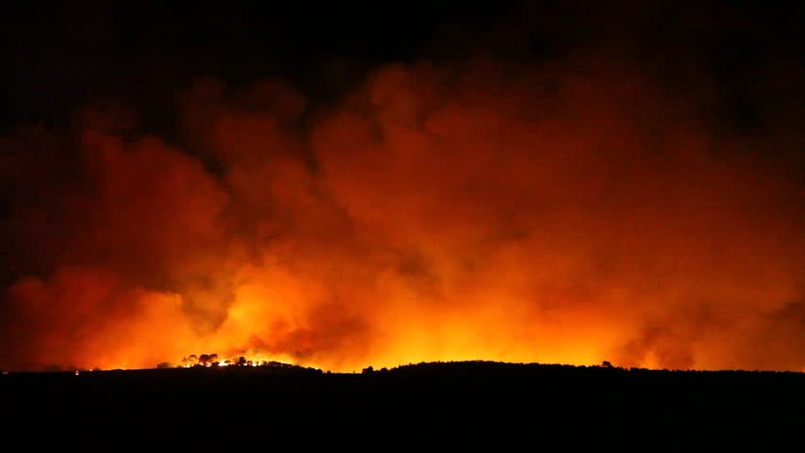
^{1:6} In this you greatly rejoice, even though now for a little while, if necessary, you have been distressed by various trials…
2) The mindset of hope:
a new perspective
The presence of hope dramatically changes the experience of suffering

Slide 54
^{1:6} In this you greatly rejoice, even though now for a little while, if necessary, you have been distressed by various trials…
^{1:6} In this you greatly rejoice, even though now for a little while, if necessary, you have been distressed by various trials…
2) The mindset of hope:
a new perspective
Confidence
Perspective
The presence of hope dramatically changes the experience of suffering

Slide 55
^{1:6} In this you greatly rejoice, even though now for a little while, if necessary, you have been distressed by various trials…
^{1:6} In this you greatly rejoice, even though now for a little while, if necessary, you have been distressed by various trials…
2) The mindset of hope:
a new perspective
Confidence
Perspective
Destination
^{Rom 8:18} For I consider that the sufferings of this present time are not worthy to be compared with the glory that is to be revealed to us.
The presence of hope dramatically changes the experience of suffering

Slide 56
^{1 Pet 1:7} so that the proof of your faith, being more precious than gold which is perishable, even though tested by fire, may be found to result in praise and glory and honor at the revelation of Jesus Christ;
2) The mindset of hope:
a new perspective

Slide 57
^{1 Pet 1:7} so that the proof of your faith, being more precious than gold which is perishable, even though tested by fire, may be found to result in praise and glory and honor at the revelation of Jesus Christ;
3) The result of hope:
refined faith

Slide 58
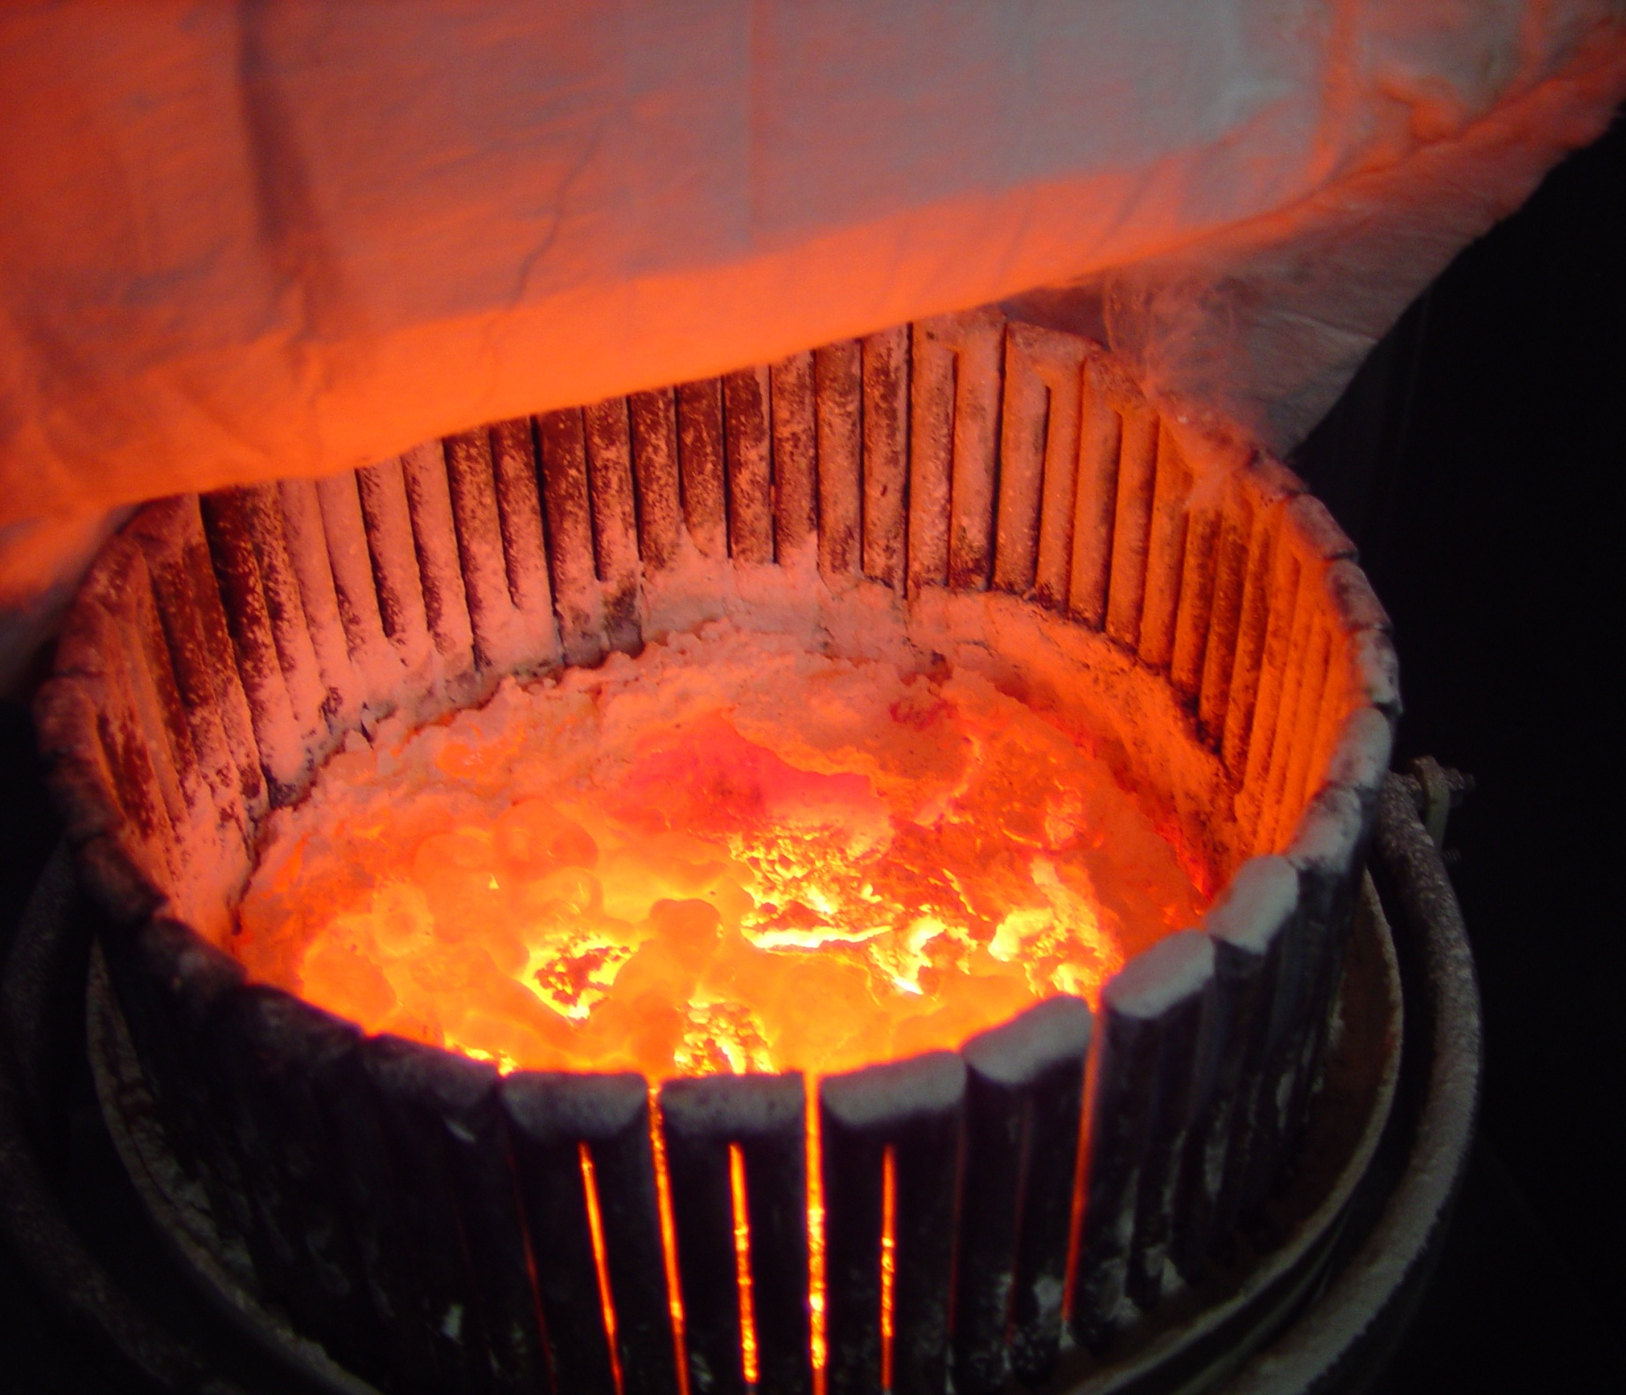
^{1 Pet 1:7} so that the proof of your faith, being more precious than gold which is perishable, even though tested by fire, may be found to result in praise and glory and honor at the revelation of Jesus Christ;
3) The result of hope:
refined faith

Slide 59
^{1 Pet 1:7} so that the proof of your faith, being more precious than gold which is perishable, even though tested by fire, may be found to result in praise and glory and honor at the revelation of Jesus Christ;
3) The result of hope:
refined faith
What’s your hope pinned on?
Trials force our hope to higher ground

Slide 60
^{1 Pet 1:7} so that the proof of your faith, being more precious than gold which is perishable, even though tested by fire, may be found to result in praise and glory and honor at the revelation of Jesus Christ;
3) The result of hope:
refined faith

Slide 61
^{1 Pet 1:7} so that the proof of your faith, being more precious than gold which is perishable, even though tested by fire, may be found to result in praise and glory and honor at the revelation of Jesus Christ;
3) The result of hope:
refined faith

Slide 62
^{1 Pet 1:8} and though you have not seen Him, you love Him, and though you do not see Him now, but believe in Him, you greatly rejoice with joy inexpressible and full of glory, ⁹ obtaining as the outcome of your faith the salvation of your souls.
3) The result of hope:
refined faith
Can you praise God like Peter?

Slide 63
^{1 Pet 1:10} As to this salvation, the prophets who prophesied of the grace that would come to you made careful searches and inquiries, ¹¹ seeking to know what person or time the Spirit of Christ within them was indicating as He predicted the sufferings of Christ and the glories to follow. ¹² It was revealed to them that they were not serving themselves, but you, in these things which now have been announced to you through those who preached the gospel to you by the Holy Spirit sent from heaven—things into which angels long to look.

Slide 64
The foundation of the Christian life is a forward-looking hope
The object of hope: Inheritance
The mindset of hope: Eternal Perspective
The result of hope: Refined Faith

Slide 65
1 Peter:
Living well as “resident aliens”

Slide 66
1 Peter 1:1-12
Living Hope

