Slide 1
Acts
Acts 16 Through Many Tribulations

Slide 2
Iconium
Lystra
Pisidian Antioch
Antioch
Perga
The First Missionary Journey
Paphos
Salamis

Slide 3
Iconium
Lystra
Pisidian Antioch
Antioch
Perga
Paphos
Salamis
^{Acts 14:18}
Even saying these things, with difficulty they restrained the crowds from offering sacrifice to them.

Slide 4
Iconium
Lystra
Pisidian Antioch
Antioch
Perga
Paphos
Salamis
^{Acts 14:19} But Jews came from Antioch and Iconium, and having won over the crowds, they stoned Paul and dragged him out of the city, supposing him to be dead. ²⁰ But while the disciples stood around him, he got up and entered the city.

Slide 5
Iconium
Lystra
Pisidian Antioch
Antioch
Perga
Paphos
Salamis
^{Acts 14:19} But Jews came from Antioch and Iconium, and having won over the crowds, they stoned Paul and dragged him out of the city, supposing him to be dead. ²⁰ But while the disciples stood around him, he got up and entered the city.

Slide 6
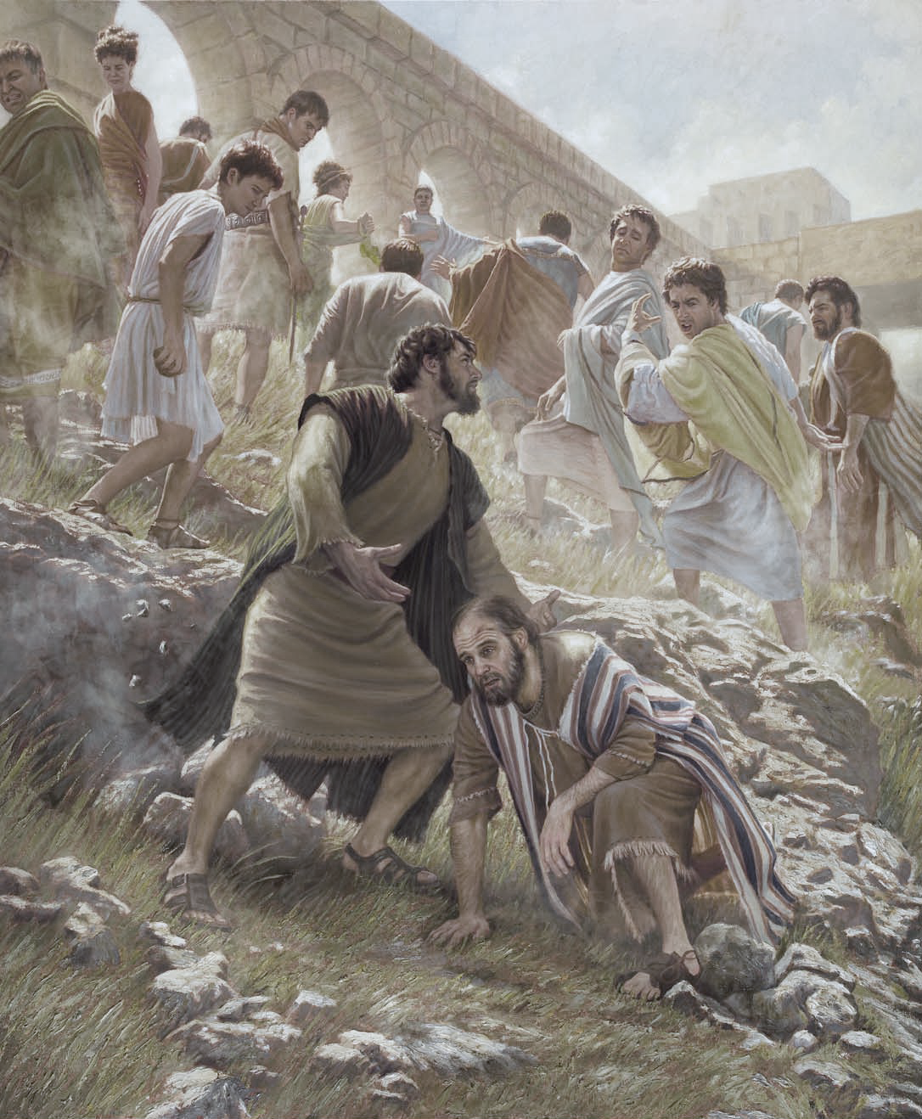
^{Acts 14:19} But Jews came from Antioch and Iconium, and having won over the crowds, they stoned Paul and dragged him out of the city, supposing him to be dead. ²⁰ But while the disciples stood around him, he got up and entered the city.

Slide 7
Principles of Christian “Ministry:”
^{Acts 14:19} But Jews came from Antioch and Iconium, and having won over the crowds, they stoned Paul and dragged him out of the city, supposing him to be dead. ²⁰ But while the disciples stood around him, he got up and entered the city.

Slide 8
Principles of Christian “Ministry:”
#1 Ministry involves FAILURE
^{Acts 14:19} But Jews came from Antioch and Iconium, and having won over the crowds, they stoned Paul and dragged him out of the city, supposing him to be dead. ²⁰ But while the disciples stood around him, he got up and entered the city.

Slide 9
Principles of Christian “Ministry:”
#1 Ministry involves FAILURE
Which usually HURTS
^{Acts 14:19} But Jews came from Antioch and Iconium, and having won over the crowds, they stoned Paul and dragged him out of the city, supposing him to be dead. ²⁰ But while the disciples stood around him, he got up and entered the city.

Slide 10
Principles of Christian “Ministry:”
#1 Ministry involves FAILURE
Which usually HURTS
^{Acts 14:19} But Jews came from Antioch and Iconium, and having won over the crowds, they stoned Paul and dragged him out of the city, supposing him to be dead. ²⁰ But while the disciples stood around him, he got up and entered the city.

Slide 11
Principles of Christian “Ministry:”
#2 Ministry involves BUILDING God’s Kingdom
^{Acts 14:19} But Jews came from Antioch and Iconium, and having won over the crowds, they stoned Paul and dragged him out of the city, supposing him to be dead. ²⁰ But while the disciples stood around him, he got up and entered the city.

Slide 12
Principles of Christian “Ministry:”
#2 Ministry involves BUILDING God’s Kingdom
^{Acts 14:19} But Jews came from Antioch and Iconium, and having won over the crowds, they stoned Paul and dragged him out of the city, supposing him to be dead. ²⁰ But while the disciples stood around him, he got up and entered the city.

Slide 13
Principles of Christian “Ministry:”
#3 Ministry requires a “next-play” mentality
^{Acts 14:19} But Jews came from Antioch and Iconium, and having won over the crowds, they stoned Paul and dragged him out of the city, supposing him to be dead. ²⁰ But while the disciples stood around him, he got up and entered the city.

Slide 14
Iconium
Lystra
Derbe
Pisidian Antioch
Antioch
Perga
Paphos
Salamis
^{Acts 14:20} The next day he went away with Barnabas to Derbe. ²¹ After they had preached the gospel to that city and had made many disciples,
^{Acts 14:20} The next day he went away with Barnabas to Derbe. ²¹ After they had preached the gospel to that city and had made many disciples,

Slide 15
Iconium
Lystra
Derbe
Pisidian Antioch
Antioch
Perga
Paphos
Salamis
^{Acts 14:21} they returned to Lystra and to Iconium and to Antioch,²² strengthening the souls of the disciples, encouraging them to continue in the faith, and saying, “Through many tribulations we must enter the kingdom of God.”

Slide 16
Iconium
Lystra
Derbe
Pisidian Antioch
Antioch
Perga
Paphos
Salamis
^{Acts 14:21} they returned to Lystra and to Iconium and to Antioch,²² strengthening the souls of the disciples, encouraging them to continue in the faith, and saying, “Through many tribulations we must enter the kingdom of God.”

Slide 17
Iconium
Lystra
Derbe
Pisidian Antioch
Antioch
Perga
= 200 Miles
Paphos
Salamis
^{Acts 14:21} they returned to Lystra and to Iconium and to Antioch,²² strengthening the souls of the disciples, encouraging them to continue in the faith, and saying, “Through many tribulations we must enter the kingdom of God.”

Slide 18
Iconium
Lystra
Derbe
Pisidian Antioch
Antioch
Perga
Paphos
Salamis
^{Acts 14:21} they returned to Lystra and to Iconium and to Antioch,²² strengthening the souls of the disciples, encouraging them to continue in the faith, and saying, “Through many tribulations we must enter the kingdom of God.”

Slide 19
Iconium
Lystra
Derbe
Pisidian Antioch
Antioch
Perga
#2 Ministry involves BUILDING God’s Kingdom
Paphos
Salamis
^{Acts 14:21} they returned to Lystra and to Iconium and to Antioch,²² strengthening the souls of the disciples, encouraging them to continue in the faith, and saying, “Through many tribulations we must enter the kingdom of God.”
^{Acts 14:21} they returned to Lystra and to Iconium and to Antioch,²² strengthening the souls of the disciples, encouraging them to continue in the faith, and saying, “Through many tribulations we must enter the kingdom of God.”

Slide 20
Iconium
Lystra
Derbe
Pisidian Antioch
Antioch
Perga
#2 Ministry involves BUILDING God’s Kingdom
Paphos
Salamis
^{Acts 14:21} they returned to Lystra and to Iconium and to Antioch,²² strengthening the souls of the disciples, encouraging them to continue in the faith, and saying, “Through many tribulations we must enter the kingdom of God.”

Slide 21
We are part of something incredible…
^{Acts 14:21} they returned to Lystra and to Iconium and to Antioch,²² strengthening the souls of the disciples, encouraging them to continue in the faith, and saying, “Through many tribulations we must enter the kingdom of God.”

Slide 22
We are part of something incredible…
But it ain’t gonna be easy
^{Acts 14:21} they returned to Lystra and to Iconium and to Antioch,²² strengthening the souls of the disciples, encouraging them to continue in the faith, and saying, “Through many tribulations we must enter the kingdom of God.”

Slide 23
We are part of something incredible…
But it ain’t gonna be easy
What big important project do you take on and expect it to be easy?
^{Acts 14:21} they returned to Lystra and to Iconium and to Antioch,²² strengthening the souls of the disciples, encouraging them to continue in the faith, and saying, “Through many tribulations we must enter the kingdom of God.”

Slide 24
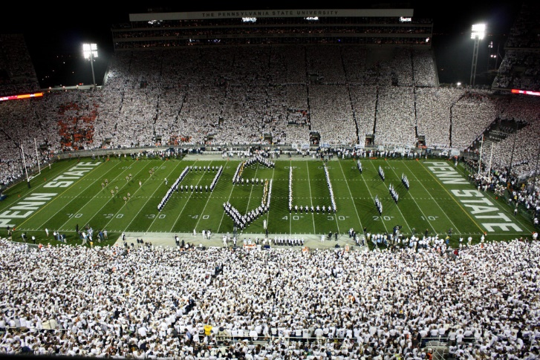
We are part of something incredible…
But it ain’t gonna be easy
What big important project do you take on and expect it to be easy?
^{Acts 14:21} they returned to Lystra and to Iconium and to Antioch,²² strengthening the souls of the disciples, encouraging them to continue in the faith, and saying, “Through many tribulations we must enter the kingdom of God.”

Slide 25
We are part of something incredible…
But it ain’t gonna be easy
And how much greater is our ministry mission?
^{Acts 14:21} they returned to Lystra and to Iconium and to Antioch,²² strengthening the souls of the disciples, encouraging them to continue in the faith, and saying, “Through many tribulations we must enter the kingdom of God.”

Slide 26
We are part of something incredible…
But it ain’t gonna be easy
And how much greater is our ministry mission?
^{1Peter 4:12} Beloved, do not be surprised at the fiery ordeal among you, which comes upon you for your testing, as though some strange thing were happening to you
^{Acts 14:21} they returned to Lystra and to Iconium and to Antioch,²² strengthening the souls of the disciples, encouraging them to continue in the faith, and saying, “Through many tribulations we must enter the kingdom of God.”

Slide 27
We are part of something incredible…
But it ain’t gonna be easy
What big, great project to you take on and expect it to be easy?
And how much greater is our ministry mission?
^{1Peter 4:12} Beloved, do not be surprised at the fiery ordeal among you, which comes upon you for your testing, as though some strange thing were happening to you
^{Acts 14:21} they returned to Lystra and to Iconium and to Antioch,²² strengthening the souls of the disciples, encouraging them to continue in the faith, and saying, “Through many tribulations we must enter the kingdom of God.”

Slide 28
But ultimately, the building of God’s kingdom will prevail
^{Matt 13:31} “The kingdom of heaven is like a mustard seed, which a man took and sowed in his field; ³² and this is smaller than all the other seeds, but when it is full grown, it is larger than the garden plants and becomes a tree, so that the birds of the air come and nest in its branches.”
^{Acts 14:21} they returned to Lystra and to Iconium and to Antioch,²² strengthening the souls of the disciples, encouraging them to continue in the faith, and saying, “Through many tribulations we must enter the kingdom of God.”

Slide 29
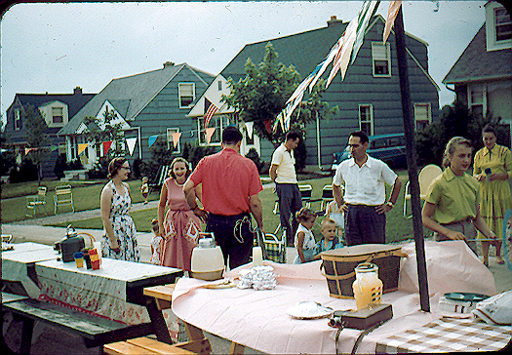

Slide 31
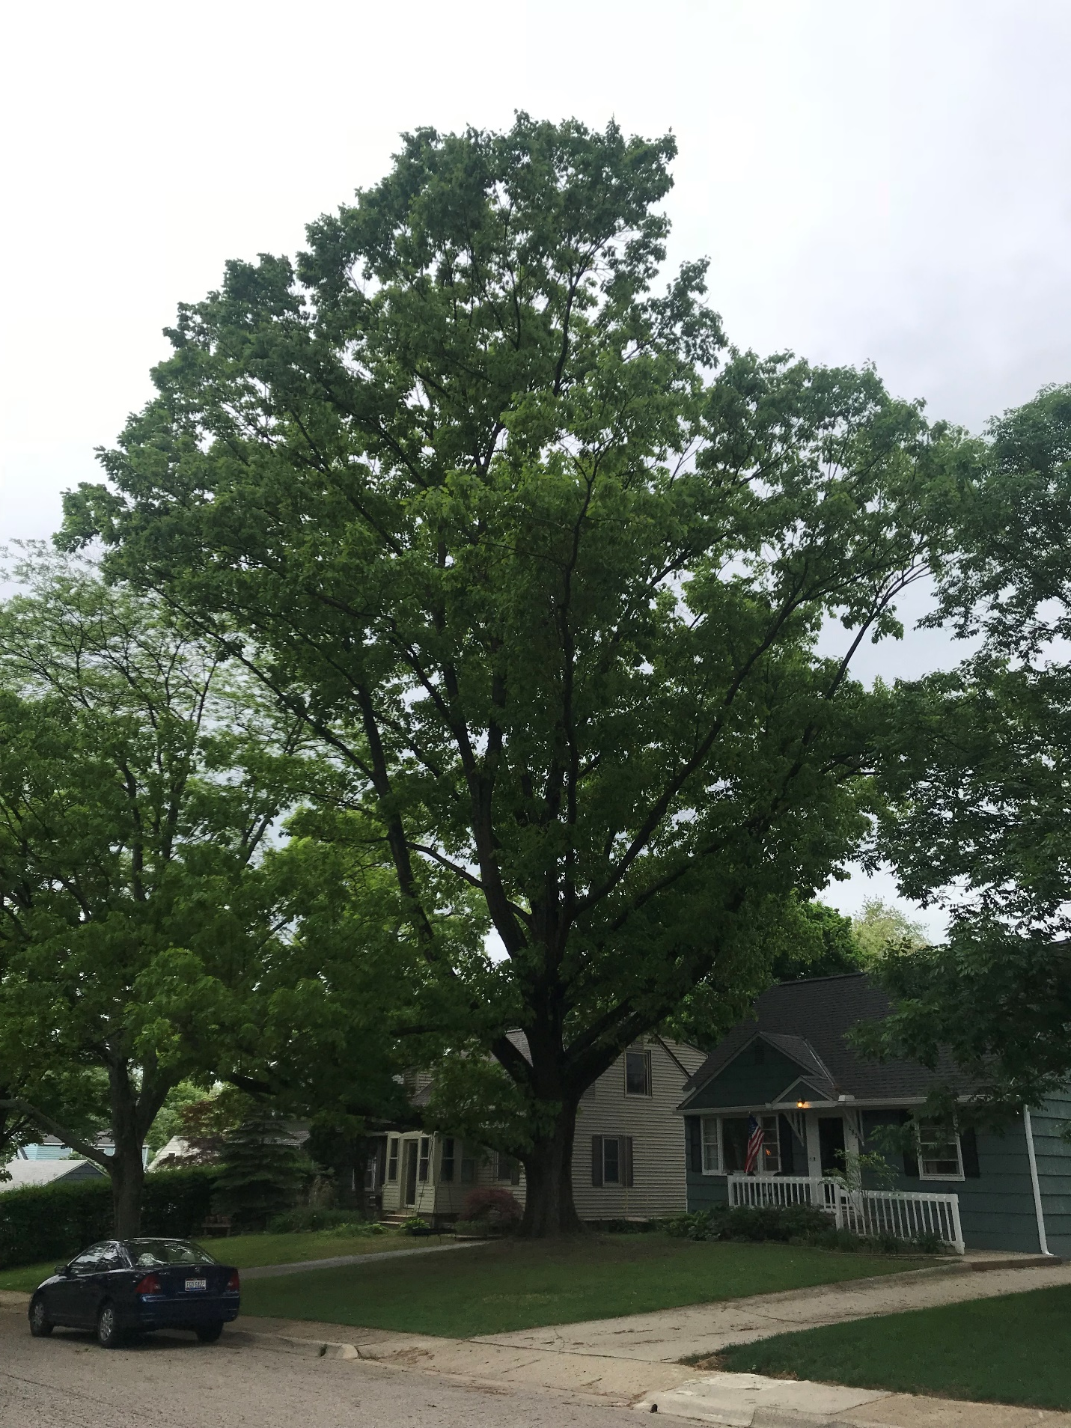

Slide 32
Think of all that tree has been through…

Slide 33
Think of all that tree has been through…
If you zoomed in on any one day…

Slide 34
Think of all that tree has been through…
If you zoomed in on any one day…
“My kingdom is like THAT”

Slide 35
Think of all that tree has been through…
If you zoomed in on any one day…
“My kingdom is like THAT”
And so “continue in the faith” despite the “tribulations” you see today

Slide 36
Iconium
Lystra
Derbe
Pisidian Antioch
Antioch
Perga
Paphos
Salamis
^{Acts 14:23} When they had appointed elders for them in every church, having prayed with fasting, they commended them to the Lord in whom they had believed.

Slide 37
Iconium
Lystra
Derbe
Pisidian Antioch
Antioch
Perga
Paphos
Salamis
^{Acts 14:24} They passed through Pisidia and came into Pamphylia. ²⁵ When they had spoken the word in Perga, they went down to Attalia. ²⁶ From there they sailed to Antioch, from which they had been commended to the grace of God for the work that they had accomplished.

Slide 38
Iconium
Lystra
Derbe
Pisidian Antioch
Antioch
Perga
Paphos
Salamis
^{Acts 14:27} When they had arrived and gathered the church together, they began to report all things that God had done with them and how He had opened a door of faith to the Gentiles. ²⁸ And they spent a long time with the disciples.

Slide 39
Iconium
Lystra
Derbe
Pisidian Antioch
Antioch
Perga
Paphos
Salamis
^{Acts 15:36} After some days Paul said to Barnabas, “Let us return and visit the brethren in every city in which we proclaimed the word of the Lord, and see how they are.”

Slide 40
Iconium
Lystra
Derbe
Pisidian Antioch
Antioch
Perga
Antioch
The Second Missionary Journey
Paphos
Salamis
^{Acts 15:36} After some days Paul said to Barnabas, “Let us return and visit the brethren in every city in which we proclaimed the word of the Lord, and see how they are.”

Slide 41
Antioch
The Second Missionary Journey
^{Acts 15:37} Barnabas wanted to take John, called Mark, along with them also. ³⁸ But Paul kept insisting that they should not take him along who had deserted them in Pamphylia and had not gone with them to the work.

Slide 42
Antioch
The Second Missionary Journey
^{Acts 15:39} And there occurred such a sharp disagreement that they separated from one another,

Slide 43
Antioch
The Second Missionary Journey
^{Acts 15:39} and Barnabas took Mark with him and sailed away to Cyprus. ⁴⁰ But Paul chose Silas and left, being committed by the brethren to the grace of the Lord. ⁴¹ And he was traveling through Syria and Cilicia, strengthening the churches.
^{Acts 15:39} and Barnabas took Mark with him and sailed away to Cyprus. ⁴⁰ But Paul chose Silas and left, being committed by the brethren to the grace of the Lord. ⁴¹ And he was traveling through Syria and Cilicia, strengthening the churches.

Slide 44
Is this a problem?
Antioch
The Second Missionary Journey
^{Acts 15:39} and Barnabas took Mark with him and sailed away to Cyprus. ⁴⁰ But Paul chose Silas and left, being committed by the brethren to the grace of the Lord. ⁴¹ And he was traveling through Syria and Cilicia, strengthening the churches.
^{Acts 15:39} and Barnabas took Mark with him and sailed away to Cyprus. ⁴⁰ But Paul chose Silas and left, being committed by the brethren to the grace of the Lord. ⁴¹ And he was traveling through Syria and Cilicia, strengthening the churches.

Slide 45
Tarsus
Antioch
The Second Missionary Journey
^{Acts 15:39} , and Barnabas took Mark with him and sailed away to Cyprus. ⁴⁰ But Paul chose Silas and left, being committed by the brethren to the grace of the Lord. ⁴¹ And he was traveling through Syria and Cilicia, strengthening the churches.
^{Acts 15:39} and Barnabas took Mark with him and sailed away to Cyprus. ⁴⁰ But Paul chose Silas and left, being committed by the brethren to the grace of the Lord. ⁴¹ And he was traveling through Syria and Cilicia, strengthening the churches.
?

Slide 46
Lystra
Derbe
Tarsus
Antioch
The Second Missionary Journey
^{Acts 15:39} , and Barnabas took Mark with him and sailed away to Cyprus. ⁴⁰ But Paul chose Silas and left, being committed by the brethren to the grace of the Lord. ⁴¹ And he was traveling through Syria and Cilicia, strengthening the churches.
^{Acts 16:1} Paul came also to Derbe and to Lystra. And a disciple was there, named Timothy, the son of a Jewish woman who was a believer, but his father was a Greek, ² and he was well spoken of by the brethren who were in Lystra and Iconium

Slide 47
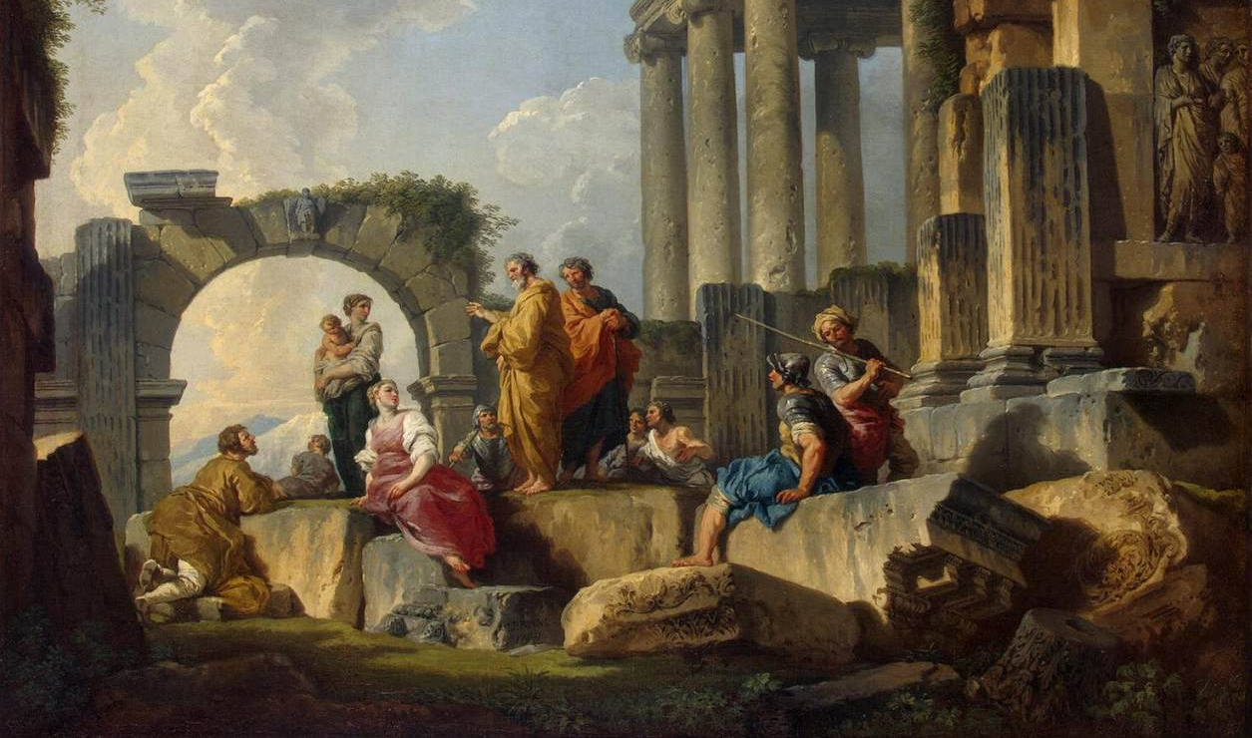
Lystra
Derbe
Tarsus
Antioch
The Second Missionary Journey
^{Acts 15:39} , and Barnabas took Mark with him and sailed away to Cyprus. ⁴⁰ But Paul chose Silas and left, being committed by the brethren to the grace of the Lord. ⁴¹ And he was traveling through Syria and Cilicia, strengthening the churches.
^{Acts 16:1} Paul came also to Derbe and to Lystra. And a disciple was there, named Timothy, the son of a Jewish woman who was a believer, but his father was a Greek, ² and he was well spoken of by the brethren who were in Lystra and Iconium

Slide 48
God’s Kingdom grows through discipleship
Lystra
Derbe
Tarsus
Antioch
The Second Missionary Journey
^{Acts 15:39} , and Barnabas took Mark with him and sailed away to Cyprus. ⁴⁰ But Paul chose Silas and left, being committed by the brethren to the grace of the Lord. ⁴¹ And he was traveling through Syria and Cilicia, strengthening the churches.
^{Acts 16:1} Paul came also to Derbe and to Lystra. And a disciple was there, named Timothy, the son of a Jewish woman who was a believer, but his father was a Greek, ² and he was well spoken of by the brethren who were in Lystra and Iconium

Slide 49
God’s Kingdom grows through discipleship
Lystra
Derbe
Tarsus
Antioch
The Second Missionary Journey
^{Acts 15:39} , and Barnabas took Mark with him and sailed away to Cyprus. ⁴⁰ But Paul chose Silas and left, being committed by the brethren to the grace of the Lord. ⁴¹ And he was traveling through Syria and Cilicia, strengthening the churches.
^{Acts 16:3} Paul wanted this man to go with him; and he took him and circumcised him because of the Jews who were in those parts, for they all knew that his father was a Greek.

Slide 50
God’s Kingdom grows through discipleship
Lystra
Derbe
Tarsus
Antioch
The Second Missionary Journey
^{Acts 15:39} , and Barnabas took Mark with him and sailed away to Cyprus. ⁴⁰ But Paul chose Silas and left, being committed by the brethren to the grace of the Lord. ⁴¹ And he was traveling through Syria and Cilicia, strengthening the churches.
^{Acts 16:3} Paul wanted this man to go with him; and he took him and circumcised him because of the Jews who were in those parts, for they all knew that his father was a Greek.

Slide 51
God’s Kingdom grows through discipleship
Lystra
Derbe
Tarsus
There is a lot to learn if you are going to be a disciple of Jesus
Antioch
The Second Missionary Journey
^{Acts 15:39} , and Barnabas took Mark with him and sailed away to Cyprus. ⁴⁰ But Paul chose Silas and left, being committed by the brethren to the grace of the Lord. ⁴¹ And he was traveling through Syria and Cilicia, strengthening the churches.
^{Acts 16:3} Paul wanted this man to go with him; and he took him and circumcised him because of the Jews who were in those parts, for they all knew that his father was a Greek.

Slide 52
God’s Kingdom grows through discipleship
Lystra
Derbe
Tarsus
There is a lot to learn if you are going to be a disciple of Jesus
And the best way to do that is to find someone who is a step ahead of you in following Christ, and ask them to teach you
Antioch
The Second Missionary Journey
^{Acts 15:39} , and Barnabas took Mark with him and sailed away to Cyprus. ⁴⁰ But Paul chose Silas and left, being committed by the brethren to the grace of the Lord. ⁴¹ And he was traveling through Syria and Cilicia, strengthening the churches.
^{Acts 16:3} Paul wanted this man to go with him; and he took him and circumcised him because of the Jews who were in those parts, for they all knew that his father was a Greek.

Slide 53
God’s Kingdom grows through discipleship
Lystra
Derbe
Tarsus
“I am an adult… I don’t need mentored.”
And the best way to do that is to find someone who is a step ahead of you in following Christ, and ask them to teach you
Antioch
The Second Missionary Journey
^{Acts 15:39} , and Barnabas took Mark with him and sailed away to Cyprus. ⁴⁰ But Paul chose Silas and left, being committed by the brethren to the grace of the Lord. ⁴¹ And he was traveling through Syria and Cilicia, strengthening the churches.
^{Acts 16:3} Paul wanted this man to go with him; and he took him and circumcised him because of the Jews who were in those parts, for they all knew that his father was a Greek.

Slide 54
God’s Kingdom grows through discipleship
Lystra
Derbe
Tarsus
“I am perfectly capable of feeding myself spiritually, thank you very much.”
And the best way to do that is to find someone who is a step ahead of you in following Christ, and ask them to teach you
Antioch
The Second Missionary Journey
^{Acts 15:39} , and Barnabas took Mark with him and sailed away to Cyprus. ⁴⁰ But Paul chose Silas and left, being committed by the brethren to the grace of the Lord. ⁴¹ And he was traveling through Syria and Cilicia, strengthening the churches.
^{Acts 16:3} Paul wanted this man to go with him; and he took him and circumcised him because of the Jews who were in those parts, for they all knew that his father was a Greek.

Slide 55
God’s Kingdom grows through discipleship
Lystra
Derbe
Tarsus
Discipleship is a privilege, a virtue, a worthy aspiration for every Christian!
Antioch
The Second Missionary Journey
^{Acts 15:39} , and Barnabas took Mark with him and sailed away to Cyprus. ⁴⁰ But Paul chose Silas and left, being committed by the brethren to the grace of the Lord. ⁴¹ And he was traveling through Syria and Cilicia, strengthening the churches.
^{Acts 16:3} Paul wanted this man to go with him; and he took him and circumcised him because of the Jews who were in those parts, for they all knew that his father was a Greek.

Slide 56
Lystra
Derbe
Tarsus
Antioch
The Second Missionary Journey
^{Acts 16:4} Now while they were passing through the cities, they were delivering the decrees which had been decided upon by the apostles and elders who were in Jerusalem, for them to observe. ⁵ So the churches were being strengthened in the faith, and were increasing in number daily.
^{Acts 15:39} , and Barnabas took Mark with him and sailed away to Cyprus. ⁴⁰ But Paul chose Silas and left, being committed by the brethren to the grace of the Lord. ⁴¹ And he was traveling through Syria and Cilicia, strengthening the churches.

Slide 57
P. Antioch
Iconium
Derbe
Lystra
Tarsus
Antioch
^{Acts 16:6} They passed through the Phrygian and Galatian region, having been forbidden by the Holy Spirit to speak the word in Asia; ⁷ and after they came to Mysia, they were trying to go into Bithynia, and the Spirit of Jesus did not permit them;⁸ and passing by Mysia, they came down to Troas.
^{Acts 15:39} , and Barnabas took Mark with him and sailed away to Cyprus. ⁴⁰ But Paul chose Silas and left, being committed by the brethren to the grace of the Lord. ⁴¹ And he was traveling through Syria and Cilicia, strengthening the churches.

Slide 58
P. Antioch
Iconium
Derbe
Lystra
Tarsus
Antioch
^{Acts 16:6} They passed through the Phrygian and Galatian region, having been forbidden by the Holy Spirit to speak the word in Asia; ⁷ and after they came to Mysia, they were trying to go into Bithynia, and the Spirit of Jesus did not permit them;⁸ and passing by Mysia, they came down to Troas.
^{Acts 15:39} , and Barnabas took Mark with him and sailed away to Cyprus. ⁴⁰ But Paul chose Silas and left, being committed by the brethren to the grace of the Lord. ⁴¹ And he was traveling through Syria and Cilicia, strengthening the churches.

Slide 59
P. Antioch
Iconium
Derbe
Lystra
Tarsus
Antioch
^{Acts 16:6} They passed through the Phrygian and Galatian region, having been forbidden by the Holy Spirit to speak the word in Asia; ⁷ and after they came to Mysia, they were trying to go into Bithynia, and the Spirit of Jesus did not permit them;⁸ and passing by Mysia, they came down to Troas.
^{Acts 15:39} , and Barnabas took Mark with him and sailed away to Cyprus. ⁴⁰ But Paul chose Silas and left, being committed by the brethren to the grace of the Lord. ⁴¹ And he was traveling through Syria and Cilicia, strengthening the churches.

Slide 60
Troas
P. Antioch
Iconium
Derbe
Lystra
Tarsus
Antioch
^{Acts 16:6} They passed through the Phrygian and Galatian region, having been forbidden by the Holy Spirit to speak the word in Asia; ⁷ and after they came to Mysia, they were trying to go into Bithynia, and the Spirit of Jesus did not permit them;⁸ and passing by Mysia, they came down to Troas.
^{Acts 16:6} They passed through the Phrygian and Galatian region, having been forbidden by the Holy Spirit to speak the word in Asia; ⁷ and after they came to Mysia, they were trying to go into Bithynia, and the Spirit of Jesus did not permit them;⁸ and passing by Mysia, they came down to Troas.
^{Acts 15:39} , and Barnabas took Mark with him and sailed away to Cyprus. ⁴⁰ But Paul chose Silas and left, being committed by the brethren to the grace of the Lord. ⁴¹ And he was traveling through Syria and Cilicia, strengthening the churches.

Slide 61
Troas
P. Antioch
Iconium
Derbe
Lystra
Tarsus
Antioch
^{Acts 16:9} A vision appeared to Paul in the night: a man of Macedonia was standing and appealing to him, and saying, “Come over to Macedonia and help us.” ¹⁰ When he had seen the vision, immediately we sought to go into Macedonia, concluding that God had called us to preach the gospel to them.
^{Acts 15:39} , and Barnabas took Mark with him and sailed away to Cyprus. ⁴⁰ But Paul chose Silas and left, being committed by the brethren to the grace of the Lord. ⁴¹ And he was traveling through Syria and Cilicia, strengthening the churches.

Slide 62
Troas
P. Antioch
Iconium
Derbe
Lystra
Tarsus
Antioch
^{Acts 16:9} A vision appeared to Paul in the night: a man of Macedonia was standing and appealing to him, and saying, “Come over to Macedonia and help us.” ¹⁰ When he had seen the vision, immediately we sought to go into Macedonia, concluding that God had called us to preach the gospel to them.
^{Acts 15:39} , and Barnabas took Mark with him and sailed away to Cyprus. ⁴⁰ But Paul chose Silas and left, being committed by the brethren to the grace of the Lord. ⁴¹ And he was traveling through Syria and Cilicia, strengthening the churches.

Slide 63
Philippi
Troas
P. Antioch
Iconium
Derbe
Lystra
Tarsus
Antioch
^{Acts 15:39} , and Barnabas took Mark with him and sailed away to Cyprus. ⁴⁰ But Paul chose Silas and left, being committed by the brethren to the grace of the Lord. ⁴¹ And he was traveling through Syria and Cilicia, strengthening the churches.
^{Acts 16:11} So putting out to sea from Troas, we ran a straight course to Samothrace, and on the day following to Neapolis; ¹² and from there to Philippi, which is a leading city of the district of Macedonia, a Roman colony; and we were staying in this city for some days.
^{Acts 16:11} So putting out to sea from Troas, we ran a straight course to Samothrace, and on the day following to Neapolis; ¹² and from there to Philippi, which is a leading city of the district of Macedonia, a Roman colony; and we were staying in this city for some days.

Slide 64
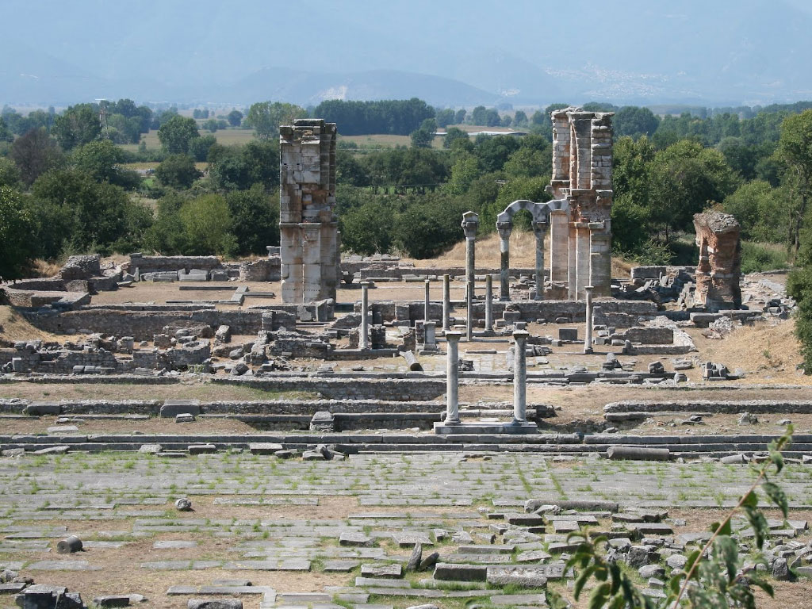
Philippi
Troas
P. Antioch
Iconium
Derbe
Lystra
Tarsus
Antioch
^{Acts 15:39} , and Barnabas took Mark with him and sailed away to Cyprus. ⁴⁰ But Paul chose Silas and left, being committed by the brethren to the grace of the Lord. ⁴¹ And he was traveling through Syria and Cilicia, strengthening the churches.
^{Acts 16:11} So putting out to sea from Troas, we ran a straight course to Samothrace, and on the day following to Neapolis; ¹² and from there to Philippi, which is a leading city of the district of Macedonia, a Roman colony; and we were staying in this city for some days.
^{Acts 16:11} So putting out to sea from Troas, we ran a straight course to Samothrace, and on the day following to Neapolis; ¹² and from there to Philippi, which is a leading city of the district of Macedonia, a Roman colony; and we were staying in this city for some days.

Slide 65
Philippi
Troas
P. Antioch
Iconium
Derbe
Lystra
Tarsus
Antioch
^{Acts 15:39} , and Barnabas took Mark with him and sailed away to Cyprus. ⁴⁰ But Paul chose Silas and left, being committed by the brethren to the grace of the Lord. ⁴¹ And he was traveling through Syria and Cilicia, strengthening the churches.
^{Acts 16:11} So putting out to sea from Troas, we ran a straight course to Samothrace, and on the day following to Neapolis; ¹² and from there to Philippi, which is a leading city of the district of Macedonia, a Roman colony; and we were staying in this city for some days.
^{Acts 16:11} So putting out to sea from Troas, we ran a straight course to Samothrace, and on the day following to Neapolis; ¹² and from there to Philippi, which is a leading city of the district of Macedonia, a Roman colony; and we were staying in this city for some days.

Slide 66
^{Acts 16:13} And on the Sabbath day we went outside the gate to a riverside, where we were supposing that there would be a place of prayer; and we sat down and began speaking to the women who had assembled.
^{Acts 16:13} And on the Sabbath day we went outside the gate to a riverside, where we were supposing that there would be a place of prayer; and we sat down and began speaking to the women who had assembled.

Slide 67
^{Acts 16:14} A woman named Lydia, from the city of Thyatira, a seller of purple fabrics, a worshiper of God, was listening; and the Lord opened her heart to respond to the things spoken by Paul.

Slide 68
^{Acts 16:15} And when she and her household had been baptized, she urged us, saying, “If you have judged me to be faithful to the Lord, come into my house and stay.” And she prevailed upon us.
^{Acts 16:15} And when she and her household had been baptized, she urged us, saying, “If you have judged me to be faithful to the Lord, come into my house and stay.” And she prevailed upon us.

Slide 69
^{Acts 16:15} And when she and her household had been baptized, she urged us, saying, “If you have judged me to be faithful to the Lord, come into my house and stay.” And she prevailed upon us.
^{Acts 16:16} It happened that as we were going to the place of prayer, a slave-girl having a spirit of divination met us, who was bringing her masters much profit by fortune-telling.
^{Acts 16:16} It happened that as we were going to the place of prayer, a slave-girl having a spirit of divination met us, who was bringing her masters much profit by fortune-telling.
^{Acts 16:16} It happened that as we were going to the place of prayer, a slave-girl having a spirit of divination met us, who was bringing her masters much profit by fortune-telling.

Slide 70
^{Acts 16:17} Following after Paul and us, she kept crying out, saying, “These men are bond-servants of the Most High God, who are proclaiming to you the way of salvation.” ¹⁸ She continued doing this for many days.

Slide 71
^{Acts 16:17} Following after Paul and us, she kept crying out, saying, “These men are bond-servants of the Most High God, who are proclaiming to you the way of salvation.” ¹⁸ She continued doing this for many days.

Slide 72
^{Acts 16:18} But Paul was greatly annoyed, and turned
and said to the spirit, “I command you in the name of Jesus Christ to come out of her!” And it came out at that very moment.
^{Acts 16:18} But Paul was greatly annoyed, and turned
and said to the spirit, “I command you in the name of Jesus Christ to come out of her!” And it came out at that very moment.

Slide 73
^{Acts 16:19} But when her masters saw that their hope of profit was gone, they seized Paul and Silas and dragged them into the market place before the authorities,
^{Acts 16:19} But when her masters saw that their hope of profit was gone, they seized Paul and Silas and dragged them into the market place before the authorities,

Slide 74
^{Acts 16:20} and when they had brought them to the chief magistrates, they said, “These men are throwing our city into confusion, being Jews, ²¹ and are proclaiming customs which it is not lawful for us to accept or to observe, being Romans.”
^{Acts 16:20} and when they had brought them to the chief magistrates, they said, “These men are throwing our city into confusion, being Jews, ²¹ and are proclaiming customs which it is not lawful for us to accept or to observe, being Romans.”
^{Acts 16:20} and when they had brought them to the chief magistrates, they said, “These men are throwing our city into confusion, being Jews, ²¹ and are proclaiming customs which it is not lawful for us to accept or to observe, being Romans.”

Slide 75
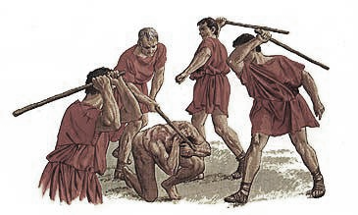
^{Acts 16:22} The crowd rose up together against them, and the chief magistrates tore their robes off them and proceeded to order them to be beaten with rods.

Slide 76
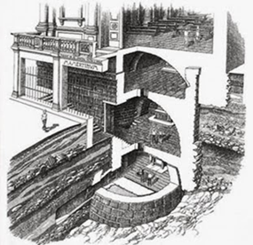
^{Acts 16:23} When they had struck them with many blows, they threw them into prison, commanding the jailer to guard them securely; ²⁴ and he, having received such a command, threw them into the inner prison and fastened their feet in the stocks.
^{Acts 16:23} When they had struck them with many blows, they threw them into prison, commanding the jailer to guard them securely; ²⁴ and he, having received such a command, threw them into the inner prison and fastened their feet in the stocks.
^{Acts 16:16} It happened that as we were going to the place of prayer, a slave-girl having a spirit of divination met us, who was bringing her masters much profit by fortune-telling.

Slide 77
^{Acts 16:23} When they had struck them with many blows, they threw them into prison, commanding the jailer to guard them securely; ²⁴ and he, having received such a command, threw them into the inner prison and fastened their feet in the stocks.
^{Acts 16:23} When they had struck them with many blows, they threw them into prison, commanding the jailer to guard them securely; ²⁴ and he, having received such a command, threw them into the inner prison and fastened their feet in the stocks.
^{Acts 16:16} It happened that as we were going to the place of prayer, a slave-girl having a spirit of divination met us, who was bringing her masters much profit by fortune-telling.

Slide 78
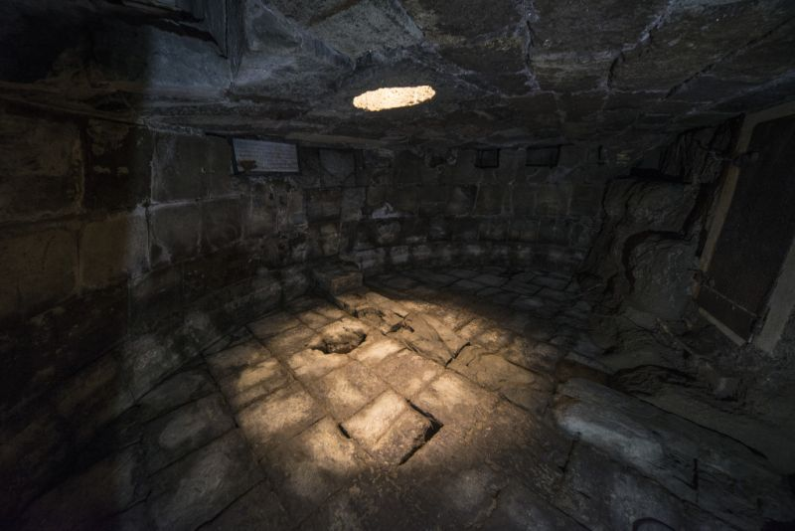
^{Acts 16:23} When they had struck them with many blows, they threw them into prison, commanding the jailer to guard them securely; ²⁴ and he, having received such a command, threw them into the inner prison and fastened their feet in the stocks.
^{Acts 16:23} When they had struck them with many blows, they threw them into prison, commanding the jailer to guard them securely; ²⁴ and he, having received such a command, threw them into the inner prison and fastened their feet in the stocks.
^{Acts 16:23} When they had struck them with many blows, they threw them into prison, commanding the jailer to guard them securely; ²⁴ and he, having received such a command, threw them into the inner prison and fastened their feet in the stocks.
^{Acts 16:16} It happened that as we were going to the place of prayer, a slave-girl having a spirit of divination met us, who was bringing her masters much profit by fortune-telling.

Slide 79
^{Acts 16:25} But about midnight Paul and Silas were praying and singing hymns of praise to God, and the prisoners were listening to them;

Slide 80
“Through many tribulations we must enter the kingdom of God.”
^{Acts 16:25} But about midnight Paul and Silas were praying and singing hymns of praise to God, and the prisoners were listening to them;

Slide 81
^{Acts 16:26} and suddenly there came a great earthquake, so that the foundations of the prison house were shaken; and immediately all the doors were opened and everyone’s chains were unfastened.

Slide 82
^{Acts 16:27} When the jailer awoke and saw the prison doors opened, he drew his sword and was about to kill himself, supposing that the prisoners had escaped.
^{Acts 16:27} When the jailer awoke and saw the prison doors opened, he drew his sword and was about to kill himself, supposing that the prisoners had escaped.

Slide 83
^{Acts 16:28} But Paul cried out with a loud voice, saying, “Do not harm yourself, for we are all here!”

Slide 84
^{Acts 16:29} And he called for lights and rushed in, and trembling with fear he fell down before Paul and Silas,
^{Acts 16:29} And he called for lights and rushed in, and trembling with fear he fell down before Paul and Silas, ³⁰ and after he brought them out, he said, “Sirs, what must I do to be saved?”

Slide 85
^{Acts 16:31} They said, “Believe in the Lord Jesus, and you will be saved, you and your household.”

Slide 86
^{Acts 16:32} And they spoke the word of the Lord to him together with all who were in his house. ³³ And he took them that very hour of the night and washed their wounds, and immediately he was baptized, he and all his household.

Slide 87
Principle: In ministry, adversity is opportunity
Because God can demonstrate His power
Because people are watching
Because “loving our enemies” is our secret weapon
^{Acts 16:34} And he brought them into his house and set food before them, and rejoiced greatly, having believed in God with his whole household.

Slide 88
God has made it His ambition to build his kingdom through the ministry of ordinary people
Have you made it yours?

Slide 89
Do you have a “next play” mentality?

Slide 90
Acts

