Slide 1
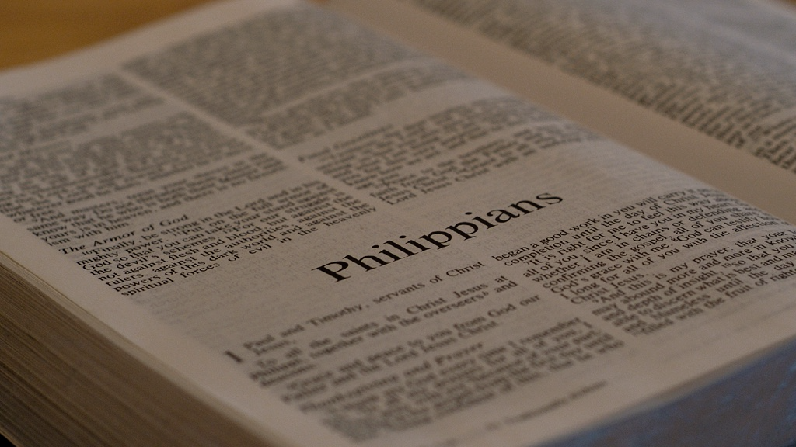
Philippians
The Humility of Jesus

Slide 2
2:3-4 Instead of being motivated by selfish ambition or vanity, each of you should, in humility, be moved to treat one another as more important than yourself. Each of you should be concerned not only about your own interests, but about the interests of others as well.
Philippians

Slide 3
2:3-4 Instead of being motivated by selfish ambition or vanity, each of you should, in humility, be moved to treat one another as more important than yourself. Each of you should be concerned not only about your own interests, but about the interests of others as well.
Philippians

Slide 4
2:3-4 Instead of being motivated by selfish ambition or vanity, each of you should, in humility, be moved to treat one another as more important than yourself. Each of you should be concerned not only about your own interests, but about the interests of others as well.
Philippians

Slide 5
5. You should have the same attitude toward one another that Christ Jesus had,
Philippians

Slide 6
5. You should have the same attitude toward one another that Christ Jesus had,
phroneō (φρονέω): in agreement with; to give careful consideration to; to be intent on; having a certain mindset…
REPEATEDLY
Philippians

Slide 7
5. You should have the same attitude toward one another that Christ Jesus had,
(1 Pt. 2:21) For to this you were called, since Christ also suffered for you, leaving an example for you to follow in his steps.
Philippians

Slide 8
5. You should have the same attitude toward one another that Christ Jesus had,
(1 Pt. 2:23-24) When he was maligned, he did not answer back; when he suffered, he threatened no retaliation, but committed himself to God who judges justly…
Philippians

Slide 9
5. You should have the same attitude toward one another that Christ Jesus had,
(1 Pt. 2:23-24)…He himself bore our sins in his body on the tree, that we may cease from sinning and live for righteousness. By his wounds you were healed.
Philippians

Slide 10
6. who though he existed in the form of God did not regard equality with God as something to be grasped,
Philippians

Slide 11
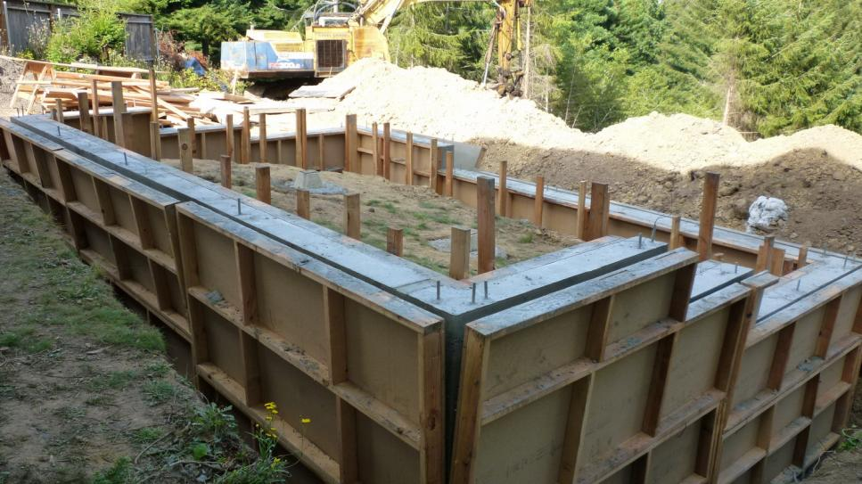
6. who though he existed in the form of God did not regard equality with God as something to be grasped,
form = essential essence & nature
Philippians

Slide 12
John 1:1;14
In the beginning was the Word, and the Word was with God, and the Word was fully God…Now the Word became flesh and took up residence among us. We saw his glory—the glory of the one and only, full of grace and truth, who came from the Father.
The Deity of Christ

Slide 13
John 8:58-59
Jesus said to them, “I tell you the solemn truth, before Abraham came into existence, I am!” Then they picked up stones to throw at him
The Deity of Christ

Slide 14
John 10:30
[Jesus said], “The Father and I are one.”
The Deity of Christ

Slide 15
John 5:17-18
So he told them, “My Father is working until now, and I too am working.” For this reason the Jewish leaders were trying even harder to kill him, because not only was he breaking the Sabbath, but he was also calling God his own Father, thus making himself equal with God.
The Deity of Christ

Slide 16
6. who though he existed in the form of God did not regard equality with God as something to be grasped,
Common Landscaper
Jesus did not choose to use His Deity to His own advantage.
Philippians

Slide 17
7. but emptied himself by taking on the form of a slave, by looking like other men, and by sharing in human nature.
Philippians

Slide 18
7. but emptied himself by taking on the form of a slave, by looking like other men, and by sharing in human nature.
Dog
This does NOT mean:
He gave up His Deity.
He was without power.
He dismissed or lost His identity.
He was somehow less than God.
Philippians

Slide 19
7. but emptied himself by taking on the form of a slave, by looking like other men, and by sharing in human nature.
So, what does this mean?
Philippians

Slide 20
7. but emptied himself [:] by taking on the form of a slave, by looking like other men, and by sharing in human nature.
Philippians

Slide 21
7. but emptied himself [:] by taking on the form of a slave, by looking like other men, and by sharing in human nature.
Philippians

Slide 22
7. but emptied himself [:] by taking on the form of a slave, by looking like other men, and by sharing in human nature.
(Jn. 13:4-5) Jesus got up from the meal, removed his outer clothes, took a towel and tied it around himself. He poured water into the washbasin and began to wash the disciples’ feet and to dry them with the towel he had wrapped around himself.
Philippians

Slide 23
7. but emptied himself [:] by taking on the form of a slave, by looking like other men, and by sharing in human nature.
(Heb. 2:17) Therefore, it was necessary for him to be made in every respect like us…Then he could offer a sacrifice that would take away the sins of the people.
Philippians

Slide 24
7. but emptied himself [:] by taking on the form of a slave, by looking like other men, and by sharing in human nature.
(Is. 53:2) he had no stately form or majesty that might catch our attention, no special appearance that we should want to follow him.
Philippians

Slide 25
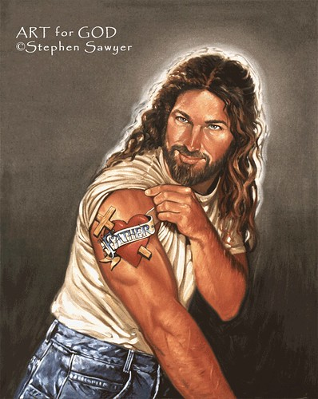
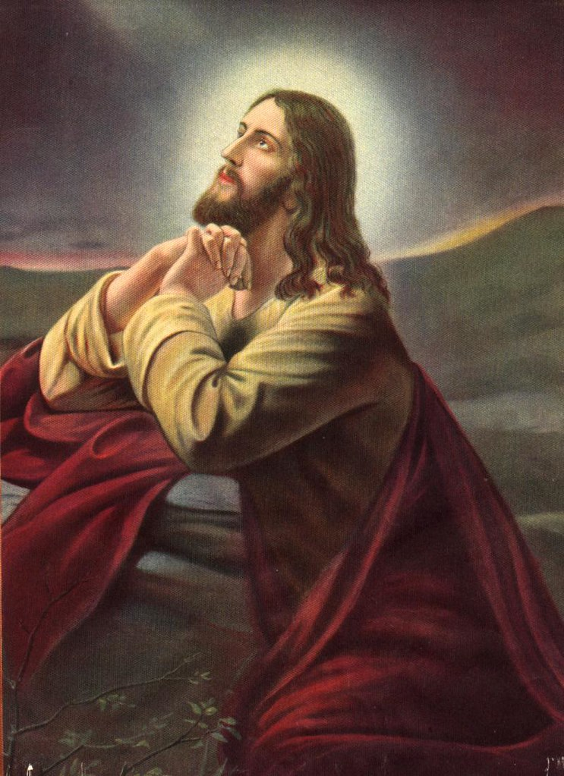
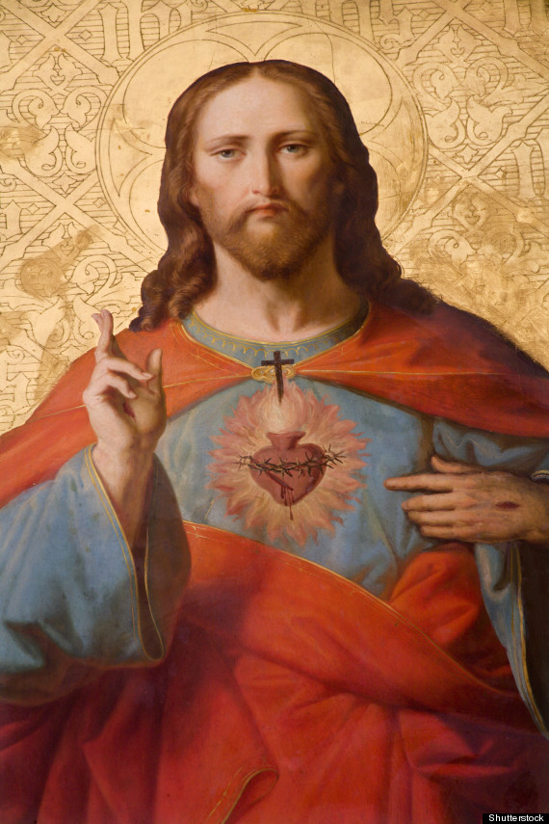
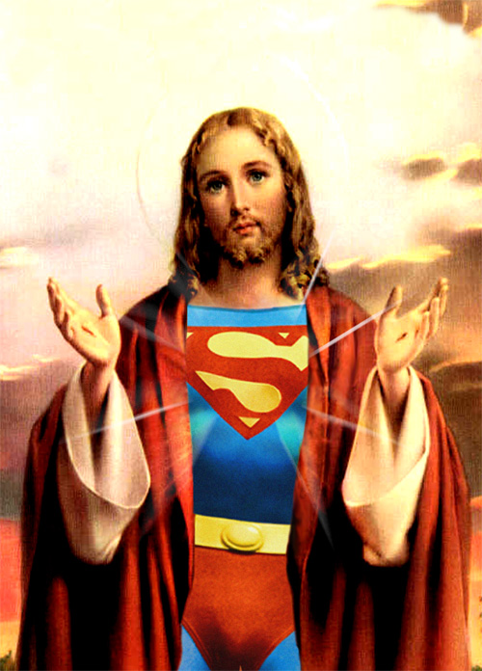
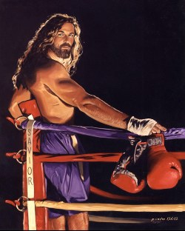
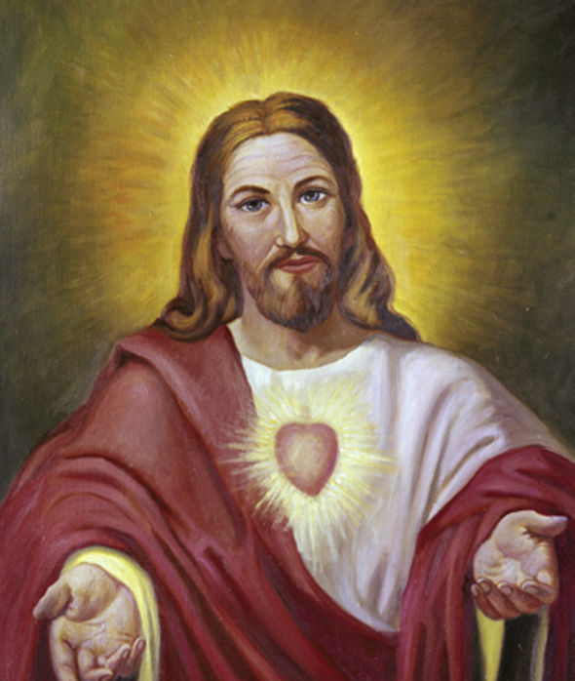
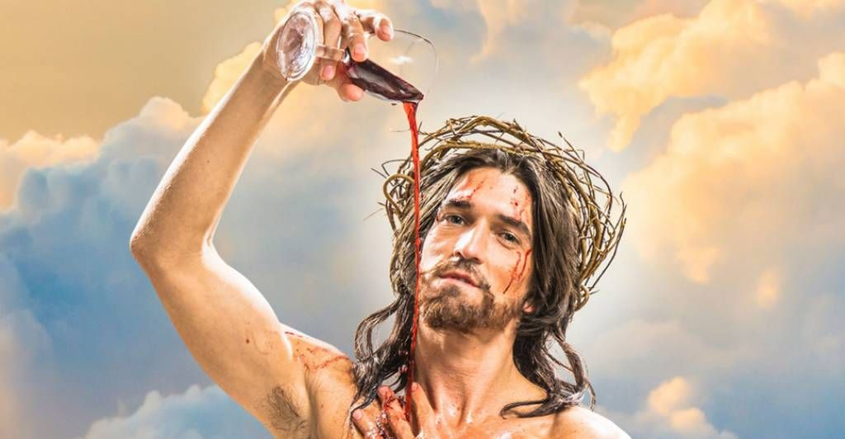
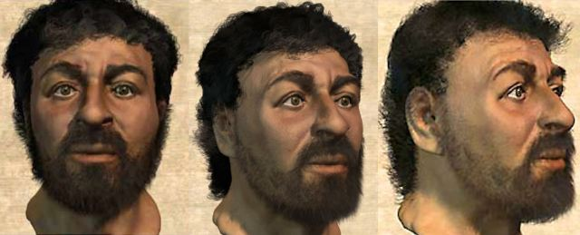
7. but emptied himself [:] by taking on the form of a slave, by looking like other men, and by sharing in human nature.
(Is. 53:2) he had no stately form or majesty that might catch our attention, no special appearance that we should want to follow him.
Philippians

Slide 26
Speaks to the dual nature of Jesus
7. but emptied himself [:] by taking on the form of a slave, by looking like other men, and by sharing in human nature.
(Col. 2:9) For in Christ lives all the fullness of God in a human body.
Philippians

Slide 27
7. but emptied himself [:] by taking on the form of a slave, by looking like other men, and by sharing in human nature.
The main difference is that He was without sin!
(Heb 4:15) …tempted in every way just as we are, yet without sin.
Philippians

Slide 28
8. He humbled himself, by becoming obedient to the point of death, even death on a cross!
Philippians

Slide 29
8. He humbled himself, by becoming obedient to the point of death, even death on a cross!
Nobody humbles a sovereign God…
but Himself!
Philippians

Slide 30
8. He humbled himself, [:] by becoming obedient to the point of death, even death on a cross!
Philippians

Slide 31
8. He humbled himself, [:] by becoming obedient to the point of death, even death on a cross!
His obedience:
His dependence on the other two persons of the Trinity
Philippians

Slide 32
8. He humbled himself, [:] by becoming obedient to the point of death, even death on a cross!
His obedience:
His dependence on the other two persons of the Trinity
(Jn. 8:58) Then Jesus said, “When you lift up the Son of Man, then you will know that I am he, and I do nothing on my own initiative, but I speak just what the Father taught me.
Philippians

Slide 33
8. He humbled himself, [:] by becoming obedient to the point of death, even death on a cross!
His obedience:
His dependence on the other two persons of the Trinity
His fulfillment of Scripture
Philippians

Slide 34
8. He humbled himself, [:] by becoming obedient to the point of death, even death on a cross!
(Mk. 10:33-34) “Look, we are going up to Jerusalem, and the Son of Man will be handed over to the chief priests and experts in the law. They will condemn him to death and will turn him over to the Gentiles. They will mock him, spit on him, flog him severely, and kill him. Yet after three days, he will rise again.”
Philippians

Slide 35
8. He humbled himself, [:] by becoming obedient to the point of death, even death on a cross!
(Is. 53:5) But He was pierced through for our rebellion, He was crushed because of our sins; he endured punishment that made us well; because of his wounds we have been healed.
Philippians

Slide 36
8. He humbled himself, [:] by becoming obedient to the point of death, even death on a cross!
(2 Cor. 8:9) For you know the grace of our Lord Jesus Christ, that although he was rich, he became poor for your sakes, so that you by his poverty could become rich.
Philippians

Slide 37
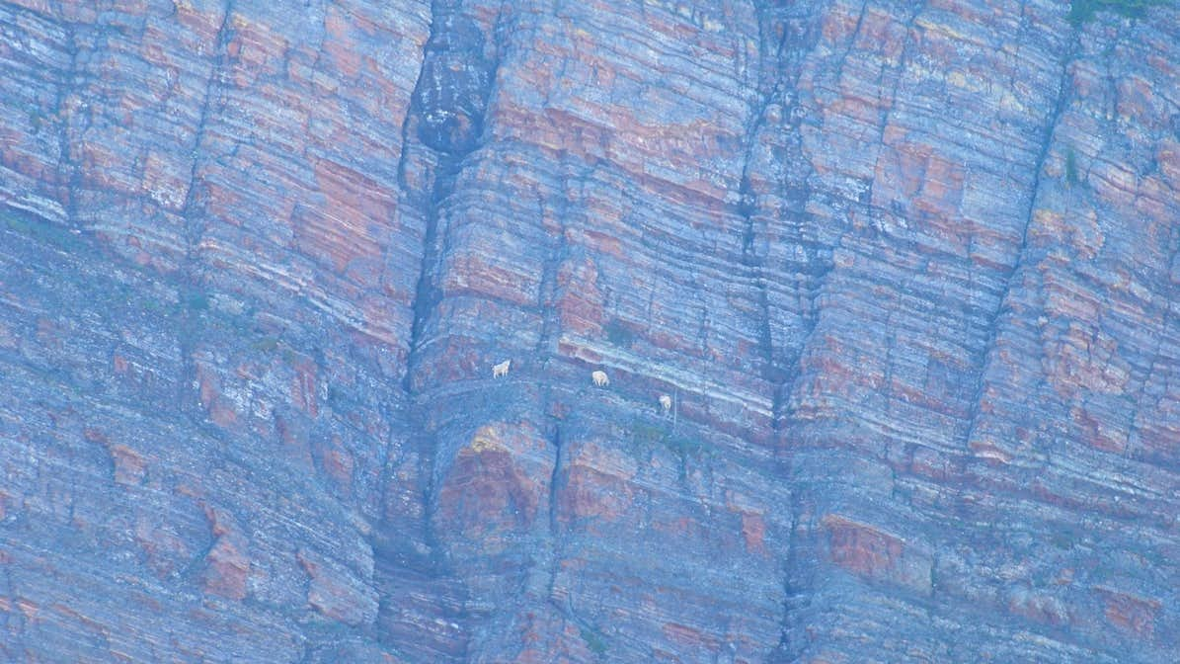
But Jesus didn’t stay this low!

Slide 38
9. As a result God exalted him and gave him the name that is above every name,
Philippians

Slide 39
9. As a result God exalted him and gave him the name that is above every name,
In God’s economy, the way up is down!
(Lk. 9:24) For whoever wants to save his life will lose it, but whoever loses his life for my sake will save it.
Philippians

Slide 40
9. As a result God exalted him and gave him the name that is above every name,
In God’s economy, the way up is down!
(Matt. 23:12) And whoever exalts himself will be humbled, and whoever humbles himself will be exalted.
Philippians

Slide 41
9. As a result God exalted him and gave him the name that is above every name,
Jesus was rejected on earth, but accepted in Heaven.
(Acts 2:32-33) “God raised Jesus from the dead, and we are all witnesses of this. Now he is exalted to the place of highest honor in heaven, at God’s right hand.
Philippians

Slide 42
10. so that at the name of Jesus every knee will bow in heaven and on earth and under the earth
Philippians

Slide 43
Isaiah 45:22-23
Let all the world look to me for salvation! For I am God; there is no other. I have sworn by my own name; I have spoken the truth, and I will never go back on my word: Every knee will bend to me, and every tongue will declare allegiance to me.

Slide 44
10. so that at the name of Jesus every knee will bow in heaven and on earth and under the earth
Philippians

Slide 45
11. and every tongue confess that Jesus Christ is Lord to the glory of God the Father.
Philippians

Slide 46
Romans 10:9-11
Because if you confess with your mouth that Jesus is Lord and believe in your heart that God raised him from the dead, you will be saved. For with the heart one believes and thus has righteousness and with the mouth one confesses and thus has salvation. For the scripture says, “Everyone who believes in him will not be put to shame.”

Slide 47
God
Name above all
Descent
Ascent
Eternity past
Eternal Glory
Emptied
Exalted
Humanity
Resurrection
Consent
Cross
Death
Christ’s Journey to Eternal Glory

Slide 48
Interested in learning more?
Pick up a FREE copy of “Discovering God”
First time joining us?

Slide 49
Philippians
Thoughts?
Questions?

