Slide 1
Nehemiah 1
A Disrupted Life

Slide 2
Nehemiah 1
Historical Context

Slide 3
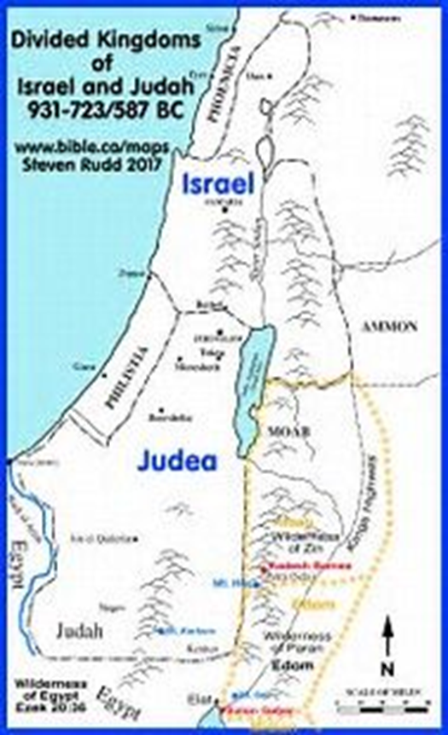
Israel conquered by Assyria in 722 BC
Judah conquered by Babylon in 586 BC

Slide 4
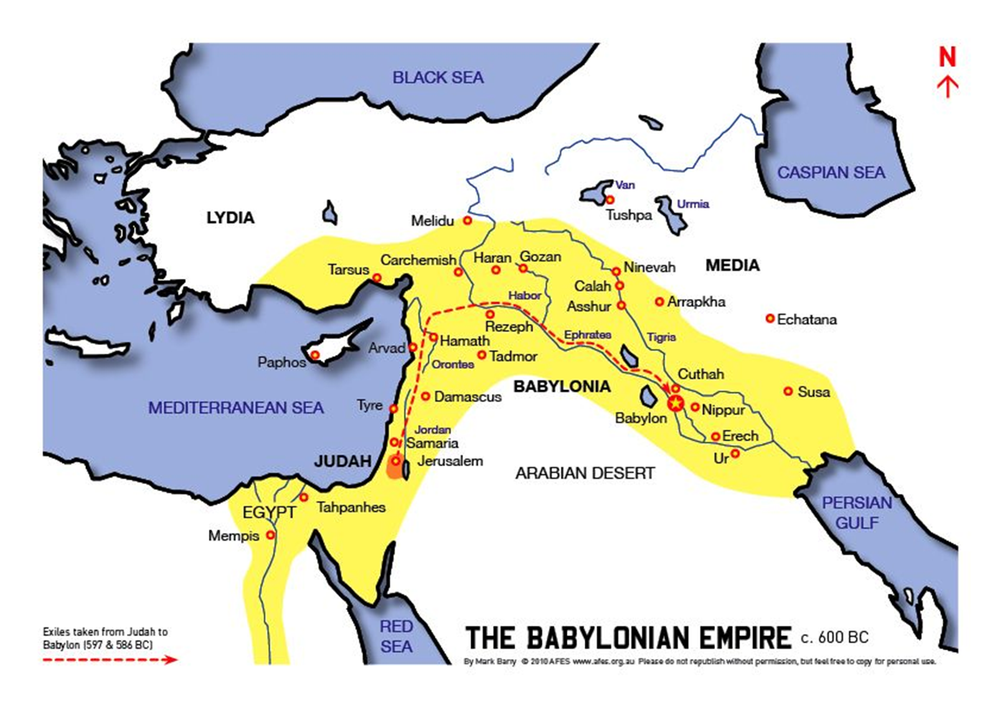
Nehemiah 1

Slide 5
Nehemiah 1
Two things Nehemiah knew
God was at work in human history (Neh. 1:7-9)

Slide 6
Nehemiah 1
Two things Nehemiah knew
God was at work in human history (Neh. 1:7-9)
He had a role in that plan (2:5, 12)
Let’s read Neh. 1:1 – 2:12

Slide 7
Nehemiah 1
How would describe Nehemiah’s life?
DISRUPTED
Thrown in disorder, interrupted
His world was turned upside down

Slide 8
Nehemiah 1
Two questions:
How was his life disrupted?
Why did he embrace these disruptions?

Slide 9
Nehemiah 1
How was his life disrupted?
Practical day to day
Emotional life
Prayer life

Slide 10
Nehemiah 1
Practical day to day life was disrupted
Where he lived: Babylon to Jerusalem
Job: cupbearer to servant/leader
Position of respect to earning respect
Life of relative ease to rough living
New set of risks and fears, physical threats

Slide 11
Nehemiah 1
Emotional life was disrupted
1:4 – “ I sat down and wept and mourned for days;”
5:6,7: He was “very angry” when he heard some were taking advantage of fellow countrymen
12:43 “and on that day they offered great sacrifices and rejoiced because God had given them great joy;”

Slide 12
Nehemiah 1
"Not only because of the human needs in Jerusalem, but also, and I think primarily, because God was being dishonored as long as Jerusalem lay waste. For Jerusalem was "the holy city" … the worship center God had chosen "as a dwelling for (his) Name" … – that is, the appointed place where the reality of his presence would be experienced in love and mercy by those who sought him...But none of this could be reality while Jerusalem was in ruins and the temple services were, inevitably, disrupted. Nehemiah identifies with the quest of God's glory and praise, and it is this that prompts his mourning, his fasting, ...and his praying itself. J.I. Packer, A Passion for Faithfulness (Crossway Books: Wheaton, Illinois, 1995), p. 60.
Emotional life was disrupted
1:4 – “ I sat down and wept and mourned for days;”
5:6,7: He was “very angry” when he heard some were taking advantage of fellow countrymen
12:43 “and on that day they offered great sacrifices and rejoiced because God had given them great joy;”

Slide 13
Nehemiah 1
Prayer Life was disrupted
Chap 1: “I was fasting and praying”
Spontaneous prayers asking for help to do God’s will
Boldness and guidance
2:4 Then the king said to me, “What would you request?” So I prayed to the God of heaven

Slide 14
Nehemiah 1
Protection
4:4 “Hear, O God, how we are despised!” Return their reproach on their own heads and give them up for plunder in a land of captivity.”
Courage and stamina
6:9 For all of them were trying to frighten us, thinking, “They will become discouraged with the work and it will not be done. But now, O God, strengthen my hands

Slide 15
Nehemiah 1
Nehemiah’s life reflects a pattern in Biblical history
Abraham
Moses
David
Prophets
Jesus
Calling of the first disciples (Mark 1:16-20)

Slide 16
As He was going along by the Sea of Galilee, He saw Simon and Andrew, the brother of Simon, casting a net in the sea; for they were fishermen.
17 And Jesus said to them, “Follow Me, and I will make you become fishers of men.”
18 Immediately they left their nets and followed Him.
19 Going on a little farther, He saw James the son of Zebedee, and John his brother, who were also in the boat mending the nets.
20 Immediately He called them; and they left their father Zebedee in the boat with the hired servants, and went away to follow Him.

Slide 17
Nehemiah 1
Paul
Col.1: 25 God has given me the responsibility of serving his church by proclaiming his entire message to you. 26 This message was kept secret for centuries and generations past, but now it has been revealed to God’s people. 27 For God wanted them to know that the riches and glory of Christ are for you Gentiles, too. And this is the secret: Christ lives in you. This gives you assurance of sharing his glory (NLT)

Slide 18
Nehemiah 1
Practical day to day
Persecutor to persecuted, 10,000 mile by foot
Emotional life
Phil 1:4: always offering prayer with joy in my every prayer for you
I Thes 2:8: fond affection ..very life;
Galatians: such concern over the gospel
2 Timothy: “longing to see you..”

Slide 19
Nehemiah 1
Prayer life
Praying for them: Romans 1:9&10; Eph 1:3, Phil 1:9, I Thes 1;3&4
Asks for prayer to speak boldly: Eph 6:19; Col. 4:3&4
God’s glory and His work be done

Slide 20
Nehemiah 1
So difficult to keep this perspective
Easily distracted
Culture aggressively and unashamedly promotes self-centeredness
Too easy to think we deserve our comfort, ease, more trips….

Slide 21
Nehemiah 1
How do I know if I am losing this perspective?
When was the last time you can remember your life being disrupted by God?
And when your schedule/agenda was disrupted, how did you respond?

Slide 22
Nehemiah 1
When was the last time your emotional life was impacted by the things of God?
When was the last time your prayer life focused on the advancement of God’s kingdom? When you do pray for yourself, do you ask God to empower you to play your role in advancing his kingdom?

Slide 23
Nehemiah 1
Why did Nehemiah embrace these disruptions?
2:18: “…so they put their hands to the good work…”
6:3: “…I am doing a great work and I can not come down.”
What made it a great work?
Neither glamorous nor much fun
Full of additional stress

Slide 24
Nehemiah 1
It was a great work because God had given Nehemiah the task.
Makes all the difference in the world
Value of job tied to giver of the job

Slide 25
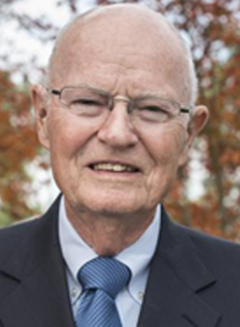
Nehemiah 1
Author
Missionary leader
College President
Founded two radio stations
Robert McQuilkin

Slide 26
Nehemiah 1
Do you miss being president?
“I didn’t sleep well that night and awoke contemplating the puzzle. Muriel was still mobile at that time, so we set out on our morning walk around the block. She wasn’t too sure on her feet, so we went slowly and held hands as we always do. This day I heard footsteps behind me and looked back to see the familiar form of a local derelict behind us. He staggered past us, then turned and looked us up and down. “Tha’ good.

Slide 27
Nehemiah 1
I like ‘at,” he said. “Tha’s real good. I likes it.” He turned and headed back down the street, mumbling to himself over and over again, “Tha’s good. I like it.”
When Muriel and I reached our little garden and sat down, his words came back to me. Then the realization hit me; God has spoken through and inebriated old derelict. “It is you who are whispering to my spirit, ‘I likes it, tha’s good,’ ” I

Slide 28
Nehemiah 1
said aloud. “I may be on the bench, but if you like it and say it’s good, that all that counts.”
Paul E. Miller, Love Walked Among Us, pg. 123.

Slide 29
Nehemiah 1
Listening to a teaching
Call/listen to someone
Pray for someone
Invite someone to this meeting
Introduce yourself to someone
Confess a sin
Be generous with money
Learn about Global Partner
Tell someone about love of God
Write a note of encouragement
Take a risk

Slide 30
Nehemiah 1
Why Nehemiah embrace the disruptions?
Part of a supernatural event
6:16 “When the enemies heard of it, and all the nations surrounding us saw it, they lost their confidence; for they recognized that this work had been accomplished with the help of our God.”

