Slide 1
1 Peter 5
Lion Survival

Slide 2
1 Peter 5
8 Be of sober spirit, be on the alert.
Your adversary, the devil, prowls around like a roaring lion, seeking someone to devour.

Slide 3
1 Peter 5
8 Be of sober spirit, be on the alert.
Your adversary, the devil, prowls around like a roaring lion, seeking someone to devour.

Slide 4
Your Adversary, The Devil

Slide 5
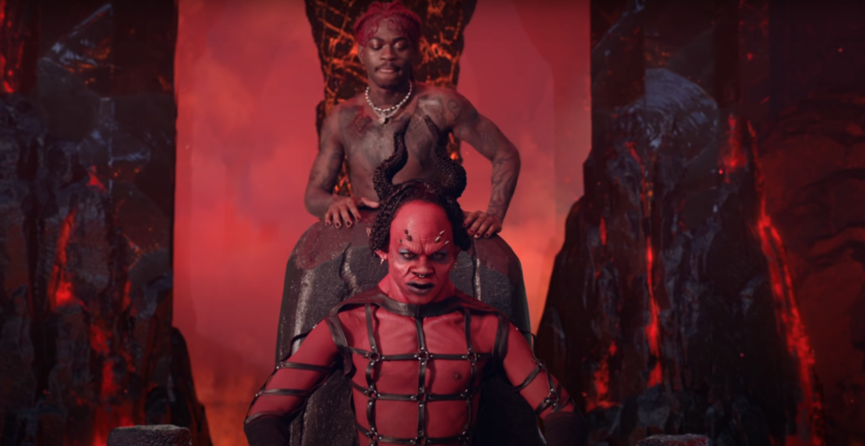
Your Adversary, The Devil

Slide 7
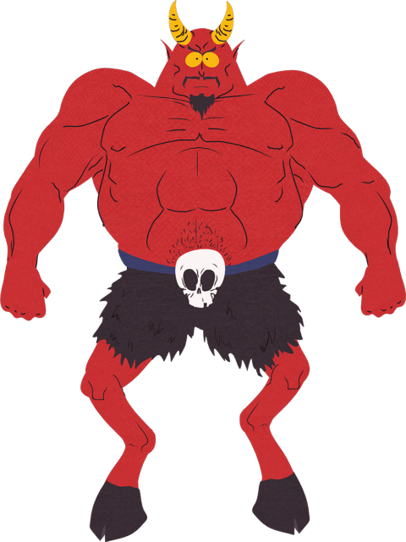
Barna Group. “Most American Christians Do Not Believe that Satan or the Holy Spirit Exist” April 10, 2009. https://www.barna.com/research/most-american-christians-do-not-believe-that-satan-or-the-holy-spirit-exist/
Four out of ten Christians (40%) strongly agreed that Satan “is not a living being but is a symbol of evil.”
An additional two out of ten Christians (19%) said they “agree somewhat” with that perspective.

Slide 8
Your Adversary, The Devil
Why believe in Satan?
There’s not time to fully explore this question
But Peter believed in him
And so did Jesus!
Luke 4
Luke 22:31-32

Slide 9
Your Adversary, The Devil
What we know:
He was once the leader of the angels (Ezek 28)
He grew proud and turned on God (1 Tim 3:6-7; Ezek 28)
Convinced other angels to join him (Rev 12:4, 9)
He has many names
Satan = the adversary
Devil = the accuser
The Father of Lies (John 8:44)
The Thief (John 10:10-11)

Slide 10
Your Adversary, The Devil
What we know:
Jesus dealt Satan a decisive defeat at the cross. (Col 2:15)
His final doom is certain. (Rev 20:10)
Satan hates God, and spends his remaining time lashing out at Him.
He tries to harm people by keeping them from God. (Acts 26:18)

Slide 11
Your Adversary, The Devil
What we know:
How does he attack?

Slide 14
Your Adversary, The Devil
What we know:
How does he attack?
Through telling lies – distorting your view of God, of yourself, of others, of reality!
And he’s really good at it!

Slide 15
1 Peter 5
8 Be of sober spirit, be on the alert.
Your adversary, the devil, prowls around like a roaring lion, seeking someone to devour.

Slide 17
1 Peter 5
8 Be of sober spirit, be on the alert.
Your adversary, the devil, prowls around like a roaring lion, seeking someone to devour.

Slide 19
Observations
“Behind the scenes the lions take their positions”
“Nearly everybody scatters”
“But the warthog seems oblivious”
Not sober or alert!
Devoured!

Slide 21
Observations
Sophistication! – “One behind the target and two lying in wait.”
Separated during panic, and devoured

Slide 23
Observations
Seeking “a manageable target”
In our context, an easy target is someone who doesn’t have a firm grasp of God’s truth

Slide 24
Observations
The lead lion “roars to scare the cows”
Lions roar for 3 reasons:
Communication with the other lions
To intimidate other creatures (“Back off!”)
To induce panic and separate their prey

Slide 25
Observations
“The calf loses his mother. Now he’s defenseless.”
How easy is it to separate you from the pack?

Slide 26
Observations
Sadness: “In disbelief she tries to urge her baby to its feet.”
We will see people picked off by Satan
Accusations
Temptation
Division
Intimidation (discouragement, unworthiness, threats)

Slide 27
1 Peter 5
8 Be of sober spirit, be on the alert.
Your adversary, the devil, prowls around like a roaring lion, seeking someone to devour.
1. Be alert!

Slide 28
1 Peter 5
9 But resist him, firm in the faith,
2. Be firm in the faith! Learn the Scriptures!
3. Resist the devil and he will flee (James 4:6)

Slide 29
1 Peter 5
9 But resist him, firm in the faith,
knowing that the same experiences of suffering are being accomplished by your brethren who are in the world.
4. Remember: You aren’t in this alone
5. Beware of strategies to separate you from God and from the pack (like division, accusation, temptation)

Slide 30
1 Peter 5
10 After you have suffered for a little while,
the God of all grace, who called you to His eternal glory in Christ,
will Himself perfect, confirm, strengthen and establish you.
11 To Him be dominion forever and ever. Amen.
6. Remember: It will all be over soon
7. Remember: God has dominion even over Satan

Slide 31
Conclusions
There’s a lion on the loose who wants to devour you
But there’s an even greater Lion who gave his life for you

Slide 32
Conclusions
There’s a lion on the loose who wants to devour you
But there’s an even greater Lion who gave his life for you
Look, the Lion of the tribe of Judah, the heir to David’s throne, has won the victory…
Then I saw a Lamb that looked as if it had been slaughtered (Rev 5:5-6)

Slide 33
1 Peter 5
Questions?
Comments?
Experiences?
risleys@dwellcc.org
See the Dwell App OR teachings.dwellcc.org

