Slide 2
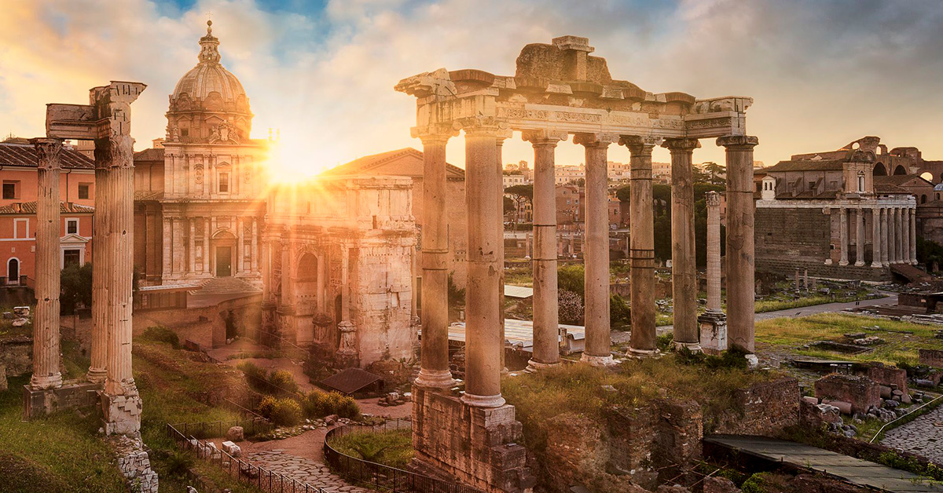
R O M A N S
Romans 8:12-17
How the Spirit Helps

Slide 3
R O M A N S
How do we grow spiritually?

Slide 4
Walking According to the Spirit
How do we grow spiritually?

Slide 5
Walking According to the Spirit
A relationship not a method
^{Romans} ^{8:10} If Christ is in you, though the body is dead because of sin, yet the spirit is alive because of righteousness. ¹¹ But if the Spirit of Him who raised Jesus from the dead dwells in you, He who raised Christ Jesus from the dead will also give life to your mortal bodies through His Spirit who dwells in you.

Slide 6
Walking According to the Spirit
A relationship not a method
^{Romans} ^{8:10} If Christ is in you, though the body is dead because of sin, yet the spirit is alive because of righteousness. ¹¹ But if the Spirit of Him who raised Jesus from the dead dwells in you, He who raised Christ Jesus from the dead will also give life to your mortal bodies through His Spirit who dwells in you.

Slide 7
Walking According to the Spirit
A relationship not a method
^{Romans} ^{8:10} If Christ is in you, though the body is dead because of sin, yet the spirit is alive because of righteousness. ¹¹ But if the Spirit of Him who raised Jesus from the dead dwells in you, He who raised Christ Jesus from the dead will also give life to your mortal bodies through His Spirit who dwells in you.

Slide 8
Walking According to the Spirit
A relationship not a method
^{Romans} ^{8:10} If Christ is in you, though the body is dead because of sin, yet the spirit is alive because of righteousness. ¹¹ But if the Spirit of Him who raised Jesus from the dead dwells in you, He who raised Christ Jesus from the dead will also give life to your mortal bodies through His Spirit who dwells in you.

Slide 9
Walking According to the Spirit
The presence of the Holy Spirit makes real change in this life possible!
^{Romans} ^{8:10} If Christ is in you, though the body is dead because of sin, yet the spirit is alive because of righteousness. ¹¹ But if the Spirit of Him who raised Jesus from the dead dwells in you, He who raised Christ Jesus from the dead will also give life to your mortal bodies through His Spirit who dwells in you.

Slide 10
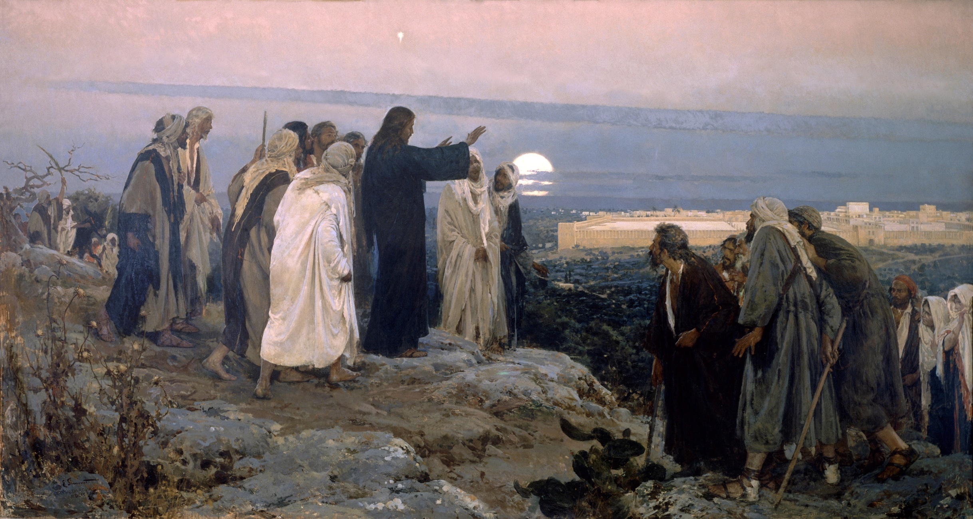
How the Spirit Helps
4 ways He helps us walk, and
1 way that we have a part
^{John 14:16} I will ask the Father, and He will give you another Helper, that He may be with you forever; ¹⁷ that is the Spirit of truth, whom the world cannot receive, because it does not see Him or know Him, but you know Him because He abides with you and will be in you.

Slide 11
How the Spirit Helps
^{Romans} ^{8:12} So then, brethren, we are under obligation, not to the flesh, to live according to the flesh— ¹³ for if you are living according to the flesh, you must die; but if by the Spirit you are putting to death the deeds of the body, you will live. ¹⁴ For all who are being led by the Spirit of God, these are sons of God.

Slide 12
How the Spirit Helps
^{Romans} ^{8:12} So then, brethren, we are under obligation, not to the flesh, to live according to the flesh— ¹³ for if you are living according to the flesh, you must die; but if by the Spirit you are putting to death the deeds of the body, you will live. ¹⁴ For all who are being led by the Spirit of God, these are sons of God.

Slide 13
How the Spirit Helps
^{Romans} ^{8:12} So then, brethren, we are under obligation, not to the flesh, to live according to the flesh— ¹³ for if you are living according to the flesh, you must die; but if by the Spirit you are putting to death the deeds of the body, you will live. ¹⁴ For all who are being led by the Spirit of God, these are sons of God.

Slide 14
How the Spirit Helps
Not a threat…
Living according to the old self is a dead end leading to defeat
^{Romans} ^{8:12} So then, brethren, we are under obligation, not to the flesh, to live according to the flesh— ¹³ for if you are living according to the flesh, you must die; but if by the Spirit you are putting to death the deeds of the body, you will live. ¹⁴ For all who are being led by the Spirit of God, these are sons of God.

Slide 15
How the Spirit Helps
Not a threat…
Living according to the old self is a dead end leading to defeat
^{Romans} ^{8:12} So then, brethren, we are under obligation, not to the flesh, to live according to the flesh— ¹³ for if you are living according to the flesh, you must die; but if by the Spirit you are putting to death the deeds of the body, you will live. ¹⁴ For all who are being led by the Spirit of God, these are sons of God.

Slide 16
How the Spirit Helps
^{Galatians 5:16} But I say, walk by the Spirit, and you will not carry out the desire of the flesh.
^{Romans} ^{8:12} So then, brethren, we are under obligation, not to the flesh, to live according to the flesh— ¹³ for if you are living according to the flesh, you must die; but if by the Spirit you are putting to death the deeds of the body, you will live. ¹⁴ For all who are being led by the Spirit of God, these are sons of God.

Slide 17
1) The Spirit helps us appropriate our New Identity
^{Galatians 5:16} But I say, walk by the Spirit, and you will not carry out the desire of the flesh.
^{Romans} ^{8:12} So then, brethren, we are under obligation, not to the flesh, to live according to the flesh— ¹³ for if you are living according to the flesh, you must die; but if by the Spirit you are putting to death the deeds of the body, you will live. ¹⁴ For all who are being led by the Spirit of God, these are sons of God.

Slide 18
1) The Spirit helps us appropriate our New Identity
Walking according to the Spirit is something we do as God’s children
^{Romans} ^{8:12} So then, brethren, we are under obligation, not to the flesh, to live according to the flesh— ¹³ for if you are living according to the flesh, you must die; but if by the Spirit you are putting to death the deeds of the body, you will live. ¹⁴ For all who are being led by the Spirit of God, these are sons of God.

Slide 19
2) The Spirit helps us live as “sons of God”
Walking according to the Spirit is something we do as God’s children
^{Romans} ^{8:12} So then, brethren, we are under obligation, not to the flesh, to live according to the flesh— ¹³ for if you are living according to the flesh, you must die; but if by the Spirit you are putting to death the deeds of the body, you will live. ¹⁴ For all who are being led by the Spirit of God, these are sons of God.

Slide 20
2) The Spirit helps us live as “sons of God”
^{Romans} ^{8:15} For you have not received a spirit of slavery leading to fear again, but you have received a spirit of adoption as sons by which we cry out, “Abba! Father!” ¹⁶ The Spirit Himself testifies with our spirit that we are children of God, ¹⁷ and if children, heirs also, heirs of God and fellow heirs with Christ, if indeed we suffer with Him so that we may also be glorified with Him.

Slide 21
2) The Spirit helps us live as “sons of God”
^{Romans} ^{8:15} For you have not received a spirit of slavery leading to fear again, but you have received a spirit of adoption as sons by which we cry out, “Abba! Father!” ¹⁶ The Spirit Himself testifies with our spirit that we are children of God, ¹⁷ and if children, heirs also, heirs of God and fellow heirs with Christ, if indeed we suffer with Him so that we may also be glorified with Him.

Slide 22
2) The Spirit helps us live as “sons of God”
A relationship that is not like slavery
^{Romans} ^{8:15} For you have not received a spirit of slavery leading to fear again, but you have received a spirit of adoption as sons by which we cry out, “Abba! Father!” ¹⁶ The Spirit Himself testifies with our spirit that we are children of God, ¹⁷ and if children, heirs also, heirs of God and fellow heirs with Christ, if indeed we suffer with Him so that we may also be glorified with Him.

Slide 23
2) The Spirit helps us live as “sons of God”
A relationship that is not like slavery
A chosen relationship with a status: adoption
^{Romans} ^{8:15} For you have not received a spirit of slavery leading to fear again, but you have received a spirit of adoption as sons by which we cry out, “Abba! Father!” ¹⁶ The Spirit Himself testifies with our spirit that we are children of God, ¹⁷ and if children, heirs also, heirs of God and fellow heirs with Christ, if indeed we suffer with Him so that we may also be glorified with Him.

Slide 24
2) The Spirit helps us live as “sons of God”
A relationship that is not like slavery
A chosen relationship with a status: adoption
“In the Roman world of the first century AD an adopted son was a son deliberately chosen by his adoptive father to perpetuate his name and inherit his estate; he was no whit inferior in status to a son born in the ordinary course of nature, and might well enjoy the father’s affection more fully and reproduce the father’s character more worthily.”
^{Romans} ^{8:15} For you have not received a spirit of slavery leading to fear again, but you have received a spirit of adoption as sons by which we cry out, “Abba! Father!” ¹⁶ The Spirit Himself testifies with our spirit that we are children of God, ¹⁷ and if children, heirs also, heirs of God and fellow heirs with Christ, if indeed we suffer with Him so that we may also be glorified with Him.

Slide 25
2) The Spirit helps us live as “sons of God”
A relationship that is not like slavery
A chosen relationship with a status: adoption
^{Romans} ^{8:15} For you have not received a spirit of slavery leading to fear again, but you have received a spirit of adoption as sons by which we cry out, “Abba! Father!” ¹⁶ The Spirit Himself testifies with our spirit that we are children of God, ¹⁷ and if children, heirs also, heirs of God and fellow heirs with Christ, if indeed we suffer with Him so that we may also be glorified with Him.

Slide 26
2) The Spirit helps us live as “sons of God”
A relationship that is not like slavery
A chosen relationship with a status: adoption
An intimate relationship
French: “Maman and Papa.”​
Norwegian: “Mamma and Papa.”​
Welsh: “Mam and Tad.”​
Swahili: “Mama and Baba.”​
Philippines: “Nanay and Tatay.”​
Mandarin: “Mama and Baba.”​
Chechen: “Naana and Daa.”​
Eskimo: “Anana and Ataata.”
^{Romans} ^{8:15} For you have not received a spirit of slavery leading to fear again, but you have received a spirit of adoption as sons by which we cry out, “Abba! Father!” ¹⁶ The Spirit Himself testifies with our spirit that we are children of God, ¹⁷ and if children, heirs also, heirs of God and fellow heirs with Christ, if indeed we suffer with Him so that we may also be glorified with Him.

Slide 27
2) The Spirit helps us live as “sons of God”
A relationship that is not like slavery
A chosen relationship with a status: adoption
An intimate relationship
Jesus related this way to the father
Jesus said, “The Father loves the Son” (Jn. 5:20).
“This is My beloved Son, in whom I am well-pleased” (Mt. 3:17)
Our status is “In the Beloved” (Eph. 1:6)
Jesus isn’t “ashamed” to call us his brothers (Heb. 2:11)
Jesus taught us to relate with God this way (Matt 6:9)
^{Romans} ^{8:15} For you have not received a spirit of slavery leading to fear again, but you have received a spirit of adoption as sons by which we cry out, “Abba! Father!” ¹⁶ The Spirit Himself testifies with our spirit that we are children of God, ¹⁷ and if children, heirs also, heirs of God and fellow heirs with Christ, if indeed we suffer with Him so that we may also be glorified with Him.

Slide 28
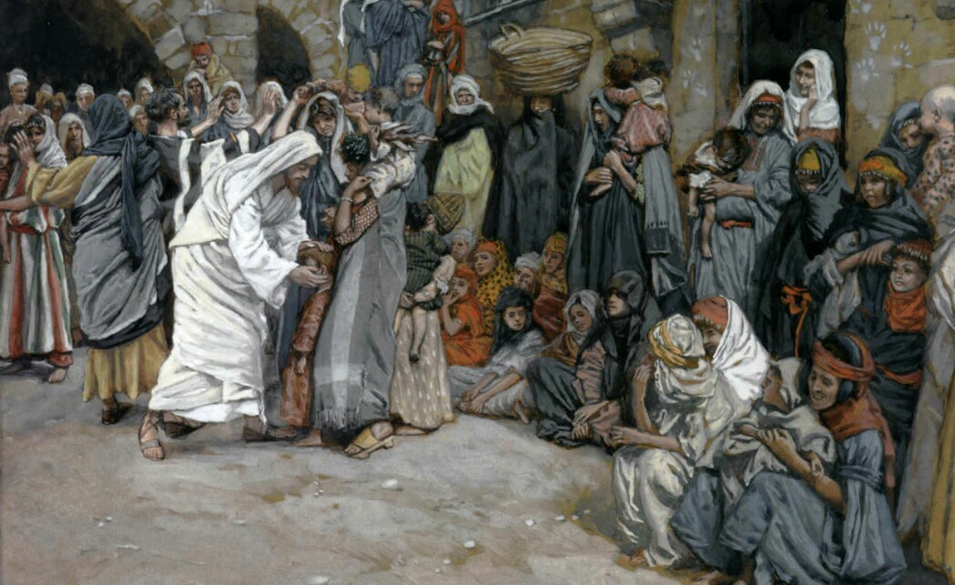
^{Luke 18:16} “Permit the children to come to Me, and do not hinder them, for the kingdom of God belongs to such as these. ¹⁷ Truly I say to you, whoever does not receive the kingdom of God like a child will not enter it at all.”
What about children is Jesus telling us to emulate?

Slide 29
^{Luke 18:16} “Permit the children to come to Me, and do not hinder them, for the kingdom of God belongs to such as these. ¹⁷ Truly I say to you, whoever does not receive the kingdom of God like a child will not enter it at all.”
What about children is Jesus telling us to emulate?

Slide 30
2) The Spirit helps us live as “sons of God”
A relationship that is not like slavery
A chosen relationship with a status: adoption
An intimate relationship
A secure relationship
He’s all in
^{Romans} ^{8:15} For you have not received a spirit of slavery leading to fear again, but you have received a spirit of adoption as sons by which we cry out, “Abba! Father!” ¹⁶ The Spirit Himself testifies with our spirit that we are children of God, ¹⁷ and if children, heirs also, heirs of God and fellow heirs with Christ, if indeed we suffer with Him so that we may also be glorified with Him.

Slide 31
2) The Spirit helps us live as “sons of God”
A relationship that is not like slavery
A chosen relationship with a status: adoption
An intimate relationship
A secure relationship
He finishes what he starts
^{Romans} ^{8:15} For you have not received a spirit of slavery leading to fear again, but you have received a spirit of adoption as sons by which we cry out, “Abba! Father!” ¹⁶ The Spirit Himself testifies with our spirit that we are children of God, ¹⁷ and if children, heirs also, heirs of God and fellow heirs with Christ, if indeed we suffer with Him so that we may also be glorified with Him.

Slide 32
2) The Spirit helps us live as “sons of God”
A relationship that is not like slavery
A chosen relationship with a status: adoption
An intimate relationship
A secure relationship
A permanent relationship with a shared future
^{Romans} ^{8:15} For you have not received a spirit of slavery leading to fear again, but you have received a spirit of adoption as sons by which we cry out, “Abba! Father!” ¹⁶ The Spirit Himself testifies with our spirit that we are children of God, ¹⁷ and if children, heirs also, heirs of God and fellow heirs with Christ, if indeed we suffer with Him so that we may also be glorified with Him.

Slide 33
2) The Spirit helps us live as “sons of God”
A relationship that is not like slavery
A chosen relationship with a status: adoption
An intimate relationship
A secure relationship
And our father shares his resources with us
^{Romans} ^{8:15} For you have not received a spirit of slavery leading to fear again, but you have received a spirit of adoption as sons by which we cry out, “Abba! Father!” ¹⁶ The Spirit Himself testifies with our spirit that we are children of God, ¹⁷ and if children, heirs also, heirs of God and fellow heirs with Christ, if indeed we suffer with Him so that we may also be glorified with Him.

Slide 34
3) A relationship in which we receive “power”
δύναμις, dýnamis:
“physical power, force, might, ability, efficacy, energy”
^{Acts 1:4} He commanded them not to leave Jerusalem, but to wait for what the Father had promised, “Which,” He said, “you heard of from Me; ⁵ for John baptized with water, but you will be baptized with the Holy Spirit not many days from now.” ⁸ you will receive power when the Holy Spirit has come upon you; and you shall be My witnesses both in Jerusalem, and in all Judea and Samaria, and even to the remotest part of the earth.”

Slide 35
3) A relationship in which we receive “power”
^{Romans} ^{8:10} If Christ is in you, though the body is dead because of sin, yet the spirit is alive because of righteousness. ¹¹ But if the Spirit of Him who raised Jesus from the dead dwells in you, He who raised Christ Jesus from the dead will also give life to your mortal bodies through His Spirit who dwells in you.

Slide 36
3) A relationship in which we receive “power”
^{Romans} ^{8:10} If Christ is in you, though the body is dead because of sin, yet the spirit is alive because of righteousness. ¹¹ But if the Spirit of Him who raised Jesus from the dead dwells in you, He who raised Christ Jesus from the dead will also give life to your mortal bodies through His Spirit who dwells in you.

Slide 37
3) A relationship in which we receive “power”
^{Romans} ^{8:10} If Christ is in you, though the body is dead because of sin, yet the spirit is alive because of righteousness. ¹¹ But if the Spirit of Him who raised Jesus from the dead dwells in you, He who raised Christ Jesus from the dead will also give life to your mortal bodies through His Spirit who dwells in you.

Slide 38
3) A relationship in which we receive “power”
When we pray (Rom 8:26,27)
When we open the Bible (1 Cor 2:12-14)
When we gather together (Eph 2:18)
When we speak (Luke 12:12)
When we step out to serve others
^{Romans} ^{8:10} If Christ is in you, though the body is dead because of sin, yet the spirit is alive because of righteousness. ¹¹ But if the Spirit of Him who raised Jesus from the dead dwells in you, He who raised Christ Jesus from the dead will also give life to your mortal bodies through His Spirit who dwells in you.

Slide 39
3) A relationship in which we receive “power”
Began His ministry (Luke 3:21)
Performed miracles (Luke 5:17)
Was led (Luke 4:1)
Taught (Luke 4:14)
Prayed (Luke 10:21)
Rose from the dead (Rom 8:11)
Commissioned the apostles (Acts 1:2)
^{Romans} ^{8:10} If Christ is in you, though the body is dead because of sin, yet the spirit is alive because of righteousness. ¹¹ But if the Spirit of Him who raised Jesus from the dead dwells in you, He who raised Christ Jesus from the dead will also give life to your mortal bodies through His Spirit who dwells in you.
“By the Holy Spirit", Jesus:

Slide 40
3) A relationship in which we receive “power”
We have literally unlimited power at our disposal!
But we don’t experience it until we step out in faith
^{Romans} ^{8:10} If Christ is in you, though the body is dead because of sin, yet the spirit is alive because of righteousness. ¹¹ But if the Spirit of Him who raised Jesus from the dead dwells in you, He who raised Christ Jesus from the dead will also give life to your mortal bodies through His Spirit who dwells in you.

Slide 41
3) A relationship in which we receive “power”
We have literally unlimited power at our disposal!
It’s power to follow Him, not ourselves
^{Romans} ^{8:10} If Christ is in you, though the body is dead because of sin, yet the spirit is alive because of righteousness. ¹¹ But if the Spirit of Him who raised Jesus from the dead dwells in you, He who raised Christ Jesus from the dead will also give life to your mortal bodies through His Spirit who dwells in you.

Slide 42
4) A relationship in which we receive leadership
It’s natural for kids to emulate their parents
But because our spiritual Father is perfect, this is something we should never grow out of
Good parents provide children with leadership
The Holy Spirit actively leads those who desire to walk with Him
^{Romans} ^{8:14} For all who are being led by the Spirit of God, these are sons of God.

Slide 43
Seeing the Spirit in nothing
Seeing the Spirit in everything
Ignores biblical teaching
man-centered
Misses out on Spirit’s leading!
Subjective
Feelings trump other factors
Who’s leading who?
The Holy Spirit actively leads those who desire to walk with Him
^{Romans} ^{8:14} For all who are being led by the Spirit of God, these are sons of God.

Slide 44
4) A relationship in which we receive leadership
But couldn’t that just be your imagination?
But the Spirit does actively lead!
Sometimes the Spirit whispers
Sometimes the Spirit prompts
Sometimes the Spirit convicts
^{Romans} ^{8:14} For all who are being led by the Spirit of God, these are sons of God.

Slide 45
4) A relationship in which we receive leadership
But couldn’t that just be your imagination?
But the Spirit does actively lead!
Always squares with scripture
Usually aligns with God’s priorities
^{Romans} ^{8:14} For all who are being led by the Spirit of God, these are sons of God.

Slide 46
So what’s our part in this?
Being “led” implies willingness to follow
^{Romans} ^{8:14} For all who are being led by the Spirit of God, these are sons of God.

Slide 47
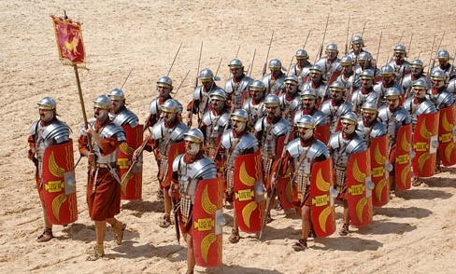
So what’s our part in this?
Being “led” implies willingness to follow
σΣτοιχέω “stoichéō” “to walk in rows” “proceed under direction”
^{Galatians 5:16} But I say, walk by the Spirit, and you will not carry out the desire of the flesh… ²⁵ Since we live by the Spirit, let us keep in step with the Spirit.

Slide 48
So what’s our part in this?
Being “led” implies willingness to follow
σΣτοιχέω “stoichéō” “to walk in rows” “proceed under direction”
^{Galatians 5:16} But I say, walk by the Spirit, and you will not carry out the desire of the flesh… ²⁵ Since we live by the Spirit, let us keep in step with the Spirit.

Slide 49
So what’s our part in this?
Do you expect to be led and listen for his leadership?
Do you ask for His direction?
^{Galatians 5:16} But I say, walk by the Spirit, and you will not carry out the desire of the flesh… ²⁵ Since we live by the Spirit, let us keep in step with the Spirit.

Slide 50
So what’s our part in this?
The alternative is to walk according to MY leadership
Are you willing to respond to His lead?
^{Galatians 5:16} But I say, walk by the Spirit, and you will not carry out the desire of the flesh… ²⁵ Since we live by the Spirit, let us keep in step with the Spirit.

Slide 51
So what’s our part in this?
The alternative is to walk according to MY leadership
Are you willing to respond to His lead?
^{Psalm 32:8} I will instruct you and teach you in the way which you should go; I will counsel you with My eye upon you. ⁹ Do not be as the horse or as the mule which have no understanding, Whose trappings include bit and bridle to hold them in check, Otherwise they will not come near to you.

Slide 52
It is truly a major undertaking, is it not, for the Lord to train us who are such wild horses? Long are the hours He must spend to subdue even us. And what a wild horse loses after being trained by its master is the same as what we lose after we too have been trained by our Master . . . And the horse becomes so trained that it can now sense the slightest movement of the one who rides it. It will thereafter run as ordered. A similar result is what God is after with us.

Slide 53
Given our higher place in God’s creation, we humans ought to be much better than a horse or mule… How much more swiftly God’s children ought to follow the wish and the leading of the Lord. A horse so trained is nevertheless termed as being without understanding because it requires a bit or a pull on the reigns to know its master’s mind. We, on the other hand, are able to look into the Lord’s eye… before ever His hand moves, His eye has already moved, and we who are teachable have noticed it.

Slide 54
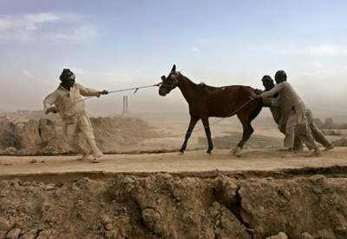
Keep in Step
If you’re unwilling to respond, don’t expect to hear His leading!
^{Psalm 32:8} I will instruct you and teach you in the way which you should go; I will counsel you with My eye upon you. ⁹ Do not be as the horse or as the mule which have no understanding, Whose trappings include bit and bridle to hold them in check, Otherwise they will not come near to you.

Slide 55
“Lord, what step do you have next for me?
I want my answer to be yes”
^{Romans} ^{8:14} For all who are being led by the Spirit of God, these are sons of God.

Slide 56
“Lord I am ready to act on your plan, even if my plan is *obviously* better from my point of view”
^{Romans} ^{8:14} For all who are being led by the Spirit of God, these are sons of God.

Slide 57
“Lord, I am ready to proceed in the direction you are leading, and I am also ready to abruptly change course if you do”
^{Romans} ^{8:14} For all who are being led by the Spirit of God, these are sons of God.

Slide 58
“Lord, I hear your conviction; I agree that I am wrong. Thank your for your forgiveness. Help me to abandon this course for another.”
^{Romans} ^{8:14} For all who are being led by the Spirit of God, these are sons of God.

Slide 59
“Lord, I trust your leadership.”
^{Romans} ^{8:14} For all who are being led by the Spirit of God, these are sons of God.

Slide 60
“Lord, I trust your leadership.”
^{Romans} ^{8:6} For the mind set on the flesh is death, but the mind set on the Spirit is life and peace

Slide 61
R O M A N S
Next Week…

