Slide 2
Jesus One on One
^{Luke 19:1}

Slide 3
Jesus One on One
^{Luke 19:1} He entered Jericho and was passing through.

Slide 4
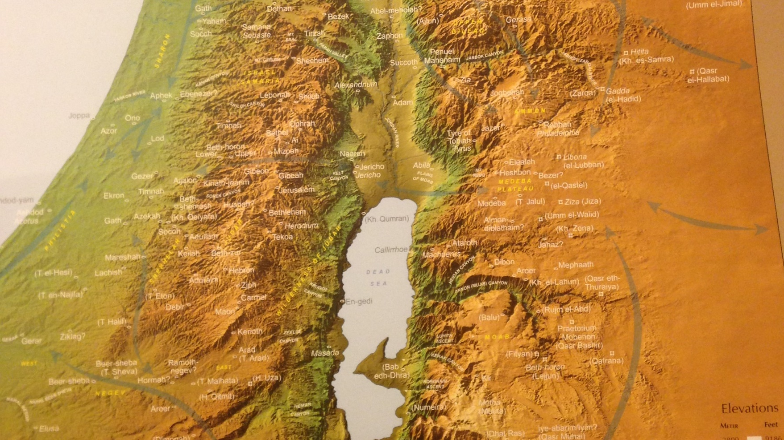
Jesus One on One
Jericho
Jerusalem
^{Luke 19:1} He entered Jericho and was passing through.

Slide 5
Jesus One on One
^{Luke 19:2} And there was a man called by the name of Zacchaeus; he was a chief tax collector and he was rich. ³ Zacchaeus was trying to see who Jesus was, and was unable because of the crowd, for he was small in stature.

Slide 6
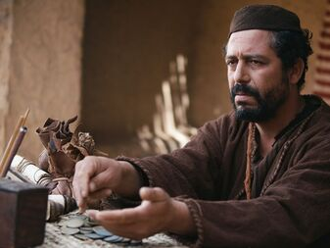
Jesus One on One
: Jesus and Zacchaeus
^{Luke 19:2} And there was a man called by the name of Zacchaeus; he was a chief tax collector and he was rich. ³ Zacchaeus was trying to see who Jesus was, and was unable because of the crowd, for he was small in stature.

Slide 7
Jesus One on One
: Jesus and Zacchaeus
Powerful
^{Luke 19:2} And there was a man called by the name of Zacchaeus; he was a chief tax collector and he was rich. ³ Zacchaeus was trying to see who Jesus was, and was unable because of the crowd, for he was small in stature.

Slide 8
Jesus One on One
: Jesus and Zacchaeus
Powerful
Rich
Corrupt
^{Luke 19:2} And there was a man called by the name of Zacchaeus; he was a chief tax collector and he was rich. ³ Zacchaeus was trying to see who Jesus was, and was unable because of the crowd, for he was small in stature.

Slide 9
Jesus One on One
: Jesus and Zacchaeus
Powerful
Rich
Corrupt
Notorious
^{Luke 19:2} And there was a man called by the name of Zacchaeus; he was a chief tax collector and he was rich. ³ Zacchaeus was trying to see who Jesus was, and was unable because of the crowd, for he was small in stature.

Slide 10
Jesus One on One
: Jesus and Zacchaeus
Powerful
Rich
Corrupt
Notorious
Short
^{Luke 19:2} And there was a man called by the name of Zacchaeus; he was a chief tax collector and he was rich. ³ Zacchaeus was trying to see who Jesus was, and was unable because of the crowd, for he was small in stature.

Slide 11
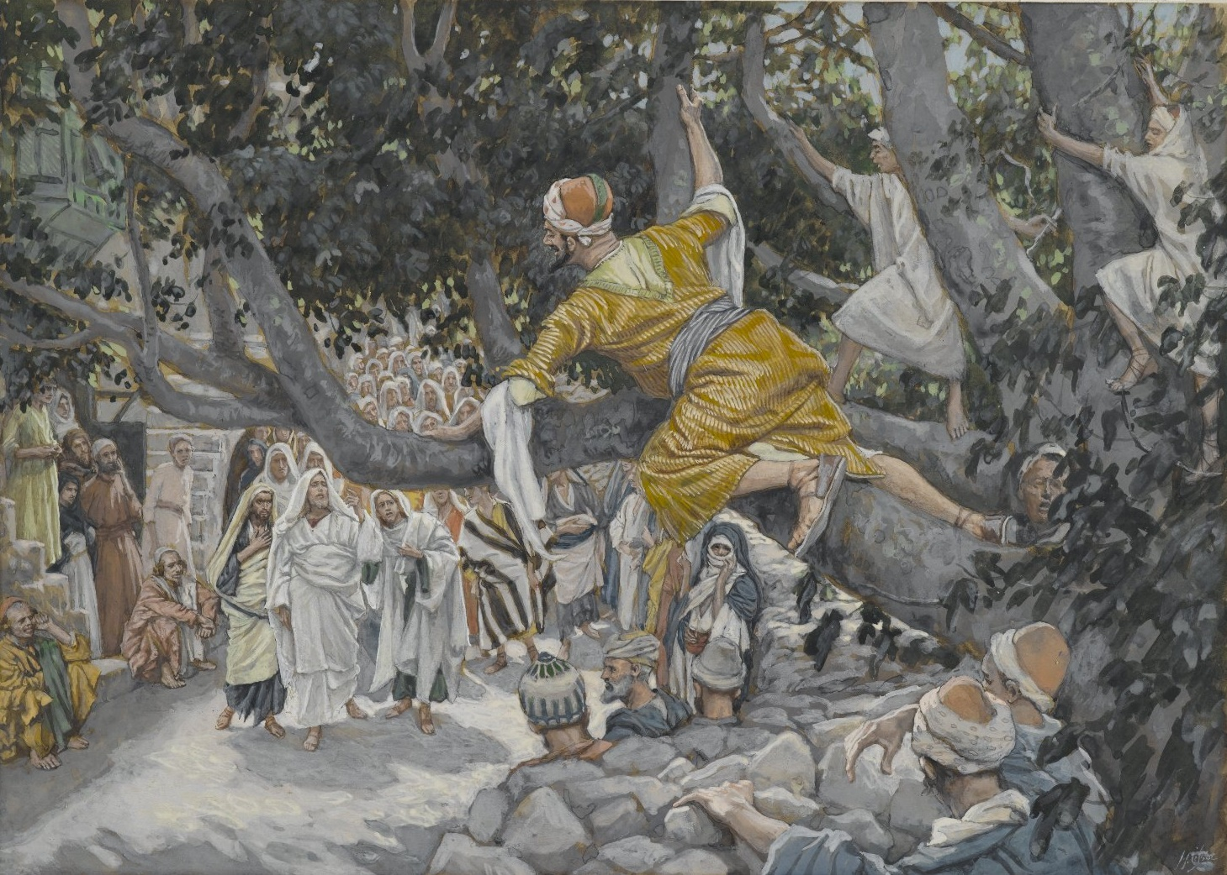
^{Luke 19:4} So he ran on ahead and climbed up into a sycamore tree in order to see Him, for He was about to pass through that way.

Slide 12
^{Luke 19:5} When Jesus came to the place, He looked up and said to him, “Zacchaeus, hurry and come down, for today I must stay at your house.”
⁶ And he hurried and came down and received Him gladly.

Slide 13
^{Luke 19:5} When Jesus came to the place, He looked up and said to him, “Zacchaeus, hurry and come down, for today I must stay at your house.”
⁶ And he hurried and came down and received Him gladly.

Slide 14
^{Luke 19:7} When they saw it, they all began to grumble, saying, “He has gone to be the guest of a man who is a sinner.”

Slide 15
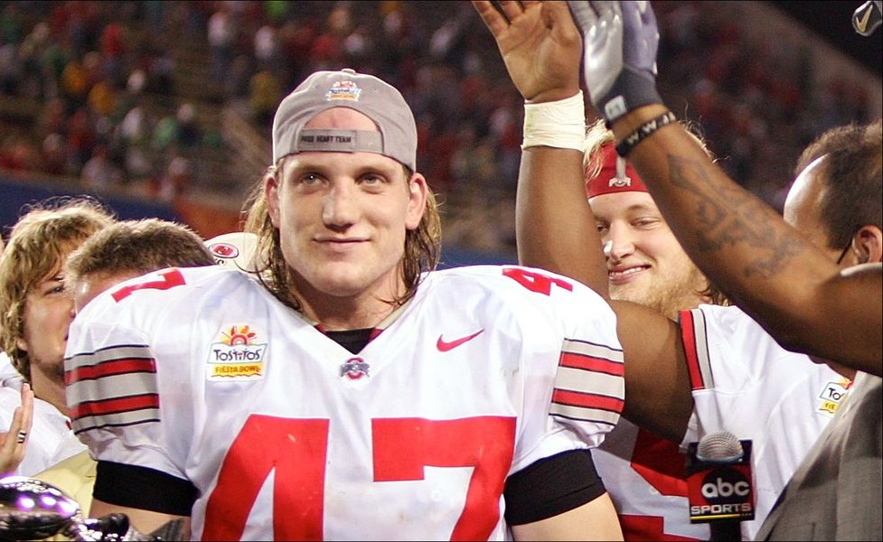
^{Luke 19:7} When they saw it, they all began to grumble, saying, “He has gone to be the guest of a man who is a sinner.”
Why are they scandalized by this?

Slide 16
^{Luke 19:7} When they saw it, they all began to grumble, saying, “He has gone to be the guest of a man who is a sinner.”
But Jesus knew what he was doing…

Slide 17
^{Luke 19:8} Zacchaeus stopped and said to the Lord,
“Behold, Lord, half of my possessions I will give to the poor, and if I have defrauded anyone of anything, I will give back four times as much.”

Slide 18
^{Luke 19:8} Zacchaeus stopped and said to the Lord,
“Behold, Lord, half of my possessions I will give to the poor, and if I have defrauded anyone of anything, I will give back four times as much.”

Slide 19
^{Luke 19:8} Zacchaeus stopped and said to the Lord,
“Behold, Lord, half of my possessions I will give to the poor, and if I have defrauded anyone of anything, I will give back four times as much.”

Slide 20
^{Luke 19:8} Zacchaeus stopped and said to the Lord,
“Behold, Lord, half of my possessions I will give to the poor, and if I have defrauded anyone of anything, I will give back four times as much.”
sudden and dramatic transformation!

Slide 21
^{Luke 19:9} And Jesus said to him, “Today salvation has come to this house, because he, too, is a son of Abraham.
¹⁰ For the Son of Man has come to seek and to save that which was lost.

Slide 22
Why did Jesus choose Zacchaeus?
Because Jesus is on a mission to seek and save lost things
¹⁰ For the Son of Man has come to seek and to save that which was lost.

Slide 23
Why did Jesus choose Zacchaeus?
“we like to go our own way… until we don’t”
^{Luke 19:4} So he ran on ahead and climbed up into a sycamore tree in order to see Him… ⁶ And he hurried and came down and received Him gladly.
Zacchaeus was lost
And he knew it
¹⁰ For the Son of Man has come to seek and to save that which was lost.

Slide 24
Why did Jesus choose Zacchaeus?
Blasphemy: All the money and influence in the world won’t satisfy you or make you happy
^{Luke 19:4} So he ran on ahead and climbed up into a sycamore tree in order to see Him… ⁶ And he hurried and came down and received Him gladly.
Zacchaeus was lost
And he knew it
¹⁰ For the Son of Man has come to seek and to save that which was lost.

Slide 25
Why did Jesus choose Zacchaeus?
Blasphemy: All the money and influence in the world won’t satisfy you or make you happy
^{Luke 19:4} So he ran on ahead and climbed up into a sycamore tree in order to see Him… ⁶ And he hurried and came down and received Him gladly.
Zacchaeus was lost
And he knew it
¹⁰ For the Son of Man has come to seek and to save that which was lost.

Slide 26
Does great wealth bring fulfillment?
An ambitious study by Boston College suggests not. For the first time, researchers prompted the very rich—people with fortunes in excess of $25 million—to speak candidly about their lives.
The result is a surprising litany of anxieties: their sense of isolation, their worries about work and love, and most of all, their fears for their children.

Slide 27
Why did Jesus choose Zacchaeus?
Roughly 165 households responded, 120 of which have at least $25 million in assets. The respondents’ average net worth is $78 million, and two report being billionaires. The goal, say the survey’s architects, was to weed out all but those at or approaching complete financial security.
Blasphemy: All the money and influence in the world won’t satisfy you or make you happy
^{Luke 19:4} So he ran on ahead and climbed up into a sycamore tree in order to see Him… ⁶ And he hurried and came down and received Him gladly.
Zacchaeus was lost
And he knew it
¹⁰ For the Son of Man has come to seek and to save that which was lost.

Slide 28
The respondents turn out to be a generally dissatisfied lot, whose money has contributed to deep anxieties involving love, work, and family. Indeed, they are frequently dissatisfied even with their sizable fortunes.
Most of them still do not consider themselves financially secure; for that, they say, they would require on average one-quarter more wealth than they currently possess.
Why did Jesus choose Zacchaeus?
Blasphemy: All the money and influence in the world won’t satisfy you or make you happy
^{Luke 19:4} So he ran on ahead and climbed up into a sycamore tree in order to see Him… ⁶ And he hurried and came down and received Him gladly.
Zacchaeus was lost
And he knew it
¹⁰ For the Son of Man has come to seek and to save that which was lost.

Slide 29
Why did Jesus choose Zacchaeus?
I would never be like Zacchaeus …
^{Luke 19:4} So he ran on ahead and climbed up into a sycamore tree in order to see Him… ⁶ And he hurried and came down and received Him gladly.
Zacchaeus was lost
And he knew it
¹⁰ For the Son of Man has come to seek and to save that which was lost.

Slide 30
Why did Jesus choose Zacchaeus?
^{Luke 19:4} So he ran on ahead and climbed up into a sycamore tree in order to see Him… ⁶ And he hurried and came down and received Him gladly.
Zacchaeus was lost
And he knew it
Jesus knew it too
¹⁰ For the Son of Man has come to seek and to save that which was lost.

Slide 31
Why did Jesus choose Zacchaeus?
^{Luke 19:5} When Jesus came to the place, He looked up and said to him, “Zacchaeus, hurry and come down, for today I must stay at your house.”
Zacchaeus was lost
And he knew it
Jesus knew it too
¹⁰ For the Son of Man has come to seek and to save that which was lost.

Slide 32
Why did Jesus choose Zacchaeus?
Jesus saw that Zacchaeus was 2 things:
Lost and ready to be found
^{Luke 19:5} When Jesus came to the place, He looked up and said to him, “Zacchaeus, hurry and come down, for today I must stay at your house.” ⁶ And he hurried and came down and received Him gladly.
Zacchaeus was lost
And he knew it
Jesus knew it too
¹⁰ For the Son of Man has come to seek and to save that which was lost.

Slide 33
Why did Jesus choose Zacchaeus?
Jesus saw that Zacchaeus was 2 things:
Lost and ready to be found
^{Luke 19:5} When Jesus came to the place, He looked up and said to him, “Zacchaeus, hurry and come down, for today I must stay at your house.” ⁶ And he hurried and came down and received Him gladly.
Zacchaeus was lost
And he knew it
Jesus knew it too
¹⁰ For the Son of Man has come to seek and to save that which was lost.

Slide 34
Why did Jesus choose Zacchaeus?
^{Luke 19:5} When Jesus came to the place, He looked up and said to him, “Zacchaeus, hurry and come down, for today I must stay at your house.” ⁶ And he hurried and came down and received Him gladly.
Zacchaeus was lost
And he knew it
Jesus knew it too
¹⁰ For the Son of Man has come to seek and to save that which was lost.

Slide 35
Why did Jesus choose Zacchaeus?
¹⁰ For the Son of Man has come to seek and to save that which was lost.

Slide 36
Why did Jesus choose Zacchaeus?
What you’re seeing is not just a change of heart, or a bold resolution…
it is something so much bigger…
it is salvation in action
^{Luke 19:9} And Jesus said to him, “Today salvation has come to this house, because he, too, is a son of Abraham.
Zacchaeus is saved
¹⁰ For the Son of Man has come to seek and to save that which was lost.

Slide 37
Why did Jesus choose Zacchaeus?
Does this mean that Zacchaeus earned his salvation by resolving to give his money away?
^{Luke 19:9} And Jesus said to him, “Today salvation has come to this house, because he, too, is a son of Abraham.
No! That would fly in the face of the entire teaching of Jesus and the New Testament
¹⁰ For the Son of Man has come to seek and to save that which was lost.

Slide 38
Why did Jesus choose Zacchaeus?
Zacchaeus was saved by faith through grace apart from works (like everyone else)
^{Luke 19:9} And Jesus said to him, “Today salvation has come to this house, because he, too, is a son of Abraham.
“what you are seeing is the result… evidence that salvation has occurred.”
¹⁰ For the Son of Man has come to seek and to save that which was lost.

Slide 39
¹⁰ For the Son of Man has come to seek and to save that which was lost.

Slide 40
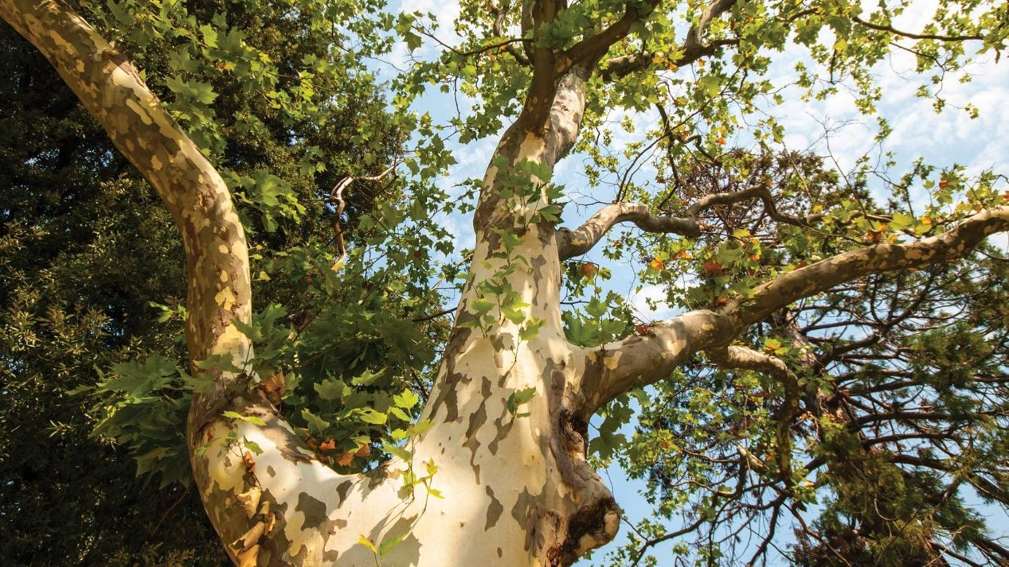
What does this passage teach us about Jesus?

Slide 41
That no one is too corrupt to be saved by the blood of Jesus
What does this passage teach us about salvation?

Slide 42
Being “found” by Jesus dramatically changes the course of people’s lives
What does this passage teach us about salvation?

Slide 43
Being “found” by Jesus dramatically changes the course of people’s lives
What changed for Zacchaeus?
Jesus showed him mercy
Jesus showed him grace
Jesus honored him
^{Luke 19:8} “Behold, Lord, half of my possessions I will give to the poor …
What does this passage teach us about salvation?

Slide 44
Being “found” by Jesus dramatically changes the course of people’s lives
What changed for Zacchaeus?
Jesus showed him mercy
Jesus showed him grace
Jesus honored him
Jesus accepted him
Jesus included him in the family of God
What does this passage teach us about salvation?

Slide 45
Being “found” by Jesus dramatically changes the course of people’s lives
What changed for Zacchaeus?
Jesus showed him mercy
Jesus showed him grace
Jesus honored him
Jesus accepted him
Jesus included him in the family of God
^{Luke 19:9} And Jesus said to him, “Today salvation has come to this house, because he, too, is a son of Abraham.
What does this passage teach us about salvation?

Slide 46
Being “found” by Jesus dramatically changes the course of people’s lives
Having been reconciled to God through Jesus, Zacchaeus has a whole new identity
which, according to the New Testament, is our basis for real and lasting change
What does this passage teach us about salvation?

Slide 47
Being “found” by Jesus dramatically changes the course of people’s lives
The Bible teaches that our sins aren’t just mistakes or lapses in judgement…
But that they stem from something much deeper… they are symptoms of our identity: lost children of God
What does this passage teach us about salvation?

Slide 48
Living for material wealth and power

Slide 49
Appropriating your New Identity
Living for material wealth and power
Greed
“I’m on my own”
Lostness

Slide 50
Appropriating your New Identity
Greed
Makes sense apart from God!
“I need to amass money for myself”
“I’m on my own”
“It’s up to me”
For security
For meaning
For happiness
Lostness
“If only I had more…”

Slide 51
Appropriating your New Identity
Found and Saved
^{Phil 4:12} I have learned the secret of living in every situation, whether it is with a full stomach or empty, with plenty or little, ¹³ for I can do everything through Christ, who gives me strength.
Greed
“I’m on my own”
Lostness

Slide 52
Appropriating your New Identity
Found and Saved
^{Phil 4:19} And this same God who takes care of me will supply all your needs from his glorious riches, which have been given to us in Christ Jesus.
Greed
“I’m on my own”
Lostness

Slide 53
Appropriating your New Identity
Found and Saved
^{Eph1:10} In Him also we have obtained an inheritance…
“I am loved by a rich Father”
Greed
“I’m on my own”
Lostness

Slide 54
Appropriating your New Identity
Found and Saved
^{Acts 20:35} “It is more blessed to give than to receive”
“I am loved by a rich Father”
Greed
“I’m on my own”
Lostness

Slide 55
Appropriating your New Identity
Found and Saved
“I am loved by a rich Father”
Greed
KNOW … CONSIDER … PRESENT
“I’m on my own”
Lostness

Slide 56
Appropriating your New Identity
Found and Saved
“I am loved by a rich Father”
Greed
KNOW … CONSIDER … PRESENT
“I’m on my own”
Do what comes naturally
Worrying…
wishing…
striving
Lostness

Slide 57
Appropriating your New Identity
Found and Saved
“I am loved by a rich Father”
Greed
KNOW … CONSIDER … PRESENT
How’s this going?
“I’m on my own”
Do what comes naturally
Worrying…
wishing…
striving
Lostness

Slide 58
Appropriating your New Identity
Found and Saved
“I am loved by a rich Father”
Greed
KNOW … CONSIDER … PRESENT
“I’m on my own”
Do what comes naturally
slavery
Lostness

Slide 59
Appropriating your New Identity
Found and Saved
Act in faith…
“I am loved by a rich Father”
Greed
KNOW … CONSIDER … PRESENT
“I’m on my own”
Do what comes naturally
slavery
Lostness

Slide 60
Appropriating your New Identity
Found and Saved
Gratitude, freedom, generosity, love!
Act in faith…
“I am loved by a rich Father”
Greed
KNOW … CONSIDER … PRESENT
“I’m on my own”
Do what comes naturally
slavery
Lostness

Slide 61
If you are lost… Jesus is seeking you.
^{Revelation 3:20} Look! I stand at the door and knock. If you hear my voice and open the door, I will come in, and we will share a meal together as friends.
Jesus’s initiation with Zacchaeus is typical of his posture toward all people
And the only prerequisite is to acknowledge your “lostness”
What does this passage teach us about ourselves?

Slide 62
Our instinctual attitude toward sinful people is often pretty different from Jesus’s
Who in your society disgusts you?
And what is it that you wish for them?
What does this passage teach us about ourselves?

