Slide 1
Building A Family On God’s Word
XSI 2017

Slide 2
Parenting Today
Isn’t working for the kids
Isn’t working for the parents

Slide 3
Jennifer Senior
Editor and Author
Jennifer Senior, All Joy and No Fun – The Paradox of Modern Parenting, p. 135
[Margaret Mead wrote a book called Keep Your Powder Dry, and as an anthropologist who was familiar with cultures around the world,]

Slide 4
Jennifer Senior
Editor and Author
Jennifer Senior, All Joy and No Fun – The Paradox of Modern Parenting, p. 135
“What struck her as different about American parents was that they didn’t know what particular goal they were steering their children toward.”

Slide 5
We Do Know!
Deut 6:4-9
⁴ “Listen, O Israel! The Lord is our God, the Lord alone. ⁵ And you must love the Lord your God with all your heart, all your soul, and all your strength. ⁶ And you must commit yourselves wholeheartedly to these commands that I am giving you today.

Slide 6
We Do Know!
Deut 6:4-9
⁷ Repeat them again and again to your children. Talk about them when you are at home and when you are on the road, when you are going to bed and when you are getting up. ⁸ Tie them to your hands and wear them on your forehead as reminders. ⁹ Write them on the doorposts of your house and on your gates.

Slide 7
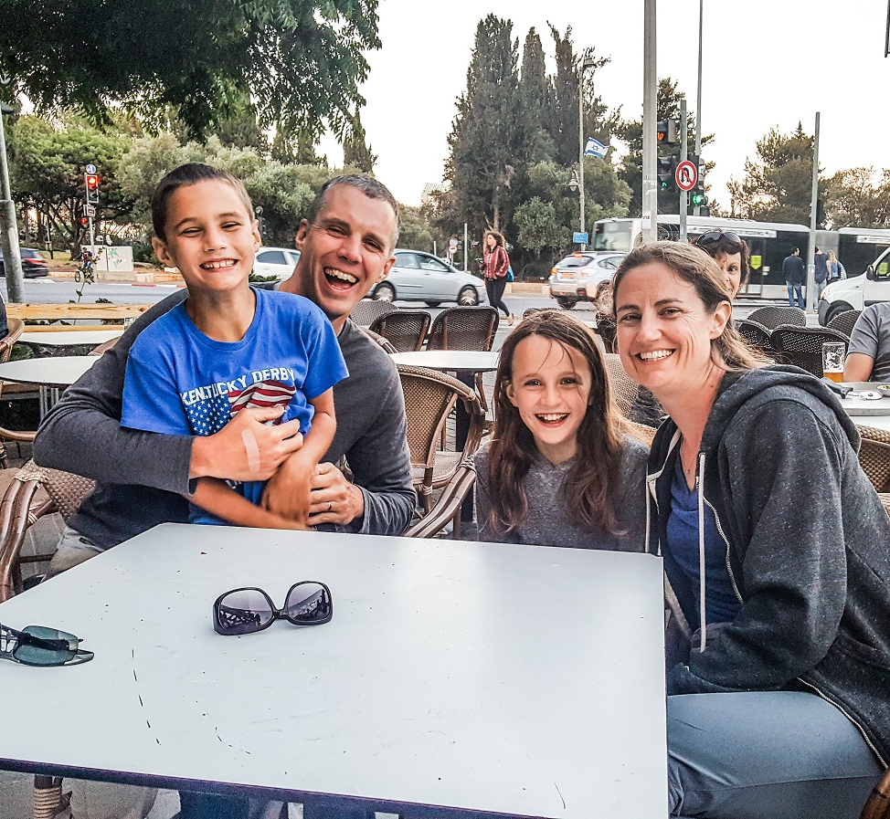
My Family:

Slide 8
Outline
Your relationship with God
Your relationship with your spouse
Your relationship with your kids

Slide 9
Where Does Deut 6 Start?
You must love the LORD your God with all your heart, all your soul, and all your strength.
And you must commit yourselves wholeheartedly to these commands that I am giving you today.
1. Your relationship with God

Slide 10
You can’t give away what you don’t have
Feeding the 5000
1 Cor 13
1. Your relationship with God

Slide 11
You can’t give away what you don’t have
Your sin
Your imperfections
1. Your relationship with God

Slide 12
Rosenfield and Wise
Pediatrician and Author
Alvin Rosenfield, M.D., and Nicole Wise, The Overscheduled Child, p. 232
Like it or not, children are splendid observers:
They watch us and see for themselves, by the choices we make and the principles we live by, what we believe is truly important.

Slide 13
You can’t give away what you don’t have
Your sin
Your imperfections
Your anxiety
Your ability to withstand the backlash
From the world
1. Your relationship with God

Slide 14
Levine
Clinician and Author
Madeline Levine, PhD, The Price of Privilege, p.172
A major challenge to effective parenting is the feeling that we are out of step with our own communities.

Slide 15
Deresiewicz
Yale Professor
William Deresiewicz, Excellent Sheep
We cannot continue to go with the flow, however powerful the current is.
If we want our kids to turn out differently, we have to raise them differently.

Slide 16
Barna
Researcher and Author
George Barna, Revolutionary Parenting, p.29
Our research found that parents are more likely to raise spiritual champions if they accept the fact that from day one
their parenting efforts will stray from the norm and will put them at odds with parents who pursue a more conventional approach.

Slide 17
You can’t give away what you don’t have
Your sin
Your imperfections
Your anxiety
Your ability to withstand the backlash
From the world
From family
From other Christians
1. Your relationship with God

Slide 18
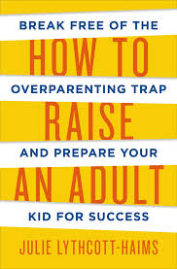
Lythcott-Haims
Stanford Dean of Admissions
Julie Lythcott-Haims, How to Raise an Adult, p.296
Brian [a parent interviewed for the book] isn’t interested in what he calls the ‘child sports industrial complex’…With their lives not scheduled to the hilt, Brian’s kids have time on the weekends to be home and do nothing…

Slide 19
Lythcott-Haims
Stanford Dean of Admissions
Julie Lythcott-Haims, How to Raise an Adult, p.296
‘We take walks, they read, they play, they do their homework. Meanwhile my friends’ kids were at this practice or with this tutor or with this private coach.’

Slide 20
A happy marriage is the foundation for your family
Takes time
Be prepared for the strain
CARE group talk: How Parenting Affects Your Marriage
2. Your relationship with your spouse

Slide 21
A happy marriage is the foundation for your family
Takes time
Be prepared for the strain
Moms, let dad try things too
2. Your relationship with your spouse

Slide 22
Dr. Emerson Eggerichs
Eggerichs , Love and Respect, p. 222
I often hear many wives complain that their husbands are too disconnected and passive on family matters.
But why is he passive?
Quite likely in the past, every time he tried to step up to the plate, she had a better idea.

Slide 23
Takes time
-This assumes that we are with them a lot and talking a lot
Deut 6:7
Repeat them again and again to your children. Talk about them when you are at home and when you are on the road, when you are going to bed and when you are getting up.
3. Your relationship with your kids

Slide 24
Barna
Researcher and Author
George Barna, Revolutionary Parenting, p.29
The research revealed an amazing insight into just how much time was spent in dialogue between parent and child on a typical day.

Slide 25
Barna
Researcher and Author
George Barna, Revolutionary Parenting, p.29
[In Revolutionary Families, t]he figures ranged between 90 and 120 minutes (verified by both the parent and the child, independent of each other).

Slide 26
Barna
Researcher and Author
George Barna, Revolutionary Parenting, p.29
To place that in context, the typical American family registers less than fifteen minutes of direct parent-child conversation each day.

Slide 27
Takes time
-This assumes that we are with them a lot and talking a lot
90-120 minutes vs 15 minutes!
3. Your relationship with your kids

Slide 28
Takes time
-This assumes that we are with them a lot and talking a lot
NO TV!!!
3. Your relationship with your kids

Slide 29
Takes time
- Stay-at-home parenting
3. Your relationship with your kids

Slide 30
Fleming
Christian Mom and Author
Fleming, A Mother’s Heart, p. 22
Naturally we can’t expect the daycare worker, the baby-sitter, or the preschool teacher to shepherd our children as lovingly as we can, because the children aren’t theirs.
God holds us accountable for the children He has placed in our care.

Slide 31
Takes time
- Stay-at-home parenting
Servant Team Meeting Fall 2012
3. Your relationship with your kids

Slide 32
Takes time
- Stay-at-home parenting
- Discipline
3. Your relationship with your kids

Slide 33
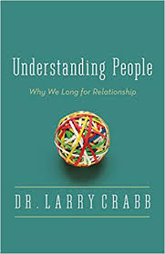
Crabb
Christian Psychologist and Author
Crabb, Understanding People, p. 18
Children, I suspect, would become more manageable and infinitely more loveable if parents would answer, properly and with some consistency, a few elementary questions that all kids ask

Slide 34
Crabb
Christian Psychologist and Author
Crabb, Understanding People, p. 18
First, “Am I loved?” Correct answer: “Yes, deeply – and here’s the unmistakable evidence of my rich, committed involvement with you.”

Slide 35
Crabb
Christian Psychologist and Author
Crabb, Understanding People, p. 18
Second, “Can I get my own way?” Correct answer: “No, not without cost, and here is a sample of the painful consequences that result from bucking against God’s plan.

Slide 36
Takes time
- Stay-at-home parenting
- Discipline
CARE group talk: Disciplining Your Toddler and Preschooler
3. Your relationship with your kids

Slide 37
Takes time
- Stay-at-home parenting
- Discipline
- Dates
3. Your relationship with your kids

Slide 38
Rosenfield and Wise
Pediatrician and Author
Alvin Rosenfield, M.D., and Nicole Wise, p212-213
One thirteen-year-old girl confided in an adult friend that she felt sad and lonely, that her mother never had any time for her.

Slide 39
Rosenfield and Wise
Pediatrician and Author
Alvin Rosenfield, M.D., and Nicole Wise, p212-213
The friend was surprised to hear this: The child’s mother was one of the most involved parents he knew. She attended every school function, every sport practice, every game…

Slide 40
Rosenfield and Wise
Pediatrician and Author
Alvin Rosenfield, M.D., and Nicole Wise, p212-213
Yes, her mom did lots of things with the children, the girl conceded.
But she was always frazzled and crabby, irritated at one or another of the kids for doing something they shouldn’t have.

Slide 41
Rosenfield and Wise
Pediatrician and Author
Alvin Rosenfield, M.D., and Nicole Wise, p212-213
What she really wanted, she told him, was just some time alone with her mom, just some conversation and cuddling that would mean that she, herself, was especially loved.
But there was never time for that.

Slide 42
Takes time
- Stay-at-home parenting
- Discipline
- Dates
- Family Sabbath
- Family Vacations (camping!)
- Family walks
- Reading
3. Your relationship with your kids

Slide 43
Takes time
Raising them according to God’s priorities
- Have the right priorities
3. Your relationship with your kids

Slide 44
Schaeffer
Christian mom and Author
Edith Schaeffer, What is a Family?, p. 146
A parent should declare to the Lord,
“This child is Yours, and I will never hinder him or her from doing Your will, even if it is against my desires or my ambitions or my hopes for his or her life.”

Slide 45
Takes time
Raising them according to God’s priorities
- Have the right priorities
- Word and prayer time
3. Your relationship with your kids

Slide 47
Takes time
Raising them according to God’s priorities
- Have the right priorities
- Word and prayer time
-Don’t force prayer
-Include gratitude
-Memorize Scripture
-Model word time
3. Your relationship with your kids

Slide 48
Takes time
Raising them according to God’s priorities
- Have the right priorities
- Word and prayer time
Ministry with your kids
- Include them on things
-Pray for your ministry
-Let them see discipleship
-Share your teachings
3. Your relationship with your kids

Slide 49
Takes time
Raising them according to God’s priorities
- Have the right priorities
- Word and prayer time
Ministry with your kids
- Include them on things
- Taking them to meetings
3. Your relationship with your kids

Slide 50
CONCLUSION
Psalm 78: 5-7
For he issued his laws to Jacob; he gave his instructions to Israel.
He commanded our ancestors to teach them to their children,
So the next generation might know them – even the children not yet born –
And they in turn will teach their own children.

Slide 51
CONCLUSION
Psalm 78: 5-7
So each generation should set its hope anew on God,
Not forgetting his glorious miracles and obeying his commands.

Slide 52
Questions?
Comments?
Experiences?
chris.risley@gmail.com

