Slide 1
How to Raise an Adult

Slide 2
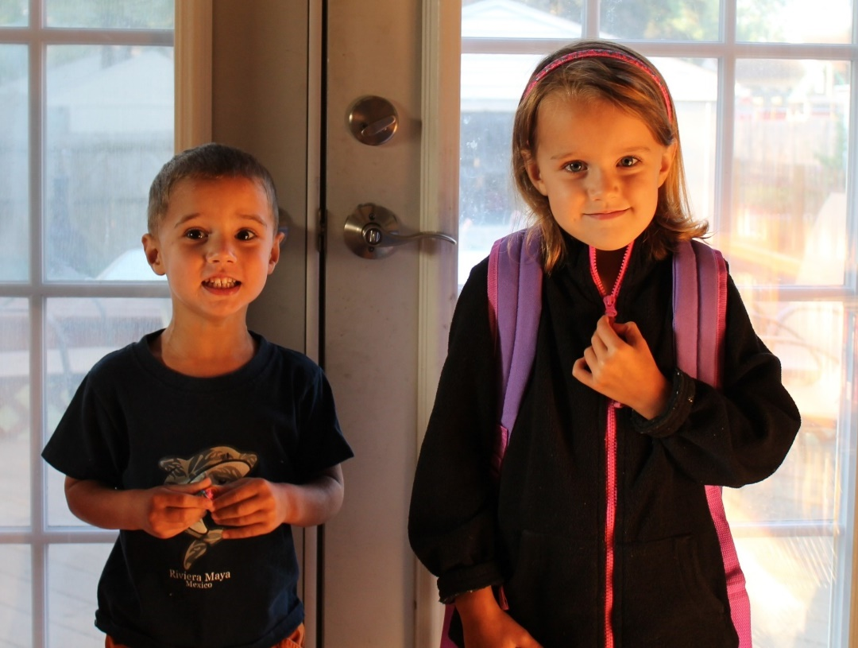
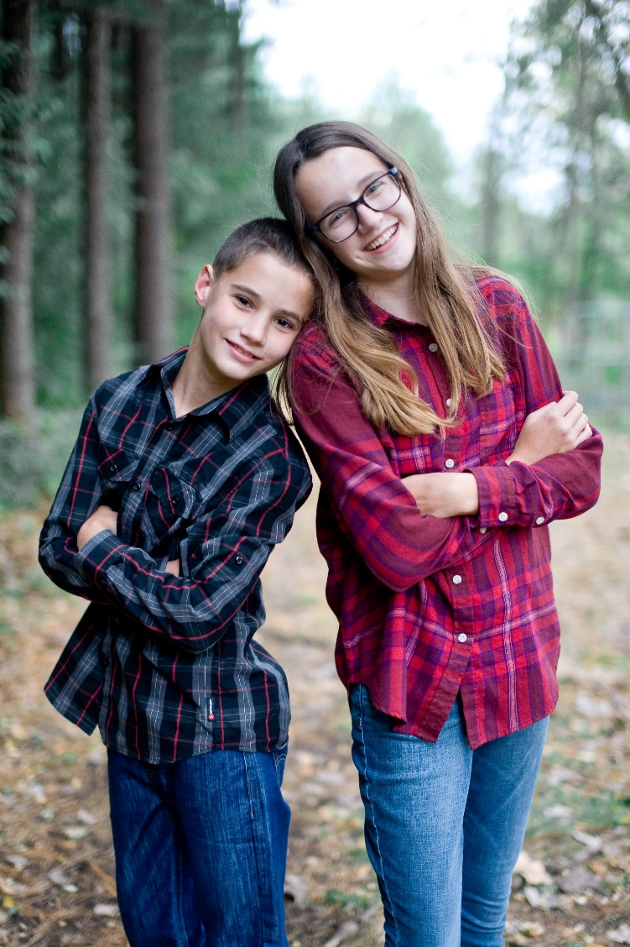
My kids

Slide 3
Overview
We as parents have been entrusted with a stewardship by God – he has given us children to raise

Slide 4
Overview
We as parents have been entrusted with a stewardship by God – he has given us children to raise for His kingdom and His work:
The ability to relate to God and others
A relatively stable emotional life
Submission to God’s discipline/training
A relatively stable functional life
Flexible and adaptable

Slide 5
Overview
Something in American parenting isn’t working.
Secular sources are telling us that young adults:
Don’t know how to have close relationships
Don’t know how to handle their emotions
Can’t handle hearing “No”
Can’t function in even basic ways
Are rigid and brittle

Slide 6
Our Goal:
Prepare the child for the path and not the path for the child
Or: How to avoid the trap of ‘overparenting’

Slide 7
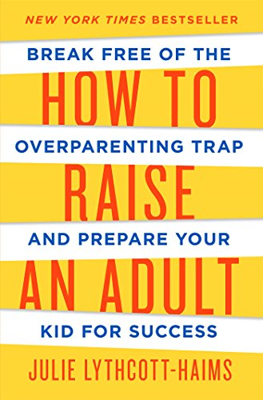
Julie Lythcott-Haims. How to Raise an Adult, p228-229.
Adina Glickman [of Stanford] and Abigail Lipson [of Harvard] determined that more and more students today are ‘failure deprived’…

Slide 8
Julie Lythcott-Haims. How to Raise an Adult, p228-229.
Harriet Rossetto of the Beit T’Shuvah rehab facility in L.A. says, ‘The best predictor of success is a sense of resiliency, grit, capacity to fail and get up.
If you’re prevented from feeling discomfort or failure, you have no sense of how to handle those things at all.’

Slide 9
Julie Lythcott-Haims. How to Raise an Adult, p43-44.
To fulfill our primary responsibilities as parents – keeping our kids safe and sound and making sure they get the right opportunities – according to our contemporary standards of safety and of opportunity,

Slide 10
Julie Lythcott-Haims. How to Raise an Adult, p43-44.
we parents have to run a lot of interference.
All the time…

Slide 11
Julie Lythcott-Haims. How to Raise an Adult, p43-44.
With the ultimate goal in mind of our kids being successful in an increasingly competitive world, we bring a ‘no mistakes’ mentality to our kids’ childhoods and we do our part by accompanying them and controlling as many outcomes as we can…

Slide 12
Julie Lythcott-Haims. How to Raise an Adult, p43-44.
We don’t trust our kids to be able to work out their own problems.
Put simply, we don’t trust anyone.

Slide 13
Julie Lythcott-Haims. How to Raise an Adult, p33.
A generation ago parents would only attend the really big games – if that.
Now we’re at every game regardless of its importance,
and often on the sidelines of every practice, rain or shine.

Slide 14
Julie Lythcott-Haims. How to Raise an Adult, p.287.
In communities in every region of this country, the overparenting model is like the popular kid we want to follow, or the bully we have trouble standing up to
because we fear being harmed, ridiculed, or left out.
My experience

Slide 15
Possible signs of Overparenting
Your kids don’t have a space without you in it
You praise and encourage everything they do

Slide 16
Possible signs of Overparenting
Your kids don’t have a space without you in it
You praise and encourage everything they do
When they complain about being mistreated, you come to their defense
They don’t want to try things without help from you

Slide 17
Possible causes of Overparenting
Our own issues:
Guilt
Loneliness
Fear
Identity

Slide 18
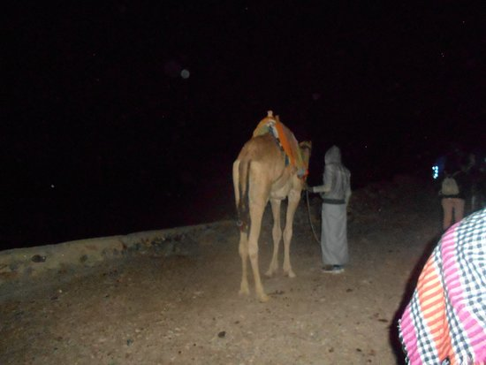
Possible causes of Overparenting
Other factors:
Family of origin issues
Culture
Projecting

Slide 19
Possible causes of Overparenting
Other factors:
Family of origin issues
Culture
Projecting
It’s just easier

Slide 20
Julie Lythcott-Haims. How to Raise an Adult, p.89-90.
Neil Montgomery of Keene State College in New Hampshire…found that students with helicopter parents were less open to new ideas and actions and more vulnerable, anxious, and self-conscious.

Slide 21
Julie Lythcott-Haims. How to Raise an Adult, p.89-90.
‘In students who were given responsibility and not constantly monitored by their parents – so-called ‘free rangers’ – the effects were reversed,’ Montgomery said…

Slide 22
Julie Lythcott-Haims. How to Raise an Adult, p.89-90.
A 2013 study of 297 college students reported in the Journal of Child and Family Studies found that college students with helicopter parents reported significantly higher levels of depression and less satisfaction with life,

Slide 23
Julie Lythcott-Haims. How to Raise an Adult, p.89-90.
and attributed this diminishment in well-being to a violation of the students’ ‘basic psychological needs for autonomy and competence.’

Slide 24
Julie Lythcott-Haims. How to Raise an Adult, p.92.
The other problem with never having to struggle is that you never experience failure and can develop and overwhelming fear of failure and of disappointing others. Both the low self-confidence and the fear of failure can lead to depression or anxiety,” says Self.

Slide 25
Madeline Levine talks about 3 ways we might be overparenting:
When we do for our kids what they can already do for themselves
When we do for our kids what they can almost do for themselves
When our parenting behavior is motivated by our own ego

Slide 26
Julie Lythcott-Haims. How to Raise an Adult, p.94.
Although we over-involve ourselves to protect our kids and it may in fact lead to short-term gains, our behavior actually delivers the rather soul-crushing message:
‘Kid, you can’t actually do any of this without me.’

Slide 27
So in sum:
Overparenting is bad for our kids
Overparenting is bad for us
This is not God’s design for parenting

Slide 28
What now?
Matt 7:9-11 - “Which of you, if your son asks for bread, will give him a stone? Or if he asks for a fish, will give him a snake?
If you, then, though you are evil, know how to give good gifts to your children, how much more will your Father in heaven give good gifts to those who ask him!

Slide 29
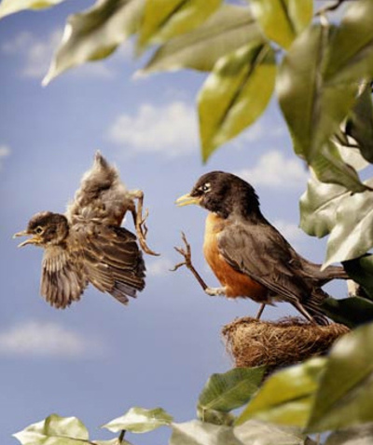
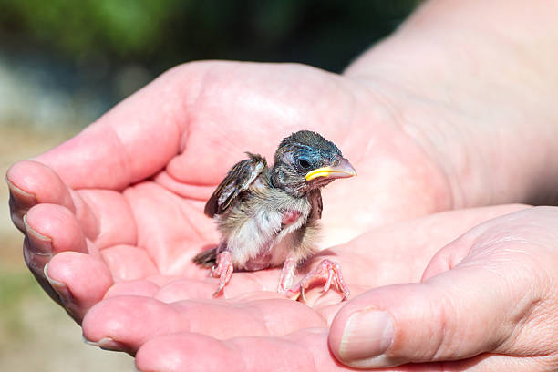
To raise our kids for God:
We should provide a loving, safe, supportive atmosphere with our kids

Slide 30
To raise our kids for God:
We should provide a loving, safe, supportive atmosphere with our kids
We should get out of God’s way as much as possible
Really: we need to believe that suffering is a means of growth for our kids just as much as it is for us

Slide 31
Hebrews 12:5-7, 11
And have you completely forgotten this word of encouragement that addresses you as a father addresses his son? It says, “My son, do not make light of the Lord’s discipline, and do not lose heart when he rebukes you, because the Lord disciplines the one he loves, and he chastens everyone he accepts as his son.”

Slide 32
Hebrews 12:5-7, 11
Endure hardship as discipline; God is treating you as his children.
No discipline seems pleasant at the time, but painful. Later on, however, it produces a harvest of righteousness and peace for those who have been trained by it.

Slide 33
God will allow painful circumstances in our kids’ lives:
Friends who are mean
Teachers who aren’t fair
Failure
Rejection
Struggles to learn

Slide 34
Cooperating with God will be more challenging in some ways:
We will need to be more thoughtful and prayerful
We will need to teach and train, as opposed to just doing it for them
But it is easier in that it removes the impossible standard of keeping our kids ‘happy’ all the time

Slide 35
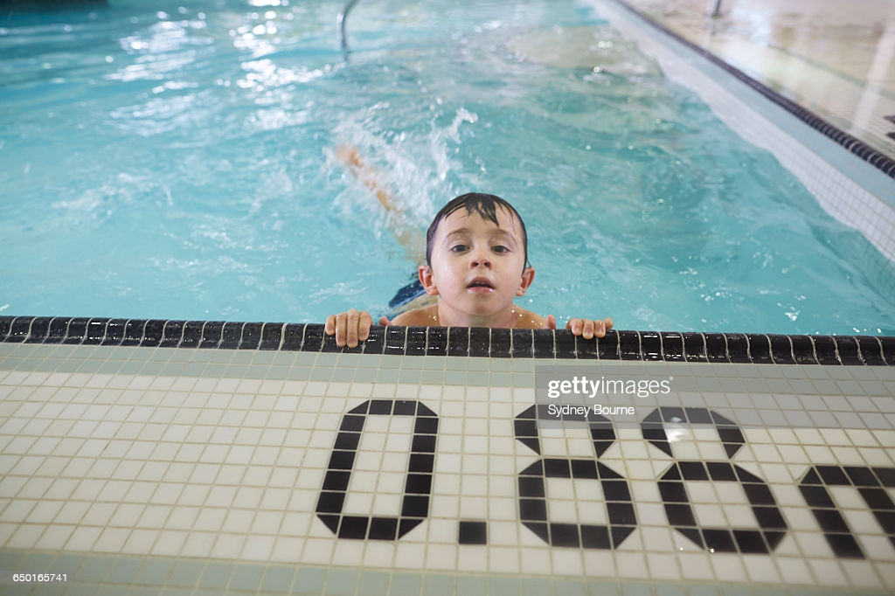
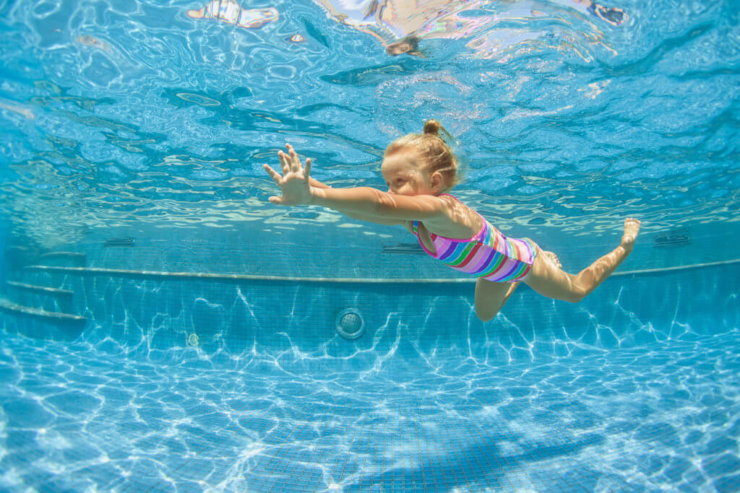
Practical Ideas:
Don’t take your kids’ rebellion/challenging too personally

Slide 36
Practical Ideas:
Don’t take your kids’ rebellion/challenging too personally
Prayerfully consider what your kids should be learning right now
Have external checklists
Don’t let them off the hook too easily

Slide 37
Practical Ideas:
Don’t take your kids’ rebellion/challenging too personally
Prayerfully consider what your kids should be learning right now
Have external checklists
Don’t let them off the hook too easily

Slide 38
Practical Ideas:
Pray with them when they run into struggles
Let them be bored often, lonely every once in a while
Enjoy, appreciate, and esteem their growing independence

Slide 39
Summary
Our kids are with us for a surprisingly short time
Every parent wants to raise kids who have successful adult lives
Christian parents want to raise kids who have successful spiritual lives
We have such a privilege to be able to cooperate with God on this

Slide 40
Parenting Meeting
Questions?
Comments?
Experiences?
risleyc@dwellcc.org
See dwellcc.org/parenting

