Slide 1
Acts
The Church in Jerusalem
Acts 6: Unity

Slide 2
Acts
The Church in Jerusalem
God is establishing His “church” in Jerusalem

Slide 3
Acts
The Church in Jerusalem
Pattern:
Crisis → Provision & Perseverance → Growth
Theme: You’re only making it stronger!
The church faces a series of obstacles …

Slide 4
Acts
The Church in Jerusalem
Pattern:
Crisis → Provision & Perseverance → Growth
Theme: You’re only making it stronger!
^{5:41} . . . So they went on their way from the presence of the Council, rejoicing that they had been considered worthy to suffer shame for His name. ⁴² And every day, in the temple and from house to house, they kept right on teaching and preaching Jesus as the Christ.
^{5:41} . . . So they went on their way from the presence of the Council, rejoicing that they had been considered worthy to suffer shame for His name. ⁴² And every day, in the temple and from house to house, they kept right on teaching and preaching Jesus as the Christ.
The church faces a series of obstacles …

Slide 5
Acts
The Church in Jerusalem
δέ “de”: but, moreover, and, etc.
^{6:1} Now at this time while the disciples were increasing in number, a complaint arose on the part of the Hellenistic Jews against the native Hebrews, because their widows were being overlooked in the daily serving of food.
^{6:1} Now at this time while the disciples were increasing in number, a complaint arose on the part of the Hellenistic Jews against the native Hebrews, because their widows were being overlooked in the daily serving of food.
^{6:1} Now at this time while the disciples were increasing in number, a complaint arose on the part of the Hellenistic Jews against the native Hebrews, because their widows were being overlooked in the daily serving of food.
^{6:1} Now at this time while the disciples were increasing in number, a complaint arose on the part of the Hellenistic Jews against the native Hebrews, because their widows were being overlooked in the daily serving of food.
The church faces a series of obstacles …

Slide 6
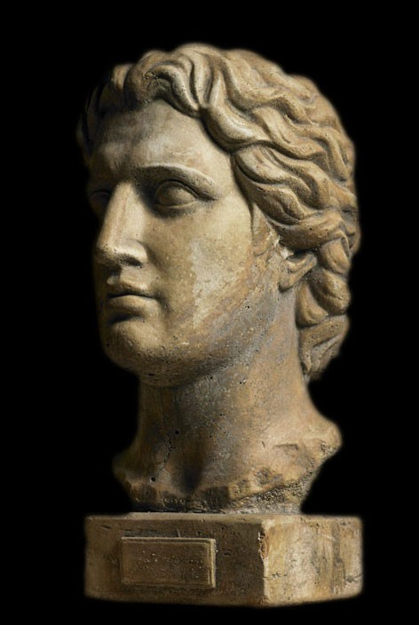
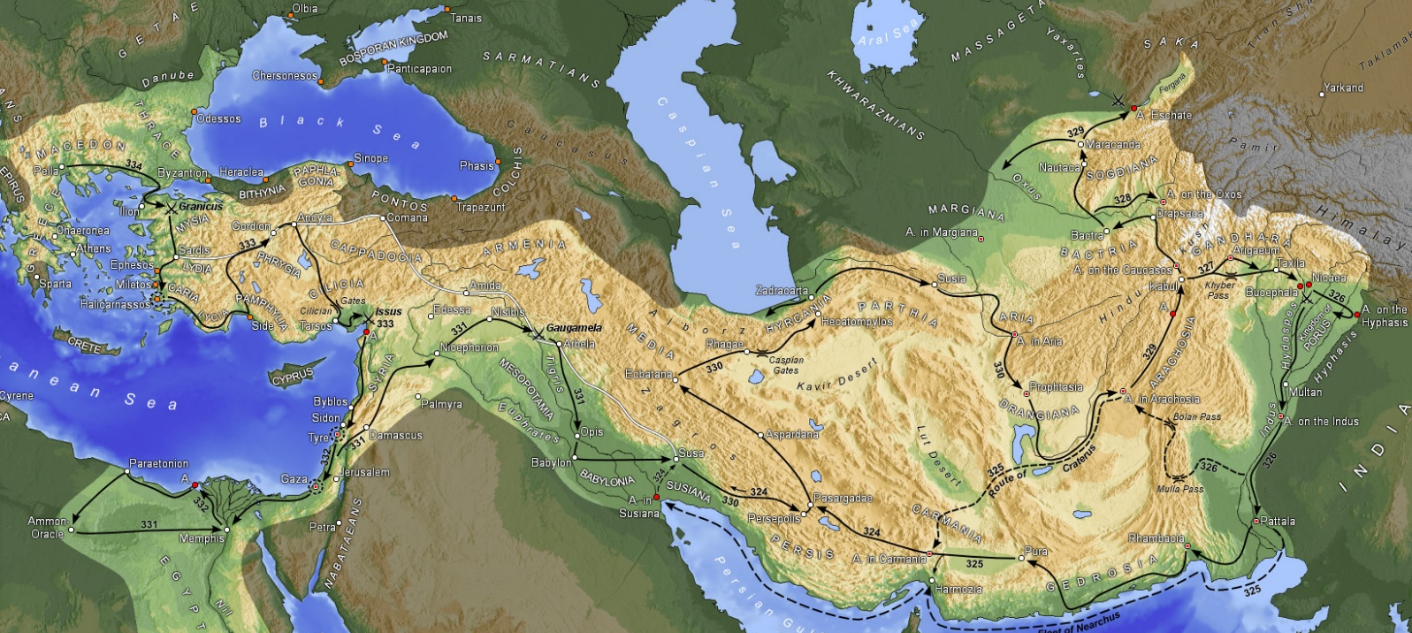
Alexander the Great
350 years earlier
“Hellenistic” (Greek) culture

Slide 7
The Jewish “diaspora”
Living outside of Israel
Retaining Jewish identity
But also embracing Hellenistic culture

Slide 8
^{Acts 2:9} Parthians and Medes and Elamites, and residents of Mesopotamia, Judea and Cappadocia, Pontus and Asia, ¹⁰ Phrygia and Pamphylia, Egypt and the districts of Libya around Cyrene, and visitors from Rome, both Jews and proselytes, ¹¹ Cretans and Arabs—we hear them in our own tongues speaking of the mighty deeds of God.”

Slide 9
The make-up of the church in Jerusalem:

Slide 10
The make-up of the church in Jerusalem:
Hellenistic Jews
Hebraic Jews
^{6:1} Now at this time while the disciples were increasing in number, a complaint arose on the part of the Hellenistic Jews against the native Hebrews, because their widows were being overlooked in the daily serving of food.
^{6:1} Now at this time while the disciples were increasing in number, a complaint arose on the part of the Hellenistic Jews against the native Hebrews, because their widows were being overlooked in the daily serving of food.

Slide 11
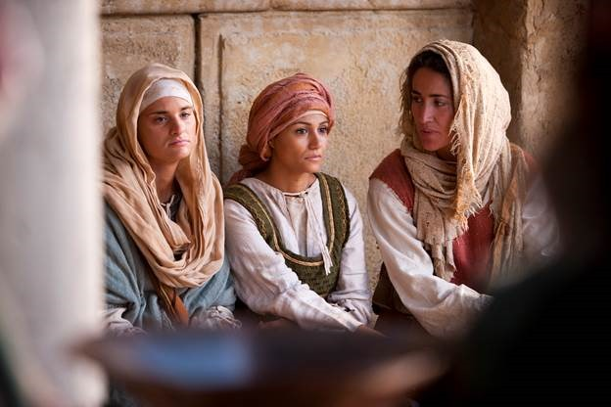
The needs
of widows:
The church was playing this role…
But …
^{6:1} Now at this time while the disciples were increasing in number, a complaint arose on the part of the Hellenistic Jews against the native Hebrews, because their widows were being overlooked in the daily serving of food.
^{6:1} Now at this time while the disciples were increasing in number, a complaint arose on the part of the Hellenistic Jews against the native Hebrews, because their widows were being overlooked in the daily serving of food.

Slide 12
CRISIS facing the church:
CRISIS facing the church:
Food distribution infrastructure?
^{6:1} Now at this time while the disciples were increasing in number, a complaint arose on the part of the Hellenistic Jews against the native Hebrews, because their widows were being overlooked in the daily serving of food.
^{6:1} Now at this time while the disciples were increasing in number, a complaint arose on the part of the Hellenistic Jews against the native Hebrews, because their widows were being overlooked in the daily serving of food.

Slide 13
^{5:34} For there was not a needy person among them…
1) Threat to integrity of the church
CRISIS facing the church:
CRISIS facing the church:
Food distribution infrastructure?
^{6:1} Now at this time while the disciples were increasing in number, a complaint arose on the part of the Hellenistic Jews against the native Hebrews, because their widows were being overlooked in the daily serving of food.
^{6:1} Now at this time while the disciples were increasing in number, a complaint arose on the part of the Hellenistic Jews against the native Hebrews, because their widows were being overlooked in the daily serving of food.

Slide 14
1) Threat to integrity of the church
2) Threat to the unity of the church
Γογγυσμός goggysmos:
“a muttering, murmuring, grumbling”
CRISIS facing the church:
CRISIS facing the church:
Food distribution infrastructure?
^{6:1} Now at this time while the disciples were increasing in number, a complaint arose on the part of the Hellenistic Jews against the native Hebrews, because their widows were being overlooked in the daily serving of food.
^{6:1} Now at this time while the disciples were increasing in number, a complaint arose on the part of the Hellenistic Jews against the native Hebrews, because their widows were being overlooked in the daily serving of food.
^{6:1} Now at this time while the disciples were increasing in number, a complaint arose on the part of the Hellenistic Jews against the native Hebrews, because their widows were being overlooked in the daily serving of food.
What we have here is a symptom

Slide 15
CRISIS facing the church:
DISUNITY and DIVISION
This church was super-diverse
And yet amazingly unified
^{Acts 2:42} They were continually devoting themselves to the apostles’ teaching and to fellowship, to the breaking of bread and to prayer… ⁴⁴ And all those who had believed were together and had all things in common … ⁴⁶ Day by day continuing with one mind in the temple, and breaking bread from house to house, they were taking their meals together with gladness and sincerity of heart …

Slide 16
CRISIS facing the church:
DISUNITY and DIVISION
This church was super-diverse
And yet amazingly unified
^{Ephesians 4:3} being diligent to preserve the unity of the Spirit in the bond of peace. ⁴ There is one body and one Spirit, just as also you were called in one hope of your calling; ⁵ one Lord, one faith, one baptism, ⁶ one God and Father of all who is over all and through all and in all.
^{Ephesians 4:3} being diligent to preserve the unity of the Spirit in the bond of peace. ⁴ There is one body and one Spirit, just as also you were called in one hope of your calling; ⁵ one Lord, one faith, one baptism, ⁶ one God and Father of all who is over all and through all and in all.
^{Acts 4:32} And the congregation of those who believed were of one heart and soul;

Slide 17
CRISIS facing the church:
DISUNITY and DIVISION
This church was super-diverse
And yet amazingly unified
^{Ephesians 4:3} being diligent to preserve the unity of the Spirit in the bond of peace. ⁴ There is one body and one Spirit, just as also you were called in one hope of your calling; ⁵ one Lord, one faith, one baptism, ⁶ one God and Father of all who is over all and through all and in all.
^{Ephesians 4:3} being diligent to preserve the unity of the Spirit in the bond of peace. ⁴ There is one body and one Spirit, just as also you were called in one hope of your calling; ⁵ one Lord, one faith, one baptism, ⁶ one God and Father of all who is over all and through all and in all.
Paul is arguing that our unity is based on our “New Identity” in Christ

Slide 19
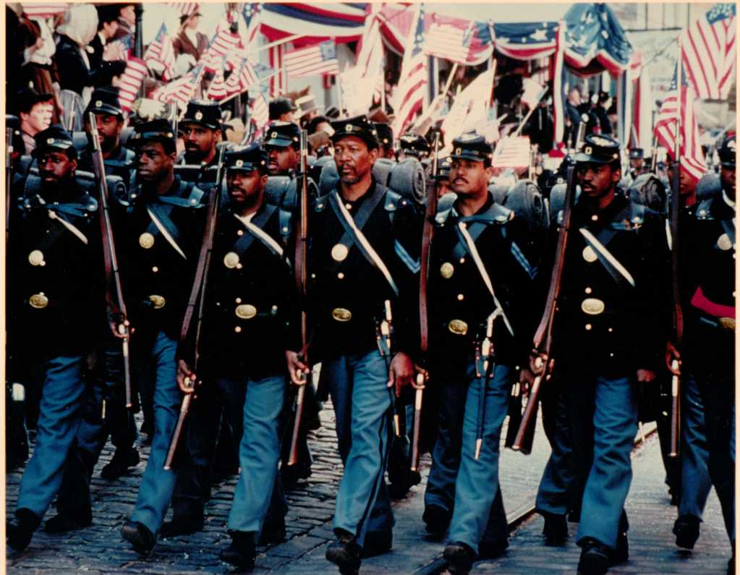
They had a new basis for their identity – a shared identity
An identity that superseded their old identity

Slide 20
They had a new basis for their identity – a shared identity
An identity that superseded their old identity

Slide 21
“Ain’t no dream. We run away slaves but we come back fightin’ men. Go tell your folks how kingdom come in the year of jubilee!”

Slide 22
Our identity in Christ is like that

Slide 23
^{2 Corinthians 5:16} Therefore from now on we recognize no one according to the flesh; even though we have known Christ according to the flesh, yet now we know Him in this way no longer. ¹⁷ Therefore if anyone is in Christ, he is a new creature; the old things passed away; behold, new things have come.
^{2 Corinthians 5:16} Therefore from now on we recognize no one according to the flesh; even though we have known Christ according to the flesh, yet now we know Him in this way no longer. ¹⁷ Therefore if anyone is in Christ, he is a new creature; the old things passed away; behold, new things have come.
Our identity in Christ is like that

Slide 24
And when we “put on Christ,” and stand in unity, we display God’s power
The more different we are, the more powerful the display!
Our uniform is made up of the things that are true of all of us “in Christ”

Slide 25
CRISIS facing the church:
DISUNITY and DIVISION
POINT: The overlooking of the Hellenistic widows flies in the face of what the church was all about!
“whether you are Hebraic or Hellenistic is more important than whether you belong to Christ”
When we elevate other ways of classifying people above our identity in Christ, it is an affront to our unity!

Slide 26
CRISIS facing the church:
DISUNITY and DIVISION
^{John 13:35} By this all men will know that you are My disciples, if you have love for one another.”
Disunity can do catastrophic damage to the church!
Distracting
Arguing factions and rivalries
Destroys Koinonia
Limits our effectiveness
Expands our vulnerability
Undermines our witness to the world
Could tear the church apart!

Slide 27
CRISIS facing the church:
DISUNITY and DIVISION
Disunity can do catastrophic damage to the church!
We have seen God make a big deal out of seemingly minor issues – why?
Because they extrapolate out into big issues
The major threats to the church haven’t changed all that much…

Slide 28
They acknowledged the problem, and set about solving it promptly
^{6:2} So the twelve summoned the congregation of the disciples and said, “It is not desirable for us to neglect the word of God in order to serve tables. ³ Therefore, brethren, select from among you seven men of good reputation, full of the Spirit and of wisdom, whom we may put in charge of this task. ⁴ But we will devote ourselves to prayer and to the ministry of the word.”

Slide 29
They acknowledged the problem, and set about solving it promptly
^{6:2} So the twelve summoned the congregation of the disciples and said, “It is not desirable for us to neglect the word of God in order to serve tables. ³ Therefore, brethren, select from among you seven men of good reputation, full of the Spirit and of wisdom, whom we may put in charge of this task. ⁴ But we will devote ourselves to prayer and to the ministry of the word.”

Slide 30
Unity is super-important, but the gospel is mission-critical
^{6:2} So the twelve summoned the congregation of the disciples and said, “It is not desirable for us to neglect the word of God in order to serve tables. ³ Therefore, brethren, select from among you seven men of good reputation, full of the Spirit and of wisdom, whom we may put in charge of this task. ⁴ But we will devote ourselves to prayer and to the ministry of the word.”

Slide 31
Unity is super-important, but the gospel is mission-critical
^{6:2} So the twelve summoned the congregation of the disciples and said, “It is not desirable for us to neglect the word of God in order to serve tables. ³ Therefore, brethren, select from among you seven men of good reputation, full of the Spirit and of wisdom, whom we may put in charge of this task. ⁴ But we will devote ourselves to prayer and to the ministry of the word.”

Slide 32
Unity is super-important, but the gospel is mission-critical
^{6:2} So the twelve summoned the congregation of the disciples and said, “It is not desirable for us to neglect the word of God in order to serve tables. ³ Therefore, brethren, select from among you seven men of good reputation, full of the Spirit and of wisdom, whom we may put in charge of this task. ⁴ But we will devote ourselves to prayer and to the ministry of the word.”

Slide 33
Unity is super-important, but the gospel is mission-critical
^{6:2} So the twelve summoned the congregation of the disciples and said, “It is not desirable for us to neglect the word of God in order to serve tables. ³ Therefore, brethren, select from among you seven men of good reputation, full of the Spirit and of wisdom, whom we may put in charge of this task. ⁴ But we will devote ourselves to prayer and to the ministry of the word.”

Slide 34
Spiritual men of high-quality character
^{6:2} So the twelve summoned the congregation of the disciples and said, “It is not desirable for us to neglect the word of God in order to serve tables. ³ Therefore, brethren, select from among you seven men of good reputation, full of the Spirit and of wisdom, whom we may put in charge of this task. ⁴ But we will devote ourselves to prayer and to the ministry of the word.”

Slide 35
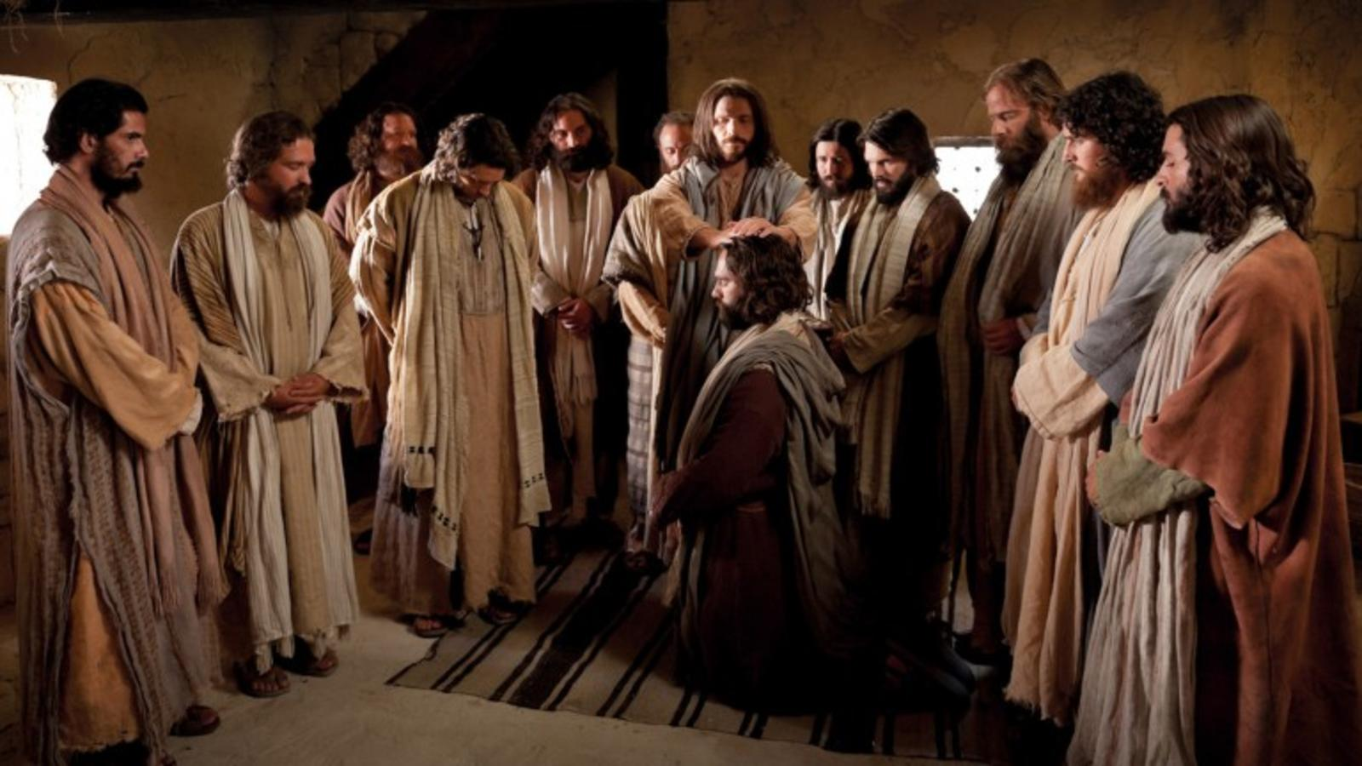
Spiritual men of high-quality character
^{6:5} The statement found approval with the whole congregation; and they chose Stephen, a man full of faith and of the Holy Spirit, and Philip, Prochorus, Nicanor, Timon, Parmenas and Nicolas, a proselyte from Antioch. ⁶ And these they brought before the apostles; and after praying, they laid their hands on them.

Slide 36
Criteria for leadership = Character
^{6:5} The statement found approval with the whole congregation; and they chose Stephen, a man full of faith and of the Holy Spirit, and Philip, Prochorus, Nicanor, Timon, Parmenas and Nicolas, a proselyte from Antioch. ⁶ And these they brought before the apostles; and after praying, they laid their hands on them.

Slide 37
Criteria for leadership = Character
They are putting forward their best men
^{6:5} The statement found approval with the whole congregation; and they chose Stephen, a man full of faith and of the Holy Spirit, and Philip, Prochorus, Nicanor, Timon, Parmenas and Nicolas, a proselyte from Antioch. ⁶ And these they brought before the apostles; and after praying, they laid their hands on them.

Slide 38
Criteria for leadership = Character
^{6:5} The statement found approval with the whole congregation; and they chose Stephen, a man full of faith and of the Holy Spirit, and Philip, Prochorus, Nicanor, Timon, Parmenas and Nicolas, a proselyte from Antioch. ⁶ And these they brought before the apostles; and after praying, they laid their hands on them.

Slide 39
Criteria for leadership = Character
They handled it with sensitivity
^{6:5} The statement found approval with the whole congregation; and they chose Stephen, a man full of faith and of the Holy Spirit, and Philip, Prochorus, Nicanor, Timon, Parmenas and Nicolas, a proselyte from Antioch. ⁶ And these they brought before the apostles; and after praying, they laid their hands on them.

Slide 40
Criteria for leadership = Character
Theme: You’re only making it stronger!
God is using the challenge to grow the church quantitatively and qualitatively
Pattern:
Crisis → Provision & Perseverance → Growth
^{6:7} The word of God kept on spreading; and the number of the disciples continued to increase greatly in Jerusalem, and a great many of the priests were becoming obedient to the faith.

Slide 41
Criteria for leadership = Character
Theme: You’re only making it stronger!
Important: “the passing of the torch”
The Holy Spirit working through non-Apostles
God is doing His work through the ever-growing “congregation” of His people
^{6:7} The word of God kept on spreading; and the number of the disciples continued to increase greatly in Jerusalem, and a great many of the priests were becoming obedient to the faith.

Slide 42
Criteria for leadership = Character
Theme: You’re only making it stronger!
God is raising up a new crop of leaders
Increasing capacity… preparing them for growth
Foreshadows the expansion of the gospel – a church about to spill its banks
^{6:7} The word of God kept on spreading; and the number of the disciples continued to increase greatly in Jerusalem, and a great many of the priests were becoming obedient to the faith.

Slide 43
Once again, God has made a provision to overcome the challenge
Criteria for leadership = Character
And the provision is PEOPLE
^{Matt 9:37} “The harvest is great, but the workers are few. ³⁸ So pray to the Lord who is in charge of the harvest; ask him to send more workers into his fields.”
Ever think of yourself as God’s provision to the church?
^{6:7} The word of God kept on spreading; and the number of the disciples continued to increase greatly in Jerusalem, and a great many of the priests were becoming obedient to the faith.

Slide 44
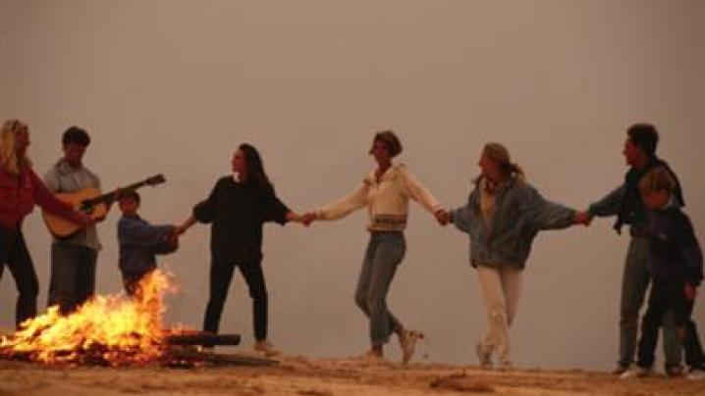
Christ’s church advances, unified, growing, and stronger than ever!
Criteria for leadership = Character
^{6:7} The word of God kept on spreading; and the number of the disciples continued to increase greatly in Jerusalem, and a great many of the priests were becoming obedient to the faith.

Slide 45
But the lesson is that unity takes work!
The good news is that we have unity in Christ …
^{6:7} The word of God kept on spreading; and the number of the disciples continued to increase greatly in Jerusalem, and a great many of the priests were becoming obedient to the faith.

Slide 46
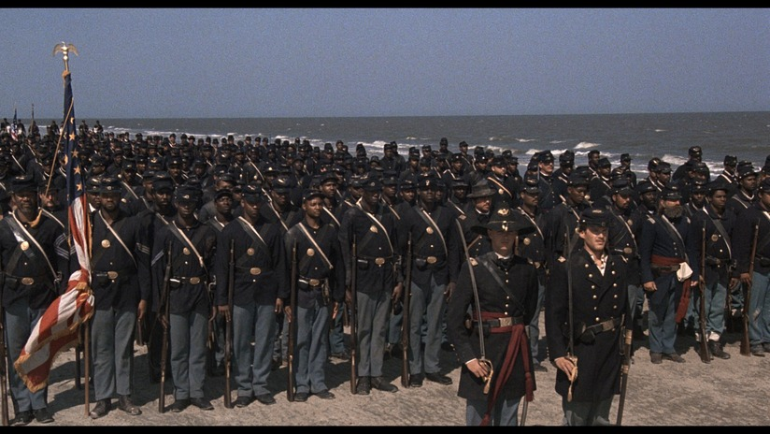
But the lesson is that unity takes work!
We have unity, but it must be preserved
The good news is that we have unity in Christ …
Because it WILL be tested and challenged
^{6:7} The word of God kept on spreading; and the number of the disciples continued to increase greatly in Jerusalem, and a great many of the priests were becoming obedient to the faith.
^{Ephesians 4:2} with all humility and gentleness, with patience, showing tolerance for one another in love, ³ being diligent to preserve the unity of the Spirit in the bond of peace.

Slide 47
But the lesson is that unity takes work!
We have unity, but it must be preserved
The good news is that we have Unity in Christ …
We have every reason to be divided!
A factious culture
A diverse church
On top of that – we’re sinners!
Because it WILL be tested and challenged
Different backgrounds, ethnicities, political persuasions, generations, personalities, opinions…
^{6:7} The word of God kept on spreading; and the number of the disciples continued to increase greatly in Jerusalem, and a great many of the priests were becoming obedient to the faith.
^{Ephesians 4:2} with all humility and gentleness, with patience, showing tolerance for one another in love, ³ being diligent to preserve the unity of the Spirit in the bond of peace.

Slide 48
But the lesson is that unity takes work!
We have unity, but it must be preserved
The good news is that we have Unity in Christ …
We have every reason to be divided!
A factious culture
A diverse church
On top of that – we’re sinners!
This is one of the biggest threats we face!
Because it WILL be tested and challenged
^{6:7} The word of God kept on spreading; and the number of the disciples continued to increase greatly in Jerusalem, and a great many of the priests were becoming obedient to the faith.
^{Ephesians 4:2} with all humility and gentleness, with patience, showing tolerance for one another in love, ³ being diligent to preserve the unity of the Spirit in the bond of peace.

Slide 49
But the lesson is that unity takes work!
We have unity, but it must be preserved
The good news is that we have Unity in Christ …
And that takes “diligence”
Because it WILL be tested and challenged
^{6:7} The word of God kept on spreading; and the number of the disciples continued to increase greatly in Jerusalem, and a great many of the priests were becoming obedient to the faith.
^{Ephesians 4:2} with all humility and gentleness, with patience, showing tolerance for one another in love, ³ being diligent to preserve the unity of the Spirit in the bond of peace.

Slide 50
How can we be diligent to preserve our unity?
1) We must be vigilant in noticing and responding to challenges to our unity
The good news is that we have Unity in Christ …
^{6:7} The word of God kept on spreading; and the number of the disciples continued to increase greatly in Jerusalem, and a great many of the priests were becoming obedient to the faith.
^{Ephesians 4:2} with all humility and gentleness, with patience, showing tolerance for one another in love, ³ being diligent to preserve the unity of the Spirit in the bond of peace.

Slide 51
How can we be diligent to preserve our unity?
2) We must fight for the right mindset about one another
The good news is that we have Unity in Christ …
What’s more valuable: unity or winning?
Can you acknowledge your need for others?
Can you take the log out of your eye?
^{6:7} The word of God kept on spreading; and the number of the disciples continued to increase greatly in Jerusalem, and a great many of the priests were becoming obedient to the faith.
^{Ephesians 4:2} with all humility and gentleness, with patience, showing tolerance for one another in love, ³ being diligent to preserve the unity of the Spirit in the bond of peace.
^{Ephesians 4:2} with all humility and gentleness, with patience, showing tolerance for one another in love, ³ being diligent to preserve the unity of the Spirit in the bond of peace.

Slide 52
How can we be diligent to preserve our unity?
2) We must fight for the right mindset about one another
The good news is that we have Unity in Christ …
Are you aware of the ways that you tend to alienate others?
^{6:7} The word of God kept on spreading; and the number of the disciples continued to increase greatly in Jerusalem, and a great many of the priests were becoming obedient to the faith.
^{Ephesians 4:2} with all humility and gentleness, with patience, showing tolerance for one another in love, ³ being diligent to preserve the unity of the Spirit in the bond of peace.
^{Ephesians 4:2} with all humility and gentleness, with patience, showing tolerance for one another in love, ³ being diligent to preserve the unity of the Spirit in the bond of peace.

Slide 53
How can we be diligent to preserve our unity?
2) We must fight for the right mindset about one another
The good news is that we have Unity in Christ …
^{6:7} The word of God kept on spreading; and the number of the disciples continued to increase greatly in Jerusalem, and a great many of the priests were becoming obedient to the faith.
^{Ephesians 4:2} with all humility and gentleness, with patience, showing tolerance for one another in love, ³ being diligent to preserve the unity of the Spirit in the bond of peace.
^{Ephesians 4:2} with all humility and gentleness, with patience, showing tolerance for one another in love, ³ being diligent to preserve the unity of the Spirit in the bond of peace.

Slide 54
How can we be diligent to preserve our unity?
2) We must fight for the right mindset about one another
The good news is that we have Unity in Christ …
Can you give thanks for your brothers and sisters who are the most different from you?
^{6:7} The word of God kept on spreading; and the number of the disciples continued to increase greatly in Jerusalem, and a great many of the priests were becoming obedient to the faith.
^{Ephesians 4:2} with all humility and gentleness, with patience, showing tolerance for one another in love, ³ being diligent to preserve the unity of the Spirit in the bond of peace.
^{Ephesians 4:2} with all humility and gentleness, with patience, showing tolerance for one another in love, ³ being diligent to preserve the unity of the Spirit in the bond of peace.

Slide 55
How can we be diligent to preserve our unity?
2) We must fight for the right mindset about one another
The good news is that we have Unity in Christ …
Who is God calling you to draw near to?
… Who might be different from you
… Who you might have a complaint against
^{6:7} The word of God kept on spreading; and the number of the disciples continued to increase greatly in Jerusalem, and a great many of the priests were becoming obedient to the faith.
^{Ephesians 4:2} with all humility and gentleness, with patience, showing tolerance for one another in love, ³ being diligent to preserve the unity of the Spirit in the bond of peace.
^{Ephesians 4:2} with all humility and gentleness, with patience, showing tolerance for one another in love, ³ being diligent to preserve the unity of the Spirit in the bond of peace.

Slide 56
How can we be diligent to preserve our unity?
2) We must fight for the right mindset about one another
The good news is that we have Unity in Christ …
^{6:7} The word of God kept on spreading; and the number of the disciples continued to increase greatly in Jerusalem, and a great many of the priests were becoming obedient to the faith.
^{Ephesians 4:2} with all humility and gentleness, with patience, showing tolerance for one another in love, ³ being diligent to preserve the unity of the Spirit in the bond of peace.
^{Ephesians 4:2} with all humility and gentleness, with patience, showing tolerance for one another in love, ³ being diligent to preserve the unity of the Spirit in the bond of peace.

Slide 57
If we do that, we will demonstrate God’s power to the world!
The good news is that we have Unity in Christ …
^{6:7} The word of God kept on spreading; and the number of the disciples continued to increase greatly in Jerusalem, and a great many of the priests were becoming obedient to the faith.
^{Ephesians 4:2} with all humility and gentleness, with patience, showing tolerance for one another in love, ³ being diligent to preserve the unity of the Spirit in the bond of peace.

