Slide 1
The Rise of The Antichrist And The End of The World
2 Thessalonians 2

Slide 2
Paul’s Second Letter to the Thessalonians
A new Christian community in ancient Greece (c. 50 A.D.)
This was a follow up letter, shortly after his first one
They were confused on some topics related to the end of human history

Slide 3
Paul’s Second Letter to the Thessalonians
History isn’t cyclical. It’s headed toward a finale.

Slide 4
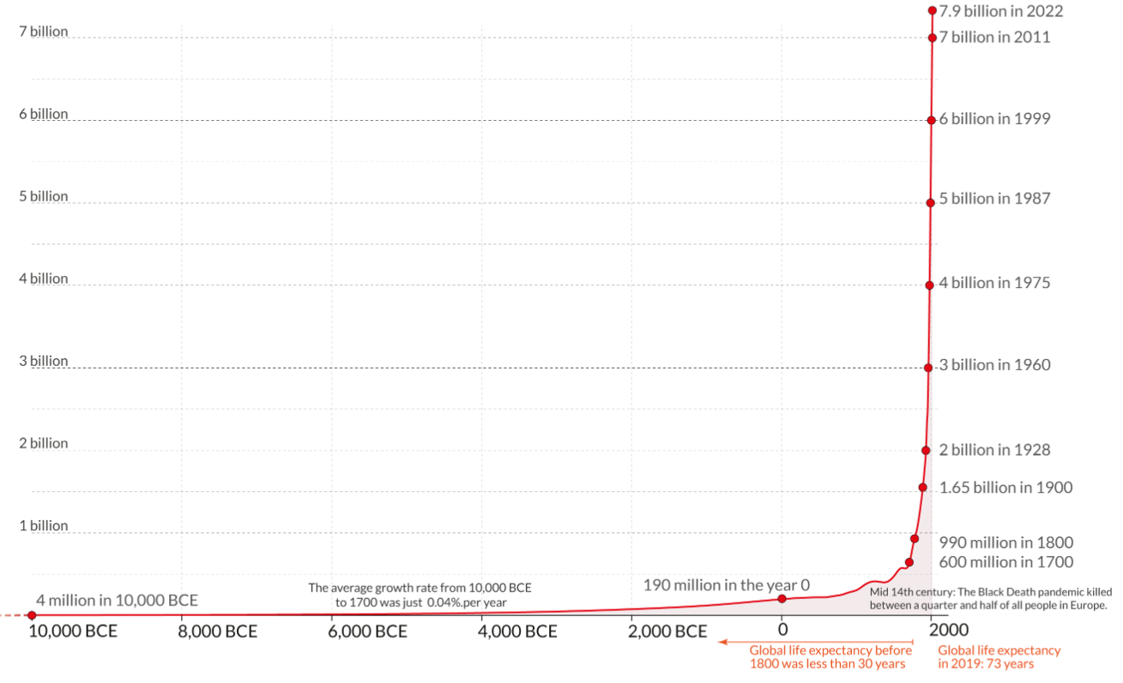
The end times scenario envisions world population in the billions (Rev 9:16)

Slide 5
The end times scenario envisions world population in the billions (Rev 9:16)

Slide 6
The end times scenario envisions world population in the billions (Rev 9:16)
8,053,540,322
4:29 PM – August 10, 2023
https://www.worldometers.info/world-population/

Slide 7
Paul’s Second Letter to the Thessalonians
Scripture teaches repeatedly on the “end times”
It gives multiple iterations of predictions which need to be correlated with each other
Paul had taught these new believers, and now he needed to teach them some more.

Slide 8
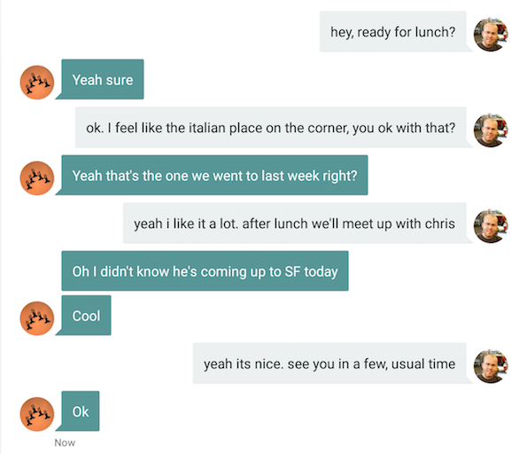
Paul’s Second Letter to the Thessalonians
In this passage, we get one side of a conversation

Slide 9
2 Thessalonians 2
¹ Now we request you, brethren, with regard to the coming of our Lord Jesus Christ and our gathering together to Him,
² that you not be quickly shaken from your composure or be disturbed
either by a spirit or a message or a letter as if from us,
to the effect that the day of the Lord has come.

Slide 10
2 Thessalonians 2
³ Let no one in any way deceive you,
for it will not come unless the apostasy comes first,
and the man of lawlessness is revealed, the son of destruction,
⁴ who opposes and exalts himself above every so-called god or object of worship,
so that he takes his seat in the temple of God, displaying himself as being God.

Slide 11
2 Thessalonians 2
⁵ Do you not remember that while I was still with you, I was telling you these things?
⁶ And you know what restrains him now, so that in his time he will be revealed.

Slide 12
2 Thessalonians 2
⁷ For the mystery of lawlessness is already at work;
only he who now restrains will do so until he is taken out of the way.
⁸ Then that lawless one will be revealed whom the Lord will slay with the breath of His mouth and bring to an end by the appearance of His coming;

Slide 13
2 Thessalonians 2
⁹ that is, the one whose coming is in accord with the activity of Satan,
with all power and signs and false wonders,
¹⁰ and with all the deception of wickedness for those who perish,
because they did not receive the love of the truth so as to be saved.

Slide 14
2 Thessalonians 2
¹¹ For this reason God will send upon them a deluding influence so that they will believe what is false,
¹² in order that they all may be judged who did not believe the truth, but took pleasure in wickedness.

Slide 15
Leon Morris, TNTC, 124
This passage is probably the most obscure and difficult in the whole of the Pauline writings
and the many gaps in our knowledge have given rise to extravagant speculations.

Slide 16
Augustine, City of God, 20.19, quoted in ZIBBC, 438
I frankly confess that the meaning of this completely escapes me.

Slide 17
Five Questions We Need To Answer
What did the letter say? (v. 1-2)
What is the “apostasy”? (v. 3)
Who is the “man of lawlessness”? (v. 3-5, 8-10)
Who or what is the “restrainer”? (v. 6-7)
What is the “deluding influence”? (v. 11-12)

Slide 18
2 Thessalonians 2
¹ Now we request you, brethren, with regard to the coming of our Lord Jesus Christ and our gathering together to Him,
² that you not be quickly shaken from your composure or be disturbed
either by a spirit or a message or a letter as if from us,
to the effect that the day of the Lord has come.
1. What did the letter say?

Slide 19
2 Thessalonians 2
¹ Now we request you, brethren, with regard to the coming of our Lord Jesus Christ and our gathering together to Him,
² that you not be quickly shaken from your composure or be disturbed
either by a spirit or a message or a letter as if from us,
to the effect that the day of the Lord has come.
Hold to the traditions which you were taught, whether by word of mouth or by letter from us. (2 Thessalonians 2:15)
1. What did the letter say?

Slide 20
2 Thessalonians 2
¹ Now we request you, brethren, with regard to the coming of our Lord Jesus Christ and our gathering together to Him,
² that you not be quickly shaken from your composure or be disturbed
either by a spirit or a message or a letter as if from us,
to the effect that the day of the Lord has come.
I, Paul, write this greeting with my own hand, and this is a distinguishing mark in every letter; this is the way I write. (2 Thessalonians 3:17)
1. What did the letter say?

Slide 21
2 Thessalonians 2
¹ Now we request you, brethren, with regard to the coming of our Lord Jesus Christ and our gathering together to Him,
² that you not be quickly shaken from your composure or be disturbed
either by a spirit or a message or a letter as if from us,
to the effect that the day of the Lord has come.
The general topic = the end of the world as we know it
1. What did the letter say?

Slide 22
2 Thessalonians 2
¹ Now we request you, brethren, with regard to the coming of our Lord Jesus Christ and our gathering together to Him,
² that you not be quickly shaken from your composure or be disturbed
either by a spirit or a message or a letter as if from us,
to the effect that the day of the Lord has come.
The “Rapture”
Great tribulation
Jesus returns
The “Day of the Lord”
The content of the letter
1. What did the letter say?

Slide 23
2 Thessalonians 2
¹ Now we request you, brethren, with regard to the coming of our Lord Jesus Christ and our gathering together to Him,
² that you not be quickly shaken from your composure or be disturbed
either by a spirit or a message or a letter as if from us,
to the effect that the day of the Lord has come.
= When God finally intervenes to bring this stage of history to an end
Wail, for the day of the Lord is near! It will come as destruction from the Almighty. (Isaiah 13:6)
The “Day of the Lord”
1. What did the letter say?

Slide 24
2 Thessalonians 2
¹ Now we request you, brethren, with regard to the coming of our Lord Jesus Christ and our gathering together to Him,
² that you not be quickly shaken from your composure or be disturbed
either by a spirit or a message or a letter as if from us,
to the effect that the day of the Lord has come.
You yourselves know full well that the day of the Lord will come just like a thief in the night. (1 Thessalonians 5:2)
The “Day of the Lord”
1. What did the letter say?

Slide 25
2 Thessalonians 2
¹ Now we request you, brethren, with regard to the coming of our Lord Jesus Christ and our gathering together to Him,
² that you not be quickly shaken from your composure or be disturbed
either by a spirit or a message or a letter as if from us,
to the effect that the day of the Lord has come.
While they are saying, “Peace and safety!” then destruction will come upon them suddenly… (1 Thessalonians 5:3)
The “Day of the Lord”
1. What did the letter say?

Slide 26
2 Thessalonians 2
¹ Now we request you, brethren, with regard to the coming of our Lord Jesus Christ and our gathering together to Him,
² that you not be quickly shaken from your composure or be disturbed
either by a spirit or a message or a letter as if from us,
to the effect that the day of the Lord has come.
The “Rapture”
Great tribulation
Jesus returns
The “Day of the Lord”
They were suffering greatly
Some apparently were worried they had missed the rapture or misunderstood the plan
1. What did the letter say?

Slide 27
2 Thessalonians 2
¹ Now we request you, brethren, with regard to the coming of our Lord Jesus Christ and our gathering together to Him,
² that you not be quickly shaken from your composure or be disturbed
either by a spirit or a message or a letter as if from us,
to the effect that the day of the Lord has come.
The “Rapture”
Great tribulation
Jesus returns
The “Day of the Lord”
Paul: “Ignore those rumors”
“Remember all the other things that come before the end?”
1. What did the letter say?

Slide 28
2 Thessalonians 2
³ Let no one in any way deceive you,
for it will not come unless the apostasy comes first,
2. What is the “Apostasy”?

Slide 29
2 Thessalonians 2
³ Let no one in any way deceive you,
for it will not come unless the apostasy comes first,
= falling away or departure
Probably theological – The church departs from God’s truth
Jesus: “Many false prophets will arise and will mislead many.” (Matthew 24:11)
2. What is the “Apostasy”?

Slide 30
2 Thessalonians 2
³ Let no one in any way deceive you,
for it will not come unless the apostasy comes first,
= falling away or departure
Probably theological – The church departs from God’s truth
Paul: Now the Holy Spirit tells us clearly that in the last times some will turn away from the true faith;
2. What is the “Apostasy”?

Slide 31
2 Thessalonians 2
³ Let no one in any way deceive you,
for it will not come unless the apostasy comes first,
= falling away or departure
Probably theological – The church departs from God’s truth
Paul: they will follow deceptive spirits and teachings that come from demons.
2. What is the “Apostasy”?

Slide 32
2 Thessalonians 2
³ Let no one in any way deceive you,
for it will not come unless the apostasy comes first,
= falling away or departure
Probably theological – The church departs from God’s truth
Paul: These people are hypocrites and liars, and their consciences are dead (1 Timothy 4:1-2)
2. What is the “Apostasy”?

Slide 33
Daniel Dennett in Evolutionary Psychology – ISSN 1474-7049 – Volume 8(1). 2010. -143- Preachers who are not believers
“Wes” – a Methodist pastor:
My colleagues here are very educated, very well read, and do not believe the significance of Christianity lies in whether it’s literally true.
They don’t believe Jesus rose from the dead literally.

Slide 34
Daniel Dennett in Evolutionary Psychology – ISSN 1474-7049 – Volume 8(1). 2010. -143- Preachers who are not believers
“Wes” – a Methodist pastor:
They don’t believe Jesus was born of a virgin.
They don’t believe all those things that would cause a big stir in their churches.
But that’s not uncommon in mainline denominations, or even in the Catholic Church.

Slide 35
Daniel Dennett in Evolutionary Psychology – ISSN 1474-7049 – Volume 8(1). 2010. -143- Preachers who are not believers
“Darryl” – a Presbyterian minister
It’s not that I’m not a believer. I do believe in God.
But I find that the character of my belief is much closer to that pantheist view than the typical theist.

Slide 36
Daniel Dennett in Evolutionary Psychology – ISSN 1474-7049 – Volume 8(1). 2010. -143- Preachers who are not believers
Adam, Church of Christ:
Here’s how I’m handling my job on Sunday mornings:
I see it as play acting.
I kind of see myself as taking on a role of a believer in a worship service, and performing.

Slide 37
Daniel Dennett in Evolutionary Psychology – ISSN 1474-7049 – Volume 8(1). 2010. -143- Preachers who are not believers
Adam, Church of Christ:
Because I know what to say. I know how to pray publicly.
I can lead singing.
I love singing.
I don’t believe what I’m saying anymore in some of these songs.

Slide 38
Daniel Dennett in Evolutionary Psychology – ISSN 1474-7049 – Volume 8(1). 2010. -143- Preachers who are not believers
Adam, Church of Christ:
But I see it as taking on the role and performing.
Maybe that’s what it takes for me to get myself through this, but that’s what I’m doing…

Slide 39
Daniel Dennett in Evolutionary Psychology – ISSN 1474-7049 – Volume 8(1). 2010. -143- Preachers who are not believers
Adam, Church of Christ:
I’m where I am because I need the job still.
If I had an alternative, a comfortable paying job, something I was interested in doing, and a move that wouldn’t destroy my family, that’s where I’d go.

Slide 40
Daniel Dennett in Evolutionary Psychology – ISSN 1474-7049 – Volume 8(1). 2010. -143- Preachers who are not believers
Adam, Church of Christ:
Because I do feel kind of hypocritical.
It used to be the word “hypocritical” was like a sin.
I don’t hold that view anymore… I use the word “hypocritical” differently,
as in, I’m just not being forthright.

Slide 41
2 Thessalonians 2
³ Let no one in any way deceive you,
for it will not come unless the apostasy comes first,
Application: Soak your mind in Scripture, and be careful who you listen to
2. What is the “Apostasy”?

Slide 42
2 Thessalonians 2
³ Let no one in any way deceive you,
for it will not come unless the apostasy comes first,
and the man of lawlessness is revealed,
the son of destruction,
John calls him “The Beast” (Revelation 13:1) and “The Antichrist” (1 John 2:18)
Daniel calls him “The Small Horn” (Daniel 8:9) and “The King” (Daniel 11:36)
3. Who is the “Man of Lawlessness”?

Slide 43
2 Thessalonians 2
⁴ who opposes and exalts himself above every so-called god or object of worship,
He will show no regard for the gods of his fathers … nor will he show regard for any other god; for he will magnify himself above them all. (Dan. 11:37)
3. Who is the “Man of Lawlessness”?

Slide 44
2 Thessalonians 2
⁴ who opposes and exalts himself above every so-called god or object of worship,
so that he takes his seat in the temple of God, displaying himself as being God.
Jesus: “When you see the Abomination of Desolation which was spoken of through Daniel the prophet, standing in the holy place…” (Matthew 24:15; cf. Dan 9:27; 12:11)
3. Who is the “Man of Lawlessness”?

Slide 45
2 Thessalonians 2
⁴ who opposes and exalts himself above every so-called god or object of worship,
so that he takes his seat in the temple of God, displaying himself as being God.
The Man of Lawlessness (Antichrist):
Performs some defiling act in the temple
Which inaugurates the greatest suffering the world has ever seen
Jesus: “When you see the Abomination of Desolation which was spoken of through Daniel the prophet, standing in the holy place…” (Matthew 24:15; cf. Dan 9:27; 12:11)
3. Who is the “Man of Lawlessness”?

Slide 46
2 Thessalonians 2
⁴ who opposes and exalts himself above every so-called god or object of worship,
so that he takes his seat in the temple of God, displaying himself as being God.
The Man of Lawlessness (Antichrist):
Performs some defiling act in the temple
Which inaugurates the greatest suffering the world has ever seen
Jesus: “For then there will be great tribulation, unequaled from the beginning of the world until now—and never to be equaled again.” (Matthew 24:21)
3. Who is the “Man of Lawlessness”?

Slide 47
2 Thessalonians 2
⁴ who opposes and exalts himself above every so-called god or object of worship,
so that he takes his seat in the temple of God, displaying himself as being God.
The Man of Lawlessness (Antichrist):
Performs some defiling act in the temple
Which inaugurates the greatest suffering the world has ever seen
Jesus: “Unless those days had been cut short, no life would have been saved” (Matthew 24:22)
3. Who is the “Man of Lawlessness”?

Slide 48
2 Thessalonians 2
⁴ who opposes and exalts himself above every so-called god or object of worship,
so that he takes his seat in the temple of God, displaying himself as being God.
The Man of Lawlessness (Antichrist):
Wins the devotion and allegiance of the whole world
Hates God and God’s people
It was also given to [the beast] to make war with the saints and to overcome them,
and authority over every tribe and people and tongue and nation was given to him.
All who dwell on the earth will worship him (Rev. 13:7-8)
3. Who is the “Man of Lawlessness”?

Slide 49
2 Thessalonians 2
⁹ that is, the one whose coming is in accord with the activity of Satan,
with all power and signs and false wonders,
3. Who is the “Man of Lawlessness”?

Slide 50
2 Thessalonians 2
⁹ that is, the one whose coming is in accord with the activity of Satan,
with all power and signs and false wonders,
They worshiped [Satan] because he gave his authority to the beast;
and they worshiped the beast, saying, “Who is like the beast, and who is able to wage war with him?” … He performs great signs… (Rev. 13:4, 13)
The Man of Lawlessness (Antichrist):
Empowered by Satan
Wages war like no other
Total economic control
3. Who is the “Man of Lawlessness”?

Slide 51
2 Thessalonians 2
⁹ that is, the one whose coming is in accord with the activity of Satan,
with all power and signs and false wonders,
He required everyone… to be given a mark … and no one could buy or sell anything without that mark (Revelation 13:16-17)
The Man of Lawlessness (Antichrist):
Empowered by Satan
Wages war like no other
Total economic control
3. Who is the “Man of Lawlessness”?

Slide 52
2 Thessalonians 2
⁸ Then that lawless one will be revealed whom the Lord will slay with the breath of His mouth and bring to an end by the appearance of His coming;
The Man of Lawlessness (Antichrist):
Will be defeated by Jesus at the climax of history
3. Who is the “Man of Lawlessness”?

Slide 53
2 Thessalonians 2
⁸ Then that lawless one will be revealed whom the Lord will slay with the breath of His mouth and bring to an end by the appearance of His coming;
I saw heaven opened, and behold, a white horse,
and He who sat on it is called Faithful and True…
He is clothed with a robe dipped in blood,
and His name is called The Word of God…
From His mouth comes a sharp sword… (Rev. 19:11-15)
The Man of Lawlessness (Antichrist):
Will be defeated by Jesus at the climax of history
3. Who is the “Man of Lawlessness”?

Slide 54
2 Thessalonians 2
⁸ Then that lawless one will be revealed whom the Lord will slay with the breath of His mouth and bring to an end by the appearance of His coming;
And the beast was captured, and … thrown alive into the fiery lake of burning sulfur.
Their entire army was killed by the sharp sword that came from the mouth of the one riding the white horse. (Revelation 19:20-21)
The Man of Lawlessness (Antichrist):
Will be defeated by Jesus at the climax of history
3. Who is the “Man of Lawlessness”?

Slide 55
2 Thessalonians 2
⁶ And you know what restrains now, so that in his time he will be revealed.
⁷ For the mystery of lawlessness is already at work; only he who now restrains will do so until he is taken out of the way.
4. Who or what is the “Restrainer”?

Slide 56
2 Thessalonians 2
⁶ And you know what restrains now, so that in his time he will be revealed.
⁷ For the mystery of lawlessness is already at work; only he who now restrains will do so until he is taken out of the way.
The Restrainer:
Referred to as “it” and “he.”
Seems to be holding back evil
Will be removed in the end times
4. Who or what is the “Restrainer”?

Slide 57
2 Thessalonians 2
⁶ And you know what restrains now, so that in his time he will be revealed.
⁷ For the mystery of lawlessness is already at work; only he who now restrains will do so until he is taken out of the way.
The Restrainer:
“He” could refer to the activity of the Holy Spirit
“It” could be the church, or the power of God
Removed, so humans can be as evil as they want
4. Who or what is the “Restrainer”?

Slide 58
2 Thessalonians 2
¹⁰ [The antichrist will come] with all the deception of wickedness for those who perish,
because they did not receive the love of the truth so as to be saved.
5. What is the “Deluding Influence”?

Slide 59
2 Thessalonians 2
¹¹ For this reason God will send upon them a deluding influence so that they will believe what is false,
¹² in order that they all may be judged who did not believe the truth, but took pleasure in wickedness.
5. What is the “Deluding Influence”?

Slide 60
2 Thessalonians 2
¹¹ For this reason God will send upon them a deluding influence so that they will believe what is false,
¹² in order that they all may be judged who did not believe the truth, but took pleasure in wickedness.
The Deluding Influence:
Sent (or allowed) by God
Will make it very easy to believe the Antichrist
Only works on those who reject God’s truth and salvation
This is a bad time to be an unbeliever
5. What is the “Deluding Influence”?

Slide 61
Overall Conclusions
The world has seen many powerful brutal rulers who sought to expand their power

Slide 62
Overall Conclusions
Apostasy will increase toward the end
The Antichrist is yet to come
The temple will be rebuilt, and it will matter
The “restrainer” will be removed and replaced with a dangerous “deluding influence”
Jesus will return!
Be ready for his coming!!

Slide 63
The Rise of the Antichrist
Questions?
Comments?
Experiences?
risleys@dwellcc.org
See the Dwell App OR teachings.dwellcc.org

