Slide 1
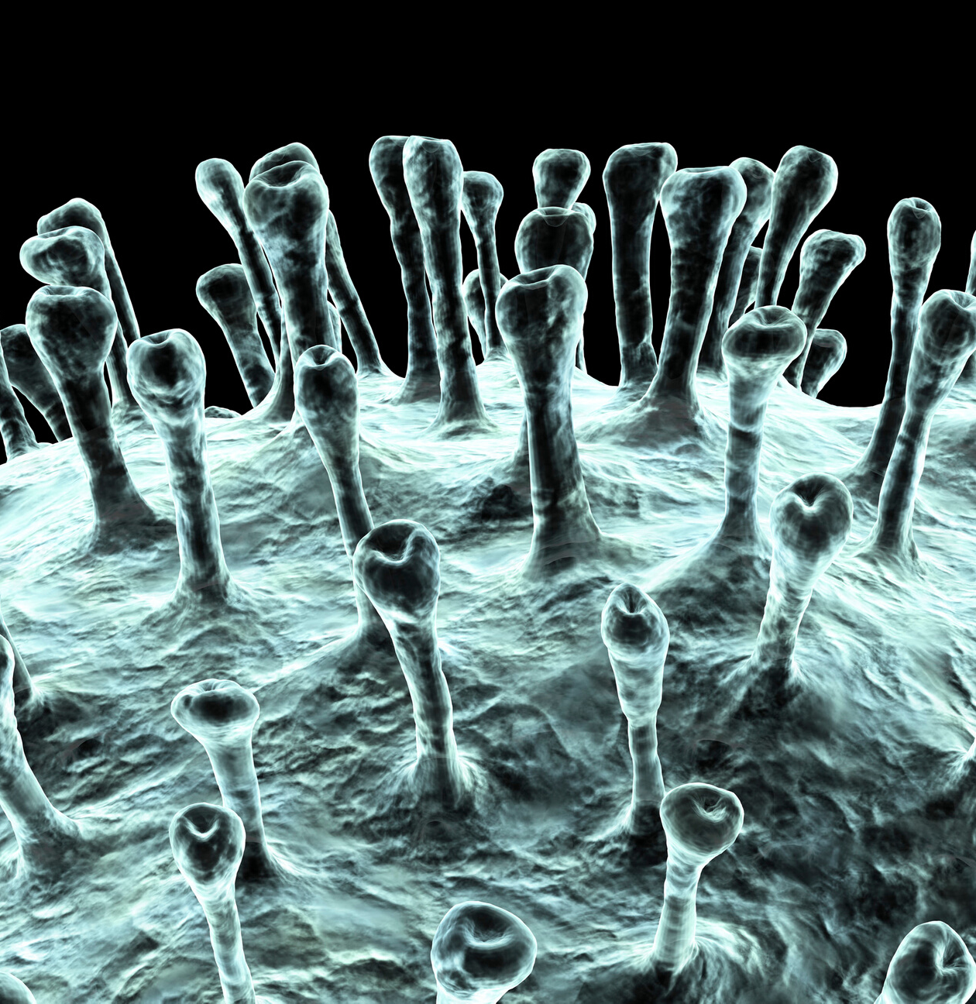
A “Post-Covid” Missiology
Three Ongoing Realities
By Dr. Ed Stetzer

Slide 2
[S]o that what cannot be shaken may remain.
Hebrews 12:27 (NIV)

Slide 3
Six Pandemics
Disease
Distrust in Culture
Defamation from Technology
Disorientation in Identity
Disruption to Mental Health
Division in Church

Slide 4
COVID and Our Cultural Convulsion
Post-Covid Reality

Slide 5
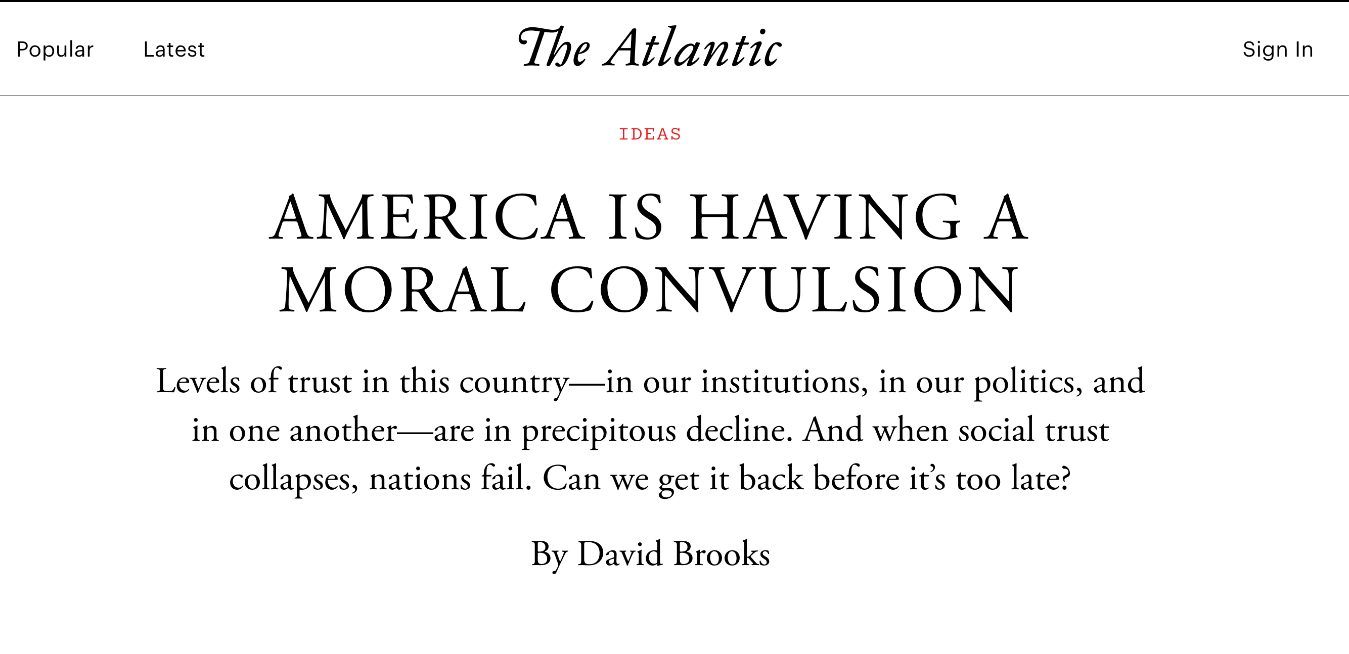

Slide 6
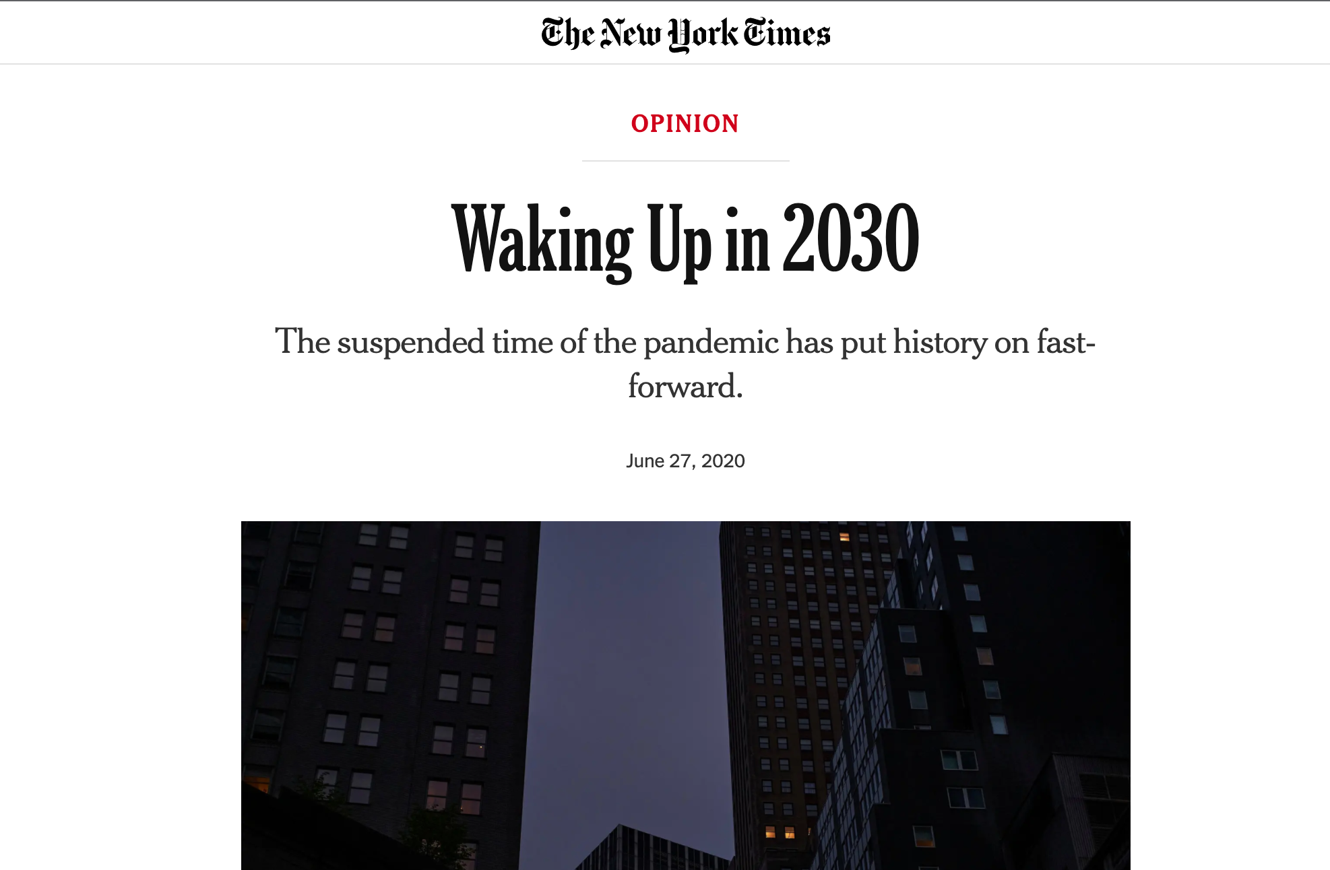

Slide 7
COVID and the Great Sort
Post-Covid Reality

Slide 8
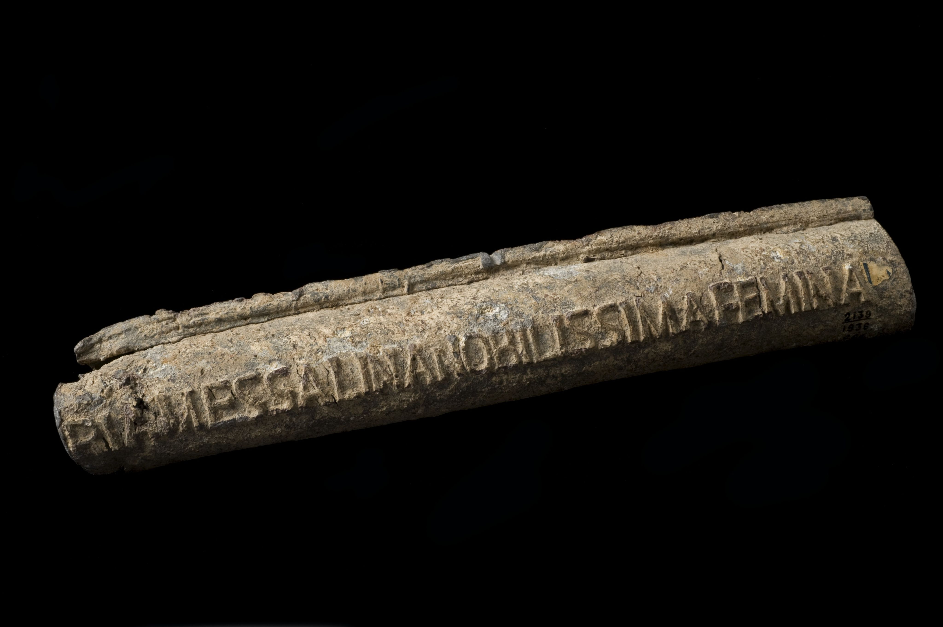

Slide 9
COVID and Layers of Disengagement
Post-Covid Reality

Slide 11
Who knows, perhaps you have come to your… position for such as time as this.
Esther 4:14

Slide 12
A POST-PANDEMIC MISSIOLOGY
Ed Stetzer, Ph.D. @EdStetzer

