Slide 3
Matthew 19
Marriage and Divorce

Slide 4
Context
Matt 18
-Who are God’s people?
Humble
Genuine
Forgiving

Slide 5
A very sensitive topic
Marriage
The most intimate lifelong human relationship we should have
Genesis 2:24 (NASB95) — 24 For this reason a man shall leave his father and his mother, and be joined to his wife; and they shall become one flesh.

Slide 6
A very sensitive topic
Marriage
The most intimate lifelong human relationship we should have
Clear statements from God about divorce
(Mal 2:15-16)
…Take heed then to your spirit and let no one deal treacherously against the wife of your youth. 16“For I hate divorce,” says the Lord, the God of Israel,…

Slide 7
A very sensitive topic
Marriage
Can be the most painful relationship you will ever have
Can be the most rewarding human relationship

Slide 8
Matthew 19:3 (NASB95)
3 Some Pharisees came to Jesus, testing Him and asking, “Is it lawful for a man to divorce his wife for any reason at all?”

Slide 9
Cultural Context
Different Rabbi’s had different “schools”
A major debate in Jesus’ day
Hillel school vs. Shammai school

Slide 10
The Mishna 9:10
A The House of Shammai say, “A man should divorce his wife only because he has found grounds for it in unchastity,
B “since it is said, Because he has found in her indecency in anything (Dt. 24:).”

Slide 11
The Mishna 9:10
C And the House of Hillel say, “Even if she spoiled his dish,
D “since it is said, Because he has found in her indecency In anything.
Neusner, J. (1988). (p. 487). New Haven, CT: Yale University Press.

Slide 12
Deuteronomy 24:1 (NASB95)
1 “When a man takes a wife and marries her, and it happens that she finds no favor in his eyes because he has found some indecency in her, and he writes her a certificate of divorce and puts it in her hand and sends her out from his house,

Slide 13
Matthew 19:3 (NASB95)
3 Some Pharisees came to Jesus, testing Him and asking, “Is it lawful for a man to divorce his wife for any reason at all?”

Slide 14
Matthew 19:4–6 (NASB95) —
4 And He answered and said, “Have you not read that He who created them from the beginning made them male and female, 5 and said, ‘For this reason a man shall leave his father and mother and be joined to his wife, and the two shall become one flesh’? 6 “So they are no longer two, but one flesh. What therefore God has joined together, let no man separate.”

Slide 15
Jesus’ answer
Divorce is bad

Slide 16
Matthew 19:7 (NASB95)
7 They said to Him, “Why then did Moses command to give her a certificate of divorce and send her away?”

Slide 17
Matthew 19:8–9 (NASB95)
8 He said to them, “Because of your hardness of heart Moses permitted you to divorce your wives; but from the beginning it has not been this way. 9 “And I say to you, whoever divorces his wife, except for immorality, and marries another woman commits adultery.”

Slide 18
Matthew 19:8–9 (NASB95)
8 He said to them, “Because of your hardness of heart Moses permitted you to divorce your wives; but from the beginning it has not been this way. 9 “And I say to you, whoever divorces his wife, except for immorality, and marries another woman commits adultery.”

Slide 19
The Nuclear response
For the pharisee’s
1) Moses made a concession because you are unspiritual and fleshly
2) You are adulterers who are making other people into adulterers because of your bad theology

Slide 20
The Nuclear response
For us
All re-married people are adulterers if adultery wasn’t the reason for their divorce?

Slide 21
Who is the primary target
Pharisees who are trying to trap Jesus
How do we know this?
The historical context
The fact that there are other Biblical reasons for divorce

Slide 22
Biblical Divorce
(1 Cor. 7:10-11) “To the married I give instructions, not I, but the Lord, that the wife should not leave her husband. 11 But if she does leave, she must remain unmarried, or else be reconciled to her husband, and that the husband should not divorce his wife.”
You can leave, but don’t get remarried

Slide 23
Biblical Divorce
1 Corinthians 7:27–28 (NASB95) — 27 Are you bound to a wife? Do not seek to be released. Are you released from a wife? Do not seek a wife. 28 But if you marry, you have not sinned; and if a virgin marries, she has not sinned. Yet such will have trouble in this life, and I am trying to spare you.

Slide 24
Biblical Divorce
1 Corinthians 7:27–28 (NASB95) — 27 Are you bound to a wife? Do not seek to be released. Are you released from a wife? Do not seek a wife. 28 But if you marry, you have not sinned; and if a virgin marries, she has not sinned. Yet such will have trouble in this life, and I am trying to spare you.

Slide 25
Summary
Pharisees are wrong
Marriage is important to God
Adultery is a permissible reason for divorce and remarriage
Abandonment is a permissible reason for divorce and remarriage

Slide 26
What about…
Physical/sexual abuse
Drug Addiction
Crime
We should help protect spouses and children

Slide 27
What about…
Psalm 71:1–5 (NASB95) — 1 In You, O Lord, I have taken refuge; Let me never be ashamed. 2 In Your righteousness deliver me and rescue me; Incline Your ear to me and save me. 3 Be to me a rock of habitation to which I may continually come; You have given commandment to save me, For You are my rock and my fortress. 4 Rescue me, O my God, out of the hand of the wicked, Out of the grasp of the wrongdoer and ruthless man, 5 For You are my hope; O Lord God, You are my confidence from my youth.
Physical/sexual abuse
Drug Addiction
Crime
We should help protect spouses and children

Slide 28
What about…
See our paper on this

Slide 29
An alternative
Legal separation
All the protections of divorce without the remarrying
The guilty spouse may repent OR may abandon or commit adultery

Slide 30
The stuff we don’t want to miss
What does this tell us about marriage.
It is supposed to be for life
It is not supposed to be easy
It is supposed to be GOOD!
Except in extreme cases there should be no alternative

Slide 31
The stuff we don’t want to miss
The tension
Most people get divorced because marriage is hard
If you do that you never have sex again and die alone
Imagine how hard we would work to fix our marriages

Slide 32
The stuff we don’t want to miss
What does this tell us about humans
We are hard hearted
We tend to seek the easy way out
We sometimes need to choose the lesser of two evils
We are very bad at deciding what the lesser of two evil’s is by ourselves

Slide 33
The stuff we don’t want to miss
What does this tell us about humans
We tend to get blinded by emotions
We don’t think it through
Holidays, Grandkids, Inheritances
The unpleasantries of the dating scene

Slide 34
Dell Curry and Sonya Curry
33 years of marriage

Slide 35
Dell Curry and Sonya Curry
"After exploring a trial separation over the past year and much thoughtful consideration, we have decided to end our marriage. As this comes with a great deal of sadness, our focus and desire is for our family's continued happiness," Sonya and Dell, 58, tells PEOPLE. "We are so thankful for all the many blessings and successes! We stay committed to and supportive of our children and grandchildren and will remain on connected paths. We ask that our privacy be respected and prayer for our family as we move forward."

Slide 36
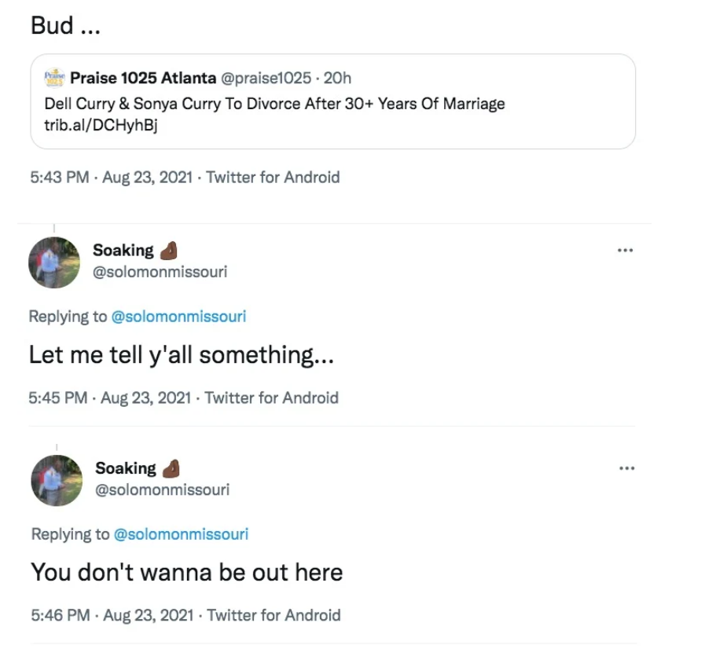
Dell Curry’s experience

Slide 37
Dell Curry’s experience

Slide 38
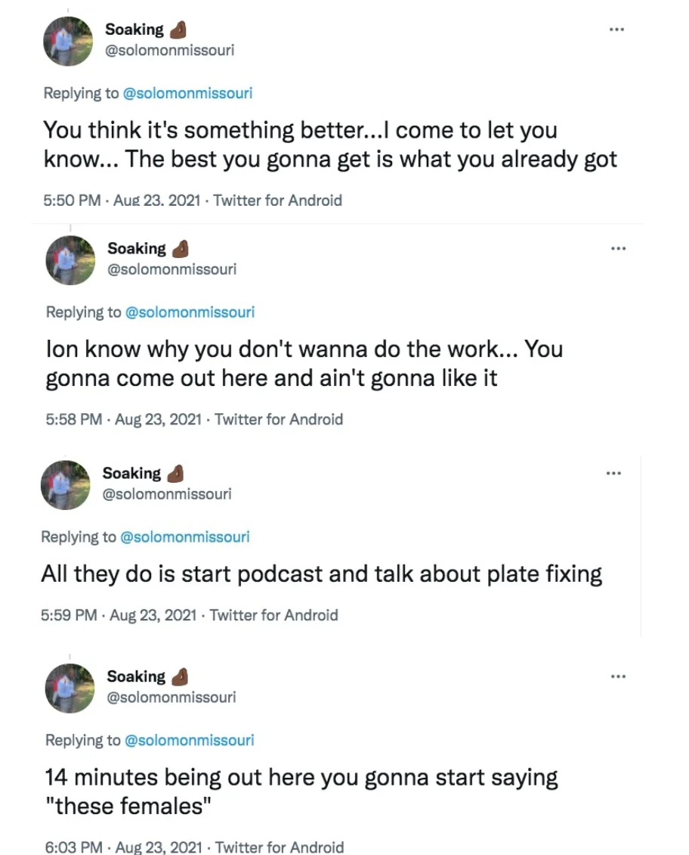
Dell Curry’s experience

Slide 39
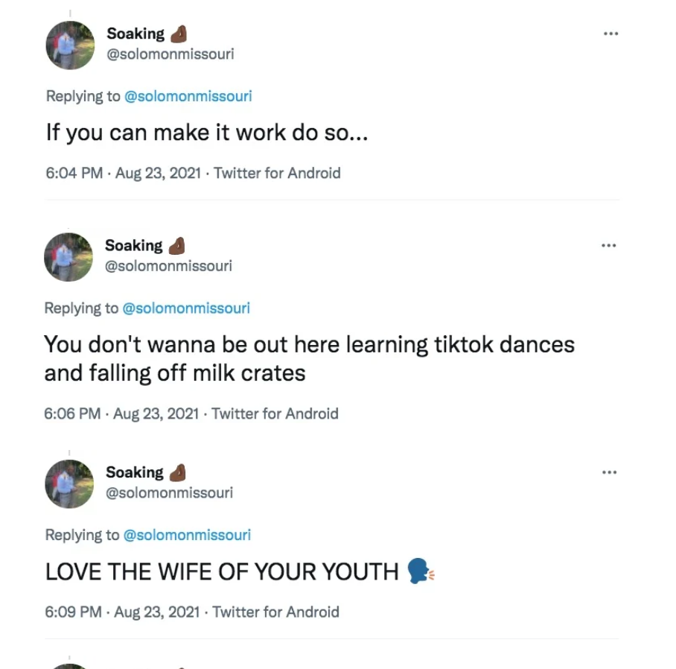
Dell Curry’s experience

Slide 40
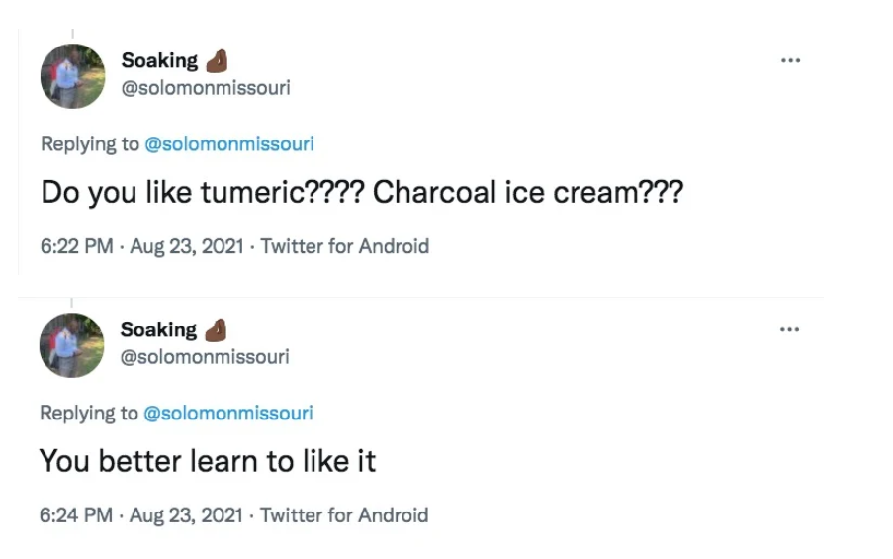
Dell Curry’s experience

Slide 41
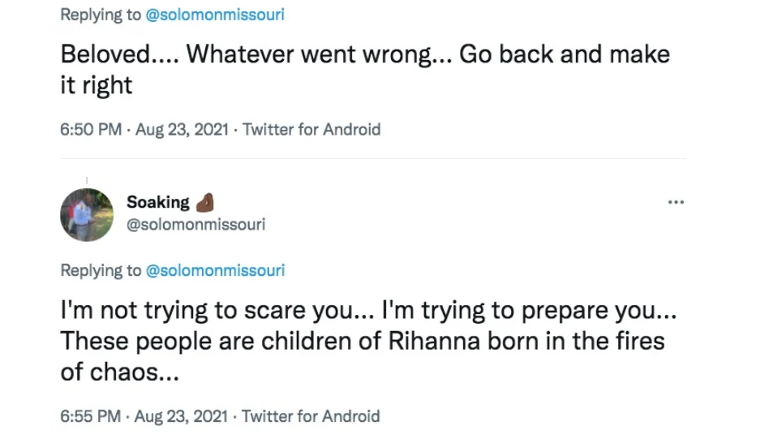
Dell Curry’s experience

Slide 42
Dell Curry’s experience

Slide 43
Dell Curry’s experience

Slide 44
The stuff we don’t want to miss
What does this tell us about humans
On the other hand, when there are real dangers, from which we MUST protect ourselves and our children.
Ephesians 5:11 (NASB95) — 11 Do not participate in the unfruitful deeds of darkness, but instead even expose them;

Slide 45
The stuff we don’t want to miss
What does this tell us about humans
On the other hand, when there are real dangers, from which we MUST protect ourselves and our children.
Proverbs 24:10–11 (NASB95) — 10 If you are slack in the day of distress, Your strength is limited. 11 Deliver those who are being taken away to death, And those who are staggering to slaughter, Oh hold them back.

Slide 46
The stuff we don’t want to miss
What does this tell us about humans
Our culture is too quick to divorce
Physically/Sexually abused spouses and children are often too slow
Legal Separation is tough medicine but is needed in some cases

Slide 47
The stuff we don’t want to miss
What does this tell us about God?
He cares about every aspect of our lives
He knows the number of hairs on your head (Luke 12)

Slide 48
The stuff we don’t want to miss
What does this tell us about God?
He is the inventor of marriage, sex, and justice

Slide 49
The stuff we don’t want to miss
What does this tell us about God?
He wants good things for us
Matthew 7:11 (NASB95) — 11 “If you then, being evil, know how to give good gifts to your children, how much more will your Father who is in heaven give what is good to those who ask Him!

Slide 50
The stuff we don’t want to miss
What does this tell us about God?
God cares about women’s rights

Slide 51
The stuff we don’t want to miss
What does this tell us about God?
God cares about women’s rights
1 Peter 3:7 (NASB95) — 7 You husbands in the same way, live with your wives in an understanding way, as with someone weaker, since she is a woman; and show her honor as a fellow heir of the grace of life, so that your prayers will not be hindered.

Slide 52
The stuff we don’t want to miss
What does this tell us about God?
God cares about women’s rights
1 Peter 3:7 (NASB95) — 7 You husbands in the same way, live with your wives in an understanding way, as with someone weaker, since she is a woman; and show her honor as a fellow heir of the grace of life, so that your prayers will not be hindered.

Slide 53
The Best Guide
The rule of love
1 Corinthians 13:4–7 (NASB95) — 4 Love is patient, love is kind and is not jealous; love does not brag and is not arrogant, 5 does not act unbecomingly; it does not seek its own, is not provoked, does not take into account a wrong suffered, 6 does not rejoice in unrighteousness, but rejoices with the truth; 7 bears all things, believes all things, hopes all things, endures all things.

Slide 54
The Best Guide
The rule of love
Get support
Proverbs 11:14 (NASB95) — 14 Where there is no guidance the people fall, But in abundance of counselors there is victory.

Slide 55
The Best Guide
The rule of love
Get support
Get right with God
Philippians 4:13 (NASB95) — 13 I can do all things through Him who strengthens me.

Slide 56
The Best Guide
The rule of love
Get support
Get right with God
The easy way is almost never the best way
Proverbs 14:12 (NASB95) — 12 There is a way which seems right to a man, But its end is the way of death.

Slide 57
Next Time
Matthew 21 “The Triumphal Entry”

