Slide 1
2 Corinthians 1
God’s Comfort

Slide 2
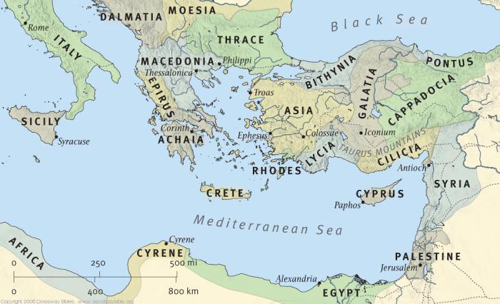
Background
Acts 18: Paul plants the church in Corinth

Slide 3
Background
Acts 18: Paul plants the church in Corinth
He stays for about 1.5-2 years and then heads home
Acts 18:11,18-19 – So Paul stayed in Corinth for a year and a half, teaching them the word of God…Paul stayed on in Corinth for some time. Then he left the brothers and sisters and sailed for Syria

Slide 4
Background
Acts 19: Paul starts his 3rd missionary journey by heading up to Ephesus

Slide 5
Background
Acts 19: Paul starts his 3rd missionary journey by heading up to Ephesus
A huge revival breaks out, delaying Paul’s return to Corinth
But…maybe that’s from the Lord
As far as we can tell, things were not going well in Corinth

Slide 6
Background
The Corinthian Church:
Great initial response to the message of Christ
But people’s lives don’t change as fast as their hearts do

Slide 7
Background
The Corinthian Church:
Great initial response to the message of Christ
But people’s lives don’t change as fast as their hearts do
Their issues:
-Guy hooking up with stepmom
-Other immorality
-People suing each other
-Out of control meetings
-Rampant selfishness

Slide 8
Background
Paul in Ephesus:
Gets a report from Corinth via Chloe’s people (1 Cor 1)
Answers the Corinthians’ questions but also addresses the concerning reports by writing 1 Corinthians
The Corinthians get really upset

Slide 9
Background
Paul in Ephesus:
Gets a report from Corinth via Chloe’s people (1 Cor 1)
Answers the Corinthians’ questions but also addresses the concerning reports by writing 1 Corinthians
The Corinthians get really upset
2 Important Questions:
Will they correct course?
Will they reconcile with Paul?

Slide 10
Background
Finally…Acts 19:21 – Paul decided to go to Jerusalem, passing through Macedonia and Achaia.
- Meets up with Titus in Macedonia
2 Cor 7:5,7 – when we came into Macedonia…Titus…told us about your longing for me, your deep sorrow, your ardent concern for me, so that my joy was greater than ever.

Slide 11
Background
2 Corinthians:
A letter written to people who now agree with Paul but still have suspicions towards him
If you win the argument but lose the person, you still lose
Paul takes the time to try to quiet their suspicions – he finds a way to back off without ever backing down from the truth

Slide 12
2 Corinthians 1
1 Paul, an apostle of Christ Jesus by the will of God, and Timothy our brother,
To the church of God in Corinth, together with all his holy people throughout Achaia:

Slide 13
2 Corinthians 1
1 Paul, an apostle of Christ Jesus by the will of God, and Timothy our brother,
To the church of God in Corinth, together with all his holy people throughout Achaia:

Slide 14
2 Corinthians 1
1 Paul, an apostle of Christ Jesus by the will of God, and Timothy our brother,
To the church of God in Corinth, together with all his holy people throughout Achaia:

Slide 15
2 Corinthians 1
1 Paul, an apostle of Christ Jesus by the will of God, and Timothy our brother,
To the church of God in Corinth, together with all his holy people throughout Achaia:

Slide 16
2 Corinthians 1
1 Paul, an apostle of Christ Jesus by the will of God, and Timothy our brother,
To the church of God in Corinth, together with all his holy people throughout Achaia:
Lit: “Saints”

Slide 17
2 Corinthians 1
2 Grace and peace to you from God our Father and the Lord Jesus Christ.
Grace = gift
Peace = reconciliation

Slide 18
2 Corinthians 1
3 Praise be to the God and Father of our Lord Jesus Christ, the Father of compassion and the God of all comfort,
4 who comforts us in all our troubles,

Slide 19
2 Corinthians 1
3 Praise be to the God and Father of our Lord Jesus Christ, the Father of compassion and the God of all comfort,
4 who comforts us in all our troubles,
protection
keeps us from all suffering

Slide 20
2 Corinthians 1
3 Praise be to the God and Father of our Lord Jesus Christ, the Father of compassion and the God of all comfort,
4 who comforts us in all our troubles,
protection
keeps us from all suffering
Our world is allergic to suffering
I am bad at suffering

Slide 21
2 Corinthians 1
3 Praise be to the God and Father of our Lord Jesus Christ, the Father of compassion and the God of all comfort,
4 who comforts us in all our troubles,

Slide 22
2 Corinthians 1
This passage can re-orient our perspective on suffering by teaching us:
We are going to suffer
Some suffering increases if we follow God:
-Persecution
-Anger/resentment
-Rejection
-Sacrifice (e.g. loss of sleep)
-Failure
-Oppression from Satan
-Overwhelming confusion

Slide 23
2 Corinthians 1
This passage can re-orient our perspective on suffering by teaching us:
We are going to suffer
Some suffering increases if we follow God
You can avoid some suffering, but not all (until the new heavens and new earth)

Slide 24
2 Corinthians 1
This passage can re-orient our perspective on suffering by teaching us:
We are going to suffer
Some suffering increases if we follow God
You can avoid some suffering, but not all (until the new heavens and new earth)
It does help to be prepared
1 Peter 4:1 – Therefore, since Christ has suffered in the flesh, arm yourselves also with the same purpose

Slide 25
2 Corinthians 1
This passage can re-orient our perspective on suffering by teaching us:
We are going to suffer
Some suffering increases if we follow God
You can avoid some suffering, but not all (until the new heavens and new earth)
It does help to be prepared
1 Peter 4:12 – Beloved, do not be surprised at the fiery ordeal among you…as though some strange thing were happening to you

Slide 26
2 Corinthians 1
This passage can re-orient our perspective on suffering by teaching us:
God comforts us in our suffering
Ps 23:4 – Even though I walk through the darkest valley, I will fear no evil,
For you are with me.

Slide 27
2 Corinthians 1
3 Praise be to the God and Father of our Lord Jesus Christ, the Father of compassion and the God of all comfort,
4 who comforts us in all our troubles,
This is not Buddhism

Slide 28
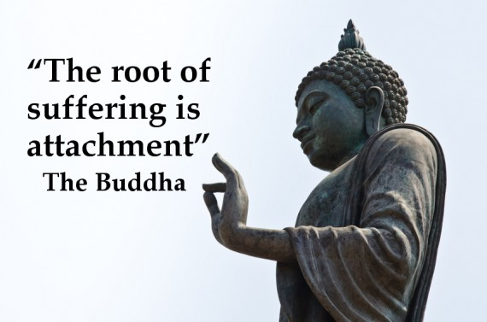
2 Corinthians 1
3 Praise be to the God and Father of our Lord Jesus Christ, the Father of compassion and the God of all comfort,
4 who comforts us in all our troubles,
This is not Buddhism

Slide 29
2 Corinthians 1
3 Praise be to the God and Father of our Lord Jesus Christ, the Father of compassion and the God of all comfort,
4 who comforts us in all our troubles,
Comfort = parakaleo – “To come alongside; to urge, implore, exhort”
This is available thru the Holy Spirit

Slide 30
2 Corinthians 1
3 Praise be to the God and Father of our Lord Jesus Christ, the Father of compassion and the God of all comfort,
4 who comforts us in all our troubles,
How?
Eternal perspective (camping)
Joy in relationships
His word

Slide 31
Isaiah 43:1-3
But now, this is what the Lord says—
he who created you, Jacob, he who formed you, Israel:
“Do not fear, for I have redeemed you;
I have summoned you by name; you are mine.

Slide 32
Isaiah 43:1-3
2 When you pass thru the water, I will be with you;
and when you pass through the rivers,
they will not sweep over you.
When you walk through the fire,
you will not be burned;
the flames will not set you ablaze.
³ For I am Yahweh your God

Slide 33
2 Corinthians 1
3 Praise be to the God and Father of our Lord Jesus Christ, the Father of compassion and the God of all comfort,
4 who comforts us in all our troubles,
What if the suffering is my fault?
1 Peter 3:17 – For it is better, if God should will is so, that you suffer for doing what is right rather than for doing what is wrong.

Slide 34
2 Corinthians 1
3 Praise be to the God and Father of our Lord Jesus Christ, the Father of compassion and the God of all comfort,
4 who comforts us in all our troubles,
But the most counterintuitive truth is next:

Slide 35
2 Corinthians 1
so that we can comfort those in any trouble with the comfort we ourselves receive from God.
5 For just as we share abundantly in the sufferings of Christ, so also our comfort abounds through Christ.

Slide 36
2 Corinthians 1
6 If we are distressed, it is for your comfort and salvation; if we are comforted, it is for your comfort, which produces in you patient endurance of the same sufferings we suffer.
7 And our hope for you is firm, because we know that just as you share in our sufferings, so also you share in our comfort.

Slide 37
YOUR SUFFERING IS NOT JUST ABOUT YOU!

Slide 38
2 Corinthians 1
God doesn’t comfort us to make us comfortable,
but to make us comforters
There might be something you are going through right now that will benefit someone else
Someone who has never really suffered:

Slide 39
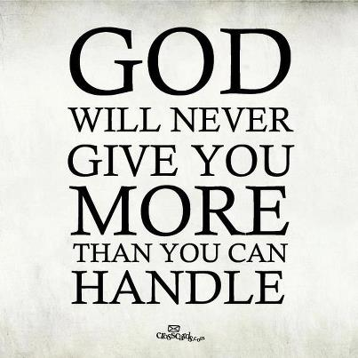

Slide 40
2 Corinthians 1
God doesn’t comfort us to make us comfortable,
but to make us comforters
There might be something you are going through right now that will benefit someone else
My sufferings:
Marriage timing
Losing a friend

Slide 41
2 Corinthians 1
God doesn’t comfort us to make us comfortable,
but to make us comforters
This can keep us from giving up or pulling the rip cord
Hang in there!

Slide 42
2 Corinthians 1
8 We do not want you to be uninformed, brothers and sisters, about the troubles we experienced in the province of Asia.
We were under great pressure, far beyond our ability to endure, so that we despaired of life itself.

Slide 43
2 Corinthians 1
9 Indeed, we felt we had received the sentence of death. But this happened that we might not rely on ourselves but on God, who raises the dead.
10 He has delivered us from such a deadly peril, and he will deliver us again. On him we have set our hope that he will continue to deliver us,

Slide 44
2 Corinthians 1
Suffering transforms our self-reliance to reliance on God
We can feel like we’re doing pretty well until –
BOOM – we run into some suffering
V8 – we despaired of life itself
John 15:5 – Jesus says, “Apart from me you can do nothing.”

Slide 45
2 Corinthians 1
Suffering transforms our self-reliance to reliance on God
We can feel like we’re doing pretty well until –
BOOM – we run into some suffering
Suffering brings us face to face with our need for God in a way that nothing else will
Our need for God includes our need for other people (another thing I’m allergic to)

Slide 46
2 Corinthians 1
8 …we despaired of life itself….
9 that we might not rely on ourselves but on God
10… On him we have set our hope
Don’t just stop at despair
Key check: Complaining or Gratitude?
Eph 5:20 - always giving thanks to God the Father for everything, in the name of our Lord Jesus Christ.

Slide 47
2 Corinthians 1
8 …we despaired of life itself….
9 that we might not rely on ourselves but on God
10… On him we have set our hope
Don’t just stop at despair
Key check: Complaining or Gratitude?
Keep looking forward

Slide 48
2 Corinthians 1
11 as you help us by your prayers. Then many will give thanks on our behalf for the gracious favor granted us in answer to the prayers of many.
Paul isn’t a masochist – he is grateful when God delivers him

Slide 49
Summary
Paul is not the worldly leader who has it all together – he shares openly with the Corinthians, and he gently comforts them
My Suffering:
Is God’s provision for others
Is God’s provision for me:
So I can rely more on him
So I can rely more on others

Slide 50
Conclusion
The areas where I have suffered the most are the areas where God has used me the most.
And the same can be true for you

Slide 51
2 Corinthians 1
Next time: 2 Corinthians 1-2 – Paul’s Plans

