Slide 1
Philippians
Standing Firm Together

Slide 2
27. Only conduct yourselves in a manner worthy of the gospel of Christ so that—whether I come and see you or whether I remain absent—I should hear that you are standing firm in one spirit, with one mind, by contending side by side for the faith of the gospel,
Philippians

Slide 3
27. Only conduct yourselves in a manner worthy of the gospel of Christ so that—whether I come and see you or whether I remain absent—I should hear that you are standing firm in one spirit, with one mind, by contending side by side for the faith of the gospel,
politeuomai (πολιτεύομαι): to be a citizen; to live out one’s citizenship
Honeymoon
(Phil. 3:20) But our citizenship is in heaven—and we also await a savior from there, the Lord Jesus Christ
Philippians

Slide 4
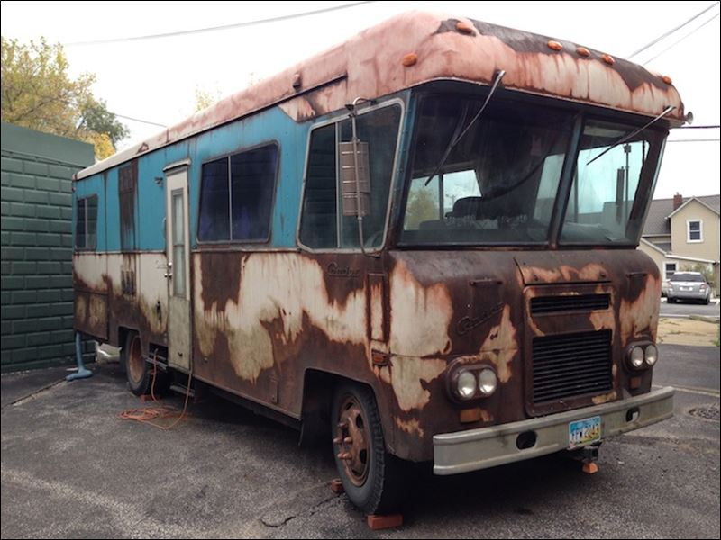
27. Only conduct yourselves in a manner worthy of the gospel of Christ so that—whether I come and see you or whether I remain absent—I should hear that you are standing firm in one spirit, with one mind, by contending side by side for the faith of the gospel,
House for RV
Zoom for In-Person
Philippians

Slide 5
27. Only conduct yourselves in a manner worthy of the gospel of Christ so that—whether I come and see you or whether I remain absent—I should hear that you are standing firm in one spirit, with one mind, by contending side by side for the faith of the gospel,
Philippians

Slide 6
27. Only conduct yourselves in a manner worthy of the gospel of Christ so that—whether I come and see you or whether I remain absent—I should hear that you are standing firm in one spirit, with one mind, by contending side by side for the faith of the gospel,
Teacher left the room
Philippians

Slide 7
27. Only conduct yourselves in a manner worthy of the gospel of Christ so that—whether I come and see you or whether I remain absent—I should hear that you are standing firm in one spirit, with one mind, by contending side by side for the faith of the gospel,
Philippians

Slide 8
27. Only conduct yourselves in a manner worthy of the gospel of Christ so that—whether I come and see you or whether I remain absent—I should hear that you are standing firm in one spirit, with one mind, by contending side by side for the faith of the gospel,
Philippians

Slide 9
27. Only conduct yourselves in a manner worthy of the gospel of Christ so that—whether I come and see you or whether I remain absent—I should hear that you are standing firm in one spirit, with one mind, by contending side by side for the faith of the gospel,
Philippians

Slide 10
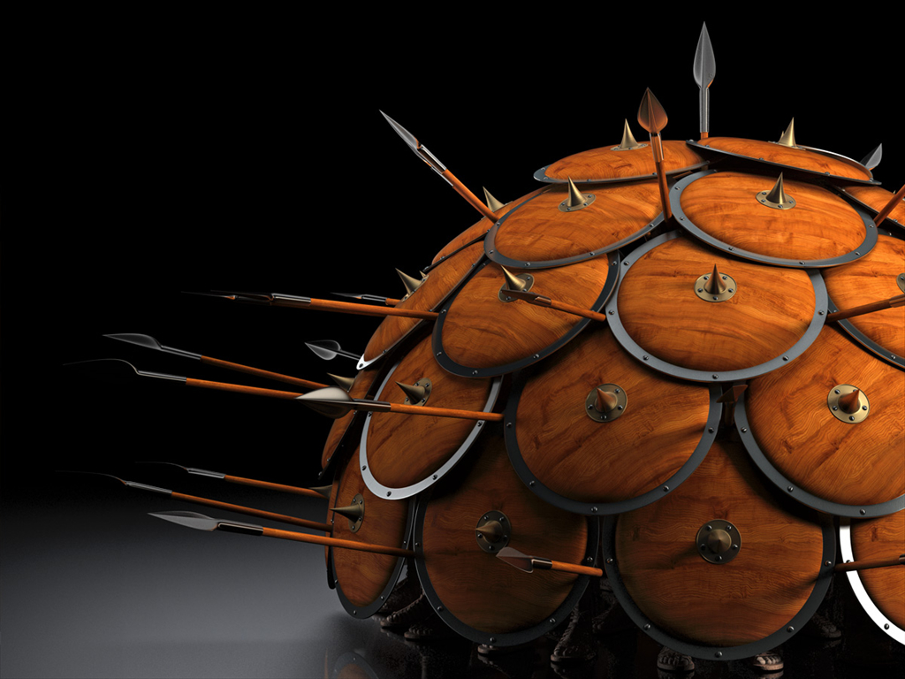
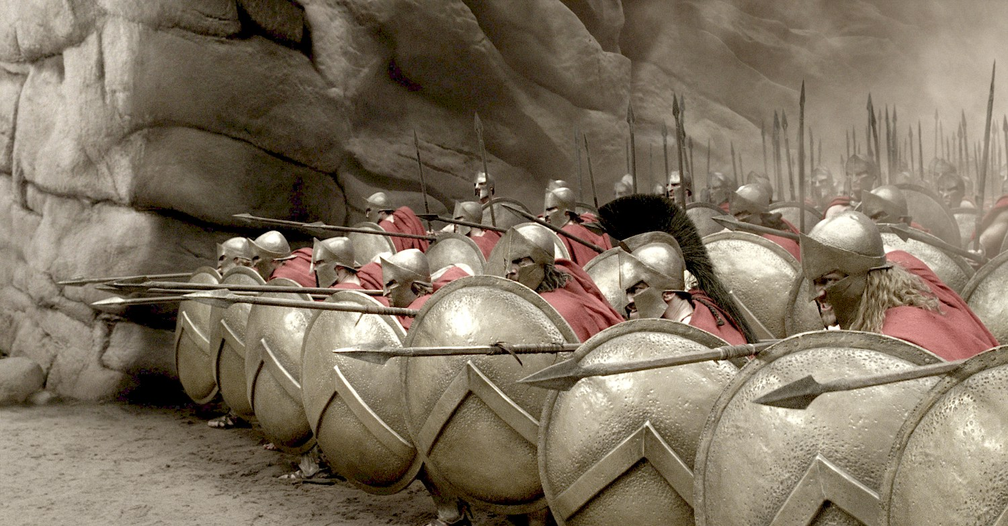
27. Only conduct yourselves in a manner worthy of the gospel of Christ so that—whether I come and see you or whether I remain absent—I should hear that you are standing firm in one spirit, with one mind, by contending side by side for the faith of the gospel,
Philippians

Slide 11
27. Only conduct yourselves in a manner worthy of the gospel of Christ so that—whether I come and see you or whether I remain absent—I should hear that you are standing firm in one spirit, with one mind, by contending side by side for the faith of the gospel,
Paul is explaining an offensive strategy here.
Philippians

Slide 12
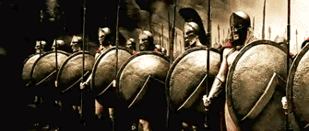
27. Only conduct yourselves in a manner worthy of the gospel of Christ so that—whether I come and see you or whether I remain absent—I should hear that you are standing firm in one spirit, with one mind, by contending side by side for the faith of the gospel,
Paul is explaining an offensive strategy here.
Philippians

Slide 13
27. Only conduct yourselves in a manner worthy of the gospel of Christ so that—whether I come and see you or whether I remain absent—I should hear that you are standing firm in one spirit, with one mind, by contending side by side for the faith of the gospel,
The Good News about Jesus should strengthen, unify and empower the church to move forward!
Philippians

Slide 14
Often times trouble in the Christian life comes not because we are doing something wrong, but because we aren’t doing anything.
27. Only conduct yourselves in a manner worthy of the gospel of Christ so that—whether I come and see you or whether I remain absent—I should hear that you are standing firm in one spirit, with one mind, by contending side by side for the faith of the gospel,
(Romans 1:16-17) For I am not ashamed of this Good News about Christ. It is the power of God at work, saving everyone who believes—the Jew first and also the Gentile. This Good News tells us how God makes us right in his sight. This is accomplished from start to finish by faith.
The Good News about Jesus should strengthen, unify and empower the church to move forward!
cars, knees & sports
Philippians

Slide 15
28. and by not being intimidated in any way by your opponents. This is a sign of their destruction, but of your salvation—a sign which is from God.
Philippians

Slide 16
28. and by not being intimidated in any way by your opponents. This is a sign of their destruction, but of your salvation—a sign which is from God.
alarmed, frightened, scared, panicked
(Matt. 5:11) “Blessed are you when people insult you and persecute you and say all kinds of evil things about you falsely on account of me.
Philippians

Slide 17
28. and by not being intimidated in any way by your opponents. This is a sign of their destruction, but of your salvation—a sign which is from God.
alarmed, frightened, scared, panicked
(2 Tim. 3:12) Now in fact all who want to live godly lives in Christ Jesus will be persecuted.
Philippians

Slide 18
29-30. For it has been granted to you not only to believe in Christ but also to suffer for him, since you are encountering the same conflict that you saw me face and now hear that I am facing.
Philippians

Slide 19
29-30. For it has been granted to you not only to believe in Christ but also to suffer for him, since you are encountering the same conflict that you saw me face and now hear that I am facing.
(Eph. 2:8) For by grace you are saved through faith, and this is not from yourselves, it is the gift of God
Philippians

Slide 20
29-30. For it has been granted to you not only to believe in Christ but also to suffer for him, since you are encountering the same conflict that you saw me face and now hear that I am facing.
Suffering in this way then is not a sign that God has rejected you, rather it is a sign that God is with you!
Satan’s role
Philippians

Slide 21
2:1. Therefore, if there is any encouragement in Christ, any comfort provided by love, any fellowship in the Spirit, any affection or mercy,
Philippians

Slide 22
2:1. Therefore, if there is any encouragement in Christ, any comfort provided by love, any fellowship in the Spirit, any affection or mercy,
1st class conditional:
SINCE
Philippians

Slide 23
2:1. Therefore, if there is any encouragement in Christ, any comfort provided by love, any fellowship in the Spirit, any affection or mercy,
Philippians

Slide 24
2:1. Therefore, if there is any encouragement in Christ, any comfort provided by love, any fellowship in the Spirit, any affection or mercy,
Philippians

Slide 25
2:1. Therefore, if there is any encouragement in Christ, any comfort provided by love, any fellowship in the Spirit, any affection or mercy,
Philippians

Slide 26
2:1. Therefore, if there is any encouragement in Christ, any comfort provided by love, any fellowship in the Spirit, any affection or mercy,
Philippians

Slide 27
2:1. Therefore, if there is any encouragement in Christ, any comfort provided by love, any fellowship in the Spirit, any affection or mercy,
Marriage
Bag of marbles vs magnets
Each of these has already been given to us by Jesus first and as a result we can give out to others.
Philippians

Slide 28
2. complete my joy and be of the same mind, by having the same love, being united in spirit, and having one purpose.
Philippians

Slide 29
2. complete my joy and be of the same mind, by having the same love, being united in spirit, and having one purpose.
Philippians

Slide 30
2. complete my joy and be of the same mind, by having the same love, being united in spirit, and having one purpose.
Philippians

Slide 31
2. complete my joy and be of the same mind, by having the same love, being united in spirit, and having one purpose.
Philippians

Slide 32
2. complete my joy and be of the same mind, by having the same love, being united in spirit, and having one purpose.
Tuning Fork
Unity is NOT the same as uniformity!
Philippians

Slide 33
3. Instead of being motivated by selfish ambition or vanity, each of you should, in humility, be moved to treat one another as more important than yourself.
Philippians

Slide 34
3. Instead of being motivated by selfish ambition or vanity, each of you should, in humility, be moved to treat one another as more important than yourself.
Philippians

Slide 35
3. Instead of being motivated by selfish ambition or vanity, each of you should, in humility, be moved to treat one another as more important than yourself.
kenodoxia (κενοδοξία): empty splendor; exaggerated self-evaluation; delusion
Philippians

Slide 36
3. Instead of being motivated by selfish ambition or vanity, each of you should, in humility, be moved to treat one another as more important than yourself.
(Rom. 12:3) I give each of you this warning: Don’t think you are better than you really are. Be honest in your evaluation of yourselves, measuring yourselves by the faith God has given us.
kenodoxia (κενοδοξία): empty splendor; exaggerated self-evaluation; delusion
Philippians

Slide 37
3. Instead of being motivated by selfish ambition or vanity, each of you should, in humility, be moved to treat one another as more important than yourself.
The key to humility is to never stray too far from the cross.
Philippians

Slide 38
3. Instead of being motivated by selfish ambition or vanity, each of you should, in humility, be moved to treat one another as more important than yourself.
Notice that Paul does NOT say, ‘treat others as better than yourself.’
This is not a statement of value, but of interest.
Philippians

Slide 39
4. Each of you should be concerned not only about your own interests, but about the interests of others as well.
The danger of pride is that it feeds on goodness!
Philippians

Slide 40
NOT: total self-denial, self-abuse, self-centeredness or self-improvement
4. Each of you should be concerned not only about your own interests, but about the interests of others as well.
If our focus in life is only on self, we will end up empty, isolated and lonely.
Philippians

Slide 41
NOT: total self-denial, self-abuse, self-centeredness or self-improvement
4. Each of you should be concerned not only about your own interests, but about the interests of others as well.
(1 Pt. 4:10) God has given each of you a gift from his great variety of spiritual gifts. Use them well to serve one another.
If our focus in life is only on self, we will end up empty, isolated and lonely.
Philippians

Slide 42
Interested in learning more?
Pick up a FREE copy of “Discovering God”
First time joining us?

Slide 43
Philippians
Thoughts?
Questions?

