Slide 2
Mark 6:30-44
The Biggest Miracle of Jesus’s Life

Slide 3
Mark 6
About two years into Jesus’s public ministry
Jesus had sent out his disciples in teams of two in order to try to do some ministry
Mk 6:30 – The apostles returned to Jesus from their ministry tour and told him all they had done and taught.

Slide 4
Mark 6
About two years into Jesus’s public ministry
Jesus had sent out his disciples in teams of two in order to try to do some ministry
After months apart they finally get back together to talk about how it went
Jesus has just heard some devastating news about John the Baptist (Matt 14:12-13; Mk 6:14-29)

Slide 5
Mark 6
31 Then Jesus said, “Let’s go off by ourselves to a quiet place and rest awhile.”
He said this because there were so many people coming and going that Jesus and his apostles didn’t even have time to eat.
32 So they left by boat for a quiet place, where they could be alone.

Slide 6
Mark 6
33 But many people recognized them and saw them leaving,
and people from many towns ran ahead along the shore and got there ahead of them.

Slide 7
Mark 6
34 Jesus saw the huge crowd as he stepped from the boat,
and he had compassion on them because they were like sheep without a shepherd. [cf. Matt 9:36]
So he began teaching them many things.

Slide 8
Mark 6
35 By this time it was late in the day, so his disciples came to him.
“This is a remote place,” they said, “and it’s already very late.
36 Send the people away so that they can go to the surrounding countryside and villages and buy themselves something to eat.”

Slide 9
Mark 6
37 But he answered, “You give them something to eat.” (cf. John 6:5-6)

Slide 10
Mark 6
37 But he answered, “You give them something to eat.” (cf. John 6:5-6)
Turning to Philip, he asked, “Where can we buy bread to feed all these people?”
He was testing Philip, for he already knew what he was going to do. (John 6:5-6)

Slide 11
Mark 6
37 But he answered, “You give them something to eat.” (cf. John 6:5-6)
They said to him, “That would take more than half a year’s wages! [“200 denarii” = $20,000]
Are we to go and spend that much on bread and give it to them to eat?”

Slide 12
Mark 6
37 But he answered, “You give them something to eat.” (cf. John 6:5-6)
They said to him, “That would take more than half a year’s wages! [“200 denarii” = $20,000]
Are we to go and spend that much on bread and give it to them to eat?”
Philip’s response:
Angrily explains why this can’t be done
He’s right… if you ignore the power of God
Jesus is trying to teach them something…

Slide 13
Mark 6
38 “How many loaves do you have?” he asked. “Go and see.” (cf. John 6:8-9)

Slide 14
Mark 6
38 “How many loaves do you have?” he asked. “Go and see.” (cf. John 6:8-9)
Andrew, Simon Peter’s brother, spoke up.
“There’s a young boy here with five barley loaves and two fish.
But what good is that with this huge crowd?” (John 6:8-9)

Slide 15
Mark 6
38 “How many loaves do you have?” he asked. “Go and see.” (cf. John 6:8-9)
Andrew, Simon Peter’s brother, spoke up.
“There’s a young boy here with five barley loaves and two fish.
But what good is that with this huge crowd?” (John 6:8-9)
Andrew’s response seems foolish at first
But maybe there’s something to it
1. Bring Jesus what you have

Slide 16
Watchman Nee
Chinese Author and Pastor
Quoted in Kinnear, Against the Tide, 253-254
The point was not the quantity of material in hand but the blessing that rested upon it.

Slide 17
Watchman Nee
Chinese Author and Pastor
Quoted in Kinnear, Against the Tide, 253-254
This lesson is not easily learned.
The hopes of so many are still centered, not on the blessing of the Lord but on the few loaves in their hands.

Slide 18
Watchman Nee
Chinese Author and Pastor
Quoted in Kinnear, Against the Tide, 253-254
It is so pitifully little we have in hand, and yet we keep calculating with it;
and the more we calculate the harder the work becomes.

Slide 19
Mark 6
39 Then Jesus told the disciples to have the people sit down in groups on the green grass.
40 So they sat down in groups of fifty or a hundred.

Slide 20
Mark 6
41 Jesus took the five loaves and two fish, looked up toward heaven, and blessed them.
Then, breaking the loaves into pieces, he kept giving the bread to the disciples so they could distribute it to the people.
He also divided the fish for everyone to share.
How did he do that?

Slide 21
Mark 6
41 Jesus took the five loaves and two fish, looked up toward heaven, and blessed them.
Then, breaking the loaves into pieces, he kept giving the bread to the disciples so they could distribute it to the people.
He also divided the fish for everyone to share.
How did he do that?

Slide 22
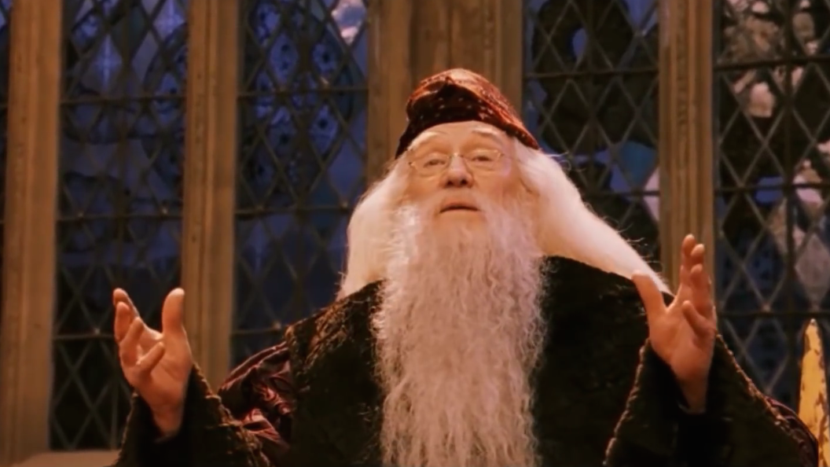

Slide 23
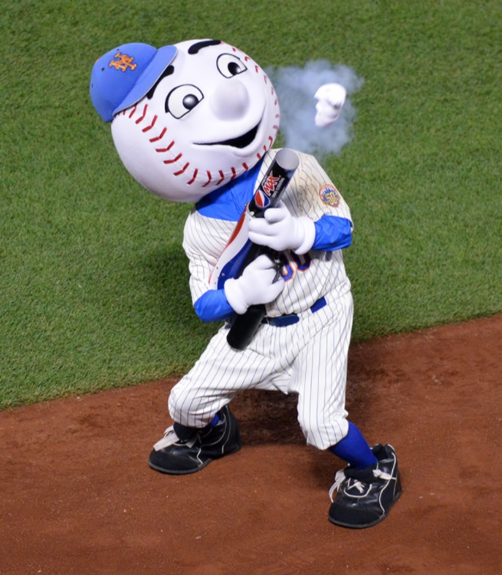

Slide 24
Mark 6
41 Jesus took the five loaves and two fish, looked up toward heaven, and blessed them.
Then, breaking the loaves into pieces, he kept giving the bread to the disciples so they could distribute it to the people.
He also divided the fish for everyone to share.
2. Keep coming back for more bread

Slide 25
Mark 6
41 Jesus took the five loaves and two fish, looked up toward heaven, and blessed them.
Then, breaking the loaves into pieces, he kept giving the bread to the disciples so they could distribute it to the people.
He also divided the fish for everyone to share.
We tend to think there’s something inherently awesome about the people God uses
But consider the people Jesus used here:
Exhausted and fresh off of some bad news
Young, with nothing to give
Didn’t want to serve and angrily refused when asked
Just failed their ministry final exam
AND: Willing to keep coming back to Jesus for more food for the crowds
2. Keep coming back for more bread

Slide 26
Mark 6
42 They all ate as much as they wanted,
43 and afterward, the disciples picked up twelve baskets of leftover bread and fish.
44 A total of 5,000 men and their families were fed.

Slide 27
Mark 6
42 They all ate as much as they wanted,
43 and afterward, the disciples picked up twelve baskets of leftover bread and fish.
44 A total of 5,000 men and their families were fed.
Why did Jesus make too much bread?
Where did they get 12 baskets?
3. Enjoy the leftovers

Slide 28
Mark 6
42 They all ate as much as they wanted,
43 and afterward, the disciples picked up twelve baskets of leftover bread and fish.
44 A total of 5,000 men and their families were fed.
This is how it goes with serving God:
At the beginning of the evening…
But by the end of the night…
3. Enjoy the leftovers

Slide 29
Final Thoughts
The biggest barrier is the feeling that “I can’t do this”
Andrew’s objection is correct
God already knows! (Jn 15:5; 2 Cor 3:5)
Those loaves and fish were nothing special on their own

Slide 30
Final Thoughts
Will you put yourself and your meager abilities in the hands of Jesus?
Tell God “Here I am”
Tell your fellow Christians you are interested
Ask God what step he wants you to take
Trust him to multiply the loaves and fish

Slide 31
Watchman Nee
Chinese Author and Pastor
Quoted in Kinnear, Against the Tide, 254-255
What is “blessing”? It is the working of God where there is nothing to account for His working…
When five loaves provide food for five thousand and leave twelve baskets of fragments, that is blessing.

Slide 32
Watchman Nee
Chinese Author and Pastor
Quoted in Kinnear, Against the Tide, 254-255
When the fruit of your service is out of all proportion to the gifts you possess, that is blessing.

Slide 33
Watchman Nee
Chinese Author and Pastor
Quoted in Kinnear, Against the Tide, 254-255
Or to be rather extreme, when, taking account of your failures, there should be no fruit at all from your labors
and still there is fruit, that is blessing…

Slide 34
Watchman Nee
Chinese Author and Pastor
Quoted in Kinnear, Against the Tide, 254-255
Blessing is fruit that is out of all correspondence with what we are.
It is not just the working of cause and effect,

Slide 35
Watchman Nee
Chinese Author and Pastor
Quoted in Kinnear, Against the Tide, 254-255
for when we calculate on the basis of what we put in
we merely bar the way for God to work beyond our calculations.

Slide 36
Watchman Nee
Chinese Author and Pastor
Quoted in Kinnear, Against the Tide, 254-255
If on the other hand we set our hearts upon the blessing of the Lord,
we shall find things happen that are altogether out of keeping with our capacity and that surpass even our dreams.

