Slide 1
Acts
The Church in Jerusalem
Waiting
teachings available at www.xenos.org/adultCT/

Slide 2
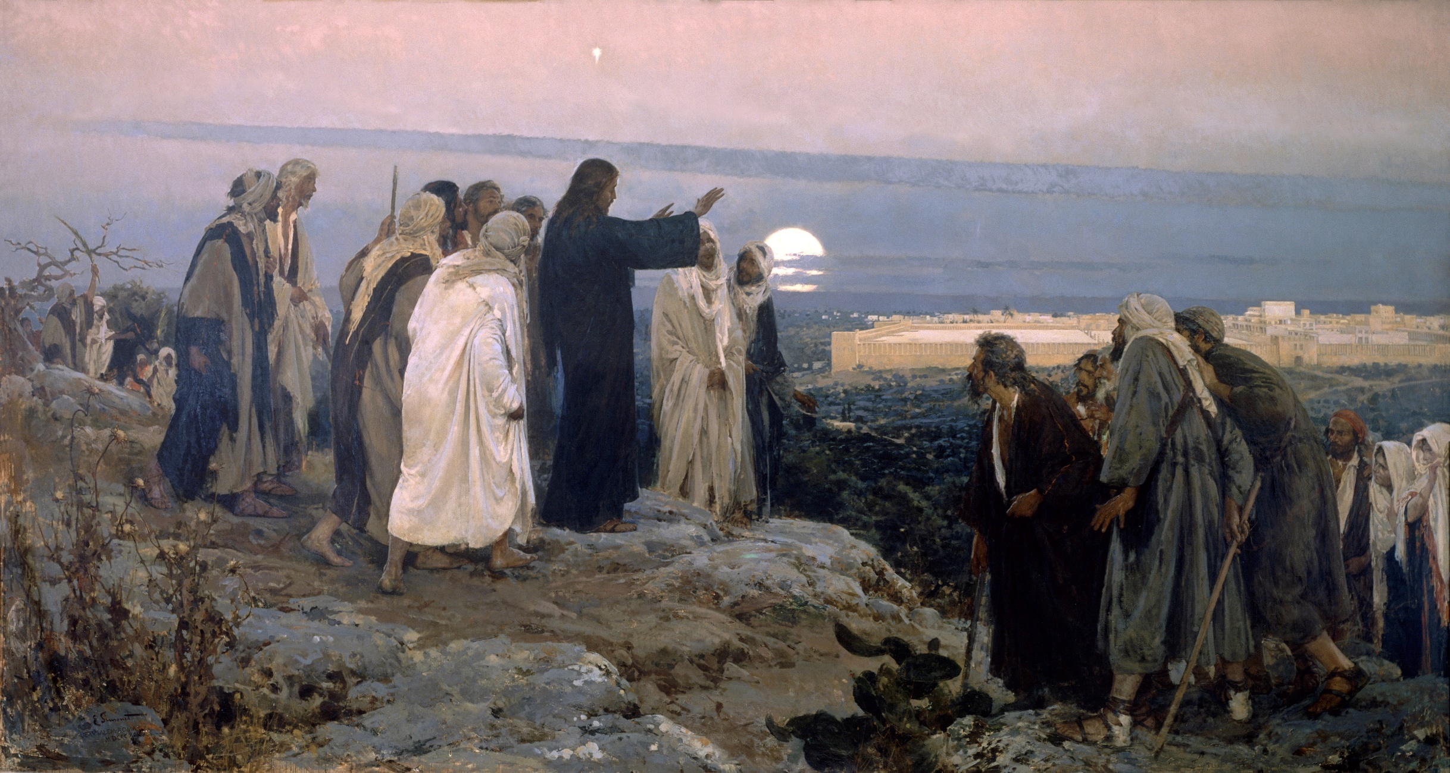
⁸ but you will receive power when the Holy Spirit has come upon you; and you shall be My witnesses both in Jerusalem, and in all Judea and Samaria, and even to the remotest part of the earth.”
^{Acts1:8} you will receive power when the Holy Spirit has come upon you; and you shall be My witnesses both in Jerusalem, and in all Judea and Samaria, and even to the remotest part of the earth.”
^{Acts1:8} you will receive power when the Holy Spirit has come upon you; and you shall be My witnesses both in Jerusalem, and in all Judea and Samaria, and even to the remotest part of the earth.”

Slide 3
^{Acts1:9} And after He had said these things, He was lifted up while they were looking on, and a cloud received Him out of their sight.
^{Acts1:9} And after He had said these things, He was lifted up while they were looking on, and a cloud received Him out of their sight.
^{Acts1:9} And after He had said these things, He was lifted up while they were looking on, and a cloud received Him out of their sight.

Slide 4
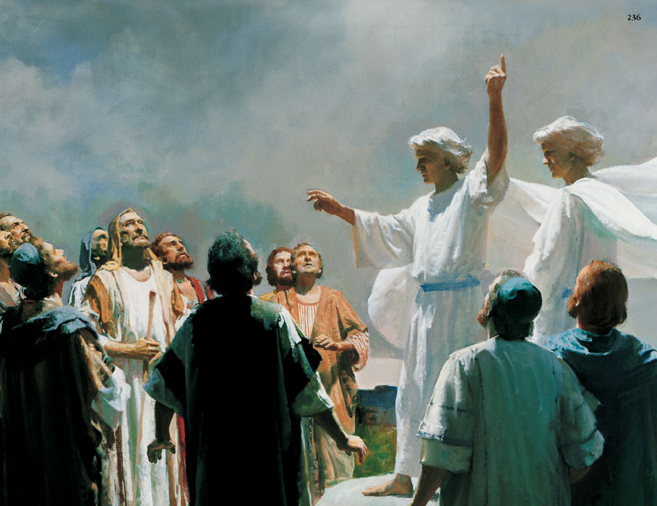
^{Acts1:10} And as they were gazing intently into the sky while He was going, behold, two men in white clothing stood beside them.¹¹ They also said, “Men of Galilee, why do you stand looking into the sky?
^{Acts1:10} And as they were gazing intently into the sky while He was going, behold, two men in white clothing stood beside them.¹¹ They also said, “Men of Galilee, why do you stand looking into the sky?
^{Acts1:10} And as they were gazing intently into the sky while He was going, behold, two men in white clothing stood beside them.¹¹ They also said, “Men of Galilee, why do you stand looking into the sky?

Slide 5
^{Acts1:10} And as they were gazing intently into the sky while He was going, behold, two men in white clothing stood beside them.¹¹ They also said, “Men of Galilee, why do you stand looking into the sky?
^{Acts1:10} And as they were gazing intently into the sky while He was going, behold, two men in white clothing stood beside them.¹¹ They also said, “Men of Galilee, why do you stand looking into the sky?
^{Acts1:10} And as they were gazing intently into the sky while He was going, behold, two men in white clothing stood beside them.¹¹ They also said, “Men of Galilee, why do you stand looking into the sky?

Slide 6
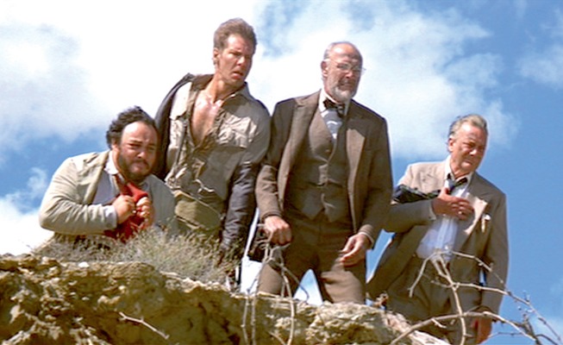
^{Acts1:10} And as they were gazing intently into the sky while He was going, behold, two men in white clothing stood beside them.¹¹ They also said, “Men of Galilee, why do you stand looking into the sky?
^{Acts1:10} And as they were gazing intently into the sky while He was going, behold, two men in white clothing stood beside them.¹¹ They also said, “Men of Galilee, why do you stand looking into the sky?
^{Acts1:10} And as they were gazing intently into the sky while He was going, behold, two men in white clothing stood beside them.¹¹ They also said, “Men of Galilee, why do you stand looking into the sky?

Slide 7
^{Acts1:10} And as they were gazing intently into the sky while He was going, behold, two men in white clothing stood beside them.¹¹ They also said, “Men of Galilee, why do you stand looking into the sky?
^{Acts1:10} And as they were gazing intently into the sky while He was going, behold, two men in white clothing stood beside them.¹¹ They also said, “Men of Galilee, why do you stand looking into the sky?

Slide 8
^{Acts1:11} And this Jesus, who has been taken up from you into heaven, will come in just the same way as you have watched Him go into heaven.”

Slide 9
Sets the mood for the book: expectation of the imminent return of Jesus Christ
^{Acts1:11} And this Jesus, who has been taken up from you into heaven, will come in just the same way as you have watched Him go into heaven.”

Slide 10
Sets the mood for the book: expectation of the imminent return of Jesus Christ
^{Acts1:12} Then they returned to Jerusalem from the mount called Olivet, which is near Jerusalem, a Sabbath day’s journey away.

Slide 11
^{Acts1:13} When they had entered the city, they went up to the upper room where they were staying;

Slide 12
They WAIT
Ready … Set … wait.
^{Acts1:13} When they had entered the city, they went up to the upper room where they were staying;

Slide 13
They WAIT
Ready … Set … wait.
^{Acts1:4} He commanded them not to leave Jerusalem, but to wait for what the Father had promised, “Which,” He said, “you heard of from Me; ⁵ for John baptized with water, but you will be baptized with the Holy Spirit not many days from now.”
^{Acts1:13} When they had entered the city, they went up to the upper room where they were staying;

Slide 14
^{Acts1:13} When they had entered the city, they went up to the upper room where they were staying;

Slide 15
So why are we waiting again?
^{Acts1:13} When they had entered the city, they went up to the upper room where they were staying;

Slide 16
So why are we waiting again?
Isn’t this a waste of time?
^{Acts1:13} When they had entered the city, they went up to the upper room where they were staying;

Slide 17
So why are we waiting again?
Isn’t this a waste of time?
So, we can’t do anything?
^{Acts1:13} When they had entered the city, they went up to the upper room where they were staying;

Slide 18
So why are we waiting again?
Isn’t this a waste of time?
So, we can’t do anything?
How long did he say?
^{Acts1:13} When they had entered the city, they went up to the upper room where they were staying;

Slide 19
So why are we waiting again?
Isn’t this a waste of time?
So, we can’t do anything?
How long did he say?
Nothing’s going to happen … is it?
^{Acts1:13} When they had entered the city, they went up to the upper room where they were staying;

Slide 20
So why are we waiting again?
Isn’t this a waste of time?
So, we can’t do anything?
How long did he say?
Nothing’s going to happen … is it?
Nobody likes waiting
^{Acts1:13} When they had entered the city, they went up to the upper room where they were staying;

Slide 21
And yet in this life, we have to wait a lot
Nobody likes waiting

Slide 22
And yet in this life, we have to wait a lot
Nobody likes waiting
If you set out to follow God, there will be
times when He asks you to wait.

Slide 23
And yet in this life, we have to wait a lot
“waiting is living through those moments when you do not understand what God is doing and you have no power to change your circumstances for the better”
- Paul Tripp, Broken Down House, 114
Nobody likes waiting
If you set out to follow God, there will be
times when He asks you to wait.

Slide 24
We wait on God to deliver on promises He has made in scripture
Waiting sucks.
If you set out to follow God, there will be
times when He asks you to wait.

Slide 25
We wait through times of confusion
We wait on God to deliver on promises He has made in scripture
Waiting sucks.
If you set out to follow God, there will be
times when He asks you to wait.

Slide 26
We wait through times of confusion
We wait on God to deliver on promises He has made in scripture
… for something to change
Waiting sucks.
If you set out to follow God, there will be
times when He asks you to wait.

Slide 27
We wait through times of confusion
We wait on God to deliver on promises He has made in scripture
… for something to change
… we wait on people
Waiting sucks.
If you set out to follow God, there will be
times when He asks you to wait.

Slide 28
God places a high value on waiting
“Waiting is not an interruption in the plan. It is His plan.”
- Paul Tripp, Broken Down House, 119
Waiting sucks.
If you set out to follow God, there will be
times when He asks you to wait.

Slide 29
Why does God have us wait?
Waiting sucks.
If you set out to follow God, there will be
times when He asks you to wait.

Slide 30
To align with His leading, power, and timing
Why does God have us wait?
Waiting sucks.
If you set out to follow God, there will be
times when He asks you to wait.

Slide 31
To get us ready for what’s next
Why does God have us wait?
Waiting sucks.
If you set out to follow God, there will be
times when He asks you to wait.

Slide 32
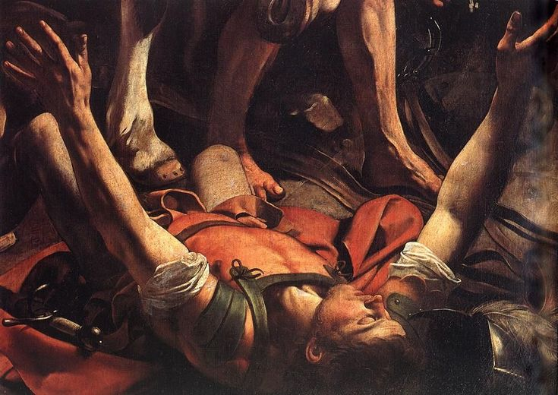
To get us ready for what’s next
Why does God have us wait?
Waiting sucks.
If you set out to follow God, there will be
times when He asks you to wait.

Slide 33
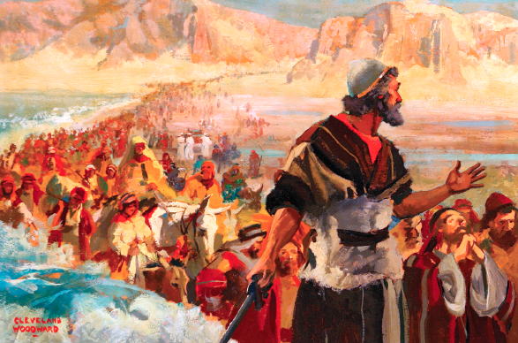
To get us ready for what’s next
Why does God have us wait?
Waiting sucks.
If you set out to follow God, there will be
times when He asks you to wait.

Slide 34
To get us ready for what’s next
^{Joshua 5:1} Now it came about when all the kings of the Amorites who were beyond the Jordan to the west, and all the kings of the Canaanites who were by the sea, heard how the Lord had dried up the waters of the Jordan before the sons of Israel until they had crossed, that their hearts melted, and there was no spirit in them any longer because of the sons of Israel.
Why does God have us wait?
Waiting sucks.
If you set out to follow God, there will be
times when He asks you to wait.

Slide 35
To get us ready for what’s next
^{Joshua 5:2} At that time the Lord said to Joshua, “Make for yourself flint knives and circumcise again the sons of Israel the second time.”
^{Joshua 5:2} At that time the Lord said to Joshua, “Make for yourself flint knives and circumcise again the sons of Israel the second time.”
Why does God have us wait?
Waiting sucks.
If you set out to follow God, there will be
times when He asks you to wait.

Slide 36
In waiting, we learn patience
Why does God have us wait?
Waiting sucks.
If you set out to follow God, there will be
times when He asks you to wait.

Slide 37
Waiting redirects our attention to God
Why does God have us wait?
Waiting sucks.
If you set out to follow God, there will be
times when He asks you to wait.

Slide 38
Waiting redirects our attention to God
^{Psalm 40:1} I waited patiently for the Lord; And He inclined to me and heard my cry.
Why does God have us wait?
Waiting sucks.
If you set out to follow God, there will be
times when He asks you to wait.

Slide 39
In waiting, we learn to trust God
Why does God have us wait?
Waiting sucks.
If you set out to follow God, there will be
times when He asks you to wait.

Slide 40
In waiting, we learn to trust God
In love, God weans us off of our own power and leadership and onto His
Why does God have us wait?
Waiting sucks.
If you set out to follow God, there will be
times when He asks you to wait.

Slide 41
Waiting can build our courage
^{Psalm 33:20} Our soul waits for the Lord; He is our help and our shield.
^{Psalm 27:14} Wait for the Lord; Be strong and let your heart take courage; Yes, wait for the Lord.
Why does God have us wait?
Waiting sucks.
If you set out to follow God, there will be
times when He asks you to wait.

Slide 42
Waiting is par for the course
Why does God have us wait?
Waiting sucks.
If you set out to follow God, there will be
times when He asks you to wait.

Slide 43
The question isn’t whether He will ask us to wait…
Waiting is par for the course
Why does God have us wait?
Waiting sucks.
If you set out to follow God, there will be
times when He asks you to wait.

Slide 44
The question isn’t whether He will ask us to wait…
The question isn’t whether or not we will wait…
Waiting is par for the course
Why does God have us wait?
Waiting sucks.
If you set out to follow God, there will be
times when He asks you to wait.

Slide 45
The question isn’t whether He will ask us to wait…
The question isn’t whether or not we will wait…
What does it mean to wait well?

Slide 46
The question isn’t whether He will ask us to wait…
This is an essential and relevant question for us as modern Christians!
The question isn’t whether or not we will wait…
What does it mean to wait well?

Slide 47
The question isn’t whether He will ask us to wait…
This is an essential and relevant question for us as modern Christians!
The question isn’t whether or not we will wait…
What does it mean to wait well?

Slide 48
^{Acts1:13} When they had entered the city, they went up to the upper room where they were staying; that is, Peter and John and James and Andrew, Philip and Thomas, Bartholomew and Matthew, James the son of Alphaeus, and Simon the Zealot, and Judas the son of James. ¹⁴ These all with one mind were continually devoting themselves to prayer, along with the women, and Mary the mother of Jesus, and with with His brothers.
^{Acts1:13} When they had entered the city, they went up to the upper room where they were staying; that is, Peter and John and James and Andrew, Philip and Thomas, Bartholomew and Matthew, James the son of Alphaeus, and Simon the Zealot, and Judas the son of James. ¹⁴ These all with one mind were continually devoting themselves to prayer, along with the women, and Mary the mother of Jesus, and with with His brothers.
^{Acts1:13} When they had entered the city, they went up to the upper room where they were staying; that is, Peter and John and James and Andrew, Philip and Thomas, Bartholomew and Matthew, James the son of Alphaeus, and Simon the Zealot, and Judas the son of James. ¹⁴ These all with one mind were continually devoting themselves to prayer, along with the women, and Mary the mother of Jesus, and with with His brothers.
^{Acts1:13} When they had entered the city, they went up to the upper room where they were staying; that is, Peter and John and James and Andrew, Philip and Thomas, Bartholomew and Matthew, James the son of Alphaeus, and Simon the Zealot, and Judas the son of James. ¹⁴ These all with one mind were continually devoting themselves to prayer, along with the women, and Mary the mother of Jesus, and with with His brothers.
^{Acts1:13} When they had entered the city, they went up to the upper room where they were staying; that is, Peter and John and James and Andrew, Philip and Thomas, Bartholomew and Matthew, James the son of Alphaeus, and Simon the Zealot, and Judas the son of James. ¹⁴ These all with one mind were continually devoting themselves to prayer, along with the women, and Mary the mother of Jesus, and with with His brothers.
The question isn’t whether we will wait…
Waiting is par for the course
Why does God have us wait?
Waiting sucks.
If you set out to follow God, there will be
times when He asks you to wait.
What does it mean to wait well?

Slide 49
1) They prayed
^{Acts1:13} When they had entered the city, they went up to the upper room where they were staying; that is, Peter and John and James and Andrew, Philip and Thomas, Bartholomew and Matthew, James the son of Alphaeus, and Simon the Zealot, and Judas the son of James. ¹⁴ These all with one mind were continually devoting themselves to prayer, along with the women, and Mary the mother of Jesus, and with with His brothers.
^{Acts1:13} When they had entered the city, they went up to the upper room where they were staying; that is, Peter and John and James and Andrew, Philip and Thomas, Bartholomew and Matthew, James the son of Alphaeus, and Simon the Zealot, and Judas the son of James. ¹⁴ These all with one mind were continually devoting themselves to prayer, along with the women, and Mary the mother of Jesus, and with with His brothers.
^{Acts1:13} When they had entered the city, they went up to the upper room where they were staying; that is, Peter and John and James and Andrew, Philip and Thomas, Bartholomew and Matthew, James the son of Alphaeus, and Simon the Zealot, and Judas the son of James. ¹⁴ These all with one mind were continually devoting themselves to prayer, along with the women, and Mary the mother of Jesus, and with with His brothers.
^{Acts1:13} When they had entered the city, they went up to the upper room where they were staying; that is, Peter and John and James and Andrew, Philip and Thomas, Bartholomew and Matthew, James the son of Alphaeus, and Simon the Zealot, and Judas the son of James. ¹⁴ These all with one mind were continually devoting themselves to prayer, along with the women, and Mary the mother of Jesus, and with with His brothers.
^{Acts1:13} When they had entered the city, they went up to the upper room where they were staying; that is, Peter and John and James and Andrew, Philip and Thomas, Bartholomew and Matthew, James the son of Alphaeus, and Simon the Zealot, and Judas the son of James. ¹⁴ These all with one mind were continually devoting themselves to prayer, along with the women, and Mary the mother of Jesus, and with with His brothers.
The question isn’t whether we will wait…
Waiting is par for the course
Why does God have us wait?
Waiting sucks.
If you set out to follow God, there will be
times when He asks you to wait.
What does it mean to wait well?

Slide 50
1) They prayed
Major Theme in Acts: the Church is characterized by prayer
^{Acts1:13} When they had entered the city, they went up to the upper room where they were staying; that is, Peter and John and James and Andrew, Philip and Thomas, Bartholomew and Matthew, James the son of Alphaeus, and Simon the Zealot, and Judas the son of James. ¹⁴ These all with one mind were continually devoting themselves to prayer, along with the women, and Mary the mother of Jesus, and with with His brothers.
^{Acts1:13} When they had entered the city, they went up to the upper room where they were staying; that is, Peter and John and James and Andrew, Philip and Thomas, Bartholomew and Matthew, James the son of Alphaeus, and Simon the Zealot, and Judas the son of James. ¹⁴ These all with one mind were continually devoting themselves to prayer, along with the women, and Mary the mother of Jesus, and with with His brothers.
^{Acts1:13} When they had entered the city, they went up to the upper room where they were staying; that is, Peter and John and James and Andrew, Philip and Thomas, Bartholomew and Matthew, James the son of Alphaeus, and Simon the Zealot, and Judas the son of James. ¹⁴ These all with one mind were continually devoting themselves to prayer, along with the women, and Mary the mother of Jesus, and with with His brothers.
^{Acts1:13} When they had entered the city, they went up to the upper room where they were staying; that is, Peter and John and James and Andrew, Philip and Thomas, Bartholomew and Matthew, James the son of Alphaeus, and Simon the Zealot, and Judas the son of James. ¹⁴ These all with one mind were continually devoting themselves to prayer, along with the women, and Mary the mother of Jesus, and with with His brothers.
^{Acts1:13} When they had entered the city, they went up to the upper room where they were staying; that is, Peter and John and James and Andrew, Philip and Thomas, Bartholomew and Matthew, James the son of Alphaeus, and Simon the Zealot, and Judas the son of James. ¹⁴ These all with one mind were continually devoting themselves to prayer, along with the women, and Mary the mother of Jesus, and with with His brothers.
The question isn’t whether we will wait…
Waiting is par for the course
Why does God have us wait?
Waiting sucks.
If you set out to follow God, there will be
times when He asks you to wait.
What does it mean to wait well?

Slide 51
1) They prayed
^{Acts1:15} At this time Peter stood up in the midst of of the brethren (a gathering of about one hundred and twenty persons was there together) and said,
Waiting is par for the course
Why does God have us wait?
Waiting sucks.
If you set out to follow God, there will be
times when He asks you to wait.
What does it mean to wait well?

Slide 52
1) They prayed
^{Acts 1:16} “Brethren, the Scripture had to be fulfilled, which the Holy Spirit foretold by the mouth of David concerning Judas, who became a guide to those who arrested Jesus.
^{Acts 1:16} “Brethren, the Scripture had to be fulfilled, which the Holy Spirit foretold by the mouth of David concerning Judas, who became a guide to those who arrested Jesus.
Waiting is par for the course
Why does God have us wait?
Waiting sucks.
If you set out to follow God, there will be
times when He asks you to wait.
What does it mean to wait well?

Slide 53
1) They prayed
2) They focused on His promises in Scripture
^{Acts 1:16} “Brethren, the Scripture had to be fulfilled, which the Holy Spirit foretold by the mouth of David concerning Judas, who became a guide to those who arrested Jesus.
^{Acts 1:16} “Brethren, the Scripture had to be fulfilled, which the Holy Spirit foretold by the mouth of David concerning Judas, who became a guide to those who arrested Jesus.
Waiting is par for the course
Why does God have us wait?
Waiting sucks.
If you set out to follow God, there will be
times when He asks you to wait.
What does it mean to wait well?

Slide 54
1) They prayed
2) They focused on His promises in Scripture
^{Psalm 130:5} I wait for the Lord, my soul does wait, And in His word do I hope.
^{Acts 1:16} “Brethren, the Scripture had to be fulfilled, which the Holy Spirit foretold by the mouth of David concerning Judas, who became a guide to those who arrested Jesus.
^{Acts 1:16} “Brethren, the Scripture had to be fulfilled, which the Holy Spirit foretold by the mouth of David concerning Judas, who became a guide to those who arrested Jesus.
Waiting is par for the course
Why does God have us wait?
Waiting sucks.
If you set out to follow God, there will be
times when He asks you to wait.
What does it mean to wait well?

Slide 55
1) They prayed
2) They focused on His promises in Scripture
^{Psalm 130:5} I wait for the Lord, my soul does wait, And in His word do I hope.
^{Acts 1:16} “Brethren, the Scripture had to be fulfilled, which the Holy Spirit foretold by the mouth of David concerning Judas, who became a guide to those who arrested Jesus.
Waiting is par for the course
Why does God have us wait?
Waiting sucks.
If you set out to follow God, there will be
times when He asks you to wait.
What does it mean to wait well?

Slide 56
1) They prayed
2) They focused on His promises in Scripture
^{Acts1:17} For he was counted among us and received his share in this ministry.” ¹⁸ (Now this man acquired a field with the price of his wickedness, and falling headlong, he burst open in the middle and all his intestines gushed out. ¹⁹ And it became known to all who were living in Jerusalem; so that in their own language that field was called Hakeldama, that is, Field of Blood.)
^{Acts1:17} For he was counted among us and received his share in this ministry.” ¹⁸ (Now this man acquired a field with the price of his wickedness, and falling headlong, he burst open in the middle and all his intestines gushed out. ¹⁹ And it became known to all who were living in Jerusalem; so that in their own language that field was called Hakeldama, that is, Field of Blood.)

Slide 57
1) They prayed
Why the gross-out description?
2) They focused on His promises in Scripture
^{Acts1:17} For he was counted among us and received his share in this ministry.” ¹⁸ (Now this man acquired a field with the price of his wickedness, and falling headlong, he burst open in the middle and all his intestines gushed out. ¹⁹ And it became known to all who were living in Jerusalem; so that in their own language that field was called Hakeldama, that is, Field of Blood.)
^{Acts1:17} For he was counted among us and received his share in this ministry.” ¹⁸ (Now this man acquired a field with the price of his wickedness, and falling headlong, he burst open in the middle and all his intestines gushed out. ¹⁹ And it became known to all who were living in Jerusalem; so that in their own language that field was called Hakeldama, that is, Field of Blood.)

Slide 58
^{Acts1:20} “For it is written in the book of Psalms, ‘Let his homestead be made desolate, And let no one dwell in it’; and, ‘Let another man take his office.’
^{Acts1:20} “For it is written in the book of Psalms, ‘Let his homestead be made desolate, And let no one dwell in it’; and, ‘Let another man take his office.’

Slide 59
He’s showing how the OT scriptures speak prophetically
^{Acts1:20} “For it is written in the book of Psalms, ‘Let his homestead be made desolate, And let no one dwell in it’; and, ‘Let another man take his office.’
^{Acts1:20} “For it is written in the book of Psalms, ‘Let his homestead be made desolate, And let no one dwell in it’; and, ‘Let another man take his office.’

Slide 60
He’s showing how the OT scriptures speak prophetically
Psalm 69 and 109, are about King David defeating His enemies
^{Acts1:20} “For it is written in the book of Psalms, ‘Let his homestead be made desolate, And let no one dwell in it’; and, ‘Let another man take his office.’
^{Acts1:20} “For it is written in the book of Psalms, ‘Let his homestead be made desolate, And let no one dwell in it’; and, ‘Let another man take his office.’

Slide 61
It means that they need to do something…
^{Acts1:20} “For it is written in the book of Psalms, ‘Let his homestead be made desolate, And let no one dwell in it’; and, ‘Let another man take his office.’
^{Acts1:20} “For it is written in the book of Psalms, ‘Let his homestead be made desolate, And let no one dwell in it’; and, ‘Let another man take his office.’
^{Acts1:20} “For it is written in the book of Psalms, ‘Let his homestead be made desolate, And let no one dwell in it’; and, ‘Let another man take his office.’

Slide 62
^{Acts1:21} Therefore it is necessary that of the men who have accompanied us all the time that the Lord Jesus went in and out among us— ²² beginning with the baptism of John until the day that He was taken up from us—one of these must become a witness with us of His resurrection.”

Slide 63
^{Acts1:23} So they put forward two men, Joseph called Barsabbas (who was also called Justus), and Matthias. ²⁴ And they prayed and said, “You, Lord, who know the hearts of all men, show which one of these two You have chosen ²⁵ to occupy this ministry and apostleship from which Judas turned aside to go to his own place.”

Slide 64
^{Acts1:26} And they drew lots for them, and the lot fell to Matthias; and he was added to the eleven apostles.

Slide 65
1) They prayed
2) They focused on His promises in Scripture
3) Took initiative to do what they could do
Waiting is par for the course
Why does God have us wait?
Waiting sucks.
If you set out to follow God, there will be
times when He asks you to wait.
What does it mean to wait well?

Slide 66
1) They prayed
2) They focused on His promises in Scripture
3) Took initiative to do what they could do
Waiting on God is not the same as passive waiting
Waiting is par for the course
Why does God have us wait?
Waiting sucks.
If you set out to follow God, there will be
times when He asks you to wait.
What does it mean to wait well?

Slide 67
1) They prayed
2) They focused on His promises in Scripture
3) Took initiative to do what they could do
Waiting on God is not the same as passive waiting
There’s usually not nothing we can do
Waiting is par for the course
Why does God have us wait?
Waiting sucks.
If you set out to follow God, there will be
times when He asks you to wait.
What does it mean to wait well?

Slide 68
1) They prayed
2) They focused on His promises in Scripture
3) Took initiative to do what they could do
4) Active waiting
Waiting is par for the course
Why does God have us wait?
Waiting sucks.
If you set out to follow God, there will be
times when He asks you to wait.
What does it mean to wait well?

Slide 69
1) They prayed
2) They focused on His promises in Scripture
3) Took initiative to do what they could do
4) Active waiting
Not rest or inaction…
Waiting is par for the course
Why does God have us wait?
Waiting sucks.
If you set out to follow God, there will be
times when He asks you to wait.
What does it mean to wait well?

Slide 70
1) They prayed
2) They focused on His promises in Scripture
3) Took initiative to do what they could do
4) Active waiting
Not rest or inaction…
Waiting that is attentive to God, that includes and cultivates readiness
Waiting is par for the course
Why does God have us wait?
Waiting sucks.
If you set out to follow God, there will be
times when He asks you to wait.
What does it mean to wait well?

Slide 71
1) They prayed
2) They focused on His promises in Scripture
3) Took initiative to do what they could do
4) Active waiting
Not rest or inaction…
Waiting that is attentive to God, that includes and cultivates readiness
Waiting on God is hard work.
Waiting is par for the course
Why does God have us wait?
Waiting sucks.
If you set out to follow God, there will be
times when He asks you to wait.
What does it mean to wait well?

Slide 72
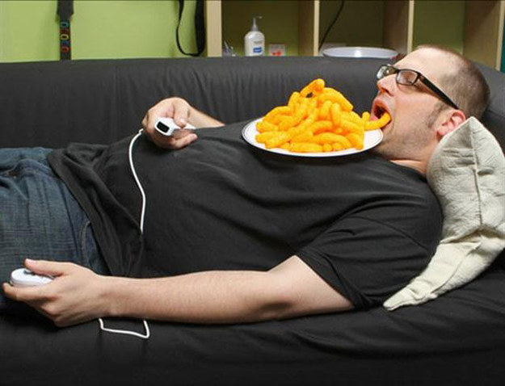
1) They prayed
2) They focused on His promises in Scripture
3) Took initiative to do what they could do
4) Active waiting
Not rest or inaction…
Waiting that is attentive to God, that includes and cultivates readiness
Waiting on God is hard work.
Waiting is par for the course
Why does God have us wait?
Waiting sucks.
If you set out to follow God, there will be
times when He asks you to wait.
What does it mean to wait well?

Slide 73
1) They prayed
2) They focused on His promises in Scripture
3) Took initiative to do what they could do
4) Active waiting
Not rest or inaction…
Waiting that is attentive to God, that includes and cultivates readiness
Waiting on God is hard work.
Waiting is par for the course
Why does God have us wait?
Waiting sucks.
If you set out to follow God, there will be
times when He asks you to wait.
What does it mean to wait well?

Slide 74
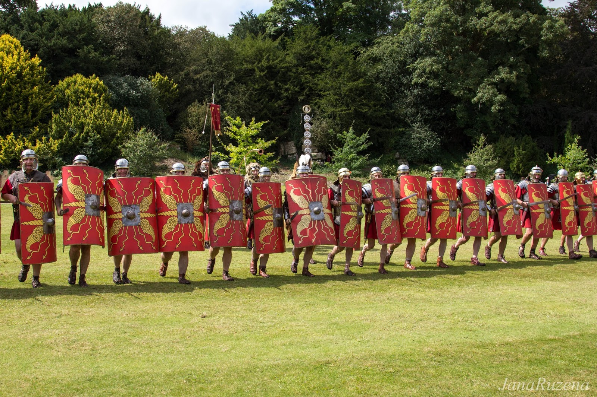
“Keep in Step with the Spirit”

Slide 75
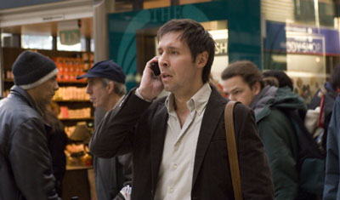
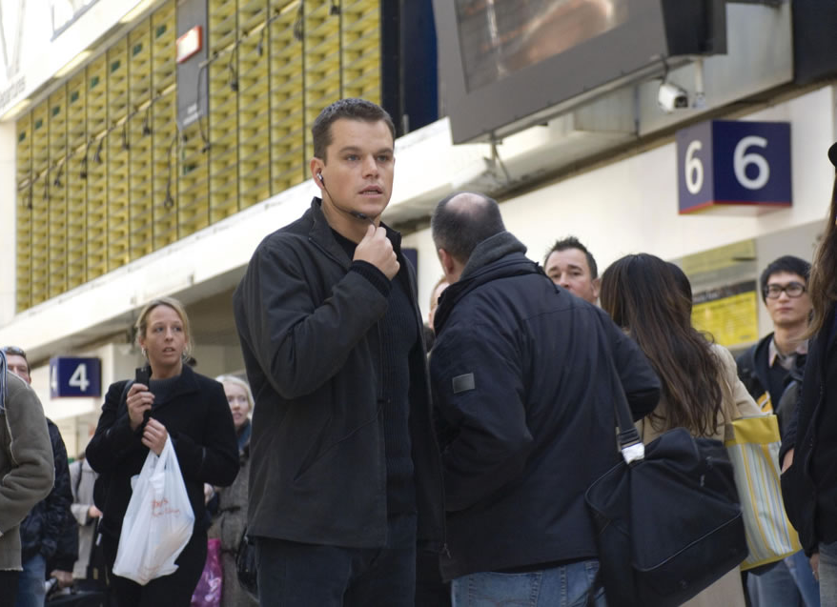
“Keep in Step with the Spirit”

Slide 76
“Keep in Step with the Spirit”
Ready to ACT
Ready to YEILD

Slide 77
“Keep in Step with the Spirit”
Ready to ACT
You’re probably prone toward one of them
Ready to YEILD

Slide 78
1) They prayed
2) They focused on His promises in Scripture
3) Took initiative to do what they could do
4) Active waiting, Attentive, Ready waiting
Waiting is par for the course
Why does God have us wait?
Waiting sucks.
If you set out to follow God, there will be
times when He asks you to wait.
What does it mean to wait well?

Slide 79
1) They prayed
2) They focused on His promises in Scripture
3) Took initiative to do what they could do
4) Active waiting, Attentive, Ready waiting
5) They trusted God
Waiting is par for the course
Why does God have us wait?
Waiting sucks.
If you set out to follow God, there will be
times when He asks you to wait.
What does it mean to wait well?

Slide 80
1) They prayed
2) They focused on His promises in Scripture
3) Took initiative to do what they could do
4) Active waiting, Attentive, Ready waiting
5) They trusted God
Waiting is par for the course
Why does God have us wait?
Waiting sucks.
If you set out to follow God, there will be
times when He asks you to wait.
What does it mean to wait well?
They held to what they knew was true of God

Slide 81
That He keeps His promises
They held to what they knew was true of God

Slide 82
^{Acts1:4} He commanded them not to leave Jerusalem, but to wait for what the Father had promised,
That He keeps His promises
They held to what they knew was true of God

Slide 83
^{Acts1:4} He commanded them not to leave Jerusalem, but to wait for what the Father had promised,
^{Psalm 39:7} “And now, Lord, for what do I wait? My hope is in You.
That He keeps His promises
Our waiting is an expectant waiting

Slide 84
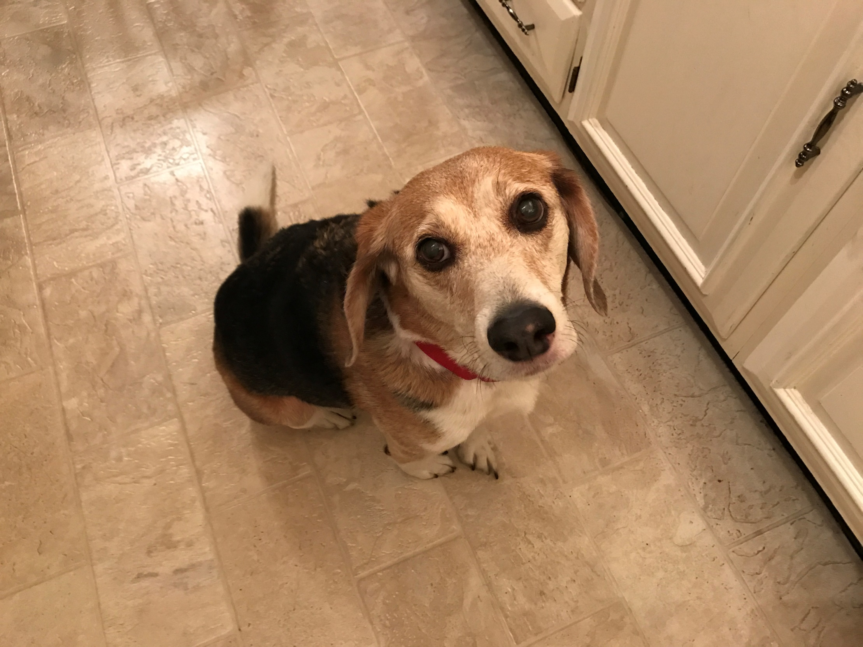
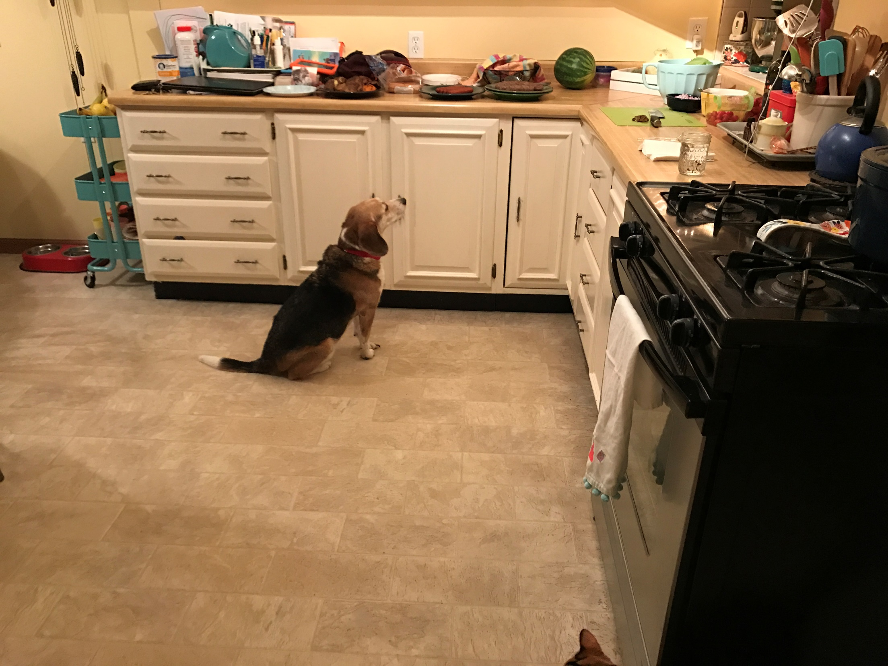
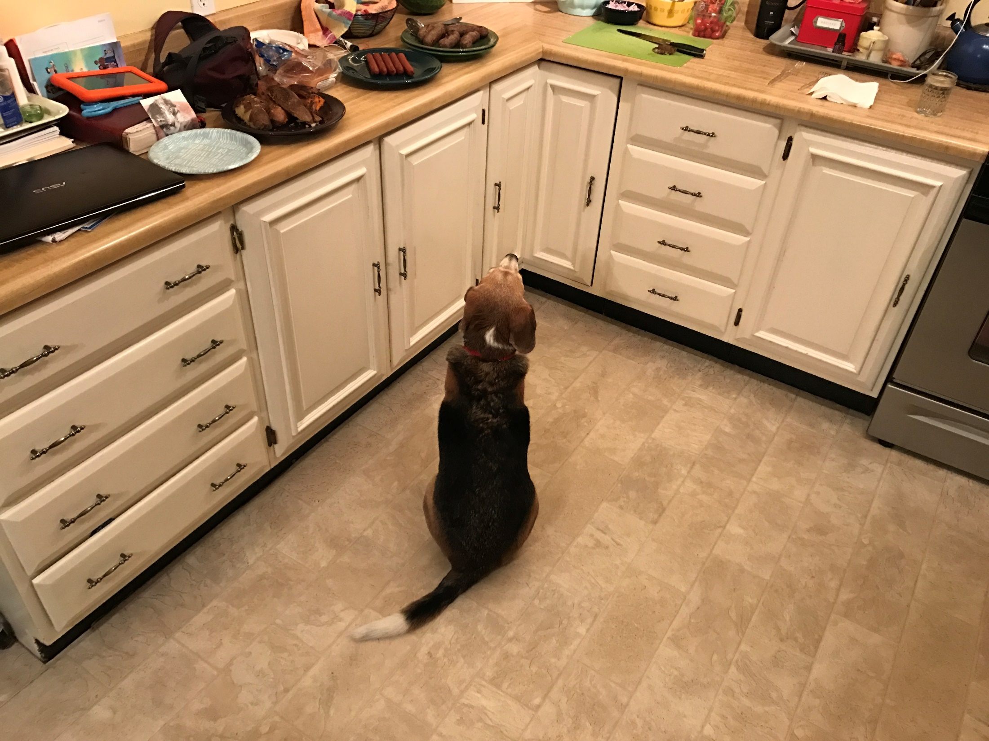
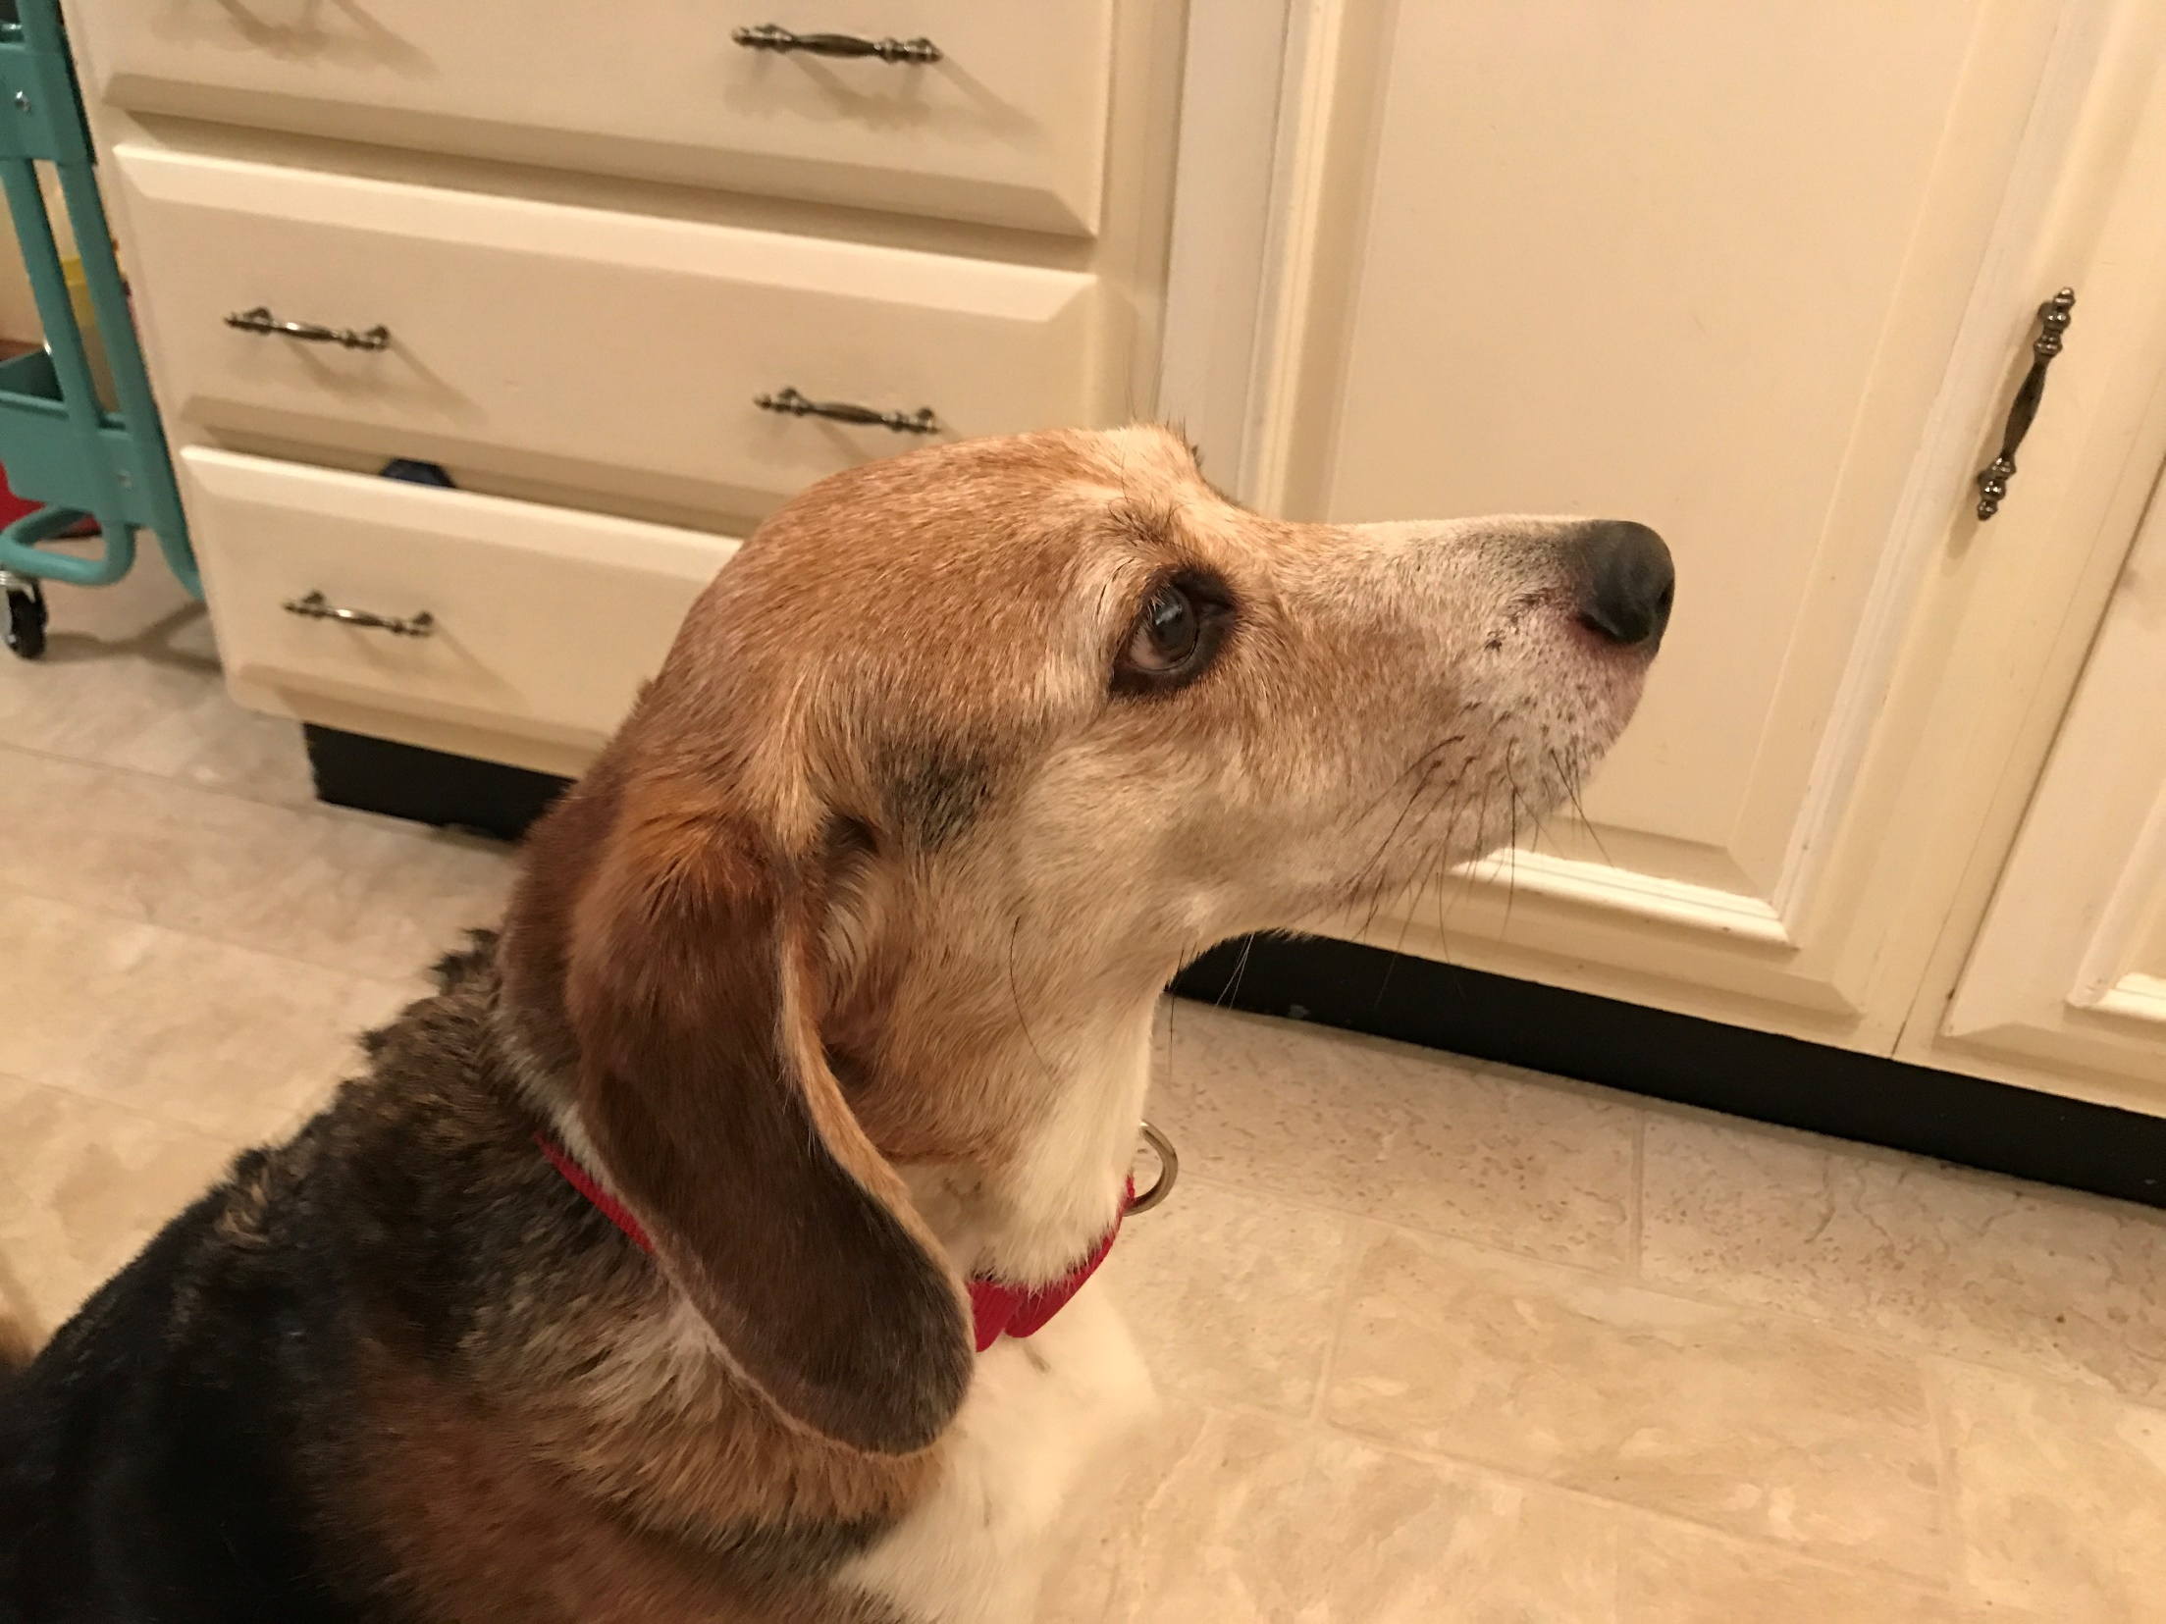
^{Acts1:4} He commanded them not to leave Jerusalem, but to wait for what the Father had promised,
That He keeps His promises
They acted on what they knew was true of God
Our waiting is an expectant waiting
We wait in confident assurance – in hope

Slide 85
^{Acts1:4} He commanded them not to leave Jerusalem, but to wait for what the Father had promised, “Which,” He said, “you heard of from Me; ⁵ for John baptized with water, but you will be baptized with the Holy Spirit not many days from now.”
That His timing is different from ours
They held to what they knew was true of God

Slide 86
^{Acts1:4} He commanded them not to leave Jerusalem, but to wait for what the Father had promised, “Which,” He said, “you heard of from Me; ⁵ for John baptized with water, but you will be baptized with the Holy Spirit not many days from now.”
^{Acts 1:7} He said to them, “It is not for you to know times or epochs which the Father has fixed by His own authority;
That His timing is different from ours
They held to what they knew was true of God

Slide 87
^{Acts1:4} He commanded them not to leave Jerusalem, but to wait for what the Father had promised, “Which,” He said, “you heard of from Me; ⁵ for John baptized with water, but you will be baptized with the Holy Spirit not many days from now.”
^{Acts 1:7} He said to them, “It is not for you to know times or epochs which the Father has fixed by His own authority;
That His timing is different from ours
And better than ours
They held to what they knew was true of God

Slide 88
From our vantage point, God’s path can look pretty counterintuitive
God sometimes takes the long way around – for His own purposes

Slide 89
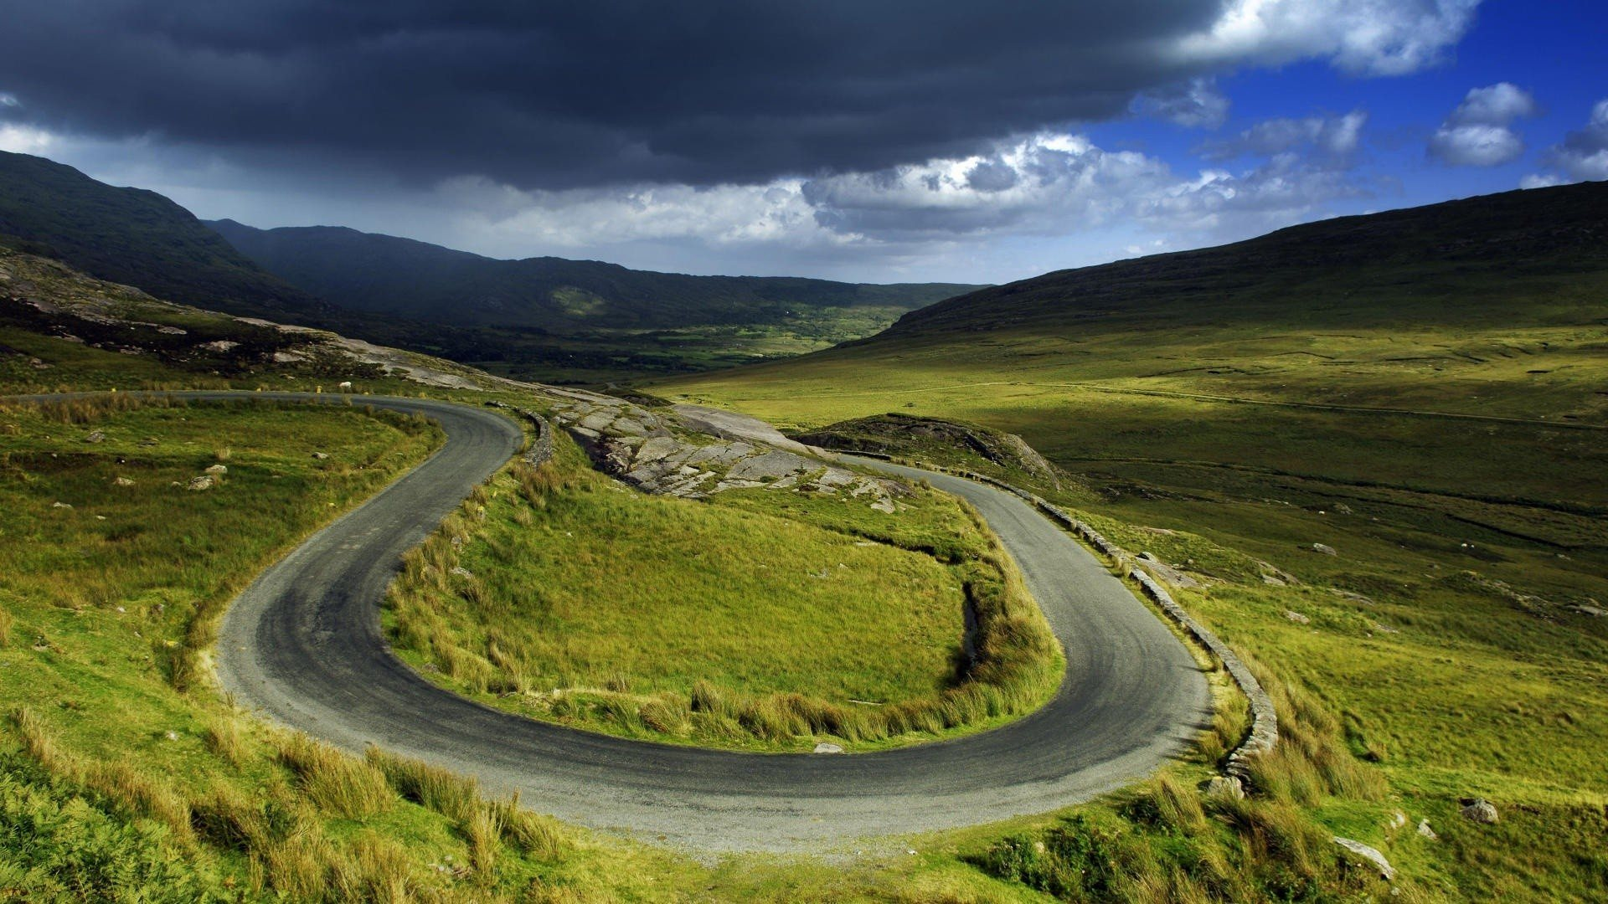
From our vantage point, God’s path can look pretty counterintuitive
God sometimes takes the long way around – for His own purposes

Slide 90
^{Acts1:4} He commanded them not to leave Jerusalem, but to wait for what the Father had promised, “Which,” He said, “you heard of from Me; ⁵ for John baptized with water, but you will be baptized with the Holy Spirit not many days from now.”
His outcomes are different from ours
They held to what they knew was true of God

Slide 91
^{Acts1:4} He commanded them not to leave Jerusalem, but to wait for what the Father had promised, “Which,” He said, “you heard of from Me; ⁵ for John baptized with water, but you will be baptized with the Holy Spirit not many days from now.”
Waiting on God doesn’t mean that since we have paid our dues in waiting, that we will eventually get exactly what we want
His outcomes are different from ours
They held to what they knew was true of God

Slide 92
^{Acts1:4} He commanded them not to leave Jerusalem, but to wait for what the Father had promised, “Which,” He said, “you heard of from Me; ⁵ for John baptized with water, but you will be baptized with the Holy Spirit not many days from now.”
Waiting on God doesn’t mean that since we have paid our dues in waiting, that we will eventually get exactly what we want
Because it’s a fallen world
His outcomes are different from ours
They held to what they knew was true of God

Slide 93
^{Acts1:4} He commanded them not to leave Jerusalem, but to wait for what the Father had promised, “Which,” He said, “you heard of from Me; ⁵ for John baptized with water, but you will be baptized with the Holy Spirit not many days from now.”
Waiting on God doesn’t mean that since we have paid our dues in waiting, that we will eventually get exactly what we want
Because what you want isn’t always what He wants
Because it’s a fallen world
His outcomes are different from ours
They held to what they knew was true of God

Slide 94
^{Acts1:4} He commanded them not to leave Jerusalem, but to wait for what the Father had promised, “Which,” He said, “you heard of from Me; ⁵ for John baptized with water, but you will be baptized with the Holy Spirit not many days from now.”
Often, when we are being asked to wait, it’s because God has a greater good in mind that we can’t see
Because it’s a fallen world
His outcomes are different from ours
They held to what they knew was true of God

Slide 95
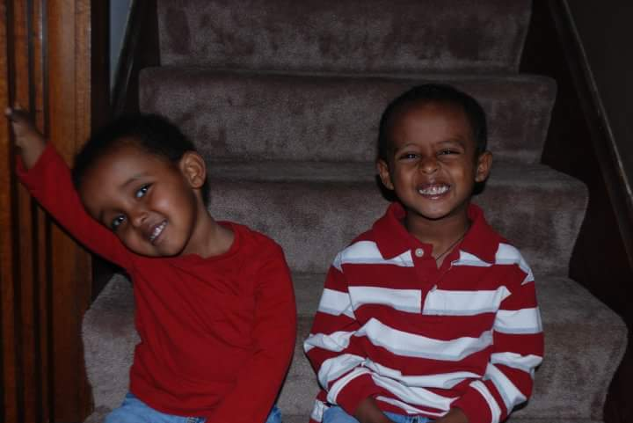
^{Acts1:4} He commanded them not to leave Jerusalem, but to wait for what the Father had promised, “Which,” He said, “you heard of from Me; ⁵ for John baptized with water, but you will be baptized with the Holy Spirit not many days from now.”
Often, when we are being asked to wait, it’s because God has a greater good in mind that we can’t see
Because it’s a fallen world
His outcomes are different from ours
They held to what they knew was true of God

Slide 96
^{Acts1:4} He commanded them not to leave Jerusalem, but to wait for what the Father had promised, “Which,” He said, “you heard of from Me; ⁵ for John baptized with water, but you will be baptized with the Holy Spirit not many days from now.”
Sometimes, the outcome He has in mind isn’t about you at all!
His outcomes are different from ours
They held to what they knew was true of God

Slide 97
^{Acts1:4} He commanded them not to leave Jerusalem, but to wait for what the Father had promised, “Which,” He said, “you heard of from Me; ⁵ for John baptized with water, but you will be baptized with the Holy Spirit not many days from now.”
God knows exactly what is best for us
His outcomes are different from ours
They held to what they knew was true of God

Slide 98
^{Acts1:4} He commanded them not to leave Jerusalem, but to wait for what the Father had promised, “Which,” He said, “you heard of from Me; ⁵ for John baptized with water, but you will be baptized with the Holy Spirit not many days from now.”
God knows exactly what is best for us
His outcomes are different from ours
And better than ours
They held to what they knew was true of God

Slide 99
^{Acts1:4} He commanded them not to leave Jerusalem, but to wait for what the Father had promised, “Which,” He said, “you heard of from Me; ⁵ for John baptized with water, but you will be baptized with the Holy Spirit not many days from now.”
^{Is 49:23} Those who hopefully wait for Me will not be disappointed
God knows exactly what is best for us
His outcomes are different from ours
And better than ours
They held to what they knew was true of God

Slide 100
^{Acts1:4} He commanded them not to leave Jerusalem, but to wait for what the Father had promised, “Which,” He said, “you heard of from Me; ⁵ for John baptized with water, but you will be baptized with the Holy Spirit not many days from now.”
^{Is 49:23} Those who hopefully wait for Me will not be disappointed
God knows exactly what is best for us
He is Good
They held to what they knew was true of God

Slide 101
^{Acts1:4} He commanded them not to leave Jerusalem, but to wait for what the Father had promised, “Which,” He said, “you heard of from Me; ⁵ for John baptized with water, but you will be baptized with the Holy Spirit not many days from now.”
That they wouldn’t be waiting forever
They held to what they knew was true of God

Slide 102
^{Acts1:4} He commanded them not to leave Jerusalem, but to wait for what the Father had promised, “Which,” He said, “you heard of from Me; ⁵ for John baptized with water, but you will be baptized with the Holy Spirit not many days from now.”
Whatever you are waiting for will be satisfied in eternity with Christ
That they wouldn’t be waiting forever
They held to what they knew was true of God

Slide 103
^{Acts1:4} He commanded them not to leave Jerusalem, but to wait for what the Father had promised, “Which,” He said, “you heard of from Me; ⁵ for John baptized with water, but you will be baptized with the Holy Spirit not many days from now.”
This is really the first picture we get of the “church”

Slide 104
Lord I am ready today to leap into action. What do you have for me to do?
^{Acts1:4} He commanded them not to leave Jerusalem, but to wait for what the Father had promised, “Which,” He said, “you heard of from Me; ⁵ for John baptized with water, but you will be baptized with the Holy Spirit not many days from now.”
This is really the first picture we get of the “church”

Slide 105
Lord I will gladly wait, (even if my plan is *obviously* better than yours)
This is really the first picture we get of the “church”

Slide 106
Lord, what can I do as I wait?
This is really the first picture we get of the “church”

Slide 107
Help me to learn and cooperate with whatever it is you are teaching me during this time of waiting
This is really the first picture we get of the “church”

Slide 108
Thank you that you care about my pain in waiting, and want to hear from me
This is really the first picture we get of the “church”

Slide 109
You don’t have to wait to receive The Spirit

Slide 110
Acts
Next Time . . .
teachings available at www.xenos.org/adultCT/

