Slide 1
1 Corinthians
THE BOOK OF
1:1-9: Shining light in a dark place

Slide 2
Intro
❶ Author

Slide 3
Intro
❶ Author
1:1: “This letter is from Paul…”

Slide 4
Intro
❶ Author
❷ Date

Slide 5
Intro
❶ Author
❷ Date
AD 54/55

Slide 6
Intro
❶ Author
❷ Date
❸ Destination

Slide 7
Intro
❶ Author
❷ Date
❸ Destination
1:2: “To the church of God in Corinth…”

Slide 8
City of Corinth

Slide 9
City of Corinth
❶ Renowned as a wealthy port city

Slide 10
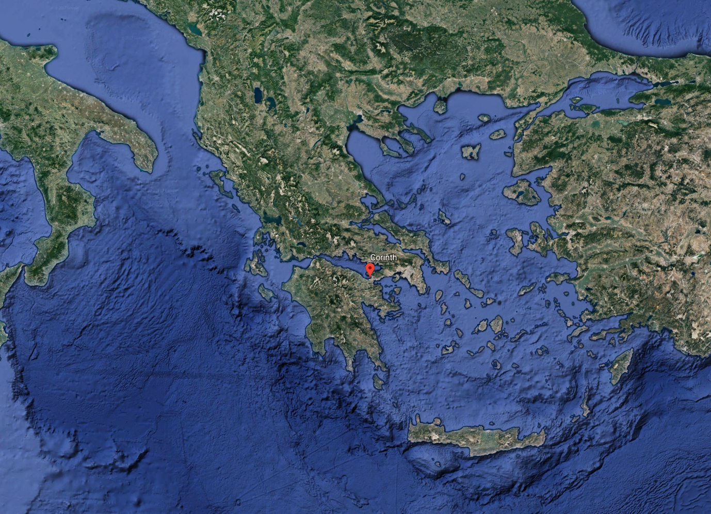

Slide 12
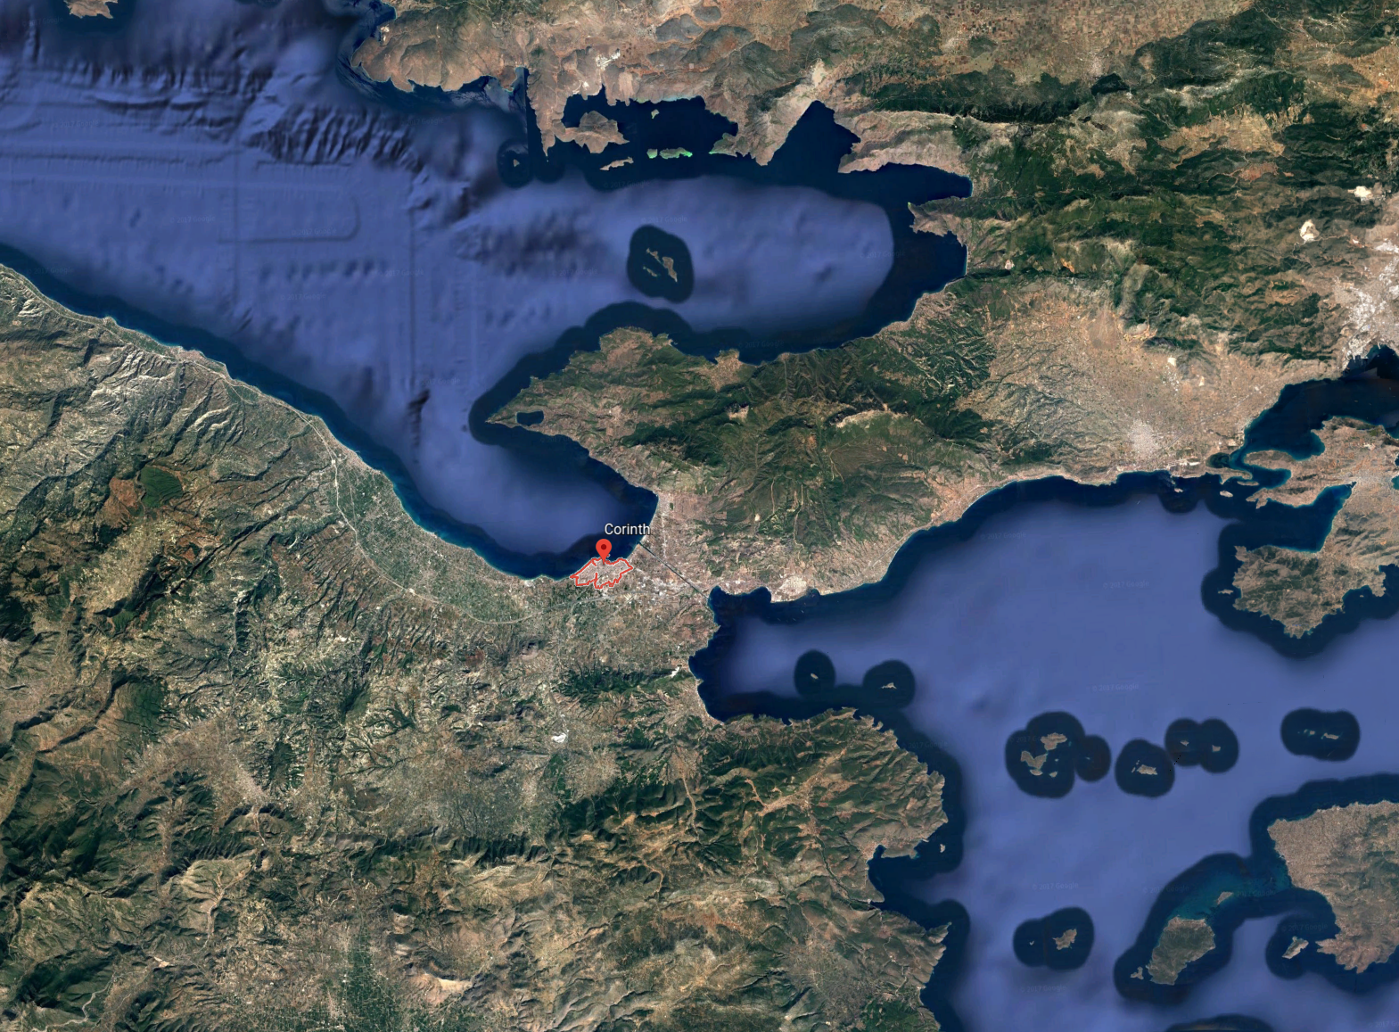

Slide 15
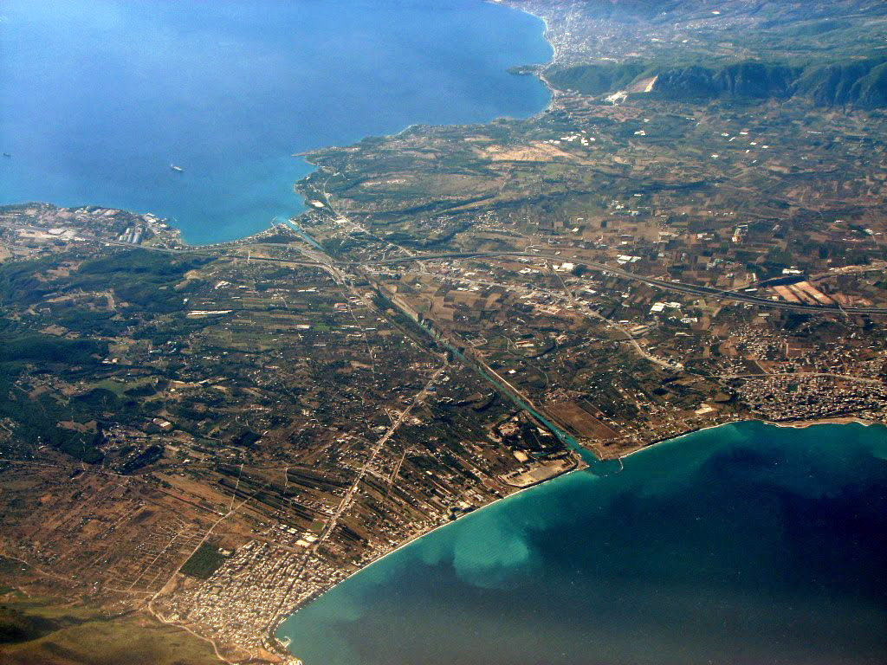
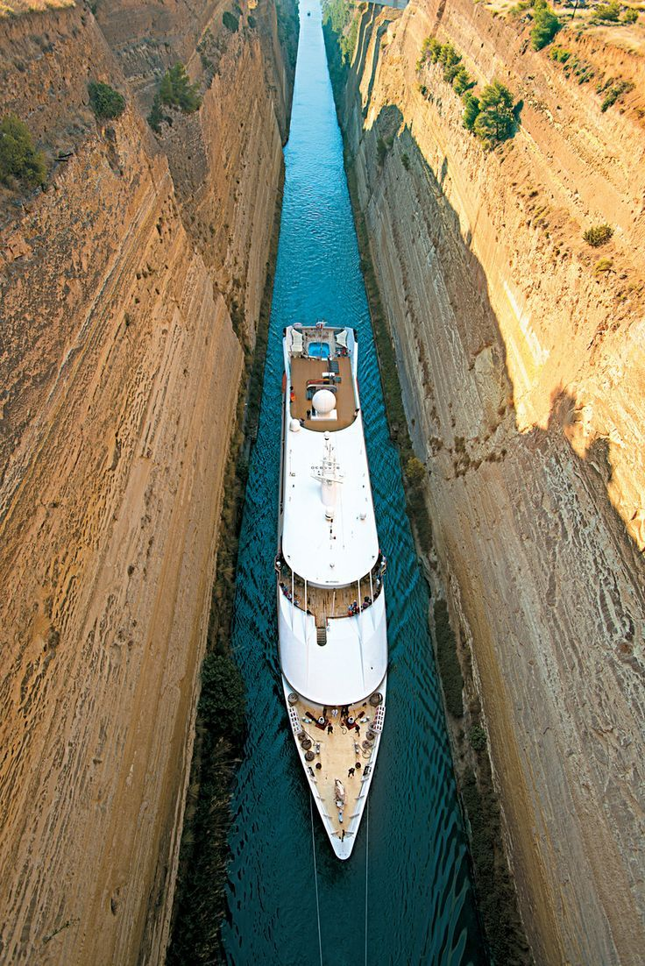

Slide 16
City of Corinth
❶ Renowned as a wealthy port city
❷ Boasted one of the largest populations in the ancient world

Slide 17
City of Corinth
❶ Renowned as a wealthy port city
❷ Boasted one of the largest populations in the ancient world
❸ Regarded as a center of intellectual activity

Slide 18
City of Corinth
❶ Renowned as a wealthy port city
❷ Boasted one of the largest populations in the ancient world
❸ Regarded as a center of intellectual activity
❹ Famed for its Isthmian games

Slide 19
City of Corinth
❺ Contained a large pantheon of gods (with its principle temples dedicated to Aphrodite and Apollo)

Slide 20
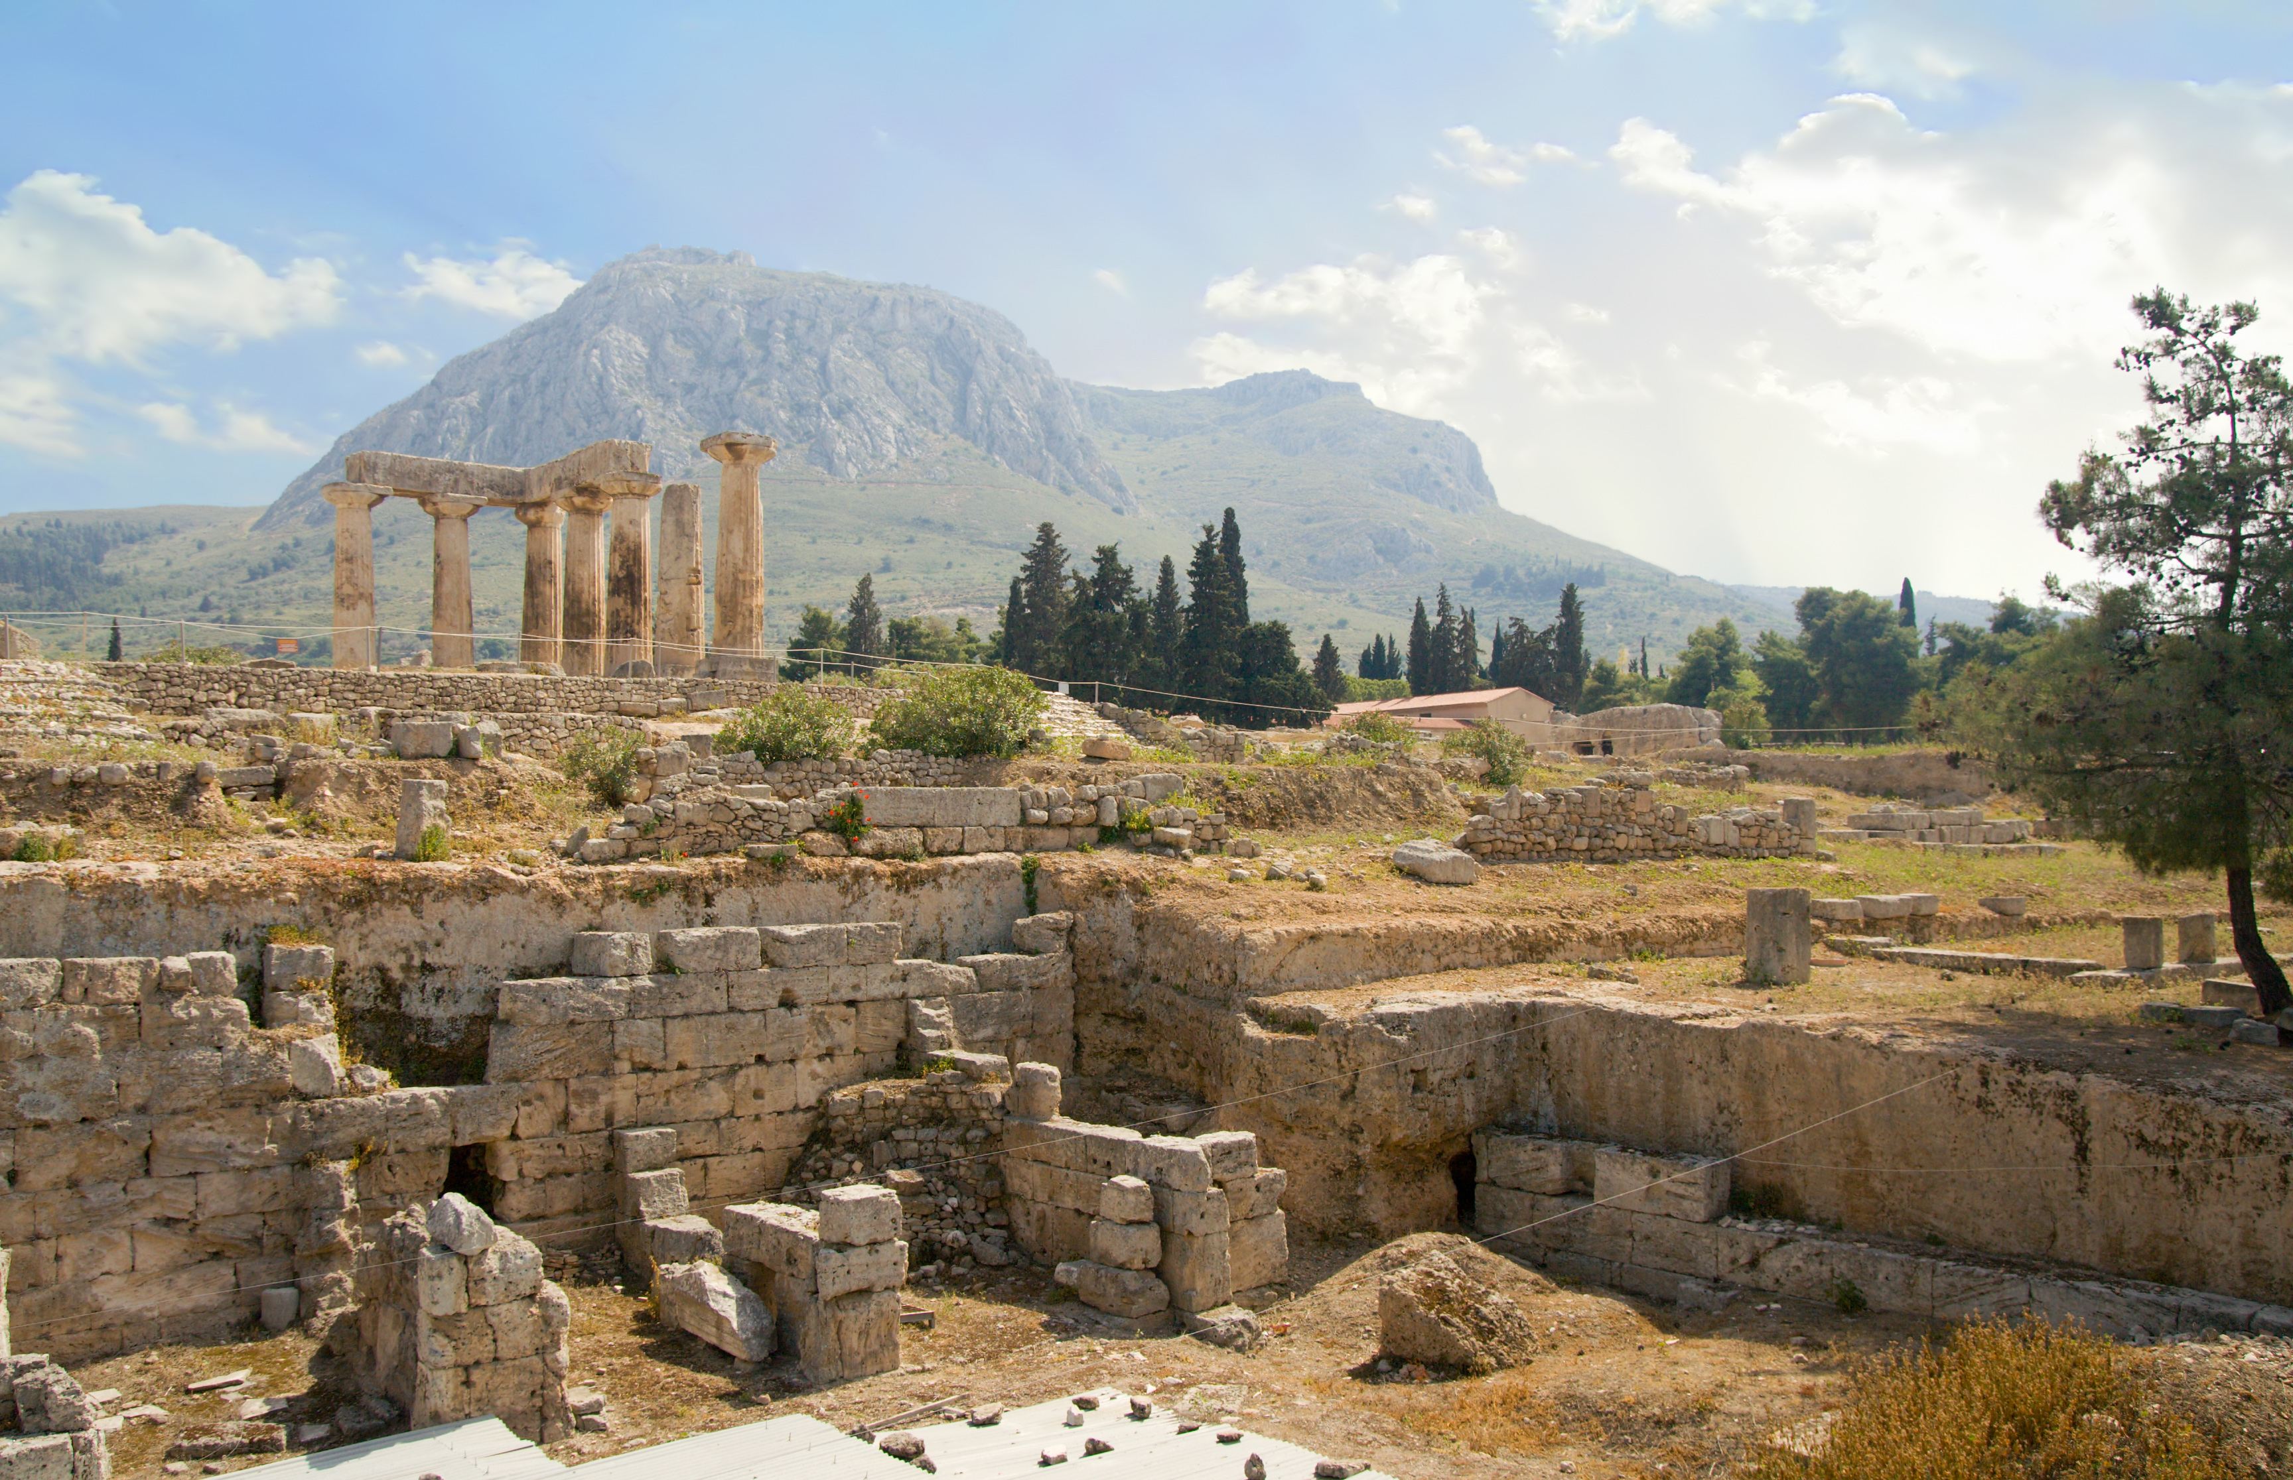

Slide 21
City of Corinth
❺ Contained a large pantheon of gods (with its principle temples dedicated to Aphrodite and Apollo)
❻ Immoral

Slide 22
City of Corinth
❺ Contained a large pantheon of gods (with its principle temples dedicated to Aphrodite and Apollo)
❻ Immoral
❼ A city marked by moral anarchy and self-indulgence

Slide 23
City of Corinth
❺ Contained a large pantheon of gods (with its principle temples dedicated to Aphrodite and Apollo)
❻ Immoral
❼ A city marked by moral anarchy and self-indulgence
Yet, the Corinthians weren’t spiritually resistant.

Slide 24
Acts 18
¹ Then Paul left Athens and went to Corinth.
² There he became acquainted with a Jew named Aquila, born in Pontus, who had recently arrived from Italy with his wife, Priscilla. They had left Italy when Claudius Caesar deported all Jews from Rome.

Slide 25
Acts 18
¹ Then Paul left Athens and went to Corinth.
² There he became acquainted with a Jew named Aquila, born in Pontus, who had recently arrived from Italy with his wife, Priscilla. They had left Italy when Claudius Caesar deported all Jews from Rome.

Slide 26
Acts 18
¹ Then Paul left Athens and went to Corinth.
² There he became acquainted with a Jew named Aquila, born in Pontus, who had recently arrived from Italy with his wife, Priscilla. They had left Italy when Claudius Caesar deported all Jews from Rome.
Suetonius, Life of Claudius (25:4): ‘As the Jews were making constant disturbances at the instigation of Chrestus, he [Claudius] banished them from Rome.’

Slide 27
Acts 18
¹ Then Paul left Athens and went to Corinth.
² There he became acquainted with a Jew named Aquila, born in Pontus, who had recently arrived from Italy with his wife, Priscilla. They had left Italy when Claudius Caesar deported all Jews from Rome.
Romans 16:3-4: Greet Priscilla and Aquila, my fellow workers in Christ Jesus who risked their own neck for me.

Slide 28
Acts 18
¹ Then Paul left Athens and went to Corinth.
² There he became acquainted with a Jew named Aquila, born in Pontus, who had recently arrived from Italy with his wife, Priscilla. They had left Italy when Claudius Caesar deported all Jews from Rome.
³ Paul lived and worked with them, for they were tentmakers just as he was.

Slide 29
Acts 18
¹ Then Paul left Athens and went to Corinth.
² There he became acquainted with a Jew named Aquila, born in Pontus, who had recently arrived from Italy with his wife, Priscilla. They had left Italy when Claudius Caesar deported all Jews from Rome.
³ Paul lived and worked with them, for they were tentmakers just as he was.

Slide 30
Acts 18
¹ Then Paul left Athens and went to Corinth.
² There he became acquainted with a Jew named Aquila, born in Pontus, who had recently arrived from Italy with his wife, Priscilla. They had left Italy when Claudius Caesar deported all Jews from Rome.
³ Paul lived and worked with them, for they were tentmakers just as he was.
Paul renounced his right to receive support from the Corinthians because they accused him of preaching for money (2 Thess. 3:8).

Slide 31
Acts 18
¹ Then Paul left Athens and went to Corinth.
² There he became acquainted with a Jew named Aquila, born in Pontus, who had recently arrived from Italy with his wife, Priscilla. They had left Italy when Claudius Caesar deported all Jews from Rome.
³ Paul lived and worked with them, for they were tentmakers just as he was.
Paul renounced his right to receive support from the Corinthians because they accused him of preaching for money (2 Thess. 3:8).
It’s important to show integrity, especially in the area of money

Slide 32
Acts 18
⁴ Each Sabbath found Paul at the synagogue, trying to convince the Jews and Greeks alike.
⁵ And after Silas and Timothy came down from Macedonia, Paul spent all his time preaching the word. He testified to the Jews that Jesus was the Messiah.

Slide 33
Acts 18
⁶ But when they opposed and insulted him, Paul shook the dust from his clothes and said, “Your blood is upon your own heads—I am innocent. From now on I will go preach to the Gentiles.”

Slide 34
Acts 18
⁶ But when they opposed and insulted him, Paul shook the dust from his clothes and said, “Your blood is upon your own heads—I am innocent. From now on I will go preach to the Gentiles.”

Slide 35
Acts 18
⁶ But when they opposed and insulted him, Paul shook the dust from his clothes and said, “Your blood is upon your own heads—I am innocent. From now on I will go preach to the Gentiles.”

Slide 36
Acts 18
⁶ But when they opposed and insulted him, Paul shook the dust from his clothes and said, “Your blood is upon your own heads—I am innocent. From now on I will go preach to the Gentiles.”
We should move on if people don’t want to give us a hearing.

Slide 37
Acts 18
⁶ But when they opposed and insulted him, Paul shook the dust from his clothes and said, “Your blood is upon your own heads—I am innocent. From now on I will go preach to the Gentiles.”
We should move on if people don’t want to give us a hearing.
❶ It shows respect for their free will

Slide 38
Acts 18
⁶ But when they opposed and insulted him, Paul shook the dust from his clothes and said, “Your blood is upon your own heads—I am innocent. From now on I will go preach to the Gentiles.”
We should move on if people don’t want to give us a hearing.
❶ It shows respect for their free will
❷ Battering people with the message of Christ might inoculate them from the truth.

Slide 39
Acts 18
⁶ But when they opposed and insulted him, Paul shook the dust from his clothes and said, “Your blood is upon your own heads—I am innocent. From now on I will go preach to the Gentiles.”
We should move on if people don’t want to give us a hearing.
❸ Focusing our attention on unreceptive people may prevent us from seeing those who might be open to spiritual things.

Slide 40
Acts 18
⁶ But when they opposed and insulted him, Paul shook the dust from his clothes and said, “Your blood is upon your own heads—I am innocent. From now on I will go preach to the Gentiles.”
⁷ Then he left and went to the home of Titius Justus, a Gentile who worshiped God and lived next door to the synagogue.

Slide 41
Acts 18
⁸ Crispus, the leader of the synagogue, and everyone in his household believed in the Lord. Many others in Corinth also heard Paul, became believers, and were baptized.

Slide 42
Acts 18
⁹ One night the Lord spoke to Paul in a vision and told him, “Don’t be afraid! Speak out! Don’t be silent!
¹⁰ For I am with you, and no one will attack and harm you, for many people in this city belong to me.”

Slide 43
Acts 18
⁹ One night the Lord spoke to Paul in a vision and told him, “Don’t be afraid! Speak out! Don’t be silent!
¹⁰ For I am with you, and no one will attack and harm you, for many people in this city belong to me.”

Slide 44
Acts 18
⁹ One night the Lord spoke to Paul in a vision and told him, “Don’t be afraid! Speak out! Don’t be silent!
¹⁰ For I am with you, and no one will attack and harm you, for many people in this city belong to me.”
Maybe the moral anarchy in the city intimidated him.

Slide 45
Acts 18
⁹ One night the Lord spoke to Paul in a vision and told him, “Don’t be afraid! Speak out! Don’t be silent!
¹⁰ For I am with you, and no one will attack and harm you, for many people in this city belong to me.”

Slide 46
Acts 18
⁹ One night the Lord spoke to Paul in a vision and told him, “Don’t be afraid! Speak out! Don’t be silent!
¹⁰ For I am with you, and no one will attack and harm you, for many people in this city belong to me.”
He feared persecution

Slide 47
Acts 18
⁹ One night the Lord spoke to Paul in a vision and told him, “Don’t be afraid! Speak out! Don’t be silent!
¹⁰ For I am with you, and no one will attack and harm you, for many people in this city belong to me.”
He feared the people in Corinth wouldn’t give him a hearing.

Slide 48
Acts 18
1 Corinthians 1:2-3: For I resolved to know nothing while I was with you except Jesus Christ and him crucified. I came to you in weakness and fear, and with much trembling.
⁹ One night the Lord spoke to Paul in a vision and told him, “Don’t be afraid! Speak out! Don’t be silent!
¹⁰ For I am with you, and no one will attack and harm you, for many people in this city belong to me.”
“Don’t be afraid, for I have many people in this city” (NIV)

Slide 49
Acts 18
1 Corinthians 1:2-3: For I resolved to know nothing while I was with you except Jesus Christ and him crucified. I came to you in weakness and fear, and with much trembling.
⁹ One night the Lord spoke to Paul in a vision and told him, “Don’t be afraid! Speak out! Don’t be silent!
¹⁰ For I am with you, and no one will attack and harm you, for many people in this city belong to me.”
¹¹ So Paul stayed there for the next year and a half, teaching the word of God.
Don’t be afraid to share the message of Christ.

Slide 50
Acts 18
¹¹ So Paul stayed there for the next year and a half, teaching the word of God.

Slide 51
Acts 18
¹¹ So Paul stayed there for the next year and a half, teaching the word of God.
¹² But when Gallio became governor of Achaia…

Slide 52
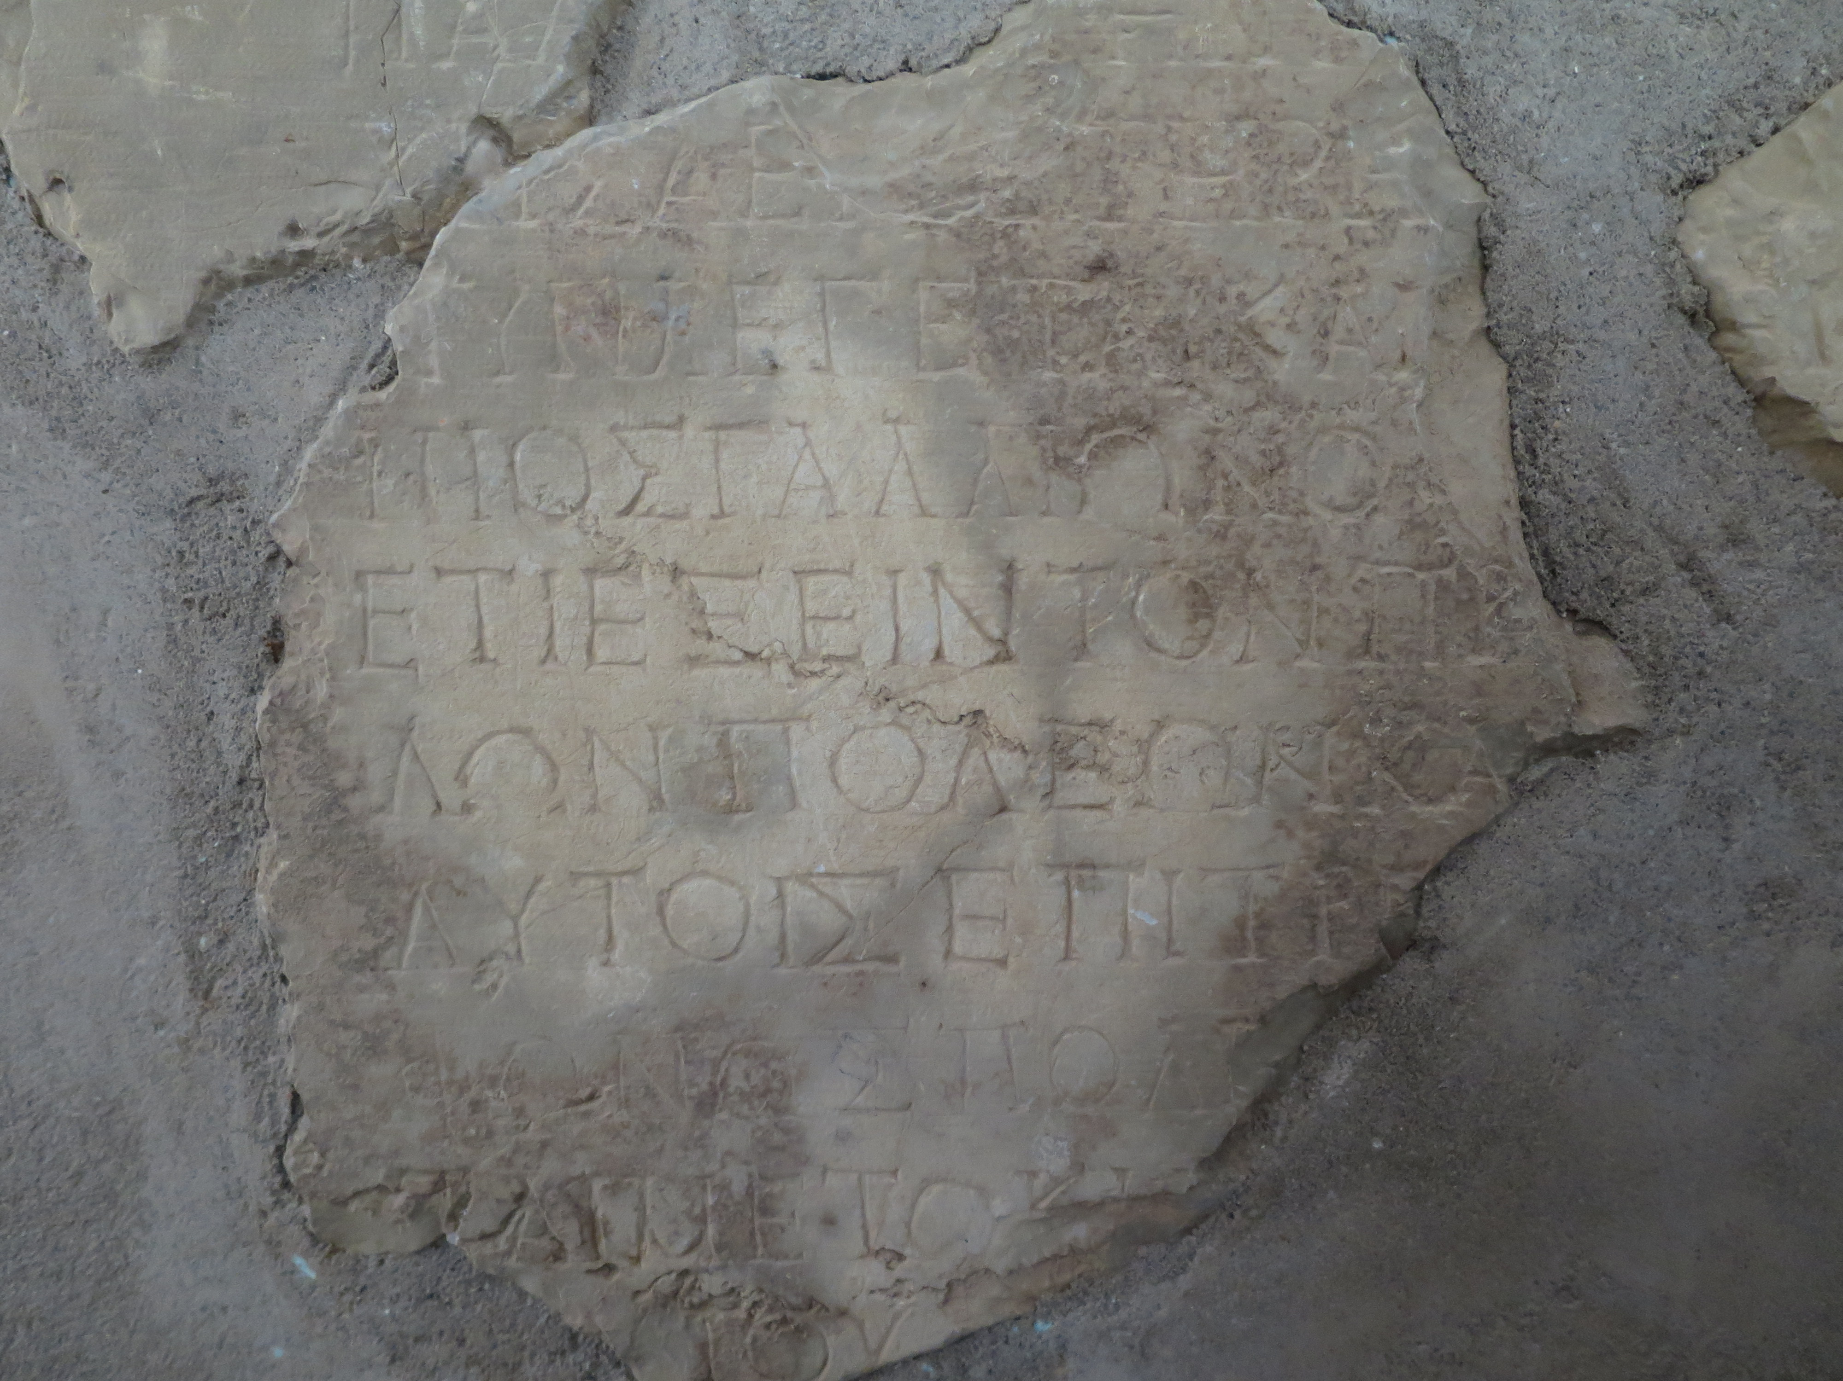
Acts 18
¹¹ So Paul stayed there for the next year and a half, teaching the word of God.
¹² But when Gallio became governor of Achaia…
Delphi Stone
AD 51/52

Slide 53
Acts 18
¹² Some Jews rose up together against Paul and brought him before the governor for judgment.
¹³ They accused Paul of “persuading people to worship God in ways that are contrary to our law.”

Slide 54
Acts 18
¹⁴ But just as Paul started to make his defense, Gallio turned to Paul’s accusers and said, “Listen, you Jews, if this were a case involving some wrongdoing or a serious crime, I would have a reason to accept your case.
¹⁵ But since it is merely a question of words and names and your Jewish law, take care of it yourselves. I refuse to judge such matters.”

Slide 55
Acts 18
¹⁶ And he threw them out of the courtroom.
¹⁷ The crowd then grabbed Sosthenes, the leader of the synagogue, and beat him right there in the courtroom…

Slide 56
Acts 18
¹⁶ And he threw them out of the courtroom.
¹⁷ The crowd then grabbed Sosthenes, the leader of the synagogue, and beat him right there in the courtroom…
But Gallio paid no attention.

Slide 57
Acts 18
¹⁶ And he threw them out of the courtroom.
¹⁷ The crowd then grabbed Sosthenes, the leader of the synagogue, and beat him right there in the courtroom…
But Gallio paid no attention.
¹⁸ Paul stayed on in Corinth for some time. Then he left the brothers and sailed for Syria.

Slide 58
1 Corinthians 1
¹ Paul, called to be an apostle of Christ Jesus by the will of God, and our brother Sosthenes.

Slide 59
1 Corinthians 1
² To the church of God in Corinth, to those sanctified in Christ Jesus and called to be holy, together with all those everywhere who call on the name of our Lord Jesus Christ—their Lord and ours:
³ Grace and peace to you from God our Father and the Lord Jesus Christ.

Slide 60
1 Corinthians 1
² To the church of God in Corinth, to those sanctified in Christ Jesus and called to be holy, together with all those everywhere who call on the name of our Lord Jesus Christ—their Lord and ours:
³ Grace and peace to you from God our Father and the Lord Jesus Christ.
= “set apart” “to make distinct”

Slide 61
1 Corinthians 1
² To the church of God in Corinth, to those sanctified in Christ Jesus and called to be holy, together with all those everywhere who call on the name of our Lord Jesus Christ—their Lord and ours:
³ Grace and peace to you from God our Father and the Lord Jesus Christ.

Slide 62
1 Corinthians 1
⁴ I always thank God for you because of his grace given you in Christ Jesus.
⁵ For in him you have been enriched in every way—in all your speaking and in all your knowledge—
⁶ because our testimony about Christ was confirmed in you.

Slide 63
1 Corinthians 1
⁴ I always thank God for you because of his grace given you in Christ Jesus.
⁵ For in him you have been enriched in every way—in all your speaking and in all your knowledge—
⁶ because our testimony about Christ was confirmed in you.

Slide 64
1 Corinthians 1
⁷ Therefore you do not lack any spiritual gift as you eagerly wait for our Lord Jesus Christ to be revealed.
⁸ He will keep you strong to the end, so that you will be blameless on the day of our Lord Jesus Christ.
⁹ God, who has called you into fellowship with his Son Jesus Christ our Lord, is faithful.

Slide 65
1 Corinthians 1
⁷ Therefore you do not lack any spiritual gift as you eagerly wait for our Lord Jesus Christ to be revealed.
⁸ He will keep you strong to the end, so that you will be blameless on the day of our Lord Jesus Christ.
⁹ God, who has called you into fellowship with his Son Jesus Christ our Lord, is faithful.

Slide 66
1 Corinthians 1
⁷ Therefore you do not lack any spiritual gift as you eagerly wait for our Lord Jesus Christ to be revealed.
⁸ He will keep you strong to the end, so that you will be blameless on the day of our Lord Jesus Christ.
⁹ God, who has called you into fellowship with his Son Jesus Christ our Lord, is faithful.

Slide 67
Application
❶ God wants to meet you where you’re at in your life.

Slide 68
Application
❶ God wants to meet you where you’re at in your life.
❷ God calls on us shine like a beacon of light in the dark world in which we live.

Slide 69
1 Corinthians
THE BOOK OF
1:1-9: Shining light in a dark place

