Slide 1
James 1:1-11
Walking with God through Suffering

Slide 2
Have you asked yourself…
Why is God allowing me to go through severe suffering? Why me? Why now?
Why hasn’t my career path worked out the way I planned?
How come my romantic life hasn’t come together the way I’d hoped?
Why am I serving twice as much,
but I’m seeing half of the results?
Is this all my fault?

Slide 3
(Jas. 1:1) James, a bond-servant of God and of the Lord Jesus Christ,
to the twelve tribes who are dispersed abroad: Greetings.

Slide 4
(Jas. 1:1) James, a bond-servant of God and of the Lord Jesus Christ,
to the twelve tribes who are dispersed abroad: Greetings.
Author: Jesus’ half-brother (Mt. 13:55)
The simple title “James” implies an influential man—not an obscure person.
James stayed in Jerusalem, and his letter is steeped in OT Jewish teaching.
James’ language is similar to Acts 15.

Slide 5
(Jas. 1:1) James, a bond-servant of God and of the Lord Jesus Christ,
to the twelve tribes who are dispersed abroad: Greetings.
Jesus transformed James’ life!
Originally, James didn’t believe in Jesus (Jn. 7:5; Mk. 3:21).
Then, Jesus appeared to him! (1 Cor. 15:7)
He became an “apostle” (Gal. 1:19), a “pillar” (Gal. 2:9), and finally, a martyr…

Slide 6
[Albinus the high priest] assembled the Sanhedrin of judges and brought before them
the brother of Jesus,
who was called Christ,
whose name was James,
and some of his companions.

Slide 7
When [Albinus] had formed an accusation against them as breakers of the law,
he delivered them to be stoned.

Slide 8
(Jas. 1:1) James, a bond-servant of God and of the Lord Jesus Christ,
to the twelve tribes who are dispersed abroad: Greetings.

Slide 9
(Jas. 1:1) James, a bond-servant of God and of the Lord Jesus Christ,
to the twelve tribes who are dispersed abroad: Greetings.
Twelve tribes?
Jewish believers in Jesus (cf. Acts 26:7; Mt. 19:28).
They met in the “assembly” (Jas. 2:2; synagōgē).
Many allusions to the OT (Jas. 2:19).

Slide 10
(Jas. 1:2) Consider it all joy, my brethren, when you encounter various trials,
³ knowing that the testing of your faith produces endurance.

Slide 11
(Jas. 1:2) Consider it all joy, my brethren, when you encounter various trials,
³ knowing that the testing of your faith produces endurance.

Slide 12
“But what about the suffering of innocent people?”
There is no logical problem with God and evil coexisting.
William Rowe (1979). ‘The Problem Of Evil And Some Varieties Of Atheism,’ American Philosophical Quarterly. Vol. 16. 4. 335—see footnote.
Michael Martin (1978). ‘Is Evil Evidence Against the Existence of God?’ Mind, New Series, Vol. 87, No. 347: 429.
Paul Draper (1989). ‘Pain and Pleasure: An Evidential Problem For Theists,’ Nous. 23:349. See footnote.
How could we know evil is meaningless?
What’s the alternative?
How does rejecting God help our suffering?

Slide 13
(Jas. 1:2) Consider it all joy, my brethren, when you encounter various trials,
³ knowing that the testing of your faith produces endurance.
Are you ready for the suffering that’s currently on its way?

Slide 14
(Jas. 1:2) Consider it all joy, my brethren, when you encounter various trials,
³ knowing that the testing of your faith produces endurance.
The battle begins in the mind, but eventually invades the heart.

Slide 15
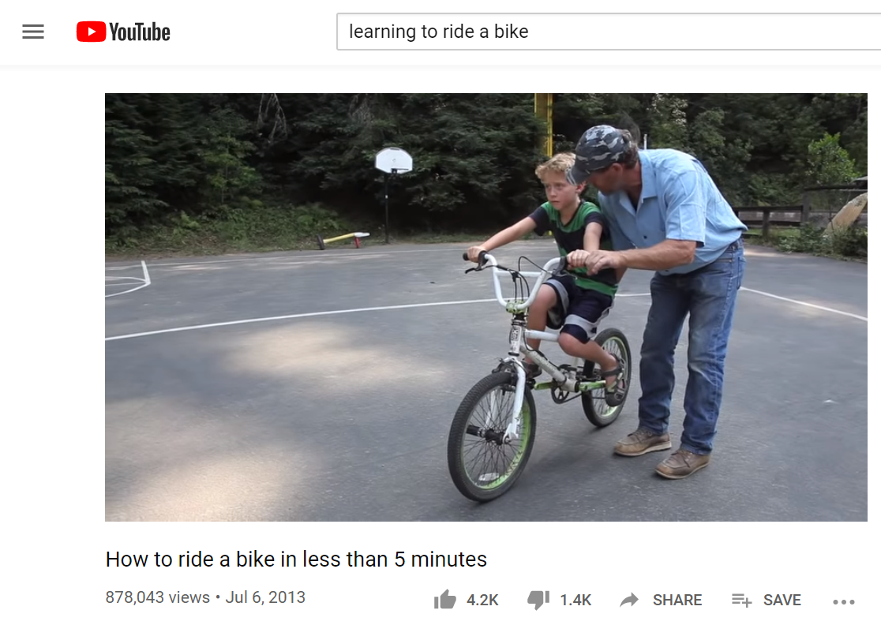
(Jas. 1:2) Consider it all joy, my brethren, when you encounter various trials,
³ knowing that the testing of your faith produces endurance.
“Testing” (dokimion)
Used for identifying fake currency (LXX).
Haarbeck, NIDNT (3:808).
“Approved” (Rom. 14:18; 16:10; 2 Cor. 10:18).
Can’t be learned in a book or a video tutorial!

Slide 16
(Jas. 1:2) Consider it all joy, my brethren, when you encounter various trials,
³ knowing that the testing of your faith produces endurance.
“Testing” (dokimion)
Used for identifying fake currency (LXX).
Haarbeck, NIDNT (3:808).
“Approved” (Rom. 14:18; 16:10; 2 Cor. 10:18).
Can’t be learned in a book or a video tutorial!

Slide 17
(Jas. 1:2) Consider it all joy, my brethren, when you encounter various trials,
³ knowing that the testing of your faith produces endurance.
“Endurance” (hypomonē)
Hypo (“under”)
Menō (“remain” or “stay”).
“Stay put” or “stand your ground.”

Slide 18
(Jas. 1:4) Let endurance have its perfect result,
that you may be perfect and complete, lacking in nothing.

Slide 19
(Jas. 1:4) Let endurance have its perfect result,
that you may be perfect and complete, lacking in nothing.
Isn’t it possible to go through suffering and still regret it?
Think of events that deeply changed you as a person.
Were they painful or painless?
If you were asked beforehand, would you have allowed it?
Now that it’s over, would you take it back if you could?
“Perfect” (teleios)
(Jas. 3:2) “We all stumble in many ways.”
“Complete, expert, mature, full-grown” (BDAG).
“Mature” (1 Cor. 2:6; 14:20; Eph. 4:13; Heb. 5:14).

Slide 20
(Jas. 1:4) Let endurance have its perfect result,
that you may be perfect and complete, lacking in nothing.
YES!
Think of events that deeply changed you as a person.
Were they painful or painless?
If you were asked beforehand, would you have allowed it?
Now that it’s over, would you take it back if you could?
“Perfect” (teleios)
(Jas. 3:2) “We all stumble in many ways.”
“Complete, expert, mature, full-grown” (BDAG).
“Mature” (1 Cor. 2:6; 14:20; Eph. 4:13; Heb. 5:14).

Slide 21
(Jas. 1:5) But if any of you lacks wisdom, let him ask of God, who gives to all generously and without reproach, and it will be given to him.

Slide 22
(Jas. 1:5) But if any of you lacks wisdom, let him ask of God, who gives to all generously and without reproach, and it will be given to him.
We need to actively seek wisdom during these times.

Slide 23
(Jas. 1:6) But he must ask in faith
without any doubting,
for the one who doubts is like the surf of the sea, driven and tossed by the wind.

Slide 24
(Jas. 1:7) For that man ought not to expect that he will receive anything from the Lord,
⁸ being a double-minded man, unstable in all his ways.
Is it a sin to doubt?
We need a “mustard seed” of faith (Mt. 17:20).
“I do believe; help my unbelief!” (Mk. 9:24)
“Have mercy on some, who are doubting” (Jude 22).
Thomas doubted Christ (Jn. 20:24).

Slide 25
(Jas. 1:7) For that man ought not to expect that he will receive anything from the Lord,
⁸ being a double-minded man, unstable in all his ways.
Doubting (diakrino)
Dia (“through”)
Krino (“to judge”).
“to conclude that there is a difference, make a distinction, differentiate” (BDAG).

Slide 26
(Jas. 1:7) For that man ought not to expect that he will receive anything from the Lord,
⁸ being a double-minded man, unstable in all his ways.
(Jas. 4:4) You adulterers!
Don’t you realize that friendship with the world makes you an enemy of God?
If you want to be a friend of the world, you make yourself an enemy of God.
Double-minded (dipsychos)
Dis (“twice”) and psuchē (“soul” or “mind”).
Not intellectual, but ethical and spiritual (Jas. 4:8).

Slide 27
(Jas. 1:7) For that man ought not to expect that he will receive anything from the Lord,
⁸ being a double-minded man, unstable in all his ways.
(Jas. 4:8) Come near to God and he will come near to you.
Wash your hands, you sinners, and purify your hearts,
you double-minded.
Double-minded (dipsychos)
Dis (“twice”) and psuchē (“soul” or “mind”).
Not intellectual, but ethical and spiritual (Jas. 4:8).

Slide 28
(Jas. 1:7) For that man ought not to expect that he will receive anything from the Lord,
⁸ being a double-minded man, unstable in all his ways.
“I know God is real, but I don’t want to trust him or follow him.”
Double-minded (dipsychos)
Dis (“twice”) and psuchē (“soul” or “mind”).
Not intellectual, but ethical and spiritual (Jas. 4:8).
Conflicted commitments—not confusing evidence.
Like a man choosing between his wife and mistress.

Slide 29
(Jas. 1:7) For that man ought not to expect that he will receive anything from the Lord,
⁸ being a double-minded man, unstable in all his ways.
Results of being double-minded?
The “line goes dead” in prayer (v.7).
Broken expectations (v.7).
We become increasingly more unstable (v.8).
Truly the worst of both worlds!

Slide 30
(Jas. 1:9) The brother in humble circumstances
ought to take pride in his high position.

Slide 31
(Jas. 1:10) But the one who is rich
should take pride in his humiliation,
because he will pass away like a wild flower.

Slide 32
(Jas. 1:11) The hot sun rises and the grass withers; the little flower droops and falls, and its beauty fades away.
In the same way, the rich will fade away
with all of their achievements.

Slide 33
Some people never learn this.
Have you committed to walk with God through trials and suffering—no matter the cost?
It isn’t that God needs you…
It’s that you need Him!

