Slide 1
Philippians 1
Aspirations

Slide 2
Philippians 1
1:1 Paul and Timothy, bond-servants of Christ Jesus, to all the saints in Christ Jesus who are in Philippi, including the overseers and deacons: 2 Grace to you and peace from God our Father and the Lord Jesus Christ.

Slide 3
Philippians 1
1:1 Paul and Timothy, bond-servants of Christ Jesus, to all the saints in Christ Jesus who are in Philippi, including the overseers and deacons: 2 Grace to you and peace from God our Father and the Lord Jesus Christ.

Slide 4
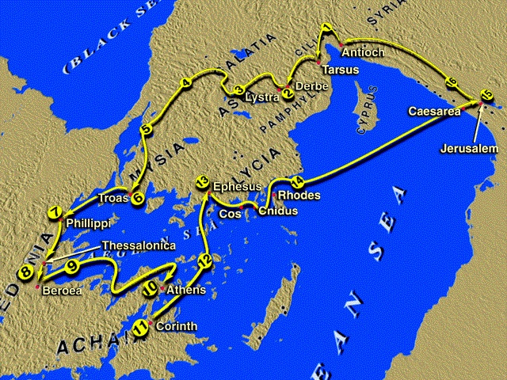
Philippians

Slide 5
Philippians

Slide 6
Philippians

Slide 7
Philippians 1
1:1 Paul and Timothy, bond-servants of Christ Jesus, to all the saints in Christ Jesus who are in Philippi, including the overseers and deacons: 2 Grace to you and peace from God our Father and the Lord Jesus Christ.

Slide 8
Philippians 1
1:1 Paul and Timothy, bond-servants of Christ Jesus, to all the saints in Christ Jesus who are in Philippi, including the overseers and deacons: 2 Grace to you and peace from God our Father and the Lord Jesus Christ.

Slide 9
Philippians 1
= “those set apart”
1:1 Paul and Timothy, bond-servants of Christ Jesus, to all the saints in Christ Jesus who are in Philippi, including the overseers and deacons: 2 Grace to you and peace from God our Father and the Lord Jesus Christ.

Slide 10
Philippians 1
= “those set apart” or “those belonging to God”
1:1 Paul and Timothy, bond-servants of Christ Jesus, to all the saints in Christ Jesus who are in Philippi, including the overseers and deacons: 2 Grace to you and peace from God our Father and the Lord Jesus Christ.

Slide 11
Philippians 1
= “those set apart” or “those belonging to God” Over 60X in the NT.
1:1 Paul and Timothy, bond-servants of Christ Jesus, to all the saints in Christ Jesus who are in Philippi, including the overseers and deacons: 2 Grace to you and peace from God our Father and the Lord Jesus Christ.

Slide 12
Philippians 1
1:1 Paul and Timothy, bond-servants of Christ Jesus, to all the saints in Christ Jesus who are in Philippi, including the overseers and deacons: 2 Grace to you and peace from God our Father and the Lord Jesus Christ.

Slide 13
Philippians 1
1:1 Paul and Timothy, bond-servants of Christ Jesus, to all the saints in Christ Jesus who are in Philippi, including the overseers and deacons: 2 Grace to you and peace from God our Father and the Lord Jesus Christ.
episcopoi
diakonoi

Slide 14
Philippians 1
Key verse showing universal perspicuity
1:1 Paul and Timothy, bond-servants of Christ Jesus, to all the saints in Christ Jesus who are in Philippi, including the overseers and deacons: 2 Grace to you and peace from God our Father and the Lord Jesus Christ.
episcopoi
diakonoi

Slide 15
Philippians 1
Key verse showing universal perspicuity
= ease of understanding
1:1 Paul and Timothy, bond-servants of Christ Jesus, to all the saints in Christ Jesus who are in Philippi, including the overseers and deacons: 2 Grace to you and peace from God our Father and the Lord Jesus Christ.
episcopoi
diakonoi

Slide 16
Philippians 1
1:2 Grace to you and peace from God our Father and the Lord Jesus Christ.
3 I thank my God in all my remembrance of you.
4 Whenever I pray, I make my requests for all of you with joy,

Slide 17
Philippians 1
5 in view of your participation in the gospel from the first day until now.

Slide 18
Philippians 1
5 in view of your participation in the gospel from the first day until now.

Slide 19
Philippians 1
5 in view of your participation in the gospel from the first day until now.
6 For I am confident of this very thing, that He who began a good work in you will perfect it until the day of Christ Jesus.

Slide 20
Philippians 1
5 in view of your participation in the gospel from the first day until now.
6 For I am confident of this very thing, that He who began a good work in you will perfect it until the day of Christ Jesus.

Slide 21
Philippians 1
5 in view of your participation in the gospel from the first day until now.
6 For I am confident of this very thing, that He who began a good work in you will perfect it until the day of Christ Jesus.
Security

Slide 22
Philippians 1
7 For it is only right for me to feel this way about you all, because I have you in my heart, since both in my imprisonment and in the defense and confirmation of the gospel, you all are partakers of grace with me.

Slide 23
Philippians 1
7 For it is only right for me to feel this way about you all, because I have you in my heart, since both in my imprisonment and in the defense and confirmation of the gospel, you all are partakers of grace with me.

Slide 24
Philippians 1
8 For God is my witness, how I long for you all with the affection of Christ Jesus.

Slide 25
Philippians 1
9 And this I pray, that your love may abound still more and more in real knowledge and all discernment,

Slide 26
Philippians 1
9 And this I pray, that your love may abound still more and more in real knowledge and all discernment,
10 so that you may approve the things that are excellent, in order to be sincere and blameless until the day of Christ

Slide 27
Philippians 1
9 And this I pray, that your love may abound still more and more in real knowledge and all discernment,
10 so that you may approve the things that are excellent, in order to be sincere and blameless until the day of Christ

Slide 28
Philippians 1
9 And this I pray, that your love may abound still more and more in real knowledge and all discernment,
10 so that you may approve the things that are excellent, in order to be sincere and blameless until the day of Christ
Therefore, our ability to love is not static

Slide 29
Philippians 1
Ways to see our love abound:
More new friends
Identify own self- protection strategies
Learn to take true interest in others
Devote time
Prayer
Read Spiritual Love
9 And this I pray, that your love may abound still more and more in real knowledge and all discernment,
10 so that you may approve the things that are excellent, in order to be sincere and blameless until the day of Christ
Therefore, our ability to love is not static

Slide 30
Philippians 1
9 And this I pray, that your love may abound still more and more in real knowledge and all discernment,
10 so that you may approve the things that are excellent, in order to be sincere and blameless until the day of Christ

Slide 31
Philippians 1
9 And this I pray, that your love may abound still more and more in real knowledge and all discernment,
10 so that you may approve the things that are excellent, in order to be sincere and blameless until the day of Christ

Slide 32
Philippians 1
9 And this I pray, that your love may abound still more and more in real knowledge and all discernment,
10 so that you may approve the things that are excellent, in order to be sincere and blameless until the day of Christ
Not enough to abound in love!

Slide 33
Philippians 1
Knowledge and discernment:
9 And this I pray, that your love may abound still more and more in real knowledge and all discernment,
10 so that you may approve the things that are excellent, in order to be sincere and blameless until the day of Christ
Not enough to abound in love!

Slide 34
Philippians 1
Knowledge and discernment:
‘Love the Lord your God with all your heart and with all your soul and with all your mind.’
9 And this I pray, that your love may abound still more and more in real knowledge and all discernment,
10 so that you may approve the things that are excellent, in order to be sincere and blameless until the day of Christ
Not enough to abound in love!

Slide 35
Philippians 1
Knowledge and discernment:
‘Love the Lord your God with all your heart and with all your soul and with all your mind.’
9 And this I pray, that your love may abound still more and more in real knowledge and all discernment,
10 so that you may approve the things that are excellent, in order to be sincere and blameless until the day of Christ
Not enough to abound in love!

Slide 36
Philippians 1
Knowledge and discernment:
‘Love the Lord your God with all your heart and with all your soul and with all your mind.’
Ephesians 4:14
9 And this I pray, that your love may abound still more and more in real knowledge and all discernment,
10 so that you may approve the things that are excellent, in order to be sincere and blameless until the day of Christ
Not enough to abound in love!

Slide 37
Philippians 1
Knowledge and discernment:
‘Love the Lord your God with all your heart and with all your soul and with all your mind.’
Ephesians 4:14
“As a result, we are no longer to be children, tossed here and there by waves and carried about by every wind of doctrine, by the trickery of men, by craftiness in deceitful scheming”
9 And this I pray, that your love may abound still more and more in real knowledge and all discernment,
10 so that you may approve the things that are excellent, in order to be sincere and blameless until the day of Christ
Not enough to abound in love!

Slide 38
Philippians 1
Knowledge and discernment:
‘Love the Lord your God with all your heart and with all your soul and with all your mind.’
Ephesians 4:14
“As a result, we are no longer to be children, tossed here and there by waves and carried about by every wind of doctrine, by the trickery of men, by craftiness in deceitful scheming”
9 And this I pray, that your love may abound still more and more in real knowledge and all discernment,
10 so that you may approve the things that are excellent, in order to be sincere and blameless until the day of Christ
Not enough to abound in love!

Slide 39
Philippians 1
Knowledge and discernment:
‘Love the Lord your God with all your heart and with all your soul and with all your mind.’
Ephesians 4:14
Our choice today
9 And this I pray, that your love may abound still more and more in real knowledge and all discernment,
10 so that you may approve the things that are excellent, in order to be sincere and blameless until the day of Christ
Not enough to abound in love!

Slide 40
Philippians
Ignorant faith:
Suspicious of learning and knowledge
Vulnerable to charisma
Unable to recognize falsehood
Undiscerning
Narrow
Out of step with modernity – isolated
Unpersuasive
Knowledge and discernment:
‘Love the Lord your God with all your heart and with all your soul and with all your mind.’
Ephesians 4:14
Our choice today
9 And this I pray, that your love may abound still more and more in real knowledge and all discernment,
10 so that you may approve the things that are excellent, in order to be sincere and blameless until the day of Christ

Slide 41
Philippians
Ignorant faith:
Quest for ecstasy and dissociation
Lost children
Isolated and dwindling
Knowledge and discernment:
‘Love the Lord your God with all your heart and with all your soul and with all your mind.’
Ephesians 4:14
Our choice today
9 And this I pray, that your love may abound still more and more in real knowledge and all discernment,
10 so that you may approve the things that are excellent, in order to be sincere and blameless until the day of Christ

Slide 42
Philippians
Real knowledge and discernment:
Know why we believe and can explain it
Actively engaged with all fields of learning
Respected as thoughtful believers
Able to refute lies
Credible to own kids
Enjoy learning
Knowledge and discernment:
‘Love the Lord your God with all your heart and with all your soul and with all your mind.’
Ephesians 4:14
Our choice today
9 And this I pray, that your love may abound still more and more in real knowledge and all discernment,
10 so that you may approve the things that are excellent, in order to be sincere and blameless until the day of Christ

Slide 43
Philippians 1
Knowledge and discernment:
‘Love the Lord your God with all your heart and with all your soul and with all your mind.’
Ephesians 4:14
Martin Luther and the Reformation brought in universal compulsory education
9 And this I pray, that your love may abound still more and more in real knowledge and all discernment,
10 so that you may approve the things that are excellent, in order to be sincere and blameless until the day of Christ

Slide 44
Philippians 1
Knowledge and discernment:
‘Love the Lord your God with all your heart and with all your soul and with all your mind.’
Ephesians 4:14
Current status
9 And this I pray, that your love may abound still more and more in real knowledge and all discernment,
10 so that you may approve the things that are excellent, in order to be sincere and blameless until the day of Christ

Slide 45
Philippians
2020 Barna nationwide survey
51% of “evangelicals” didn’t know what “The Great Commission” is!
Knowledge and discernment:
‘Love the Lord your God with all your heart and with all your soul and with all your mind.’
Ephesians 4:14
Current status
9 And this I pray, that your love may abound still more and more in real knowledge and all discernment,
10 so that you may approve the things that are excellent, in order to be sincere and blameless until the day of Christ

Slide 46
Philippians
2020 Barna nationwide survey
Does ring a bell for 25%, though they can’t remember what it is.
Knowledge and discernment:
‘Love the Lord your God with all your heart and with all your soul and with all your mind.’
Ephesians 4:14
Current status
9 And this I pray, that your love may abound still more and more in real knowledge and all discernment,
10 so that you may approve the things that are excellent, in order to be sincere and blameless until the day of Christ

Slide 47
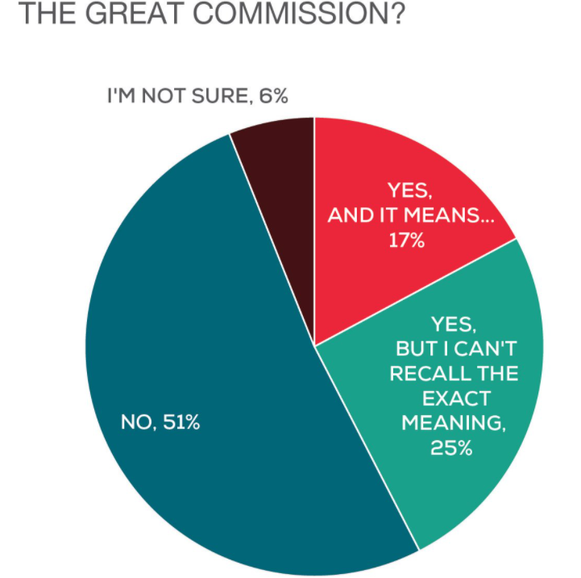
Philippians
2020 Barna nationwide survey
Does ring a bell for 25%, though they can’t remember what it is.
Knowledge and discernment:
‘Love the Lord your God with all your heart and with all your soul and with all your mind.’
Ephesians 4:14
Current status
9 And this I pray, that your love may abound still more and more in real knowledge and all discernment,
10 so that you may approve the things that are excellent, in order to be sincere and blameless until the day of Christ

Slide 48
Philippians
2020 Barna nationwide survey
Does ring a bell for 25%, though they can’t remember what it is.
Knowledge and discernment:
‘Love the Lord your God with all your heart and with all your soul and with all your mind.’
Ephesians 4:14
Current status
Only 10% of millennials
9 And this I pray, that your love may abound still more and more in real knowledge and all discernment,
10 so that you may approve the things that are excellent, in order to be sincere and blameless until the day of Christ

Slide 49
Philippians
American Enterprise Institute: 27% of white evangelicals believe the Qanon conspiracy theory!
Knowledge and discernment:
‘Love the Lord your God with all your heart and with all your soul and with all your mind.’
Ephesians 4:14
Current status
9 And this I pray, that your love may abound still more and more in real knowledge and all discernment,
10 so that you may approve the things that are excellent, in order to be sincere and blameless until the day of Christ

Slide 50
Philippians
American Enterprise Institute: 27% of white evangelicals believe the Qanon conspiracy theory!
Data from the Barna Research Group:
Fewer than half of all adults can name the four gospels.
Many Christians cannot identify more than two or three of the disciples.
60 percent of Americans can’t name even five of the Ten Commandments
Knowledge and discernment:
‘Love the Lord your God with all your heart and with all your soul and with all your mind.’
Ephesians 4:14
Current status
9 And this I pray, that your love may abound still more and more in real knowledge and all discernment,
10 so that you may approve the things that are excellent, in order to be sincere and blameless until the day of Christ

Slide 51
Philippians 1
9 And this I pray, that your love may abound still more and more in real knowledge and all discernment,
10 so that you may approve the things that are excellent, in order to be sincere and blameless until the day of Christ

Slide 52
Philippians 1
9 And this I pray, that your love may abound still more and more in real knowledge and all discernment,
10 so that you may approve the things that are excellent, in order to be sincere and blameless until the day of Christ

Slide 53
Philippians 1
9 And this I pray, that your love may abound still more and more in real knowledge and all discernment,
10 so that you may approve the things that are excellent, in order to be sincere and blameless until the day of Christ
NLT: “to understand what really matters”

Slide 54
Philippians 1
9 And this I pray, that your love may abound still more and more in real knowledge and all discernment,
10 so that you may approve the things that are excellent, in order to be sincere and blameless until the day of Christ
NLT: “to understand what really matters”
NIV “to discern what is best”

Slide 55
Philippians 1
11 having been filled with the fruit of goodness which comes through Jesus Christ, to the glory and praise of God.

Slide 56
Philippians 1
11 having been filled with the fruit of goodness which comes through Jesus Christ, to the glory and praise of God.

Slide 57
Philippians 1
11 having been filled with the fruit of goodness which comes through Jesus Christ, to the glory and praise of God.
Plainly and basically good.

Slide 58
Philippians 1
11 having been filled with the fruit of goodness which comes through Jesus Christ, to the glory and praise of God.
Plainly and basically good.
= friendly, helpful, not hostile, etc.

Slide 59
Philippians 1
11 having been filled with the fruit of goodness which comes through Jesus Christ, to the glory and praise of God.
Plainly and basically good.
= friendly, helpful, not hostile, etc.
Comes through Jesus

Slide 60
Philippians 1
Comments?
Questions?
Experiences?

