Slide 1
Acts
Acts 13 Sent

Slide 2
Acts
Chronicling the progress of “the gospel”

Slide 3
Acts
Chap 13 gets down to business: the “remotest parts of the earth”

Slide 4
Acts
^{Acts 11:19} So then those who were scattered because of the persecution that occurred in connection with Stephen made their way to Phoenicia and Cyprus and Antioch, speaking the word to no one except to Jews alone.
Chronicling the progress of “the gospel”

Slide 5
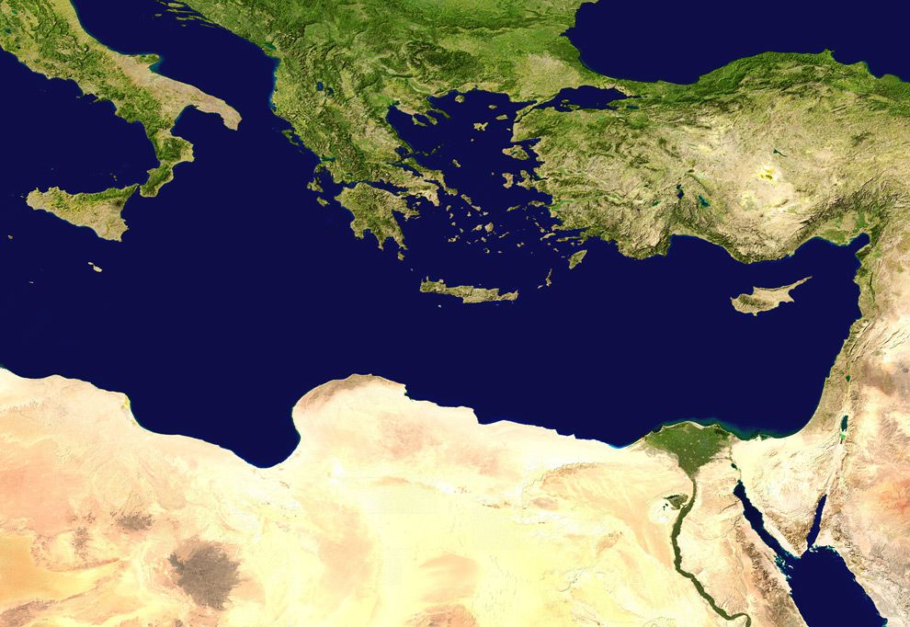
Acts
Antioch
Jerusalem
^{Acts 11:19} So then those who were scattered because of the persecution that occurred in connection with Stephen made their way to Phoenicia and Cyprus and Antioch, speaking the word to no one except to Jews alone.
Chronicling the progress of “the gospel”

Slide 6
Acts
Antioch
Jerusalem
^{Acts 11:19} So then those who were scattered because of the persecution that occurred in connection with Stephen made their way to Phoenicia and Cyprus and Antioch, speaking the word to no one except to Jews alone.
Chronicling the progress of “the gospel”

Slide 7
Acts
Antioch
Jerusalem
^{Acts 11:20} But there were some of them, men of Cyprus and Cyrene, who came to Antioch and began speaking to the Greeks also, preaching the Lord Jesus. ²¹ And the hand of the Lord was with them, and a large number who believed turned to the Lord.
Chronicling the progress of “the gospel”

Slide 8
Acts
Antioch
Jerusalem
^{Acts 11:20} But there were some of them, men of Cyprus and Cyrene, who came to Antioch and began speaking to the Greeks also, preaching the Lord Jesus. ²¹ And the hand of the Lord was with them, and a large number who believed turned to the Lord.
Chronicling the progress of “the gospel”

Slide 9
Acts
Antioch
Jerusalem
^{Acts 11:22} The news about them reached the ears of the church at Jerusalem, and they sent Barnabas off to Antioch. ²³ Then when he arrived and witnessed the grace of God, he rejoiced and began to encourage them all with resolute heart to remain true to the Lord;
^{Acts 11:22} The news about them reached the ears of the church at Jerusalem, and they sent Barnabas off to Antioch. ²³ Then when he arrived and witnessed the grace of God, he rejoiced and began to encourage them all with resolute heart to remain true to the Lord;
Chronicling the progress of “the gospel”

Slide 10
Acts
Antioch
Jerusalem
^{Acts 11:24} for he was a good man, and full of the Holy Spirit and of faith. And considerable numbers were brought to the Lord. ²⁵ And he left for Tarsus to look for Saul; ²⁶ and when he had found him, he brought him to Antioch.
Chronicling the progress of “the gospel”

Slide 11
Acts
Antioch
Jerusalem
^{Acts 11:24} for he was a good man, and full of the Holy Spirit and of faith. And considerable numbers were brought to the Lord. ²⁵ And he left for Tarsus to look for Saul; ²⁶ and when he had found him, he brought him to Antioch.
Chronicling the progress of “the gospel”

Slide 12
Acts
Tarsus
Antioch
Jerusalem
^{Acts 11:24} for he was a good man, and full of the Holy Spirit and of faith. And considerable numbers were brought to the Lord. ²⁵ And he left for Tarsus to look for Saul; ²⁶ and when he had found him, he brought him to Antioch.
Chronicling the progress of “the gospel”

Slide 13
Acts
Tarsus
Antioch
Jerusalem
^{Acts 11:24} for he was a good man, and full of the Holy Spirit and of faith. And considerable numbers were brought to the Lord. ²⁵ And he left for Tarsus to look for Saul; ²⁶ and when he had found him, he brought him to Antioch.
^{Acts 11:24} for he was a good man, and full of the Holy Spirit and of faith. And considerable numbers were brought to the Lord. ²⁵ And he left for Tarsus to look for Saul; ²⁶ and when he had found him, he brought him to Antioch.
Chronicling the progress of “the gospel”

Slide 14
Acts
Tarsus
Antioch
Jerusalem
^{Acts 11:25} And for an entire year they met with the church and taught considerable numbers; and the disciples were first called Christians in Antioch.
Chronicling the progress of “the gospel”

Slide 15
Acts
Tarsus
Antioch
Jerusalem
So God is doing something in Antioch!
^{Acts 11:25} And for an entire year they met with the church and taught considerable numbers; and the disciples were first called Christians in Antioch.
Chronicling the progress of “the gospel”

Slide 16
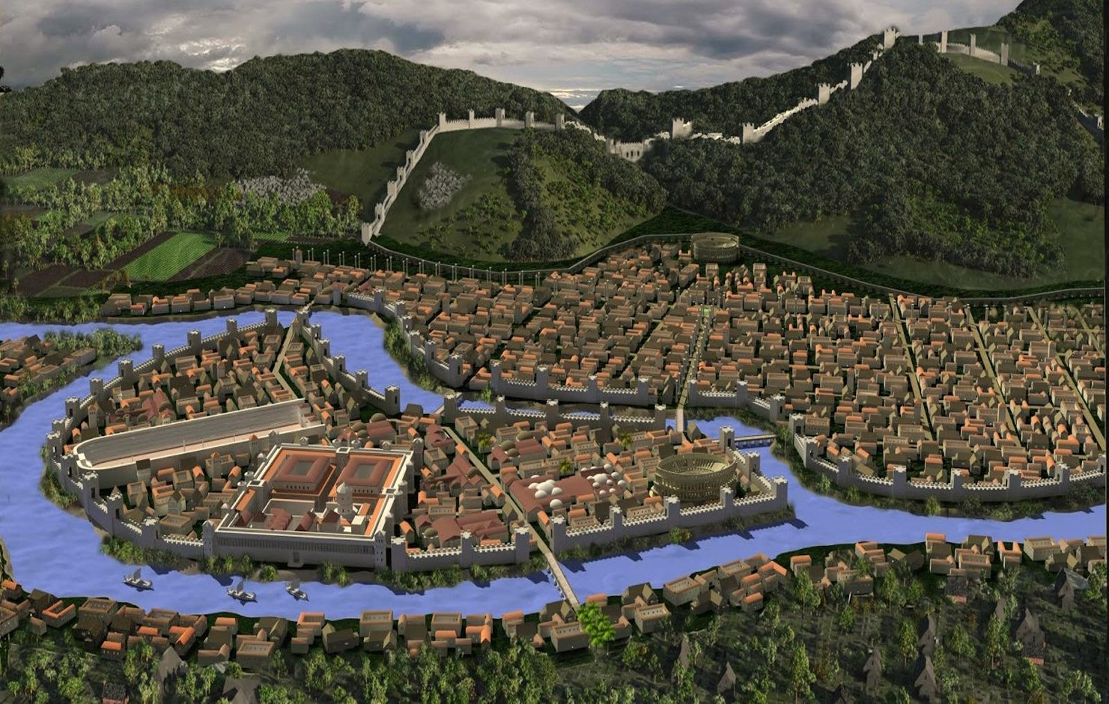
Acts
The Church at Antioch
A spontaneous movement
Reaching gentiles in a mixed city
Antioch
So God is doing something in Antioch!
^{Acts 11:25} And for an entire year they met with the church and taught considerable numbers; and the disciples were first called Christians in Antioch.
^{Acts 11:25} And for an entire year they met with the church and taught considerable numbers; and the disciples were first called Christians in Antioch.
Chronicling the progress of “the gospel”

Slide 17
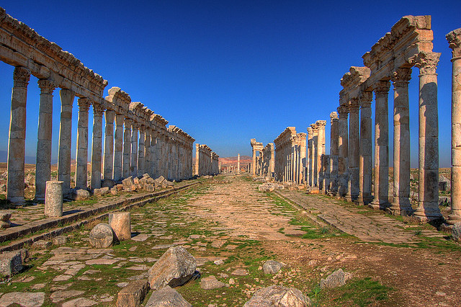
Acts
The Church at Antioch
A spontaneous movement
Reaching gentiles in a mixed city
Antioch
So God is doing something in Antioch!
^{Acts 11:25} And for an entire year they met with the church and taught considerable numbers; and the disciples were first called Christians in Antioch.
^{Acts 11:25} And for an entire year they met with the church and taught considerable numbers; and the disciples were first called Christians in Antioch.
Chronicling the progress of “the gospel”

Slide 18
The Church at Antioch
A spontaneous movement
Reaching gentiles in a mixed city
Unified with Jerusalem Church
Antioch
^{Acts 11:29} And in the proportion that any of the disciples had means, each of them determined to send a contribution for the relief of the brethren living in Judea. ³⁰ And this they did, sending it in charge of Barnabas and Saul to the elders.
^{Acts 11:25} And for an entire year they met with the church and taught considerable numbers; and the disciples were first called Christians in Antioch.
^{Acts 11:25} And for an entire year they met with the church and taught considerable numbers; and the disciples were first called Christians in Antioch.
Chronicling the progress of “the gospel”

Slide 19
The Church at Antioch
A spontaneous movement
Reaching gentiles in a mixed city
Unified with Jerusalem Church
Generous
Antioch
^{Acts 11:29} And in the proportion that any of the disciples had means, each of them determined to send a contribution for the relief of the brethren living in Judea. ³⁰ And this they did, sending it in charge of Barnabas and Saul to the elders.
^{Acts 11:25} And for an entire year they met with the church and taught considerable numbers; and the disciples were first called Christians in Antioch.
^{Acts 11:25} And for an entire year they met with the church and taught considerable numbers; and the disciples were first called Christians in Antioch.
Chronicling the progress of “the gospel”

Slide 20
The Church at Antioch
A spontaneous movement
Reaching gentiles in a mixed city
Unified with Jerusalem Church
Generous
New leaders
Antioch
^{Acts 11:29} And in the proportion that any of the disciples had means, each of them determined to send a contribution for the relief of the brethren living in Judea. ³⁰ And this they did, sending it in charge of Barnabas and Saul to the elders.
^{Acts 11:25} And for an entire year they met with the church and taught considerable numbers; and the disciples were first called Christians in Antioch.
^{Acts 11:25} And for an entire year they met with the church and taught considerable numbers; and the disciples were first called Christians in Antioch.
Chronicling the progress of “the gospel”

Slide 21
The Church at Antioch
A spontaneous movement
Reaching gentiles in a mixed city
Unified with Jerusalem Church
Generous
New leaders
Antioch
^{Acts 13:1} Now there were at Antioch, in the church that was there, prophets and teachers: Barnabas, and Simeon who was called Niger, and Lucius of Cyrene, and Manaen who had been brought up with Herod the tetrarch, and Saul.
^{Acts 11:25} And for an entire year they met with the church and taught considerable numbers; and the disciples were first called Christians in Antioch.
Chronicling the progress of “the gospel”

Slide 22
The Church at Antioch
A spontaneous movement
Reaching gentiles in a mixed city
Unified with Jerusalem Church
Generous
New leaders
Diverse
Antioch
^{Acts 13:1} Now there were at Antioch, in the church that was there, prophets and teachers: Barnabas, and Simeon who was called Niger, and Lucius of Cyrene, and Manaen who had been brought up with Herod the tetrarch, and Saul.
^{Acts 13:1} Now there were at Antioch, in the church that was there, prophets and teachers: Barnabas, and Simeon who was called Niger, and Lucius of Cyrene, and Manaen who had been brought up with Herod the tetrarch, and Saul.
^{Acts 13:1} Now there were at Antioch, in the church that was there, prophets and teachers: Barnabas, and Simeon who was called Niger, and Lucius of Cyrene, and Manaen who had been brought up with Herod the tetrarch, and Saul.
^{Acts 13:1} Now there were at Antioch, in the church that was there, prophets and teachers: Barnabas, and Simeon who was called Niger, and Lucius of Cyrene, and Manaen who had been brought up with Herod the tetrarch, and Saul.
^{Acts 13:1} Now there were at Antioch, in the church that was there, prophets and teachers: Barnabas, and Simeon who was called Niger, and Lucius of Cyrene, and Manaen who had been brought up with Herod the tetrarch, and Saul.
^{Acts 13:1} Now there were at Antioch, in the church that was there, prophets and teachers: Barnabas, and Simeon who was called Niger, and Lucius of Cyrene, and Manaen who had been brought up with Herod the tetrarch, and Saul.
^{Acts 11:25} And for an entire year they met with the church and taught considerable numbers; and the disciples were first called Christians in Antioch.
Chronicling the progress of “the gospel”

Slide 23
The Church at Antioch
A spontaneous movement
Reaching gentiles in a mixed city
Unified with Jerusalem Church
Generous
New leaders
Diverse
Antioch
^{Acts 13:1} Now there were at Antioch, in the church that was there, prophets and teachers: Barnabas, and Simeon who was called Niger, and Lucius of Cyrene, and Manaen who had been brought up with Herod the tetrarch, and Saul.
^{Acts 13:1} Now there were at Antioch, in the church that was there, prophets and teachers: Barnabas, and Simeon who was called Niger, and Lucius of Cyrene, and Manaen who had been brought up with Herod the tetrarch, and Saul.
^{Acts 13:1} Now there were at Antioch, in the church that was there, prophets and teachers: Barnabas, and Simeon who was called Niger, and Lucius of Cyrene, and Manaen who had been brought up with Herod the tetrarch, and Saul.
^{Acts 13:1} Now there were at Antioch, in the church that was there, prophets and teachers: Barnabas, and Simeon who was called Niger, and Lucius of Cyrene, and Manaen who had been brought up with Herod the tetrarch, and Saul.
^{Acts 13:1} Now there were at Antioch, in the church that was there, prophets and teachers: Barnabas, and Simeon who was called Niger, and Lucius of Cyrene, and Manaen who had been brought up with Herod the tetrarch, and Saul.
^{Acts 13:1} Now there were at Antioch, in the church that was there, prophets and teachers: Barnabas, and Simeon who was called Niger, and Lucius of Cyrene, and Manaen who had been brought up with Herod the tetrarch, and Saul.
^{Acts 11:25} And for an entire year they met with the church and taught considerable numbers; and the disciples were first called Christians in Antioch.
Chronicling the progress of “the gospel”

Slide 24
The Church at Antioch
A spontaneous movement
Reaching gentiles in a mixed city
Unified with Jerusalem Church
Generous
New leaders
Diverse
Beachhead in the gentile world
Antioch
^{Acts 13:1} Now there were at Antioch, in the church that was there, prophets and teachers: Barnabas, and Simeon who was called Niger, and Lucius of Cyrene, and Manaen who had been brought up with Herod the tetrarch, and Saul.
^{Acts 13:1} Now there were at Antioch, in the church that was there, prophets and teachers: Barnabas, and Simeon who was called Niger, and Lucius of Cyrene, and Manaen who had been brought up with Herod the tetrarch, and Saul.
^{Acts 13:1} Now there were at Antioch, in the church that was there, prophets and teachers: Barnabas, and Simeon who was called Niger, and Lucius of Cyrene, and Manaen who had been brought up with Herod the tetrarch, and Saul.
^{Acts 13:1} Now there were at Antioch, in the church that was there, prophets and teachers: Barnabas, and Simeon who was called Niger, and Lucius of Cyrene, and Manaen who had been brought up with Herod the tetrarch, and Saul.
^{Acts 13:1} Now there were at Antioch, in the church that was there, prophets and teachers: Barnabas, and Simeon who was called Niger, and Lucius of Cyrene, and Manaen who had been brought up with Herod the tetrarch, and Saul.
^{Acts 13:1} Now there were at Antioch, in the church that was there, prophets and teachers: Barnabas, and Simeon who was called Niger, and Lucius of Cyrene, and Manaen who had been brought up with Herod the tetrarch, and Saul.
^{Acts 11:25} And for an entire year they met with the church and taught considerable numbers; and the disciples were first called Christians in Antioch.
Chronicling the progress of “the gospel”

Slide 25
The Church at Antioch
A spontaneous movement
Reaching gentiles in a mixed city
Unified with Jerusalem Church
Generous
New leaders
Diverse
Beachhead in the gentile world
A sending church
Antioch
^{Acts 13:1} Now there were at Antioch, in the church that was there, prophets and teachers: Barnabas, and Simeon who was called Niger, and Lucius of Cyrene, and Manaen who had been brought up with Herod the tetrarch, and Saul.
^{Acts 13:1} Now there were at Antioch, in the church that was there, prophets and teachers: Barnabas, and Simeon who was called Niger, and Lucius of Cyrene, and Manaen who had been brought up with Herod the tetrarch, and Saul.
^{Acts 13:1} Now there were at Antioch, in the church that was there, prophets and teachers: Barnabas, and Simeon who was called Niger, and Lucius of Cyrene, and Manaen who had been brought up with Herod the tetrarch, and Saul.
^{Acts 13:1} Now there were at Antioch, in the church that was there, prophets and teachers: Barnabas, and Simeon who was called Niger, and Lucius of Cyrene, and Manaen who had been brought up with Herod the tetrarch, and Saul.
^{Acts 13:1} Now there were at Antioch, in the church that was there, prophets and teachers: Barnabas, and Simeon who was called Niger, and Lucius of Cyrene, and Manaen who had been brought up with Herod the tetrarch, and Saul.
^{Acts 13:1} Now there were at Antioch, in the church that was there, prophets and teachers: Barnabas, and Simeon who was called Niger, and Lucius of Cyrene, and Manaen who had been brought up with Herod the tetrarch, and Saul.
^{Acts 11:25} And for an entire year they met with the church and taught considerable numbers; and the disciples were first called Christians in Antioch.
Chronicling the progress of “the gospel”

Slide 26
The Church at Antioch
A spontaneous movement
Reaching gentiles in a mixed city
Unified with Jerusalem Church
Generous
New leaders
Diverse
Beachhead in the gentile world
A sending church
Antioch
^{Acts 13:2} While they were ministering to the Lord and fasting, the Holy Spirit said, “Set apart for Me Barnabas and Saul for the work to which I have called them.” ³ Then, when they had fasted and prayed and laid their hands on them, they sent them away.

Slide 27
The First Missionary Journey
^{Acts 13:2} While they were ministering to the Lord and fasting, the Holy Spirit said, “Set apart for Me Barnabas and Saul for the work to which I have called them.” ³ Then, when they had fasted and prayed and laid their hands on them, they sent them away.

Slide 28
The First Missionary Journey
Principles of Adventuring for Christ:
^{Acts 13:2} While they were ministering to the Lord and fasting, the Holy Spirit said, “Set apart for Me Barnabas and Saul for the work to which I have called them.” ³ Then, when they had fasted and prayed and laid their hands on them, they sent them away.

Slide 29
The First Missionary Journey
Principles of Adventuring for Christ:
#1 The mission of Christ is led by the Holy Spirit
^{Acts 13:2} While they were ministering to the Lord and fasting, the Holy Spirit said, “Set apart for Me Barnabas and Saul for the work to which I have called them.” ³ Then, when they had fasted and prayed and laid their hands on them, they sent them away.

Slide 30
The First Missionary Journey
Principles of Adventuring for Christ:
#1 The mission of Christ is led by the Holy Spirit
^{Luke 24:49} And behold, I am sending forth the promise of My Father upon you; but you are to stay in the city until you are clothed with power from on high.”
^{Acts 13:2} While they were ministering to the Lord and fasting, the Holy Spirit said, “Set apart for Me Barnabas and Saul for the work to which I have called them.” ³ Then, when they had fasted and prayed and laid their hands on them, they sent them away.
^{Acts 1:8} but you will receive power when the Holy Spirit has come upon you; and you shall be My witnesses both in Jerusalem, and in all Judea and Samaria, and even to the remotest part of the earth.”

Slide 31
The First Missionary Journey
Principles of Adventuring for Christ:
#1 The mission of Christ is led by the Holy Spirit
^{Acts 13:4} So, being sent out by the Holy Spirit, they went down to Seleucia and from there they sailed to Cyprus.

Slide 32
The First Missionary Journey
Principles of Adventuring for Christ:
Antioch
#1 The mission of Christ is led by the Holy Spirit
^{Acts 13:4} So, being sent out by the Holy Spirit, they went down to Seleucia and from there they sailed to Cyprus.

Slide 33
The First Missionary Journey
Principles of Adventuring for Christ:
Antioch
#1 The mission of Christ is led by the Holy Spirit
^{Acts 13:4} So, being sent out by the Holy Spirit, they went down to Seleucia and from there they sailed to Cyprus.

Slide 34
The First Missionary Journey
This is a true adventure!
Principles of Adventuring for Christ:
Antioch
Exotic foreign places
Wildly Ambitious
#1 The mission of Christ is led by the Holy Spirit
Rigorous
Dangerous!
^{Acts 13:4} So, being sent out by the Holy Spirit, they went down to Seleucia and from there they sailed to Cyprus.

Slide 35
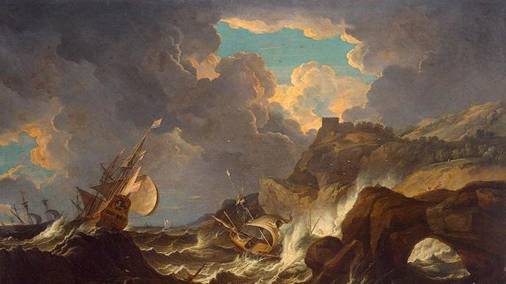
The First Missionary Journey
This is a true adventure!
Principles of Adventuring for Christ:
Antioch
#1 The mission of Christ is led by the Holy Spirit
^{Acts 13:4} So, being sent out by the Holy Spirit, they went down to Seleucia and from there they sailed to Cyprus.

Slide 36
The First Missionary Journey
#2 The essence of the mission is “proclaiming the word of God”
Principles of Adventuring for Christ:
Antioch
#1 The mission of Christ is led by the Holy Spirit
Salamis
^{Acts 13:5} When they reached Salamis, they began to proclaim the word of God in the synagogues of the Jews; and they also had John as their helper.
^{Acts 13:5} When they reached Salamis, they began to proclaim the word of God in the synagogues of the Jews; and they also had John as their helper.

Slide 37
The First Missionary Journey
Principles of Adventuring for Christ:
Antioch
#1 The mission of Christ is led by the Holy Spirit
Paphos
Salamis
^{Acts 13:6} When they had gone through the whole island as far as Paphos, they found a magician, a Jewish false prophet whose name was Bar-Jesus, ⁷ who was with the proconsul, Sergius Paulus, a man of intelligence. This man summoned Barnabas and Saul and sought to hear the word of God.
^{Acts 13:5} When they reached Salamis, they began to proclaim the word of God in the synagogues of the Jews; and they also had John as their helper.

Slide 38
The First Missionary Journey
Principles of Adventuring for Christ:
Antioch
#1 The mission of Christ is led by the Holy Spirit
Paphos
Salamis
^{Acts 13:6} When they had gone through the whole island as far as Paphos, they found a magician, a Jewish false prophet whose name was Bar-Jesus, ⁷ who was with the proconsul, Sergius Paulus, a man of intelligence. This man summoned Barnabas and Saul and sought to hear the word of God.
^{Acts 13:6} When they had gone through the whole island as far as Paphos, they found a magician, a Jewish false prophet whose name was Bar-Jesus, ⁷ who was with the proconsul, Sergius Paulus, a man of intelligence. This man summoned Barnabas and Saul and sought to hear the word of God.
^{Acts 13:5} When they reached Salamis, they began to proclaim the word of God in the synagogues of the Jews; and they also had John as their helper.

Slide 39
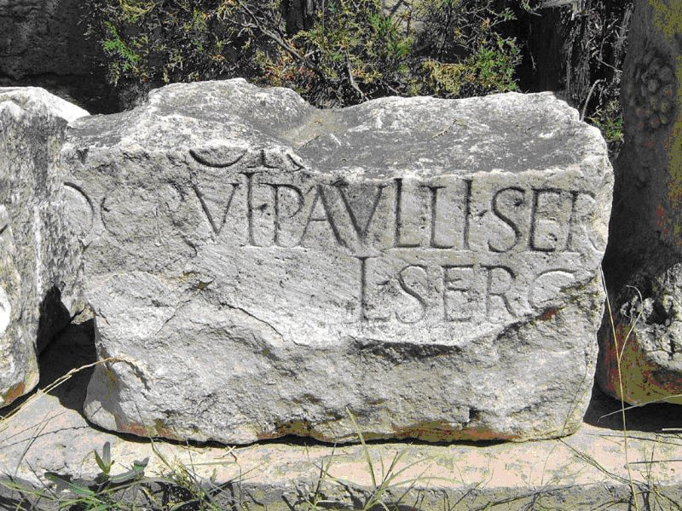
The First Missionary Journey
Principles of Adventuring for Christ:
Antioch
#1 The mission of Christ is led by the Holy Spirit
Paphos
Salamis
^{Acts 13:6} When they had gone through the whole island as far as Paphos, they found a magician, a Jewish false prophet whose name was Bar-Jesus, ⁷ who was with the proconsul, Sergius Paulus, a man of intelligence. This man summoned Barnabas and Saul and sought to hear the word of God.
^{Acts 13:6} When they had gone through the whole island as far as Paphos, they found a magician, a Jewish false prophet whose name was Bar-Jesus, ⁷ who was with the proconsul, Sergius Paulus, a man of intelligence. This man summoned Barnabas and Saul and sought to hear the word of God.
^{Acts 13:5} When they reached Salamis, they began to proclaim the word of God in the synagogues of the Jews; and they also had John as their helper.

Slide 40
The First Missionary Journey
Principles of Adventuring for Christ:
Antioch
#1 The mission of Christ is led by the Holy Spirit
Paphos
Salamis
^{Acts 13:6} When they had gone through the whole island as far as Paphos, they found a magician, a Jewish false prophet whose name was Bar-Jesus, ⁷ who was with the proconsul, Sergius Paulus, a man of intelligence. This man summoned Barnabas and Saul and sought to hear the word of God.
^{Acts 13:6} When they had gone through the whole island as far as Paphos, they found a magician, a Jewish false prophet whose name was Bar-Jesus, ⁷ who was with the proconsul, Sergius Paulus, a man of intelligence. This man summoned Barnabas and Saul and sought to hear the word of God.
^{Acts 13:5} When they reached Salamis, they began to proclaim the word of God in the synagogues of the Jews; and they also had John as their helper.

Slide 41
The First Missionary Journey
Principles of Adventuring for Christ:
Antioch
#1 The mission of Christ is led by the Holy Spirit
Paphos
Salamis
^{Acts 13:8} But Elymas the magician (for so his name is translated) was opposing them, seeking to turn the proconsul away from the faith.
^{Acts 13:5} When they reached Salamis, they began to proclaim the word of God in the synagogues of the Jews; and they also had John as their helper.

Slide 42
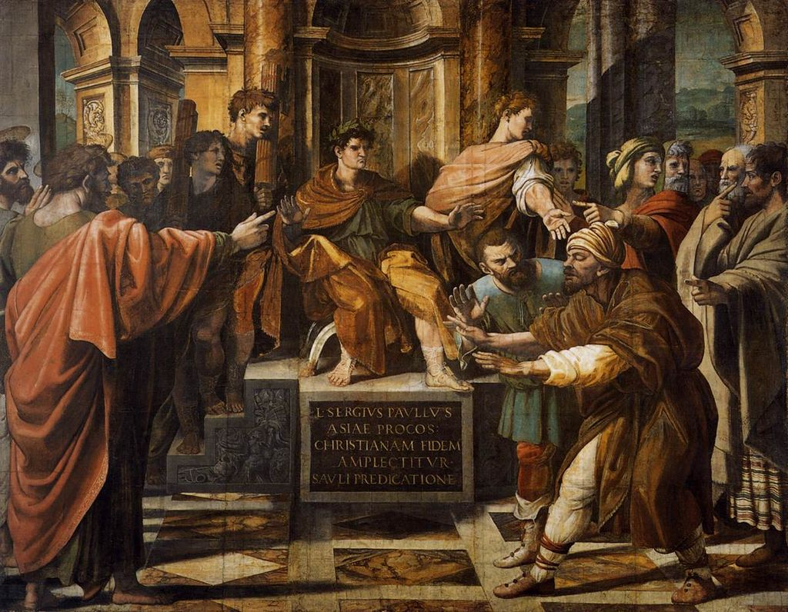
The First Missionary Journey
Principles of Adventuring for Christ:
Antioch
#1 The mission of Christ is led by the Holy Spirit
Paphos
Salamis
^{Acts 13:8} But Elymas the magician (for so his name is translated) was opposing them, seeking to turn the proconsul away from the faith.
^{Acts 13:5} When they reached Salamis, they began to proclaim the word of God in the synagogues of the Jews; and they also had John as their helper.

Slide 43
The First Missionary Journey
Principles of Adventuring for Christ:
Antioch
#1 The mission of Christ is led by the Holy Spirit
Paphos
Salamis
^{Acts 13:9} But Saul, who was also known as Paul, filled with the Holy Spirit, fixed his gaze on him,
^{Acts 13:9} But Saul, who was also known as Paul, filled with the Holy Spirit, fixed his gaze on him,
^{Acts 13:9} But Saul, who was also known as Paul, filled with the Holy Spirit, fixed his gaze on him,
^{Acts 13:5} When they reached Salamis, they began to proclaim the word of God in the synagogues of the Jews; and they also had John as their helper.

Slide 44
The First Missionary Journey
Principles of Adventuring for Christ:
Antioch
#1 The mission of Christ is led by the Holy Spirit
Paphos
Salamis
^{Acts 13:10} and said, “You who are full of all deceit and fraud, you son of the devil, you enemy of all righteousness, will you not cease to make crooked the straight ways of the Lord?
^{Acts 13:5} When they reached Salamis, they began to proclaim the word of God in the synagogues of the Jews; and they also had John as their helper.

Slide 45
The First Missionary Journey
Principles of Adventuring for Christ:
Antioch
#1 The mission of Christ is led by the Holy Spirit
Paphos
Salamis
^{Acts 13:11} Now, behold, the hand of the Lord is upon you, and you will be blind and not see the sun for a time.” And immediately a mist and a darkness fell upon him, and he went about seeking those who would lead him by the hand.
^{Acts 13:5} When they reached Salamis, they began to proclaim the word of God in the synagogues of the Jews; and they also had John as their helper.

Slide 46
The First Missionary Journey
Principles of Adventuring for Christ:
Antioch
#1 The mission of Christ is led by the Holy Spirit
This is a unique miraculous event
Paphos
Salamis
^{Acts 13:11} Now, behold, the hand of the Lord is upon you, and you will be blind and not see the sun for a time.” And immediately a mist and a darkness fell upon him, and he went about seeking those who would lead him by the hand.
^{Acts 13:5} When they reached Salamis, they began to proclaim the word of God in the synagogues of the Jews; and they also had John as their helper.

Slide 47
The First Missionary Journey
Principles of Adventuring for Christ:
Antioch
#1 The mission of Christ is led by the Holy Spirit
This was God’s doing, not Saul’s
Paphos
Salamis
^{Acts 13:11} Now, behold, the hand of the Lord is upon you, and you will be blind and not see the sun for a time.” And immediately a mist and a darkness fell upon him, and he went about seeking those who would lead him by the hand.
^{Acts 13:5} When they reached Salamis, they began to proclaim the word of God in the synagogues of the Jews; and they also had John as their helper.

Slide 48
The First Missionary Journey
^{Acts 13:10} “You who are full of all deceit and fraud, you son of the devil, you enemy of all righteousness, will you not cease to make crooked the straight ways of the Lord?
Principles of Adventuring for Christ:
Antioch
#1 The mission of Christ is led by the Holy Spirit
He was actively opposing God
Paphos
Salamis
^{Acts 13:11} Now, behold, the hand of the Lord is upon you, and you will be blind and not see the sun for a time.” And immediately a mist and a darkness fell upon him, and he went about seeking those who would lead him by the hand.
^{Acts 13:5} When they reached Salamis, they began to proclaim the word of God in the synagogues of the Jews; and they also had John as their helper.

Slide 49
The First Missionary Journey
Principles of Adventuring for Christ:
Antioch
#1 The mission of Christ is led by the Holy Spirit
The scene is a power struggle between opposing spiritual forces
Paphos
Salamis
^{Acts 13:11} Now, behold, the hand of the Lord is upon you, and you will be blind and not see the sun for a time.” And immediately a mist and a darkness fell upon him, and he went about seeking those who would lead him by the hand.
^{Acts 13:5} When they reached Salamis, they began to proclaim the word of God in the synagogues of the Jews; and they also had John as their helper.

Slide 50
The First Missionary Journey
^{Matt 15:14} Let them alone; they are blind guides of the blind. And if a blind man guides a blind man, both will fall into a pit.”
Principles of Adventuring for Christ:
Antioch
#1 The mission of Christ is led by the Holy Spirit
Blindness was a symbolic consequence
Paphos
Salamis
^{Acts 13:11} Now, behold, the hand of the Lord is upon you, and you will be blind and not see the sun for a time.” And immediately a mist and a darkness fell upon him, and he went about seeking those who would lead him by the hand.
^{Acts 13:5} When they reached Salamis, they began to proclaim the word of God in the synagogues of the Jews; and they also had John as their helper.

Slide 51
The First Missionary Journey
Principles of Adventuring for Christ:
Antioch
#1 The mission of Christ is led by the Holy Spirit
Potentially redemptive
Paphos
Salamis
^{Acts 13:11} Now, behold, the hand of the Lord is upon you, and you will be blind and not see the sun for a time.” And immediately a mist and a darkness fell upon him, and he went about seeking those who would lead him by the hand.
^{Acts 13:11} Now, behold, the hand of the Lord is upon you, and you will be blind and not see the sun for a time.” And immediately a mist and a darkness fell upon him, and he went about seeking those who would lead him by the hand.
^{Acts 13:5} When they reached Salamis, they began to proclaim the word of God in the synagogues of the Jews; and they also had John as their helper.

Slide 52
Outcome: the gospel advances!
^{Acts 13:11} Now, behold, the hand of the Lord is upon you, and you will be blind and not see the sun for a time.” And immediately a mist and a darkness fell upon him, and he went about seeking those who would lead him by the hand.

Slide 53
Outcome: the gospel advances!
^{Acts 13:12} Then the proconsul believed when he saw what had happened, being amazed at the teaching of the Lord.
^{Acts 13:12} Then the proconsul believed when he saw what had happened, being amazed at the teaching of the Lord.

Slide 54
#3 The mission of Christ is opposed work
^{2 Cor 4:4} Satan, who is the god of this world, has blinded the minds of those who don’t believe. They are unable to see the glorious light of the Good News.
^{Acts 13:12} Then the proconsul believed when he saw what had happened, being amazed at the teaching of the Lord.
^{Acts 13:12} Then the proconsul believed when he saw what had happened, being amazed at the teaching of the Lord.

Slide 55
#3 The mission of Christ is opposed work
We should expect to face opposition, and know how to persevere and pray
Often, in order for the gospel to advance, God’s enemy must be restrained
Encouragement: We can trust that God will overcome obstacles to His word
^{Acts 13:12} Then the proconsul believed when he saw what had happened, being amazed at the teaching of the Lord.
^{Acts 13:12} Then the proconsul believed when he saw what had happened, being amazed at the teaching of the Lord.

Slide 56
The First Missionary Journey
Principles of Adventuring for Christ:
Antioch
#1 The mission of Christ is led by the Holy Spirit
Paphos
Salamis
^{Acts 13:13} Now Paul and his companions put out to sea from Paphos and came to Perga in Pamphylia; but John left them and returned to Jerusalem ¹⁴ But going on from Perga, they arrived at Pisidian Antioch

Slide 57
The First Missionary Journey
Principles of Adventuring for Christ:
Antioch
Perga
#1 The mission of Christ is led by the Holy Spirit
Paphos
Salamis
^{Acts 13:13} Now Paul and his companions put out to sea from Paphos and came to Perga in Pamphylia; but John left them and returned to Jerusalem ¹⁴ But going on from Perga, they arrived at Pisidian Antioch

Slide 58
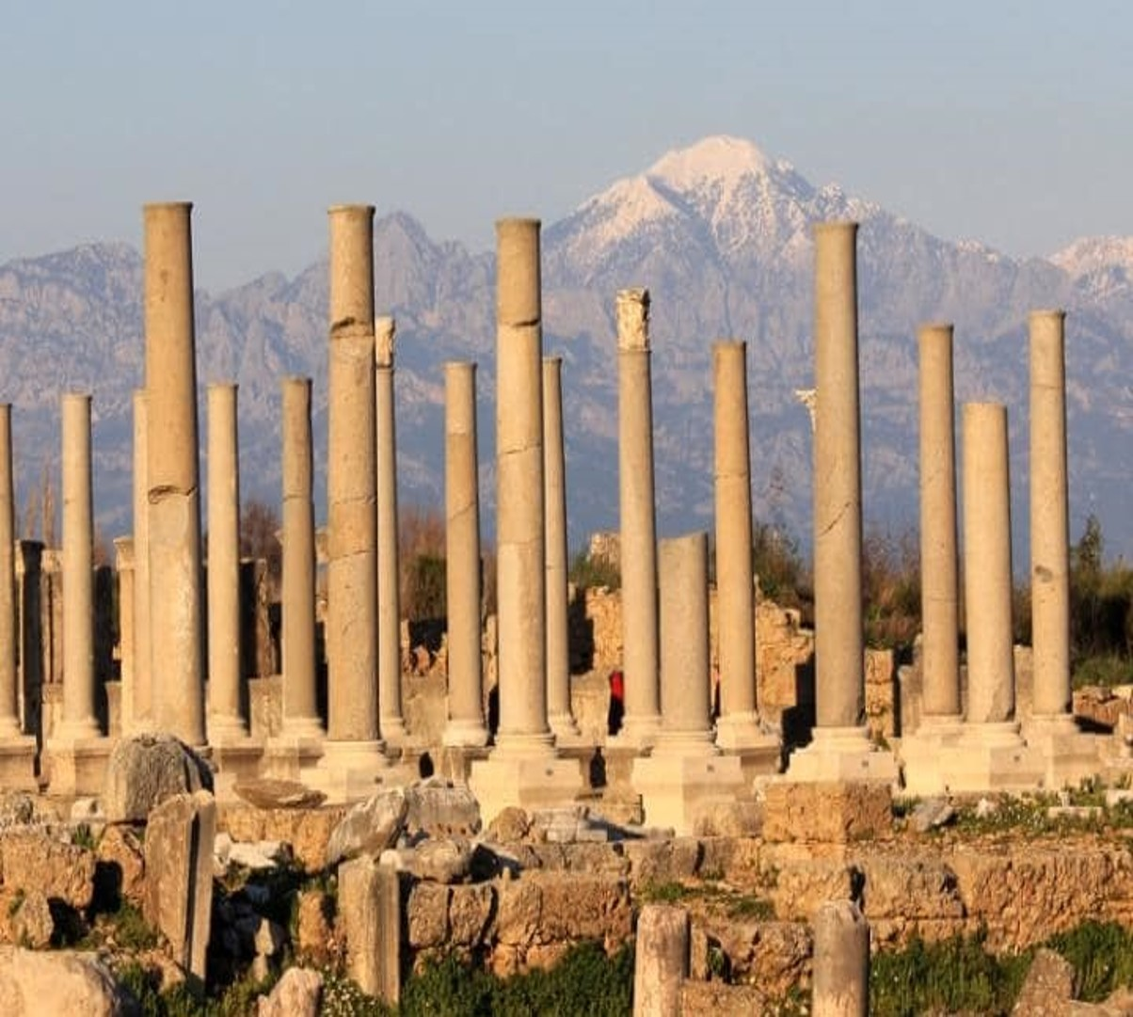
The First Missionary Journey
Principles of Adventuring for Christ:
Antioch
Perga
#1 The mission of Christ is led by the Holy Spirit
Paphos
Salamis
^{Acts 13:13} Now Paul and his companions put out to sea from Paphos and came to Perga in Pamphylia; but John left them and returned to Jerusalem ¹⁴ But going on from Perga, they arrived at Pisidian Antioch

Slide 59
The First Missionary Journey
Pisidian Antioch
Principles of Adventuring for Christ:
Antioch
Perga
#1 The mission of Christ is led by the Holy Spirit
Paphos
Salamis
^{Acts 13:13} Now Paul and his companions put out to sea from Paphos and came to Perga in Pamphylia; but John left them and returned to Jerusalem ¹⁴ But going on from Perga, they arrived at Pisidian Antioch

Slide 60
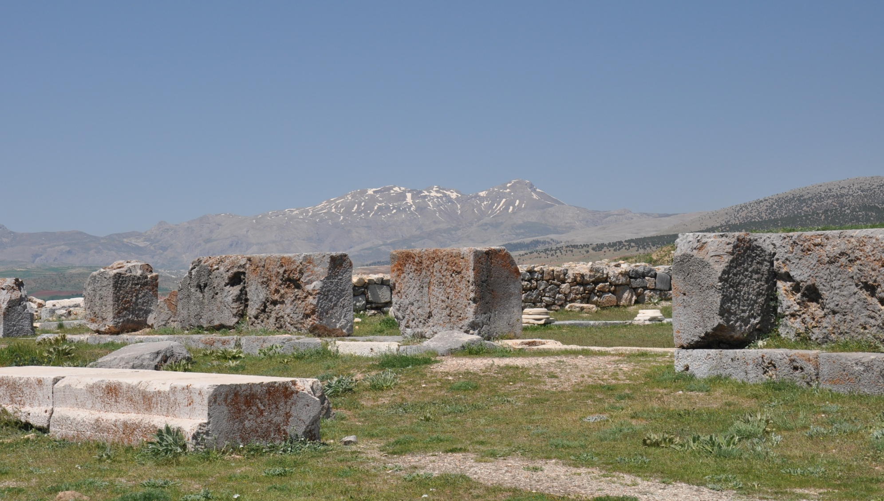
The First Missionary Journey
Pisidian Antioch
Principles of Adventuring for Christ:
Antioch
Perga
#1 The mission of Christ is led by the Holy Spirit
Paphos
Salamis
^{Acts 13:14} and on the Sabbath day they went into the synagogue and sat down. ¹⁵ After the reading of the Law and the Prophets the synagogue officials sent to them, saying, “Brethren, if you have any word of exhortation for the people, say it.”
^{Acts 13:14} and on the Sabbath day they went into the synagogue and sat down. ¹⁵ After the reading of the Law and the Prophets the synagogue officials sent to them, saying, “Brethren, if you have any word of exhortation for the people, say it.”
^{Acts 13:14} and on the Sabbath day they went into the synagogue and sat down. ¹⁵ After the reading of the Law and the Prophets the synagogue officials sent to them, saying, “Brethren, if you have any word of exhortation for the people, say it.”

Slide 61
^{Acts 13:16} Paul stood up, and motioning with his hand said, “Men of Israel, and you who fear God, listen:
^{Acts 13:16} Paul stood up, and motioning with his hand said, “Men of Israel, and you who fear God, listen:

Slide 62
God’s entire approach to the rescue of mankind has been to send
One last observation…
^{Acts 13:3} laid their hands on them, they sent them away.
^{Acts 13:4} So, being sent out by the Holy Spirit…
^{Acts 13:15} The synagogue officials sent to them…
^{Acts 13:26} to us the message of this salvation has been sent.

Slide 63
God’s entire approach to the rescue of mankind has been to send
^{John 20:21}“Peace be with you, as the father has sent me, I also send you.”
Do you see yourself as a “sent” person?
How would that change your life?
“Lord, where have you sent me today?”

Slide 64
Acts

