Slide 1
1:1-6
Learning to Meditate

Slide 2
Authorship?
Date?
Genre?
Importance?

Slide 3
Authorship?
Date?
Genre?
Importance?
David (73 psalms).
Moses (Ps. 90).
Asaph (Ps. 50, 73-83).
Descendants of Korah (42, 44-49, 84, 87-88).
Solomon (Ps. 72, 127).
Heman the Ezrahite (Ps. 88).
Ethan the Ezrahite (Ps. 89).
“Orphan psalms” (34 psalms).

Slide 4
Authorship?
Date?
Genre?
Importance?
Written over a 900 year span
Exodus (Ex. 15)
Judges (Judg. 5)
Kings and Prophets (2 Sam. 1; 1 Chron. 29; Isa. 5; Hos. 6; Hab. 3)
Exile (Ps. 137)

Slide 5
Authorship?
Date?
Genre?
Importance?
Hebrew Poetry
Parallelism
(Ps. 103:10) He has not dealt with us according to our sins,
nor rewarded us according to our iniquities.

Slide 6
Authorship?
Date?
Genre?
Importance?
Hebrew Poetry
Parallelism
Intensification
“We’re going to beat them in the second half…
We’re going to humiliate them and send them home crying!!”

Slide 7
Authorship?
Date?
Genre?
Importance?
Hebrew Poetry
Parallelism
Intensification
(Job 5:10) He gives rain on the earth
and sends water on the fields.

Slide 8
Authorship?
Date?
Genre?
Importance?
Hebrew Poetry
Parallelism
Intensification
(Ps. 18:24) The Lord has recompensed me according to my righteousness,
according to the cleanness of my hands in His eyes.

Slide 9
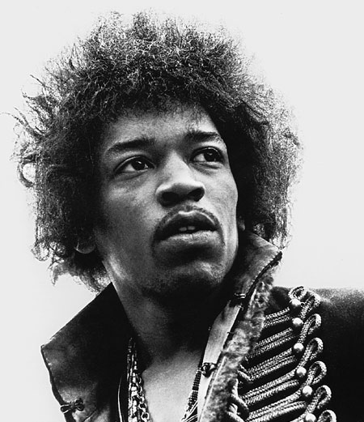
Authorship?
Date?
Genre?
Importance?
Hebrew Poetry
Parallelism
Intensification
Personification
“The wind cries Mary…”
—Jimi Hendrix

Slide 10
Authorship?
Date?
Genre?
Importance?
Hebrew Poetry
Parallelism
Intensification
Personification
(Isa. 55:12) The mountains and the hills will break forth into shouts of joy before you,
and all the trees of the field will clap their hands.

Slide 11
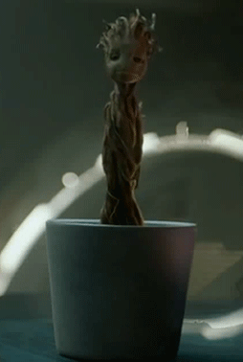
Authorship?
Date?
Genre?
Importance?
Hebrew Poetry
Parallelism
Intensification
Personification
(Isa. 55:12) The mountains and the hills will break forth into shouts of joy before you,
and all the trees of the field will clap their hands.

Slide 12
Authorship?
Date?
Genre?
Importance?
Hebrew Poetry
Parallelism
Intensification
Personification
(Isa. 55:12) The mountains and the hills will break forth into shouts of joy before you,
and all the trees of the field will clap their hands.

Slide 13
Authorship?
Date?
Genre?
Importance?
Hebrew Poetry
Parallelism
Intensification
Personification
Chiasm
“It’s not what your COUNTRY can do for YOU…
It’s what YOU can do for your COUNTRY!”
A
B
B
A

Slide 14
Authorship?
Date?
Genre?
Importance?
NT cites the Psalms 166x!
Best commentaries on the Bible.
Show us—rather than tell us—how to relate with God.
Teach us how to have a “heart for God.” (e.g. David)

Slide 15
(Ps. 1:1) Blessed is the one who does not walk in step with the wicked or stand in the way that sinners take or sit in the company of mockers.
² but whose delight is in the law of the Lord,
and who meditates on his law day and night.

Slide 16
(Ps. 1:3) That person is like a tree planted by streams of water, which yields its fruit in season and whose leaf does not wither—whatever they do prospers.

Slide 17
(Ps. 1:4) Not so the wicked!
They are like chaff that the wind blows away.

Slide 18
(Ps. 1:5) Therefore the wicked will not stand in the judgment, nor sinners in the assembly of the righteous.

Slide 19
(Ps. 1:6) For the Lord watches over the way of the righteous, but the way of the wicked leads to destruction.

Slide 20
(Ps. 1:1) Blessed is the one who does not walk in step with the wicked or stand in the way that sinners take or sit in the company of mockers.

Slide 21
Willem VanGemeren
(OT Scholar)
Willem VanGemeren, Psalms (Grand Rapids, MI: Zondervan Publishing House, 1991), p.53.
The word ‘happy’ is a good rendition of ‘blessed’ (ʾašhrê),
provided one keeps in mind that the condition of ‘bliss’ is not merely a feeling.

Slide 22
Willem VanGemeren
(OT Scholar)
Willem VanGemeren, Psalms (Grand Rapids, MI: Zondervan Publishing House, 1991), p.53.
Even when the righteous do not feel happy, they are still considered ‘blessed’ from God’s perspective. He bestows this gift on them.

Slide 23
Willem VanGemeren
(OT Scholar)
Willem VanGemeren, Psalms (Grand Rapids, MI: Zondervan Publishing House, 1991), p.53.
Neither negative feelings nor adverse conditions can take his blessing away.

Slide 24
(Ps. 1:1) Blessed is the one who does not walk in step with the wicked or stand in the way that sinners take or sit in the company of mockers.
² but whose delight is in the law of the Lord,
and who meditates on his law day and night.
“Delight” (ḥep̱ṣô) is our “chief desire.”
Willem VanGemeren, Psalms (Grand Rapids, MI: Zondervan Publishing House, 1991), p.55.
“Law” (tôrâ) refers to the entire OT.
Derek Kidner, Psalms 1–72 (Downers Grove, IL: InterVarsity Press. 1973), 65.

Slide 25
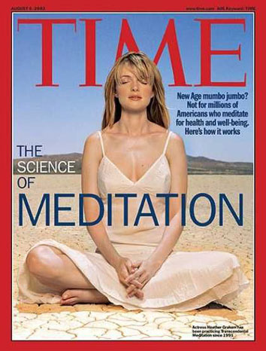
(Ps. 1:1) Blessed is the one who does not walk in step with the wicked or stand in the way that sinners take or sit in the company of mockers.
² but whose delight is in the law of the Lord,
and who meditates on his law day and night.
Not emptying our mind—but filling it!
“Meditates” (hāg̱āh)
“Growling” (Isa. 31:4; 38:14).
“Treasuring” (Ps. 119:11).
“Devising” (Ps. 2:1).

Slide 26
(Ps. 1:1) Blessed is the one who does not walk in step with the wicked or stand in the way that sinners take or sit in the company of mockers.
² but whose delight is in the law of the Lord,
and who meditates on his law day and night.
“I’m just not that good at meditating like this…”
“Meditates” (hāg̱āh)
“Growling” (Isa. 31:4; 38:14).
“Treasuring” (Ps. 119:11).
“Devising” (Ps. 2:1).

Slide 27
(Ps. 1:3) That person is like a tree planted by streams of water, which yields its fruit in season and whose leaf does not wither—whatever they do prospers.
Brings stability

Slide 28
(Ps. 1:3) That person is like a tree planted by streams of water, which yields its fruit in season and whose leaf does not wither—whatever they do prospers.
Takes time
(Isa. 55:10) For as the rain and the snow come down from heaven,
and do not return there without watering the earth and making it bear and sprout, and furnishing seed to the sower and bread to the eater.

Slide 29
(Ps. 1:3) That person is like a tree planted by streams of water, which yields its fruit in season and whose leaf does not wither—whatever they do prospers.
Takes time
(Isa. 55:11) So will My word be which goes forth from My mouth;
it will not return to Me empty,
without accomplishing what I desire,
and without succeeding in the matter for which I sent it.

Slide 30
(Ps. 1:3) That person is like a tree planted by streams of water, which yields its fruit in season and whose leaf does not wither—whatever they do prospers.
Takes time
(Heb. 4:12) The word of God is living and active. Sharper than any double-edged sword…
It judges the thoughts and attitudes of the heart.

Slide 32
Explore the evidence for the reliability, inspiration, and authority of the Bible.
Jesus clung to every word!
Jesus’ quoted the Bible…
…while on trial
(Mt. 26:64; Dan. 7:13-14)
…while being tortured
(Lk. 23:30; Hos. 10:8)
…while he was dying
(Mt. 27:46; Ps. 22:1; Lk. 23:46; Ps. 31:5)

Slide 33
Explore the evidence for the reliability, inspiration, and authority of the Bible.
Jesus clung to every word!
An inspired Bible is central to a personal relationship with God.
Transcendent truth helps us see through cultural conditioning.
Learn to doubt that we are the final authority on life.

Slide 35
Don’t jump into the deep end!
Pray for God to speak (Ps. 119:18).
(Ps. 119:18) Open my eyes to see the wonderful truths in your instructions.

Slide 36
Don’t jump into the deep end!
Pray for God to speak (Ps. 119:18).
Start small (5 minutes).
Interpret correctly (2 Tim. 2:15).
Ask questions: what jumps off the page?
Pray about what you read.
“Use it or lose it” (Jas. 1:22).
Explore what works for you!

Slide 37
J. Oswald Sanders
(Author and Director of Overseas Missionary Fellowship)
J. Oswald Sanders, Enjoying Intimacy with God (Grand Rapids, MI: Discovery House, 2000), Kindle 71.
(Jas. 4:8) Come close to God,
and He will come close to you.
Both Scripture and experience teach that it is we, not God, who determine the degree of intimacy with Him that we enjoy.
We are at this moment as close to God as we really choose to be.

Slide 38
(Ps. 1:3) That person is like a tree planted by streams of water, which yields its fruit in season and whose leaf does not wither—whatever they do prospers.

Slide 39
(Ps. 1:4) Not so the wicked!
They are like chaff that the wind blows away.
Transitory and useless

Slide 40
(Ps. 1:5) Therefore the wicked will not stand in the judgment, nor sinners in the assembly of the righteous.

Slide 41
(Ps. 1:6) For the Lord watches over the way of the righteous,
but the way of the wicked leads to destruction.
Some things are subjective and unclear…
But not this!
(Jn. 3:16) God so loved the world,
that He gave His only begotten Son,
that whoever believes in Him
shall not perish, but have eternal life.

Slide 42
(Ps. 1:6) For the Lord watches over the way of the righteous,
but the way of the wicked leads to destruction.
Some things are subjective and unclear…
But not this!
We can get so accustomed to this message that we don’t really hear it…

Slide 43
(Ps. 1:6) For the Lord watches over the way of the righteous,
but the way of the wicked leads to destruction.
Some things are subjective and unclear…
But not this!
We can get so accustomed to this message that we don’t really hear it…

Slide 44
(Ps. 1:6) For the Lord watches over the way of the righteous,
but the way of the wicked leads to destruction.
Some things are subjective and unclear…
But not this!
(Jn. 3:16) God so loved the world,
that He gave His only begotten Son,
that whoever believes in Him
shall not perish, but have eternal life.

