Slide 3
(Col. 2:1) I want you to know how great a struggle (agōna) I have on your behalf and for those who are at Laodicea,
and for all those who have not personally seen my face.
Why was Paul in “agony” for them?
“No one will delude you” (2:4).
“No one takes you captive” (2:8).
“No one is to act as your judge” (2:16).
“No one keep defrauding you… delighting in self-abasement
and the worship of the angels” (2:18).
“Self-made religion and self-abasement and severe treatment of the body” (2:23).

Slide 4
(Col. 2:2-3) My goal is that their hearts may be encouraged,
having been knit together in love,
and attaining to all the wealth that comes from the full assurance of understanding,
resulting in a true knowledge of God’s mystery, that is, Christ Himself,
in whom are hidden all the treasures of wisdom and knowledge.
Why am I not “encouraged”?

Slide 5
(Col. 2:2-3) My goal is that their hearts may be encouraged,
having been knit together in love,
and attaining to all the wealth that comes from the full assurance of understanding,
resulting in a true knowledge of God’s mystery, that is, Christ Himself,
in whom are hidden all the treasures of wisdom and knowledge.
Why am I not “encouraged”?
Am I being “knit together” (sumbibazō) in my friendships?
“Together” (sun) and “walk” (bainō)

Slide 6
(Col. 2:2-3) My goal is that their hearts may be encouraged,
having been knit together in love,
and attaining to all the wealth that comes from the full assurance of understanding,
resulting in a true knowledge of God’s mystery, that is, Christ Himself,
in whom are hidden all the treasures of wisdom and knowledge.
Why am I not “encouraged”?

Slide 7
(Col. 2:2-3) My goal is that their hearts may be encouraged,
having been knit together in love,
and attaining to all the wealth that comes from the full assurance of understanding,
resulting in a true knowledge of God’s mystery, that is, Christ Himself,
in whom are hidden all the treasures of wisdom and knowledge.
Why am I not “encouraged”?
Am I growing in truth and knowledge?
“Full assurance of understanding”
“True knowledge”
“Wisdom and knowledge”

Slide 8
(Col. 2:4) I say this so that no one will delude you with persuasive argument.
“Persuasive rhetoric” or the “art of persuasion”
Curtis Vaughan, Colossians (Grand Rapids, MI: Zondervan Publishing House, 1981), 195.
Plato, Theaetetus 162e

Slide 9
(Col. 2:5) For even though I am absent in body, I am with you in spirit.
I am rejoicing to see your good discipline and the stability of your faith in Christ.

Slide 10
(Col. 2:5) For even though I am absent in body, I am with you in spirit.
I am rejoicing to see your good discipline and the stability of your faith in Christ.
What made Paul rejoice?
They were banding together against this false teaching.
“Good discipline” (taxin) was a “military term connoting the orderly array of a band of disciplined soldiers.” Curtis Vaughan, Colossians (1981), 195.

Slide 11
(Col. 2:5) For even though I am absent in body, I am with you in spirit.
I am rejoicing to see your good discipline and the stability of your faith in Christ.
Truth has the ability to reassure, motivate, and stabilize us.

Slide 13
(Col. 2:5) For even though I am absent in body, I am with you in spirit.
I am rejoicing to see your good discipline and the stability of your faith in Christ.
Truth has the ability to reassure, motivate, and stabilize us.

Slide 14
(Col. 2:6) Therefore as you have received Christ Jesus the Lord,
so walk in Him.

Slide 15
(Col. 2:6) Therefore as you have received Christ Jesus the Lord,
so walk in Him.
(Jn. 1:12) To all who did receive him,
to those who believed in his name,
he gave the right to become children of God.

Slide 16
(Col. 2:6) Therefore as you have received Christ Jesus the Lord,
so walk in Him.

Slide 17
(Col. 2:7) You are being firmly rooted,
and you are being built up in Him and established in your faith,
just as you were instructed,
and overflowing with gratitude.

Slide 18
(Col. 2:8) See to it that no one
takes you captive through philosophy and empty deception, according to the tradition of men, according to the elementary principles of the world, rather than according to Christ.

Slide 19
(Col. 2:8) See to it that no one
takes you captive through philosophy and empty deception, according to the tradition of men, according to the elementary principles of the world, rather than according to Christ.
Was Paul anti-philosophy?
Not just any philosophy.
“The philosophy and empty deceit.”
(tēs philosophias kai kenēs)

Slide 20
(Col. 2:8) See to it that no one
takes you captive through philosophy and empty deception, according to the tradition of men, according to the elementary principles of the world, rather than according to Christ.
“Takes you captive” (sylagōgeō)
Being carried away as a slave or as booty in war.
William Arndt et al., A Greek-English Lexicon of the New Testament and Other Early Christian Literature (Chicago: University of Chicago Press, 2000), 955.
This presupposes that not all worldviews are true,
and it presupposes that not all worldviews are good.
World religions have similarities, but they are not the same.
Either one is correct, or none are correct.

Slide 22
(Col. 2:8) See to it that no one
takes you captive through philosophy and empty deception, according to the tradition of men, according to the elementary principles of the world, rather than according to Christ.
“Takes you captive” (sylagōgeō)
Being carried away as a slave or as booty in war.
William Arndt et al., A Greek-English Lexicon of the New Testament and Other Early Christian Literature (Chicago: University of Chicago Press, 2000), 955.
This presupposes that not all worldviews are true,
and it presupposes that not all worldviews are good.
World religions have similarities, but they are not the same.
Either one is correct, or none are correct.

Slide 25
The “gods” are finite and flawed.
These beings are not maximally great and lack ultimate “worth” or “worthiness.”
Zeus committed adultery with mortal women.
Zeus seduced Leda by transforming into a swan, abducted Europa while disguised as a bull, and took the form of Alcmene’s husband to sleep with her, resulting in the birth of Hercules.
Hera punished everyone—except Zeus!
Hera tried to kill Hercules with two serpents in his crib, drove him insane (killing his wife and kids), and sabotaged his Twelve Labors.

Slide 26
Our perception of reality is an illusion (maya).
Denise & John Carmody, Ways to the Center (Belmont, CA: Wadsworth, 1984), 95.
Life ends in annihilation: “release” (moksha).
Like dropping a piece of salt into water (Chandogya Upanishad, 6.13.2)
History is cyclical: No final justice for evil.
David Knipe, The Oxford Handbook of Eschatology (Oxford: Oxford UP, 2008), 149.

Slide 27
Atheism gives no basis for consciousness, freewill, and objective morality.
Everything operates according natural law—either cause and effect or indeterminacy.
Life has no ultimate significance.

Slide 28
What is the purpose of the universe?
There is none.
What is the meaning of life?
Ditto.
Why am I here?
Just dumb luck.
Alexander Rosenberg, The Atheist’s Guide to Reality: Enjoying Life without Illusions (New York: W.W. Norton, 2011), 2-3.

Slide 29
Is there free will?
Not a chance!
What is the difference between right and wrong, good and bad?
There is no moral difference between them.
Alexander Rosenberg, The Atheist’s Guide to Reality: Enjoying Life without Illusions (New York: W.W. Norton, 2011), 2-3.

Slide 30
Does history have any meaning or purpose?
It’s full of sound and fury, but signifies nothing.
Alexander Rosenberg, The Atheist’s Guide to Reality: Enjoying Life without Illusions (New York: W.W. Norton, 2011), 2-3.

Slide 31
“Human life has no more meaning than the life of a slime mould.”
John Gray, Straw Dogs: Thoughts on Humans and Other Animals (New York: Farrar, Straus and Giroux, 2007), 33.

Slide 32
“Human babies are not born self-aware, or capable of grasping that they exist over time…
The life of a newborn is of less value than the life of a
pig, a dog, or a chimpanzee.”
Peter Singer, Practical Ethics, 1st ed. (Cambridge: Cambridge University Press, 1979), 122-123.

Slide 33
Atheism gives no basis for consciousness, freewill, and objective morality.
Everything operates according natural law—either cause and effect or indeterminacy.
Life has no ultimate significance.

Slide 34
What is the best explanation?
Origin of the universe
Everything came from nothing?
Fine-tuning of the universe
Design came from chaos or chance?
Objective morality
Molecules in motion created morality?
Freewill and consciousness
Freewill came from fatalism?
Minds came from mindless matter?

Slide 35
Which of these four major worldviews do you believe?
Why do you believe it?
Because your friends believe it?
Because your parents believe it?
Because your mind is already made up?

Slide 36
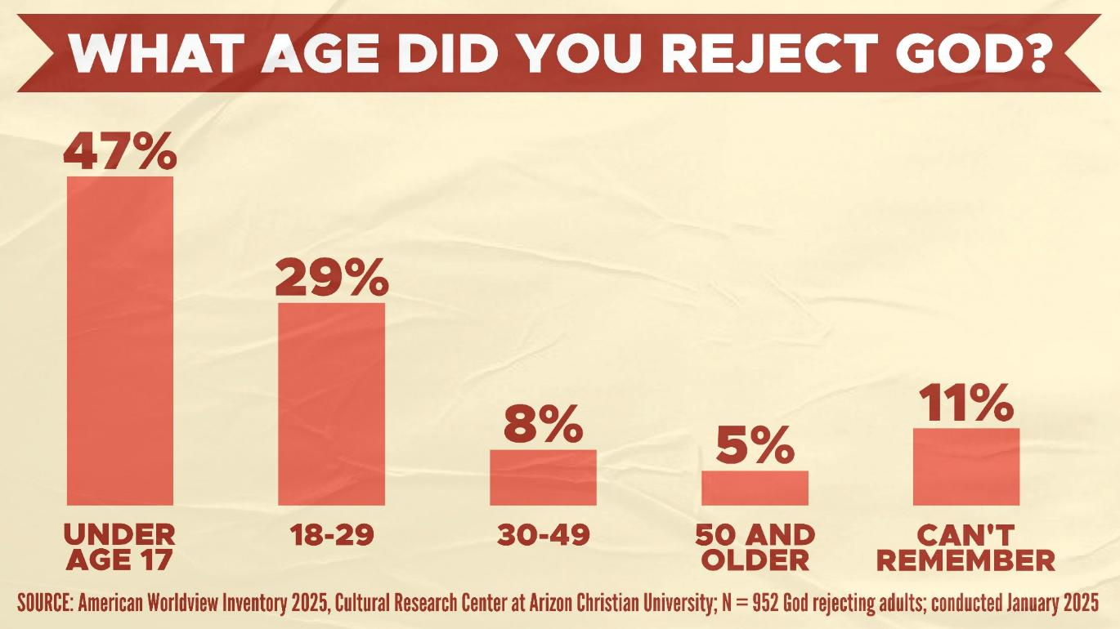
Which of these four major worldviews do you believe?
Why do you believe it?
Because your friends believe it?
Because your parents believe it?
Because your mind is already made up?

Slide 37
Which of these four major worldviews do you believe?
Why do you believe it?
Because your friends believe it?
Because your parents believe it?
Because your mind is already made up?
Are you willing to bet your life on it?
Are you willing to bet your afterlife?

