Slide 2
R O M A N S
The Good News
The Bad News

Slide 3
R O M A N S
The Good News
The Bad News
^{Romans} ^{3:9} What then? Are we better than they? Not at all; for we have already charged that both Jews and Greeks are all under sin;

Slide 4
R O M A N S
The Good News
The Bad News
^{Romans} ^{3:9} What then? Are we better than they? Not at all; for we have already charged that both Jews and Greeks are all under sin;

Slide 5
R O M A N S
The Good News
The Bad News
^{Romans} ^{3:9} What then? Are we better than they? Not at all; for we have already charged that both Jews and Greeks are all under sin;

Slide 6
R O M A N S
^{Romans} ^{3:10} as it is written,
“There is none righteous, not even one; ¹¹ There is none who understands, There is none who seeks for God; ¹² All have turned aside, together they have become useless; There is none who does good, There is not even one.” ¹³ “Their throat is an open grave, With their tongues they keep deceiving,” “The poison of asps is under their lips”; ¹⁴ “Whose mouth is full of cursing and bitterness”; ¹⁵ “Their feet are swift to shed blood, ¹⁶ Destruction and misery are in their paths, ¹⁷ And the path of peace they have not known.” ¹⁸ “There is no fear of God before their eyes.”

Slide 7
R O M A N S
Psalm 53:1-3
Psalm 5:9
Psalm 140:3
Isaiah 59:7
Psalm 10:7
^{Romans} ^{3:10} as it is written,
“There is none righteous, not even one; ¹¹ There is none who understands, There is none who seeks for God; ¹² All have turned aside, together they have become useless; There is none who does good, There is not even one.” ¹³ “Their throat is an open grave, With their tongues they keep deceiving,” “The poison of asps is under their lips”; ¹⁴ “Whose mouth is full of cursing and bitterness”; ¹⁵ “Their feet are swift to shed blood, ¹⁶ Destruction and misery are in their paths, ¹⁷ And the path of peace they have not known.” ¹⁸ “There is no fear of God before their eyes.”
Psalm 36:1

Slide 8
R O M A N S
^{Romans} ^{3:10} as it is written,
“There is none righteous, not even one; ¹¹ There is none who understands, There is none who seeks for God; ¹² All have turned aside, together they have become useless; There is none who does good, There is not even one.” ¹³ “Their throat is an open grave, With their tongues they keep deceiving,” “The poison of asps is under their lips”; ¹⁴ “Whose mouth is full of cursing and bitterness”; ¹⁵ “Their feet are swift to shed blood, ¹⁶ Destruction and misery are in their paths, ¹⁷ And the path of peace they have not known.” ¹⁸ “There is no fear of God before their eyes.”

Slide 9
R O M A N S
^{Romans} ^{3:10} as it is written,
“There is none righteous, not even one; ¹¹ There is none who understands, There is none who seeks for God; ¹² All have turned aside, together they have become useless; There is none who does good, There is not even one.” ¹³ “Their throat is an open grave, With their tongues they keep deceiving,” “The poison of asps is under their lips”; ¹⁴ “Whose mouth is full of cursing and bitterness”; ¹⁵ “Their feet are swift to shed blood, ¹⁶ Destruction and misery are in their paths, ¹⁷ And the path of peace they have not known.” ¹⁸ “There is no fear of God before their eyes.”

Slide 10
R O M A N S
^{Romans} ^{3:10} as it is written,
“There is none righteous, not even one; ¹¹ There is none who understands, There is none who seeks for God; ¹² All have turned aside, together they have become useless; There is none who does good, There is not even one.” ¹³ “Their throat is an open grave, With their tongues they keep deceiving,” “The poison of asps is under their lips”; ¹⁴ “Whose mouth is full of cursing and bitterness”; ¹⁵ “Their feet are swift to shed blood, ¹⁶ Destruction and misery are in their paths, ¹⁷ And the path of peace they have not known.” ¹⁸ “There is no fear of God before their eyes.”

Slide 11
R O M A N S
^{Romans} ^{3:10} as it is written,
“There is none righteous, not even one; ¹¹ There is none who understands, There is none who seeks for God; ¹² All have turned aside, together they have become useless; There is none who does good, There is not even one.” ¹³ “Their throat is an open grave, With their tongues they keep deceiving,” “The poison of asps is under their lips”; ¹⁴ “Whose mouth is full of cursing and bitterness”; ¹⁵ “Their feet are swift to shed blood, ¹⁶ Destruction and misery are in their paths, ¹⁷ And the path of peace they have not known.” ¹⁸ “There is no fear of God before their eyes.”

Slide 12
“Total Depravity”
Our turning away from God has permeated every part of every person’s life
^{Romans} ^{3:10} as it is written,
“There is none righteous, not even one; ¹¹ There is none who understands, There is none who seeks for God; ¹² All have turned aside, together they have become useless; There is none who does good, There is not even one.” ¹³ “Their throat is an open grave, With their tongues they keep deceiving,” “The poison of asps is under their lips”; ¹⁴ “Whose mouth is full of cursing and bitterness”; ¹⁵ “Their feet are swift to shed blood, ¹⁶ Destruction and misery are in their paths, ¹⁷ And the path of peace they have not known.” ¹⁸ “There is no fear of God before their eyes.”

Slide 13
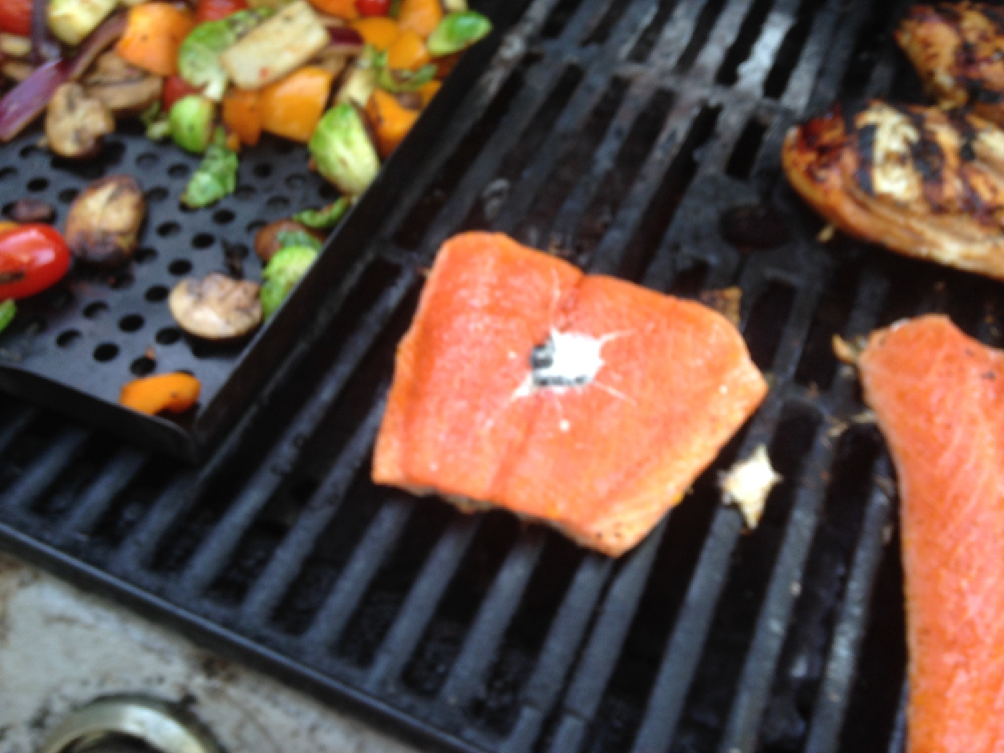
“Total Depravity”
Our turning away from God has permeated every part of every person’s life
^{Romans} ^{3:10} as it is written,
“There is none righteous, not even one; ¹¹ There is none who understands, There is none who seeks for God; ¹² All have turned aside, together they have become useless; There is none who does good, There is not even one.” ¹³ “Their throat is an open grave, With their tongues they keep deceiving,” “The poison of asps is under their lips”; ¹⁴ “Whose mouth is full of cursing and bitterness”; ¹⁵ “Their feet are swift to shed blood, ¹⁶ Destruction and misery are in their paths, ¹⁷ And the path of peace they have not known.” ¹⁸ “There is no fear of God before their eyes.”

Slide 14
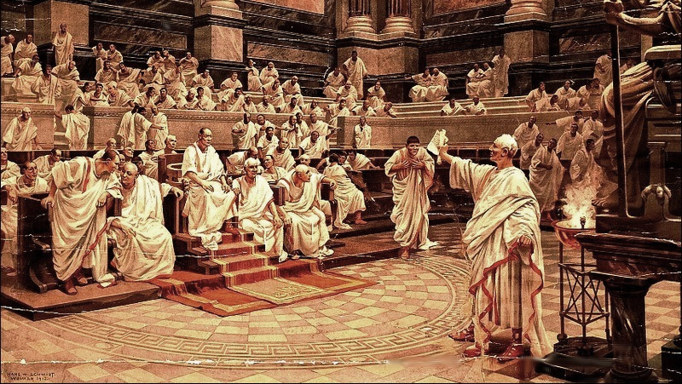
^{Romans} ^{3:19} Now we know that whatever the Law says, it speaks to those who are under the Law, so that every mouth may be closed and all the world may become accountable to God; ²⁰ because by the works of the Law no flesh will be justified in His sight; for through the Law comes the knowledge of sin.

Slide 15
dikaiósis: the act of pronouncing righteous; acquittal
^{Romans} ^{3:19} Now we know that whatever the Law says, it speaks to those who are under the Law, so that every mouth may be closed and all the world may become accountable to God; ²⁰ because by the works of the Law no flesh will be justified in His sight; for through the Law comes the knowledge of sin.

Slide 16
^{Romans} ^{3:19} Now we know that whatever the Law says, it speaks to those who are under the Law, so that every mouth may be closed and all the world may become accountable to God; ²⁰ because by the works of the Law no flesh will be justified in His sight; for through the Law comes the knowledge of sin.

Slide 17
Justified: Declared righteous by a just God
Something that, deep down, we all crave
^{Romans} ^{3:19} Now we know that whatever the Law says, it speaks to those who are under the Law, so that every mouth may be closed and all the world may become accountable to God; ²⁰ because by the works of the Law no flesh will be justified in His sight; for through the Law comes the knowledge of sin.

Slide 18
Justified: Declared righteous by a just God
So… Am I justified in God’s sight?
NO!
(That’s the “Bad News”)
^{Romans} ^{3:19} Now we know that whatever the Law says, it speaks to those who are under the Law, so that every mouth may be closed and all the world may become accountable to God; ²⁰ because by the works of the Law no flesh will be justified in His sight; for through the Law comes the knowledge of sin.

Slide 19
What do I do with my “guilt?”
Justified: Declared righteous by a just God
This idea of “justification” in God’s sight is interacting with a universal human problem:
^{Romans} ^{3:19} Now we know that whatever the Law says, it speaks to those who are under the Law, so that every mouth may be closed and all the world may become accountable to God; ²⁰ because by the works of the Law no flesh will be justified in His sight; for through the Law comes the knowledge of sin.

Slide 20
What do I do with my “guilt?”
We feel guilt when there is dissonance between how I think / act
and how I perceive I should think / act
^{Romans} ^{3:19} Now we know that whatever the Law says, it speaks to those who are under the Law, so that every mouth may be closed and all the world may become accountable to God; ²⁰ because by the works of the Law no flesh will be justified in His sight; for through the Law comes the knowledge of sin.

Slide 21
What do I do with my “guilt?”
We generally have 2 ways of dealing with guilt:
We try to deny our guilt
Since living in guilt is bad mental health…
No one should feel guilty EVER!
^{Romans} ^{3:19} Now we know that whatever the Law says, it speaks to those who are under the Law, so that every mouth may be closed and all the world may become accountable to God; ²⁰ because by the works of the Law no flesh will be justified in His sight; for through the Law comes the knowledge of sin.

Slide 22
What do I do with my “guilt?”
We generally have 2 ways of dealing with guilt:
We try to deny our guilt
Minimization
Rationalization
Blame Shifting
Since living in guilt is bad mental health…
No one should feel guilty EVER!
^{Romans} ^{3:19} Now we know that whatever the Law says, it speaks to those who are under the Law, so that every mouth may be closed and all the world may become accountable to God; ²⁰ because by the works of the Law no flesh will be justified in His sight; for through the Law comes the knowledge of sin.

Slide 23
What do I do with my “guilt?”
We generally have 2 ways of dealing with guilt:
We try to deny our guilt
What I’m really saying: “I actually AM justified!”
Not totally honest
^{Romans} ^{3:19} Now we know that whatever the Law says, it speaks to those who are under the Law, so that every mouth may be closed and all the world may become accountable to God; ²⁰ because by the works of the Law no flesh will be justified in His sight; for through the Law comes the knowledge of sin.

Slide 24
What do I do with my “guilt?”
We generally have 2 ways of dealing with guilt:
We try to deny our guilt
We try to fix our guilt
What I’m really saying:
“If you give me a little time, I can get to being justified”
^{Romans} ^{3:19} Now we know that whatever the Law says, it speaks to those who are under the Law, so that every mouth may be closed and all the world may become accountable to God; ²⁰ because by the works of the Law no flesh will be justified in His sight; for through the Law comes the knowledge of sin.

Slide 25
What do I do with my “guilt?”
We generally have 2 ways of dealing with guilt:
We try to deny our guilt
We try to fix our guilt
In this passage, Romans takes both of these away from us, by pointing us to the “law.”
^{Romans} ^{3:19} Now we know that whatever the Law says, it speaks to those who are under the Law, so that every mouth may be closed and all the world may become accountable to God; ²⁰ because by the works of the Law no flesh will be justified in His sight; for through the Law comes the knowledge of sin.

Slide 26
What do I do with my “guilt?”
We generally have 2 ways of dealing with guilt:
We try to deny our guilt
We try to fix our guilt
In this passage, Romans takes both of these away from us, by pointing us to the “law.”
Hypodikos: under judgment, one who lost his suit, liable to prosecution, a debtor owing satisfaction to one
^{Romans} ^{3:19} Now we know that whatever the Law says, it speaks to those who are under the Law, so that every mouth may be closed and all the world may become accountable to God; ²⁰ because by the works of the Law no flesh will be justified in His sight; for through the Law comes the knowledge of sin.

Slide 27
What do I do with my “guilt?”
We generally have 2 ways of dealing with guilt:
We try to deny our guilt
We try to fix our guilt
But it’s real.
In this passage, Romans takes both of these away from us, by pointing us to the “law.”
^{Romans} ^{3:19} Now we know that whatever the Law says, it speaks to those who are under the Law, so that every mouth may be closed and all the world may become accountable to God; ²⁰ because by the works of the Law no flesh will be justified in His sight; for through the Law comes the knowledge of sin.

Slide 28
What do I do with my “guilt?”
We generally have 2 ways of dealing with guilt:
We try to deny our guilt
We try to fix our guilt
But it’s real.
In this passage, Romans takes both of these away from us, by pointing us to the “law.”
^{Romans} ^{3:19} Now we know that whatever the Law says, it speaks to those who are under the Law, so that every mouth may be closed and all the world may become accountable to God; ²⁰ because by the works of the Law no flesh will be justified in His sight; for through the Law comes the knowledge of sin.

Slide 29
What do I do with my “guilt?”
We generally have 2 ways of dealing with guilt:
We try to deny our guilt
We try to fix our guilt
But it’s real.
In this passage, Romans takes both of these away from us, by pointing us to the “law.”
^{Romans} ^{3:19} Now we know that whatever the Law says, it speaks to those who are under the Law, so that every mouth may be closed and all the world may become accountable to God; ²⁰ because by the works of the Law no flesh will be justified in His sight; for through the Law comes the knowledge of sin.

Slide 30
What do I do with my “guilt?”
We generally have 2 ways of dealing with guilt:
We try to deny our guilt
We try to fix our guilt
But it’s real.
But we can’t.
In this passage, Romans takes both of these away from us, by pointing us to the “law.”
^{Romans} ^{3:19} Now we know that whatever the Law says, it speaks to those who are under the Law, so that every mouth may be closed and all the world may become accountable to God; ²⁰ because by the works of the Law no flesh will be justified in His sight; for through the Law comes the knowledge of sin.

Slide 31
What do I do with my “guilt?”
We generally have 2 ways of dealing with guilt:
We try to deny our guilt
We try to fix our guilt
But it’s real.
But we can’t.
In this passage, Romans takes both of these away from us, by pointing us to the “law.”
^{Romans} ^{3:19} Now we know that whatever the Law says, it speaks to those who are under the Law, so that every mouth may be closed and all the world may become accountable to God; ²⁰ because by the works of the Law no flesh will be justified in His sight; for through the Law comes the knowledge of sin.

Slide 32
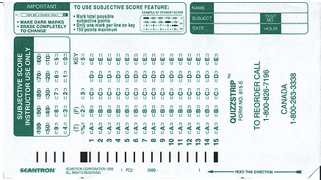
^{Romans} ^{3:19} Now we know that whatever the Law says, it speaks to those who are under the Law, so that every mouth may be closed and all the world may become accountable to God; ²⁰ because by the works of the Law no flesh will be justified in His sight; for through the Law comes the knowledge of sin.

Slide 33
Then how can anyone be justified in God’s sight??
So we have no resolution for our guilt…
The law convicts everyone…
and no one gets acquitted by what they do…
^{Romans} ^{3:19} Now we know that whatever the Law says, it speaks to those who are under the Law, so that every mouth may be closed and all the world may become accountable to God; ²⁰ because by the works of the Law no flesh will be justified in His sight; for through the Law comes the knowledge of sin.

Slide 34
Then how can anyone be justified in God’s sight??
^{Romans 3:21} But now…

Slide 35
Then how can anyone be justified in God’s sight??
^{Romans 3:21} But now apart from the Law the righteousness of God has been manifested, being witnessed by the Law and the Prophets, ²² even the righteousness of God through faith in Jesus Christ for all those who believe; for there is no distinction; ²³ for all have sinned and fall short of the glory of God, ²⁴ being justified as a gift by His grace through the redemption which is in Christ Jesus;

Slide 36
Justification before God is possible through Jesus Christ!
^{Romans 3:21} But now apart from the Law the righteousness of God has been manifested, being witnessed by the Law and the Prophets, ²² even the righteousness of God through faith in Jesus Christ for all those who believe; for there is no distinction; ²³ for all have sinned and fall short of the glory of God, ²⁴ being justified as a gift by His grace through the redemption which is in Christ Jesus;

Slide 37
Justification before God is possible through Jesus Christ!
It is accomplished “apart from the law”
^{Romans 3:21} But now apart from the Law the righteousness of God has been manifested, being witnessed by the Law and the Prophets, ²² even the righteousness of God through faith in Jesus Christ for all those who believe; for there is no distinction; ²³ for all have sinned and fall short of the glory of God, ²⁴ being justified as a gift by His grace through the redemption which is in Christ Jesus;

Slide 38
Justification before God is possible through Jesus Christ!
It is accomplished “apart from the law”
^{Romans 3:21} But now apart from the Law the righteousness of God has been manifested, being witnessed by the Law and the Prophets, ²² even the righteousness of God through faith in Jesus Christ for all those who believe; for there is no distinction; ²³ for all have sinned and fall short of the glory of God, ²⁴ being justified as a gift by His grace through the redemption which is in Christ Jesus;

Slide 39
Justification before God is possible through Jesus Christ!
It is based on His righteousness, not ours
^{Romans 3:21} But now apart from the Law the righteousness of God has been manifested, being witnessed by the Law and the Prophets, ²² even the righteousness of God through faith in Jesus Christ for all those who believe; for there is no distinction; ²³ for all have sinned and fall short of the glory of God, ²⁴ being justified as a gift by His grace through the redemption which is in Christ Jesus;

Slide 40
Justification before God is possible through Jesus Christ!
It is based on His righteousness, not ours
^{Romans 3:21} But now apart from the Law the righteousness of God has been manifested, being witnessed by the Law and the Prophets, ²² even the righteousness of God through faith in Jesus Christ for all those who believe; for there is no distinction; ²³ for all have sinned and fall short of the glory of God, ²⁴ being justified as a gift by His grace through the redemption which is in Christ Jesus;

Slide 41
Justification before God is possible through Jesus Christ!
Promised in the Old Testament scriptures
^{Romans 3:21} But now apart from the Law the righteousness of God has been manifested, being witnessed by the Law and the Prophets, ²² even the righteousness of God through faith in Jesus Christ for all those who believe; for there is no distinction; ²³ for all have sinned and fall short of the glory of God, ²⁴ being justified as a gift by His grace through the redemption which is in Christ Jesus;

Slide 42
Justification before God is possible through Jesus Christ!
Promised in the Old Testament scriptures
^{Romans 3:21} But now apart from the Law the righteousness of God has been manifested, being witnessed by the Law and the Prophets, ²² even the righteousness of God through faith in Jesus Christ for all those who believe; for there is no distinction; ²³ for all have sinned and fall short of the glory of God, ²⁴ being justified as a gift by His grace through the redemption which is in Christ Jesus;

Slide 43
Justification before God is possible through Jesus Christ!
God’s righteousness, somehow applied to us
^{Romans 3:21} But now apart from the Law the righteousness of God has been manifested, being witnessed by the Law and the Prophets, ²² even the righteousness of God through faith in Jesus Christ for all those who believe; for there is no distinction; ²³ for all have sinned and fall short of the glory of God, ²⁴ being justified as a gift by His grace through the redemption which is in Christ Jesus;

Slide 44
Justification before God is possible through Jesus Christ!
God’s righteousness, somehow applied to us
Accessed by trusting Jesus Christ
^{Romans 3:21} But now apart from the Law the righteousness of God has been manifested, being witnessed by the Law and the Prophets, ²² even the righteousness of God through faith in Jesus Christ for all those who believe; for there is no distinction; ²³ for all have sinned and fall short of the glory of God, ²⁴ being justified as a gift by His grace through the redemption which is in Christ Jesus;

Slide 45
Justification before God is possible through Jesus Christ!
God’s righteousness, somehow applied to us
Accessed by trusting Jesus Christ
^{Romans 3:21} But now apart from the Law the righteousness of God has been manifested, being witnessed by the Law and the Prophets, ²² even the righteousness of God through faith in Jesus Christ for all those who believe; for there is no distinction; ²³ for all have sinned and fall short of the glory of God, ²⁴ being justified as a gift by His grace through the redemption which is in Christ Jesus;

Slide 46
Justification before God is possible through Jesus Christ!
Universally available to every person, no matter what
^{Romans 3:21} But now apart from the Law the righteousness of God has been manifested, being witnessed by the Law and the Prophets, ²² even the righteousness of God through faith in Jesus Christ for all those who believe; for there is no distinction; ²³ for all have sinned and fall short of the glory of God, ²⁴ being justified as a gift by His grace through the redemption which is in Christ Jesus;

Slide 47
Justification before God is possible through Jesus Christ!
Universally available to every person, no matter what
^{Romans 3:21} But now apart from the Law the righteousness of God has been manifested, being witnessed by the Law and the Prophets, ²² even the righteousness of God through faith in Jesus Christ for all those who believe; for there is no distinction; ²³ for all have sinned and fall short of the glory of God, ²⁴ being justified as a gift by His grace through the redemption which is in Christ Jesus;

Slide 48
Justification before God is possible through Jesus Christ!
No one earns justification on their own merits…
^{Romans 3:21} But now apart from the Law the righteousness of God has been manifested, being witnessed by the Law and the Prophets, ²² even the righteousness of God through faith in Jesus Christ for all those who believe; for there is no distinction; ²³ for all have sinned and fall short of the glory of God, ²⁴ being justified as a gift by His grace through the redemption which is in Christ Jesus;

Slide 49
Justification before God is possible through Jesus Christ!
No one earns justification on their own merits…
But anyone can receive it as a gift
^{Romans 3:21} But now apart from the Law the righteousness of God has been manifested, being witnessed by the Law and the Prophets, ²² even the righteousness of God through faith in Jesus Christ for all those who believe; for there is no distinction; ²³ for all have sinned and fall short of the glory of God, ²⁴ being justified as a gift by His grace through the redemption which is in Christ Jesus;

Slide 50
Justification before God is possible through Jesus Christ!
No one earns justification on their own merits…
But anyone can receive it as a gift
^{Romans 3:21} But now apart from the Law the righteousness of God has been manifested, being witnessed by the Law and the Prophets, ²² even the righteousness of God through faith in Jesus Christ for all those who believe; for there is no distinction; ²³ for all have sinned and fall short of the glory of God, ²⁴ being justified as a gift by His grace through the redemption which is in Christ Jesus;

Slide 51
Justification before God is possible through Jesus Christ!
Based on His character, charity, and goodwill
“Salvation by grace through faith apart from works”
^{Romans 3:21} But now apart from the Law the righteousness of God has been manifested, being witnessed by the Law and the Prophets, ²² even the righteousness of God through faith in Jesus Christ for all those who believe; for there is no distinction; ²³ for all have sinned and fall short of the glory of God, ²⁴ being justified as a gift by His grace through the redemption which is in Christ Jesus;

Slide 52
Justification before God is possible through Jesus Christ!
Based on His character, charity, and goodwill
“Salvation by grace through faith apart from works”
^{Romans 3:21} But now apart from the Law the righteousness of God has been manifested, being witnessed by the Law and the Prophets, ²² even the righteousness of God through faith in Jesus Christ for all those who believe; for there is no distinction; ²³ for all have sinned and fall short of the glory of God, ²⁴ being justified as a gift by His grace through the redemption which is in Christ Jesus;
Apolytrōsis: liberated by a payment of ransom

Slide 53
Justification before God is possible through Jesus Christ!
How is this possible??
^{Romans 3:21} But now apart from the Law the righteousness of God has been manifested, being witnessed by the Law and the Prophets, ²² even the righteousness of God through faith in Jesus Christ for all those who believe; for there is no distinction; ²³ for all have sinned and fall short of the glory of God, ²⁴ being justified as a gift by His grace through the redemption which is in Christ Jesus;

Slide 54
Justification before God is possible through Jesus Christ!
How is this possible??
^{Romans 3:25} For God presented Jesus as the sacrifice for sin. People are made right with God when they believe that Jesus sacrificed his life, shedding his blood. This sacrifice shows that God was being fair when he held back and did not punish those who sinned in times past, ²⁶ for he was looking ahead and including them in what he would do in this present time. God did this to demonstrate his righteousness, for he himself is fair and just, and he makes sinners right in his sight when they believe in Jesus.

Slide 55
Justification before God is possible through Jesus Christ!
How is this possible??
An old testament picture of salvation by grace through faith apart form works
^{Romans 3:25} For God presented Jesus as the sacrifice for sin. People are made right with God when they believe that Jesus sacrificed his life, shedding his blood. This sacrifice shows that God was being fair when he held back and did not punish those who sinned in times past, ²⁶ for he was looking ahead and including them in what he would do in this present time. God did this to demonstrate his righteousness, for he himself is fair and just, and he makes sinners right in his sight when they believe in Jesus.
Propitiation: a sacrifice; to appease wrath through an offering

Slide 56
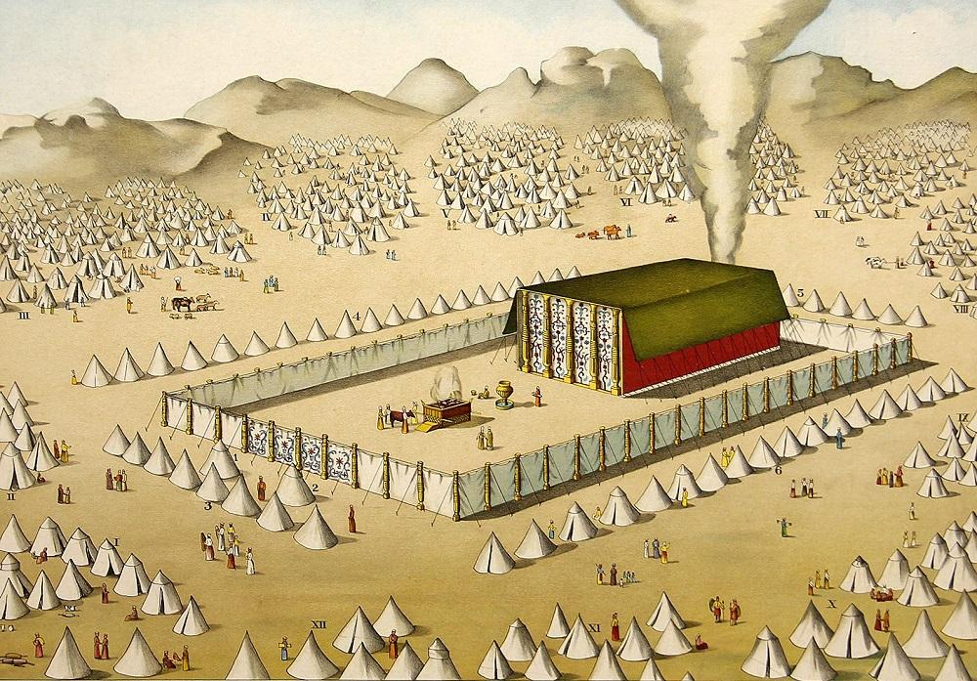
Justification before God is possible through Jesus Christ!
“Substitutionary Atonement”
^{Romans 3:25} For God presented Jesus as the sacrifice for sin. People are made right with God when they believe that Jesus sacrificed his life, shedding his blood. This sacrifice shows that God was being fair when he held back and did not punish those who sinned in times past, ²⁶ for he was looking ahead and including them in what he would do in this present time. God did this to demonstrate his righteousness, for he himself is fair and just, and he makes sinners right in his sight when they believe in Jesus.
^{Heb 10:1} The old system under the law of Moses was only a shadow, a dim preview of the good things to come, not the good things themselves.

Slide 57
Justification before God is possible through Jesus Christ!
“Substitutionary Atonement”
^{Romans 3:25} For God presented Jesus as the sacrifice for sin. People are made right with God when they believe that Jesus sacrificed his life, shedding his blood. This sacrifice shows that God was being fair when he held back and did not punish those who sinned in times past, ²⁶ for he was looking ahead and including them in what he would do in this present time. God did this to demonstrate his righteousness, for he himself is fair and just, and he makes sinners right in his sight when they believe in Jesus.

Slide 58
Justification before God is possible through Jesus Christ!
What happened on the cross?
^{Romans 3:25} For God presented Jesus as the sacrifice for sin. People are made right with God when they believe that Jesus sacrificed his life, shedding his blood. This sacrifice shows that God was being fair when he held back and did not punish those who sinned in times past, ²⁶ for he was looking ahead and including them in what he would do in this present time. God did this to demonstrate his righteousness, for he himself is fair and just, and he makes sinners right in his sight when they believe in Jesus.

Slide 59
Justification before God is possible through Jesus Christ!
What happened on the cross?
^{Heb 9:11} So Christ has now become the High Priest over all the good things that have come. He has entered that greater, more perfect Tabernacle in heaven, which was not made by human hands and is not part of this created world. ¹² With his own blood—not the blood of goats and calves—he entered the Most Holy Place once for all time and secured our redemption forever.

Slide 60
Justification before God is possible through Jesus Christ!
What happened on the cross?
^{Heb 9:11} So Christ has now become the High Priest over all the good things that have come. He has entered that greater, more perfect Tabernacle in heaven, which was not made by human hands and is not part of this created world. ¹² With his own blood—not the blood of goats and calves—he entered the Most Holy Place once for all time and secured our redemption forever.

Slide 61
Justification before God is possible through Jesus Christ!
What happened on the cross?
^{Heb 9:11} So Christ has now become the High Priest over all the good things that have come. He has entered that greater, more perfect Tabernacle in heaven, which was not made by human hands and is not part of this created world. ¹² With his own blood—not the blood of goats and calves—he entered the Most Holy Place once for all time and secured our redemption forever.

Slide 62
Justification before God is possible through Jesus Christ!
What happened on the cross?
^{Heb 9:11} So Christ has now become the High Priest over all the good things that have come. He has entered that greater, more perfect Tabernacle in heaven, which was not made by human hands and is not part of this created world. ¹² With his own blood—not the blood of goats and calves—he entered the Most Holy Place once for all time and secured our redemption forever.

Slide 63
Justification before God is possible through Jesus Christ!
Our guilt fell on Him… He is our propitiation
Jesus’s death on the cross completely and permanently settled the matter of our guilt before God
This is why salvation can only come through Jesus Christ
^{Heb 9:11} So Christ has now become the High Priest over all the good things that have come. He has entered that greater, more perfect Tabernacle in heaven, which was not made by human hands and is not part of this created world. ¹² With his own blood—not the blood of goats and calves—he entered the Most Holy Place once for all time and secured our redemption forever.

Slide 64
Justification before God is possible through Jesus Christ!
Our guilt fell on Him… He is our propitiation
Jesus’s death on the cross completely and permanently settled the matter of our guilt before God
This is why salvation can only come through Jesus Christ
^{2 Cor 5:21} He made Him who knew no sin to be sin on our behalf, so that we might become the righteousness of God in Him.

Slide 65
Justification before God is possible through Jesus Christ!
^{Romans 3:25} For God presented Jesus as the sacrifice for sin. People are made right with God when they believe that Jesus sacrificed his life, shedding his blood. This sacrifice shows that God was being fair when he held back and did not punish those who sinned in times past, ²⁶ for he was looking ahead and including them in what he would do in this present time. God did this to demonstrate his righteousness, for he himself is fair and just, and he makes sinners right in his sight when they believe in Jesus.

Slide 66
Justification before God is possible through Jesus Christ!
^{Romans 3:25} For God presented Jesus as the sacrifice for sin. People are made right with God when they believe that Jesus sacrificed his life, shedding his blood. This sacrifice shows that God was being fair when he held back and did not punish those who sinned in times past, ²⁶ for he was looking ahead and including them in what he would do in this present time. God did this to demonstrate his righteousness, for he himself is fair and just, and he makes sinners right in his sight when they believe in Jesus.

Slide 67
Justification before God is possible through Jesus Christ!
^{Romans 3:26 NASB} … so that He would be just and the justifier of the one who has faith in Jesus.

Slide 68
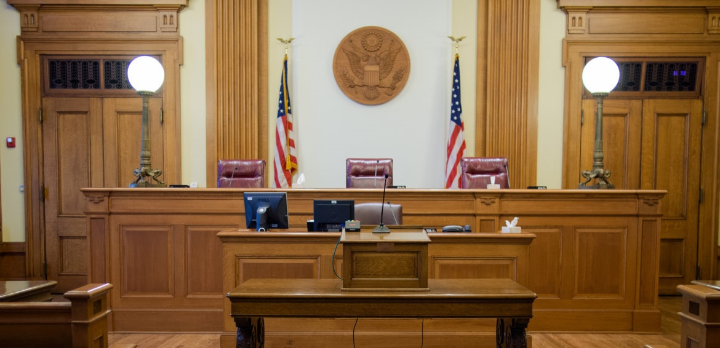
Justification before God is possible through Jesus Christ!
^{Romans 3:26 NASB} … so that He would be just and the justifier of the one who has faith in Jesus.

Slide 69
What do I do with my guilt?
Justification goes further than forgiveness
^{Colossians 2:13} You were dead because of your sins… Then God made you alive with Christ, for he forgave all our sins. ¹⁴ He canceled the record of the charges against us and took it away by nailing it to the cross.
^{Romans 3:26 NASB} … so that He would be just and the justifier of the one who has faith in Jesus.

Slide 70
^{Romans 3:22} … we are made right with God by placing our faith in Jesus Christ … ²⁵ People are made right with God when they believe that Jesus sacrificed his life, shedding his blood … ²⁸ So we are made right with God through faith and not by obeying the law …
^{Rom1:17} This Good News tell us how God makes us right in his sight. This is accomplished from start to finish by faith. As the Scriptures say, “It is through faith that a righteous person has life.”
^{Romans 3:26 NASB} … so that He would be just and the justifier of the one who has faith in Jesus.

Slide 71
Quiz:
^{Romans} ^{3:27} Where then is boasting?

Slide 72
Quiz:
^{Romans} ^{3:27} Where then is boasting? It is excluded.

Slide 73
Quiz:
^{Romans} ^{3:27} By what kind of law? Of works?

Slide 74
Quiz:
^{Romans} ^{3:27} By what kind of law? Of works? No, but by a law of faith. ²⁸ For we maintain that a man is justified by faith apart from works of the Law.

Slide 75
Quiz:
^{Romans} ^{3:29} Or is God the God of Jews only?

Slide 76
Quiz:
^{Romans} ^{3:29} Or is God the God of Jews only? Is He not the God of Gentiles also? Yes, of Gentiles also, ³⁰ since indeed God who will justify the circumcised by faith and the uncircumcised through faith is one.

Slide 77
Quiz:
^{Romans} ^{3:31} Do we then nullify the Law through faith?

Slide 78
Quiz:
^{Romans} ^{3:31} Do we then nullify the Law through faith? May it never be! On the contrary, we establish the Law.

Slide 79
R O M A N S
Next Week …

