Slide 1
Philippians 1:27-2:4
United We Stand

Slide 2
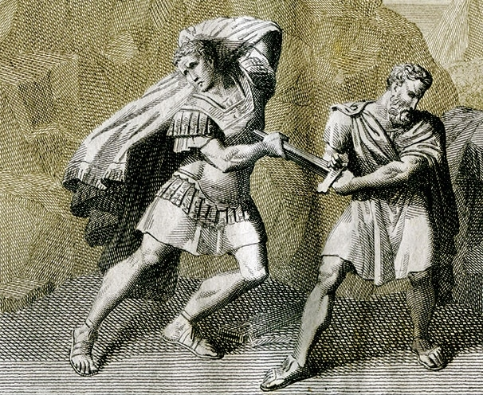
The City of Philippi
Brutus
44BCE

Slide 3
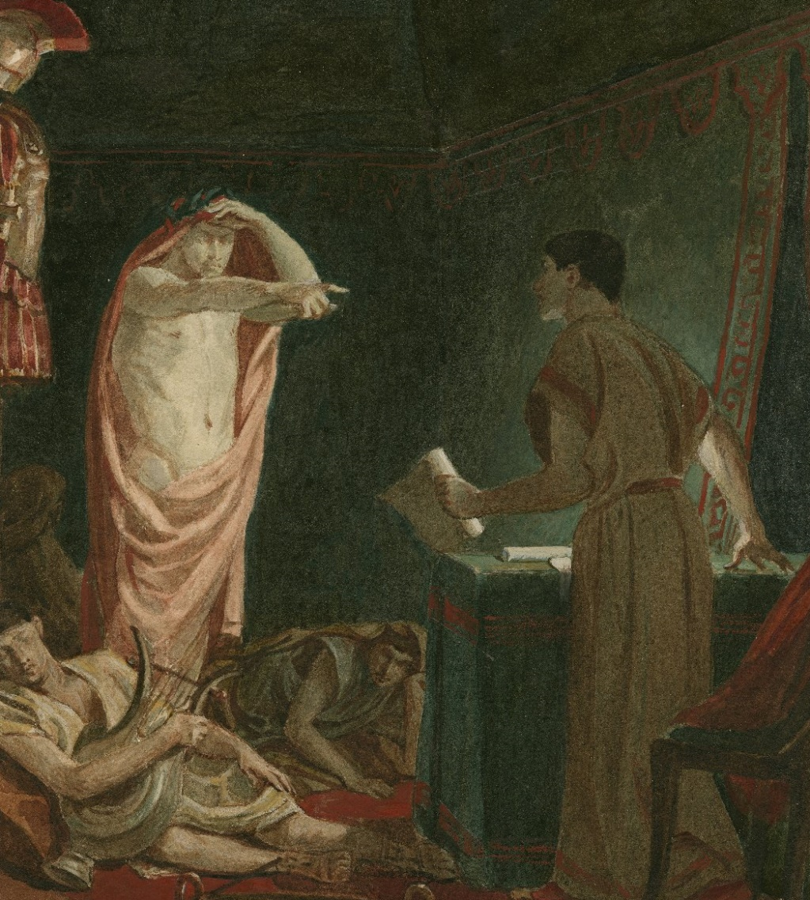
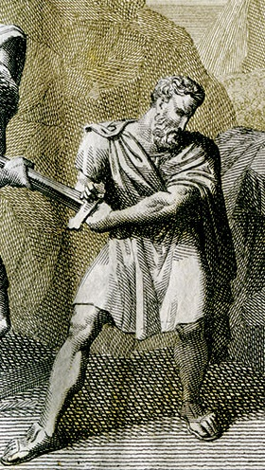
The City of Philippi
“Thou shalt see me at Philippi”
Brutus

Slide 4
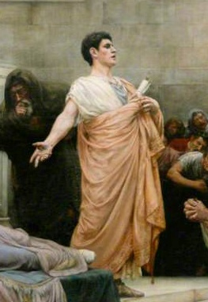
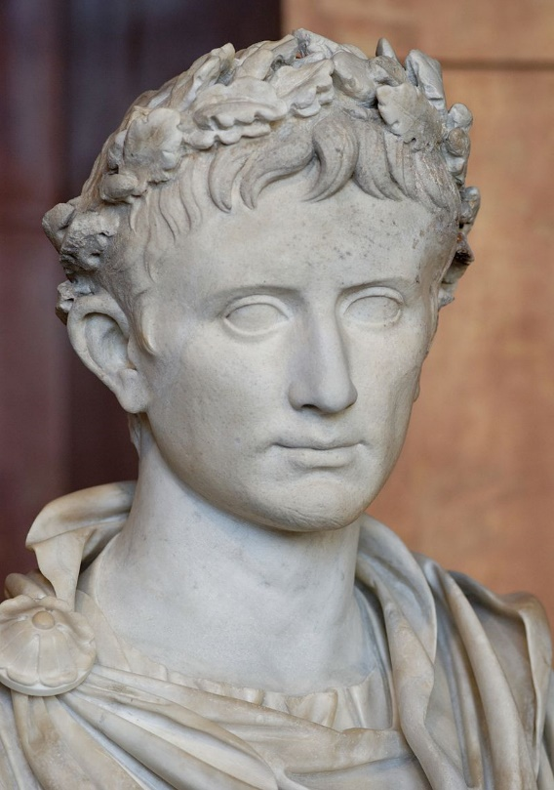
The City of Philippi
Augustus Caesar
Brutus
Mark Antony
42 BCE

Slide 5
The City of Philippi
Augustus Caesar
Mark Antony

Slide 6
The City of Philippi
Augustus Caesar
Mark Antony
30 BCE

Slide 7
The City of Philippi
Declared Philippi a Roman colony
Granted everyone Roman citizenship
Self-governing, tax exempt
The Ius Italicium – Roman dress, language, coinage and holidays
Hundreds of former soldiers retire there
Augustus Caesar

Slide 8
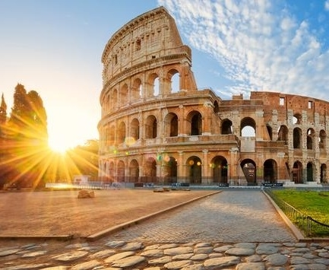
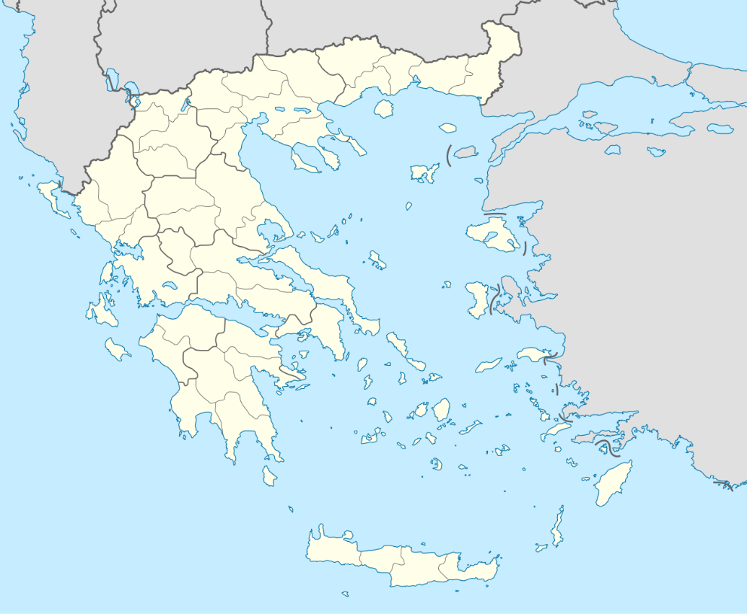
The City of Philippi
Our True Location: In Rome
Our Geographical Location: In Philippi

Slide 9
The City of Philippi
Our True Location: “In Christ”
Our Geographical Location: In Philippi
To all the saints in Christ Jesus who are in Philippi (Philippians 1:1)

Slide 10
The City of Philippi
Our True Location: “In Christ”
Our Geographical Location: In Philippi
JC
You

Slide 11
The City of Philippi
Our True Location: “In Christ”
Our Geographical Location: In Philippi
Forgiven
Adopted
Indwelt by the Holy Spirit
Heaven-bound
Joined to others
JC

Slide 12
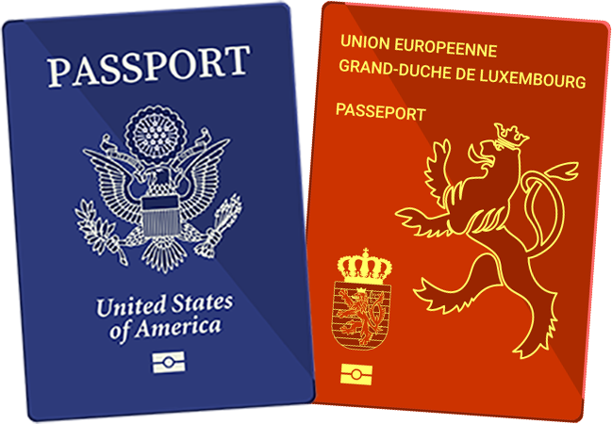
The City of Philippi
Our True Location: “In Christ”
Our Geographical Location: In Philippi
“Citizens of Heaven” (Phil 3:20)
JC

Slide 13
The City of Philippi
Last two weeks:
“What is Paul so happy about?”
This week:
“What would make Paul even happier?”
Stand firm together!

Slide 14
Philippians 1
27 Only conduct yourselves in a manner worthy of the good news of Christ,
Only = The most important thing above all else

Slide 15
Philippians 1
27 Only conduct yourselves in a manner worthy of the good news of Christ,
Only = The most important thing above all else
Conduct yourselves = “live as citizens”
NLT: “live as citizens of heaven”

Slide 16
Philippians 1
27 Only conduct yourselves in a manner worthy of the good news of Christ,
so that whether I come and see you or remain absent, I will hear of you
that you are standing firm in one Spirit,
with one mind striving together
for the faith of the good news;

Slide 17
Philippians 1
27 Only conduct yourselves in a manner worthy of the good news of Christ,
so that whether I come and see you or remain absent, I will hear of you
that you are standing firm in one Spirit,
with one mind striving together
for the faith of the good news;

Slide 18
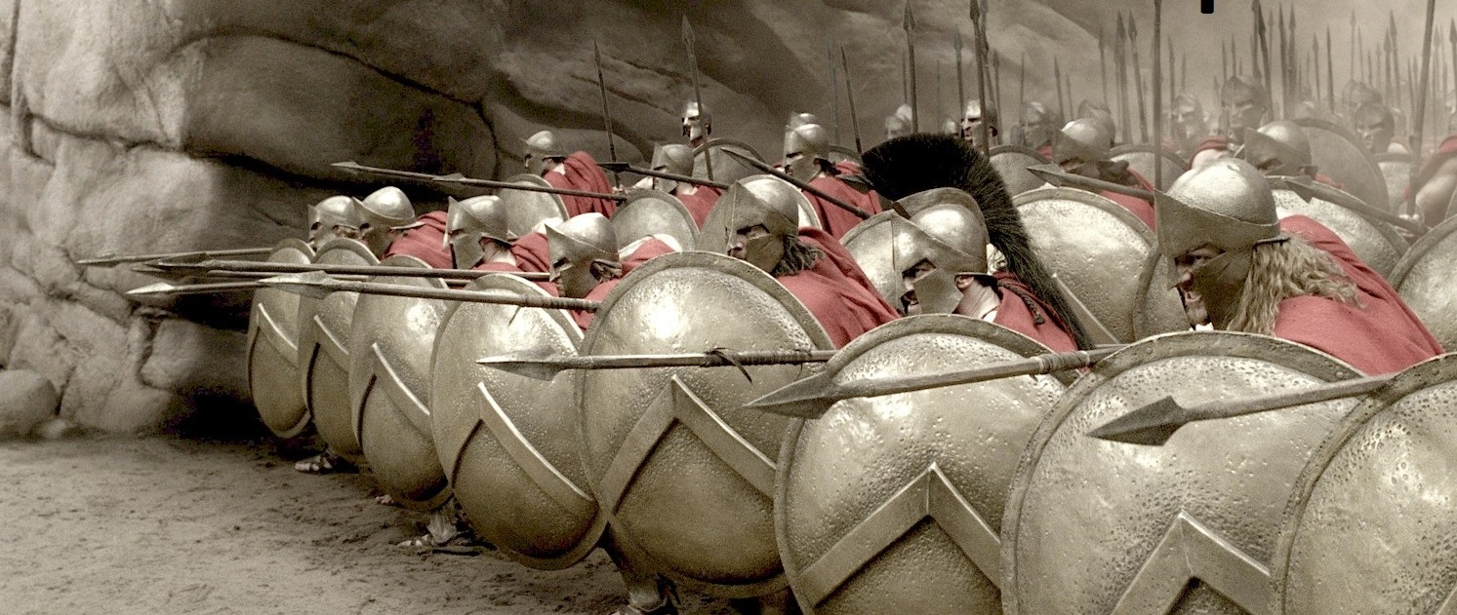
standing firm, striving together

Slide 19
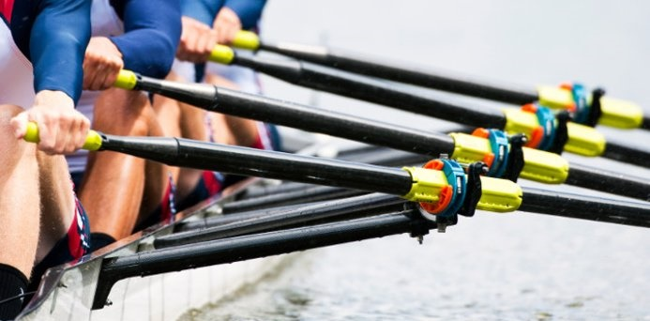
standing firm, striving together

Slide 20
standing firm, striving together

Slide 21
Philippians 1
27 Only conduct yourselves in a manner worthy of the good news of Christ,
so that whether I come and see you or remain absent, I will hear of you
that you are standing firm in one Spirit,
with one mind striving together
for the faith of the good news;
“In one Spirit”
Reminder of the unity God has given us
Our job is to preserve this unity, not produce it
JC

Slide 22
Philippians 1
27 Only conduct yourselves in a manner worthy of the good news of Christ,
so that whether I come and see you or remain absent, I will hear of you
that you are standing firm in one Spirit,
with one mind striving together
for the faith of the good news;
“With one mind”
Not groupthink, but coming together around a common goal
Connected with each other, part of each other’s lives

Slide 23
Philippians 1
27 Only conduct yourselves in a manner worthy of the good news of Christ,
so that whether I come and see you or remain absent, I will hear of you
that you are standing firm in one Spirit,
with one mind striving together
for the faith of the good news;
“for the faith of the good news”
Christians are known for a lot of things:
Politics, self-righteousness, hypocrisy, judgmentalism, anti-intellectualism
We should be known for our love: loving God, loving people, and sharing the message of Christ’s love

Slide 24
Philippians 1
28 in no way alarmed by your opponents—

Slide 25
Philippians 1
28 in no way alarmed by your opponents
Opponents?
False teachers (Phil 3:2ff)
The imperial cult: “Caesar is Lord”
God’s enemy (Satan) is now your enemy too

Slide 26
Philippians 1
28 in no way alarmed by your opponents
= ‘the uncontrollable stampede of startled horses’
Some horses freak out too much to be useful in battle
People will be upset with us for speaking God’s truth

Slide 27
Philippians 1
28 in no way alarmed by your opponents
If you aren’t ready for opposition, you’ll get blindsided
We are to be calm and happy and loving even in the face of opposition

Slide 28
Philippians 1
28 in no way alarmed by your opponents—
which is a sign of destruction for them, but of salvation for you, and that too, from God.
Your opponents will realize that God is right and they are in the wrong (Josef Tson)

Slide 29
Philippians 1
29 For to you it has been granted for Christ’s sake,
not only to believe in Him,
but also to suffer for His sake,
30 experiencing the same conflict which you saw in me, and now hear to be in me.
The extent of their suffering

Slide 30
Philippians 1
29 For to you it has been granted for Christ’s sake,
not only to believe in Him,
but also to suffer for His sake,
30 experiencing the same conflict which you saw in me, and now hear to be in me.
The extent of their suffering
The reason for their suffering

Slide 31
Philippians 1
29 For to you it has been granted for Christ’s sake,
not only to believe in Him,
but also to suffer for His sake,
30 experiencing the same conflict which you saw in me, and now hear to be in me.
“We can rejoice, too, when we run into problems and trials, for we know that they help us develop endurance.” (Rom 5:3)
We suffer, and we think something is wrong
Is God upset with me? Am I doing something wrong?
We might reluctantly accept that suffering is unavoidable
But can we see suffering as God’s gracious gift to make us more like Christ? (e.g. praying for patience)

Slide 32
Philippians 1
29 For to you it has been granted for Christ’s sake,
not only to believe in Him,
but also to suffer for His sake,
30 experiencing the same conflict which you saw in me, and now hear to be in me.
We suffer, and we think something is wrong
We’re not just showing up to get a good feeling.
We’re here to prepare for the battle. To train for the big game.
Jesus: “If the world hates you, remember that it hated me first.” (John 15:18)

Slide 33
How to Stand Firm Together
What is our natural response to suffering?
Quit altogether?
Turn on one another!

Slide 34
https://www.bbc.com/worklife/article/20201203-why-the-pandemic-is-causing-spikes-in-break-ups-and-divorces
After seven years of marriage, 29-year-old Sophie Turner and her husband filed for divorce.
They’d never discussed splitting up before the coronavirus crisis, but during the pandemic, their marriage soured.
Why the pandemic is causing spikes in break-ups and divorces (Dec 6, 2020)

Slide 35
https://www.bbc.com/worklife/article/20201203-why-the-pandemic-is-causing-spikes-in-break-ups-and-divorces
“I was more stressed, and it was all just building up, and we decided for maybe a trial separation…
Very quickly we realised it was going to be more permanent than that.”
Why the pandemic is causing spikes in break-ups and divorces (Dec 6, 2020)

Slide 36
https://www.bbc.com/worklife/article/20201203-why-the-pandemic-is-causing-spikes-in-break-ups-and-divorces
Their experiences are becoming increasingly common, with divorce applications and break-ups skyrocketing…
Leading British law firm Stewarts logged a 122% increase in enquiries between July and October, compared with the same period last year.
Why the pandemic is causing spikes in break-ups and divorces (Dec 6, 2020)

Slide 37
https://www.bbc.com/worklife/article/20201203-why-the-pandemic-is-causing-spikes-in-break-ups-and-divorces
In the US, a major legal contract-creation site recently announced a 34% rise in sales of its basic divorce agreement,
with newlyweds who’d got married in the previous five months making up 20% of sales.
Why the pandemic is causing spikes in break-ups and divorces (Dec 6, 2020)

Slide 38
https://www.bbc.com/worklife/article/20201203-why-the-pandemic-is-causing-spikes-in-break-ups-and-divorces
There’s been a similar pattern in China, which had one of the world’s strictest lockdowns at the start of the pandemic.
Why the pandemic is causing spikes in break-ups and divorces (Dec 6, 2020)

Slide 39
How to Stand Firm Together
What is our natural response to suffering?
Quit altogether?
Turn on one another!
When suffering, your secret negative thoughts about others come out
Right now would be a great time for God’s enemy to attack, so close to the finish line

Slide 40
Philippians 2
1 Therefore if there is any encouragement in Christ,
if there is any consolation of love, (1 Jn 4:7-8)
if there is any fellowship of the Spirit, (1 Cor 12:13)
if any affection and compassion,
1. Focus on your new identity

Slide 41
Philippians 2
2 make my joy happiness complete
by being of the same mind,
maintaining the same love,
united in spirit,
intent on one purpose.
It’s exciting to working together, doing something important
2. Focus on the mission

Slide 42
Philippians 2
2 make my joy happiness complete
by being of the same mind,
maintaining the same love,
united in spirit,
intent on one purpose.
3. Love one another

Slide 43
Philippians 2
3 Do nothing from selfishness or empty conceit,
but with humility of mind regard one another as more important than yourselves;
4 do not merely look out for your own personal interests, but also for the interests of others.
3. Love one another

Slide 44
Philippians 2
3 Do nothing from selfishness or empty conceit,
but with humility of mind regard one another as more important than yourselves;
4 do not merely look out for your own personal interests, but also for the interests of others.
Thinking about them
Sacrificing for them
Empathizing with them
Encouraging them
Apologizing before they do
3. Love one another

Slide 45
Conclusions
Christians carry dual passports: citizens of heaven living in a hostile world
As the pressure increases, we need to remember who we are and why we are here
Above all, we must stand firm together, holding forth the good news!

Slide 46
Philippians 1:27-2:4
Questions?
Comments?
Experiences?
risleys@dwellcc.org
See the Dwell App OR xenos.org/teachings
Next time: Philippians 2:5-11 – The Attitude of Christ

