Slide 2
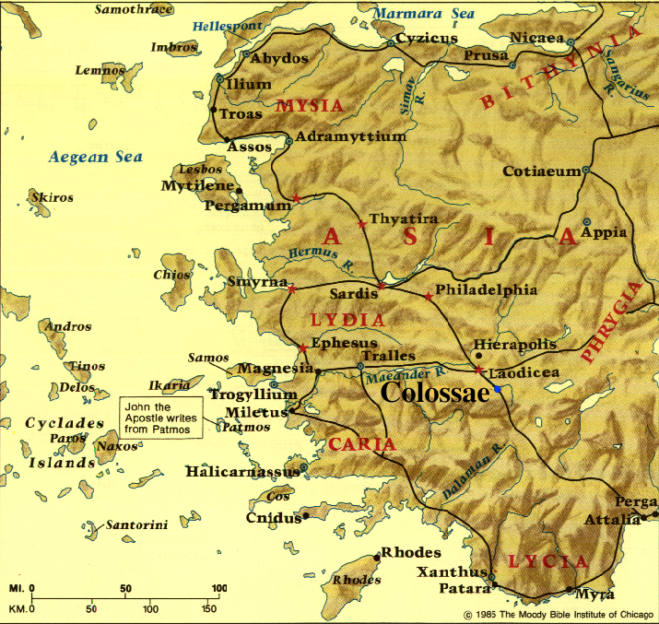

Slide 3
WHAT THE GNOSTICS WERE SAYING:

Slide 4
WHAT THE GNOSTICS WERE SAYING:
“Jesus is a lower emanation of ‘the fullness’”

Slide 5
WHAT THE GNOSTICS WERE SAYING:
“Jesus is a lower emanation of ‘the fullness’”
“Paul’s gospel is only a spiritual starter-kit”

Slide 6
Who Jesus is determines what He can provide for us

Slide 7
Colossians 1:15-23 The “Who” of the Gospel: Jesus

Slide 8
Colossians 1:15-23 The “Who” of the Gospel: Jesus
JESUS IS ABSOLUTELY SUPREME
THEREFORE, HE CAN RESCUE US COMPLETELY

Slide 9
Colossians 1:15-23 The “Who” of the Gospel: Jesus
JESUS IS ABSOLUTELY SUPREME
^{1:15} He is the image of the invisible God, the firstborn of all creation. ¹⁶ For by Him all things were created, both in the heavens and on earth, visible and invisible, whether thrones or dominions or rulers or authorities—all things have been created through Him and for Him. ¹⁷ He is before all things, and in Him all things hold together. ¹⁸ He is also head of the body, the church; and He is the beginning, the firstborn from the dead, so that He Himself will come to have first place in everything. ¹⁹ For it was the Father’s good pleasure for all the fullness to dwell in Him, ²⁰ and through Him to reconcile all things to Himself, having made peace through the blood of His cross; through Him, I say, whether things on earth or things in heaven.

Slide 10
Colossians 1:15-23 The “Who” of the Gospel: Jesus
JESUS IS ABSOLUTELY SUPREME
He is the unique & perfect Revelation of God
^{1:15} He is the image of the invisible God . . . ¹⁹ For it was the Father’s good pleasure for all the fullness to dwell in Him . . .
^{2:9} For in Him all the fullness of Deity dwells in bodily form . . .

Slide 11
Colossians 1:15-23 The “Who” of the Gospel: Jesus
JESUS IS ABSOLUTELY SUPREME
He is the rightful Owner of the entire universe
^{1:15} He is . . . the firstborn of all creation. ¹⁶ For by Him all things were created, both in the heavens and on earth, visible and invisible, whether thrones or dominions or rulers or authorities—all things have been created through Him and for Him. ¹⁷ He is before all things, and in Him all things hold together.

Slide 12
Colossians 1:15-23 The “Who” of the Gospel: Jesus
JESUS IS ABSOLUTELY SUPREME
He is the sole Redeemer of our broken universe
¹⁸ He is also head of the body, the church; and He is the beginning, the firstborn from the dead, so that He Himself will come to have first place in everything. ¹⁹ For it was the Father’s good pleasure for all the fullness to dwell in Him, ²⁰ and through Him to reconcile all things to Himself, having made peace through the blood of His cross; through Him, I say, whether things on earth or things in heaven.

Slide 13
Colossians 1:15-23 The “Who” of the Gospel: Jesus
JESUS IS ABSOLUTELY SUPREME
He is the unique & perfect Revelation of God
He is the rightful Owner of the entire universe
He is the sole Redeemer of our broken universe

Slide 14
Colossians 1:15-23 The “Who” of the Gospel: Jesus
JESUS IS ABSOLUTELY SUPREME
He is the unique & perfect Revelation of God
He is the rightful Owner of the entire universe
He is the sole Redeemer of our broken universe
This is the consistent message of the entire Bible & the early church

Slide 15
Colossians 1:15-23 The “Who” of the Gospel: Jesus
THEREFORE, HE CAN RESCUE US COMPLETELY
^{1:21} And although you were formerly alienated and hostile in mind, engaged in evil deeds, ²² yet He has now reconciled you in His fleshly body through death, in order to present you before Him holy and blameless and beyond reproach . . .

Slide 16
Colossians 1:15-23 The “Who” of the Gospel: Jesus
THEREFORE, HE CAN RESCUE US COMPLETELY
Reconciliation
^{1:21} And although you were formerly alienated and hostile in mind, engaged in evil deeds, ²² yet He has now reconciled you in His fleshly body through death . . .

Slide 17
Colossians 1:15-23 The “Who” of the Gospel: Jesus
THEREFORE, HE CAN RESCUE US COMPLETELY
Reconciliation
Have you told God that you want to be reconciled to Him through Jesus?
^{1:21} And although you were formerly alienated and hostile in mind, engaged in evil deeds, ²² yet He has now reconciled you in His fleshly body through death . . .

Slide 18
Colossians 1:15-23 The “Who” of the Gospel: Jesus
THEREFORE, HE CAN RESCUE US COMPLETELY
Transformation
^{1:22} yet He has now reconciled you in His fleshly body through death, in order to present you before Him holy and blameless and beyond reproach . . .
²⁸ We proclaim Him, admonishing every person and teaching every person with all wisdom, so that we may present every person complete (mature) in Christ.

Slide 19
Colossians 1:15-23 The “Who” of the Gospel: Jesus
THEREFORE, HE CAN RESCUE US COMPLETELY
Transformation
^{1:22} yet He has now reconciled you in His fleshly body through death, in order to present you before Him holy and blameless and beyond reproach . . .
²⁸ We proclaim Him, admonishing every person and teaching every person with all wisdom, so that we may present every person complete (mature) in Christ. (See also Phil. 2:15)

Slide 20
Colossians 1:15-23 The “Who” of the Gospel: Jesus
THEREFORE, HE CAN RESCUE US COMPLETELY
Transformation
^{1:22} yet He has now reconciled you in His fleshly body through death, in order to present you before Him holy and blameless and beyond reproach – ²³ if indeed you continue in the faith firmly established and steadfast, and not moved away from the hope of the gospel that you have heard . . .

Slide 21
Colossians 1:15-23 The “Who” of the Gospel: Jesus
THEREFORE, HE CAN RESCUE US COMPLETELY
Transformation
The only condition to our transformation is that we stay focused on the gospel (see also 2 Cor. 3:18)
^{1:22} yet He has now reconciled you in His fleshly body through death, in order to present you before Him holy and blameless and beyond reproach – ²³ if indeed you continue in the faith firmly established and steadfast, and not moved away from the hope of the gospel that you have heard . . .

Slide 22
Colossians 1:15-23 The “Who” of the Gospel: Jesus
THEREFORE, HE CAN RESCUE US COMPLETELY
Transformation
One way to stay focused on the gospel: singing or reciting biblical songs/poems about Jesus (1:15-20)
^{1:22} yet He has now reconciled you in His fleshly body through death, in order to present you before Him holy and blameless and beyond reproach – ²³ if indeed you continue in the faith firmly established and steadfast, and not moved away from the hope of the gospel that you have heard . . .

