Slide 1
Humble yourselves!
…all of you, clothe yourselves with humility toward one another, for God is opposed to the proud, but gives grace to the humble. Therefore humble yourselves under the mighty hand of God, that He may exalt you at the proper time… 1 Peter 5:5-6

Slide 2
Humble yourselves!
…all of you, clothe yourselves with humility toward one another, for God is opposed to the proud, but gives grace to the humble. Therefore humble yourselves under the mighty hand of God, that He may exalt you at the proper time…1 Peter 5:5-6
You are proud.

Slide 3
Humble yourselves!
…all of you, clothe yourselves with humility toward one another, for God is opposed to the proud, but gives grace to the humble. Therefore humble yourselves under the mighty hand of God, that He may exalt you at the proper time…1 Peter 5:5-6
Humble yourselves toward God.

Slide 4
Humble yourselves!
…all of you, clothe yourselves with humility toward one another, for God is opposed to the proud, but gives grace to the humble. Therefore humble yourselves under the mighty hand of God, that He may exalt you at the proper time…1 Peter 5:5-6
Humble yourselves toward one another.

Slide 5
Humble yourselves!
…all of you, clothe yourselves with humility toward one another, for God is opposed to the proud, but gives grace to the humble. Therefore humble yourselves under the mighty hand of God, that He may exalt you at the proper time…1 Peter 5:5-6
God will oppose the proud & exalt the humble.

Slide 6
Humble yourselves!
You are proud.
Humble yourselves toward God.
Humble yourselves toward one another.
God will oppose the proud & exalt the humble.

Slide 7
Humble yourselves!
You are proud.
“The first step in acquiring humility is to realize that you are proud. Until you realize this, nothing can be done about it.” Mere Christianity, ch.8 The Great Sin, C. S. Lewis
Take the Humility Assessment
What did you notice about your attitudes…
toward yourself?
toward God?
toward others?

Slide 8
Humble yourselves!
You are proud.
Pride is the mother of all sins (Gen.3:6ff; Rom.1:21) & humility of all virtues.
“Humility is the precondition and basic presupposition for the genuineness, the beauty, and the truth of all virtue . . . Pride is not only by itself our primal sin: it also inwardly contaminates all intrinsically good dispositions and robs every virtue of its value before God.” Humility: Wellspring of Virtue, von Hildebrand, pp. 5,6

Slide 9
Humble yourselves!
You are proud.
Pride is the mother of all sins & humility of all virtues.
He leads the humble in justice, and He teaches the humble His way. Psalm 25:9
When pride comes, then comes dishonor, But with the humble is wisdom. Prov.11:2

Slide 10
Humble yourselves!
You are proud.
 | Pride is narcissistic | Humility is realistic

Slide 11
Humble yourselves!
You are proud.
 | Pride is narcissistic | Humility is realistic
 | Biblical words about pride carry the idea of self elevation; puffing self up.

Slide 12
Humble yourselves!
You are proud.
 | Pride is narcissistic | Humility is realistic
 | Biblical words about pride carry the idea of self elevation; puffing self up. | Biblical words about humility carry the idea of shrinking. Since the Bible presumes that we are proud, the ‘shrinking’ is toward our actual size.

Slide 13
Humble yourselves!
You are proud.
 | Pride is narcissistic | Humility is realistic
focus

Slide 14
Humble yourselves!
You are proud.
 | Pride is narcissistic | Humility is realistic
focus | Inordinate self attention
“True humility is not thinking less of yourself; it is thinking of yourself less.”
Lewis, Mere Christianity

Slide 15
During my afternoon ‘meditations’…I have found out ludicrous and terrible things about my own character. …will you believe it, one out of every three (thoughts) is a thought of self-admiration: …I catch myself posturing before the mirror, so to speak, all day long. I pretend I am carefully thinking out loud what to say to the next pupil (for his good, of course) and then suddenly realize I am thinking how frightfully clever I’m going to be and how he will admire me . . . And then when you force yourselves to stop it, you admire yourself for doing that. It’s like fighting the hydra . . . There seems to be no end to it. Depth under depth of self-love and self-admiration.
The Collected Letters of C.S. Lewis, Volume 1 pp. 878-879.

Slide 16
Humble yourselves!
You are proud.
 | Pride is narcissistic | Humility is realistic
focus | Inordinate self attention
Even negative self attention is…
self attention

Slide 17
Sin turns you in on yourself, blinding you to God... Self-loathing exalts your opinion of yourself as supremely important; shame exalts the opinion of other people. But…what God chooses to “remember” about you is decisive. Your conscience, if well-tuned, is…dependent on the stance He takes.
David Powlison from, Making All Things New

Slide 18
Humble yourselves!
You are proud.
 | Pride is narcissistic | Humility is realistic
focus | Inordinate self attention
Self-focus often shows up through comparison & competition with others.

Slide 19
Now what you want to get clear is that Pride is essentially competitive - is competitive by its very nature…Pride gets no pleasure out of having something, only out of having more of it than the next man. We say that people are proud of being rich, or clever, or good-looking, but they are not. They are proud of being richer, or cleverer, or better-looking than others. If everyone else became equally rich, or clever, or good-looking there would be nothing to be proud about. It is the comparison that makes you proud: the pleasure of being above the rest. Once the element of competition has gone, pride has gone.
C.S. Lewis, “The Great Sin,” Mere Christianity pp. 121-122

Slide 20
Humble yourselves!
You are proud.
 | Pride is narcissistic | Humility is realistic
focus | Inordinate self attention | Focusing on God is an important feature of humility.
Not to us, O LORD, not to us, But to Your name be the glory because of Your lovingkindness, because of Your truth. Psalm 115:1

Slide 21
Humble yourselves!
You are proud.
 | Pride is narcissistic | Humility is realistic
focus | Inordinate self attention | Focusing on God is an important feature of humility.
Delight yourself in the Lord…
Commit your way to the Lord, trust also in Him…
Rest in the Lord and wait patiently for Him;
…the humble will inherit the land
excerpts from Psalm 37:4-11

Slide 22
Humble yourselves!
You are proud.
 | Pride is narcissistic | Humility is realistic
knows

Slide 23
Humble yourselves!
You are proud.
 | Pride is narcissistic | Humility is realistic
knows | Pride is inordinately confident in what it knows.

Slide 24
Sidebar: reasons to doubt yourself.
Scientific reasons:
We self-deceive & self-justify.

Slide 25
Sidebar: reasons to doubt yourself.
Scientific reasons:
We self-deceive & self-justify.
Our brains make consistent, predictable errors.

Slide 26
Sidebar: reasons to doubt yourself.
Scientific reasons:
We self-deceive & self-justify
Our brains make consistent predictable errors.
Cognitive biases
Selective attention
Memory formation/recall
Mutual inhibition of cognitive/emotional areas

Slide 27
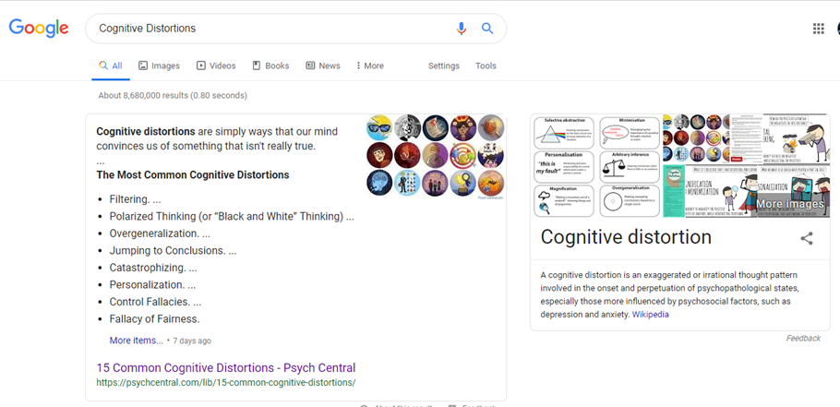
Sidebar: reasons to doubt yourself.
Scientific reasons:
We self-deceive & self-justify
Our brains make consistent, predictable errors.
Development can distort our thinking & feeling

Slide 28
Sidebar: reasons to doubt yourself.
Scientific reasons:
Biblical reasons:
We are fallen.
Fallen people are self-seeking.
Fallen people are self-righteous
We justify, conceal, condemn, overpower, lie, withdraw, blame, punish and confuse others to avoid feeling guilt & shame.
The heart is deceitful and desperately sick, who can know it? Jeremiah 17:9

Slide 29
Sidebar: reasons to doubt yourself.
Scientific reasons:
Biblical reasons:
We are fallen.
We have an enemy who’s deceptive.
Lying, accusing & deceiving (Jn.8:44; 2Tim.2:26)
Creating & sustaining human cultures that resonate with our fallenness; keeping the wool pulled over our eyes (1 Jn.2:16)

Slide 30
Humble yourselves!
You are proud.
 | Pride is narcissistic | Humility is realistic
knows | Pride is inordinately confident in what it knows. | Humility is much more tentative about what it knows.
I say to everyone among you not to think more highly of himself than he ought to think; but to think so as to have sound judgment… Rom.12:3
For I am conscious of nothing against myself, yet I am not by this acquitted; but the one who examines me is the Lord. 1 Cor. 4:4

Slide 31
Humble yourselves!
You are proud.
 | Pride is narcissistic | Humility is realistic
wants

Slide 32
Humble yourselves!
You are proud.
 | Pride is narcissistic | Humility is realistic
wants | Pride is willful

Slide 33
Humble yourselves!
You are proud.
 | Pride is narcissistic | Humility is realistic
wants | Pride is willful It rejects/ignores God’s authority

Slide 34
Humble yourselves!
You are proud.
 | Pride is narcissistic | Humility is realistic
wants | Pride is willful It rejects/ignores God’s authority It pursues its own desires
I have spread out My hands all day long to a rebellious people, Who walk in the way which is not good, following their own thoughts. Isaiah 65:2
Everyone did what was right in his own eyes. Jud.17:6

Slide 35
Humble yourselves!
You are proud.
 | Pride is narcissistic | Humility is realistic
wants | Pride is willful It rejects/ignores God’s authority It pursues its own desires | Humility is meek

Slide 36
Humble yourselves!
You are proud.
 | Pride is narcissistic | Humility is realistic
wants | Pride is willful It rejects/ignores God’s authority It pursues its own desires | Humility is meek God’s will (and other’s needs) have a controlling influence over personal desires.
Your kingdom come. Your will be done, On earth as it is in heaven. Mat 6:10

Slide 37
“The Son can do nothing of Himself, unless it is something He sees the Father doing” (John 5:19).
“I can do nothing on My own initiative” (John 5:30).
“I do not receive glory from men” (John 5:41).
“I have come down from heaven, not to do My own will, but the will of Him who sent Me” (John 6:38).
“My teaching is not Mine, but His who sent Me” (John 7:16).
“I have not come of Myself” (John 7:28).
“I do nothing on My own initiative” (John 8:28).
“I have not even come on My own initiative, but He sent Me” (John 8:42).
“I do not seek My glory” (John 8:50).
“I do not speak on My own initiative” (John 14:10).
“The word which you hear is not Mine, but the Father’s who sent Me” (John 14:24).

Slide 38
Humble yourselves!
You are proud.
 | Pride is narcissistic | Humility is realistic
wants | Pride is willful It rejects/ignores God’s authority It pursues its own desires | Humility is meek God’s will (and other’s needs) have a controlling influence over personal desires.
Do nothing from selfishness or empty conceit, but with humility of mind regard one another as more important than yourselves; do not merely look out for your own personal interests, but also for the interests of others. Phil. 2:3-4ff

Slide 39
Humble yourselves!
You are proud.
Humble yourselves toward God.
God…gives grace to the humble. Therefore humble yourselves under the mighty hand of God…
Disbelief in God’s love or power is typical of the proud during suffering…if handled well, suffering purges this form of pride from us.

Slide 40
Humble yourselves!
You are proud.
Humble yourselves toward God.
God initiates this process
Through biblical revelation (Ps. 19; 2 Tim. 3:16)
Through nature (Ps.19; Ro.1)

Slide 41
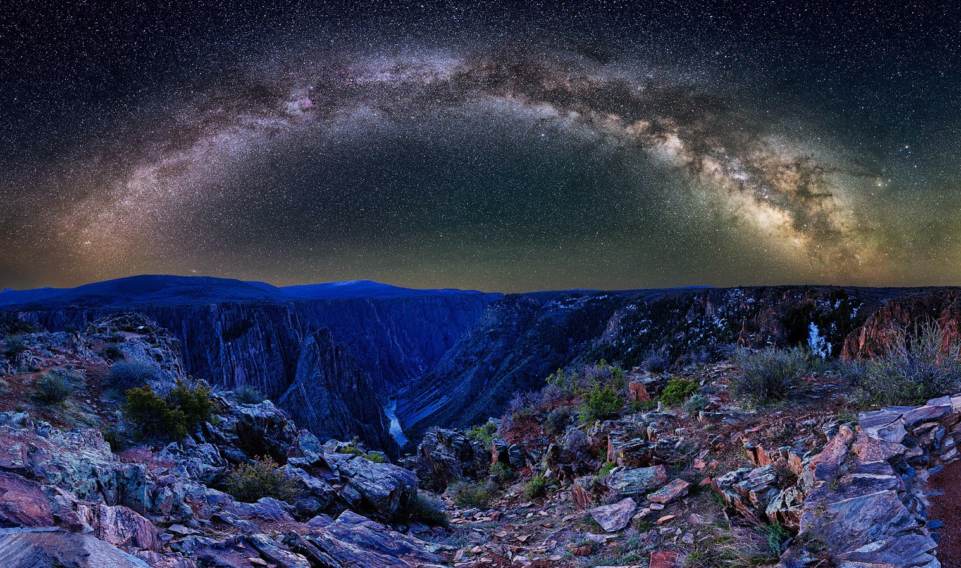
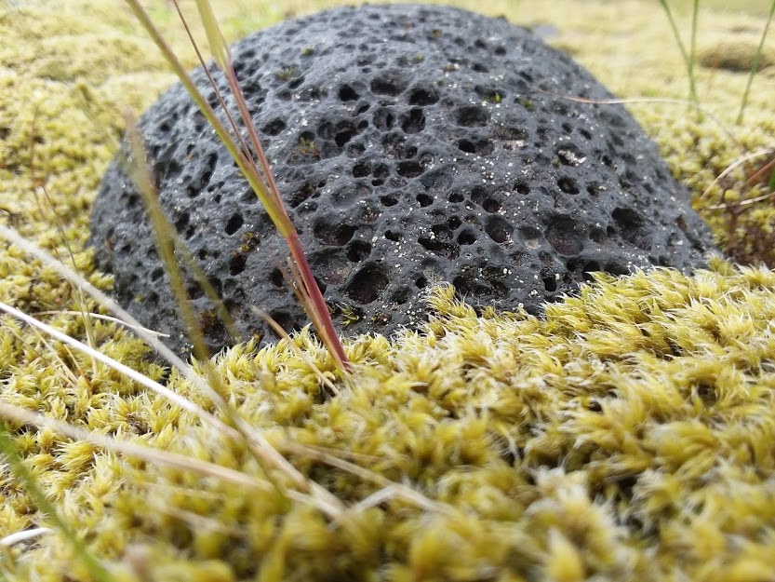

Slide 42
Humble yourselves!
You are proud.
Humble yourselves toward God.
God initiates this process
Through biblical revelation (Ps.95)
Through nature (Ps.19; Ro.1)
Through existential insights
Conviction (Jn. 6:44; 16:8)
Supernatural Provision (Deut. 8:2-4, 16)
Deprivation/Suffering (Deut.8:3 (Mt.4); 1 Tim.)
Abundance (Deut. 8:11-18)

Slide 43
…remember all the way which the Lord your God has led you in the wilderness these forty years, that He might humble you, testing you, to know what was in your heart, whether you would keep His commandments or not. He humbled you and let you be hungry, and fed you with manna which you did not know, nor did your fathers know, that He might make you understand that man does not live by bread alone, but man lives by everything that proceeds out of the mouth of the Lord. Your clothing did not wear out on you, nor did your foot swell these forty years. Thus you are to know in your heart that the Lord your God was disciplining you just as a man disciplines his son. Therefore, you shall keep the commandments of the Lord your God, to walk in His ways and to fear Him. ⁷ For the Lord your God is bringing you into a good land…When you have eaten and are satisfied, you shall bless the Lord your God for the good land which He has given you.

Slide 44
…remember all the way which the Lord your God has led you in the wilderness these forty years, that He might humble you, testing you, to know what was in your heart, whether you would keep His commandments or not. He humbled you and let you be hungry, and fed you with manna which you did not know, nor did your fathers know, that He might make you understand that man does not live by bread alone, but man lives by everything that proceeds out of the mouth of the Lord. Your clothing did not wear out on you, nor did your foot swell these forty years. Thus you are to know in your heart that the Lord your God was disciplining you just as a man disciplines his son. Therefore, you shall keep the commandments of the Lord your God, to walk in His ways and to fear Him. ⁷ For the Lord your God is bringing you into a good land…When you have eaten and are satisfied, you shall bless the Lord your God for the good land which He has given you.

Slide 45
…remember all the way which the Lord your God has led you in the wilderness these forty years, that He might humble you, testing you, to know what was in your heart, whether you would keep His commandments or not. He humbled you and let you be hungry, and fed you with manna which you did not know, nor did your fathers know, that He might make you understand that man does not live by bread alone, but man lives by everything that proceeds out of the mouth of the Lord. Your clothing did not wear out on you, nor did your foot swell these forty years. Thus you are to know in your heart that the Lord your God was disciplining you just as a man disciplines his son. Therefore, you shall keep the commandments of the Lord your God, to walk in His ways and to fear Him. ⁷ For the Lord your God is bringing you into a good land…When you have eaten and are satisfied, you shall bless the Lord your God for the good land which He has given you.

Slide 46
…remember all the way which the Lord your God has led you in the wilderness these forty years, that He might humble you, testing you, to know what was in your heart, whether you would keep His commandments or not. He humbled you and let you be hungry, and fed you with manna which you did not know, nor did your fathers know, that He might make you understand that man does not live by bread alone, but man lives by everything that proceeds out of the mouth of the Lord. Your clothing did not wear out on you, nor did your foot swell these forty years. Thus you are to know in your heart that the Lord your God was disciplining you just as a man disciplines his son. Therefore, you shall keep the commandments of the Lord your God, to walk in His ways and to fear Him. ⁷ For the Lord your God is bringing you into a good land…When you have eaten and are satisfied, you shall bless the Lord your God for the good land which He has given you.

Slide 47
…when you have eaten and are satisfied, and have built good houses and lived in them, and when your herds and your flocks multiply, and your silver and gold multiply, and all that you have multiplies, then your heart will become proud and you will forget the Lord your God… He brought water for you out of the rock of flint…He fed you manna which your fathers did not know, that He might humble you and that He might test you, to do good for you in the end. Otherwise, you may say in your heart, ‘My power and the strength of my hand made me this wealth.’But you shall remember the Lord your God, for it is He who is giving you power to make wealth…

Slide 48
…when you have eaten and are satisfied, and have built good houses and lived in them, and when your herds and your flocks multiply, and your silver and gold multiply, and all that you have multiplies, then your heart will become proud and you will forget the Lord your God… He brought water for you out of the rock of flint…He fed you manna which your fathers did not know, that He might humble you and that He might test you, to do good for you in the end. Otherwise, you may say in your heart, ‘My power and the strength of my hand made me this wealth. ’But you shall remember the Lord your God, for it is He who is giving you power to make wealth…

Slide 49
Humble yourselves!
You are proud.
Humble yourselves toward God.
God initiates this process
Through biblical revelation (Ps.95)
Through nature (Ps.19; Ro.1)
Through existential insights
Conviction (Jn. 6:44; 16:8)
Supernatural Provision (Deut. 8:2-4, 16)
Deprivation/Suffering (Deut.8:3 (Mt.4); 1 Tim.)
Abundance (Deut. 8:11-18)
Other people (Heb.3:12-13; Ps. 73)

Slide 50
Humble yourselves!
You are proud.
Humble yourselves toward God.
God initiates this process
Our job is to notice & respond
Notice
Respond
Fear of the Lord
Submit to his good leadership of you.
Practice gratitude toward God.

Slide 51
Humble yourselves!
You are proud.
Humble yourselves toward God.
God initiates this process
Our job is to notice & respond
Pride is hard to recognize – like carbon monoxide poisoning…

Slide 52
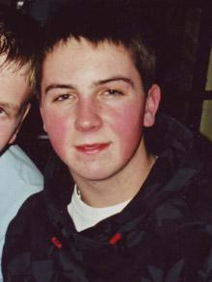

Slide 53
Humble yourselves!
You are proud.
Humble yourselves toward God.
God initiates this process
Our job is to notice & respond
Pride is hard to recognize – like carbon monoxide poisoning…
The ‘mirror’ we can look in to see pride is our unwillingness to notice & respond to God’s initiative.

Slide 54
Humble yourselves!
You are proud.
Humble yourselves toward God.
Humble yourselves toward one another.

Slide 55
Humble yourselves!
Humble yourselves toward one another.
Think about & serve others.
Do nothing from selfishness or empty conceit, but with humility of mind regard one another as more important than yourselves; do not merely look out for your own personal interests, but also for the interests of others. Have this attitude in yourselves which was also in Christ Jesus, who, although He existed in the form of God, did not regard equality with God a thing to be grasped, but emptied Himself, taking the form of a bond-servant, and being made in the likeness of men. Being found in appearance as a man, He humbled Himself by becoming obedient to the point of death, even death on a cross. Phil. 2:4-8

Slide 56
Humble yourselves!
Humble yourselves toward one another.
Think about & serve others.
Practice gratitude about/toward others.
We give thanks to God always for all of you, constantly mentioning you in our prayers 1 Thes. 1:2
I urge that supplications, prayers, intercessions, and thanksgivings be made for all people . 1 Timothy 2:1
Love one another with brotherly affection. Outdo one another in showing honor. Romans 12:10

Slide 57
Humble yourselves!
Humble yourselves toward one another.
Think about & serve others.
Practice gratitude about/toward others.
…rather than competing & criticizing
May God’s grace give you the necessary humility. Try not to think – much less, speak – of their sins. One’s own are a much more profitable theme! And if on consideration, one can find no faults on one’s own side, then cry for mercy; for this must be a most dangerous delusion. Collected letters of C. S. Lewis vol. 3

Slide 58
Humble yourselves!
Humble yourselves toward one another.
Think about & serve others.
Practice gratitude about/toward others.
…rather than competing & criticizing
…rather than seeking glory from others (Jn.5:44)

Slide 59
Humble yourselves!
Humble yourselves toward one another.
Think about & serve others.
Practice gratitude toward others.
Confess your faults & failures.
“I don’t confess my sin because I am so humble. I do it because it helps me to be humble.”
Jones and Fontenot, The Prideful Soul’s Guide to Humility, p. 154

Slide 60
Humble yourselves!
Humble yourselves toward one another.
Think about & serve others.
Practice gratitude toward others.
Confess your faults & failures.
Let others serve you…
…through their examples of faith in God, gratitude, submission & loving service
…through their attentiveness to our expressed needs
…through their direct challenges

Slide 61
Humble yourselves!
You are proud.
Humble yourselves toward God.
Humble yourselves toward one another.
God will oppose the proud & exalt the humble.

Slide 62
Humble yourselves!
God will oppose the proud & exalt the humble.
…everyone who exalts himself will be humbled, and he who humbles himself will be exalted.
Luke 14:11 social status
Luke 18:14 self-righteousness
Matt.23:1-12 loving praise from people

Slide 63
Humble yourselves!
God will oppose the proud & exalt the humble.
A man’s pride will bring him low, but a humble spirit will obtain honor…The fear of man brings a snare, But he who trusts in the LORD will be exalted. Prov.29:24, 25
…humble yourselves…casting all your anxiety on him, because he cares for you. 1 Pet. 5:6,7
Note: the peace of humility in Psalm 131)

Slide 64
Humble yourselves!
God will oppose the proud & exalt the humble.
…humble yourselves…casting all your anxiety on him, because he cares for you. 1 Pet. 5:6,7
Note: the peace of humility in Psalm 131)
“When Jesus calls us to learn of His own humility…He intends to strip us of the pride that keeps us from experiencing rest.”
Humble Roots, Hannah Anderson, 52; on Matt. 11:29

Slide 65
Humble yourselves!
You are proud
Humble yourselves toward God.
Humble yourselves toward one another.
God will oppose the proud & exalt the humble.
What are your thoughts or questions?

