Slide 2
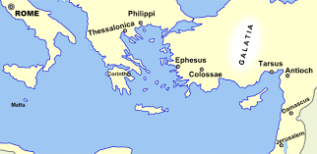

Slide 3
Philippians 1:12-18 Good News in Bad Circumstances
^{Romans 8:28} We know that God causes all things to work together for good to those who love God, to those who are called according to His purpose.

Slide 4
Philippians 1:12-18 Good News in Bad Circumstances
^{Romans 8:28} We know that God causes all things to work together for good to those who love God, to those who are called according to His purpose.
Character transformation
^{Romans 5:3} And not only this, but we also exult in our tribulations, knowing that tribulation brings about perseverance; ⁴ and perseverance, proven character; and proven character, hope.

Slide 5
Philippians 1:12-18 Good News in Bad Circumstances
^{Romans 8:28} We know that God causes all things to work together for good to those who love God, to those who are called according to His purpose.
Character transformation
Opportunities to spread the message about Jesus

Slide 6
Philippians 1:12-18 Good News in Bad Circumstances
GOD CAN GIVE US UNIQUE OPPORTUNITIES THROUGH OUR ADVERSE CIRCUMSTANCES
^{1:12} Now I want you to know, brethren, that my circumstances have turned out for the greater progress of the gospel, ¹³ so that my imprisonment in the cause of Christ has become well known throughout the whole praetorian guard and to everyone else . . .

Slide 7
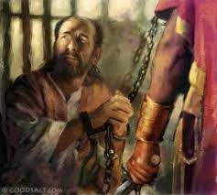
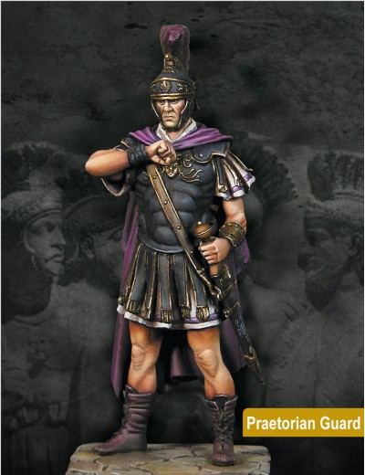
Philippians 1:12-18 Good News in Bad Circumstances
GOD CAN GIVE US UNIQUE OPPORTUNITIES THROUGH OUR ADVERSE CIRCUMSTANCES
^{1:12} Now I want you to know, brethren, that my circumstances have turned out for the greater progress of the gospel, ¹³ so that my imprisonment in the cause of Christ has become well known throughout the whole praetorian guard and to everyone else . . .
^{4:22} All the saints greet you, especially those of Caesar’s household.

Slide 8
Philippians 1:12-18 Good News in Bad Circumstances
GOD CAN GIVE US UNIQUE OPPORTUNITIES THROUGH OUR ADVERSE CIRCUMSTANCES
^{1:12} Now I want you to know, brethren, that my circumstances have turned out for the greater progress of the gospel, ¹³ so that my imprisonment in the cause of Christ has become well known throughout the whole praetorian guard and to everyone else . . .
^{Acts 28:30} And he stayed two full years in his own rented quarters and was welcoming all who came to him, ³¹ preaching the kingdom of God and teaching concerning the Lord Jesus Christ with all openness, unhindered.

Slide 9
Philippians 1:12-18 Good News in Bad Circumstances
GOD CAN GIVE US UNIQUE OPPORTUNITIES THROUGH OUR ADVERSE CIRCUMSTANCES
PLUS: Paul’s letters to the Philippians, Ephesians, Colossians & Philemon
^{1:12} Now I want you to know, brethren, that my circumstances have turned out for the greater progress of the gospel, ¹³ so that my imprisonment in the cause of Christ has become well known throughout the whole praetorian guard and to everyone else . . .

Slide 10
Philippians 1:12-18 Good News in Bad Circumstances
GOD CAN GIVE US UNIQUE OPPORTUNITIES THROUGH OUR ADVERSE CIRCUMSTANCES
God still does this!!

Slide 11
Philippians 1:12-18 Good News in Bad Circumstances
GOD CAN GIVE US UNIQUE OPPORTUNITIES THROUGH OUR ADVERSE CIRCUMSTANCES
Next time, instead focusing on what you don’t like about your circumstances, pray for & look for this!

Slide 12
Philippians 1:12-18 Good News in Bad Circumstances
GOD CAN INSPIRE & EMBOLDEN OTHER CHRISTIANS THROUGH OUR EXAMPLE
It’s easy to retreat from sharing our faith . . .
¹⁴ . . . and that most of the brethren, trusting in the Lord because of my imprisonment, have far more courage to speak the word of God without fear.

Slide 13
Philippians 1:12-18 Good News in Bad Circumstances
GOD CAN INSPIRE & EMBOLDEN OTHER CHRISTIANS THROUGH OUR EXAMPLE
It’s easy to retreat from sharing our faith . . .
. . . but hearing about others’ sharing can inspire us to trust God & speak up!
¹⁴ . . . and that most of the brethren, trusting in the Lord because of my imprisonment, have far more courage to speak the word of God without fear.

Slide 14
Philippians 1:12-18 Good News in Bad Circumstances
GOD CAN INSPIRE & EMBOLDEN OTHER CHRISTIANS THROUGH OUR EXAMPLE
Share about your recent attempts to reach out to non-Christians – the good, the bad, & the ugly
¹⁴ . . . and that most of the brethren, trusting in the Lord because of my imprisonment, have far more courage to speak the word of God without fear.

Slide 15
Philippians 1:12-18 Good News in Bad Circumstances
GOD CAN WORK EVEN THROUGH THE WITNESS OF CHRISTIANS WITH MIXED MOTIVES
¹⁵ Some, to be sure, are preaching Christ even from envy and strife, but some also from good will; ¹⁶ the latter do it out of love, knowing that I am appointed for the defense of the gospel; ¹⁷ the former proclaim Christ out of selfish ambition rather than from pure motives, thinking to cause me distress in my imprisonment. ¹⁸ What then? Only that in every way, whether in pretense or in truth, Christ is proclaimed; and in this I rejoice. Yes, and I will rejoice . . .

Slide 16
Philippians 1:12-18 Good News in Bad Circumstances
GOD CAN WORK EVEN THROUGH THE WITNESS OF CHRISTIANS WITH MIXED MOTIVES
¹⁵ Some, to be sure, are preaching Christ even from envy and strife, but some also from good will; ¹⁶ the latter do it out of love, knowing that I am appointed for the defense of the gospel; ¹⁷ the former proclaim Christ out of selfish ambition rather than from pure motives, thinking to cause me distress in my imprisonment. ¹⁸ What then? Only that in every way, whether in pretense or in truth, Christ is proclaimed; and in this I rejoice. Yes, and I will rejoice . . .

Slide 17
Philippians 1:12-18 Good News in Bad Circumstances
GOD CAN WORK EVEN THROUGH THE WITNESS OF CHRISTIANS WITH MIXED MOTIVES
Ae you aware of other examples of this truth?

Slide 18
Philippians 1:12-18 Good News in Bad Circumstances
GOD CAN WORK EVEN THROUGH THE WITNESS OF CHRISTIANS WITH MIXED MOTIVES
How do you respond when you’re aware of your own mixed motives?

Slide 19
Philippians 1:12-18 Good News in Bad Circumstances
GOD CAN GIVE US UNIQUE OPPORTUNITIES THROUGH OUR ADVERSE CIRCUMSTANCES
GOD CAN INSPIRE & EMBOLDEN OTHER CHRISTIANS THROUGH OUR EXAMPLE
GOD CAN WORK EVEN THROUGH THE WITNESS OF CHRISTIANS WITH MIXED MOTIVES

