Slide 1
Acts
The Church in Jerusalem
Acts 4 & 5: Spiritual Authenticity

Slide 2
Acts
The Church in Jerusalem
Last week: an effort to intimidate the church resulted in greater confidence!
An effort to suppress the gospel led to the spread of the gospel!
Theme in Acts:
“you’re only making it stronger”
A series of challenges

Slide 3
Acts
The Church in Jerusalem
Today: another challenge - from within

Slide 4
^{Acts 4:36} Now Joseph, a Levite of Cyprian birth, who was also called Barnabas by the apostles (which translated means Son of Encouragement),³⁷ and who owned a tract of land, sold it and brought the money and laid it at the apostles’ feet.
^{Acts 4:36} Now Joseph, a Levite of Cyprian birth, who was also called Barnabas by the apostles (which translated means Son of Encouragement),³⁷ and who owned a tract of land, sold it and brought the money and laid it at the apostles’ feet.
^{Acts 4:36} Now Joseph, a Levite of Cyprian birth, who was also called Barnabas by the apostles (which translated means Son of Encouragement),³⁷ and who owned a tract of land, sold it and brought the money and laid it at the apostles’ feet.

Slide 5
There is a deception going on here …
nosphizomai: “to set apart, misappropriate, pilfer”
^{Acts 5:1} But a man named Ananias, with his wife Sapphira, sold a piece of property, ² and kept back some of the price for himself, with his wife’s full knowledge, and bringing a portion of it, he laid it at the apostles’ feet.
^{Acts 5:1} But a man named Ananias, with his wife Sapphira, sold a piece of property, ² and kept back some of the price for himself, with his wife’s full knowledge, and bringing a portion of it, he laid it at the apostles’ feet.
^{Acts 5:1} But a man named Ananias, with his wife Sapphira, sold a piece of property, ² and kept back some of the price for himself, with his wife’s full knowledge, and bringing a portion of it, he laid it at the apostles’ feet.
^{Acts 5:1} But a man named Ananias, with his wife Sapphira, sold a piece of property, ² and kept back some of the price for himself, with his wife’s full knowledge, and bringing a portion of it, he laid it at the apostles’ feet.

Slide 6
^{Acts 5:3} But Peter said, “Ananias, why has Satan filled your heart to lie to the Holy Spirit and to keep back some of the price of the land? ⁴ While it remained unsold, did it not remain your own? And after it was sold, was it not under your control? Why is it that you have conceived this deed in your heart? You have not lied to men but to God.”
^{Acts 5:3} But Peter said, “Ananias, why has Satan filled your heart to lie to the Holy Spirit and to keep back some of the price of the land? ⁴ While it remained unsold, did it not remain your own? And after it was sold, was it not under your control? Why is it that you have conceived this deed in your heart? You have not lied to men but to God.”

Slide 7
^{Acts 5:3} But Peter said, “Ananias, why has Satan filled your heart to lie to the Holy Spirit and to keep back some of the price of the land? ⁴ While it remained unsold, did it not remain your own? And after it was sold, was it not under your control? Why is it that you have conceived this deed in your heart? You have not lied to men but to God.”
^{Acts 5:5} And as he heard these words, Ananias fell down and breathed his last; and great fear came over all who heard of it.
^{Acts 5:5} And as he heard these words, Ananias fell down and breathed his last; and great fear came over all who heard of it.
^{Acts 5:5} And as he heard these words, Ananias fell down and breathed his last; and great fear came over all who heard of it.

Slide 8
^{Acts 5:6} The young men got up and covered him up, and after carrying him out, they buried him.

Slide 9
^{Acts 5:7} Now there elapsed an interval of about three hours, and his wife came in, not knowing what had happened.

Slide 10
^{Acts 5:8} And Peter responded to her, “Tell me whether you sold the land for such and such a price?”
^{Acts 5:8} And Peter responded to her, “Tell me whether you sold the land for such and such a price?” And she said, “Yes, that was the price.”

Slide 11
^{Acts 5:9} Then Peter said to her, “Why is it that you have agreed together to put the Spirit of the Lord to the test? Behold, the feet of those who have buried your husband are at the door, and they will carry you out as well.”
^{Acts 5:9} Then Peter said to her, “Why is it that you have agreed together to put the Spirit of the Lord to the test? Behold, the feet of those who have buried your husband are at the door, and they will carry you out as well.”

Slide 12
^{Acts 5:10} And immediately she fell at his feet and breathed her last, and the young men came in and found her dead, and they carried her out and buried her beside her husband. ¹¹ And great fear came over the whole church, and over all who heard of these things.

Slide 13
So, God will kill you if you don’t give your money?
Didn’t God overact a little?
God wants His church to be “filled with fear?”
God will damn Christians if they sin too much?
Was what they did even THAT bad?
This seems unfair
^{Acts 5:10} And immediately she fell at his feet and breathed her last, and the young men came in and found her dead, and they carried her out and buried her beside her husband. ¹¹ And great fear came over the whole church, and over all who heard of these things.

Slide 14
So, God will kill you if you don’t give your money?
What was their sin?
It wasn’t whether they gave or not
It wasn’t whether they gave enough
It wasn’t even greed!
^{Acts 5:4} While it remained unsold, did it not remain your own? And after it was sold, was it not under your control? Why is it that you have conceived this deed in your heart? You have not lied to men but to God.
^{Acts 5:4} While it remained unsold, did it not remain your own? And after it was sold, was it not under your control? Why is it that you have conceived this deed in your heart? You have not lied to men but to God.
^{Acts 5:4} While it remained unsold, did it not remain your own? And after it was sold, was it not under your control? Why is it that you have conceived this deed in your heart? You have not lied to men but to God.
^{Acts 5:10} And immediately she fell at his feet and breathed her last, and the young men came in and found her dead, and they carried her out and buried her beside her husband. ¹¹ And great fear came over the whole church, and over all who heard of these things.

Slide 15
The issue was that they lied!
^{Acts 5:3} why has Satan filled your heart to lie to the Holy Spirit …?
^{Acts 5:4} While it remained unsold, did it not remain your own? And after it was sold, was it not under your control? Why is it that you have conceived this deed in your heart? You have not lied to men but to God.

Slide 16
The issue was that they lied!
Made a public demonstration of their generosity
disingenuous posturing
Conspired together to trick the church (and God)
All to look spiritual, and win celebrity, admiration, and praise!
⁹ “Why is it that you have agreed together to put the Spirit of the Lord to the test?
^{Acts 5:4} While it remained unsold, did it not remain your own? And after it was sold, was it not under your control? Why is it that you have conceived this deed in your heart? You have not lied to men but to God.
THAT’s what prompted God to have such a big reaction

Slide 17
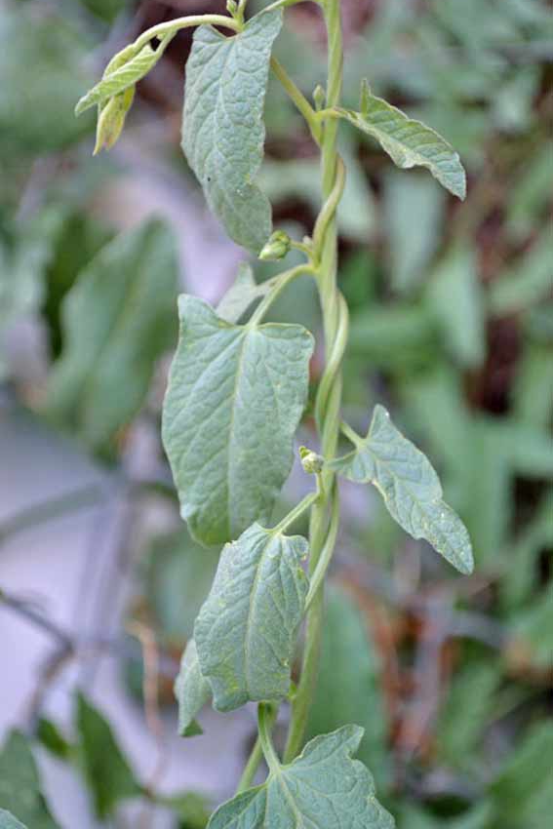

Slide 18
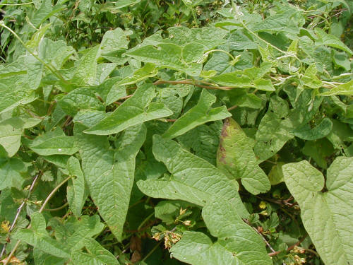
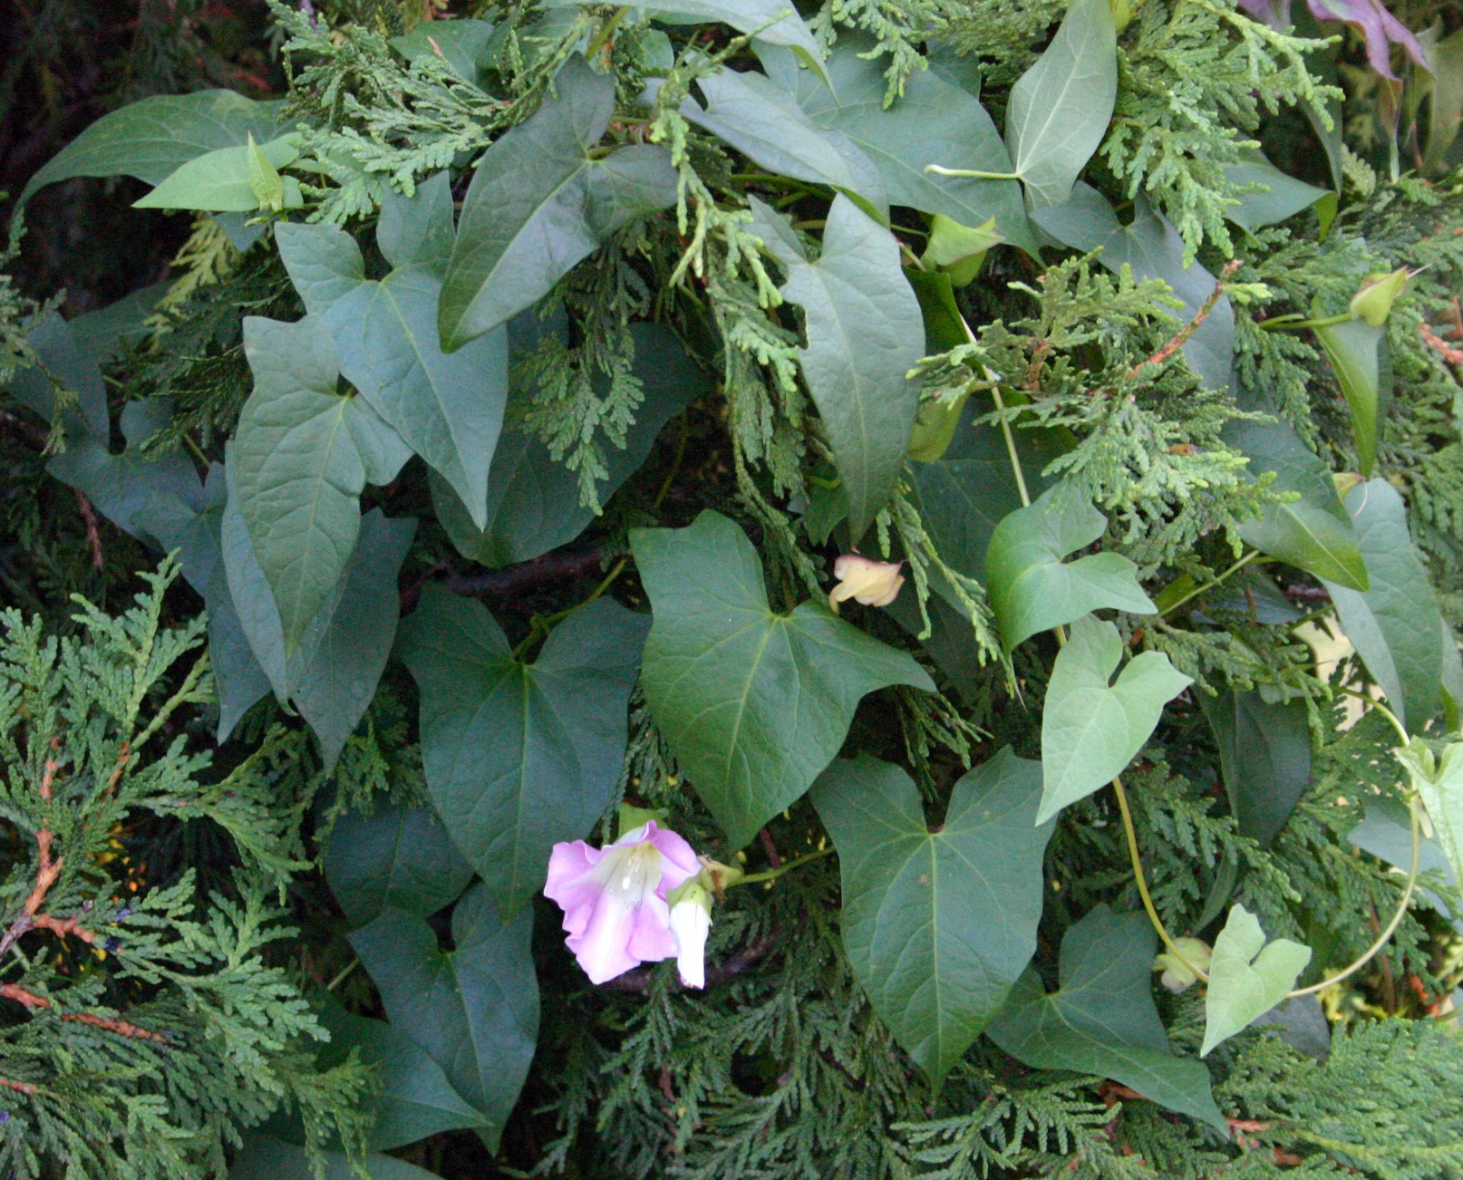

Slide 19
^{Matt 6:19} “Beware of practicing your righteousness before men to be noticed by them; otherwise you have no reward with your Father who is in heaven. ² “So when you give to the poor, do not sound a trumpet before you, as the hypocrites do in the synagogues and in the streets, so that they they may be honored by men. Truly I say to you, they have their reward in full.
What made Jesus angry?
The religious establishment: spiritually hollow, “hard of heart,” filled with fake, public posturing

Slide 20
Now he has established His Church – something new and pure!

Slide 21
^{Acts2:46} Day by day continuing with one mind in the temple, and breaking bread from house to house, they were taking their meals together with gladness and sincerity of heart.
= aphelotes: “simplicity of heart”
Now he has established His Church – something new and pure!
Something authentic and real
His witnesses, His message,
His representatives in His footsteps

Slide 22
^{Acts2:46} Day by day continuing with one mind in the temple, and breaking bread from house to house, they were taking their meals together with gladness and sincerity of heart.
= aphelotes: “simplicity of heart”
Now he has established His Church – something new and pure!
Something authentic and real
His witnesses, His message,
His representatives in His footsteps

Slide 23
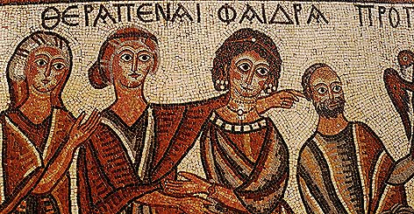
The sin is hypocrisy

Slide 24
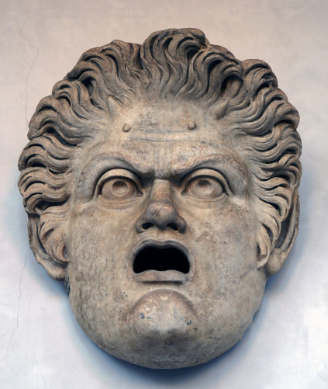
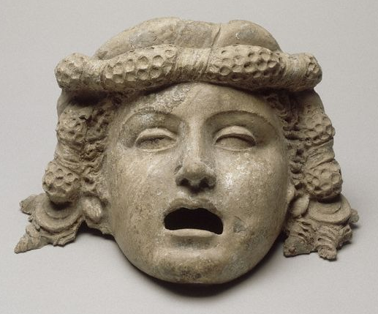
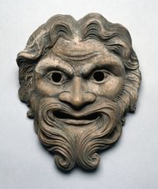
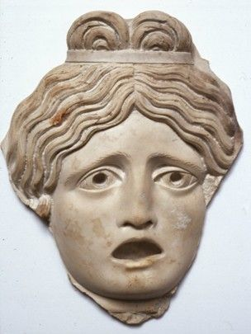
The sin is hypocrisy

Slide 25
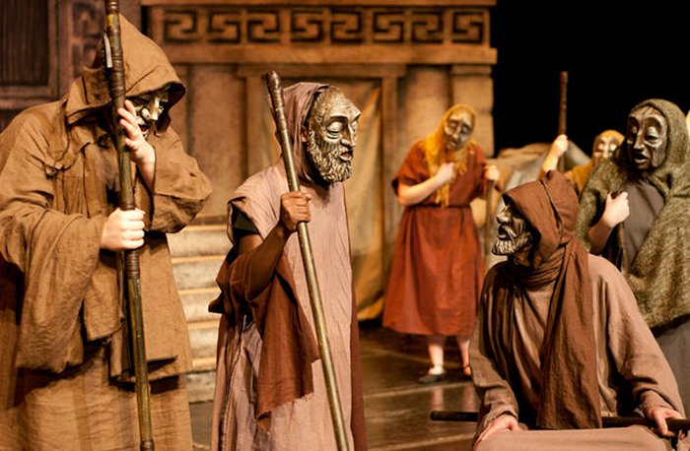
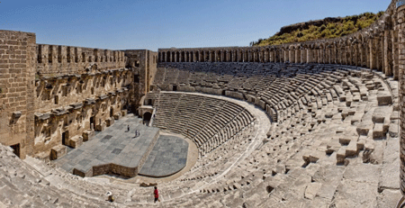
The sin is hypocrisy

Slide 26
The sin is hypocrisy
Putting on a dishonest spiritual performance, while inwardly being far from God
^{Mark 7:6} “Rightly did Isaiah prophesy of you hypocrites, as it is written: ‘This people honors Me with their lips, But their heart is far away from Me.

Slide 27
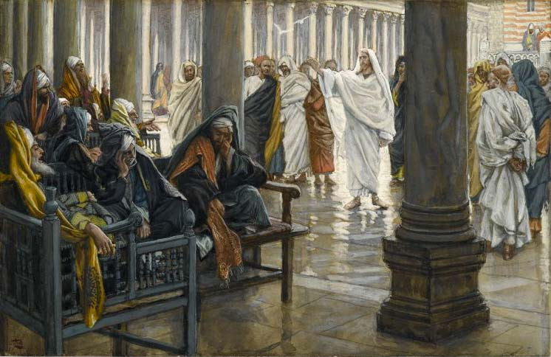
The sin is hypocrisy
Putting on a dishonest spiritual performance, while inwardly being far from God
^{Mark 7:6} “Rightly did Isaiah prophesy of you hypocrites, as it is written: ‘This people honors Me with their lips, But their heart is far away from Me.

Slide 28
The sin is hypocrisy
^{Matt 23:25} “Woe to you, scribes and Pharisees, hypocrites! For you clean the outside of the cup and of the dish, but inside they are full of robbery and self-indulgence.

Slide 29
The sin is hypocrisy
^{Matt 23:27} “Woe to you, scribes and Pharisees, hypocrites! For you are like whitewashed tombs which on the outside appear beautiful, but inside they are full of dead men’s bones and all uncleanness. ²⁸ So you, too, outwardly appear righteous to men, but inwardly you are full of hypocrisy and lawlessness.

Slide 30
The sin is hypocrisy
^{Matt 23:29} “Woe to you, scribes and Pharisees, hypocrites! For you build the tombs of the prophets and adorn the monuments of the righteous, ³⁰ and say, ‘If we had been living in the days of our fathers, we would not have been partners with them in shedding the blood of the prophets.’ ³¹ So you testify against yourselves, that you are sons of those who murdered the prophets. ³² Fill up, then, the measure of the guilt of your fathers. ³³ You serpents, you brood of vipers, how will you escape the sentence of hell?

Slide 31
The sin is hypocrisy
And it presents a clear and present danger
to the church

Slide 32
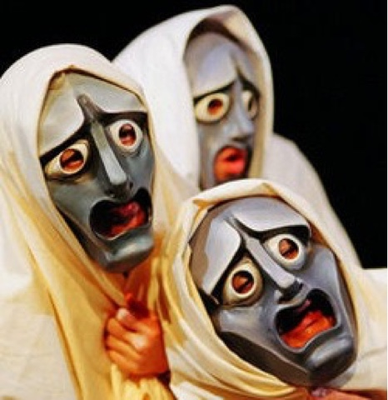
The sin is hypocrisy
And it presents a clear and present danger
to the church
External Consequences:
Presents a counterfeit Christianity
Undermines our mission: to be “witnesses”
Hypocrisy is already our reputation!

Slide 33
The sin is hypocrisy
And it presents a clear and present danger
to the church
Internal Consequences:
Fuels legalistic competition
Discourages transparency
Rots real community
Contagious
^{Luke 12:1} “Beware of the leaven of the Pharisees, which is hypocrisy.

Slide 34
What we’re seeing is in keeping with our theme:
God has intervened to valiantly defend His church from a grave threat
^{Acts 5:11} And great fear came over the whole church, and over all who heard of these things. ¹² …and they were all with one accord in Solomon’s portico. ¹³ But none of the rest dared to associate with them; however, the people held them in high esteem. ¹⁴ And all the more believers in the Lord, multitudes of men and women, were constantly added to their number
^{Acts 5:11} And great fear came over the whole church, and over all who heard of these things. ¹² …and they were all with one accord in Solomon’s portico. ¹³ But none of the rest dared to associate with them; however, the people held them in high esteem. ¹⁴ And all the more believers in the Lord, multitudes of men and women, were constantly added to their number
^{Acts 5:11} And great fear came over the whole church, and over all who heard of these things. ¹² …and they were all with one accord in Solomon’s portico. ¹³ But none of the rest dared to associate with them; however, the people held them in high esteem. ¹⁴ And all the more believers in the Lord, multitudes of men and women, were constantly added to their number
^{Acts 5:11} And great fear came over the whole church, and over all who heard of these things. ¹² …and they were all with one accord in Solomon’s portico. ¹³ But none of the rest dared to associate with them; however, the people held them in high esteem. ¹⁴ And all the more believers in the Lord, multitudes of men and women, were constantly added to their number
^{Acts 5:11} And great fear came over the whole church, and over all who heard of these things. ¹² …and they were all with one accord in Solomon’s portico. ¹³ But none of the rest dared to associate with them; however, the people held them in high esteem. ¹⁴ And all the more believers in the Lord, multitudes of men and women, were constantly added to their number
you’re only making it stronger!

Slide 35
What we’re seeing is in keeping with out theme:
God has intervened to valiantly defend His church from a grave threat
Was God overreacting?

Slide 36
What we’re seeing is in keeping with out theme:
God has intervened to valiantly defend His church from a grave threat
God will damn Christians if they sin too much?
Not a case of someone ‘finally hitting the limit’ on sin
Is God being unfair?
The “limit” is 1
^{James 2:10} For whoever keeps the whole law and yet stumbles in one point, he has become guilty of all.

Slide 37
What we’re seeing is in keeping with out theme:
God has intervened to valiantly defend His church from a grave threat
God will damn Christians if they sin too much?
Not a case of someone ‘finally hitting the limit’ on sin
Btw… it’s not clear that Ananias and Sapphira were judged by God!
Is God being unfair?
The “limit” is 1
That’s why ALL need rescued
God patiently holds back in mercy …
Begging us to turn to him and receive forgiveness

Slide 38
What we’re seeing is in keeping with out theme:
God has intervened to valiantly defend His church from a grave threat
God will damn Christians if they sin too much?
Not a case of someone ‘finally hitting the limit’ on sin
It was a unique case of God choosing not to show restraint, to make a statement for the good of the church

Slide 39
What we’re seeing is in keeping with out theme:
God has intervened to valiantly defend His church from a grave threat
Which is a good thing…
Because Ananias and
Sapphira were such jerks
“I would never do what they did”

Slide 40
What we’re seeing is in keeping with out theme:
God has intervened to valiantly defend His church from a grave threat
Which is a good thing…
Because there is a human impulse toward hypocrisy to which we are all susceptible
^{Acts 5:4} Why is it that you have conceived this deed in your heart?

Slide 41
Apart from Christ, hypocrisy is par for the course, because we are spiritual orphans, insecure in our identity
Needs: love, acceptance, significance
These go unmet when we are alienated from God
So we look to other people to meet them
Who is your unconscious audience
throughout the day?
Problem: we’re not always all that loveable, acceptable, or significant!
^{Acts 5:4} Why is it that you have conceived this deed in your heart?

Slide 42
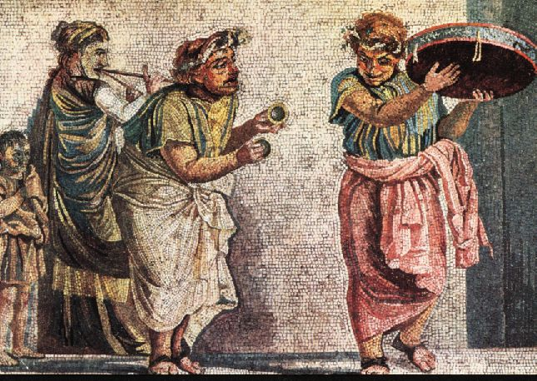
When your audience is man …
“You’re ON!”

Slide 43
When your audience is man …
And it’s a tough audience
Who is your unconscious audience
throughout the day?

Slide 44
When your audience is man …
The pressure’s on!
Who is your unconscious audience
throughout the day?

Slide 45
When your audience is man …
The stakes are high!
Who is your unconscious audience
throughout the day?

Slide 46
When your audience is man …
Don’t get upstaged!
Who is your unconscious audience
throughout the day?

Slide 47
When your audience is man …
Don’t forget your mask …
Who is your unconscious audience
throughout the day?

Slide 48
When your audience is man …
Break a leg!
This is miserable way to live
Who is your unconscious audience
throughout the day?
And in Christ, we don’t have to

Slide 49
God: make Me your audience
Who is your unconscious audience
throughout the day?

Slide 50
God: make Me your audience
^{Matt 6:3} But when you give to the poor, do not let your left hand know what your right hand is doing, ⁴ so that your giving will be in secret; and your Father who sees what is done in secret will reward you.
Who is your unconscious audience
throughout the day?

Slide 51
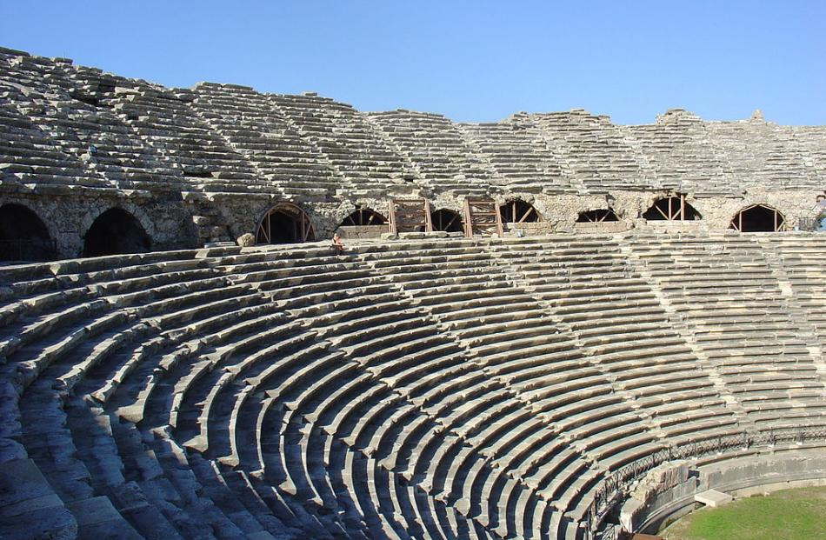
God: make Me your audience
^{Matt 6:3} But when you give to the poor, do not let your left hand know what your right hand is doing, ⁴ so that your giving will be in secret; and your Father who sees what is done in secret will reward you.
Who is your unconscious audience
throughout the day?

Slide 52
God: make Me your audience
^{Heb 4:13} And there is no creature hidden from His sight, but all things are open and laid bare to the eyes of Him with whom we have to do.
He sees through your performance
Who is your unconscious audience
throughout the day?

Slide 53
God: make Me your audience
^{Psalm 139:13} For You formed my inward parts; You wove me in my mother’s womb… ¹⁶ Your eyes have seen my unformed substance; And in Your book were all written the days that were ordained for me, when as yet there was not one of them.
He knows the real you
Who is your unconscious audience
throughout the day?

Slide 54
God: make Me your audience
^{Eph 1:4} Even before he made the world, God loved us and chose us in Christ to be holy and without fault in his eyes. ⁵ God decided in advance to adopt us into his own family by bringing us to himself through Jesus Christ. This is what he wanted to do, and it gave him great pleasure.
In Christ, He has already accepted you, is committed to love you for eternity, and purposed your life on earth
Who is your unconscious audience
throughout the day?

Slide 55
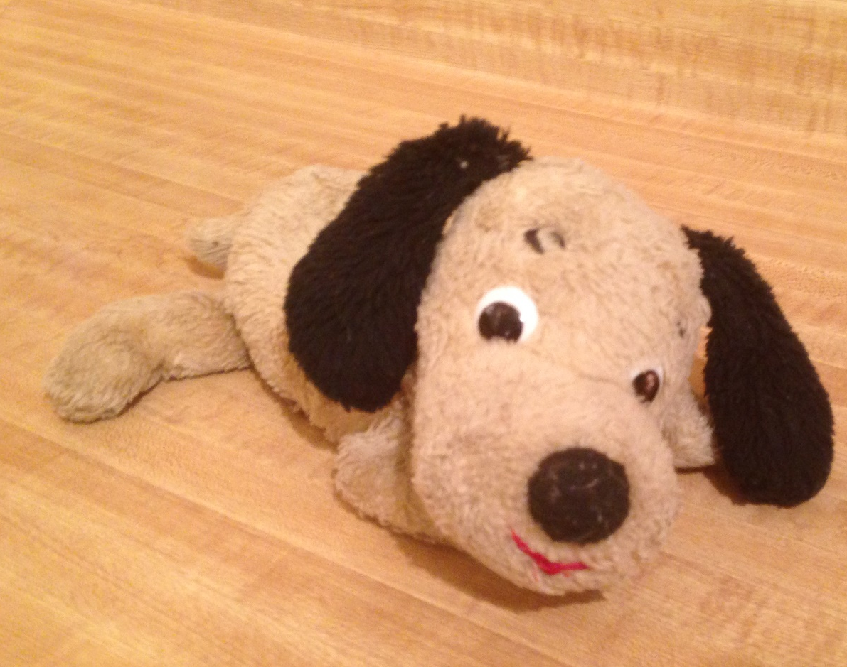
God: make Me your audience
My value comes from who I AM, not my performance
Your audience has already made up his mind about you
Who is your unconscious audience
throughout the day?

Slide 56
God: make Me your audience
John Ortberg Love Beyond Reason
“There is such a love, a love that creates value in what is loved. There is a love that turns rag dolls into priceless treasures. There is a love that fastens itself onto ragged little creatures, for reasons that no one could ever quite figure out, and makes them precious and valued beyond calculation… this is the love of God.”
My value comes from who I AM, not my performance
- Intrinsic Value
- Chosen Value
- Imputed Value
Your audience has already made up his mind about you
Who is your unconscious audience
throughout the day?

Slide 57
God: make Me your audience
Your audience delights in you!
Who is your unconscious audience
throughout the day?

Slide 58
God: make Me your audience
In Christ, I am TRULY KNOWN
and TRULY ACCEPTED
^{Heb 4:16} Therefore let us draw near with confidence to the throne of grace, so that we may receive mercy and find grace to help in time of need.
And His opinion is the only one that matters
Who is your unconscious audience
throughout the day?

Slide 59
God: make Me your audience
In Christ, I am TRULY KNOWN
and TRULY ACCEPTED
These facts release us from the need to perform for others!
So the challenge to the church is Hypocrisy
But in Christ we have a basis for overcoming this threat with genuine authenticity
Who is your unconscious audience
throughout the day?

Slide 60
God: make Me your audience

Slide 61
So what should we take home from this study?
Don’t be a hypocrite or God might strike you dead?

Slide 62
So what should we take home from this study?
An opportunity to be truly different than the world around us
^{1 Tim 1:5} But the goal of our instruction is love from a pure heart and a good conscience and a sincere faith.
= anupokritos: “unhypocritical, unfeigned”

Slide 63
So what should we take home from this study?
An opportunity to be truly different than the world around us
No mask… and yet completely confident

Slide 64
So what should we take home from this study?
An opportunity to be truly different than the world around us
Humble about our successes

Slide 65
So what should we take home from this study?
An opportunity to be truly different than the world around us
Transparent about our failures

Slide 66
So what should we take home from this study?
An opportunity to be truly different than the world around us
Not afraid to draw near in real relationships

Slide 67
So what should we take home from this study?
An opportunity to be truly different than the world around us
Showing the world the authentic love of Christ

Slide 68
So what should we take home from this study?
An opportunity to be truly different than the world around us
And all the while bringing glory to Him rather than to ourselves

Slide 69
Acts
The Church in Jerusalem
Next week:
Another challenge to the church

