Slide 1
Joshua 3-4
Crossing the Jordan

Slide 2
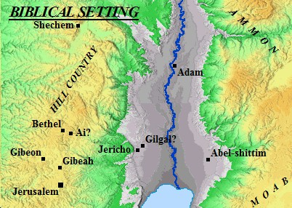
(Joshua 3)
Early in the morning Joshua and all the Israelites set out from ‘Acacia Grove’ and went to the Jordan, where they camped before crossing over.

Slide 3
(Joshua 3)
Early in the morning Joshua and all the Israelites set out from ‘Acacia Grove’ and went to the Jordan, where they camped before crossing over.
Reaching a defining moment

Slide 4
(Joshua 3)
² After three days the officers went throughout the camp, ³ giving orders to the people: “When you see the ark of the covenant…you are to move out from your positions and follow it.

Slide 5
(Joshua 3)
⁴ Then you will know which way to go, since you have never been this way before.

Slide 6
(Joshua 3)
⁴ Then you will know which way to go, since you have never been this way before.
Desert
War
Defining moments involve a consequential decision

Slide 7
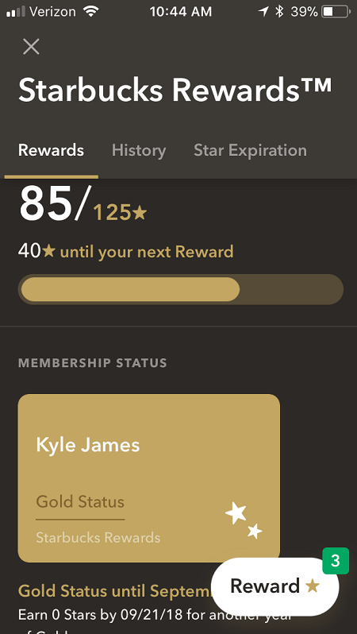
(Joshua 3)
⁴ Then you will know which way to go, since you have never been this way before.
God will mark out defining moments in our lives.

Slide 8
(Joshua 3)
⁵ Joshua told the people, “Consecrate yourselves, for tomorrow the Lord will do amazing things among you.”

Slide 9
(Psalm 37:4) Delight yourself in the Lord, and he will give you the desires of your heart. Commit your way to the Lord; trust in him, and he will act.
(Joshua 3)
⁵ Joshua told the people, “Consecrate yourselves, for tomorrow the Lord will do amazing things among you.”
Factor
Response
Real challenges
Real changes
Real God
Count the cost
Wrestle, prayer, decide!
(Luke 14) ²⁸ “Suppose one of you wants to build a tower. Won’t you first sit down and estimate the cost to see if you have enough money to complete it?
Get ready
Doing the math

Slide 10
“We fix the time for the display of His power. We consecrate and then he acts. It’s on mans side that the windows of blessing are bolted.”

Slide 11
(Joshua 3)
⁶ Joshua said to the priests, “Take up the ark of the covenant and pass on ahead of the people.” So they took it up and went ahead of them.
God leads the way

Slide 12
(Joshua 3)
⁶ Joshua said to the priests, “Take up the ark of the covenant and pass on ahead of the people.” So they took it up and went ahead of them.
(Deut. 31:8) The LORD himself goes before you and will be with you; he will never leave you nor forsake you. Do not be afraid; do not be discouraged."
God leads the way

Slide 13
(Joshua 3)
⁷ And the Lord said to Joshua, “Today I will begin to exalt you in the eyes of all Israel, so they may know that I am with you as I was with Moses.

Slide 14
(Joshua 3)
⁸ Tell the priests who carry the ark of the covenant: ‘When you reach the edge of the Jordan’s waters, go and stand in the river.’”

Slide 15
(Joshua 3)
⁹ Joshua said to the Israelites, “Come here and listen to the words of the Lord your God.

Slide 16
(Joshua 3)
¹⁰ This is how you will know that the living God is among you and that he will certainly drive out before you the peoples of Canaan.

Slide 17
(Joshua 3)
¹¹ See, the ark of the covenant of the Lord of all the earth will go into the Jordan ahead of you.

Slide 18
(Joshua 3)
¹³ And as soon as the priests who carry the ark of the Lord—the Lord of all the earth—set foot in the Jordan, its waters flowing downstream will be cut off and stand up in a heap.”

Slide 19
(Joshua 3)
¹⁴ So when the people broke camp to cross the Jordan, the priests carrying the ark of the covenant went ahead of them.

Slide 20
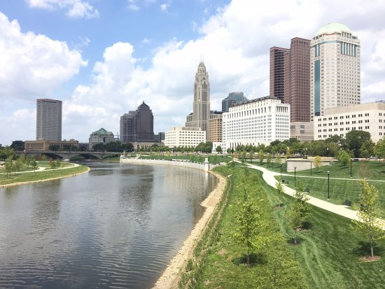
(Joshua 3)
¹⁵ Now the Jordan is at flood stage all during harvest.

Slide 21
(Joshua 3)
⁸ Tell the priests who carry the ark of the covenant: ‘When you reach the edge of the Jordan’s waters, go and stand in the river.’”

Slide 22
(Joshua 3)
Yet as soon as the priests who carried the ark reached the Jordan and their feet touched the water’s edge…
“Why can’t God part the water first!?”
“What’s going to happen next?”

Slide 23
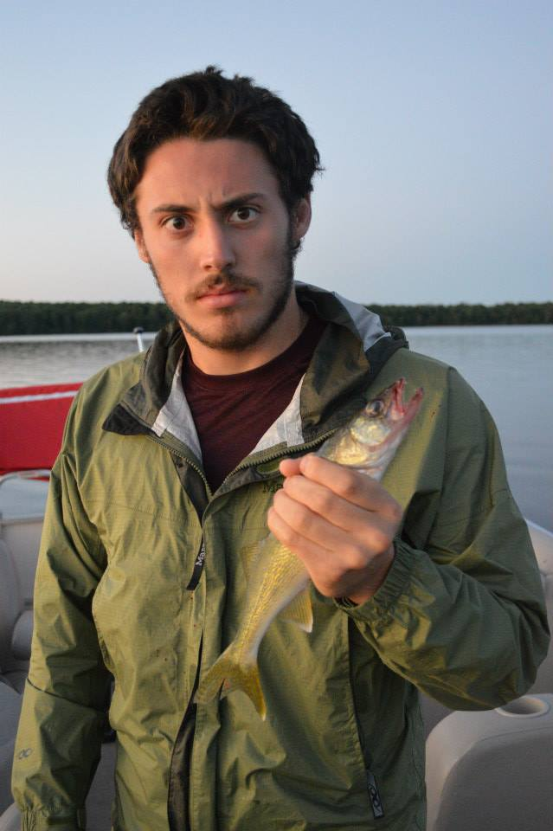
Things God won’t do:
Brush your teeth
Ask a girl out on a date
Open your mouth to speak
Have a good attitude
Think and pray
Exercise faith
“There are some things god cannot and will not do for us, although he will supply all the power and grace necessary...the initiative lies with us.”

Slide 24
(Joshua 3)
Yet as soon as the priests who carried the ark reached the Jordan and their feet touched the water’s edge…
¹⁶ the water from upstream stopped flowing.
Take the first step

Slide 25
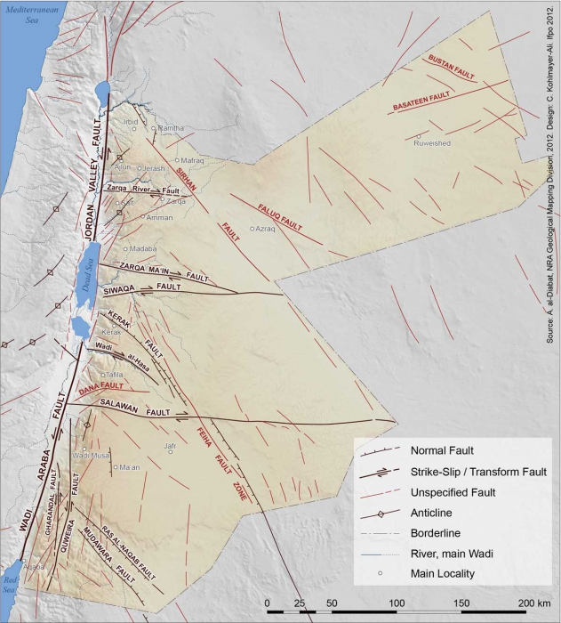
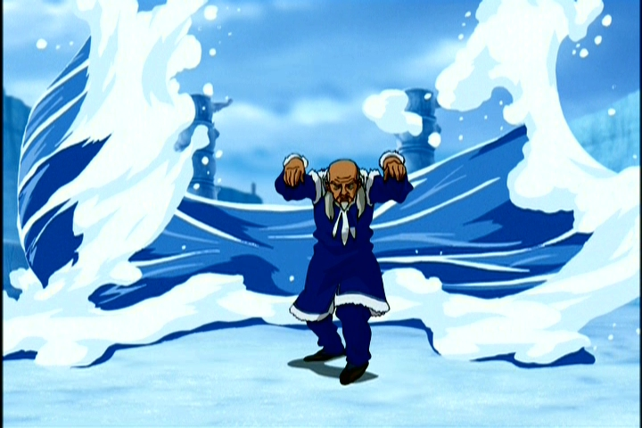
(Joshua 3)
It piled up in a heap a great distance away…So the people crossed over opposite Jericho.
Take the first step

Slide 26
(Joshua 4)
⁸ …They took twelve stones from the middle of the Jordan, according to the number of the tribes of the Israelites, as the Lord had told Joshua; and they carried them over with them to their camp…

Slide 27
(Joshua 4)
⁹ Joshua set up the twelve stones…at the spot where the priests who carried the ark of the covenant had stood. And they are there to this day.

Slide 28
(Joshua 4)
¹⁰ Now the priests who carried the ark remained standing in the middle of the Jordan…

Slide 29
(Joshua 4)
The people hurried over, ¹¹ and as soon as all of them had crossed, the ark of the Lord and the priests came to the other side while the people watched.

Slide 30
(Joshua 4)
¹⁸ …No sooner had they set their feet on the dry ground than the waters of the Jordan returned to their place and ran at flood stage as before.

Slide 31
(Joshua 4)
²⁰ And Joshua set up at Gilgal the twelve stones they had taken out of the Jordan.

Slide 32
(Joshua 4)
²¹ He said to the Israelites, “In the future when your descendants ask…‘What do these stones mean?’

Slide 33
(Joshua 4)
²² tell them, ‘Israel crossed the Jordan on dry ground.’
²³ For the Lord your God dried up the Jordan before you until you had crossed over.

Slide 34
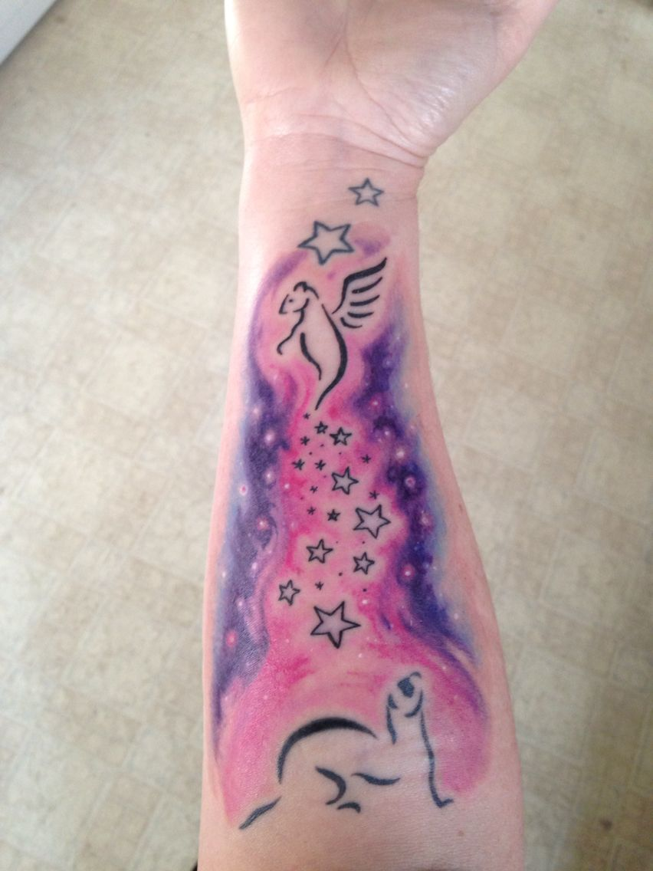
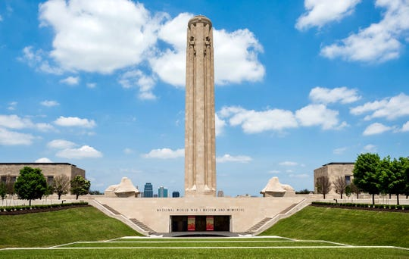
(Joshua 4)
²⁴ He did this so that all the peoples of the earth might know that the hand of the Lord is powerful and so that you might always fear the Lord your God.”

Slide 35
(Joshua 4)
²⁴ He did this so that all the peoples of the earth might know that the hand of the Lord is powerful and so that you might always fear the Lord your God.”
Why not try this at epic?
Set up a memorial

Slide 36
Conclusion
Have you come to any defining moments in your spiritual life?
Receiving Jesus
Deciding to live for Jesus
Facing major opposition
Making a major life decision
Speaking up for God

Slide 37
Conclusion
Defining moments come for groups as well as individuals

Slide 38
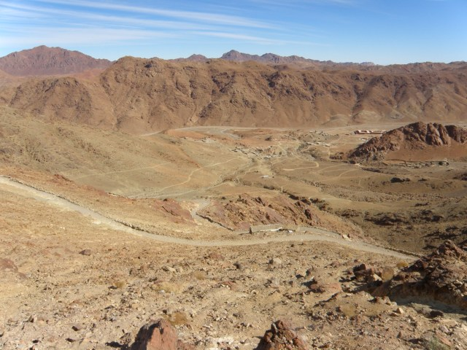
Conclusion
Have you considered the cost of not “crossing over”?

Slide 39
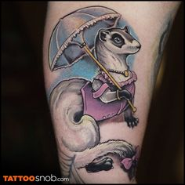
Discussion:
How would someone identify a defining moment in their spiritual life?
What role should we play for each other in take big steps of faith?
benadumj@xenos.org

