Slide 1
Leading Through Uncertainty
Lessons from Nehemiah

Slide 2
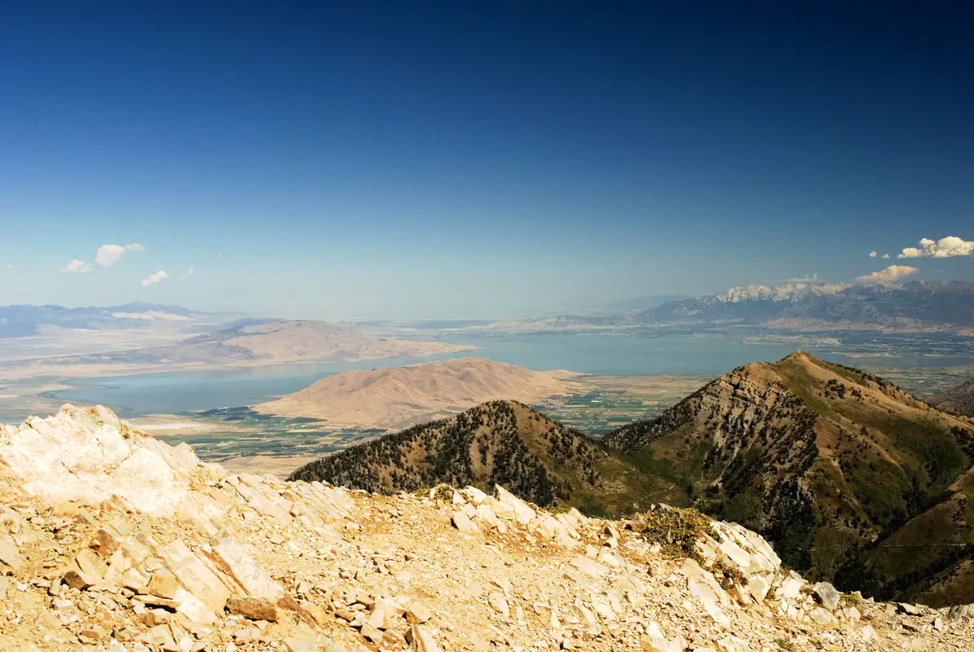

Slide 3
Deuteronomy 28
If you fully obey the Lord your God and carefully follow all his commands I give you today, the Lord your God will set you high above all the nations on earth…

Slide 4
Deuteronomy 28
⁷ The Lord will grant that the enemies who rise up against you will be defeated before you. They will come at you from one direction but flee from you in seven.
⁸ The Lord will send a blessing on your barns and on everything you put your hand to. The Lord your God will bless you in the land he is giving you.

Slide 5
Deuteronomy 28
15 However, if you do not obey the Lord your God and do not carefully follow all his commands and decrees I am giving you today, all these curses will come on you and overtake you…

Slide 6
Deuteronomy 28
³³ A people that you do not know will eat what your land and labor produce, and you will have nothing but cruel oppression all your days. ³⁴ The sights you see will drive you mad. ³⁵ The Lord will afflict your knees and legs with painful boils that cannot be cured, spreading from the soles of your feet to the top of your head.

Slide 7
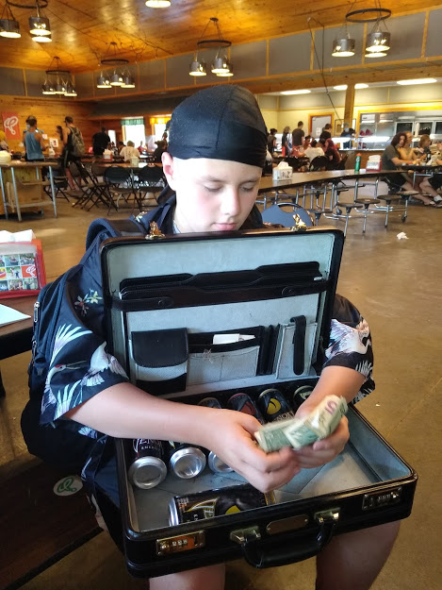
Deuteronomy 28
³³ A people that you do not know will eat what your land and labor produce, and you will have nothing but cruel oppression all your days. ³⁴ The sights you see will drive you mad. ³⁵ The Lord will afflict your knees and legs with painful boils that cannot be cured, spreading from the soles of your feet to the top of your head.

Slide 8
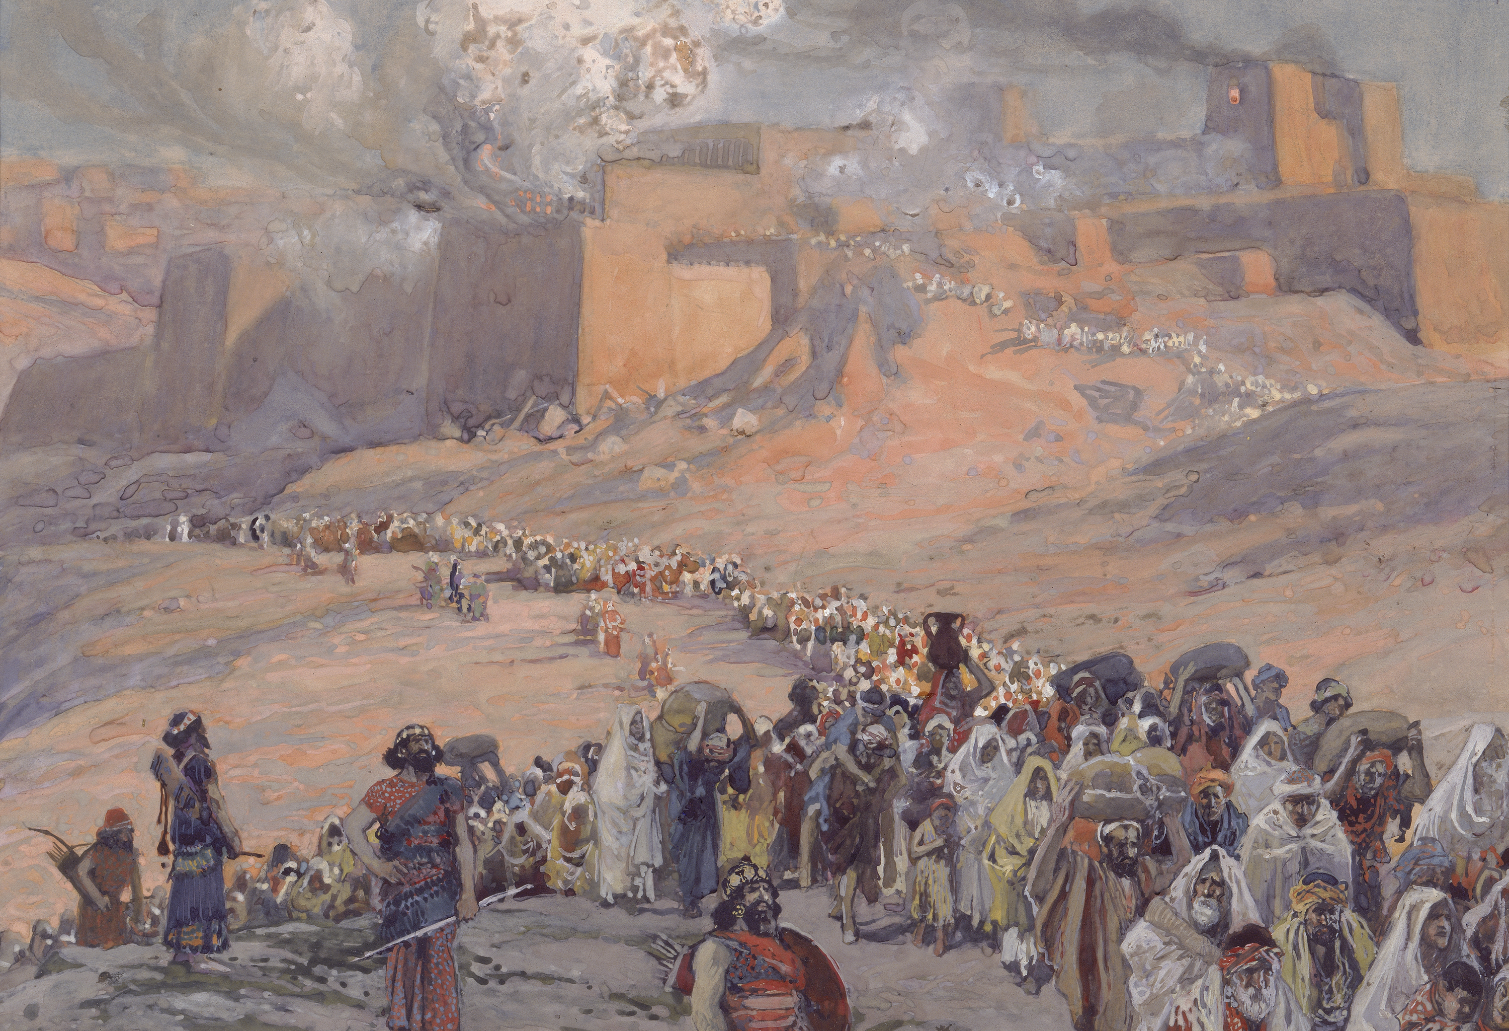

Slide 9
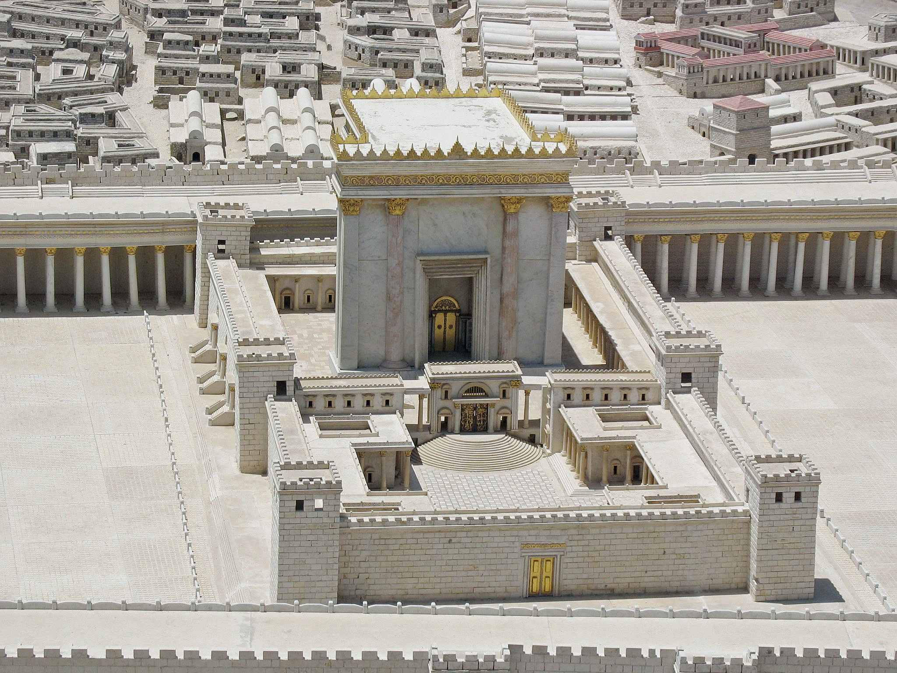

Slide 10
Nehemiah 1
In the month of Kislev in the twentieth year, while I was in the citadel of Susa, ² Hanani, one of my brothers, came from Judah with some other men, and I questioned them about the Jewish remnant that had survived the exile, and also about Jerusalem.

Slide 11
Nehemiah 1
³ They said to me, “Those who survived the exile and are back in the province are in great trouble and disgrace. The wall of Jerusalem is broken down, and its gates have been burned with fire.”
⁴ When I heard these things, I sat down and wept.

Slide 12
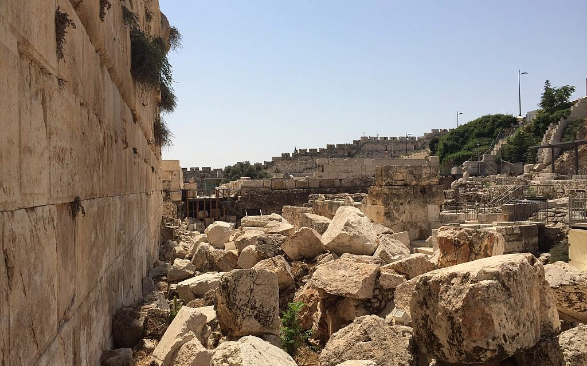
Times of Uncertainty
Jerusalem in ruins
People living in constant fear

Slide 13
Times of Uncertainty
Jerusalem in ruins
People living in constant fear
Financial destitution

Slide 14
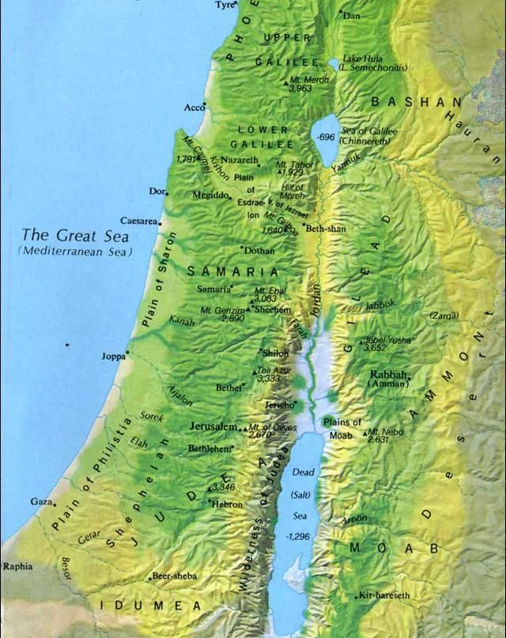
Times of Uncertainty
Jerusalem in ruins
People living in constant fear
Financial destitution

Slide 15
Times of Uncertainty
[Psalm 125:1-2] “Those who trust in the Lord are like Mount Zion, which cannot be shaken but endures forever. As the mountains surround Jerusalem, so the Lord surrounds his people both now and forevermore.”
Jerusalem in ruins
People living in constant fear
Financial destitution
Identity in shreds

Slide 16
Times of Uncertainty
Result: Leaderless and Directionless
Jerusalem in ruins
People living in constant fear
Financial destitution
Identity in shreds
Any action would be taken as revolt

Slide 17
Times of Uncertainty
With so much uncertainty, leadership feels unrealistic
Jerusalem in ruins
People living in constant fear
Financial destitution
Identity in shreds
Any action would be taken as revolt

Slide 18
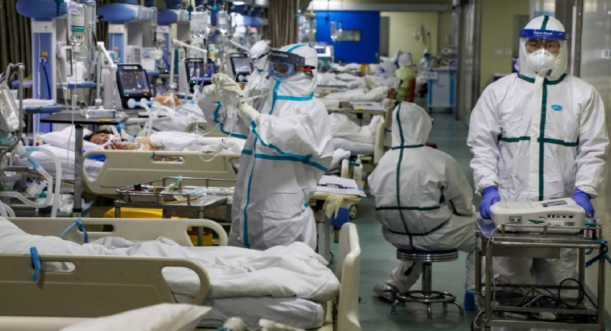
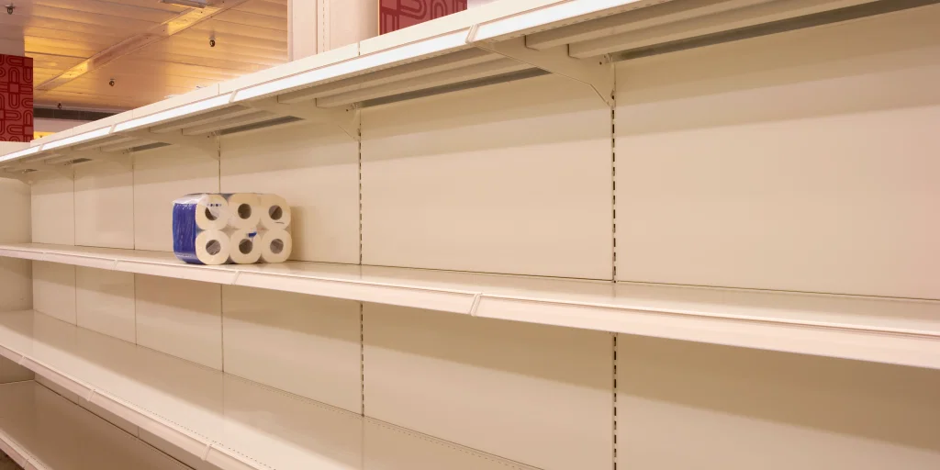
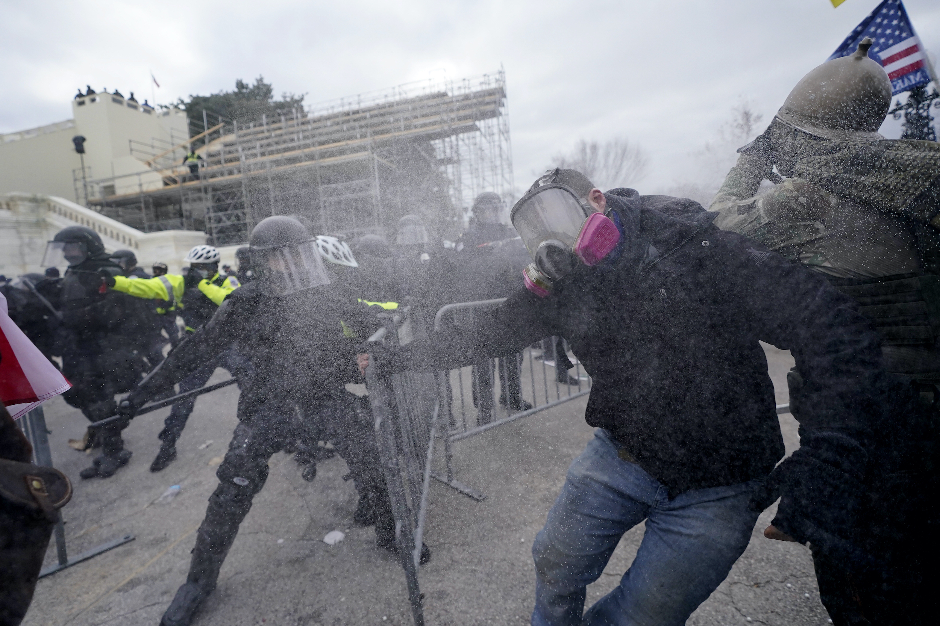
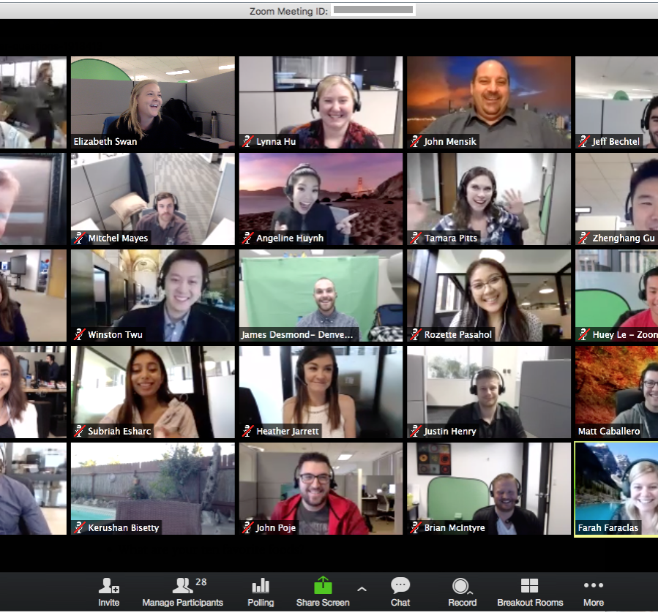
Times of Uncertainty
With so much uncertainty, leadership feels unrealistic
Jerusalem in ruins
People living in constant fear
Financial destitution
Identity in shreds
Any action would be taken as revolt
Result: Leaderless and Directionless

Slide 19
Times of Uncertainty
Times of uncertainty are when God often uses servant leaders the most
With so much uncertainty, leadership feels unrealistic
Jerusalem in ruins
People living in constant fear
Financial destitution
Identity in shreds
Any action would be taken as revolt
Result: Leaderless and Directionless
4 lessons on how servant leaders lead through uncertainty

Slide 20
1. Cling to Prayer

Slide 21
1. Cling to Prayer
[Nehemiah 2] In the month of Nisan in the twentieth year of King Artaxerxes, when wine was brought for him, I took the wine and gave it to the king. I had not been sad in his presence before, ² so the king asked me, “Why does your face look so sad when you are not ill? This can be nothing but sadness of heart.”

Slide 22
1. Cling to Prayer
[Nehemiah 2] In the month of Nisan in the twentieth year of King Artaxerxes, when wine was brought for him, I took the wine and gave it to the king. I had not been sad in his presence before, ² so the king asked me, “Why does your face look so sad when you are not ill? This can be nothing but sadness of heart.”

Slide 23
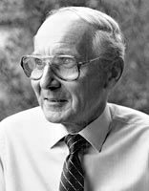
John White Excellence in Leadership

Slide 24
John White Excellence in Leadership
“Palace protocol demanded that the king’s servants always look happy in his presence. Gloom was not to cloud the royal happiness… therefore if [Nehemiah] one day allows his face to slip, I conclude he does so deliberately.”

Slide 25
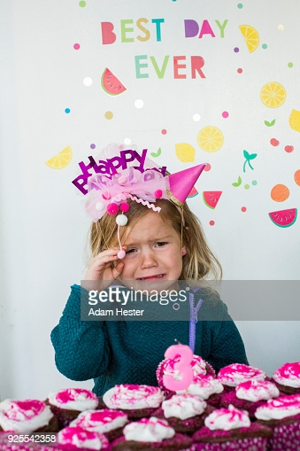
John White Excellence in Leadership
“Palace protocol demanded that the king’s servants always look happy in his presence. Gloom was not to cloud the royal happiness… therefore if [Nehemiah] one day allows his face to slip, I conclude he does so deliberately.”

Slide 26
1. Cling to Prayer
I was very much afraid, ³ but I said to the king, “May the king live forever! Why should my face not look sad when the city where my ancestors are buried lies in ruins, and its gates have been destroyed by fire?”

Slide 27
1. Cling to Prayer
⁴ The king said to me, “What is it you want?”

Slide 28
1. Cling to Prayer
⁴ The king said to me, “What is it you want?”
Then I prayed to the God of heaven,

Slide 29
1. Cling to Prayer
⁴ The king said to me, “What is it you want?”
Then I prayed to the God of heaven, ⁵ and I answered the king, “If it pleases the king and if your servant has found favor in his sight, let him send me to the city in Judah where my ancestors are buried so that I can rebuild it.”

Slide 30
1. Cling to Prayer
Nehemiah clearly viewed this decision as an answer to prayer
⁴ The king said to me, “What is it you want?”
Then I prayed to the God of heaven, ⁵ and I answered the king, “If it pleases the king and if your servant has found favor in his sight, let him send me to the city in Judah where my ancestors are buried so that I can rebuild it.”
Tendency to ditch intercessory prayer during difficult times

Slide 31
John White Excellence in Leadership
“We find that just as battles often hinge on one focal point, so a simple request might be the key to resolving vast, complex issues. In place of a list of requests we might make only one- provided we saw the battle as God saw it.”

Slide 32
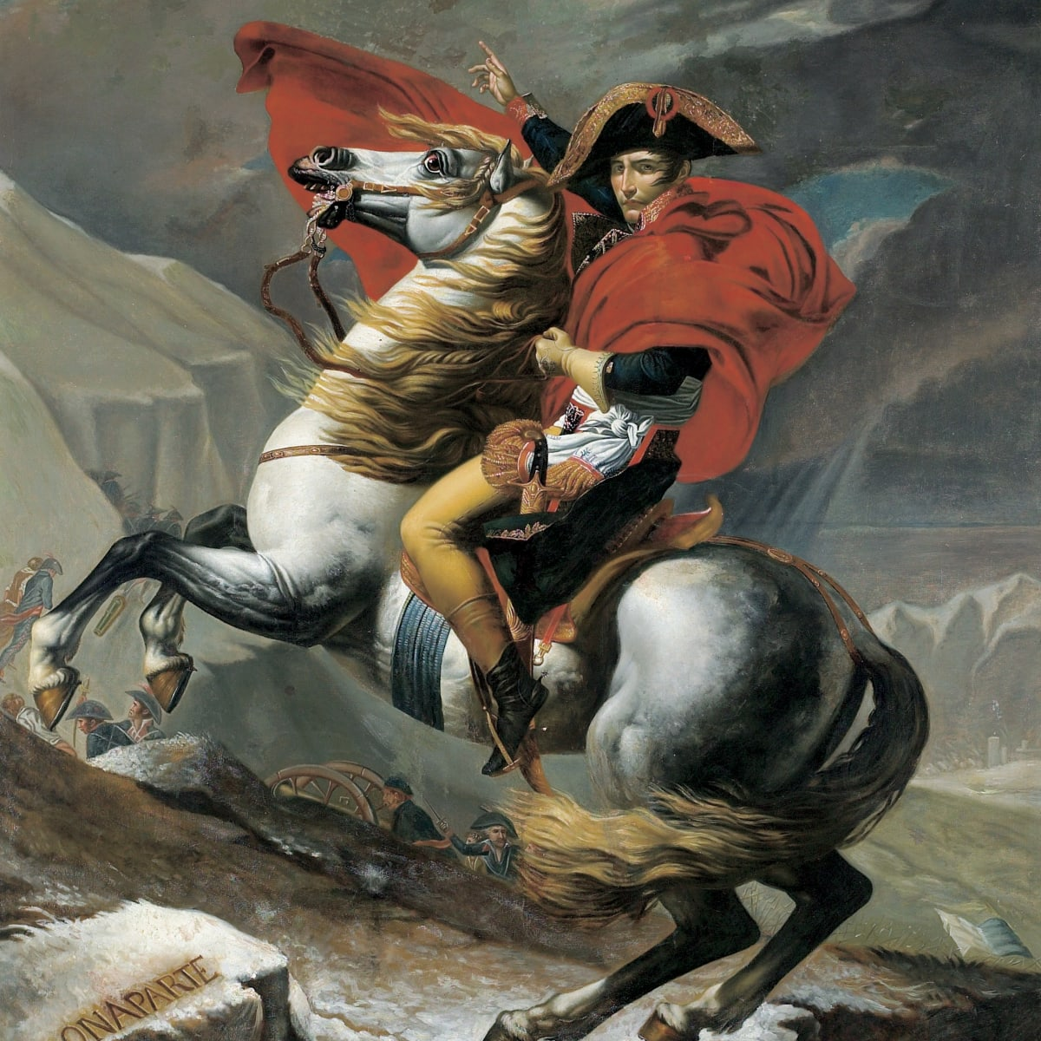
John White Excellence in Leadership
“We find that just as battles often hinge on one focal point, so a simple request might be the key to resolving vast, complex issues. In place of a list of requests we might make only one- provided we saw the battle as God saw it.”

Slide 33
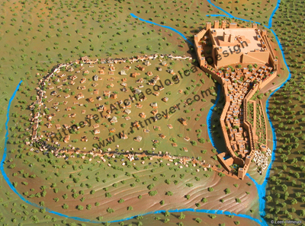

Slide 34
Nehemiah 4
⁶ So we rebuilt the wall till all of it reached half its height, for the people worked with all their heart.

Slide 35
Nehemiah 4
⁶ So we rebuilt the wall till all of it reached half its height, for the people worked with all their heart.
⁷ But when Sanballat, Tobiah, the Arabs, the Ammonites and the people of Ashdod heard that the repairs to Jerusalem’s walls had gone ahead and that the gaps were being closed, they were very angry. ⁸ They all plotted together to come and fight against Jerusalem.

Slide 36
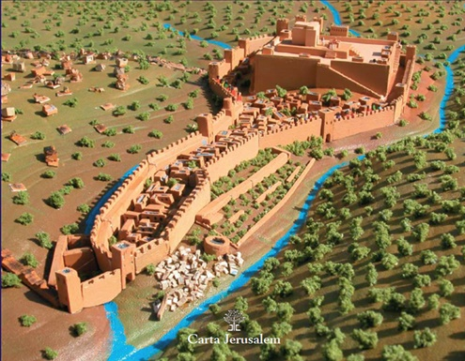
Nehemiah 4
⁶ So we rebuilt the wall till all of it reached half its height, for the people worked with all their heart.
⁷ But when Sanballat, Tobiah, the Arabs, the Ammonites and the people of Ashdod heard that the repairs to Jerusalem’s walls had gone ahead and that the gaps were being closed, they were very angry. ⁸ They all plotted together to come and fight against Jerusalem.
Sanballat
Tobiah
Geshem

Slide 37
2. Bold in the face of Opposition

Slide 38
2. Bold in the face of Opposition
[Nehemiah 4] ¹⁰ Meanwhile, the people in Judah said, “The strength of the laborers is giving out, and there is so much rubble that we cannot rebuild the wall.”

Slide 39
2. Bold in the face of Opposition
¹¹ Also our enemies said, “Before they know it or see us, we will be right there among them and will kill them and put an end to the work.”
¹² Then the Jews who lived near them came and told us ten times over, “Wherever you turn, they will attack us.”

Slide 40
2. Bold in the face of Opposition
¹⁴ After I looked things over, I stood up and said to the nobles, the officials and the rest of the people, “Don’t be afraid of them. Remember the Lord, who is great and awesome, and fight for your families, your sons and your daughters, your wives and your homes.”

Slide 41
2. Bold in the face of Opposition
¹⁵ When our enemies heard that we were aware of their plot and that God had frustrated it, we all returned to the wall, each to our own work.

Slide 42
2. Bold in the face of Opposition
¹⁴ After I looked things over, I stood up and said to the nobles, the officials and the rest of the people, “Don’t be afraid of them. Remember the Lord, who is great and awesome, and fight for your families, your sons and your daughters, your wives and your homes.”
Boldness comes from remembering

Slide 43
3. Creative in the face of setbacks

Slide 44
3. Creative in the face of setbacks
[Nehemiah 4] ¹⁶ From that day on, half of my men did the work, while the other half were equipped with spears, shields, bows and armor. The officers posted themselves behind all the people of Judah ¹⁷ who were building the wall. Those who carried materials did their work with one hand and held a weapon in the other,

Slide 45
3. Creative in the face of setbacks
¹⁹ Then I said to the nobles, the officials and the rest of the people, “The work is extensive and spread out, and we are widely separated from each other along the wall. ²⁰ Wherever you hear the sound of the trumpet, join us there. Our God will fight for us!” ²¹ So we continued the work with half the men holding spears, from the first light of dawn till the stars came out.
Not that great of a plan

Slide 46
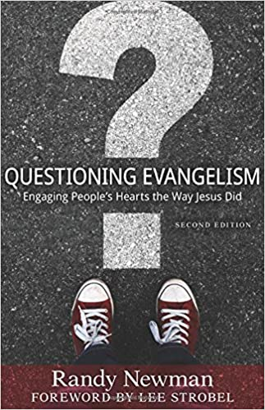
3. Creative in the face of setbacks
¹⁹ Then I said to the nobles, the officials and the rest of the people, “The work is extensive and spread out, and we are widely separated from each other along the wall. ²⁰ Wherever you hear the sound of the trumpet, join us there. Our God will fight for us!” ²¹ So we continued the work with half the men holding spears, from the first light of dawn till the stars came out.

Slide 47
4. See opportunity in upheaval

Slide 48
4. See opportunity in upheaval
[Nehemiah 6] ¹⁵ So the wall was completed on the twenty-fifth of Elul, in fifty-two days.
¹⁶ When all our enemies heard about this, all the surrounding nations were afraid and lost their self-confidence, because they realized that this work had been done with the help of our God.

Slide 49
4. See opportunity in upheaval
[Nehemiah 8] All the people came together as one in the square before the Water Gate. They told Ezra the teacher of the Law to bring out the Book of the Law of Moses, which the Lord had commanded for Israel.

Slide 50
4. See opportunity in upheaval
² …Ezra the priest brought the Law before the assembly, which was made up of men and women and all who were able to understand. ³ He read it aloud from daybreak till noon… And all the people listened attentively to the Book of the Law.

Slide 51
4. See opportunity in upheaval
⁹ Then Nehemiah the governor, Ezra the priest and teacher of the Law, and the Levites who were instructing the people said to them all, “This day is holy to the Lord your God. Do not mourn or weep.” For all the people had been weeping as they listened to the words of the Law.

Slide 52
4. See opportunity in upheaval
¹⁰ Nehemiah said, “Go and enjoy choice food and sweet drinks, and send some to those who have nothing prepared. This day is holy to our Lord. Do not grieve, for the joy of the Lord is your strength.”

Slide 53
4. See opportunity in upheaval
¹² Then all the people went away to eat and drink, to send portions of food and to celebrate with great joy, because they now understood the words that had been made known to them…
From the days of Joshua son of Nun until that day, the Israelites had not celebrated it like this. And their joy was very great.

Slide 54
4. See opportunity in upheaval
¹² Then all the people went away to eat and drink, to send portions of food and to celebrate with great joy, because they now understood the words that had been made known to them…
From the days of Joshua son of Nun until that day, the Israelites had not celebrated it like this. And their joy was very great.
When the status quo gets upended…

