Slide 1
10:46-52
Jesus the Miracle Worker

Slide 2
(Mark 10:46) Then they came to Jericho.

Slide 4
(Mark 10:46) Then they came to Jericho.
As Jesus and his disciples, together with a large crowd, were leaving the city, a blind man, Bartimaeus (which means “son of Timaeus”), was sitting by the roadside begging.
Matthew records two blind men (Mt. 20:30)
Mark doesn’t say only one.
This is an example of telescoping.
Perhaps Mark’s audience knew Bartimaeus.

Slide 5
(Mark 10:46) Then they came to Jericho.
As Jesus and his disciples, together with a large crowd, were leaving the city, a blind man, Bartimaeus (which means “son of Timaeus”), was sitting by the roadside begging.
He probably hoped to collect money from the “holiday spirit.”

Slide 6
(Mark 10:47) When he heard that it was Jesus of Nazareth, he began to shout,
“Jesus, Son of David, have mercy on me!”
Messianic title

Slide 7
(Mark 10:48) Many rebuked him and told him to be quiet,
but he shouted all the more,
“Son of David, have mercy on me!”
John 9:1-3

Slide 8
(Mark 10:49) Jesus stopped and said,
“Call him.”
So they called to the blind man,
“Cheer up! On your feet! He’s calling you.”

Slide 9
(Mark 10:50) Throwing his cloak aside, he jumped to his feet and came to Jesus.
The cloak was used to collect money from people—much like a “tin can.”
William L. Lane, The Gospel of Mark (Grand Rapids, MI: Wm. B. Eerdmans Publishing Co., 1974), p.388.

Slide 10
(Mark 10:50) Throwing his cloak aside, he jumped to his feet and came to Jesus.
⁵¹ Jesus asked him,
“What do you want me to do for you?”
The blind man said,
“Rabbi, I want to regain my sight.”

Slide 11
(Mark 10:52) “Go,” said Jesus,
“your faith has healed you.”

Slide 12
(Mark 10:52) “Go,” said Jesus,
“your faith has healed you.”
Immediately he received his sight
and followed Jesus along the road.
This is the final healing miracle in Mark…
Are miracles plausible?
If so, how should this impact our spiritual lives?

Slide 14
“An event that is not explicable by natural causes alone.”
Stanford Encyclopedia of Philosophy (2010)
If God is real, miracles are possible.

Slide 16
“An event that is not explicable by natural causes alone.”
Stanford Encyclopedia of Philosophy (2010)
If God is real, miracles are possible.
If baseball players can intervene into the laws of physics…
…why can’t God?
The greatest miracle in the Bible is the first verse! (Gen. 1:1)

Slide 17
“An event that is not explicable by natural causes alone.”
Stanford Encyclopedia of Philosophy (2010)
If God is real, miracles are possible.
How could you possibly know that God never intervenes?

Slide 18
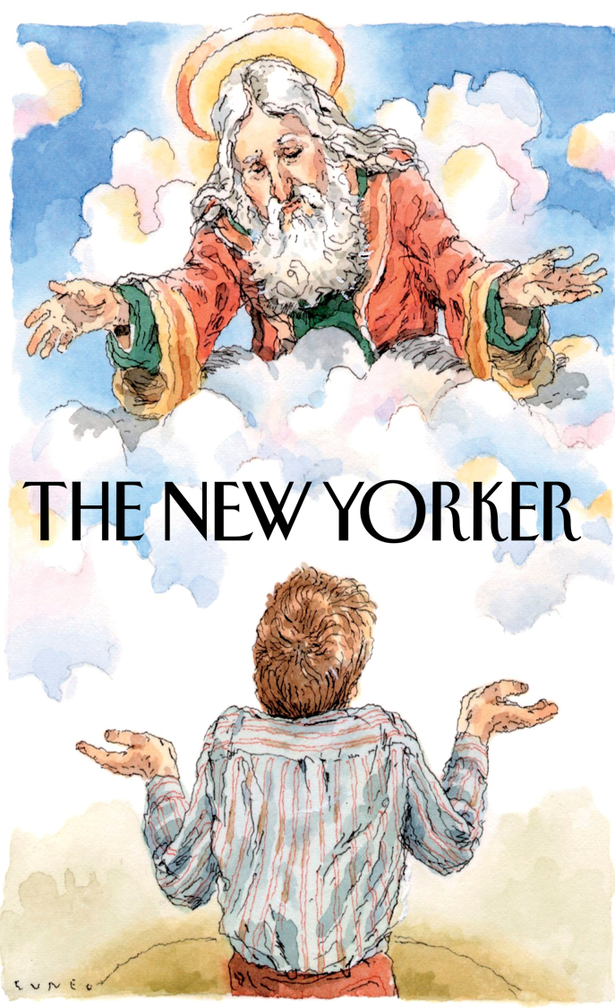
Adam Gopnik
(Atheistic Staff Writer for The New Yorker)
Adam Gopnik, “Bigger than Phil.” The New Yorker (February 2014).
“[Atheism has] a monopoly on legitimate forms of knowledge about the natural world…”

Slide 19
Adam Gopnik
(Atheistic Staff Writer for The New Yorker)
Adam Gopnik, “Bigger than Phil.” The New Yorker (February 2014).
Requires omniscience!!
“We know that… in the billions of years of the universe’s existence,
there is no evidence of a single miraculous intercession [sic] with the laws of nature.”

Slide 20
Adam Gopnik
(Atheistic Staff Writer for The New Yorker)
Adam Gopnik, “Bigger than Phil.” The New Yorker (February 2014).
27% of Americans claimed that they witnessed “a physical healing that could only be explained as a miraculous healing.”
Barna Group, “Most Americans Believe in Supernatural Healing.” September 29, 2016.
“We know that… in the billions of years of the universe’s existence,
there is no evidence of a single miraculous intercession [sic] with the laws of nature.”
88 million Americans!

Slide 21
Adam Gopnik
(Atheistic Staff Writer for The New Yorker)
Adam Gopnik, “Bigger than Phil.” The New Yorker (February 2014).
34% of Americans “say they have experienced or witnessed a divine healing of an illness or injury.”
Pew Research Center, “U.S. Religious Landscape Survey.” 2008.
“We know that… in the billions of years of the universe’s existence,
there is no evidence of a single miraculous intercession [sic] with the laws of nature.”
111 million Americans!

Slide 22
Adam Gopnik
(Atheistic Staff Writer for The New Yorker)
Adam Gopnik, “Bigger than Phil.” The New Yorker (February 2014).
Between 50-90% of Chinese people cite witnessing a miracle as a central reason for coming to faith in Jesus.
Craig Keener, Miracles (Vol. 2, Grand Rapids, MI: Baker Publishing Group, 2011), p.297.
Edmond Tang, “‘Yellers’ and Healers.” Asian and Pentecostal (Oxford: Regnum), pp. 481-485.
“We know that… in the billions of years of the universe’s existence,
there is no evidence of a single miraculous intercession [sic] with the laws of nature.”

Slide 23
“An event that is not explicable by natural causes alone.”
Stanford Encyclopedia of Philosophy (2010)
If God is real, miracles are possible.
How could you possibly know that God never intervenes?

Slide 25
Matthew, Mark, Luke, John, Acts 2:22; 1 Corinthians 15:3ff.
Internal Evidence
1. Early & Multiply Attested

Slide 26
Internal Evidence
1. Early & Multiply Attested
2. Embarrassment
(Mk. 3:22) Religious leaders claimed Jesus could heal demon possession by Satan’s power.
(Lk. 1:18) Zachariah didn’t believe in post-menopause births.
(Mt. 1:19) Joseph didn’t believe in “virgin births.”
(Acts 17:32) Greek intellectuals rejected resurrections.

Slide 27
Internal Evidence
1. Early & Multiply Attested
2. Embarrassment
3. Dissimilarity

Slide 28
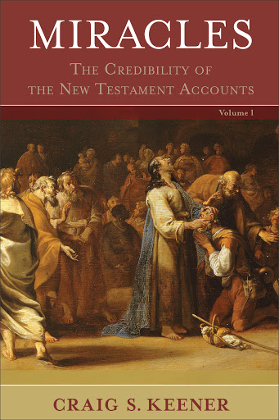
Craig Keener
(NT Scholar)
Craig Keener, Miracles: The Credibility of the New Testament Accounts (Vol. 2, Grand Rapids, MI: Baker Publishing Group, 2011), p.70.
“Pagan magicians typically sought to coerce deities or spirits by incantations;
Jesus simply commanded as God’s authoritative agent…”

Slide 29
Craig Keener
(NT Scholar)
Craig Keener, Miracles: The Credibility of the New Testament Accounts (Vol. 2, Grand Rapids, MI: Baker Publishing Group, 2011), p.70.
“Whereas the Gospel tradition provides many miracles stories,
none involve incantations.”

Slide 30
Josephus (AD 100): Jesus was a “worker of amazing deeds.”
Antiquities 18.3
Celsus (AD 150): Jesus “served for hire in Egypt” and learned “certain miraculous powers.”
Origen Contra Celsum 1.38
Talmud (AD 400): “Practiced sorcery and enticed Israel to apostasy.”
b. Sanhedrin 43a
External Evidence
The Gospels get the surrounding historical details correct (e.g. topography, geography, public officials, culture, etc.).

Slide 31
NT critics concede that Jesus was considered a miracle worker
John Meier
John P. Meier, A Marginal Jew (New York: Doubleday, 1994), p.970.
Rudolph Bultmann
Rudolph Bultmann, Jesus and the Word (London, 1958), p.124.
Marcus Borg
Marcus Borg, Jesus, A New Vision (HarperCollins, 1987), pp.67-71.
John-Dominic Crossan
John-Dominic Crossan, The Historical Jesus (HarperCollins, 1991), p.332.
The Jesus Seminar
The Acts of Jesus (San Francisco: HarperSanFrancisco, 1998), p.527.
Bart Ehrman
Bart Ehrman, Jesus (New York: Oxford University Press, 1999), p.198.
External Evidence
The Gospels get the surrounding historical details correct (e.g. topography, geography, public officials, culture, etc.).

Slide 33
Medical Condition
MS for 16 years
One functional lung (50% capacity)
Unable to eat
Twisted into the fetal position
Incontinent
Legally blind
6 months to live…
Harold P. Adolph, Today’s Decisions, Tomorrow’s Destiny (Spooner, WI: White Birch, 2006), 48-49.
Scott J. Kolbaba, MD, Physicians’ Untold Stories (North Charleston, SC: CreateSpace, 2016), 115-22.
Barbara Cummiskey Snyder
Multiple Sclerosis

Slide 34
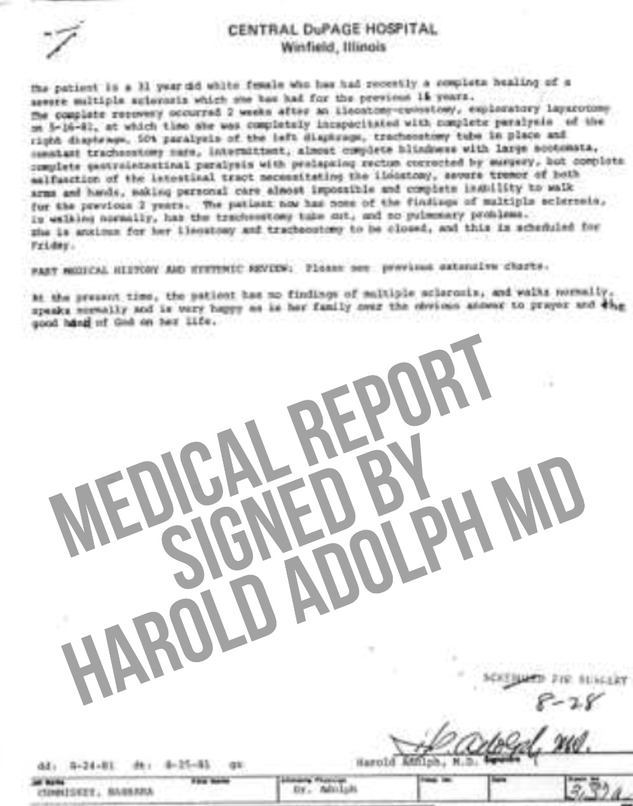
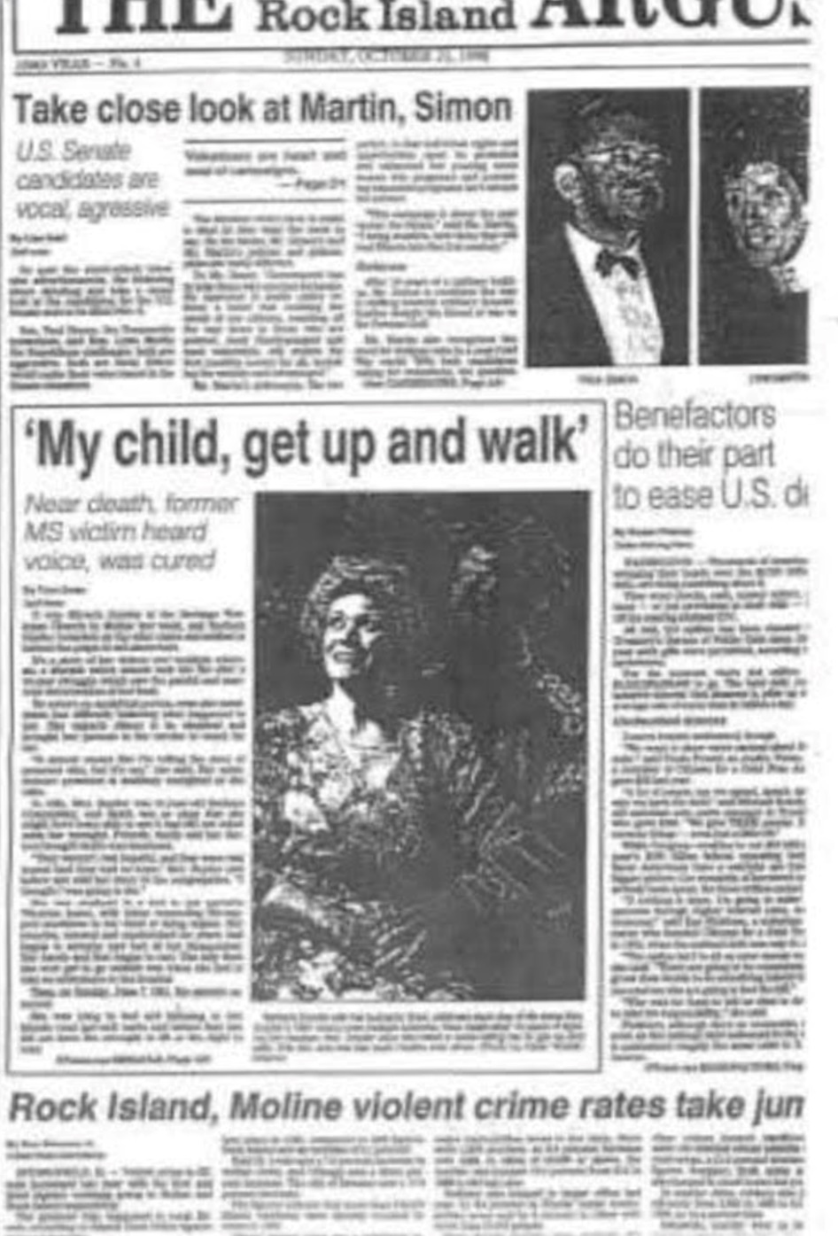
Prayers came in…
Radio station picked up her story, and 450 people wrote letters…
Family and friends read the letters, when Barbara heard,
“Get up, my child, and walk!”
Muscles, lungs, intestines, and eyesight were all restored!
Harold P. Adolph, Today’s Decisions, Tomorrow’s Destiny (Spooner, WI: White Birch, 2006), 48-49.
Scott J. Kolbaba, MD, Physicians’ Untold Stories (North Charleston, SC: CreateSpace, 2016), 115-22.
Barbara Cummiskey Snyder
Multiple Sclerosis

Slide 36
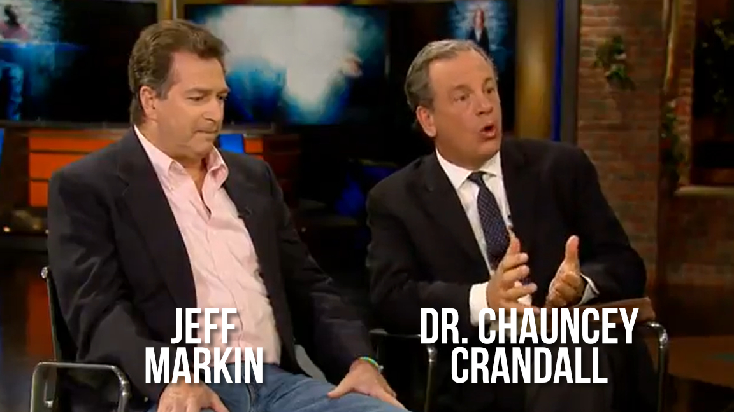
Jeff Markin suffered a severe heart attack.
40 minutes of no heartbeat, blackened skin.
Dr. Chauncey Crandall (a Yale-educated cardiologist in Palm Beach) felt an urge to pray.
Asked for one more defibrillator shock…
Heartbeat immediately returned to 75 bpm!
No brain or organ damage.
Chauncey Crandall, Raising the Dead: A Doctor Encounters the Miraculous (New York: Hatchett Book Group, 2012).
Barbara Cummiskey Snyder
Multiple Sclerosis
Jeff Markin
Legally dead

Slide 37
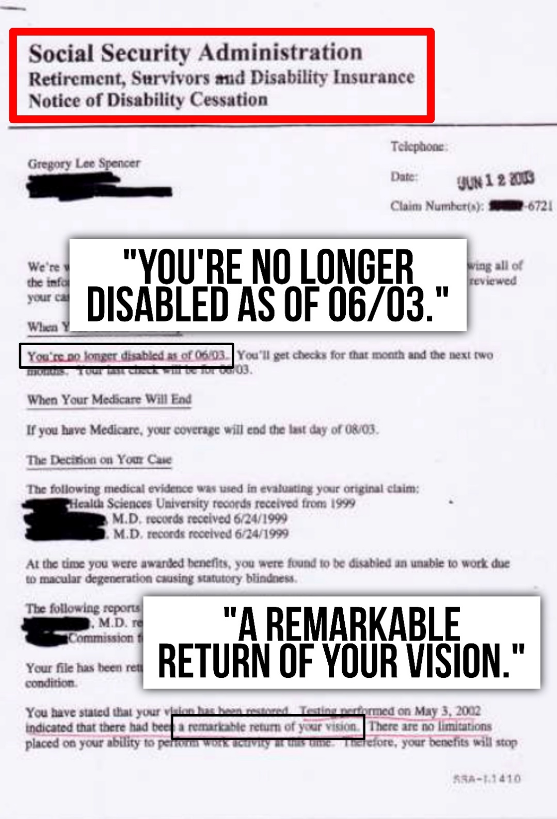
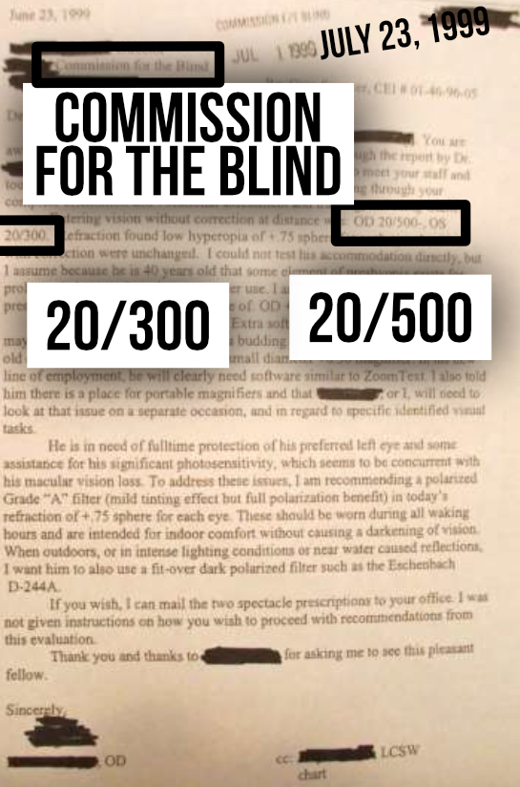
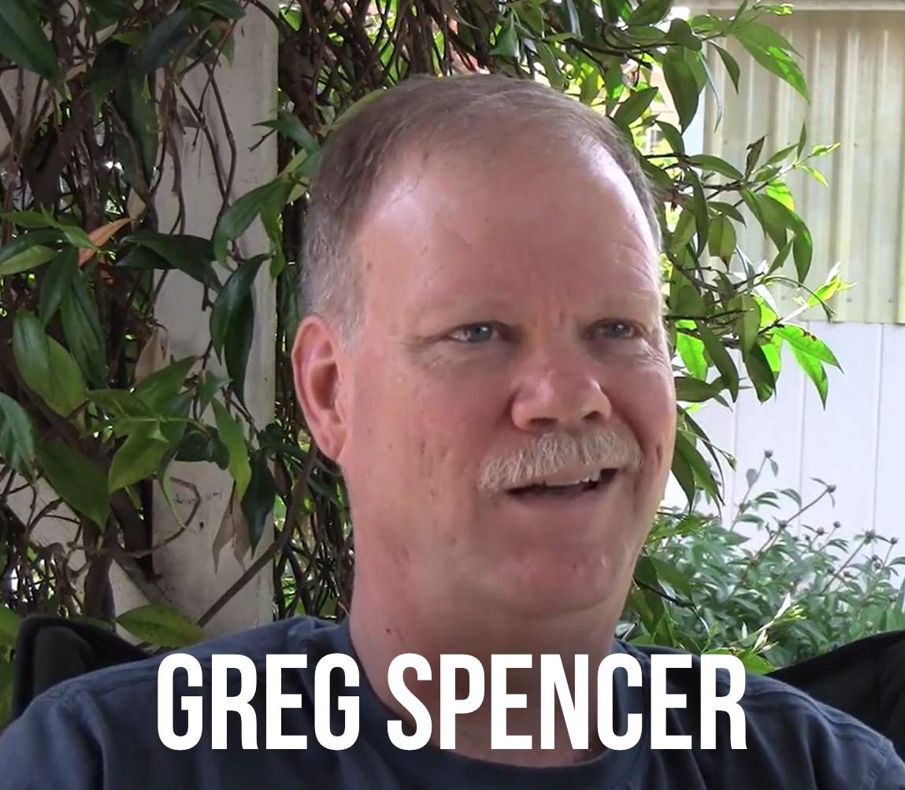
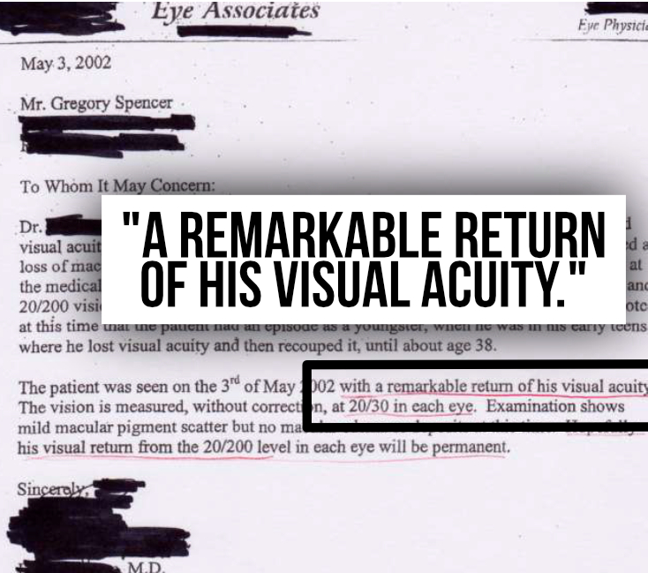
Barbara Cummiskey Snyder
Multiple Sclerosis
Jeff Markin
Legally dead
Greg Spencer
Macular Degeneration
1999: Started losing eyesight.
Macular degeneration & scarring.
2001: He went on a men’s Bible study retreat, where the topic was the “cleansing of the mind.”
After prayer, he felt God told him,
“You’re clean.” (And he could see!)
The State opened an official investigation for potential fraud!

Slide 38
Barbara Cummiskey Snyder
Multiple Sclerosis
Jeff Markin
Legally dead
Greg Spencer
Macular Degeneration
Duane Miller
Vocal damage
As a teaching pastor, the flu caused irreparable vocal damage.
Painful to speak, swallow, etc.
Had to resign as a pastor.
Saw ~200 specialists.
Buried in medical bills.
Scar tissue covered his throat.
His church asked him to teach an adult Bible class…

Slide 39
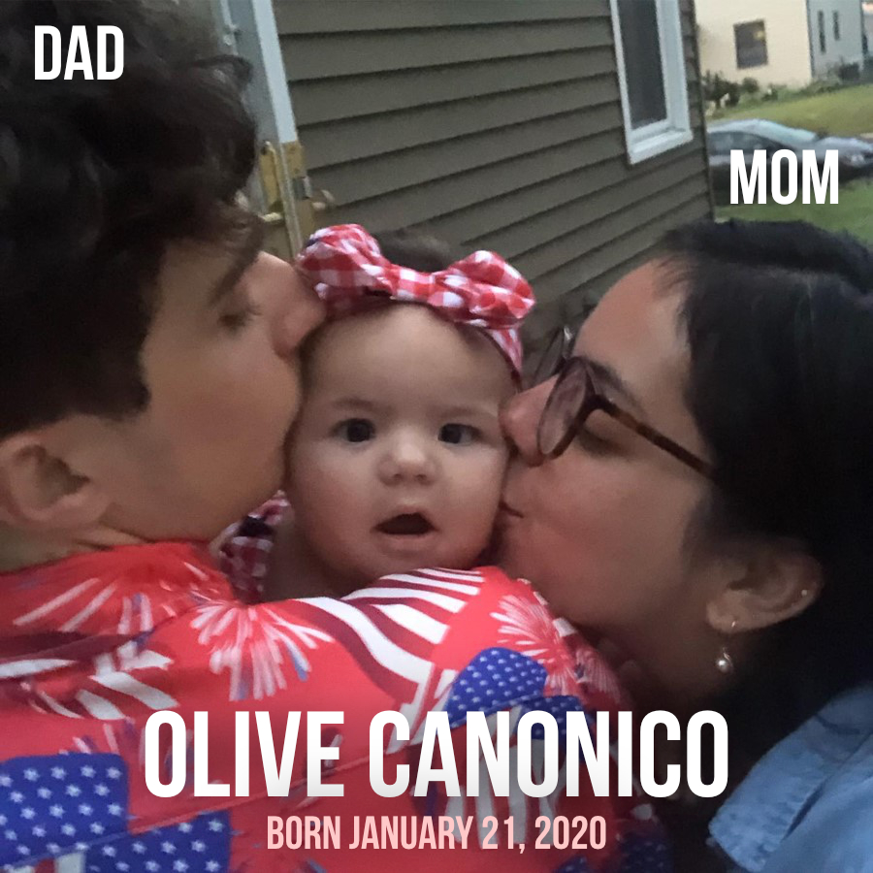
Fetomaternal hemorrhage (FMH)
80% of blood went to the mother
Kidneys stopped working
Edema (swelling) filled the body with fluid (growing the baby from 8 lbs to 16 lbs in two months!)
Doctors predicted that she’d die or be permanently blind, deaf, and on a ventilator for the rest of her life.
Many from her church began to pray for her…

Slide 41
We don’t necessarily want, “Yes.”
8-year old with Aladdin’s lamp?
God answers what we should have asked (if we knew what he does).
Romans 8:26-28; James 4:1-3
Miracles can be distracting.
John 6:26-27; Acts 14:8-13
The Bible records cases of unanswered prayers and healings.
2 Tim. 4:20; Phil. 2:27; 2 Cor. 12:8-10
Jesus is the paradigm of unanswered prayer, and yet…
Mark 14:36ff; Matthew 27:46

Slide 42
We don’t necessarily want, “Yes.”
8-year old with Aladdin’s lamp?
God answers what we should have asked (if we knew what he does).
Romans 8:26-28; James 4:1-3
Miracles can be distracting.
John 6:26-27; Acts 14:8-13
The Bible records cases of unanswered prayers and healings.
2 Tim. 4:20; Phil. 2:27; 2 Cor. 12:
(1 Pet. 2:24) Jesus bore our sins in his body on the tree, so that we might die to sins and live for righteousness;
by his wounds you have been healed.

Slide 43
Theological problems!
Only the “Unity School of Christianity.”
New-Age group that denies miracles and calls petitionary prayer “useless.” They use “affirmative prayer” instead.
We cannot measure faith—either in the participants or the recipients.
Other studies did find a correlation.
Candy Brown, Testing Prayer (Harvard University Press, 2012).
Dr. Randolph Byrd, “Positive therapeutic effects of intercessory prayer in a coronary care unit population,” Southern Medical Journal (1988). July; 81 (7): 826-829.
Dr. William Harris, “A Randomized, Controlled Trial of the Effects of Remote, Intercessory Prayer on Outcomes in Patients Admitted to the Coronary Care Unit,” Archives of Internal Medicine (1999). 159 (19): 2273-2278.
Physicians in the US:
55% claim results in patients that they consider to be miraculous.
75% believe miracles occur today.
60% pray for patients individually.
Louis Finkelstein Institute for Religious Studies, “Science or Miracle? Holiday Season Survey Reveals Physicians’ Views of Faith, Prayer, and Miracles,” BusinessWire, December 20, 2004.

Slide 44
Maybe they’ve never been common!
Egyptian slavery, birth of Isaac, John the Baptist (Jn. 10:41)
The biblical record might be the “highlight reel,” not the norm.
Used to punctuate salvation history.

