Slide 2
Luke 17
Jesus One on One

Slide 3
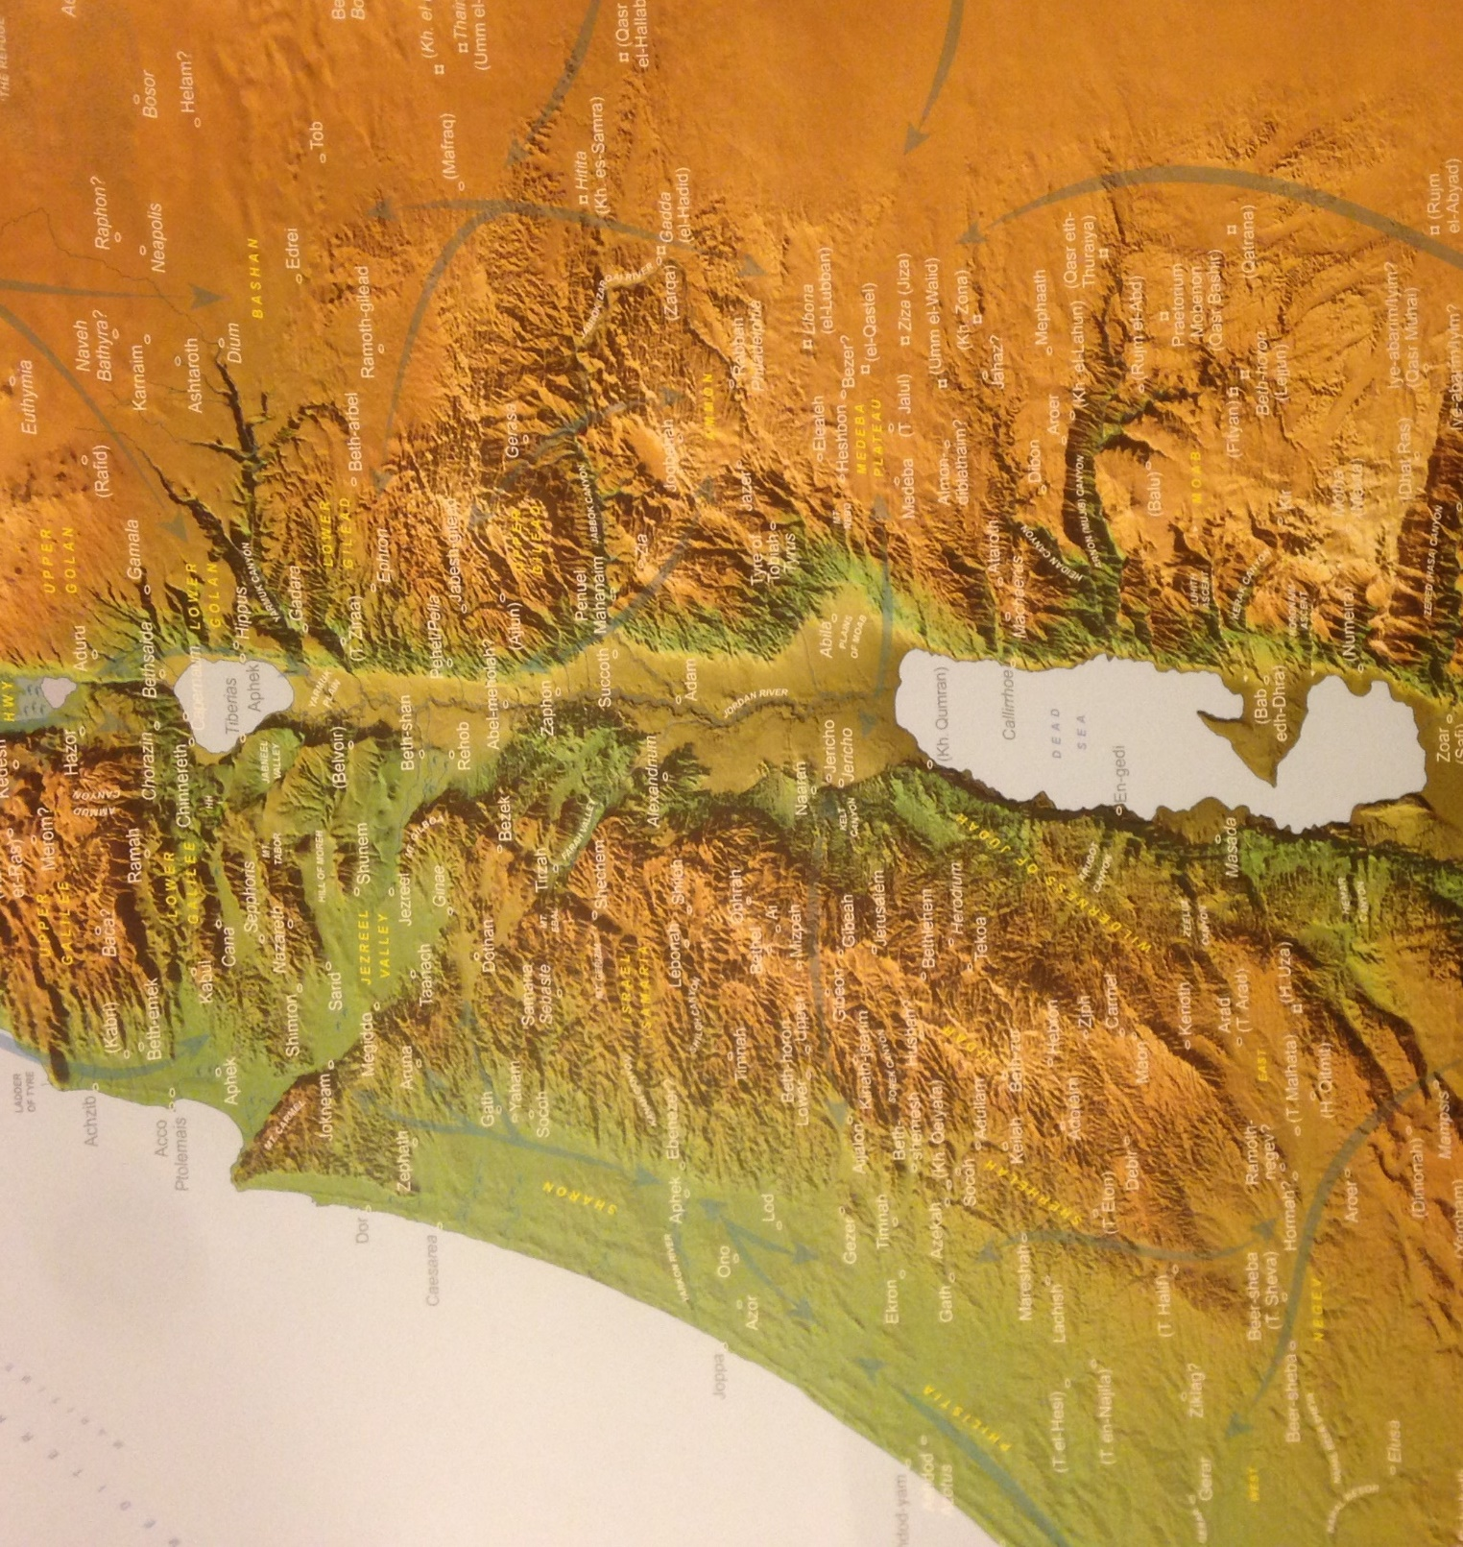
^{Luke 17:11} While He was on the way to Jerusalem, He was passing between Samaria and Galilee.
Galilee
Samaria
Judea
Jerusalem

Slide 4
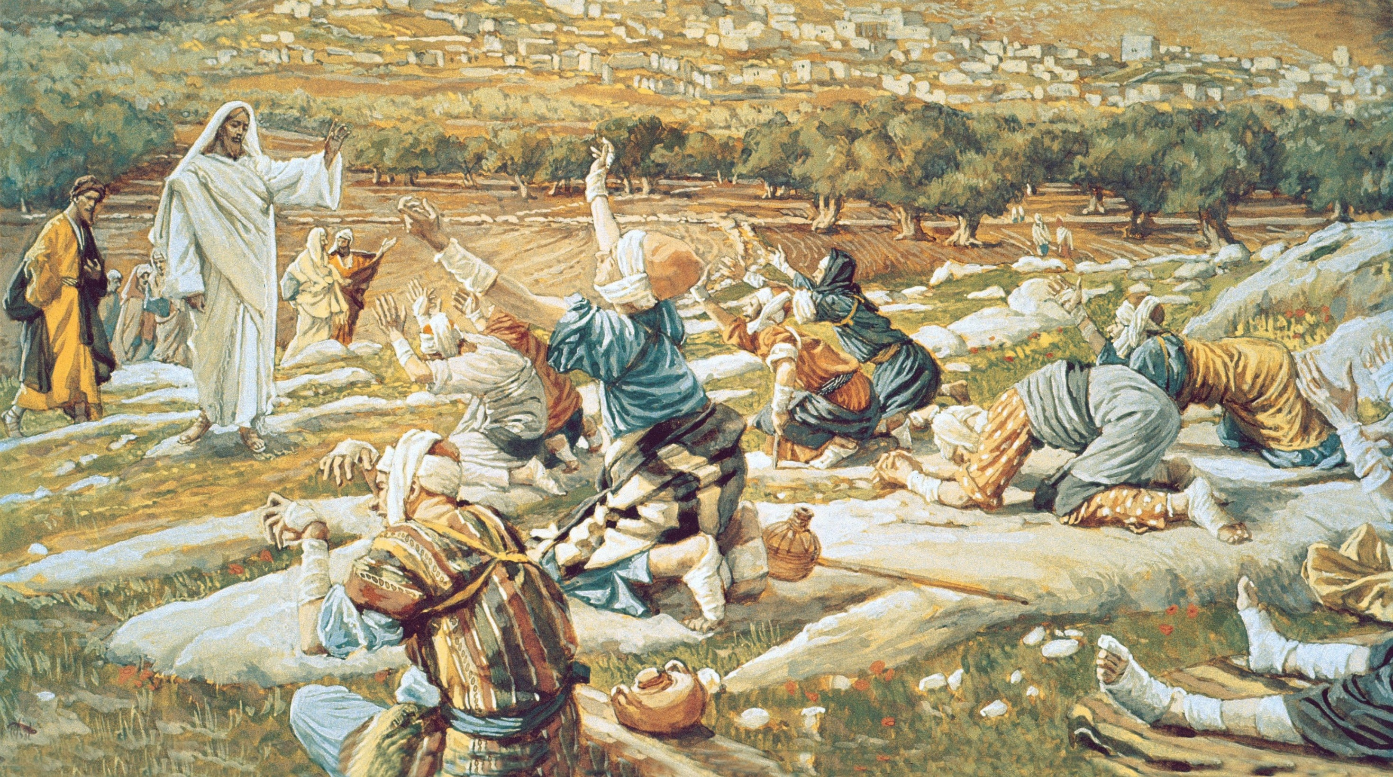
¹² As He entered a village, ten leprous men who stood at a distance met Him; ¹³ and they raised their voices, saying, “Jesus, Master, have mercy on us!”

Slide 5
Physical misery
¹² As He entered a village, ten leprous men who stood at a distance met Him; ¹³ and they raised their voices, saying, “Jesus, Master, have mercy on us!”

Slide 6
Physical misery, Social misery
¹² As He entered a village, ten leprous men who stood at a distance met Him; ¹³ and they raised their voices, saying, “Jesus, Master, have mercy on us!”

Slide 7
Physical misery, Social misery
¹² As He entered a village, ten leprous men who stood at a distance met Him; ¹³ and they raised their voices, saying, “Jesus, Master, have mercy on us!”

Slide 8
Physical misery, Social misery
¹² As He entered a village, ten leprous men who stood at a distance met Him; ¹³ and they raised their voices, saying, “Jesus, Master, have mercy on us!”

Slide 9
Physical misery, Social misery
¹² As He entered a village, ten leprous men who stood at a distance met Him; ¹³ and they raised their voices, saying, “Jesus, Master, have mercy on us!”

Slide 10
Physical misery, Social misery, Financial misery
This is a scene of ruin, poverty, and despair
¹² As He entered a village, ten leprous men who stood at a distance met Him; ¹³ and they raised their voices, saying, “Jesus, Master, have mercy on us!”

Slide 11
Physical misery, Social misery, Financial misery
¹² As He entered a village, ten leprous men who stood at a distance met Him; ¹³ and they raised their voices, saying, “Jesus, Master, have mercy on us!”

Slide 12
Physical misery, Social misery, Financial misery
¹² As He entered a village, ten leprous men who stood at a distance met Him; ¹³ and they raised their voices, saying, “Jesus, Master, have mercy on us!”

Slide 13
¹⁴ And Jesus, passing them by, pretended to be on his phone so He would not have to make eye contact with any of them.

Slide 14
^{Luke 17:14} When He saw them, He said to them, “Go and show yourselves to the priests.”

Slide 15
He had given them a “step of faith”
^{Luke 17:14} When He saw them, He said to them, “Go and show yourselves to the priests.” And as they were going, they were cleansed.

Slide 16
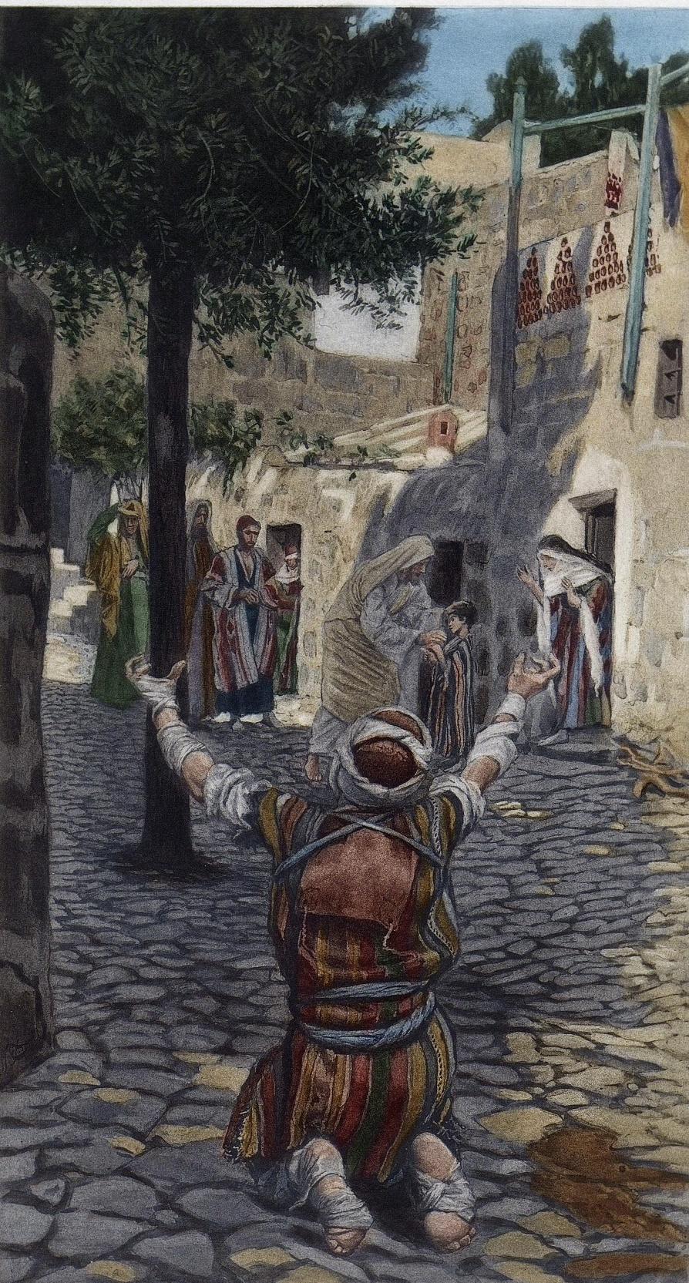
Jesus One on One: Jesus & the one who came back
^{Luke 17:15} Now one of them, when he saw that he had been healed, turned back, glorifying God with a loud voice, ¹⁶ and he fell on his face at His feet, giving thanks to Him. And he was a Samaritan.

Slide 17
Jesus One on One: Jesus & the one who came back
^{Luke 17:17} Then Jesus answered and said, “Were there not ten cleansed? But the nine—where are they? ¹⁸ Was no one found who returned to give glory to God, except this foreigner?”
¹⁹ And He said to him, “Stand up and go; your faith has made you well.”

Slide 18
^{Luke 17:17} Then Jesus answered and said, “Were there not ten cleansed? But the nine—where are they? ¹⁸ Was no one found who returned to give glory to God, except this foreigner?”
¹⁹ And He said to him, “Stand up and go; your faith has made you well.”
What does this teach us about Salvation?

Slide 19
^{Luke 17:17} Then Jesus answered and said, “Were there not ten cleansed? But the nine—where are they? ¹⁸ Was no one found who returned to give glory to God, except this foreigner?”
¹⁹ And He said to him, “Stand up and go; your faith has made you well.”
What does this teach us about Salvation?

Slide 20
^{Luke 17:17} Then Jesus answered and said, “Were there not ten cleansed? But the nine—where are they? ¹⁸ Was no one found who returned to give glory to God, except this foreigner?”
¹⁹ And He said to him, “Stand up and go; your faith has made you well.”
What does this teach us about Salvation?
The bible teaches that faith (entrusting our selves to Christ) is the mechanism of salvation
^{Eph 2:8} For by grace you have been saved through faith; and that not of yourselves, it is the gift of God; ⁹ not as a result of works, so that no one may boast.

Slide 21
^{Luke 17:17} Then Jesus answered and said, “Were there not ten cleansed? But the nine—where are they? ¹⁸ Was no one found who returned to give glory to God, except this foreigner?”
¹⁹ And He said to him, “Stand up and go; your faith has made you well.”
What does this teach us about Jesus?
Jesus is sympathetic and merciful toward our suffering
Jesus has the power and will to set right broken and hopeless things in this world

Slide 22
^{Luke 17:17} Then Jesus answered and said, “Were there not ten cleansed? But the nine—where are they? ¹⁸ Was no one found who returned to give glory to God, except this foreigner?”
¹⁹ And He said to him, “Stand up and go; your faith has made you well.”
What does this teach us about Jesus?
Jesus loved to include outsiders

Slide 23
^{Luke 17:17} Then Jesus answered and said, “Were there not ten cleansed? But the nine—where are they? ¹⁸ Was no one found who returned to give glory to God, except this foreigner?”
¹⁹ And He said to him, “Stand up and go; your faith has made you well.”
What does this teach us about Jesus?
Jesus loved to include outsiders

Slide 24
^{Luke 17:17} Then Jesus answered and said, “Were there not ten cleansed? But the nine—where are they? ¹⁸ Was no one found who returned to give glory to God, except this foreigner?”
^{Luke 17:16} And he was a Samaritan.
What does this teach us about Jesus?
Jesus loved to include outsiders
With God, acceptance is not based on group identity, but on personal faith and relationship with Him
A new identity that supersedes the old

Slide 25
^{Luke 17:17} Then Jesus answered and said, “Were there not ten cleansed? But the nine—where are they? ¹⁸ Was no one found who returned to give glory to God, except this foreigner?”
What does this teach us about Ourselves?
We tend to see Jesus as a means to an end
But Jesus is an end in Himself: a reconciled relationship with your creator

Slide 26
^{Luke 17:17} Then Jesus answered and said, “Were there not ten cleansed? But the nine—where are they? ¹⁸ Was no one found who returned to give glory to God, except this foreigner?”
What does this teach us about Ourselves?
We tend to see Jesus as a means to an end
But Jesus is an end in Himself: a reconciled relationship with your creator

Slide 27
^{Luke 17:17} Then Jesus answered and said, “Were there not ten cleansed? But the nine—where are they? ¹⁸ Was no one found who returned to give glory to God, except this foreigner?”
What does this teach us about Ourselves?
We tend to see Jesus as a means to an end
They underestimated what He had to offer, and settled for a good thing rather than the One who gives good things

Slide 28
^{Luke 17:17} Then Jesus answered and said, “Were there not ten cleansed? But the nine—where are they? ¹⁸ Was no one found who returned to give glory to God, except this foreigner?”
What does this teach us about Ourselves?
We tend toward ingratitude
“Most people return small favors, acknowledge medium ones and repay great ones—with ingratitude”
- Benjamin Franklin

Slide 29
^{Luke 17:17} Then Jesus answered and said, “Were there not ten cleansed? But the nine—where are they? ¹⁸ Was no one found who returned to give glory to God, except this foreigner?”
What does this teach us about Ourselves?
We tend toward ingratitude
Holding up the mirror:
you’re probably a lot more ungrateful than you realize

Slide 30
^{Luke 17:17} Then Jesus answered and said, “Were there not ten cleansed? But the nine—where are they? ¹⁸ Was no one found who returned to give glory to God, except this foreigner?”
What does this teach us about Ourselves?
We tend toward ingratitude
The human condition: focus on our own unmet need
^{Proverbs 27:20} The desires of man are never satisfied.

Slide 31
^{Luke 17:17} Then Jesus answered and said, “Were there not ten cleansed? But the nine—where are they? ¹⁸ Was no one found who returned to give glory to God, except this foreigner?”
What does this teach us about Jesus?
Jesus values gratitude

Slide 32
God wants us to give thanks
^{Luke 17:17} Then Jesus answered and said, “Were there not ten cleansed? But the nine—where are they? ¹⁸ Was no one found who returned to give glory to God, except this foreigner?”

Slide 33
God wants us to give thanks
^{Luke 17:17} Then Jesus answered and said, “Were there not ten cleansed? But the nine—where are they? ¹⁸ Was no one found who returned to give glory to God, except this foreigner?”
to Him
The problem isn’t that they didn’t feel grateful
Or that is was kinda rude not to say “thanks”

Slide 34
God wants us to give thanks
^{Luke 17:17} Then Jesus answered and said, “Were there not ten cleansed? But the nine—where are they? ¹⁸ Was no one found who returned to give glory to God, except this foreigner?”
to Him
It’s that they didn’t connect the dots to give the credit to God

Slide 35
God wants us to give thanks
^{Luke 17:17} Then Jesus answered and said, “Were there not ten cleansed? But the nine—where are they? ¹⁸ Was no one found who returned to give glory to God, except this foreigner?”
to Him
- WHY?
Reality:
God is deserving of our thanks
Everything we have is from God
And far beyond what we are entitled to!

Slide 36
God wants us to give thanks
^{Luke 17:17} Then Jesus answered and said, “Were there not ten cleansed? But the nine—where are they? ¹⁸ Was no one found who returned to give glory to God, except this foreigner?”
to Him
- WHY?
Reality:
God is deserving of our thanks
That makes ingratitude a sin
^{Romans 1:21} Yes, they knew God, but they wouldn’t worship him as God or even give him thanks. And they began to think up foolish ideas of what God was like. As a result, their minds became dark and confused.

Slide 37
God wants us to give thanks
to Him
- WHY?
Because it’s good for us!
The curse of ingratitude
“We pay an incalculable price for our ingratitude. After decades of ministry to hurting people, I have come to believe that failure to give thanks is at the heart of much, if not most, of the sense of gloom, despair, and despondency that is so pervasive even among believers today. I believe that many of the sins that are plaguing and devastating our society can be traced back to that persistent root of unthankfulness that often goes undetected.”

Slide 38
God wants us to give thanks
to Him
- WHY?
Because it’s good for us!
The curse of ingratitude
Ingratitude is bad for our heart, mind, spirit, relationships, and witness!

Slide 39
God wants us to give thanks
to Him
- WHY?
Gratitude is good for our physical, mental, spiritual, and relational health
Write 3 blessings each day
Or
Write 3 hassles each day
3 blessings = 25% happier affect and fewer health problems

Slide 40
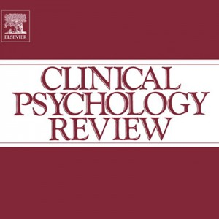
God wants us to give thanks
to Him
- WHY?
Gratitude is good for our physical, mental, spiritual, and relational health
“12 studies have supported the link between gratitude and subjective well-being… Thankfulness predicted signiﬁcantly lower risk of major depression, generalized anxiety disorder, phobia, nicotine dependence, alcohol dependence, and drug ‘abuse’ or dependence.”
Alex Wood (Professor of Behavioral Science at the University of Stirling)
Alex M. Wood (et al.), “Gratitude and well-being: A review and theoretical integration” Clinical Psychology Review (2010), 6.

Slide 41
God wants us to give thanks
to Him
- WHY?
Gratitude is good for our physical, mental, spiritual, and relational health
^{Col 2:6} Therefore as you have received Christ Jesus the Lord, so walk in Him, ⁷ having been firmly rooted and now being built up in Him and established in your faith, just as you were instructed, and overflowing with gratitude.
“Well I’d be grateful if God did something like that for me”

Slide 42
God wants us to give thanks
to Him
- WHY?
Gratitude is good for our physical, mental, spiritual, and relational health
^{Col 2:6} Therefore as you have received Christ Jesus the Lord, so walk in Him, ⁷ having been firmly rooted and now being built up in Him and established in your faith, just as you were instructed, and overflowing with gratitude.
“Well I’d be grateful if God did something like that for me”
We have even more to be grateful for than the ten lepers!

Slide 43
God wants us to give thanks
to Him
- WHY?
Gratitude is good for our physical, mental, spiritual, and relational health
^{Col 2:6} Therefore as you have received Christ Jesus the Lord, so walk in Him, ⁷ having been firmly rooted and now being built up in Him and established in your faith, just as you were instructed, and overflowing with gratitude.
“Well I’d be grateful if God did something like that for me”
We have even more to be grateful for than the ten lepers!

Slide 44
God wants us to give thanks
to Him
- WHY?
Gratitude is good for our physical, mental, spiritual, and relational health
Gets us thinking right about our circumstances
We all have plenty of bad circumstances… but gratitude adds an element of perspective (sanity) to our thinking about them
It gives us a different lens through which to perceive them, and a more accurate focus
Gratitude breaks a spell

Slide 45
God wants us to give thanks
to Him
- WHY?
Gratitude is good for our physical, mental, spiritual, and relational health
Gets us thinking right about our circumstances
^{1 Thess 5:16} Always be joyful. ¹⁷ Never stop praying. ¹⁸ Be thankful in all circumstances, for this is God’s will for you who belong to Christ Jesus
Are your circumstances as bad as you think/feel?
But how can I do that when my circumstances are BAD?

Slide 46
God wants us to give thanks
to Him
- WHY?
Gratitude is good for our physical, mental, spiritual, and relational health
Gets us thinking right about our circumstances
America is enjoying unprecedented levels of prosperity, life expectancy, health care breakthroughs, food supply, and peace. Life has never been more rich or stimulating, yet there are similarly unprecedented rates of melancholy and anxiety.
(Why is America so depressed?, Utne Reader, 2000)
But how can I do that when my circumstances are BAD?

Slide 47
God wants us to give thanks
to Him
- WHY?
Gratitude is good for our physical, mental, spiritual, and relational health
Gets us thinking right about our circumstances
“The child of God is, from necessity, a joyful man. His sins are forgiven, his soul is justified, his person is adopted, his trials are blessings, his conflicts are victories, his death is immortality, his future is a heaven of inconceivable, unthought-of, untold, and endless blessedness—with such a God, such a Saviour, and such a hope, is he not, ought he not, to be a joyful man?”
Octavius Winslow (1808–1878)
But how can I do that when my circumstances are BAD?

Slide 48
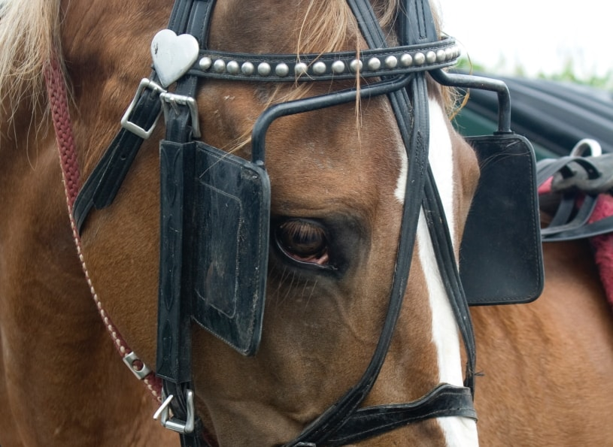
to Him

Slide 49
God wants us to give thanks
to Him
- WHY?
Gratitude is good for our physical, mental, spiritual, and relational health
Gets us thinking right about our circumstances
^{Phil 4:8} Finally, brethren, whatever is true, whatever is honorable, whatever is right, whatever is pure, whatever is lovely, whatever is of good repute, if there is any excellence and if anything worthy of praise, dwell on these things. ⁹ The things you have learned and received and heard and seen in me, practice these things, and the God of peace will be with you.

Slide 50
God wants us to give thanks
to Him
- WHY?
Gratitude is good for our physical, mental, spiritual, and relational health
Gets us thinking right about our circumstances
^{Phil 4:8} Finally, brethren, whatever is true, whatever is honorable, whatever is right, whatever is pure, whatever is lovely, whatever is of good repute, if there is any excellence and if anything worthy of praise, dwell on these things. ⁹ The things you have learned and received and heard and seen in me, practice these things, and the God of peace will be with you.

Slide 51
God wants us to give thanks
to Him
- WHY?
Gratitude is good for our physical, mental, spiritual, and relational health
Gets us thinking right about our circumstances
^{Phil 4:8} Finally, brethren, whatever is true, whatever is honorable, whatever is right, whatever is pure, whatever is lovely, whatever is of good repute, if there is any excellence and if anything worthy of praise, dwell on these things. ⁹ The things you have learned and received and heard and seen in me, practice these things, and the God of peace will be with you.
Gratitude doesn’t ignore our trials… it places them in the proper context of reality

Slide 52
God wants us to give thanks
to Him
- WHY?
Gratitude is good for our physical, mental, spiritual, and relational health
Gets us thinking right about our circumstances
^{Phil 4:8} Finally, brethren, whatever is true, whatever is honorable, whatever is right, whatever is pure, whatever is lovely, whatever is of good repute, if there is any excellence and if anything worthy of praise, dwell on these things. ⁹ The things you have learned and received and heard and seen in me, practice these things, and the God of peace will be with you.
This is not describing pretending or blind optimism, but a disciplined habit of mind which displaces a skewed focus with an accurate one

Slide 53
God wants us to give thanks
to Him
- WHY?
Gratitude is good for our physical, mental, spiritual, and relational health
Gets us thinking right about our circumstances
^{Phil 4:8} Finally, brethren, whatever is true, whatever is honorable, whatever is right, whatever is pure, whatever is lovely, whatever is of good repute, if there is any excellence and if anything worthy of praise, dwell on these things. ⁹ The things you have learned and received and heard and seen in me, practice these things, and the God of peace will be with you.
This is not describing pretending or blind optimism, but a disciplined habit of mind which displaces a skewed focus with an accurate one

Slide 54
God wants us to give thanks
to Him
- WHY?
Gratitude is good for our physical, mental, spiritual, and relational health
Gets us thinking right about our circumstances
Gets us thinking right about God

Slide 55
God wants us to give thanks
to Him
- WHY?
Gratitude is good for our physical, mental, spiritual, and relational health
Gets us thinking right about our circumstances
Gets us thinking right about God
God wants us to take both our challenges and our victories, and bring them to share with Him.
Giving thanks to God completes the enjoyment of good things

Slide 56
God wants us to give thanks
to Him
- WHY?
Gratitude is good for our physical, mental, spiritual, and relational health
Gets us thinking right about our circumstances
Gets us thinking right about God
Thanksgiving calls up the record of God’s faithfulness, power and generosity
And that’s good because we have short memories!

Slide 57
God wants us to give thanks
to Him
- WHY?
Gratitude is good for our physical, mental, spiritual, and relational health
Gets us thinking right about our circumstances
Gets us thinking right about God
Practical Idea: Keep a document of answered prayers, provisions, and great moments

Slide 58
God wants us to give thanks
to Him
- WHY?
Gratitude is good for our physical, mental, spiritual, and relational health
Gets us thinking right about our circumstances
Gets us thinking right about God
Gets us thinking right about our ourselves
Practical Idea: Write down the things you unconsciously think about yourself all day, and run them through the grid of gratitude.

Slide 59
God wants us to give thanks
to Him
- WHY?
Gratitude is good for our physical, mental, spiritual, and relational health
Gets us thinking right about our circumstances
Gets us thinking right about God
Gets us thinking right about our ourselves
Gratitude lifts up the lowly and lays low the prideful and entitled

Slide 60
God wants us to give thanks
to Him
- WHY?
Gratitude is good for our physical, mental, spiritual, and relational health
Gets us thinking right about our circumstances
Gets us thinking right about God
Gets us thinking right about our ourselves
Gets us thinking right about our others
Gratitude brings grace in the picture, lets others off the hook for all of our unmet needs and expectations

Slide 61
God wants us to give thanks
to Him
- WHY?
Gratitude is good for our physical, mental, spiritual, and relational health
Gets us thinking right about our circumstances
Gets us thinking right about God
Gets us thinking right about our ourselves
Gets us thinking right about our others
Sometimes, gratitude enables us to think about other people at all

Slide 62
God wants us to give thanks
to Him
- WHY?
Gratitude is good for our physical, mental, spiritual, and relational health
Gets us thinking right about our circumstances
Gets us thinking right about God
Gets us thinking right about our ourselves
Gets us thinking right about our others
Practical Idea: Brainstorm things your are grateful for about one other person. Thank God for them. Pick one thing to go and tell the person.

Slide 63
What did this last year do to your gratitude game?

Slide 64
Start with what’s on your mind today
Start prayer with thanksgiving
Thank God in the moment
Look forward and backward
^{Psalm 118:24} This is the day the Lord has made. We will rejoice and be glad in it…. ²⁸ You are my God, and I will praise you!...²⁹ Give thanks to the Lord, for he is good! His faithful love endures forever.

Slide 65
God wants us to give thanks
to Him
- WHY?
Gratitude is good for our physical, mental, spiritual, and relational health
Gets us thinking right about our circumstances
Demoss “Anything that makes me need God is (ultimately, in the truest sense) a blessing. Yes to give thanks “in all things” may require a sacrifice. No, it may not change your situation, perhaps not even a little. But it will put you in the only possible position for experiencing everything God desires for you through this hard stretch of life.
“be thankful in all circumstances” (1 thess 5:18)
All circumstances includes trails
“be thankful in all circumstances” includes trials

Slide 66
God wants us to give thanks
to Him
- WHY?
Gratitude is good for our physical, mental, spiritual, and relational health
Gets us thinking right about our circumstances
Gets us thinking right about our God
Requests, laments, & intercessions include God in our challenges.
But Thanksgiving and praise includes God in our blessings.

Slide 67
God wants us to give thanks
^{Luke 17:17} Then Jesus answered and said, “Were there not ten cleansed? But the nine—where are they? ¹⁸ Was no one found who returned to give glory to God, except this foreigner?”
to Him
- WHY?
Reality:
God is deserving of our thanks
thanksgiving is not a requirement for God’s generosity, it is the appropriate response to God’s generosity.

