Slide 1
Daniel
THE BOOK OF
1:1-20 – Subverting the System

Slide 2
Introduction to Daniel
❶ Author
❷ Setting
❸ Purpose
➲ The Mighty Power of Prayer
Restore God’s Splendor
Provide hope through predictive prophecy

Slide 3
Introduction to Daniel
❶ Author
❷ Setting
❸ Purpose
❹ Date

Slide 4
Daniel 1
¹ During the third year of King Jehoiakim’s reign in Judah, King Nebuchadnezzar of Babylon came to Jerusalem and besieged it.
605 BC = Nebuchadnezzar defeated Pharaoh Necco at the Battle of Carchemish

Slide 5
Daniel 1
² The Lord gave him victory over King Jehoiakim of Judah and permitted him to take some of the sacred objects from the Temple of God. So Nebuchadnezzar took them back to the land of Babylonia and placed them in the treasure-house of his god.
Daniel wanted to communicate more than what happened; he wanted to communicate why it happened.

Slide 6
Daniel 1
² The Lord gave him victory over King Jehoiakim of Judah and permitted him to take some of the sacred objects from the Temple of God. So Nebuchadnezzar took them back to the land of Babylonia and placed them in the treasure-house of his god.

Slide 7
Daniel 1
² The Lord gave him victory over King Jehoiakim of Judah and permitted him to take some of the sacred objects from the Temple of God. So Nebuchadnezzar took them back to the land of Babylonia and placed them in the treasure-house of his god.

Slide 8
Daniel 1
³ Then the king ordered Ashpenaz, his chief of staff, to bring to the palace some of the young men of Judah’s royal family and other noble families, who had been brought to Babylon as captives.

Slide 9
Daniel 1
³ Then the king ordered Ashpenaz, his chief of staff, to bring to the palace some of the young men of Judah’s royal family and other noble families, who had been brought to Babylon as captives.
Babylon’s wonder and splendor confronted them as soon as they walked through the city gate.

Slide 10
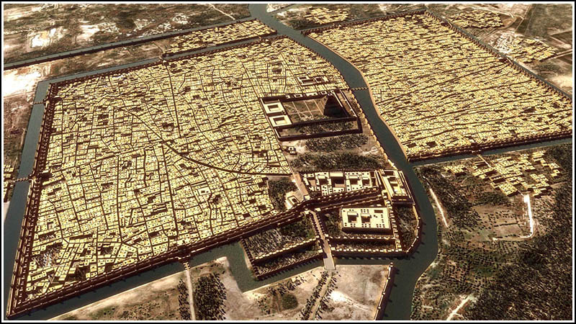

Slide 11
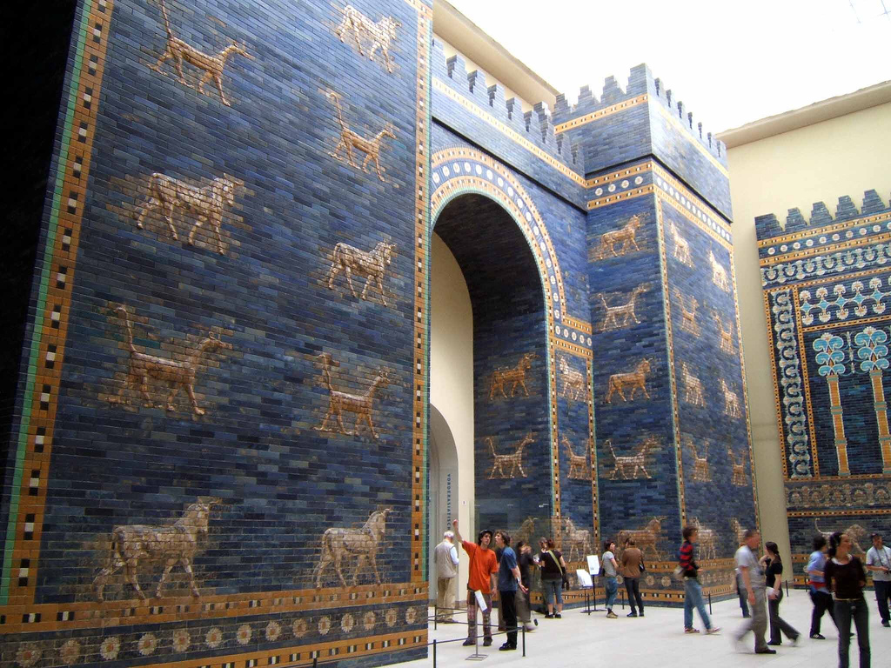

Slide 12
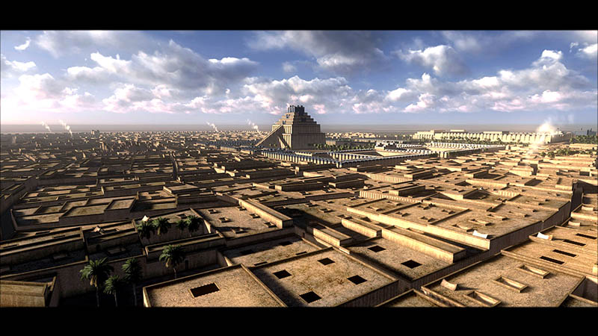

Slide 13
Daniel 1
³ Then the king ordered Ashpenaz, his chief of staff, to bring to the palace some of the young men of Judah’s royal family and other noble families, who had been brought to Babylon as captives.
Aside from its impressive architecture, Babylon was the center of learning in the ancient world.

Slide 14
Daniel 1
³ Then the king ordered Ashpenaz, his chief of staff, to bring to the palace some of the young men of Judah’s royal family and other noble families, who had been brought to Babylon as captives.
The widespread idol worship must have stunned Daniel and his friends.

Slide 15
Daniel 1
³ Then the king ordered Ashpenaz, his chief of staff, to bring to the palace some of the young men of Judah’s royal family and other noble families, who had been brought to Babylon as captives.
Can you imagine what this must have been like for Daniel and his friends?

Slide 16
Daniel 1
⁴ “Select only strong, healthy, and good-looking young men,” he said. “Make sure they are well versed in every branch of learning, are gifted with knowledge and good judgment, and are suited to serve in the royal palace. Train these young men in the language and literature of Babylon.”

Slide 17
Daniel 1
⁵ The king assigned them a daily ration of food and wine from his own kitchens. They were to be trained for three years, and then they would enter the royal service.

Slide 18
Daniel 1
⁶ Daniel, Hananiah, Mishael, and Azariah were four of the young men chosen, all from the tribe of Judah.
⁷ The chief of staff renamed them with these Babylonian names:
Daniel was called Belteshazzar. Hananiah was called Shadrach. Mishael was called Meshach.
Azariah was called Abednego.

Slide 19
Daniel 1
⁶ Daniel, Hananiah, Mishael, and Azariah were four of the young men chosen, all from the tribe of Judah.
⁷ The chief of staff renamed them with these Babylonian names:
Daniel was called Belteshazzar. Hananiah was called Shadrach. Mishael was called Meshach.
Azariah was called Abednego.
= God is our Judge

Slide 20
Daniel 1
⁶ Daniel, Hananiah, Mishael, and Azariah were four of the young men chosen, all from the tribe of Judah.
⁷ The chief of staff renamed them with these Babylonian names:
Daniel was called Belteshazzar. Hananiah was called Shadrach. Mishael was called Meshach.
Azariah was called Abednego.
= May Bel protect his life.

Slide 21
Daniel 1
⁶ Daniel, Hananiah, Mishael, and Azariah were four of the young men chosen, all from the tribe of Judah.
⁷ The chief of staff renamed them with these Babylonian names:
Daniel was called Belteshazzar. Hananiah was called Shadrach. Mishael was called Meshach.
Azariah was called Abednego.
= the Lord shows grace

Slide 22
Daniel 1
⁶ Daniel, Hananiah, Mishael, and Azariah were four of the young men chosen, all from the tribe of Judah.
⁷ The chief of staff renamed them with these Babylonian names:
Daniel was called Belteshazzar. Hananiah was called Shadrach. Mishael was called Meshach.
Azariah was called Abednego.
= command of Aku

Slide 23
Daniel 1
⁶ Daniel, Hananiah, Mishael, and Azariah were four of the young men chosen, all from the tribe of Judah.
⁷ The chief of staff renamed them with these Babylonian names:
Daniel was called Belteshazzar. Hananiah was called Shadrach. Mishael was called Meshach.
Azariah was called Abednego.
= the Lord helps

Slide 24
Daniel 1
⁶ Daniel, Hananiah, Mishael, and Azariah were four of the young men chosen, all from the tribe of Judah.
⁷ The chief of staff renamed them with these Babylonian names:
Daniel was called Belteshazzar. Hananiah was called Shadrach. Mishael was called Meshach.
Azariah was called Abednego.
= servant of Nabu

Slide 25
Daniel 1
⁶ Daniel, Hananiah, Mishael, and Azariah were four of the young men chosen, all from the tribe of Judah.
⁷ The chief of staff renamed them with these Babylonian names:
Daniel was called Belteshazzar. Hananiah was called Shadrach. Mishael was called Meshach.
Azariah was called Abednego.
= Who is God like?

Slide 26
Daniel 1
⁶ Daniel, Hananiah, Mishael, and Azariah were four of the young men chosen, all from the tribe of Judah.
⁷ The chief of staff renamed them with these Babylonian names:
Daniel was called Belteshazzar. Hananiah was called Shadrach. Mishael was called Meshach.
Azariah was called Abednego.
= Who is Aku like?

Slide 27
Daniel’s Situation
❶ The Babylonians ripped him away from his home, his family, his friends, from his life and deported him to a hostile foreign land.

Slide 28
Daniel’s Situation
❷ Nebuchadnezzar tried to brainwash him with Babylonian values, customs, religion and way of life.
➲ “to take some of the sacred objects from the Temple… and placed them in the treasure-house of his god” (v2)
Placing these sacred objects with sacred objects from other cultures lowered their importance.

Slide 29
Daniel’s Situation
❷ Nebuchadnezzar tried to brainwash him with Babylonian values, customs, religion and way of life.
➲ “to take some of the sacred objects from the Temple… and placed them in the treasure-house of his god” (v2)
Richard Dawkins: “Imagine with John Lennon a world without religion. Imagine no suicide bombers, no 9/11, no Crusades, no witch-hunts…no persecution of Jews as ‘Christ-killers’, no Northern Ireland ‘troubles’, no ‘honour killings’…
In our culture, people feel like it’s dangerous to call a religion the “one true religion.”

Slide 30
Daniel’s Situation
Richard Dawkins: No shiny-suit big-hairdo televangelists swindling gullible people of their money…Imagine no Taliban to blow up ancient statues, no public beheadings of blasphemers, no flogging of female skin for the crime of showing an inch of it.”
❷ Nebuchadnezzar tried to brainwash him with Babylonian values, customs, religion and way of life.
➲ “to take some of the sacred objects from the Temple… and placed them in the treasure-house of his god” (v2)
In our culture, people feel like it’s dangerous to call a religion the “one true religion.”

Slide 31
Daniel’s Situation
❷ Nebuchadnezzar tried to brainwash him with Babylonian values, customs, religion and way of life.
➲ “Train these young men in the language and literature of Babylon” (v4)
Unlike the God of the Bible, the Babylonian gods didn’t exist outside nature. They were subject to it.

Slide 32
Daniel’s Situation
❷ Nebuchadnezzar tried to brainwash him with Babylonian values, customs, religion and way of life.
➲ “Train these young men in the language and literature of Babylon” (v4)
Scientists and philosophers seek to give a naturalistic explanation for everything in the universe.

Slide 33
Daniel’s Situation
❸ Nebuchadnezzar tried to entice him with the promise of riches, success, power and pleasure.
The Babylonians offered them two options, the carrot or the stick.

Slide 34
Daniel 1
⁸ But Daniel was determined not to defile himself by eating the food and wine given to them by the king.

Slide 35
Daniel 1
⁸ But Daniel was determined not to defile himself by eating the food and wine given to them by the king.
He asked the chief of staff for permission not to eat these unacceptable foods.
⁹ Now God had given the chief of staff both respect and affection for Daniel.
Daniel didn’t protest as someone outside the system; he protested as a participant.

Slide 36
Daniel 1
¹⁰ But he responded, “I am afraid of my lord the king, who has ordered that you eat this food and wine. If you become pale and thin compared to the other youths your age, I am afraid the king will have me beheaded.”

Slide 37
Daniel 1
¹¹ Daniel spoke with the attendant who had been appointed by the chief of staff to look after Daniel, Hananiah, Mishael, and Azariah.
¹² “Please test us for ten days on a diet of vegetables and water,” Daniel said.
.

Slide 38
Daniel 1
¹³ “At the end of the ten days, see how we look compared to the other young men who are eating the king’s food. Then make your decision in light of what you see.”
¹⁴ The attendant agreed to Daniel’s suggestion and tested them for ten days.

Slide 39
How did Daniel manage to cling to his faith?
❶ He must have worked through some of the tough questions believers face (i.e. “Why do God’s followers suffer?”).

Slide 40
How did Daniel manage to cling to his faith?
❷ He fled to the Bible for answers and hope.
Jeremiah 29:10-14: “You will be in Babylon for seventy years. But then I will come and do for you all the good things I have promised…I will end your captivity and restore your fortunes. I will gather you out of the nations where I sent you and will bring you home again to your own land.”

Slide 41
How did Daniel manage to cling to his faith?
❷ He fled to the Bible for answers and hope.
❸ He saw that God had a plan and purpose for his life.

Slide 42
Daniel Refused to Conform
❶ Nonconformity in Our Culture

Slide 43
Daniel Refused to Conform
❶ Nonconformity in Our Culture
❷ Daniel’s Stand
➲ Rebelling Against the Rebellion

Slide 44
Daniel Refused to Conform
❶ Nonconformity in Our Culture
❷ Daniel’s Stand
❸ How do we maintain our faith in a hostile culture?
➲ Run and Hide
➲ We can stand in open defiance and declare war on our culture.

Slide 46
Daniel Refused to Conform
❶ Nonconformity in Our Culture
❷ Daniel’s Stand
❸ How do we maintain our faith in a hostile culture?
➲ We go underground and subvert the system.
We blend in with our culture, but we win people over to our cause.

Slide 47
Daniel Refused to Conform
❶ Nonconformity in Our Culture
❷ Daniel’s Stand
❸ How do we maintain our faith in a hostile culture?
➲ We go underground and subvert the system.
We let our lives silence peoples’ foolish accusations (1 Pet 2:15).

Slide 48
Daniel 1
¹⁵ At the end of the ten days, Daniel and his three friends looked healthier and better nourished than the young men who had been eating the food assigned by the king.
¹⁶ So after that, the attendant fed them only vegetables instead of the food and wine provided for the others.

Slide 49
Daniel 1
¹⁷ God gave these four young men an unusual aptitude for understanding every aspect of literature and wisdom. And God gave Daniel the special ability to interpret the meanings of visions and dreams.
¹⁸ When the training period ordered by the king was completed, the chief of staff brought all the young men to King Nebuchadnezzar.

Slide 50
Daniel 1
¹⁹ The king talked with them, and no one impressed him as much as Daniel, Hananiah, Mishael, and Azariah. So they entered the royal service.

Slide 51
Daniel 1
²⁰ Whenever the king consulted them in any matter requiring wisdom and balanced judgment, he found them ten times more capable than any of the magicians and enchanters in his entire kingdom.
Daniel took a huge risk and God still elevated him to the pinnacle of Babylonian society.

Slide 52
Daniel 1
²⁰ Whenever the king consulted them in any matter requiring wisdom and balanced judgment, he found them ten times more capable than any of the magicians and enchanters in his entire kingdom.
Daniel started a revolution that eventually turned the Babylonian Empire upside down.

